Slide 1



NUTRIENT LIMITATION OF FINE ROOTS AND FERTILIZATION EFFECTS ON SOIL NUTRIENTS IN A MOIST TROPICAL FOREST
Raphael Manu^{1*}, Marife D. Corre¹, David Eryenyu², Edzo Veldkamp¹, and Oliver van Straaten³
¹Soil Science of Tropical and Subtropical Ecosystems, University of Göttingen, Germany
²Budongo Conservation Field Station, Masindi, Uganda
³Northwest German Forest Research Institute, Germany
*Correspondence: raphael.manu@uni-goetingen.de
Funding:

Slide 2
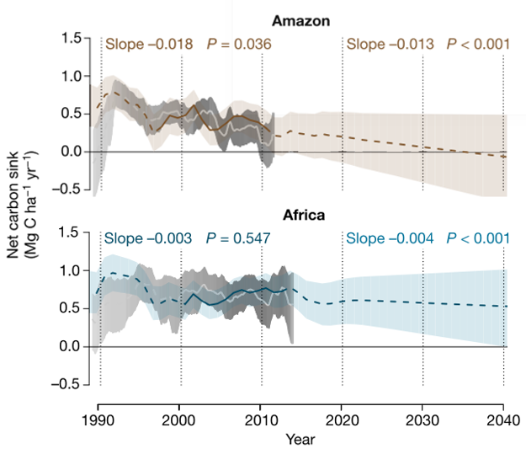
BACKGROUND: THE DECLINING TROPICAL CARBON SINK
Ecosystem nutrient limitation play a regulatory role in plant growth
Fine roots (≤ 2 mm diameter) are central in plant growth
Plants maintain a large biomass of fine roots when soil nutrients are scarce
Here, we evaluate the responses of fine root production to elevated nutrient input
Manu et al. 2022, Rammig and Lapola 2021, Maia et al 2020, Brienen et al. 2015, Sayer et al. 2012, Yavitt et al. 2011, , Jobbágy & Jackson 2000, Bloom et al. 1985

Slide 3
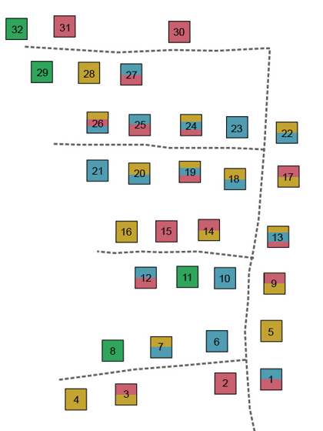
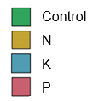
METHODS: NUTRIENT ADDITION EXPERIMENT IN UGANDA
Full factoral design with eight (8) treatments: N, P, K, N+P, N+K, P+K, N+P+K, Control
Replicated four (4) times
Fertilisation rate: 125 kg N ha⁻¹ yr⁻¹, 50 kg P ha⁻¹ yr⁻¹ ,50 kg K ha⁻¹ yr⁻¹
40 × 40 m
Exp. site
Budongo field station
Soils (0–50 cm):
Lixisols: Well drained, highly weathered soils, sandy (>50 % sand)
pH: 6.4
Fine root biomass (0–10 cm soil depth): by excavating soil monoliths
(20 × 20 cm) at six random locations within each plot
Fine root production (0–30 cm soil depth): Using sequential coring technique, samples were taken every three months in the second year of the experiment.
Photo credit: O. van Straaten
Elevation: 1050 m a.s.l. Precip.: 1670 – 2160 mm
3

Slide 4
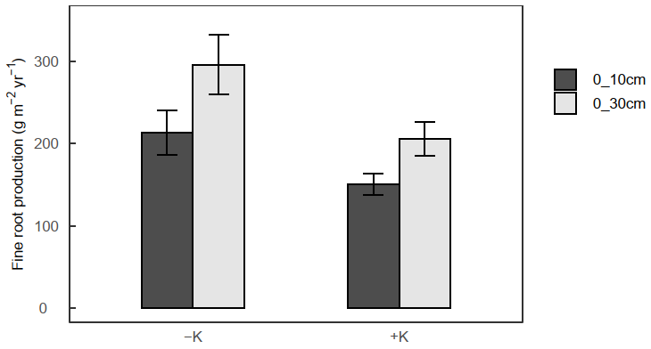
RESULTS: FINE ROOT BIOMASS & PRODUCTION
N addition decreased fine root biomass
34-35 %
K addition decreased fine root production in 0─30 cm soil depth
Responses is consistent with allocation theory & highlights that maintaining a large fine root network is an intensive process (energy and resources), and
trees will scale back their root network when they have adequate resources available
K effect (P = 0.045, 0.033)
Soil depth
29-30 %

Slide 5
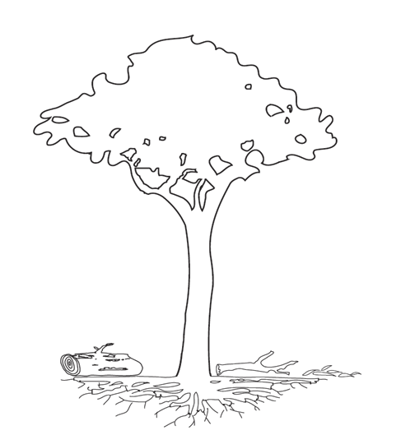
CONCLUSIONS
NPP_{Ag} = 7.8 ± 0.4
NPP_{Ag} = 8.4 ± 0.9 (51 %)
NPP_{Bg} = 2.8 ± 0.6
NPP_{Bg} = 8.1 ± 0.6 (49 %)
NPP_{total} = 10.6 ± 0.7
NPP_{total} = 16.5 ± 1.6 (9.5 ± 0.9*)
This forest ecosystem was dominantly controlled by N & K availability but not P availability.
Concept of multiple nutrient limitation was supported
(NPP_{leaf} = 3.5; NPP_{rep} = 0.6; NPP_{twigs} = 0.4)
(NPP_{leaf} = 4.3; NPP_{rep} = 0.6; NPP_{twigs} = 1.1)
*excluding course-roots
NPP_{fine-littter} = 4.8 ± 0.3
NPP_{fine-litter} = 6.4 ± 0.4
Nutrient limitations may be widespread in African tropical forest region
NPP_{stem} = 2.2 ± 0.6
NPP_{stem} = 2.2 ± 0.4 (N & K limited; Manu et al. 2022)
All units: Mg C ha⁻¹ yr⁻¹
Base cations such as K can be equally important in functional/biochemical roles related to ecosystem carbon assimilation.
NPP_{coarse-roots} = 0.7 ± 0.2
NPP_{coarse-roots} = 6.9 ± 1.2
NPP_{fine-roots} = 2.2 ± 0.6
NPP_{fine-roots} = 1.2 ± 0.1
This study site compared with neotropics (Malhi et al. 2011)

Slide 6
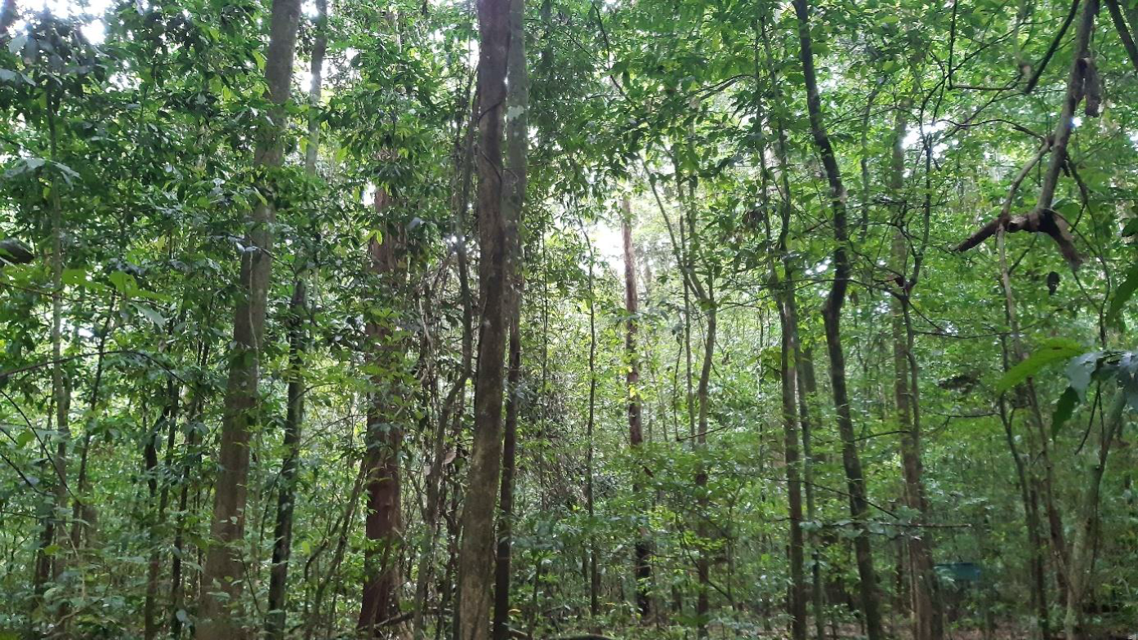
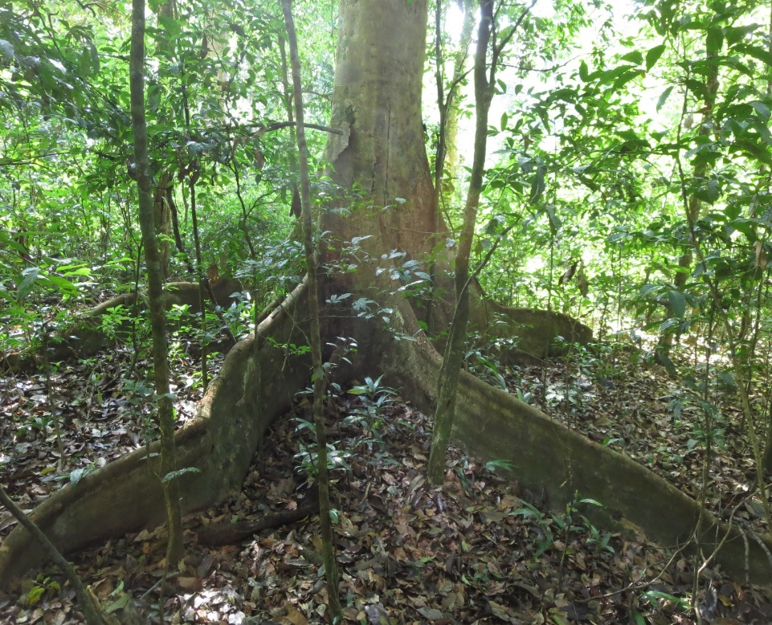
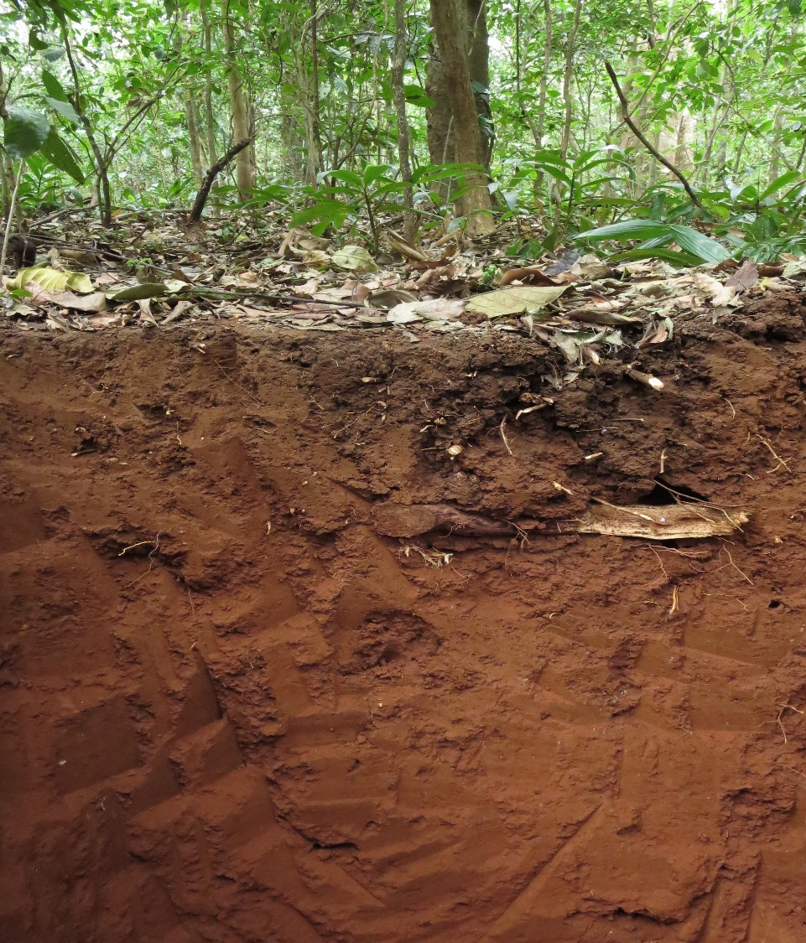



PROJECT DETAILS:
Manu et al. 2022. Ecology e3659. https://doi.org/10.1002/ecy.3659
Contact: raphael.manu@uni-goetingen.de
ACKNOWLEDGEMENTS

