Slide 1



Slide 2
Operation of a Differential Quantum Gravimeter
Camille Janvier ¹, Vincent Ménoret ¹, Sébastien Merlet ², Arnaud Landragin ², Franck Pereira dos Santos ², and Bruno Desruelle ¹
⁽¹⁾ iXblue Quantum Sensors, Talence, France
⁽²⁾ LNE-SYRTE, Observatoire de Paris, Université PSL, CNRS, Sorbonne Université, Paris, France

Slide 3
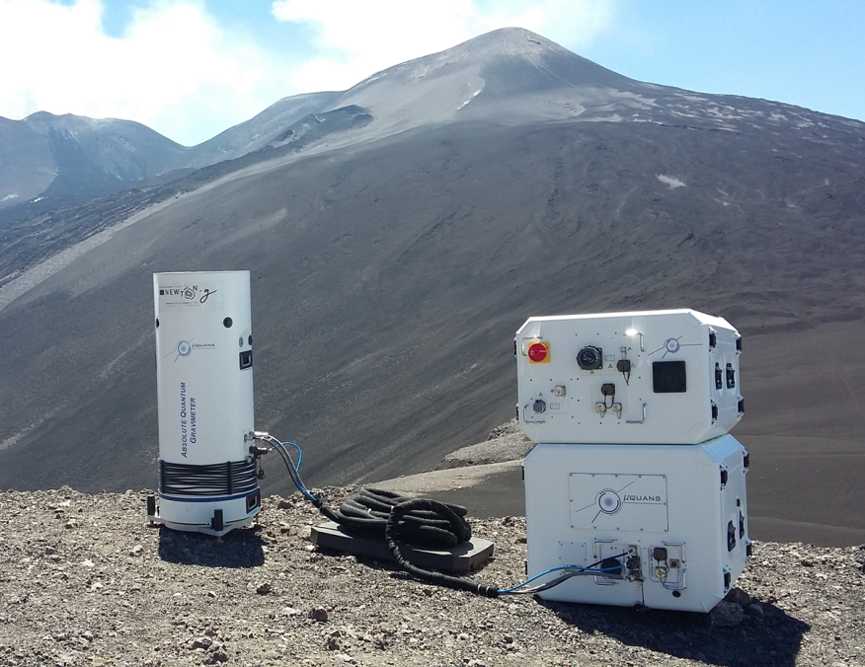
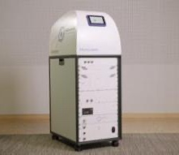
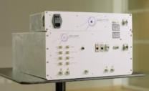
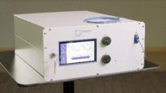
iXblue Quantum Sensors (former Muquans)
Quantum sensors & laser systems
OUR
WHY
Make atom quantum technology turn-key
    Cold atom gravity meters
    (Δg/g ≈ 10⁻⁹)
Cold atom atomic clock
(Δf/f ≈ 10⁻¹⁵)
Optical frequency transfer
(Δf/f ≈ 10⁻²⁰)
Laser and subsystem solutions
(Δλ/λ ≈ 10⁻¹⁰)

Slide 4
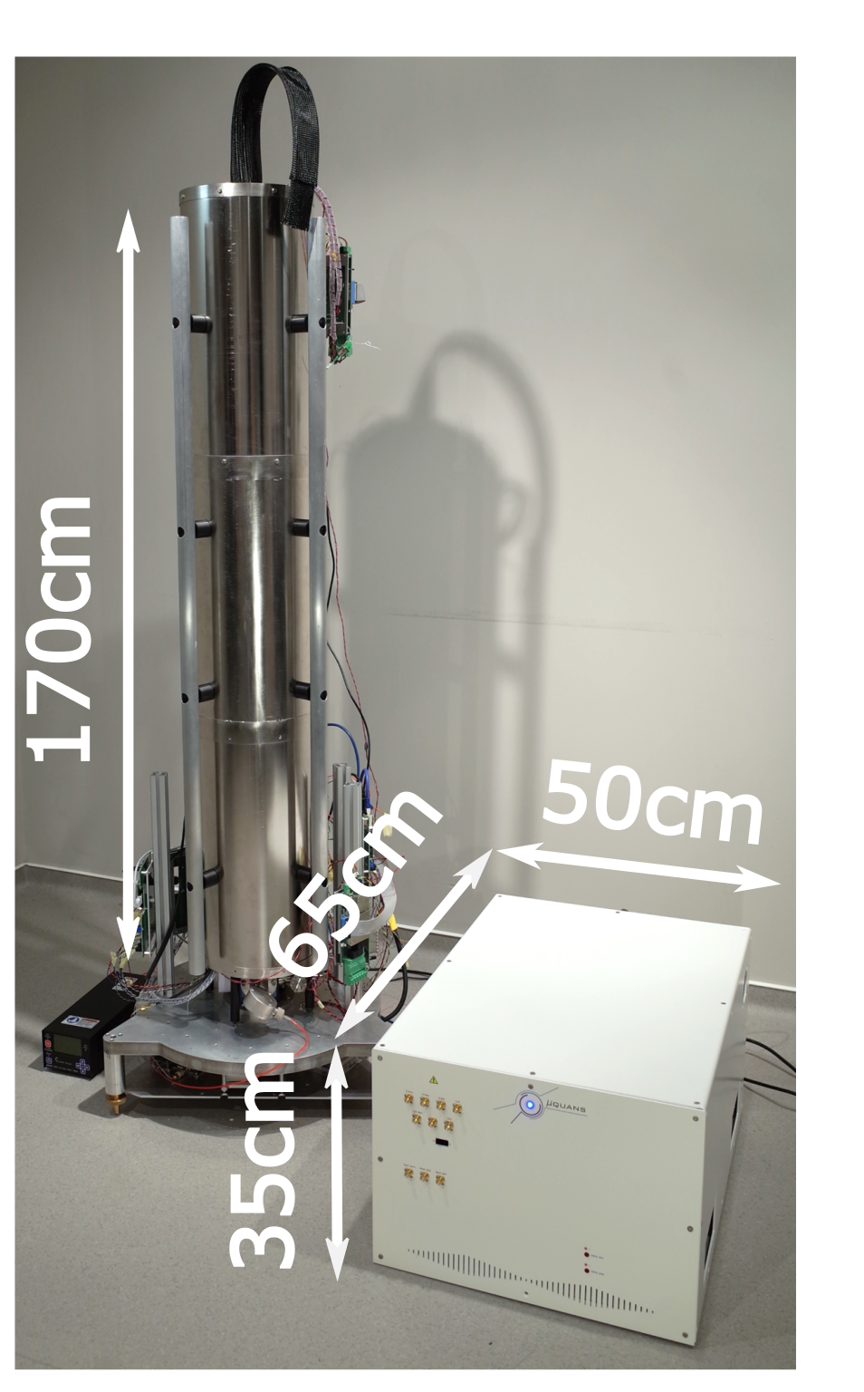
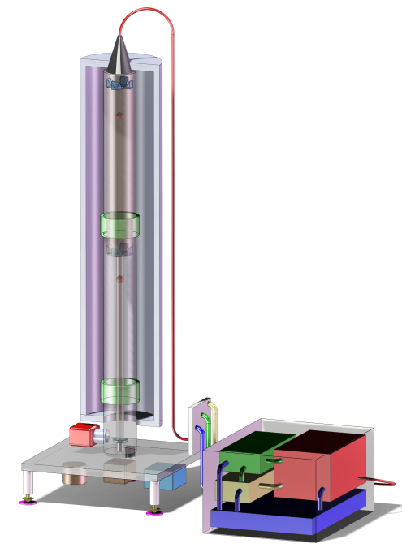
DQG: A Gravimeter + Gradiometer in a single package
A Differential Quantum Gravimeter
g₁
Weight:
  Sensor head: ~ 70kg
  Laser system: ~ 33kg
Power: ~ 200W
L
g₂
Notes:
Insister sur Differential gravimeter = Gravity + Gravity gradiometer
Faire animation avec atomes qui chutent

Slide 5
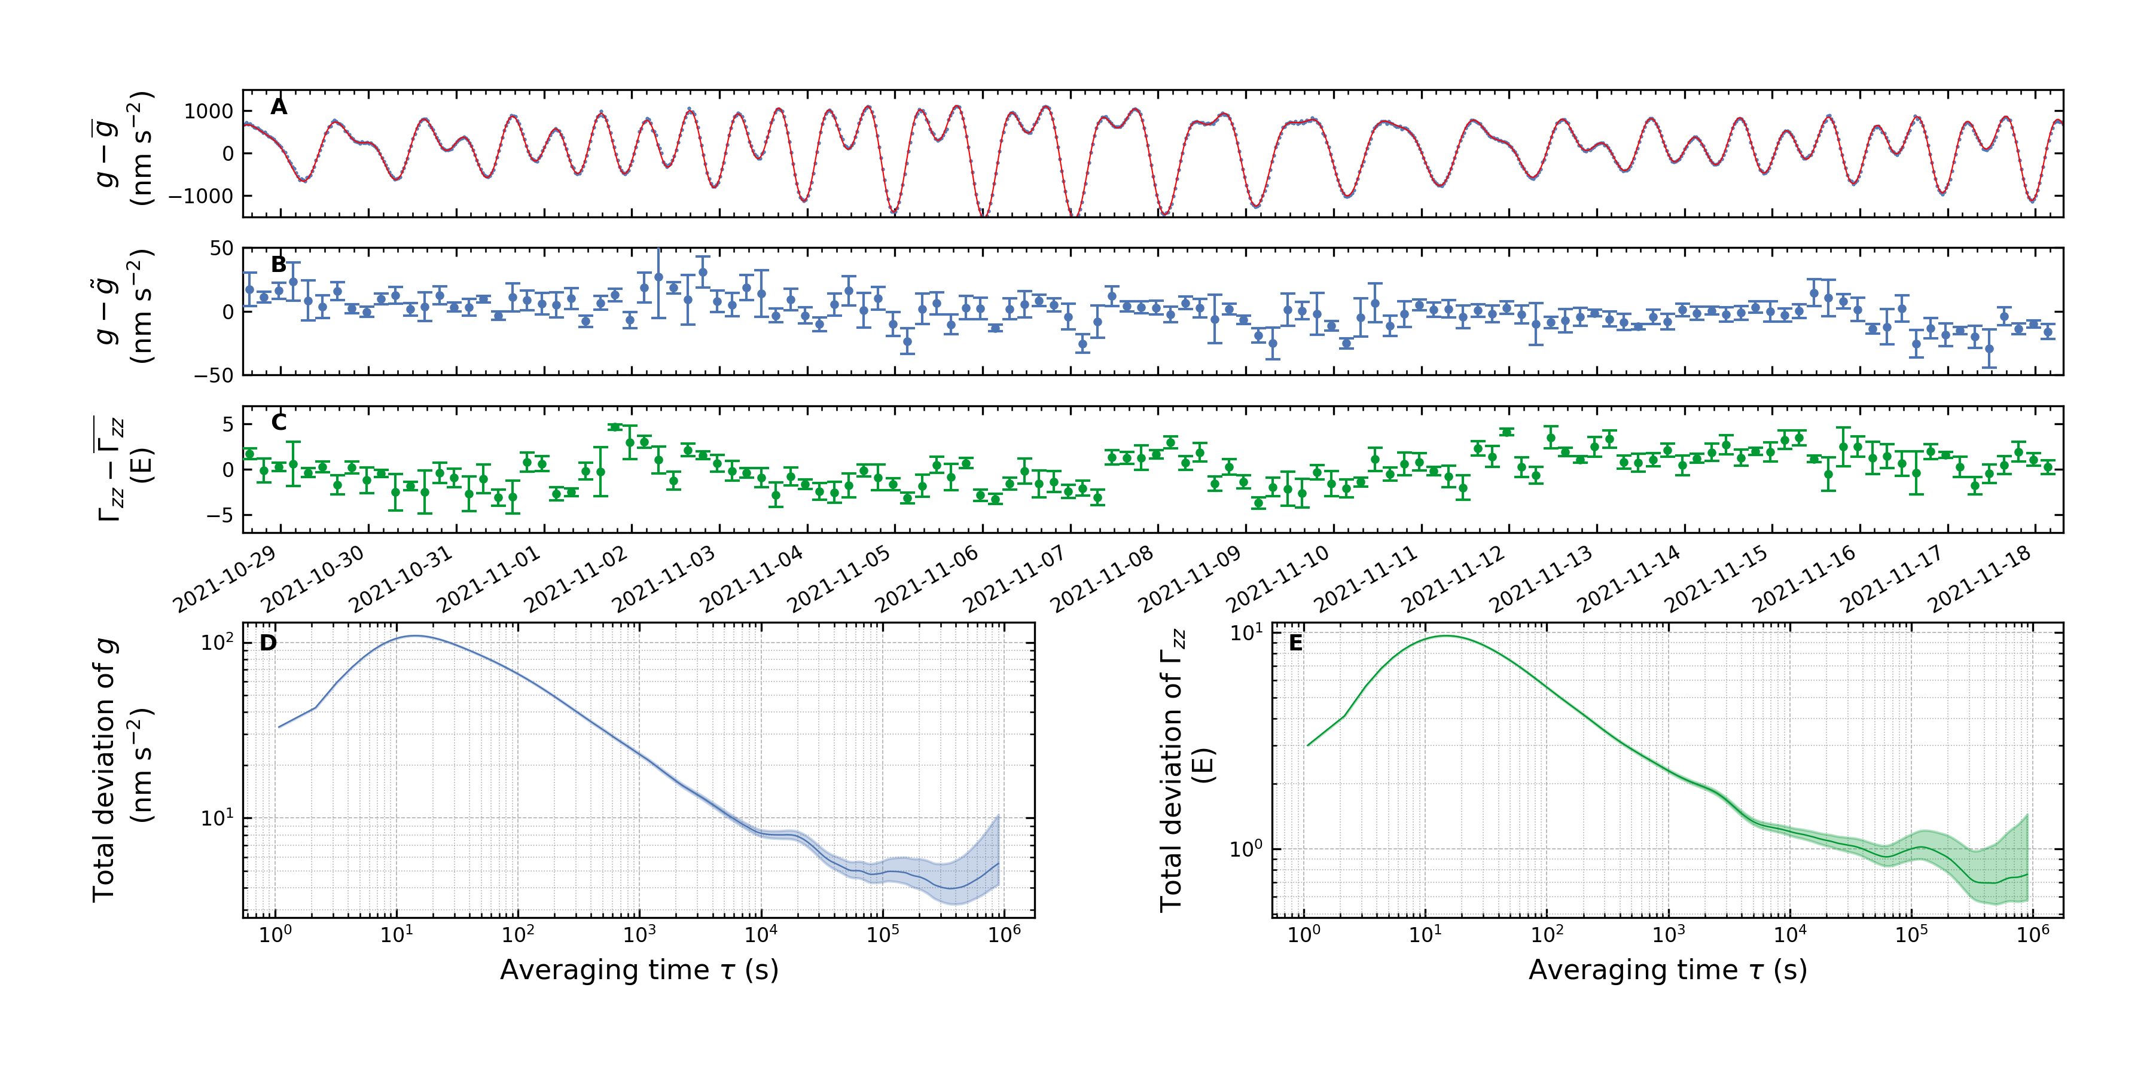
A new type of device: DQG
Public holidays
Continuous measurement
3 weeks long measurement
A very calm moment during public holidays
66 µGal/√𝜏
55 E/√𝜏
➔ Applications: reservoir monitoring (water, geothermy, gas, etc.), infrastructure monitoring

Slide 6
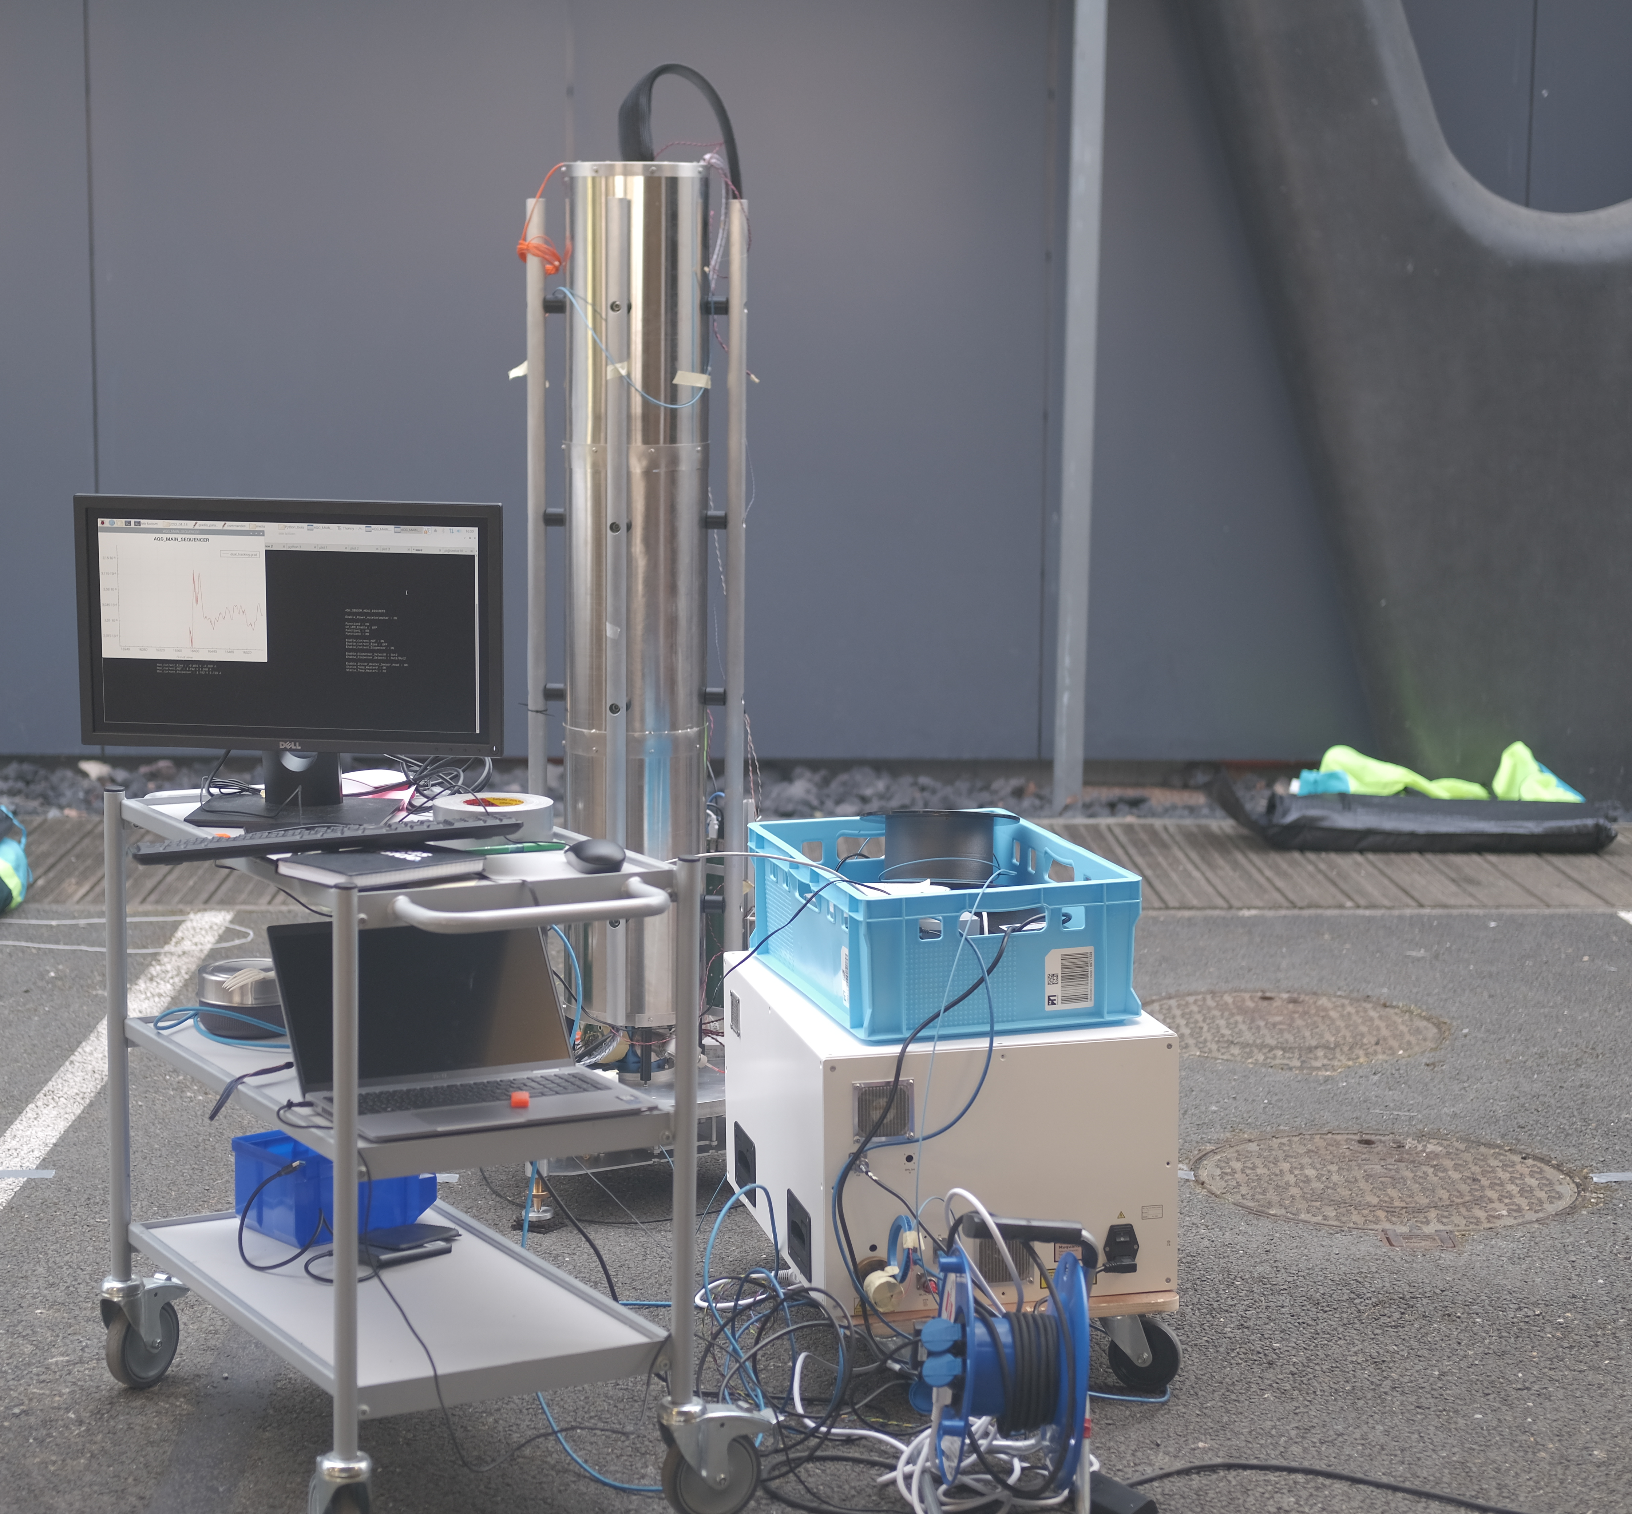
DQG: Gravimeter + Gradiometer
Ground survey
First proof of principle survey
Performed outside
Two 1m³ cavities at shallow depth

Slide 7
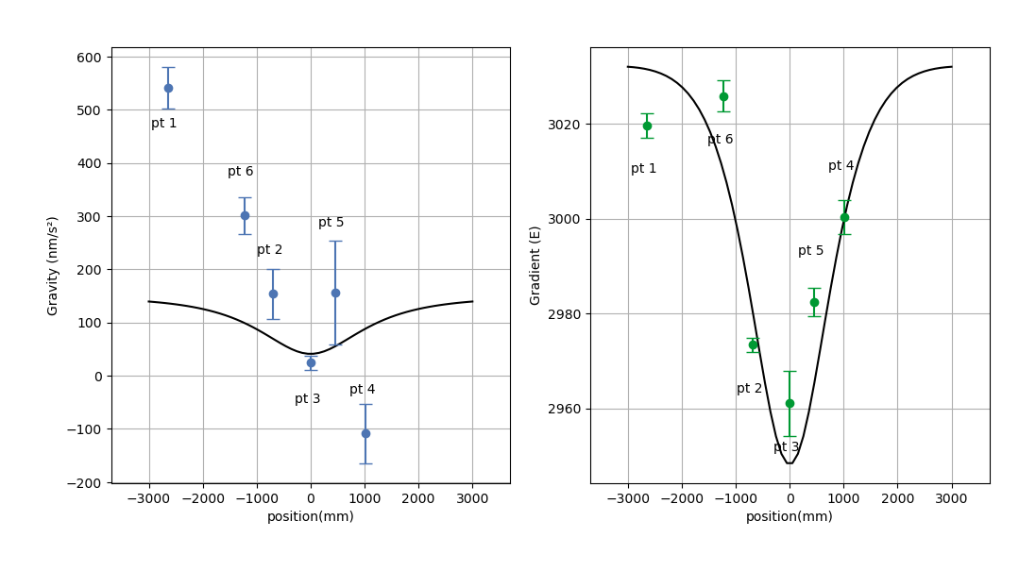
A new type of device: DQG
Survey measurements
Gravity gradient anomaly very well resolved
Gravity anomaly present a strong spatial drift
The 2 signatures are sensitive to different type of sources
Modeling ongoing
➔ Applications: civil engineering, infrastructure monitoring, archeology, prospection

Slide 8
Conclusion
A new industry-grade quantum sensor available for accurate underground mapping
  PRA: https://doi.org/10.1103/PhysRevA.99.033601
  arXiv: https://doi.org/10.48550/arXiv.2201.03345
Promising results for continuous measurements as well as ground surveys.
The DQG is available commercially (please contact jean.lautier-gaud@ixblue.com)
Funding awarded by Horizon Europe to develop an instrument for robotized survey
More work by iXblue : GI6.1 Gas bubbling monitoring using sonars by Guillaume Jouve (Replay) + Booth 17

Slide 10
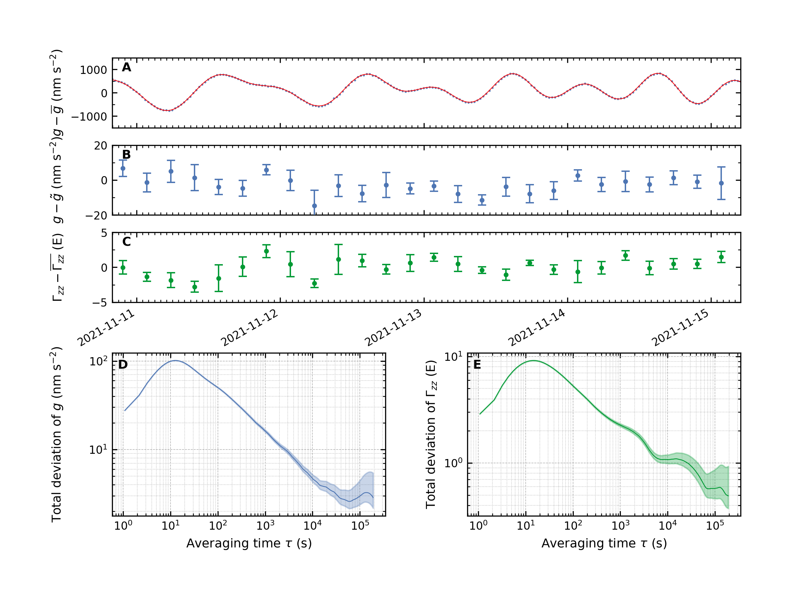
Zoom on the public holidays
50 µGal/√𝜏
53 E/√𝜏

Slide 11
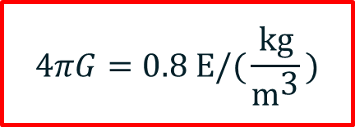
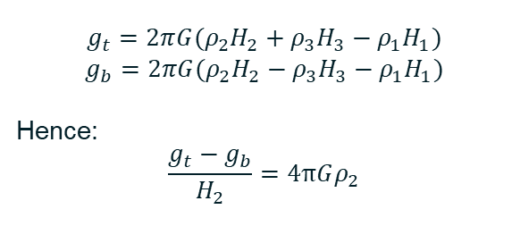
A geophysical application: Densitometry
A 1kg/m3 sensitive densitometer.
DQG
The DQG can be used as a densimeter
We present here a toy model based on Bouguer plates
H₁
Bouguer plate 1
g_{t}
H₂
Bouguer plate 2
$$g_{t}=2π{G(ρ}_{2}H_{2}+ρ_{3}H_{3}−ρ_{1}H_{1})$$
$$g_{b}=2π{G(ρ}_{2}H_{2}−ρ_{3}H_{3}−ρ_{1}H_{1})$$
Hence:
$$\frac{g_{t}−g_{b}}{H_{2}}=4πGρ_{2}$$
g_{b}
H₃
Bouguer plate 3
$$4πG=0.8 \text{E}\text{/(}\frac{\text{kg}}{{\text{m}}^{\text{3}}}\text{)}$$
➔ Applications: Hydrology, non-invasive measurements

