Slide 1
The European Geosciences Union General Assembly 2022
23-27 May 2022
A demonstration of CTBTO’s capability to identify the possible source region for the specific case of DPRK announced tests by conducting a sensitivity study using high-resolution ATM
Anne Tipka, Robin Schoemaker, Jolanta Kuśmierczyk-Michulec, Martin Kalinowski
CTBTO/IDC/SA
The views expressed herein are those of the author(s) and do not necessarily reflect the views of the CTBT Preparatory Commission.

Slide 2
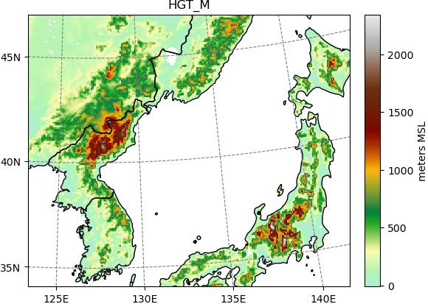
Introduction
General Aim
Further improve the accuracy in localizing possible source regions for measured elevated values of radioactive substances from nuclear tests and increase capabilities to identify CTBTO’s IMS (International Monitoring System) stations which might detect (hypothetical) releases.
Background
Numerical weather models at approx. 0.5° can reproduce observations well in case of flat terrain and the source location procedure in such terrain will work well.
For complex terrain on the other hand, such as at the Punggye-ri Nuclear Test Site from the Democratic People’s Republic of Korea (DPRK), higher resolutions provide a better source for local atmospheric dynamics (such as turbulence in complex terrain), and therefore could improve the localization results.
DPRK
JPX38
Notes:
The Comprehensive Nuclear-Test-Ban Treaty Organization (CTBTO) currently investigates the potential advantages of using high-resolution ATM. Past announced underground nuclear tests at the Punggye-ri Nuclear Test Site from the Democratic People’s Republic of Korea (DPRK) are used in this study to scale the CTBTO’s capability to identify IMS stations that might detect a hypothetical release. These events are also used to
identify the capability to locate Punggye-ri as the possible source location.
At CTBTO, we are investigating the possible improvements of source localization by using higher spatial resolutions taking all kinds of performance issues into account (different models, computational time, amount of data, complexity of usage, potential for automatization)

Slide 3
Methodology
Methodology
Using different Numerical Weather Prediction models (ECMWF, NCEP, WRF) for meteorological input to the Atmospheric Transport Model (ATM) Flexpart.
Conducting a sensitivity study on combinations of meteorological input and Flexpart output spatial resolutions.
Compare model results against each other and against measurements from an IMS station in complex terrain which is influenced by a strong source nearby.
(HR)ATM input data and resolution
Input data from ECMWF and NCEP with 0.5° & 0.1° spatial resolution.
Input data from WRF for Flexpart-WRF with different resolutions.
    The first domain setup was for 2 domains with 25 km (mother) and 5 km (nested) resolution.
(HR)ATM models
Flexpart-CTBTO with input from ECMWF/NCEP.
Flexpart-WRF with input from WRF and driven by ECMWF or NCEP.
(HR)ATM output resolution
Investigation of differences between 0.5° & 0.1° output grids.
Variations of combinations from input and output resolutions.

Slide 4
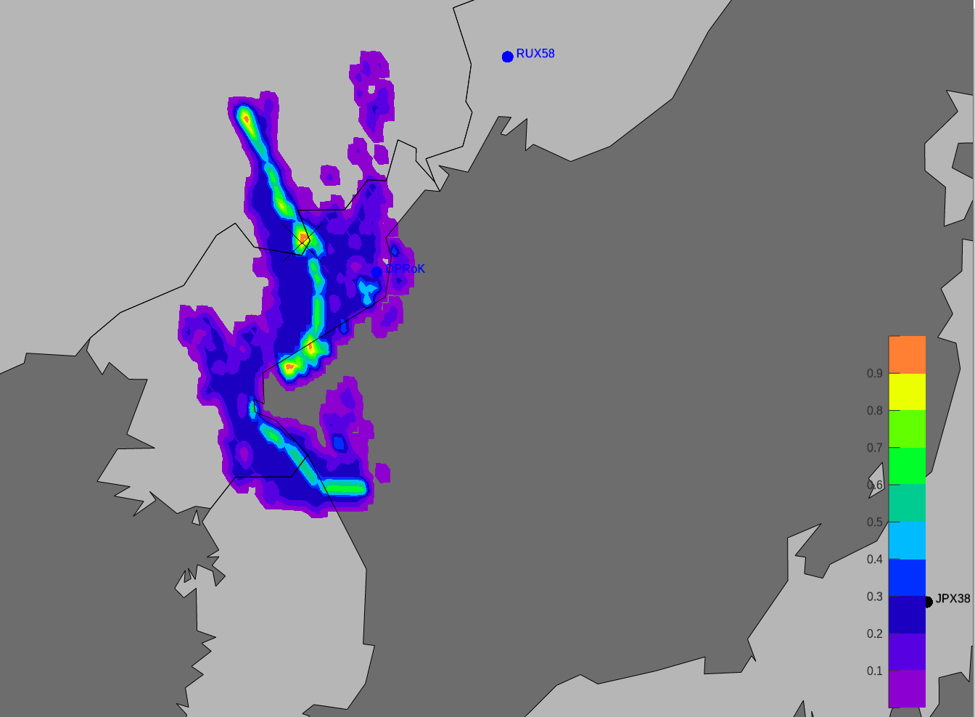
Case study - DPRK-2013
This demonstration of HRATM is conducted for the Punggye-ri Nuclear Test Site from the Democratic People’s Republic of Korea (DPRK) for the 2013 announced nuclear underground test event.
The first approach in this study considers 3 observations (samples) from JPX38, which were considered to have originated from this event.
Using PSR from WEB-GRAPE (as introduced in the previous presentation of EGU22-8689, “Quality Assessment of the different Possible Source Region (PSR) algorithms”)
PSR based on 3 samples from JPX38
collection stop times of samples
08/04/2013 07 UTC
08/04/2013 19 UTC
09/04/2013 07 UTC
See A. Ringbom, et.al., “Radioxenon detections in the CTBT international monitoring system likely related to the announced nuclear test in North Korea on February 12, 2013”, Journal of Environmental Radioactivity, 128, p47-63 (2014).
ATM PSR: 7 April 2013 at 06:00 hrs.
(0.1-degree input, 0.1-degree output, 1 hr. timestep)

Slide 5
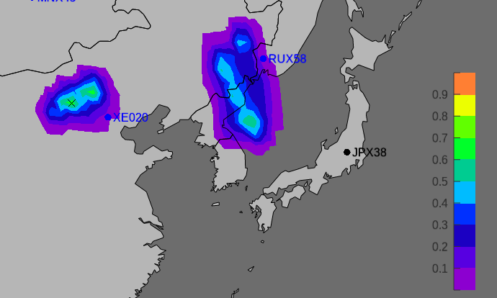
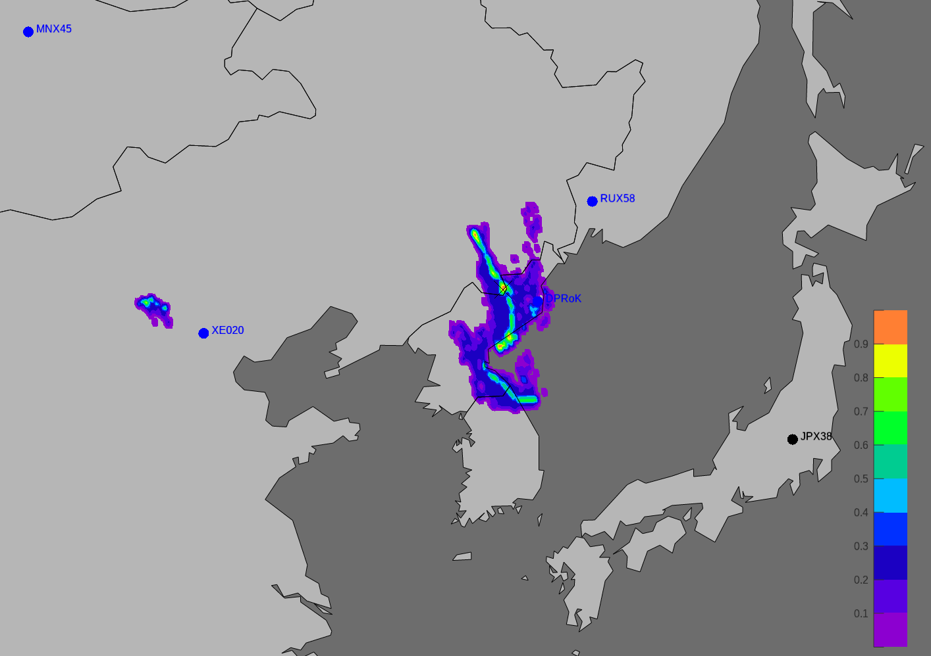
Lo-res and hi-res ATM PSR
based on three Level C detections at JPX38 on the 8th and 9th April
7 April 2013 at 06:00 hrs. UTC
(Spearman’s Rank algorithm
with Correlation / SRS > 0)
0.5-degree input, 0.5-degree output, 3 hr. timestep
0.1-degree input, 0.1-degree output, 1 hr. timestep

Slide 6
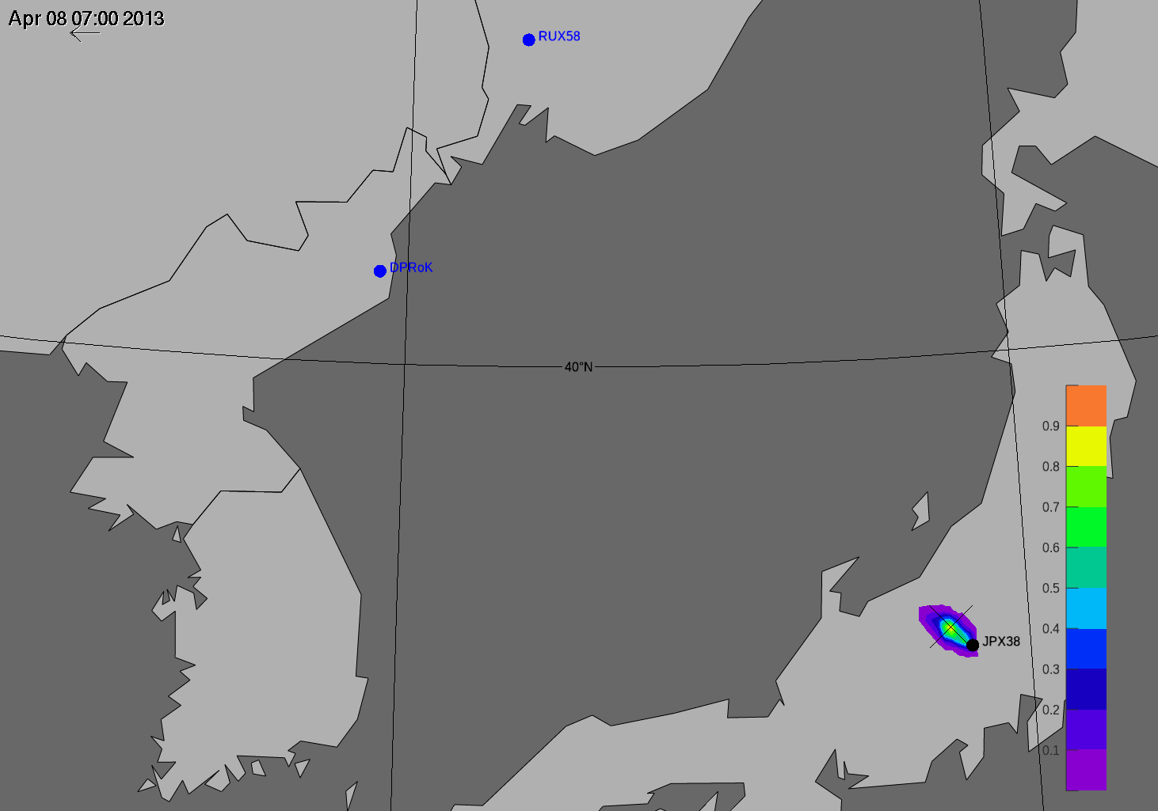
ATM PSR for 0.1-degree input
Backward from 8 April 07:00 UTC to 6 April 08:00 hrs UTC
Correlation / SRS > 0 and Spearman’s Rank algorithm

Slide 7
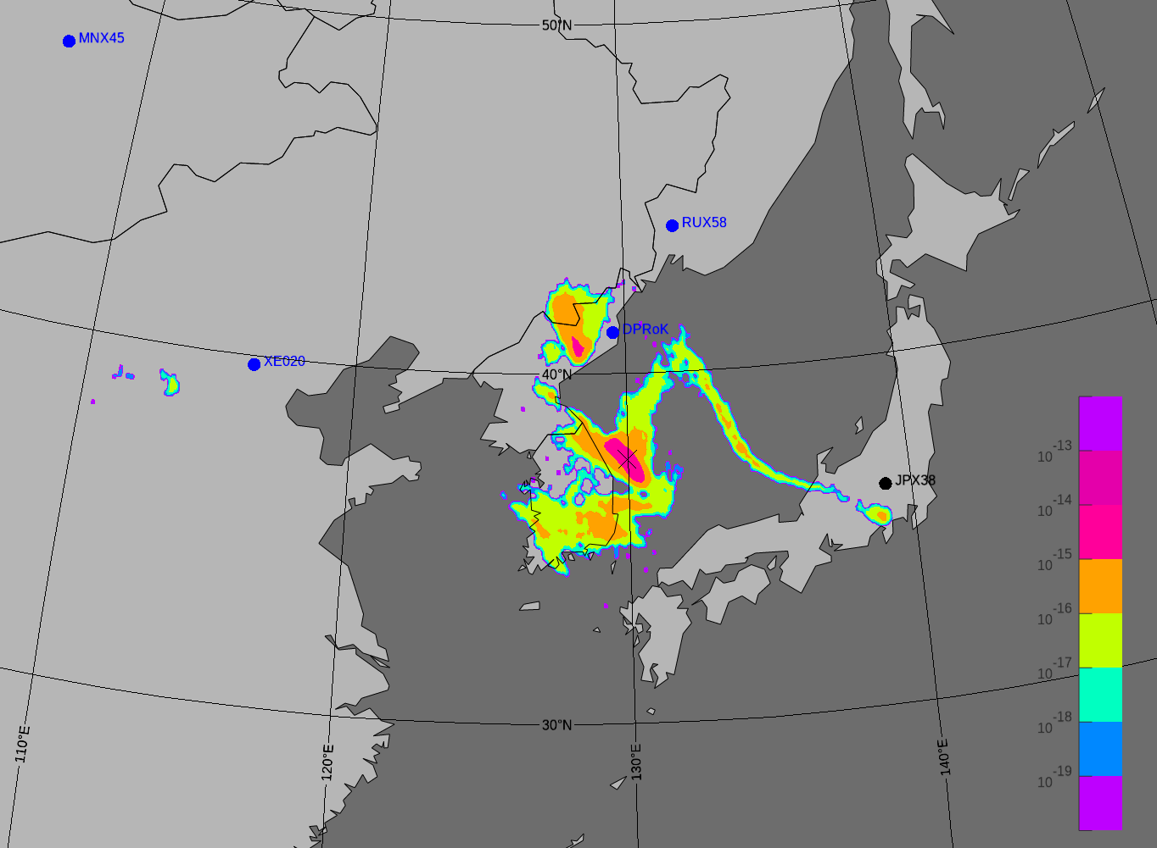
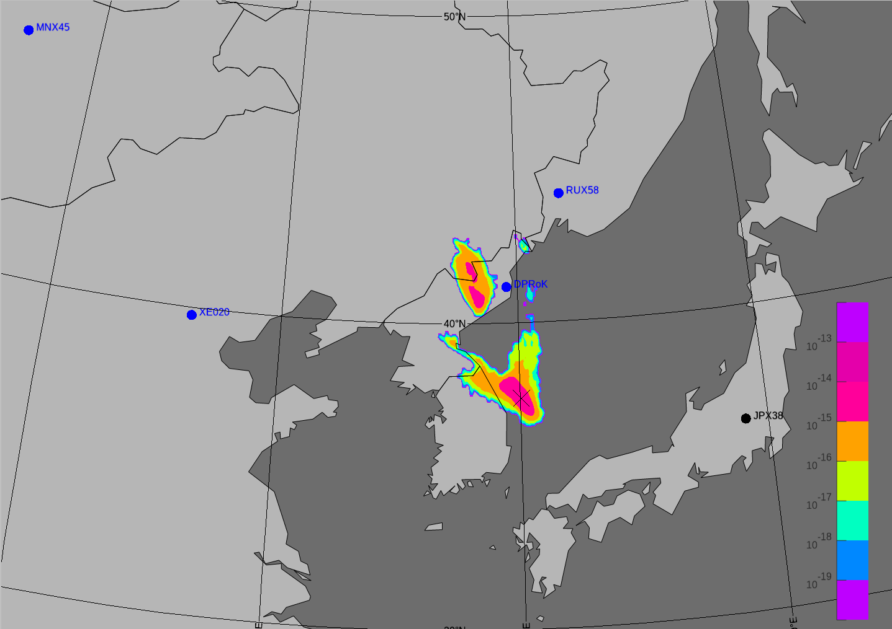
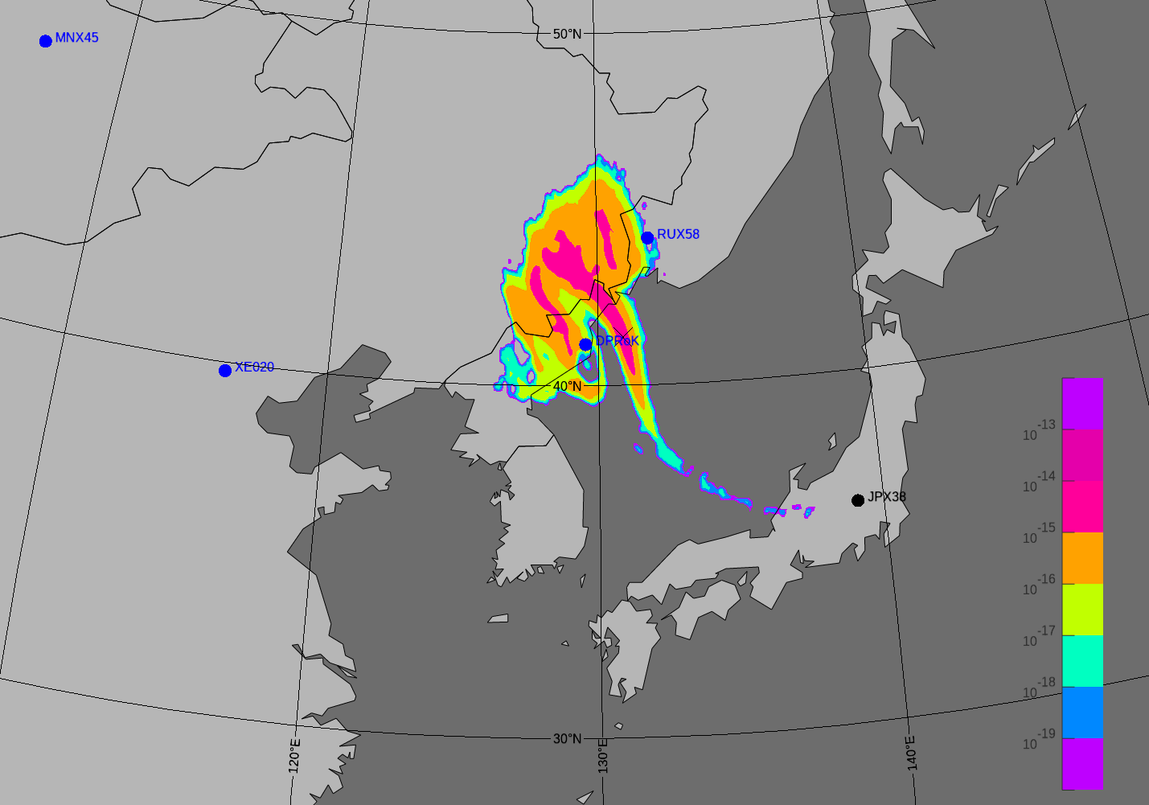
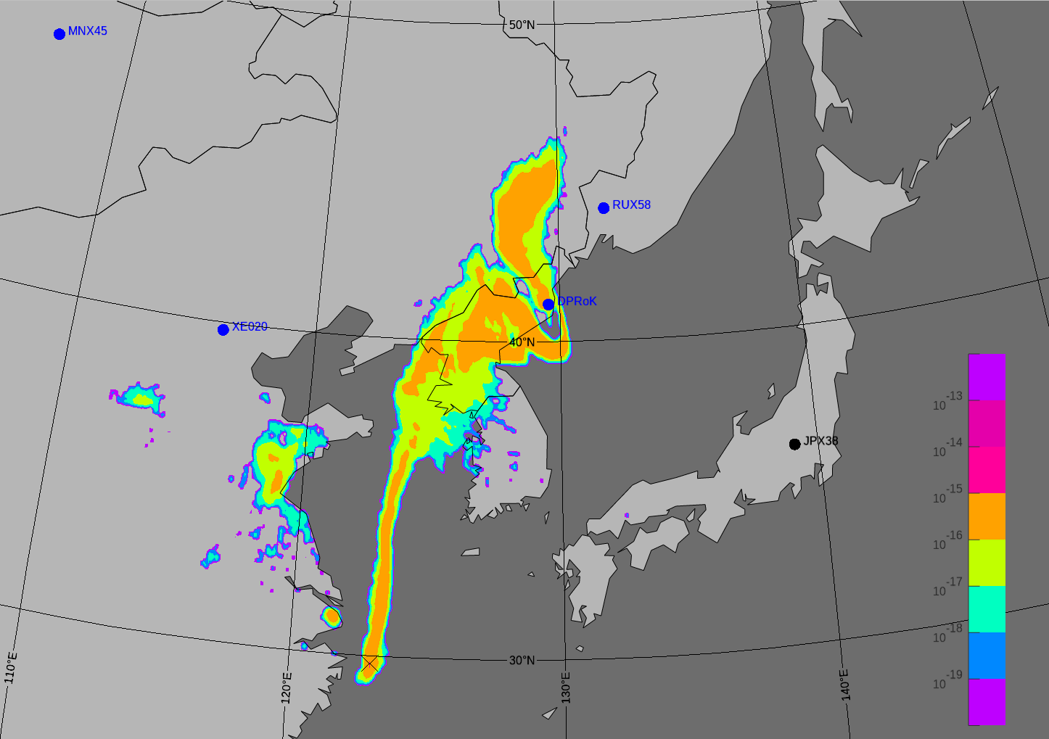
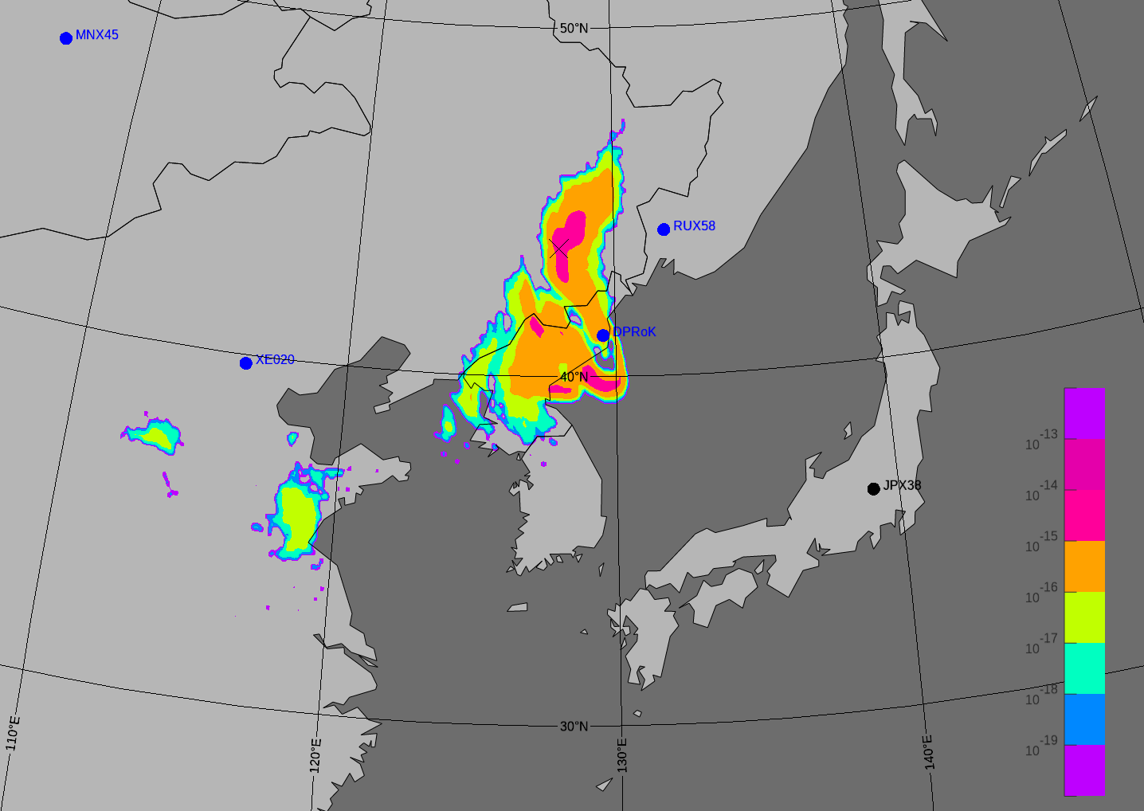
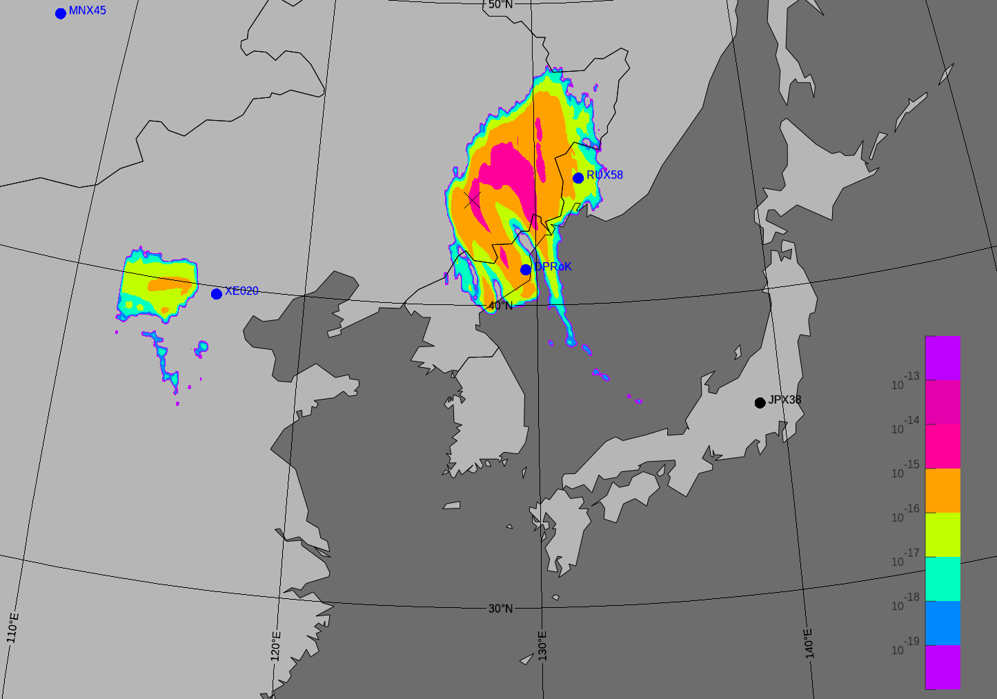
ATM vs. WRF FORs for 7 April at 07:00 hrs. UTC
Event with 3 sample collections from JPX38
ATM: FOR from SRS file from 9 April at 07:00
ATM: FOR from SRS file from 8 April at 19:00
ATM: FOR from SRS file from 8 April at 07:00
WRF: FOR from SRS file from 9 April at 07:00
WRF: FOR from SRS file from 8 April at 19:00
WRF: FOR from SRS file from 8 April at 07:00
Notes:
Double checked, FORs are OKAY in WG.

Slide 8
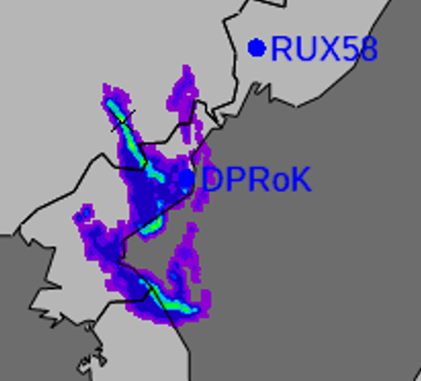
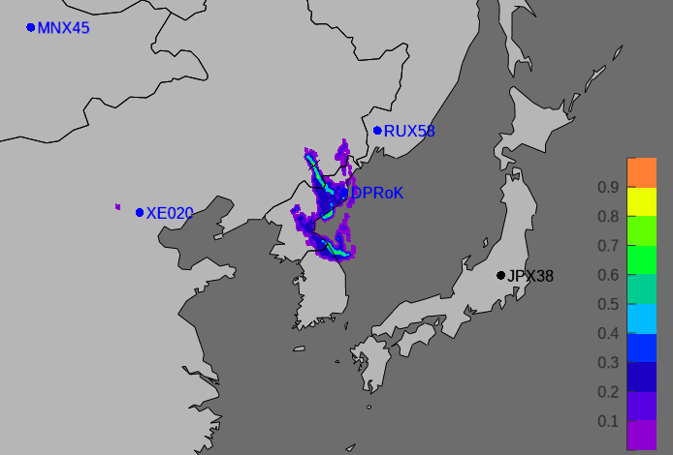
PSR from 3 ATM SRS files for 7 April at 07:00 hrs. UTC
(ATM is for 0.1-degree input)
ATM: FOR from SRS file from 9 April at 07:00
ATM: FOR from SRS file from 8 April at 19:00
ATM: FOR from SRS file from 8 April at 07:00
SRS = Source Receptor Sensitivity
PSR from 3 SRS files (Corr. / SRS > 0 Sp. Rank)

Slide 9
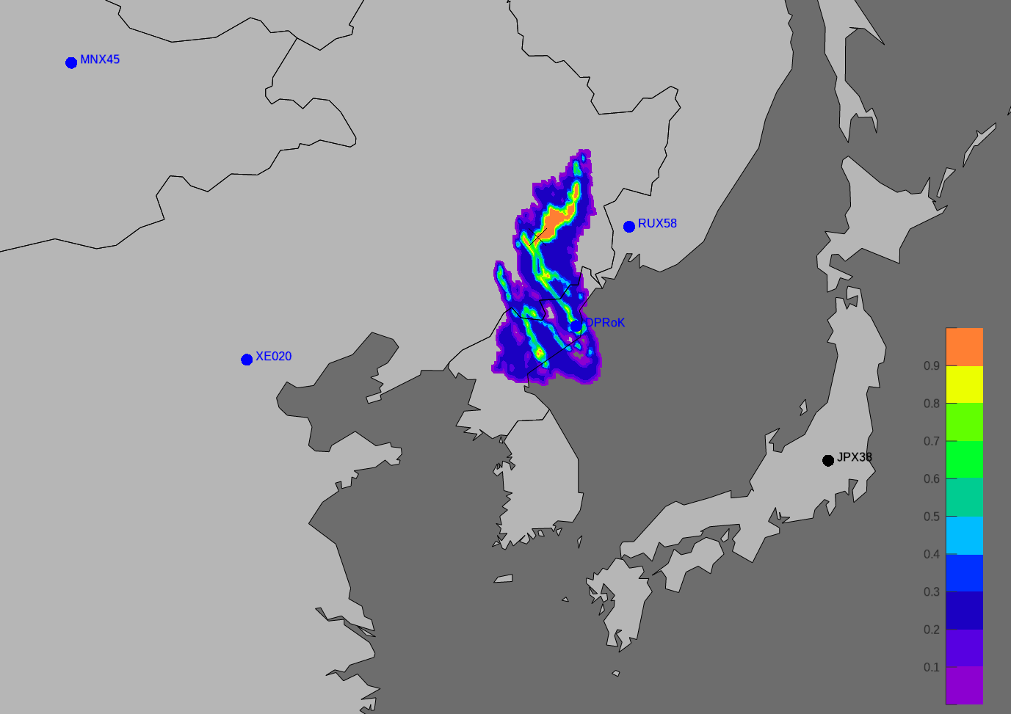
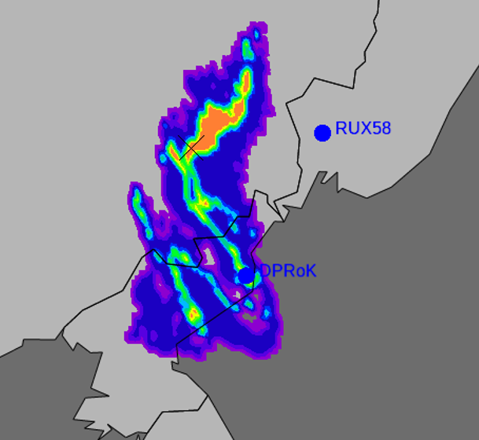
PSR from 3 WRF SRS files for 7 April at 07:00 hrs. UTC
SRS = Source Receptor Sensitivity
PSR from 3 SRS files (Corr. / SRS > 0 Sp. Rank)
WRF: FOR from SRS file from 9 April at 07:00
WRF: FOR from SRS file from 8 April at 19:00
WRF: FOR from SRS file from 8 April at 07:00

Slide 10
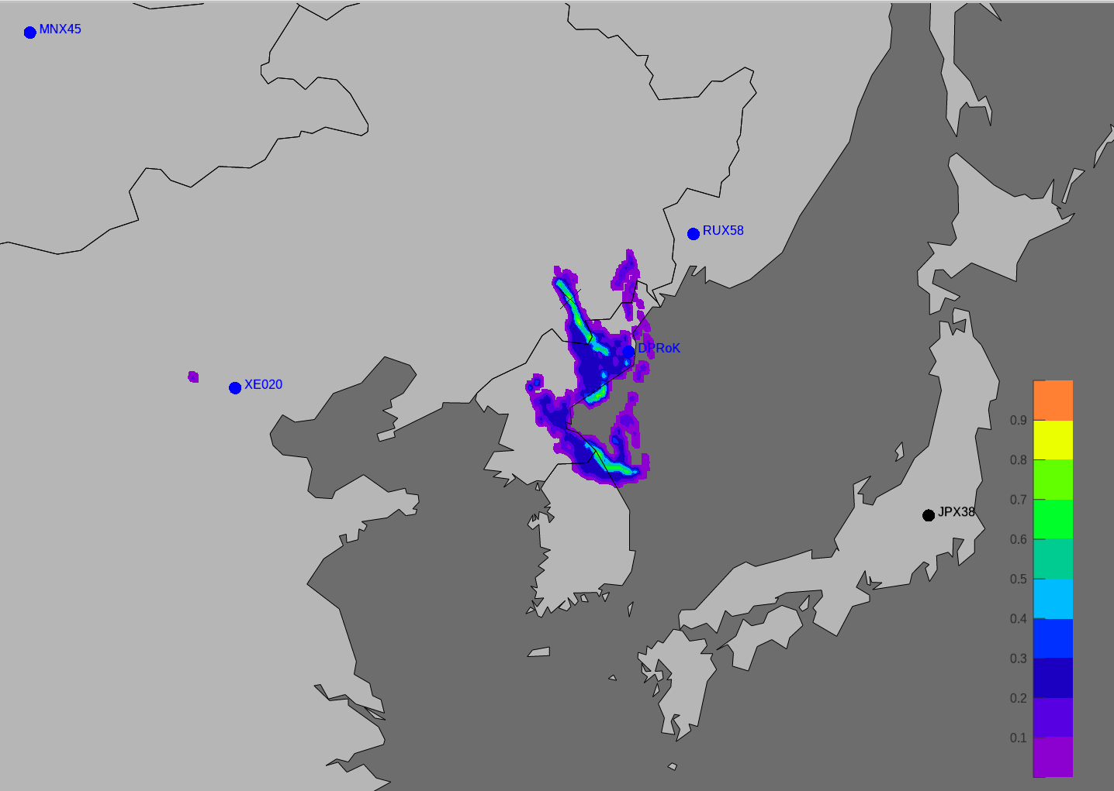
ATM vs WRF PSR based on three Level C detections at JPX38
(and Spearman’s Rank algorithm with Correlation / SRS > 0)
Snapshot timestamp:
7 April 2013 at 07:00 hrs. UTC
ATM 0.1 degrees input & output
WRF 5-km input and 0.1 degrees output

Slide 11
Summary & Outline
Increasing the spatial resolution of the meteorological input data improves the localization process.
Currently, the resolution of ECMWF data is limited to 0.1 degrees. Using WRF and Flexpart-WRF for higher spatial resolution seems to have a favorable impact on a more accurate estimation of the source location.
Using only the meteorological domain of interest for the FLEXPART-CTBTO simulations can decrease the computational time significantly.
This DPRK case study provides presents a first glimpse on what's ahead. Further investigations will cover:
  Exploring the sensitivities due to physical parameterizations in WRF setups.
  Increasing the spatial resolution in WRF to 1 km.
  Using forward modelling simulations to investigate the capability to locate possible measurements at IMS stations in case of a nuclear test event.

Slide 12
Thank you!
Please see my DISPLAY MATERIALS for more details!

