Slide 1
Micromagnetic modes of AMS in natural magnetite particles
Norwegian University of Science and Technology
Even Sunnanå Nikolaisen, Karl Fabian,
Richard J. Harrison, Suzanne A. McEnroe

Slide 2
Introduction
AMS is a primary tool in tectonics, sedimentology, and structural geology …
AMS of individual ferrimagnetic particles is the building block for AMS of bulk fabrics
Individual AMS is strongly influenced by particle shape and size
Current AMS theory is based on simple SD and MD magnetization structures: How to improve this ?

Slide 3
Method
Dataset from Nikolaisen et al, 2022
FIB-nt from "Slice and View"
302 individual magnetite particle geometries as tetrahedral meshes
Micromagnetic AMS modelling (MERRILL)
Determine the lowest local energy minimum (LLEM)
Apply fields from 5 to –5 mT in x,y,z-directions
Diagonalize calculated AMS tensor
Calculate AMS eigenmodes in eigendirections

Slide 4
New Theory of AMS
Current AMS theory is based on simple SD and MD magnetization structures
Here the FIB-nt natural particle geometries are used to provide exact micromagnetic structures
These are used to quantitatively study the eigen modes v1,v2,v3 of AMS

Slide 5
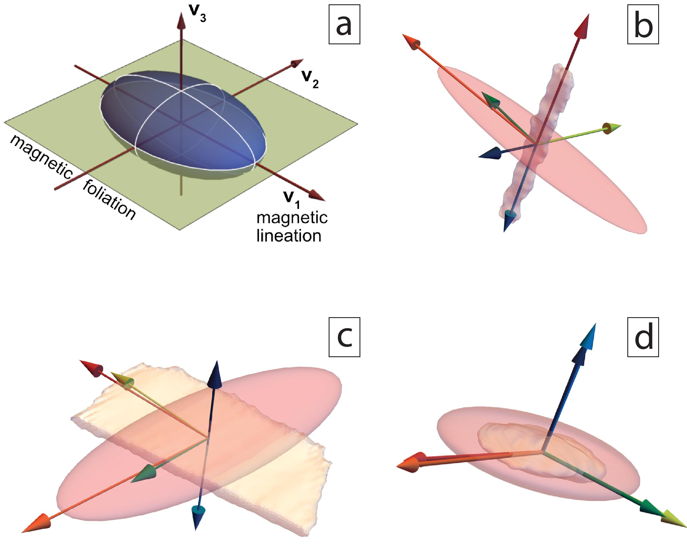
Max Elongation (L₁)
AMS ellipsoid
Max AMS (V₁)
Inverse
Min AMS (V₃)
Rotated normal
Normal

Slide 6
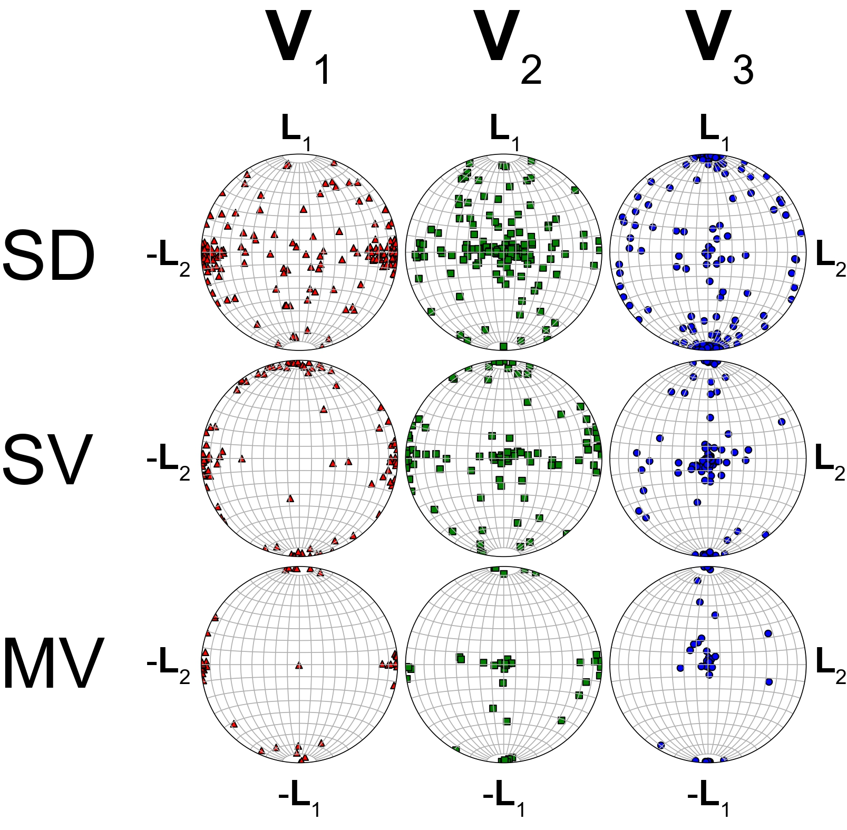
SD Magnetite:
Mainly inverse
magnetic fabric
SV and MV magnetite:
Trending away from inverse towards a normal magnetic fabric. With rotated normal magnetic fabric

Slide 7
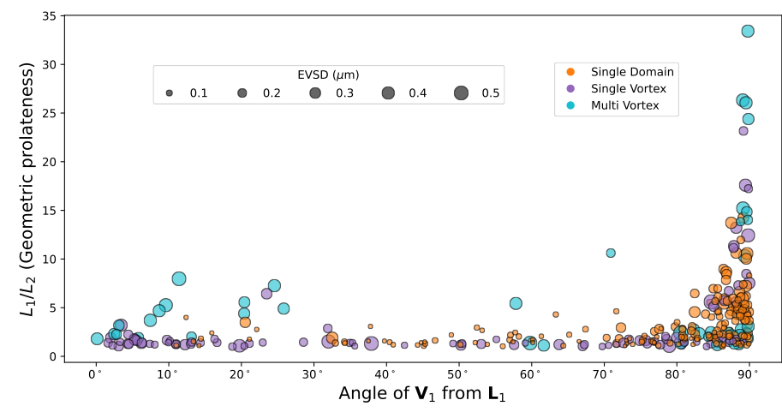
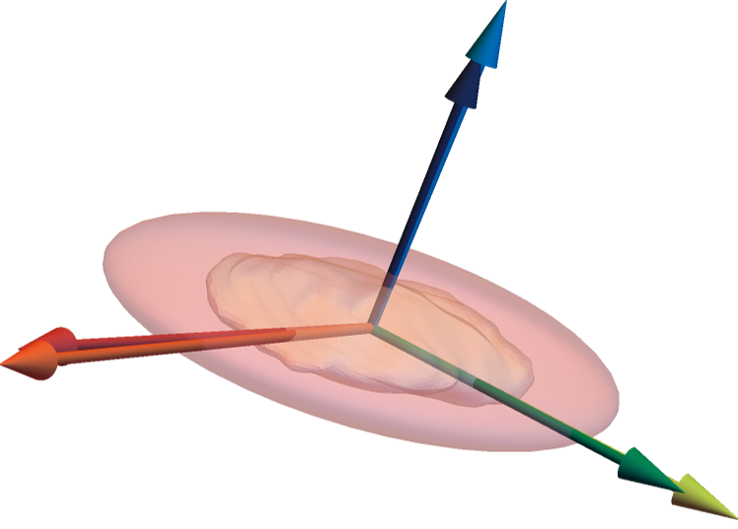
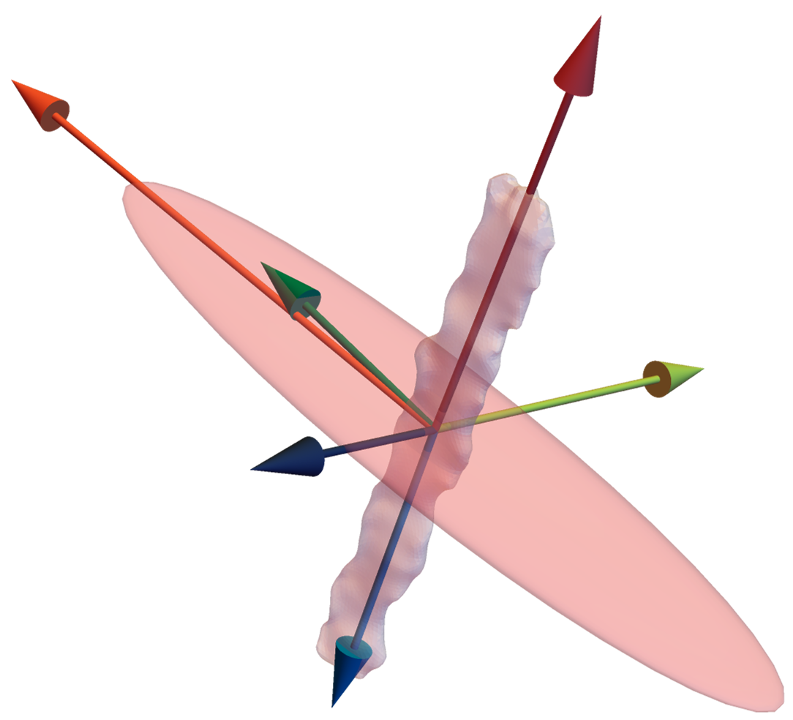
Transition from inverse to normal fabric
V₃||L₃
V₁||L₂
Normal
Inverse
V₁||L₁
V₃||L₁

Slide 8
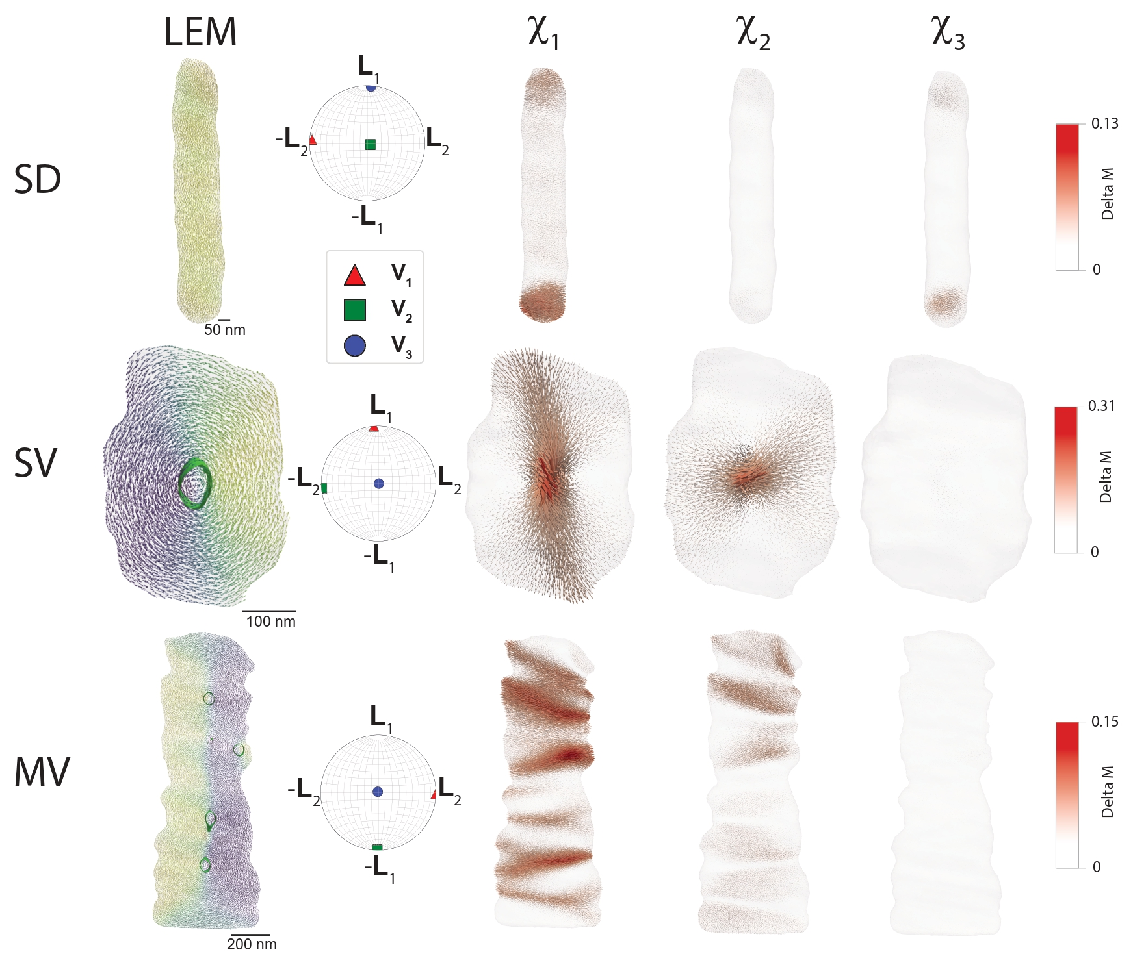
Visualizing the AMS eigen modes
Contrary to classical
SD AMS theory:
Localized magnetization changes, control high susceptibility modes
Delta M:
Difference vectors between
+5 and -5 mT states
Magnetization
structures
at 0mT

Slide 9
Conclusion
A new micromagnetic method allows to study the AMS of 302 individual natural magnetite particles
High AMS modes due to local magnetization changes: flowering, buckling, vortex motion
SD particles: mainly inverse magnetic fabric (flowering, buckling)
SV particles: transition state (vortex motion)
MV particles: dominantly normal magnetic fabric (combined vortex motion)
The study provides a new understanding of AMS modes in magnetic mineral assemblages in geological materials

