Slide 1


A Reference Observatory of Basins for INternational hydrological climate change detection
Trout Beck at Moorhouse
UK Reference catchment,
Northern England © NRFA, UKCEH
Stephen Turner, Lucy Barker, Harry Dixon, Jamie Hannaford, Adam Griffin, Alannah Killeen and the ROBIN Network
Session HS2.5.1, EGU General Assembly, Vienna, 23rd - 27th May 2022
Notes:
Seen proposal!
Going to explain the backstory.
Here is an RHN!

Slide 2
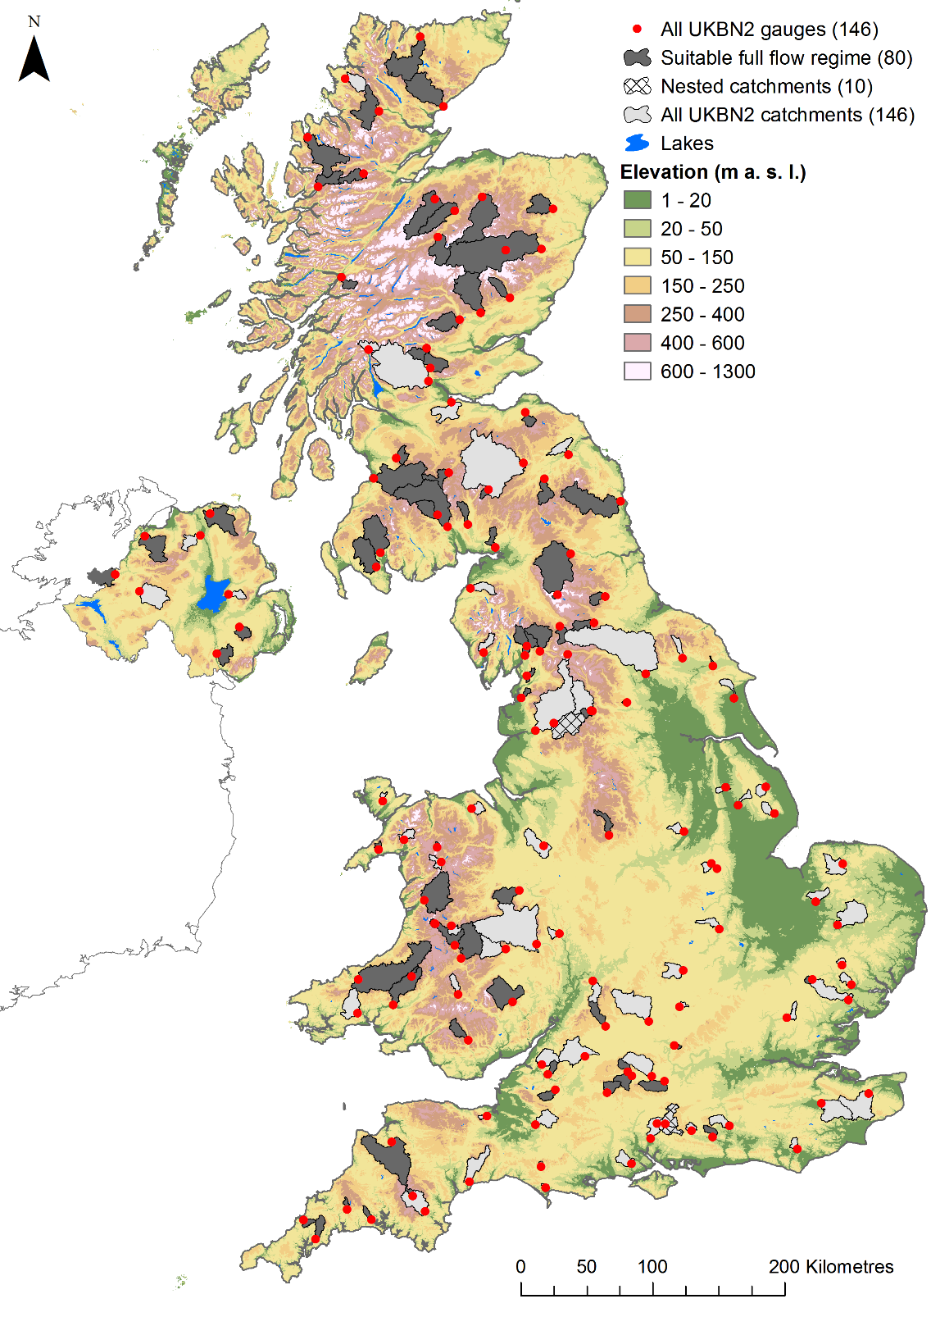
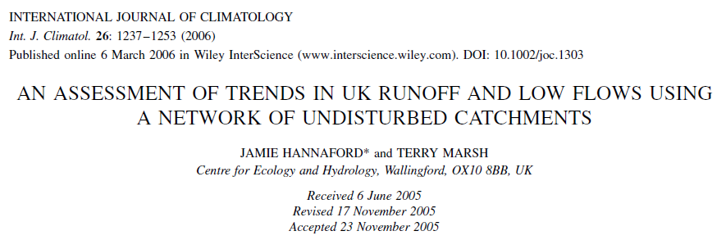
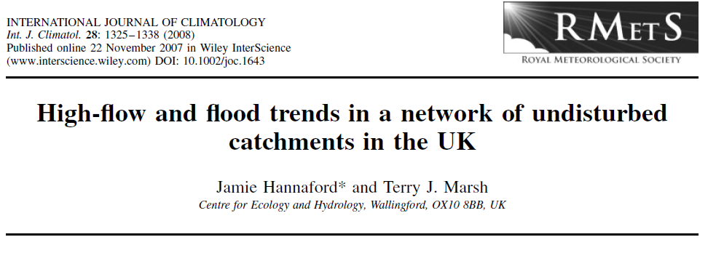
Why reference hydrologic networks (RHNs)?
RHNs filter out human influences on streamflow and focuses on catchments with undisturbed flow regimes
Allows us to monitor changes in hydrological regime relation to climate variation and change
The UK Benchmark Network
Defined: Bradford and Marsh, 2003
Updated: Harrigan et al. 2018
Notes:
What is an RHN
We wll discuss.

Slide 3
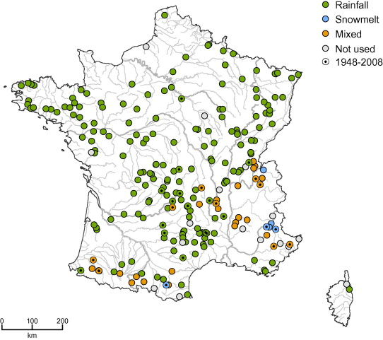
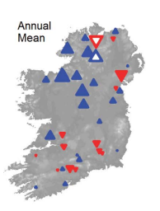
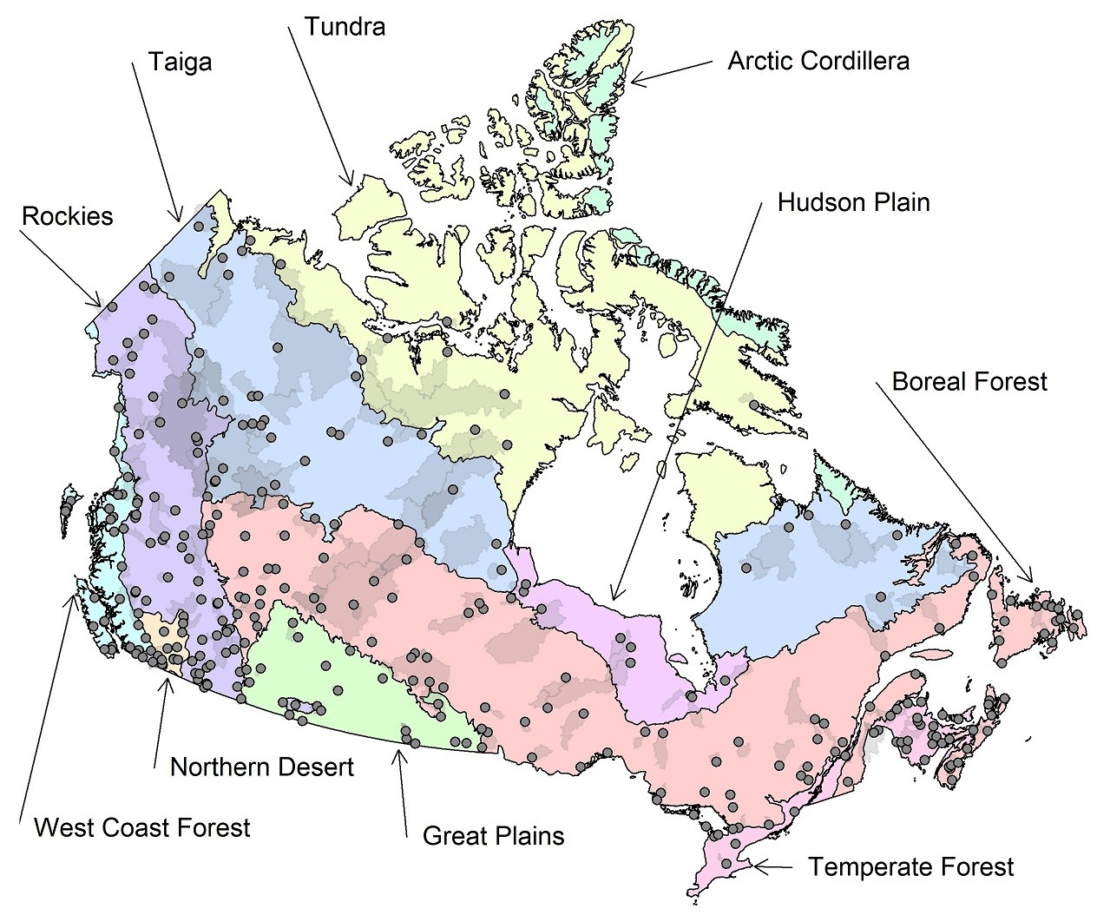
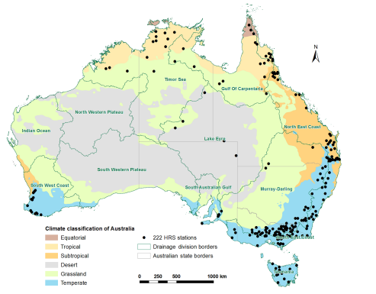
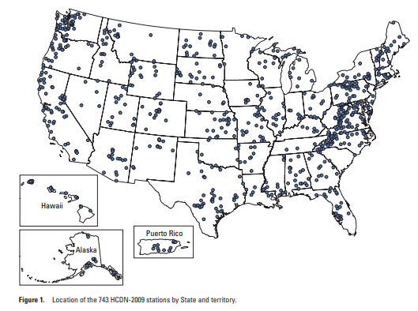
Other examples (selected!)
Irish Reference Network
(Murphy et al. 2013)
French Reference Low
Flow Network
(Giuntoli et al. 2012)
Canadian RHBN
(Harvey et al. 1999)
Australia BOM RHS
(Zhang et al. 2019)
US HCDN (Slack and Landwehr, 1992)
Notes:
What is an RHN
We wll discuss.

Slide 4
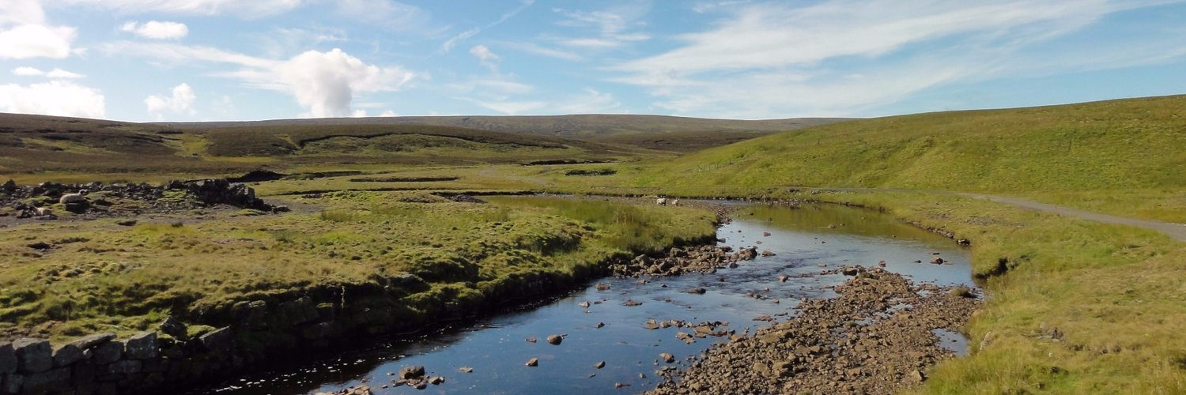
What is an (ideal) reference catchment?
Sensibly natural and free of major human disturbances
Good quality data, ideally across the flow regime
Long (40+? year) records
Headwaters of the River Tees,
Northern England © NRFA, UKCEH
Notes:
What is an RHN
We wll discuss.

Slide 5
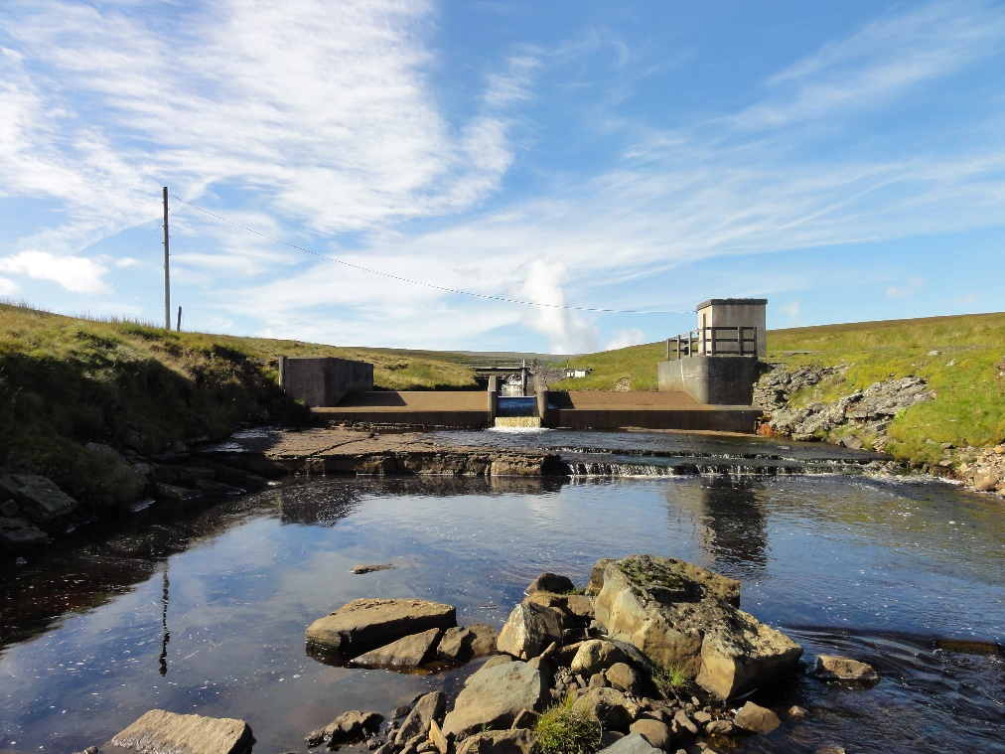
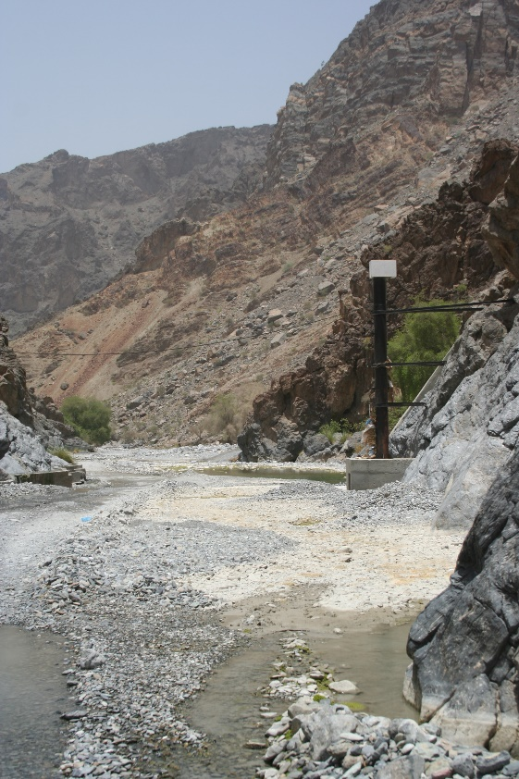
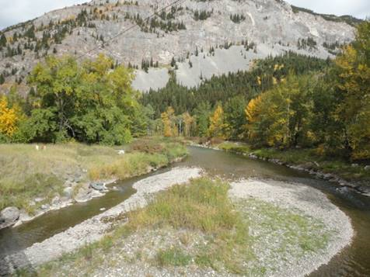
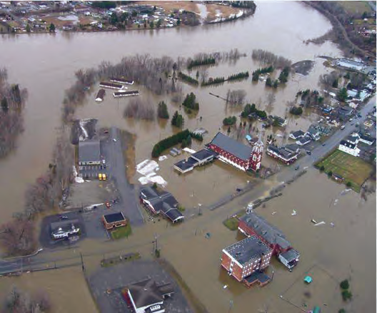
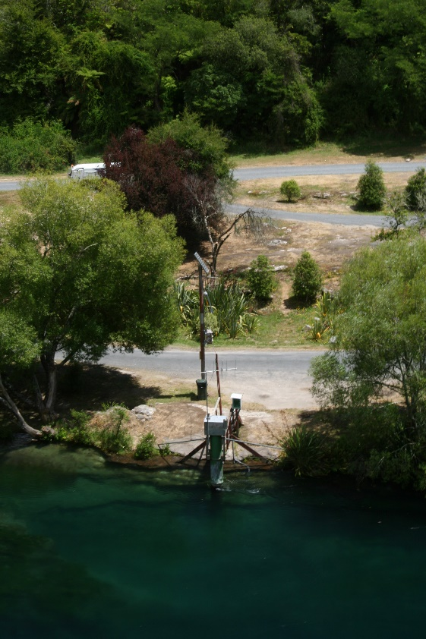
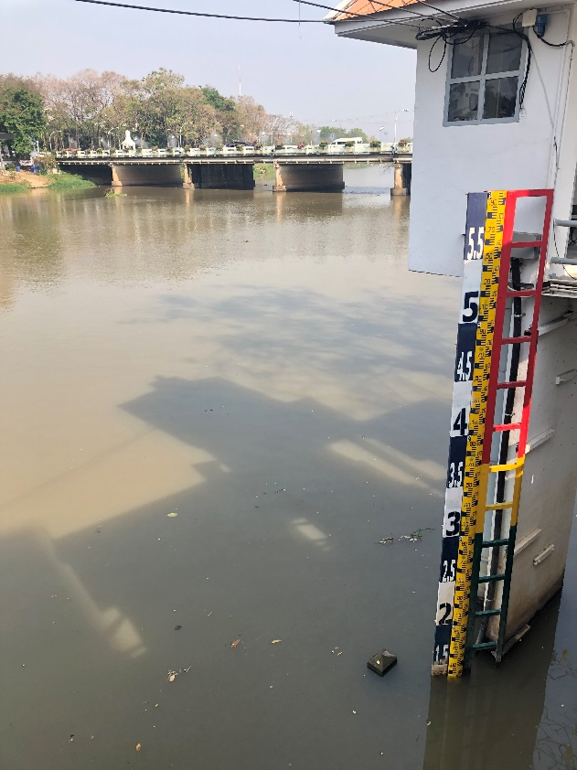
The ROBIN Network
Some countries have already declared RHNs
However, to date there have been no efforts to integrate these globally.
Within ROBIN, we are advancing a worldwide effort to bring together a global RHN.
The vision of ROBIN is that future IPCC assessments will make more confident appraisals of climate-driven global streamflow change, including floods and droughts, than has been possible hitherto, and that this will underpin improved climate adaptation.
Gauging station in Oman © Harry Dixon
Gauging station in Chiang Mai, Thailand © Lucy Barker
Maine, USA/New Brunswick, CA border 2008 © Maine Department of Public Safety
Gauging station in New Zealand © Harry Dixon
Trout Beck at Moor House, UK © NRFA, UKCEH
Crowsnest River, Canada © Paul Whitfield
https://www.ceh.ac.uk/our-science/projects/robin
Notes:
What is an RHN
We wll discuss.

Slide 6
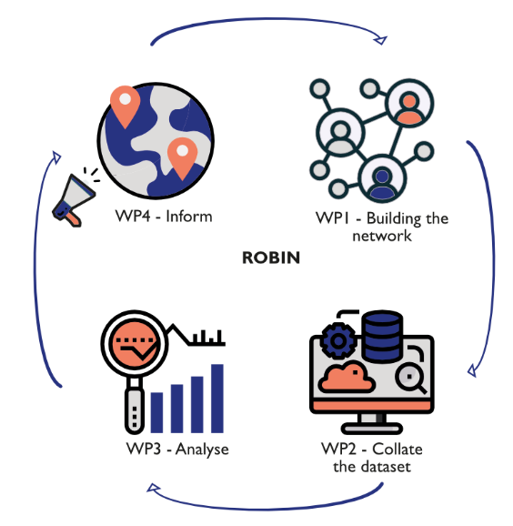
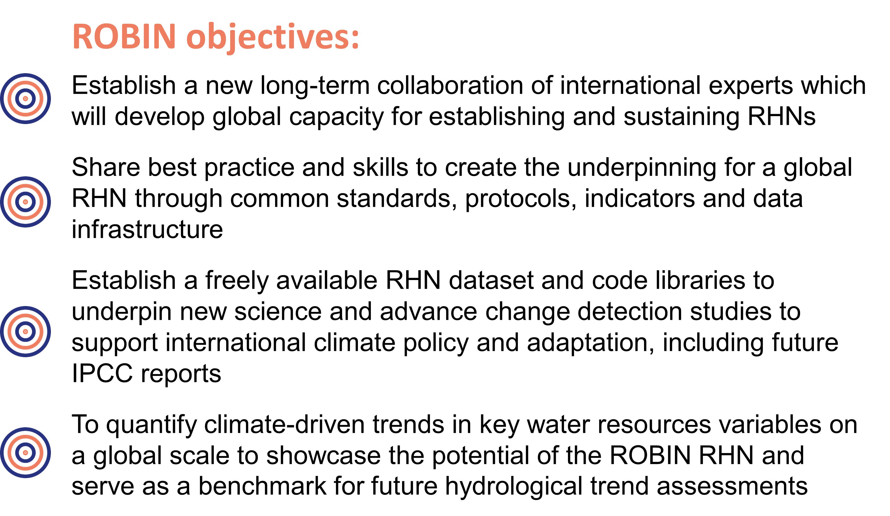
The ROBIN Project
Funding: UK Research and Innovation ‘Global Partnerships Seedcorn Fund’
£100k, Nov 2021 - 2023
Notes:
What is an RHN
We wll discuss.

Slide 7
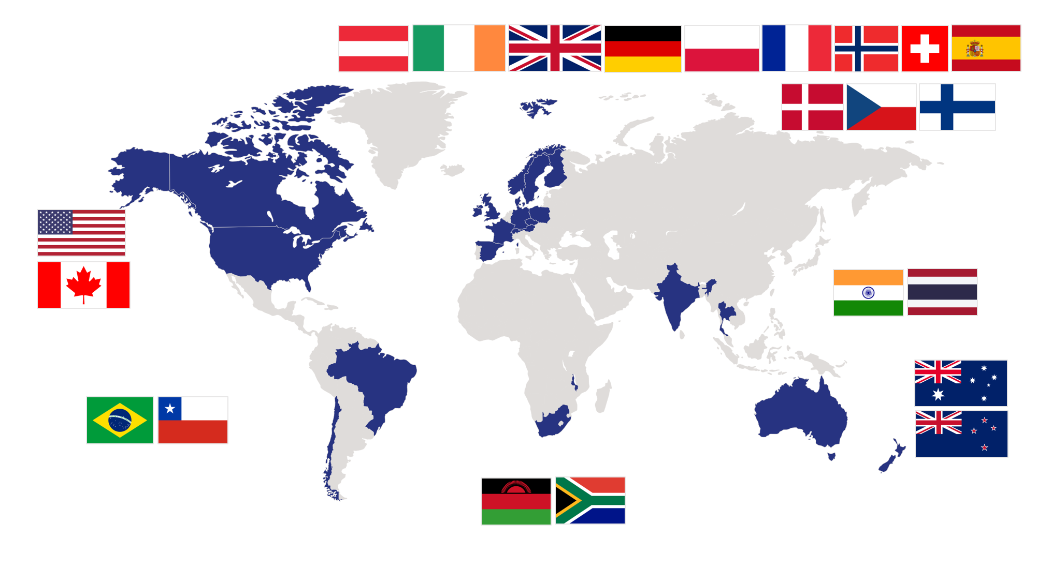
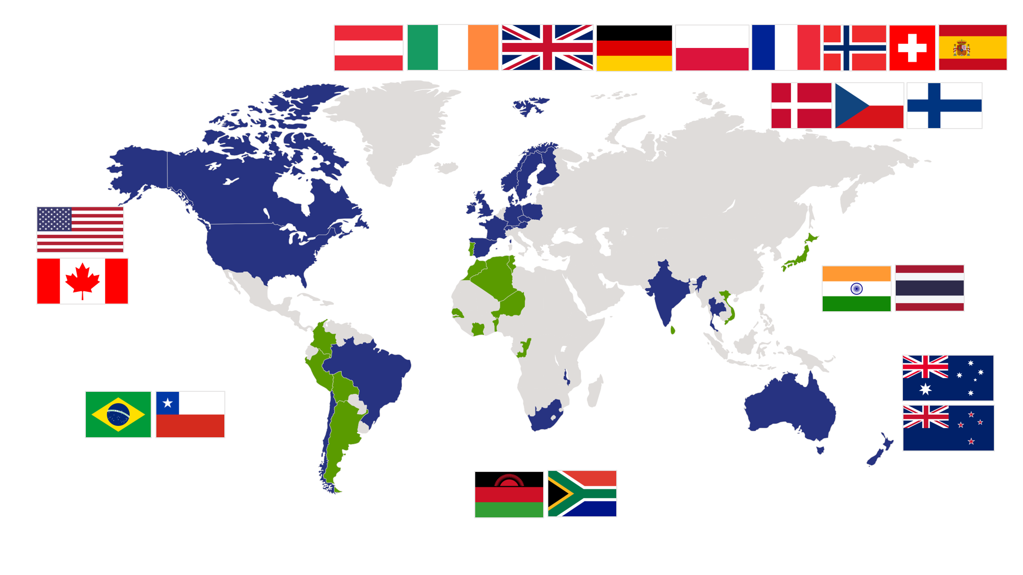






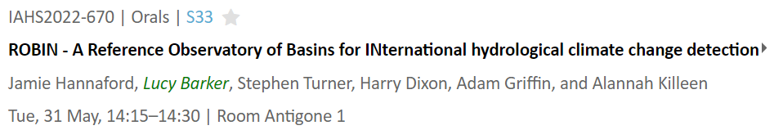
Building the Network
Mobilise the network and establish principles of data sharing and analysis
Develop guidance to illustrate network criteria and best practice from within the ROBIN network
Spread the word!
Bring more countries into the ROBIN Network
https://flagpedia.net
Supporting Organisations:
(in progress!)
Notes:
What is an RHN
We wll discuss.

Slide 8
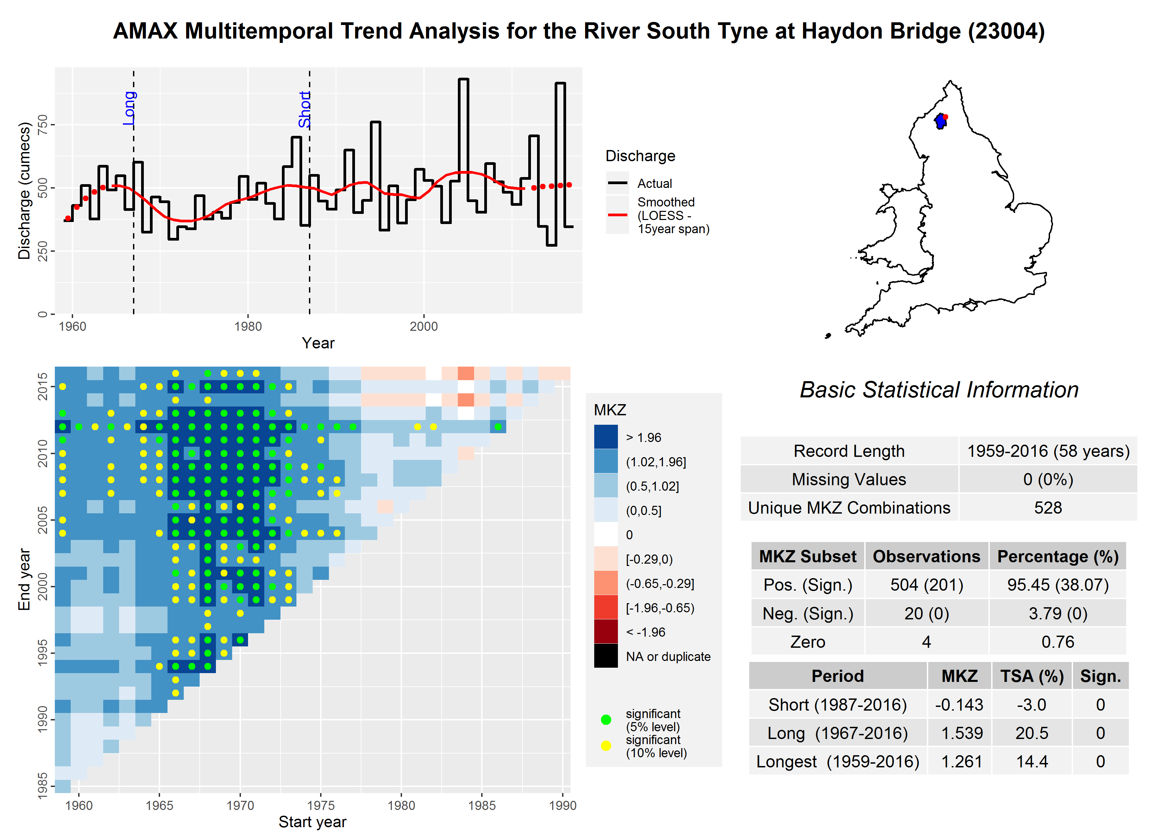
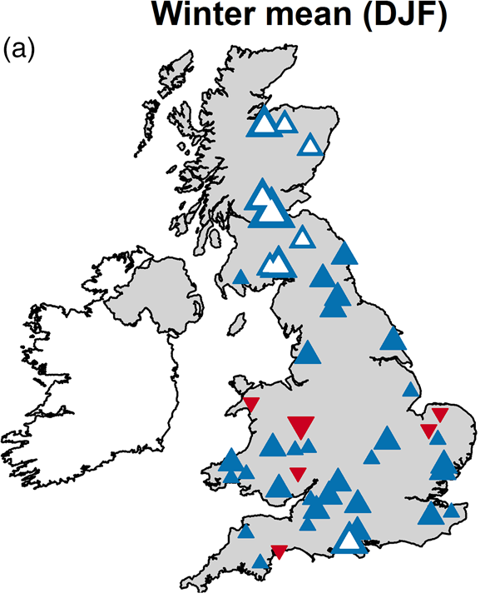
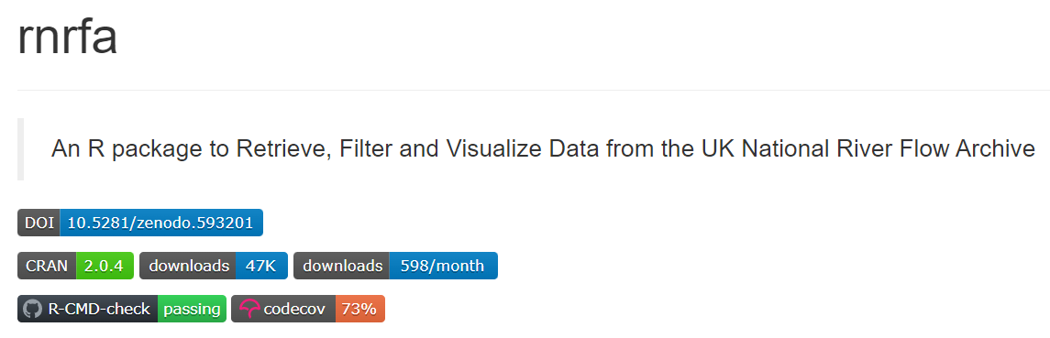
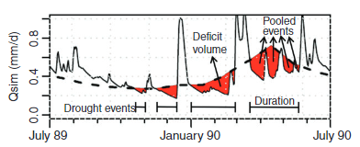
Data & Analysis
Define RHN criteria
Develop and share codes to support data transfer
Build the ROBIN dataset v1.0
Analysis of global hydrological change
Example of ‘multitemporal’ trend diagnostics from
NRFA trends libraries
(e.g. Hannaford et al. 2021)
Magnitude and direction of trends for fixed period
(e.g. Harrigan et al. 2018)
rNRFA, an example of a code library for Accessing and analysing UK river flow data​, Claudia Vitolo
https://cran.r-project.org/web/packages/rnrfa/index.html
Threshold level method with variable threshold
(e.g. Van Loon, 2015)
Notes:
What is an RHN
We wll discuss.

Slide 9
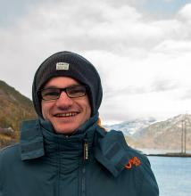
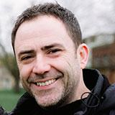

The future and ROBIN legacy
Supporting Organisations:
Within ROBIN we will publish and analyse trends in the ROBIN v1 dataset (planned for 2023)
Work with WMO, UNESCO and IPCC to create a sustainable legacy for ROBIN, to allow continued growth of the dataset and maintain the people network
Want to get involved?
ROBIN team at EGU:
Whether you already have a RHN or could select some RHN-like stations from your network – we’d love to have you on board!
Say ‘Hi!’ at EGU, and email us at
robin@ceh.ac.uk
https://www.ceh.ac.uk/our-science/projects/robin
Notes:
What is an RHN
We wll discuss.

Slide 10


Thank you for listening!
Trout Beck at Moorhouse
UK Reference catchment,
Northern England © NRFA, UKCEH
robin@ceh.ac.uk
We will be at EGU Networking zone at terrace G Fri 27 May, 12:00–13:00 CEST
@stephen_turner1
Notes:
Seen proposal!
Going to explain the backstory.
Here is an RHN!

