Slide 1


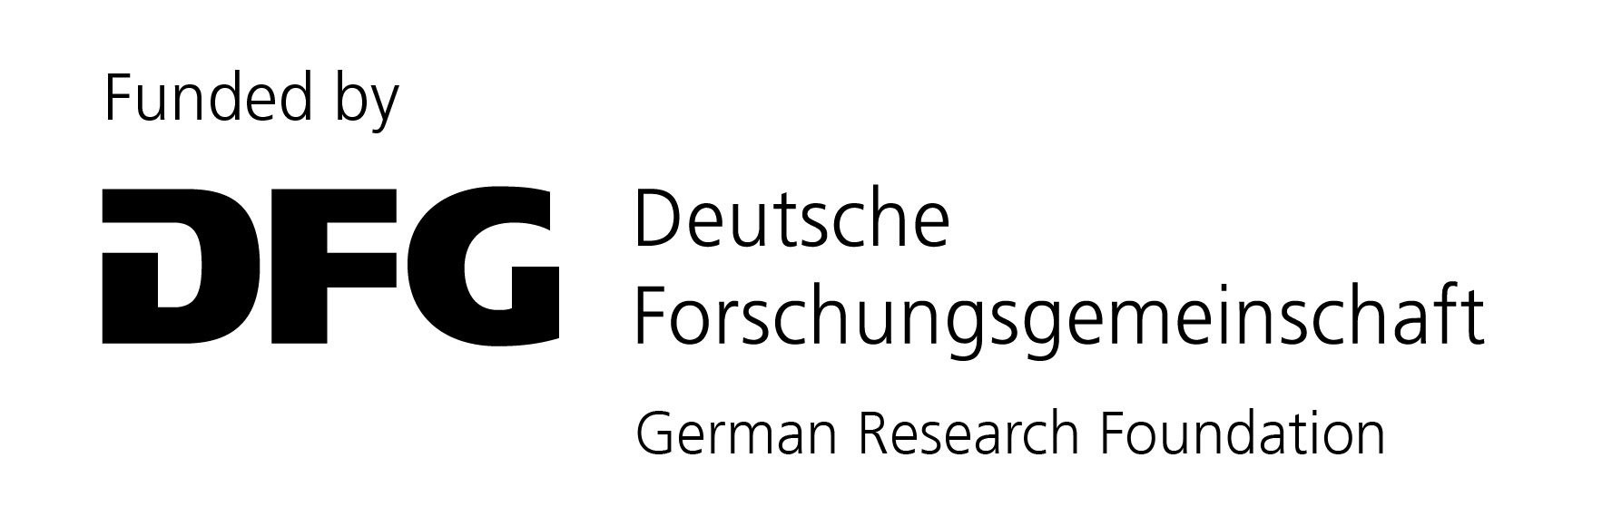
Using different seismic approaches to detect submarine permafrost and gas hydrates on the continental Beaufort shelf of the Canadian Arctic
CR2.1 Geophysical and in situ methods for snow and ice studies
EGU22-8555 – 25 May 2022, 14:14-14:20
Henrik Grob¹;
M. Riedel²; M. J. Duchesne³; S. Krastel¹; J. Bustamante Restrepo⁴; G. Fabien-Ouellet⁴; D. Kläschen²; J. Preine⁵; Y. K. Jin⁶; J. K. Hong⁶
¹ Kiel University, Germany; ² GEOMAR Helmholtz Centre for Ocean Research Kiel, Germany; ³ Geological Survey of Canada, Canada; ⁴ Polytechnique Montreal, Canada; ⁵ University of Hamburg, Germany; ⁶ Korea Polar Research Institute, Korea

Slide 2
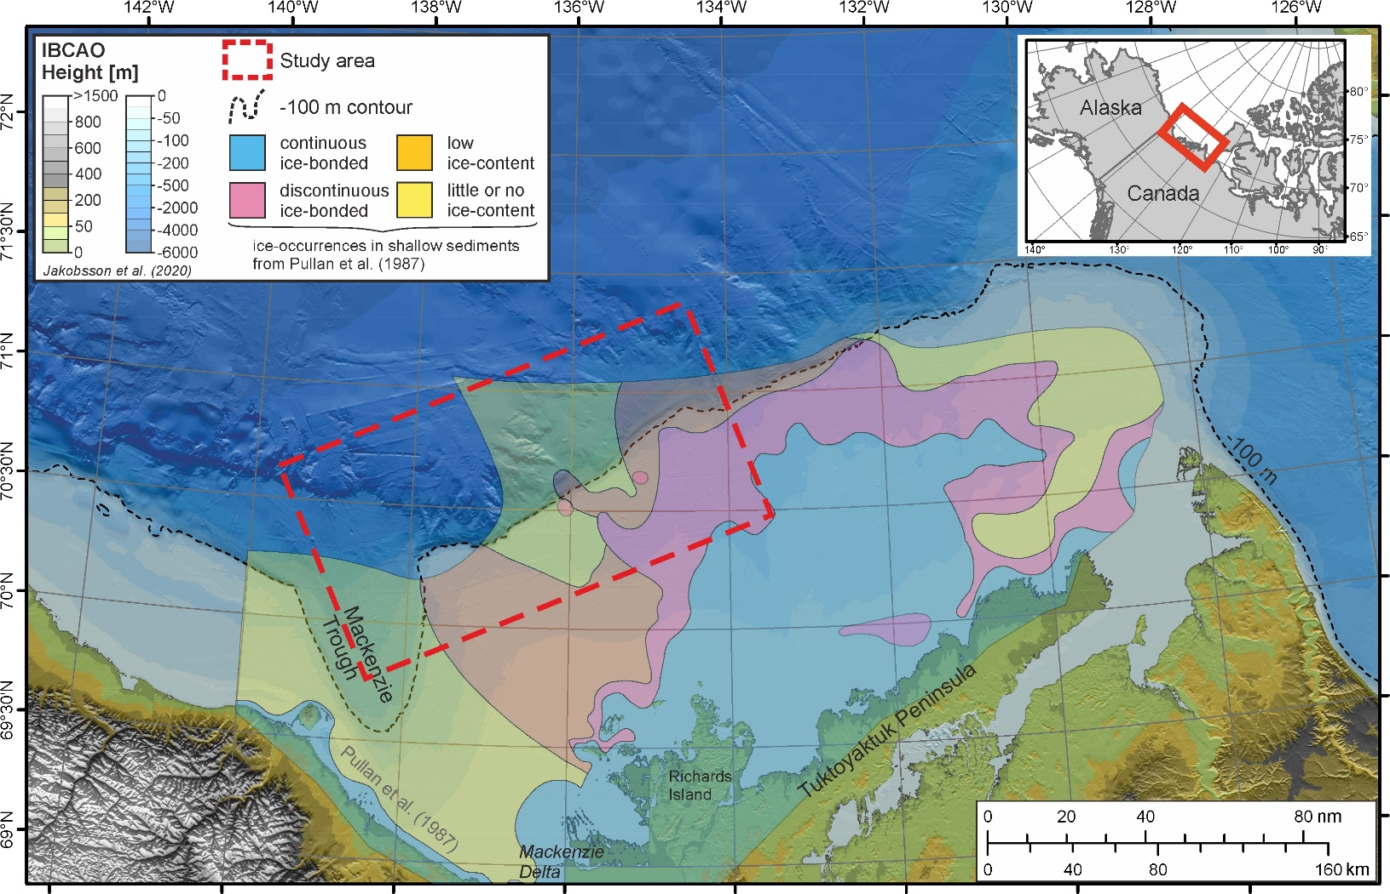
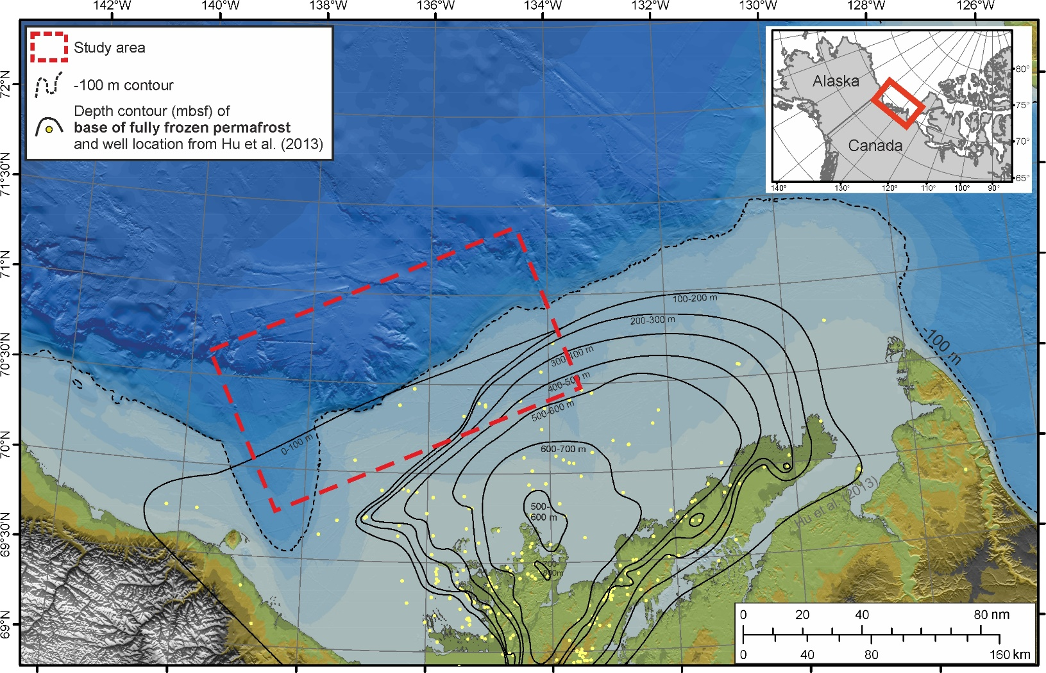
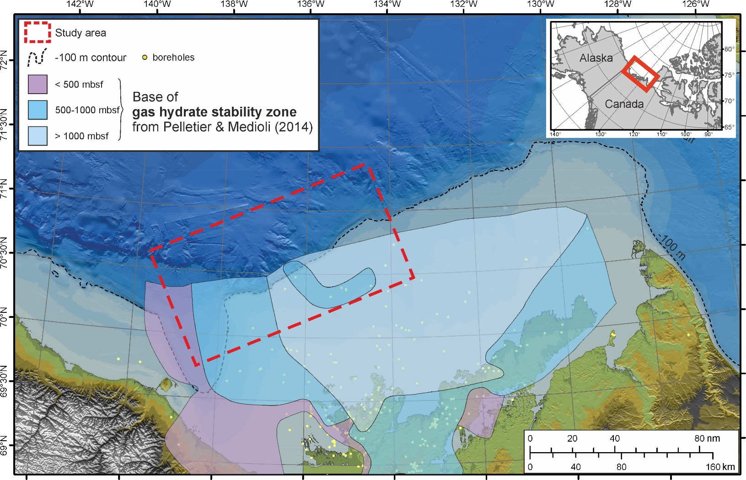
The Canadian Beaufort Sea
extensive submarine permafrost and permafrost-associated gas hydrates in the Canadian Beaufort Shelf
current knowledge known from seismic refraction surveys and borehole analyses
But: the extents of both the submarine permafrost and the permafrost-associated gas hydrates are still poorly constrained.

Slide 3
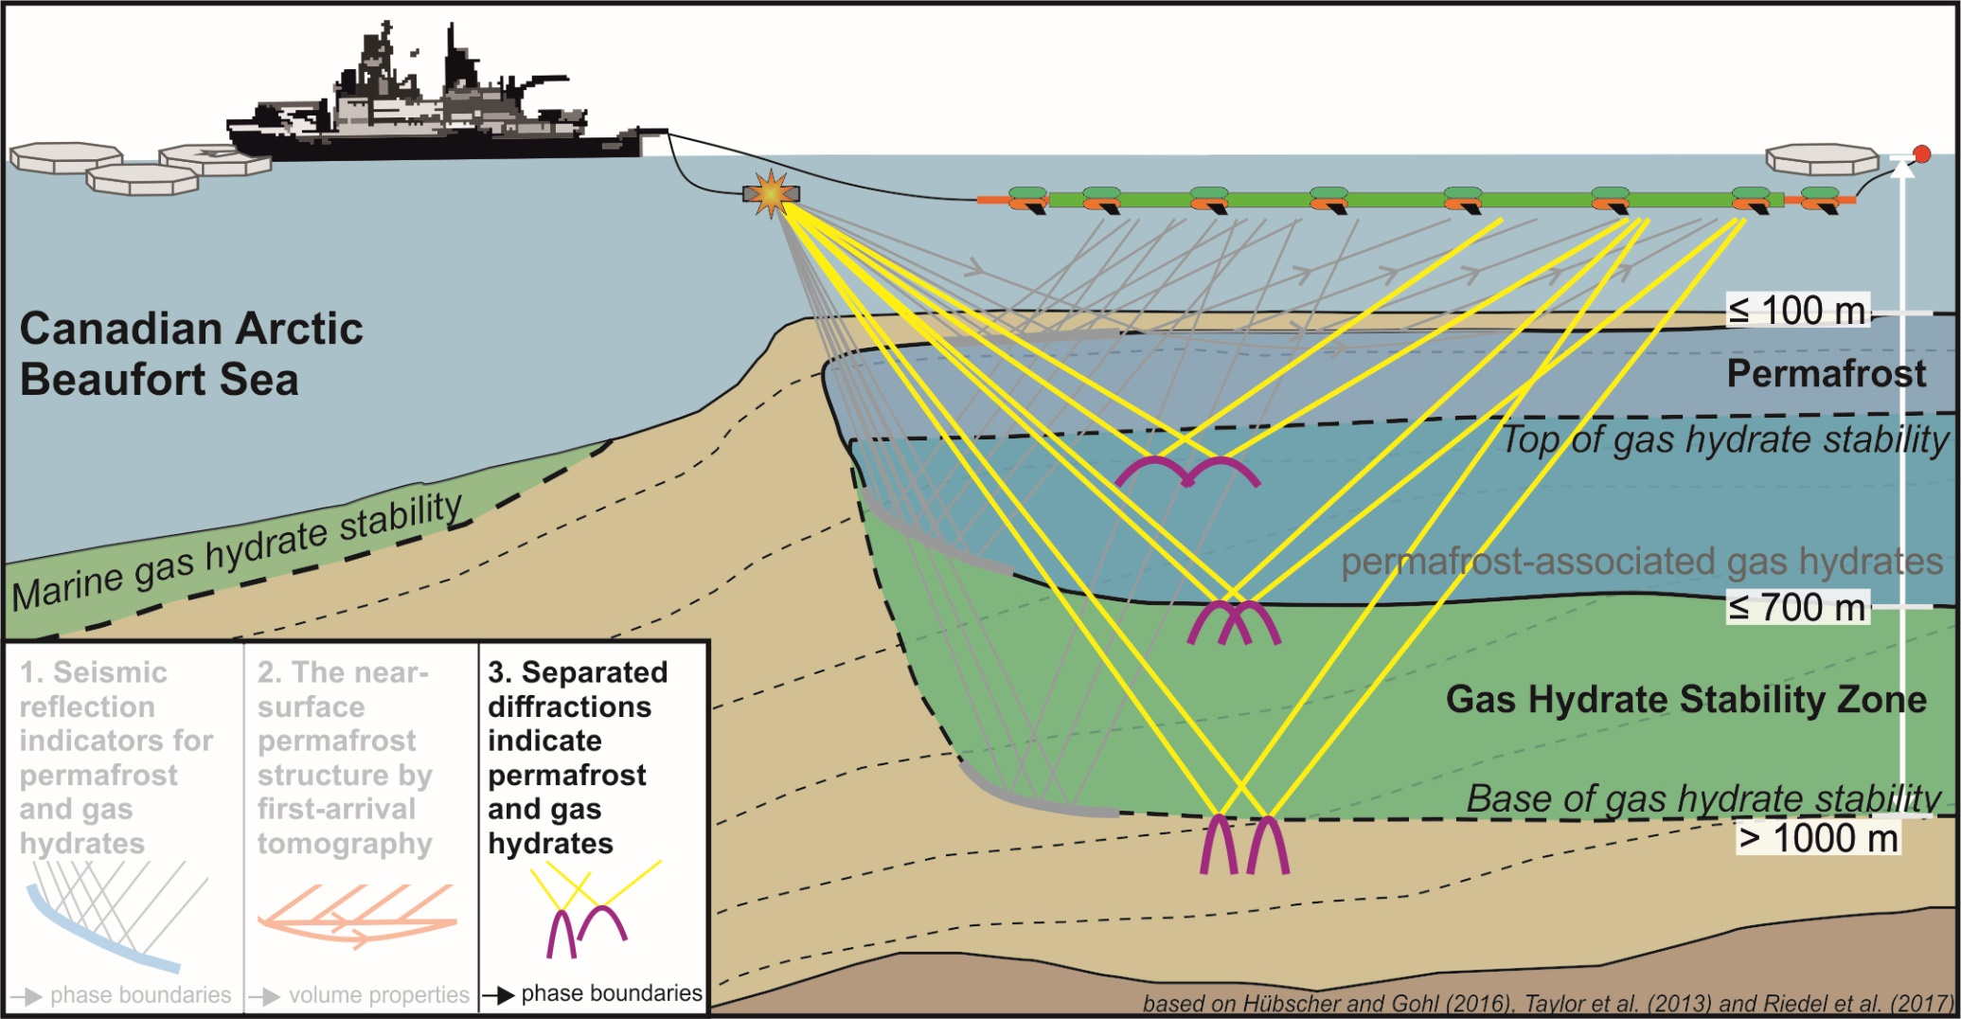
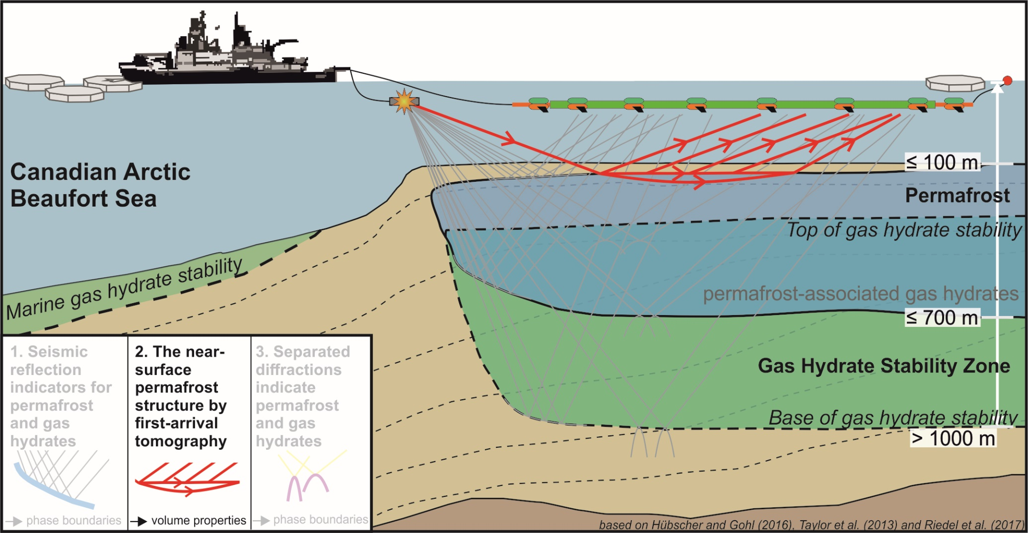
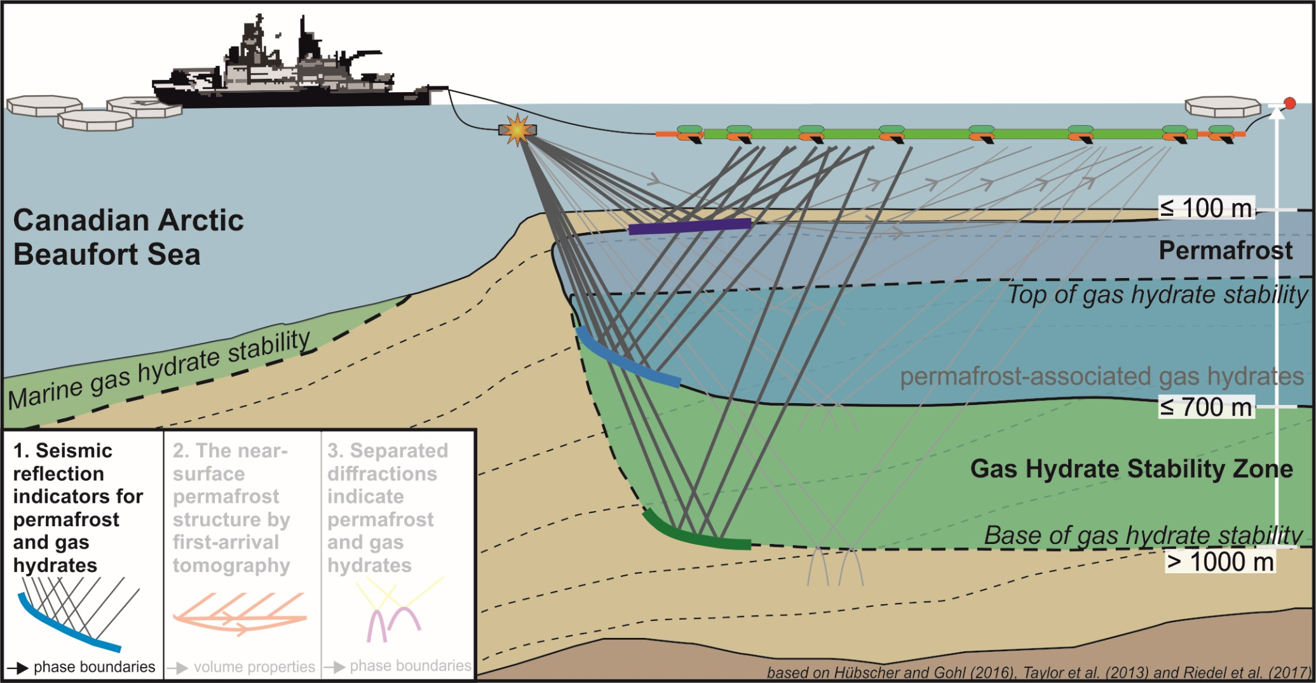
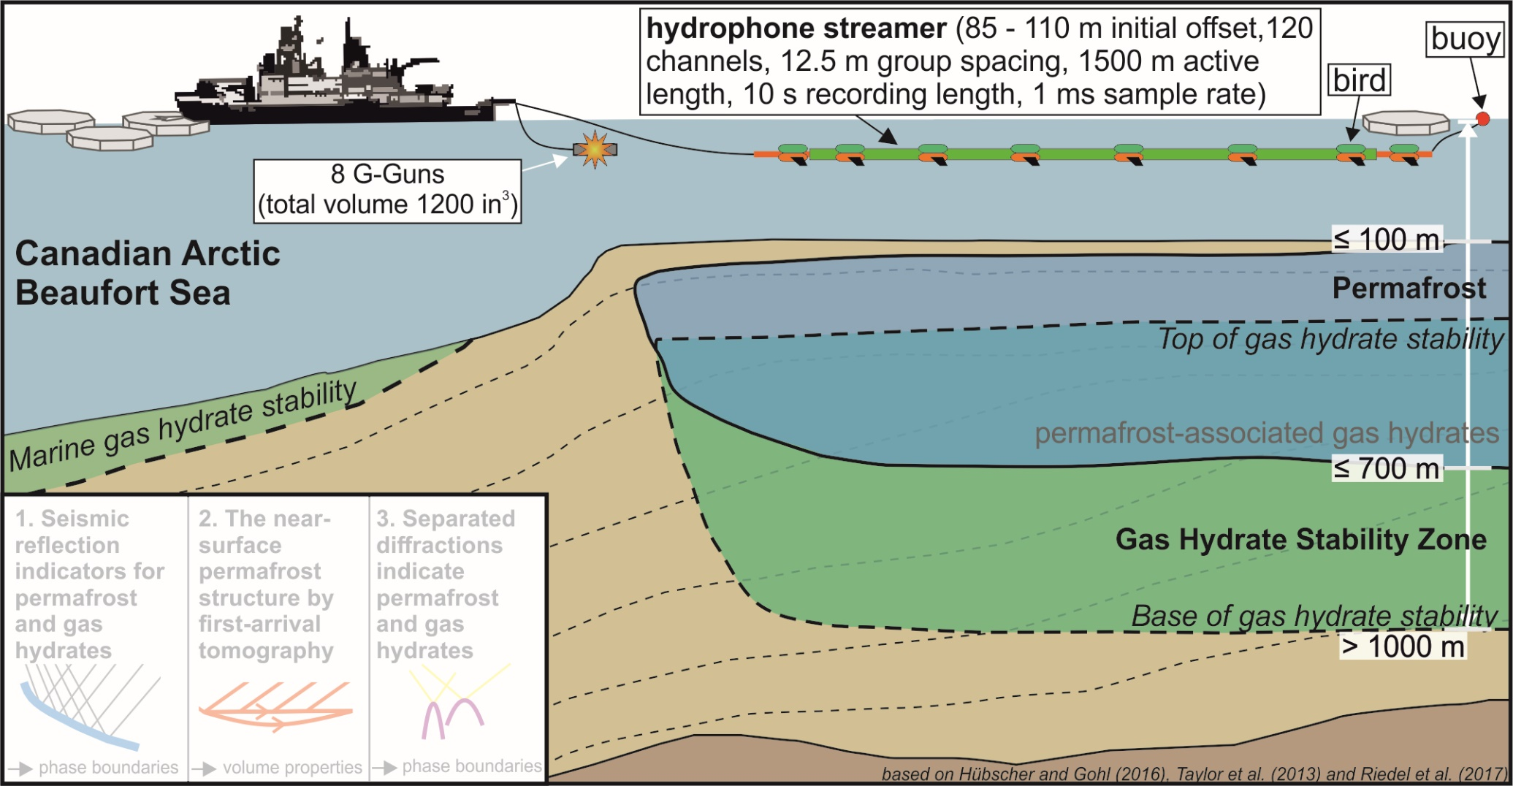
Overview of Data and Methods
Aim:
detailed information about the current state
Methods:
Based on marine multichannel seismic data we use
seismic reflection indicators
tomographic inversion of diving-wave first-arrivals
separated diffractions

Slide 4

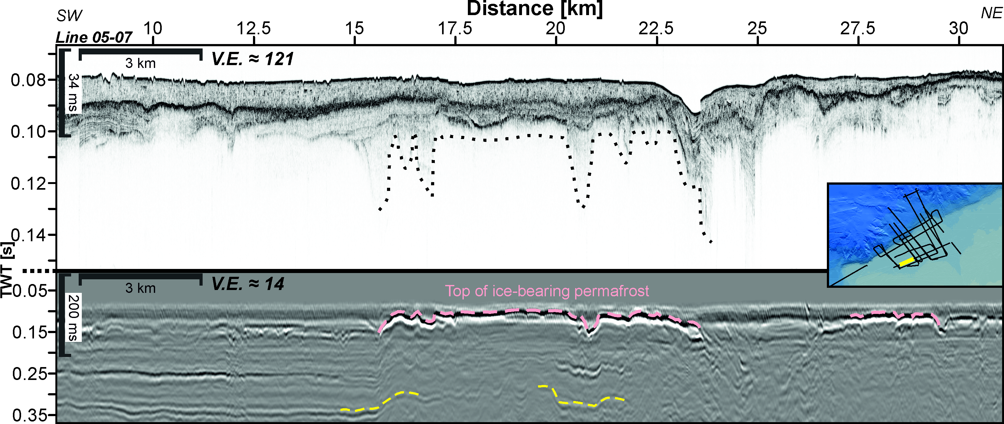
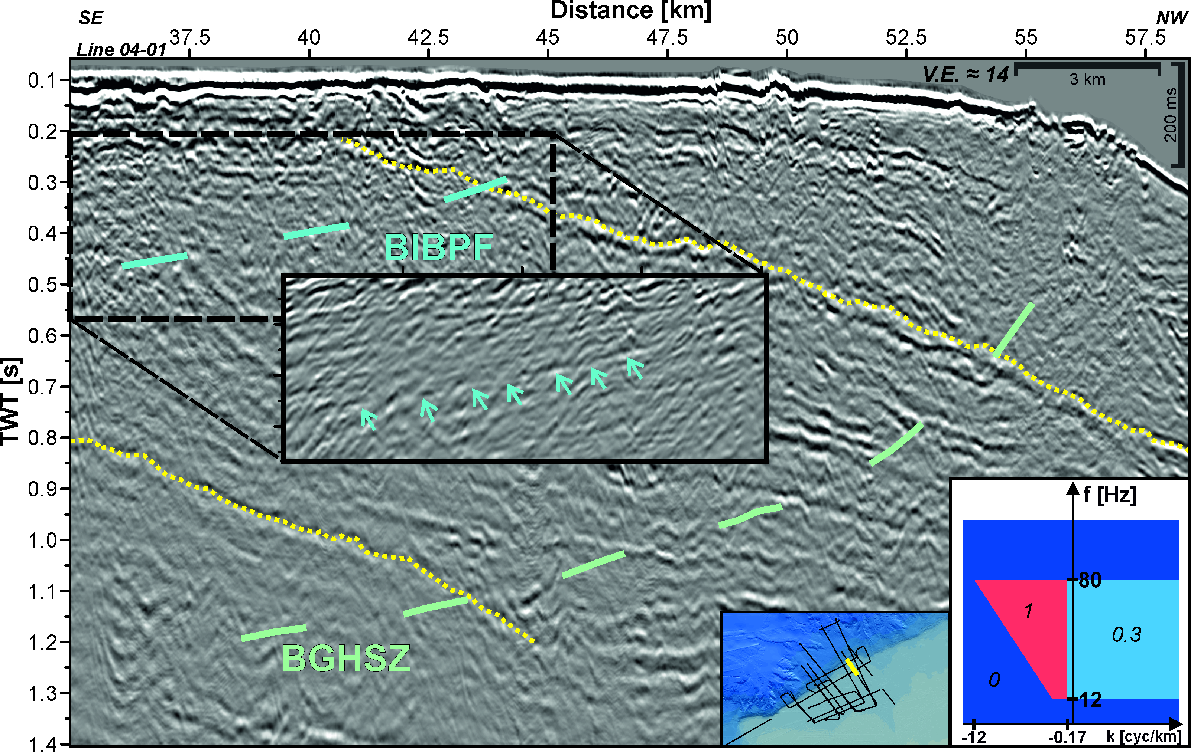
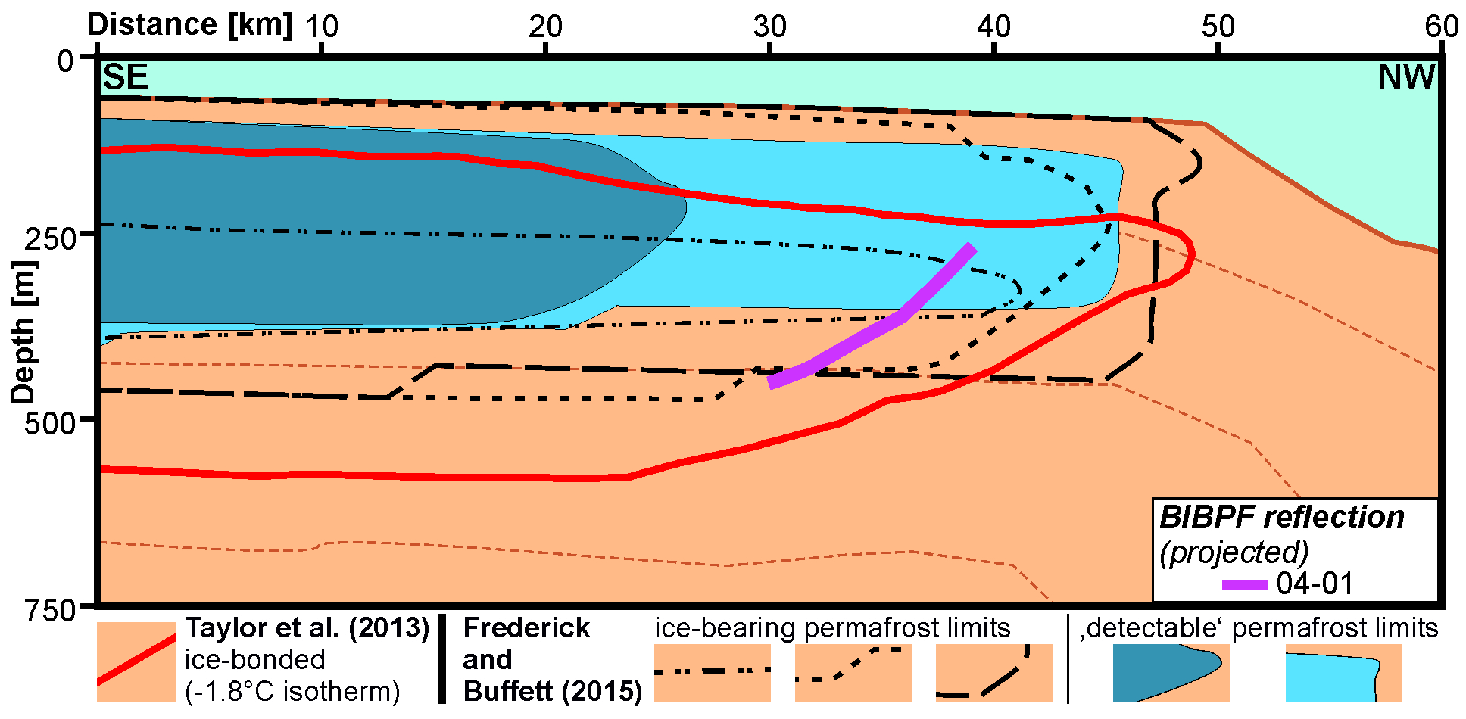
1. Seismic reflection indicators for permafrost and gas hydrates
The seismic reflection indicators corroborate the permafrost and gas hydrate extents as shown by previously published numerical models

Slide 5
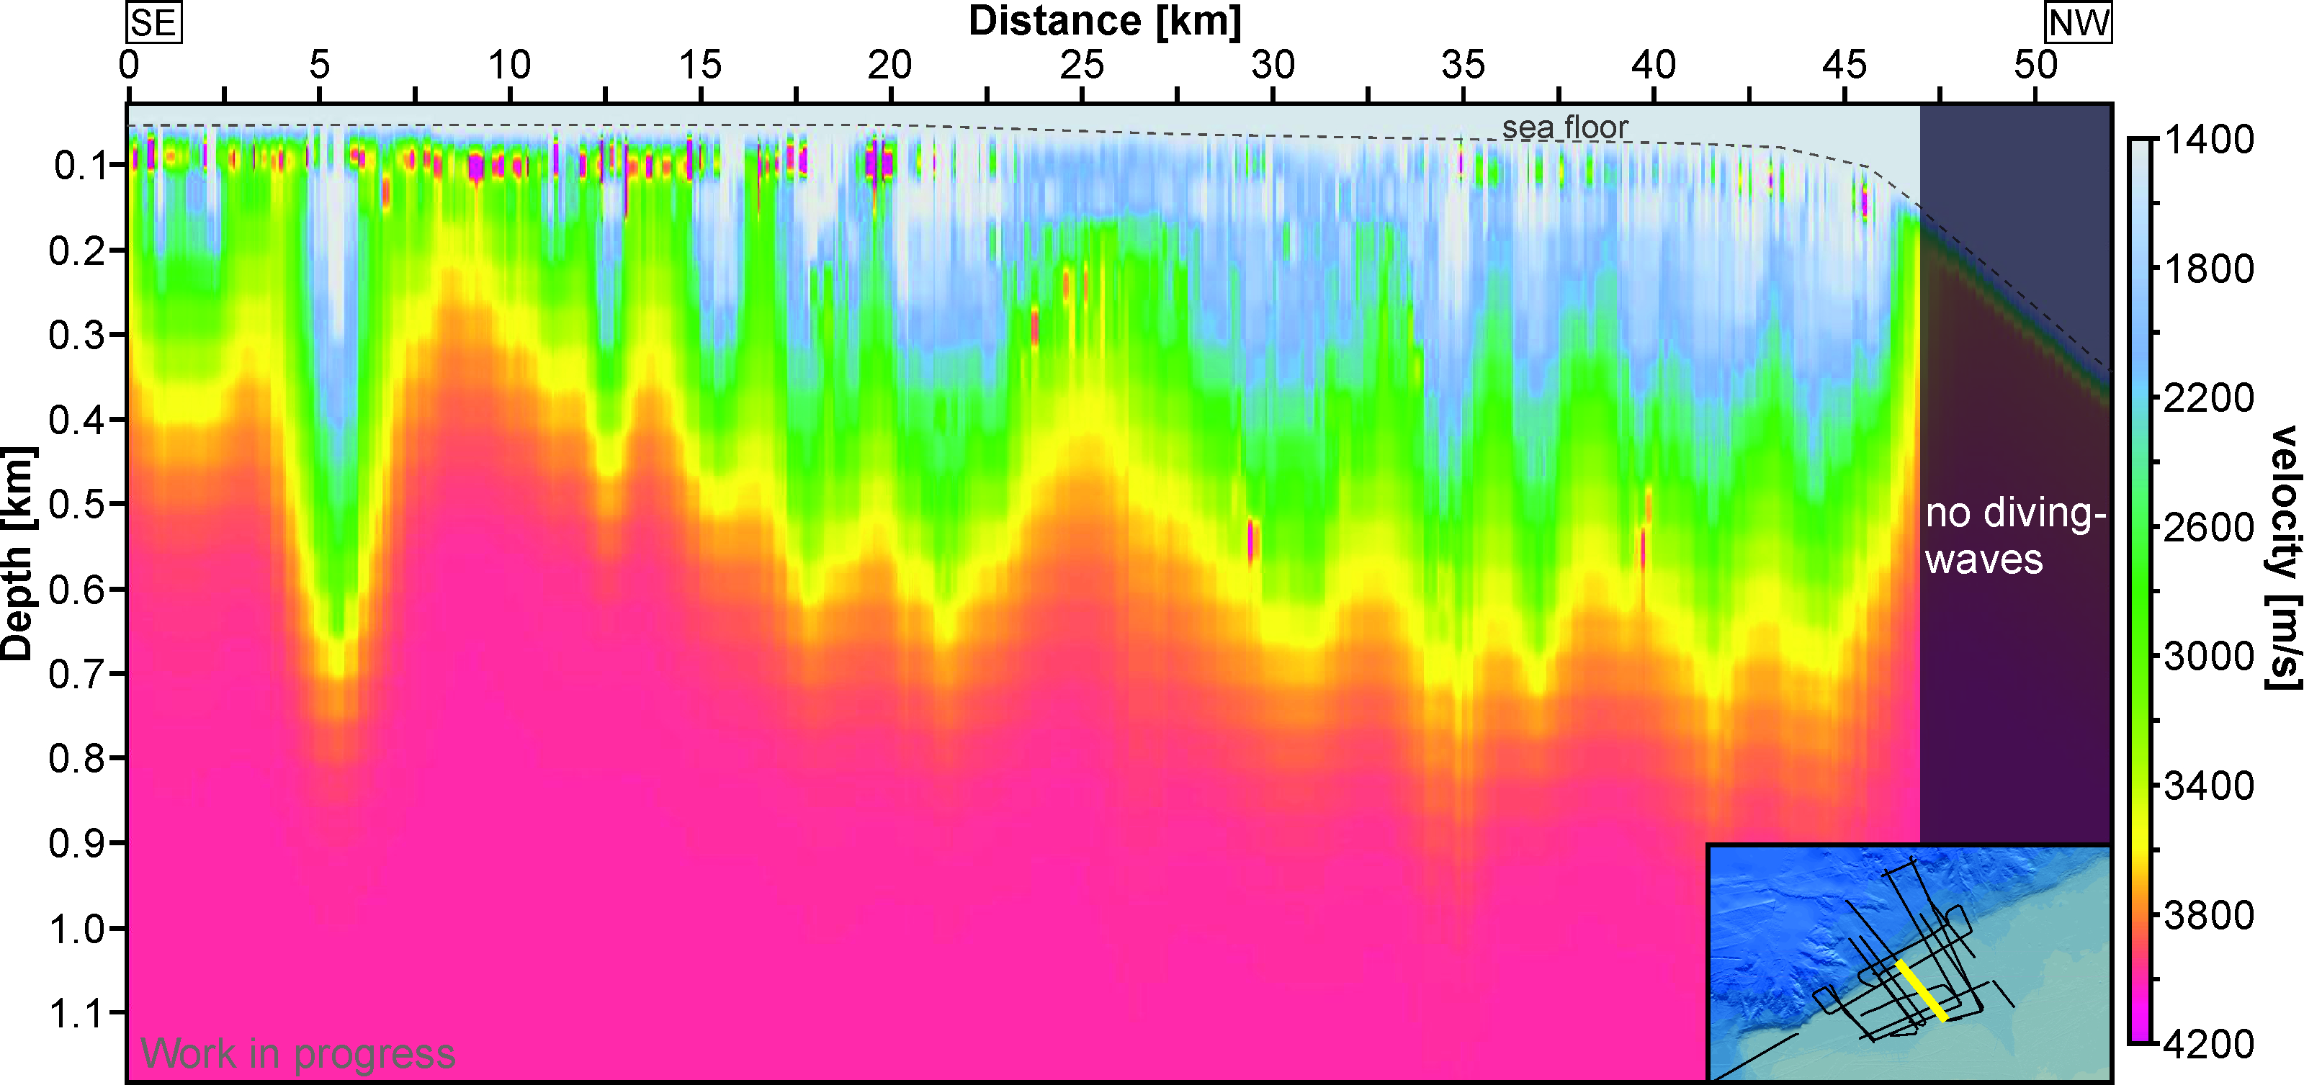
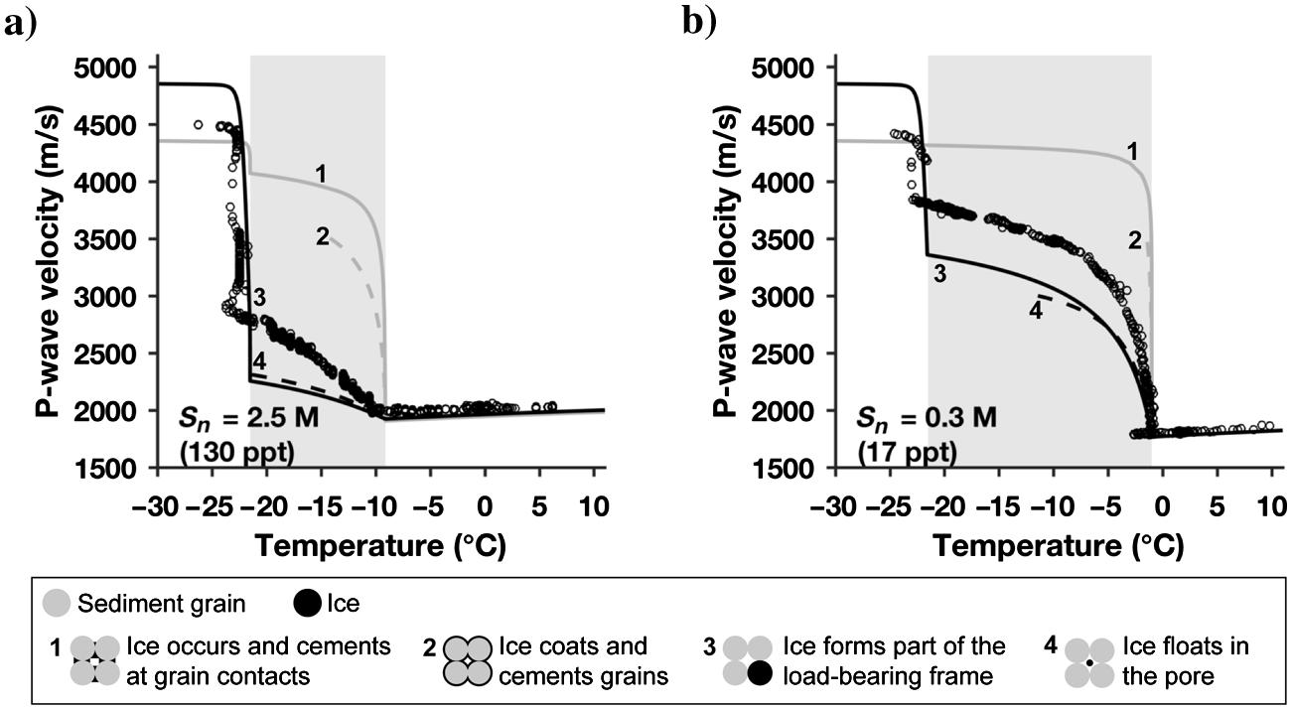
2. The near-surface permafrost structure by using first-arrival tomography
Using diving-wave tomography provides insights into the near-surface permafrost structure by imaging the velocity structure
from Dou et al. (2017)

Slide 6
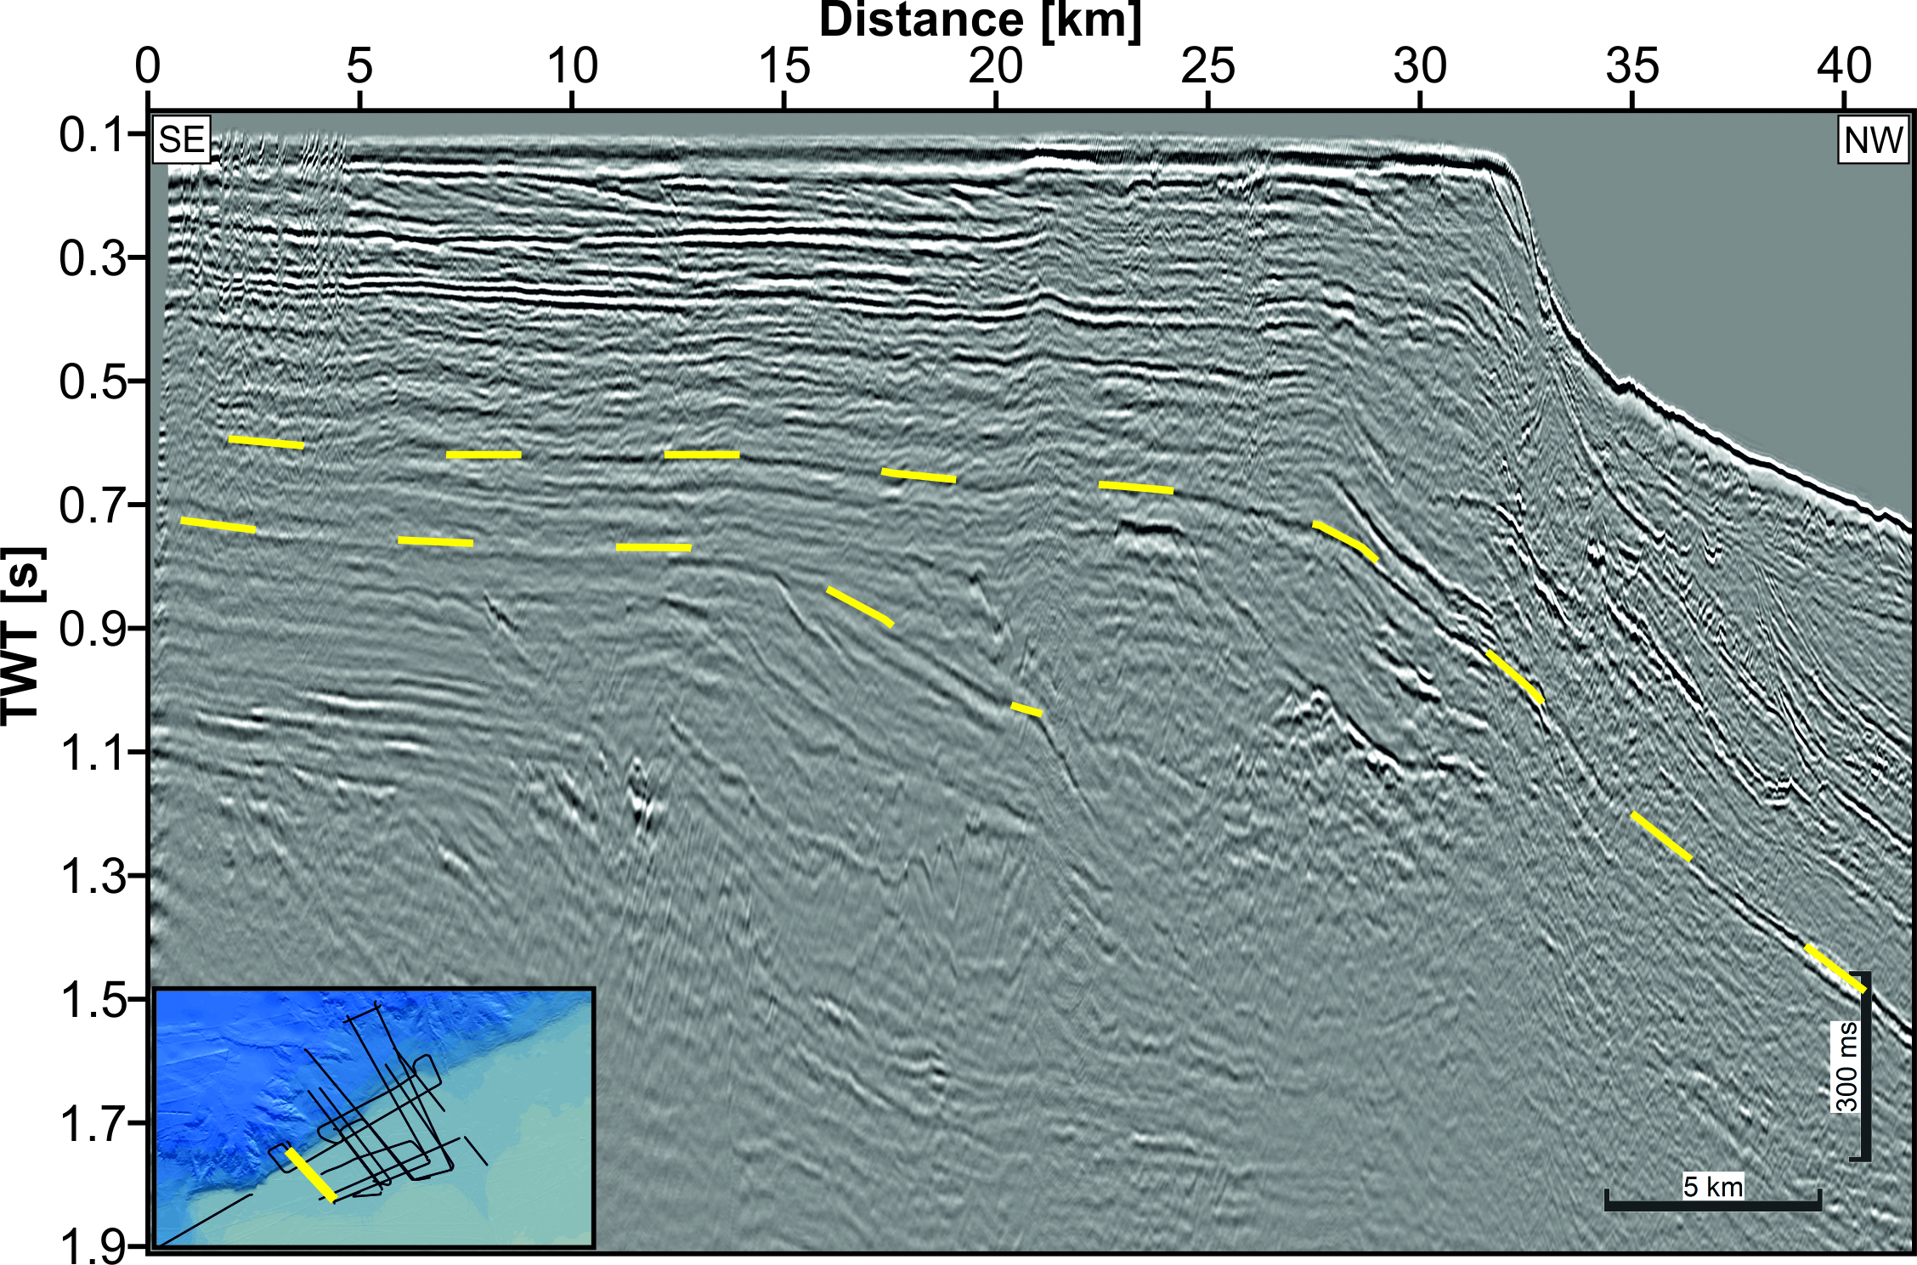
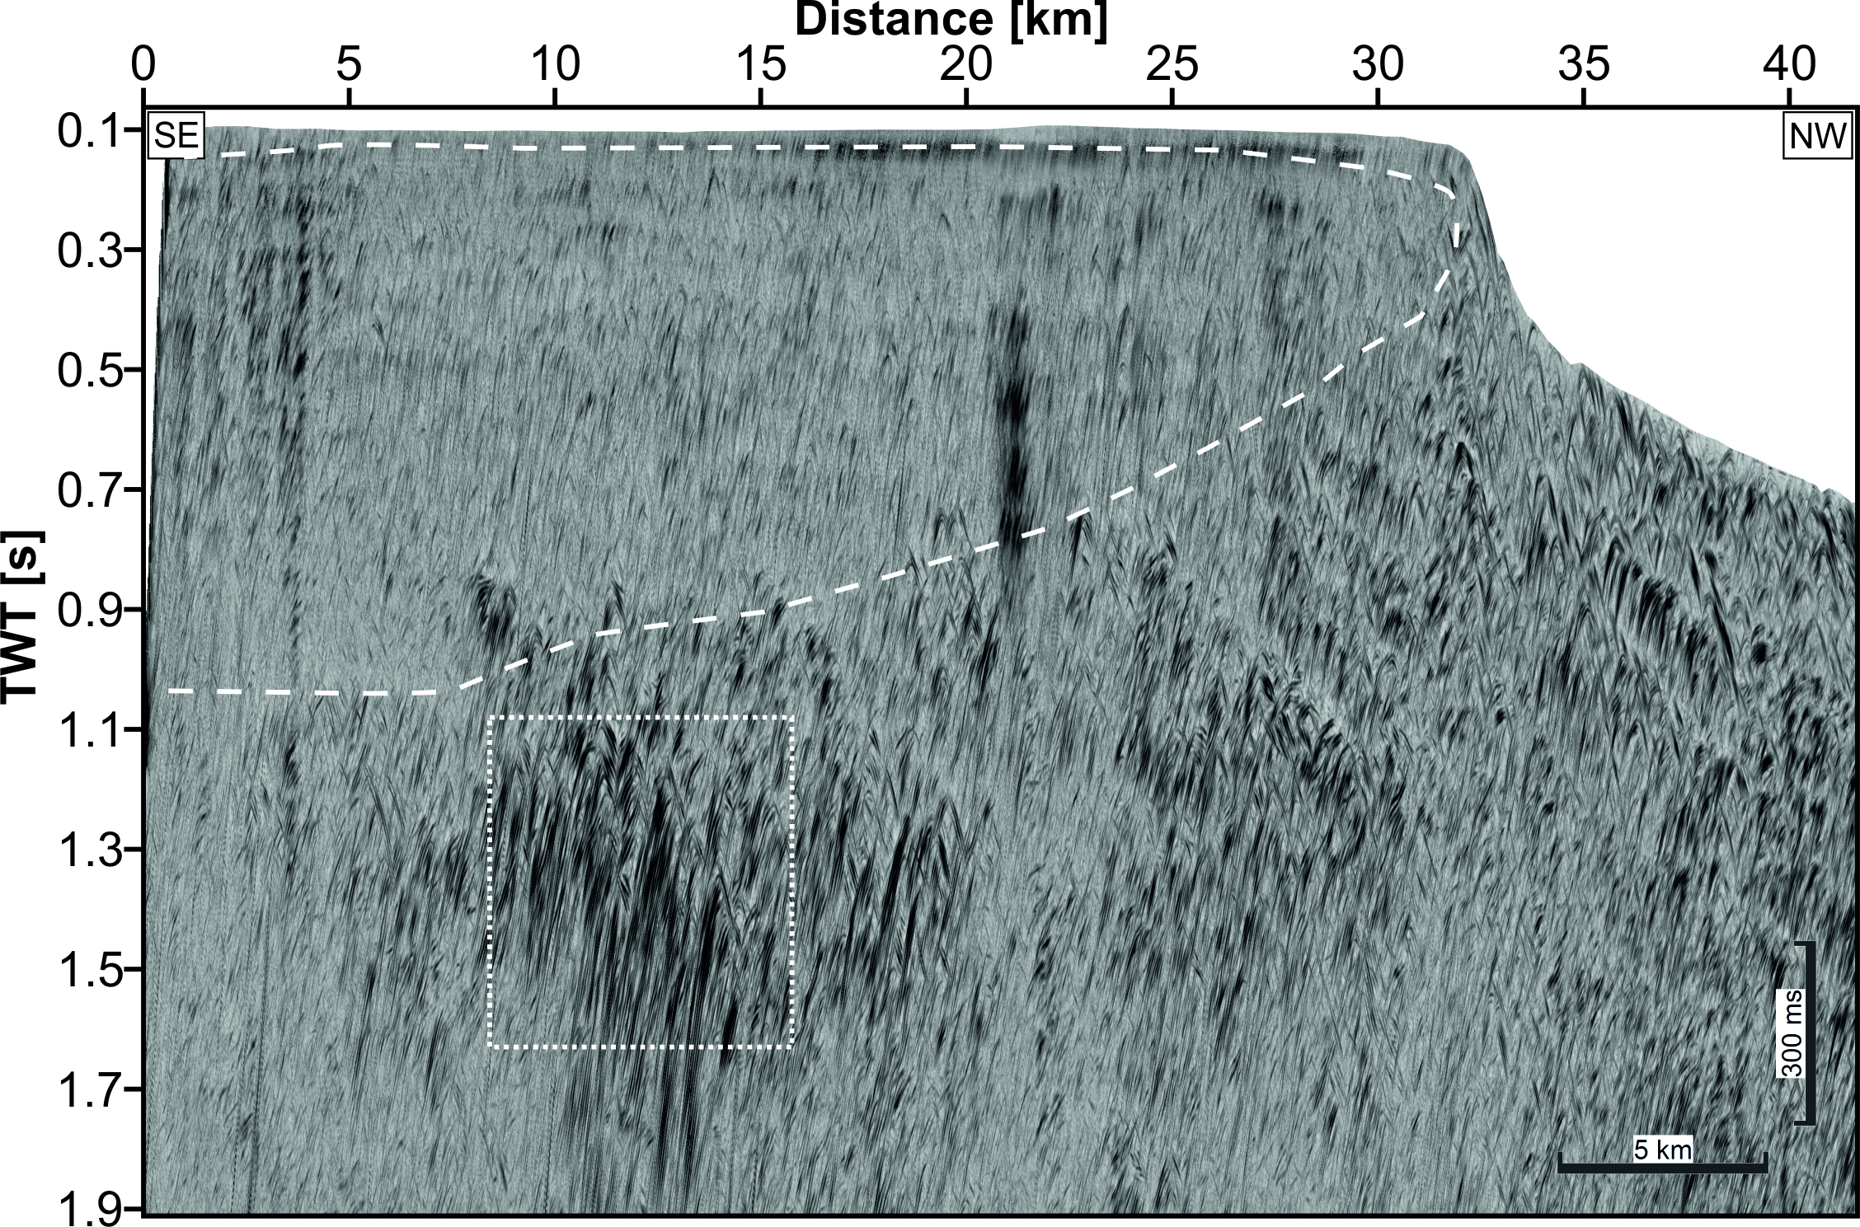
3. Separated diffractions indicate permafrost and gas hydrates
Diffractions separated from the reflected wavefield give indications for the occurrence of permafrost and gas hydrates. Furthermore, diffractions may add information about weak phase-boundaries and small-scale heterogeneities

Slide 7
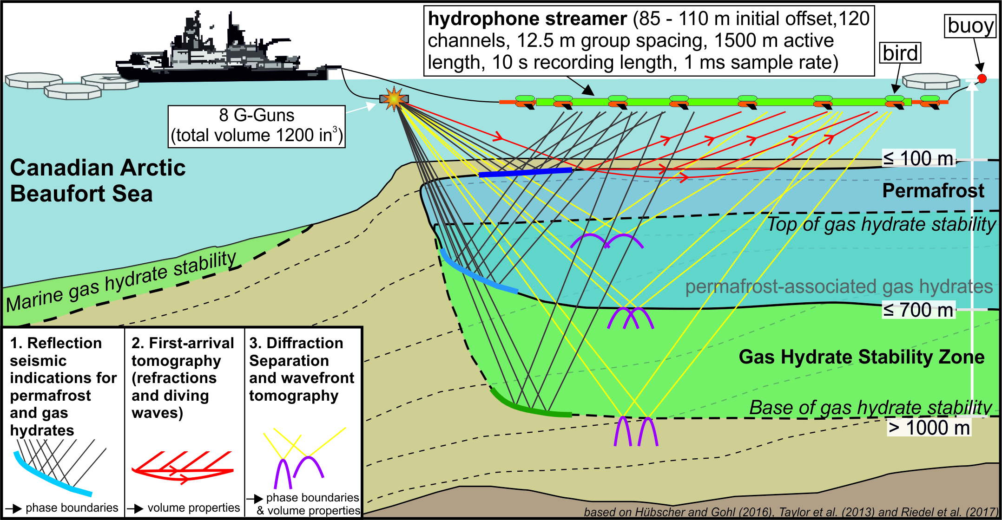
Summary
Based on marine multichannel seismic data in the Canadian Arctic Beaufort Sea
  we identify seismic reflections indicating ice-bearing permafrost and permafrost-associated gas hydrates
  we investigate the near-surface permafrost structure using diving-wave tomography
  we use diffractions separated from the reflected wavefield to delineate permafrost/ gas hydrate domains from unfrozen sediments

Slide 8


Thank you!
Henrik Grob
Institute of Geosciences
Marine Geophysics and Hydroacoustics
Kiel University
Otto-Hahn-Platz 1
24118 Kiel, Germany
henrik.grob@ifg.uni-kiel.de
for more details please visit the online material
Acknowledgments
This project is funded by the German Research Foundation (DFG grant no. KR2222/27-1, 755 RI2107/3-1). We would like to thank Benjamin Schwarz for providing his software for diffraction separation.

Slide 9
Appendix

Slide 10
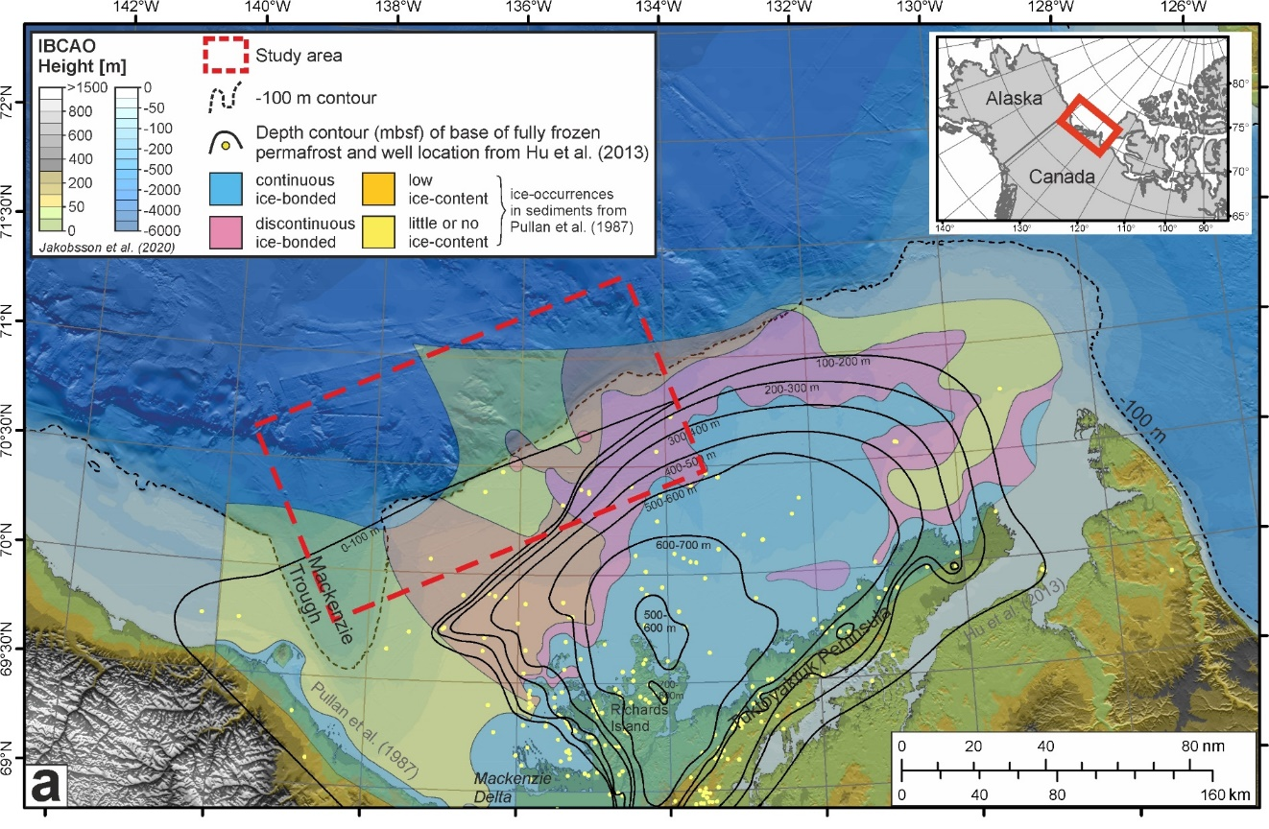
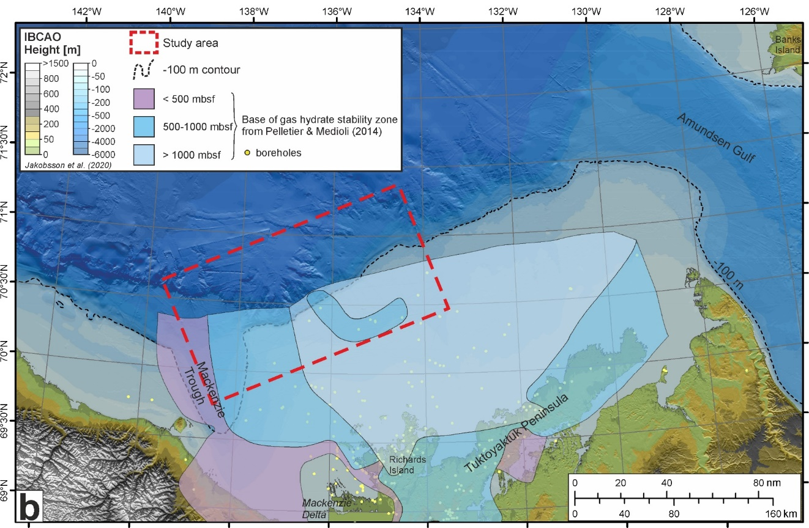
The Canadian Beaufort Sea
Permafrost and permafrost-associated gas hydrates formed extensively during the last 1 Ma
After the last glaciation, the relict submarine permafrost and gas hydrates present in the Beaufort Sea still react to ongoing thermal change which results in their continued degradation.
Yet, the extents of both the submarine permafrost and the permafrost-associated gas hydrates are still poorly constrained.
Fig. 1: Overview map of the Canadian Arctic Beaufort Sea with information about submarine permafrost and gas hydrates. In a) ice-occurrences in shallow sediments as well as the depth of the base of fully frozen permafrost are shown. b) illustrates the depth of the base of the gas hydrate stability zone. The study area is marked by the red rectangle. The maps are projected in UTM8N. (Grob et al., submitted)

Slide 11
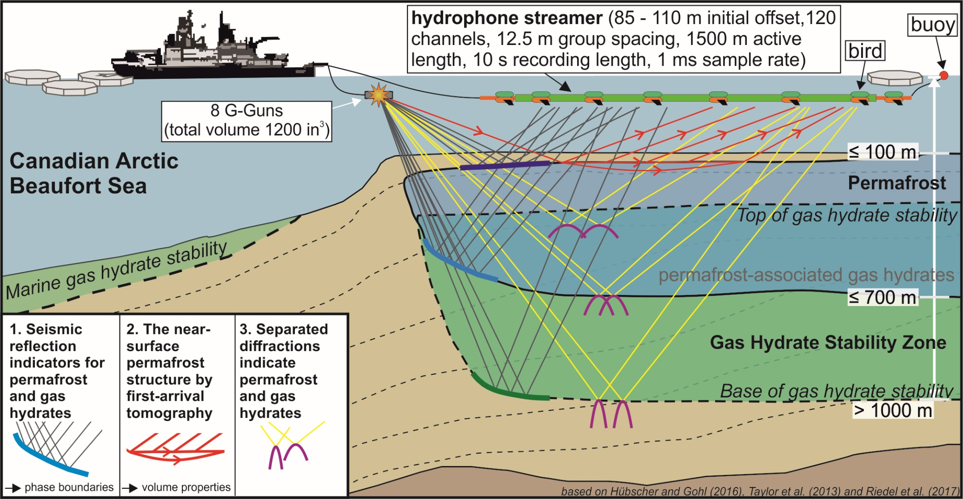
Overview of Data and Methods
Aim:
Gain detailed information about the current state of the submarine permafrost and permafrost-associated gas hydrates in the Canadian Arctic Beaufort Sea
We investigate permafrost and gas hydrates by marine multichannel seismic data by
seismic reflection indicators
tomographic inversion of diving-wave first-arrivals
separated diffractions
Fig. 2: Overview of the data and methods for detecting submarine permafrost and permafrost-associated gas hydrates at the Canadian Beaufort Shelf. The permafrost and gas hydrate sketch shows the current perception of their extent. All three methods focus on different components of the seismic wavefield: reflections, refractions and diving-waves, and diffractions

Slide 12
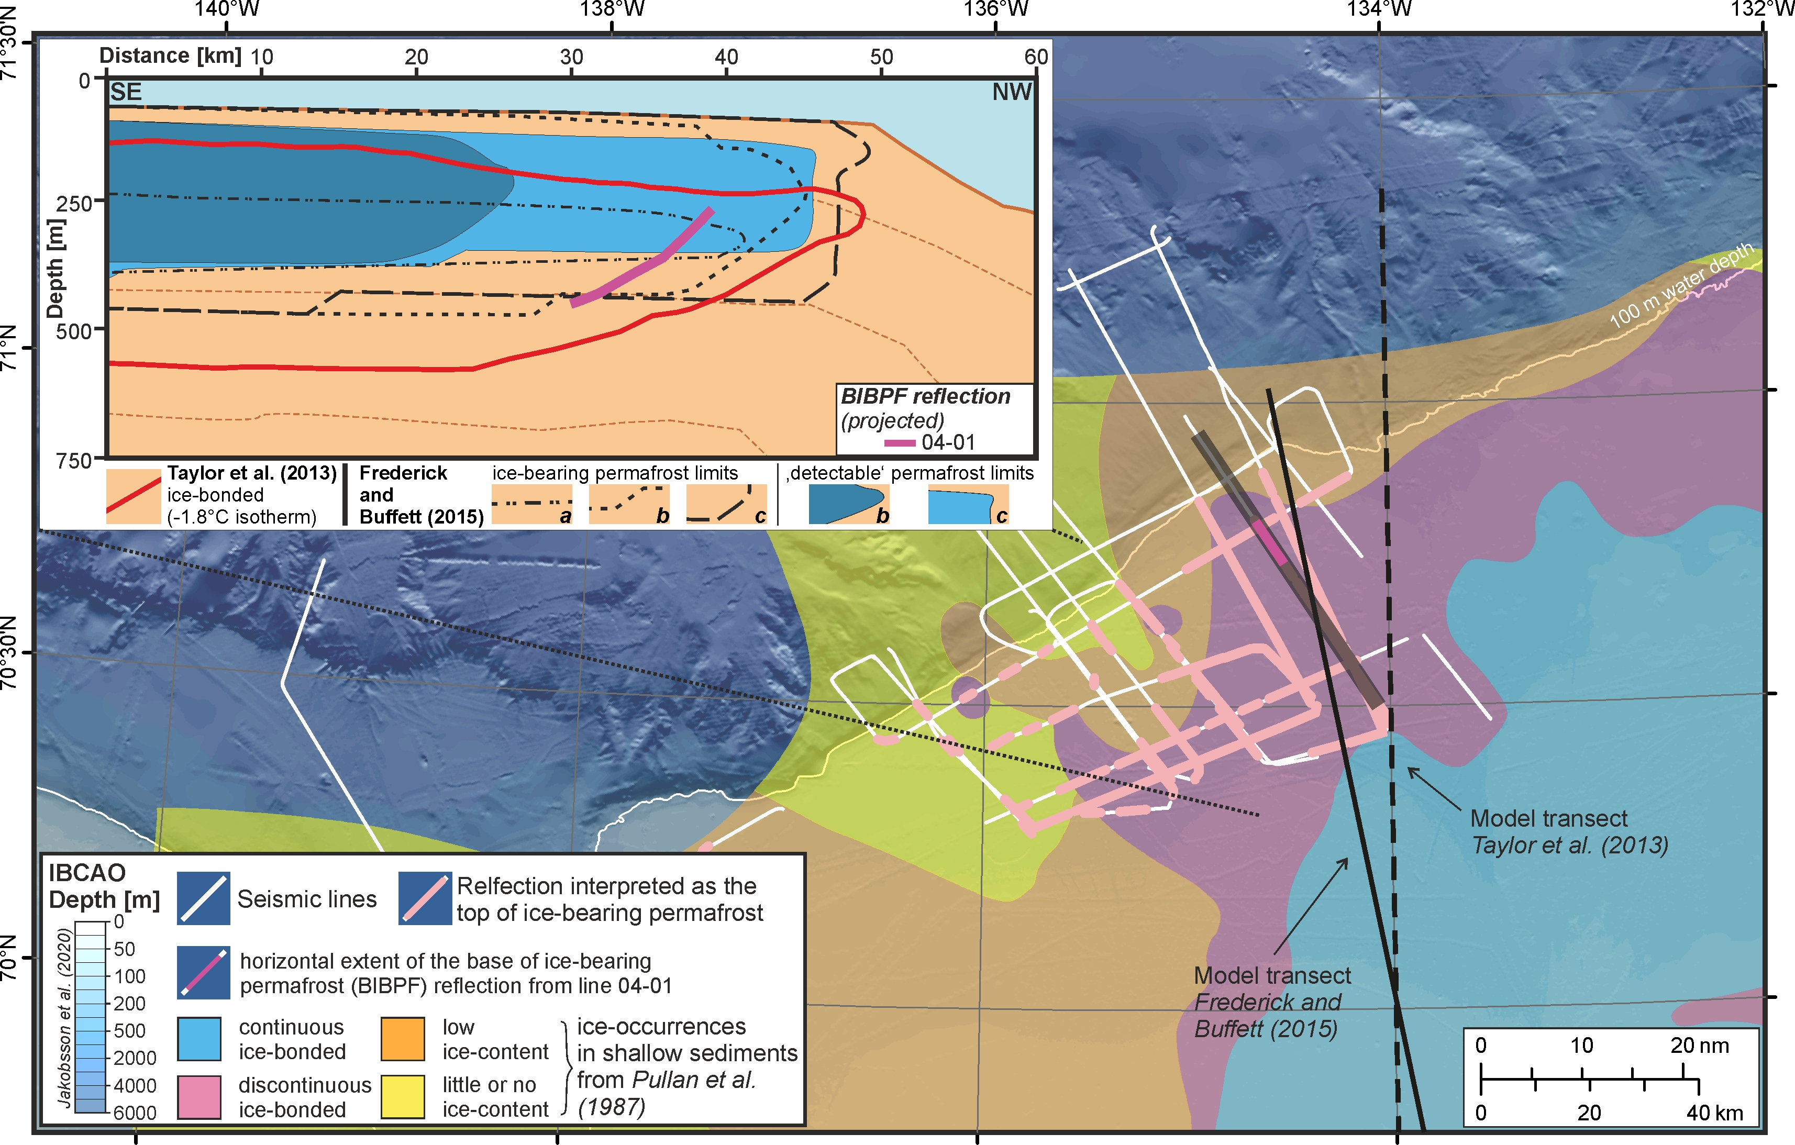
1. Seismic reflection indicators for permafrost and gas hydrates
Fig. 3: Seismic (bottom) and sub-bottom profile (top) section along the Beaufort Shelf from SW to NE. The black dotted line (top) illustrates the absence of acoustic penetration that coincides with the course of the high-amplitude reflection (bottom). This reflection is interpreted as the top of ice-bearing permafrost (pink line) and further coincide velocity pull-ups beneath (yellow lines). (Grob et al., submitted)
Fig. 5: Map of the study area showing seismic lines overlain by locations of the interpreted top of ice-bearing permafrost reflections. The schematic illustration shows the current perceptions from numerical modelling of the extent of the permafrost and gas hydrates. The BIBPF reflection (Fig. 4) is projected in the schematic illustration and is shown in the map. In the sketch: a = submarine groundwater discharge (SGD) of 0 m³ yr⁻¹ m⁻¹; b = SGD of 60 m³ yr⁻¹ m⁻¹; c = SGD of 140 m³ yr⁻¹ m⁻¹ (Grob et al., submitted)
The seismic reflection indicators corroborate the permafrost and gas hydrate extents as shown by previously published numerical models
Fig. 4: Seismic section across the Beaufort Shelf from SE to NW. The inset was extra filtered in FK domain according to the FK spectrum. Values in the FK spectrum indicate the factor for passing the filter. The yellow dotted lines show the prevailing stratigraphy. The dashed lines frame indications for the base of ice-bearing permafrost (BIBPF, light blue) and the base of the gas hydrate stability zone (BGHSZ, light green). (Grob et al., submitted)

Slide 13
2. The near-surface permafrost structure by using first-arrival tomography
Fig. 7: P-wave velocity vs temperature for high-salinity example from Dou et al. (2017). The image illustrates the relationship of p-wave velocity and the degree of freezing.
The acoustic properties of permafrost are determined by the content of ice and unfrozen pore fluids. The relationship of p-wave velocity and ice-content gives information about permafrost conditions
Fig. 6: Preliminary result of a first-arrival diving-wave tomography of a seismic line crossing the continental shelf. The p-wave velocity gives information about the current near-surface permafrost structure. A deep low-velocity, v-shaped zone at 5 km can be interpreted as talik. This result is still work in progress.
Using diving-wave tomography provides insights into the near-surface permafrost structure by imaging the velocity structure in greater detail than achievable by standard velocity analyses

Slide 14
3. Separated diffractions indicate permafrost and gas hydrates
Fig. 8: Seismic section crossing the continental shelf from SE to NW. Left: The normal seismic image after full seismic processing. Right: The seismic image shows only diffractions which were separated from the complete seismic wavefield (left). The yellow dashed line illustrates the prevailing stratigraphy. The white dashed line confines an area of less pronounced diffractions compared to the residual image. It corresponds to an area where permafrost and gas hydrates are expected. The white dotted rectangle points at high diffractive domain which could indicate a high amount of free gas. Moreover, diffractions tend to align similar to the prevailing layering.
Diffractions separated from the reflected wavefield give indications for the occurrence of permafrost and gas hydrates. Furthermore, diffractions may add information about weak phase-boundaries and small-scale heterogeneities

Slide 15
Summary
Based on marine multichannel seismic data in the Canadian Arctic Beaufort Sea
  we identify seismic reflections indicating ice-bearing permafrost and permafrost-associated gas hydrates
  we investigate the near-surface permafrost structure using diving-wave tomography
  we use diffractions separated from the reflected wavefield to delineate permafrost/ gas hydrate domains from unfrozen sediments

Slide 16
References
Thank you!
Henrik Grob
Institute of Geosciences
Marine Geophysics and Hydroacoustics
Kiel University
Otto-Hahn-Platz 1
24118 Kiel, Germany
henrik.grob@ifg.uni-kiel.de
Acknowledgments
This project is funded by the German Research Foundation (DFG grant no. KR2222/27-1, 755 RI2107/3-1). We would like to thank Benjamin Schwarz for providing his software for diffraction separation.
Dou, S., Nakagawa, S., Dreger, D., & Ajo-Franklin, J. (2017). An effective-medium model for P-wave velocities of saturated, unconsolidated saline permafrost. GEOPHYSICS, 82(3), EN33–EN50. https://doi.org/10.1190/geo2016-0474.1
Frederick, J. M., & Buffett, B. A. (2015). Effects of submarine groundwater discharge on the present-day extent of relict submarine permafrost and gas hydrate stability on the Beaufort Sea continental shelf. Journal of Geophysical Research: Earth Surface, 120(3), 417–432. https://doi.org/10.1002/2014JF003349
Hu, K., Issler, D. R., Chen, Z., & Brent, T. A. (2013). Permafrost investigation by well logs , and seismic velocity and repeated shallow temperature surveys , Beaufort-Mackenzie Basin. In Geological Survey of Canada Open File Report (Issue 6956). https://doi.org/10.4095/293120
Hübscher, C., & Gohl, K. (2014). Reflection/Refraction Seismology. In Encyclopedia of Marine Geosciences (pp. 1–15). Springer Netherlands. https://doi.org/10.1007/978-94-007-6644-0_128-1
Pelletier, B. R., & Medioli, B. E. (2014). Environmental atlas of the Beaufort coastlands. In Geological Survey of Canada, Open File (Vol. 7619). https://doi.org/10.4095/294601
Pullan, S., MacAulay, H., A, Hunter, J. A. M., Good, R., L, Gagne, R. M., & Burns, R. A. (1987). Permafrost distribution determined from seismic refraction. In B. R. Pelletier (Ed.), Marine Science Atlas of the Beaufort Sea: Geology and Geophysics (p. 48). https://doi.org/10.4095/126967
Riedel, M., Brent, T. A., Taylor, G., Taylor, A. E., Hong, J.-K., Jin, Y.-K., & Dallimore, S. R. (2017). Evidence for gas hydrate occurrences in the Canadian Arctic Beaufort Sea within permafrost-associated shelf and deep-water marine environments. Marine and Petroleum Geology, 81, 66–78. https://doi.org/10.1016/j.marpetgeo.2016.12.027
Taylor, A. E., Dallimore, S. R., Hill, P. R., Issler, D. R., Blasco, S. M., & Wright, F. (2013). Numerical model of the geothermal regime on the Beaufort Shelf, arctic Canada since the Last Interglacial. Journal of Geophysical Research: Earth Surface, 118(4), 2365–2379. https://doi.org/10.1002/2013JF002859

