Slide 1



Sulfur and carbon isotope measurements of carbonyl sulfide
This project has received funding from the European Research Council (ERC) under the European Union’s Horizon 2020 research and innovation programme under grant agreement No 742798
Sophie L. Baartman¹, Maarten Krol^{1,2} & Thomas Röckmann¹, Maria Elena Popa¹, Linda Kooijmans², Steven Driever², Maarten Wassenaar², Leon Mossink², Steven van Heuven³
¹Utrecht University, Netherlands, ²Wageningen University, Netherlands, ³Rijksuniversiteit Groningen, Netherlands

Slide 2
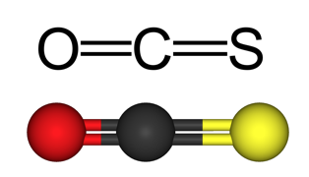
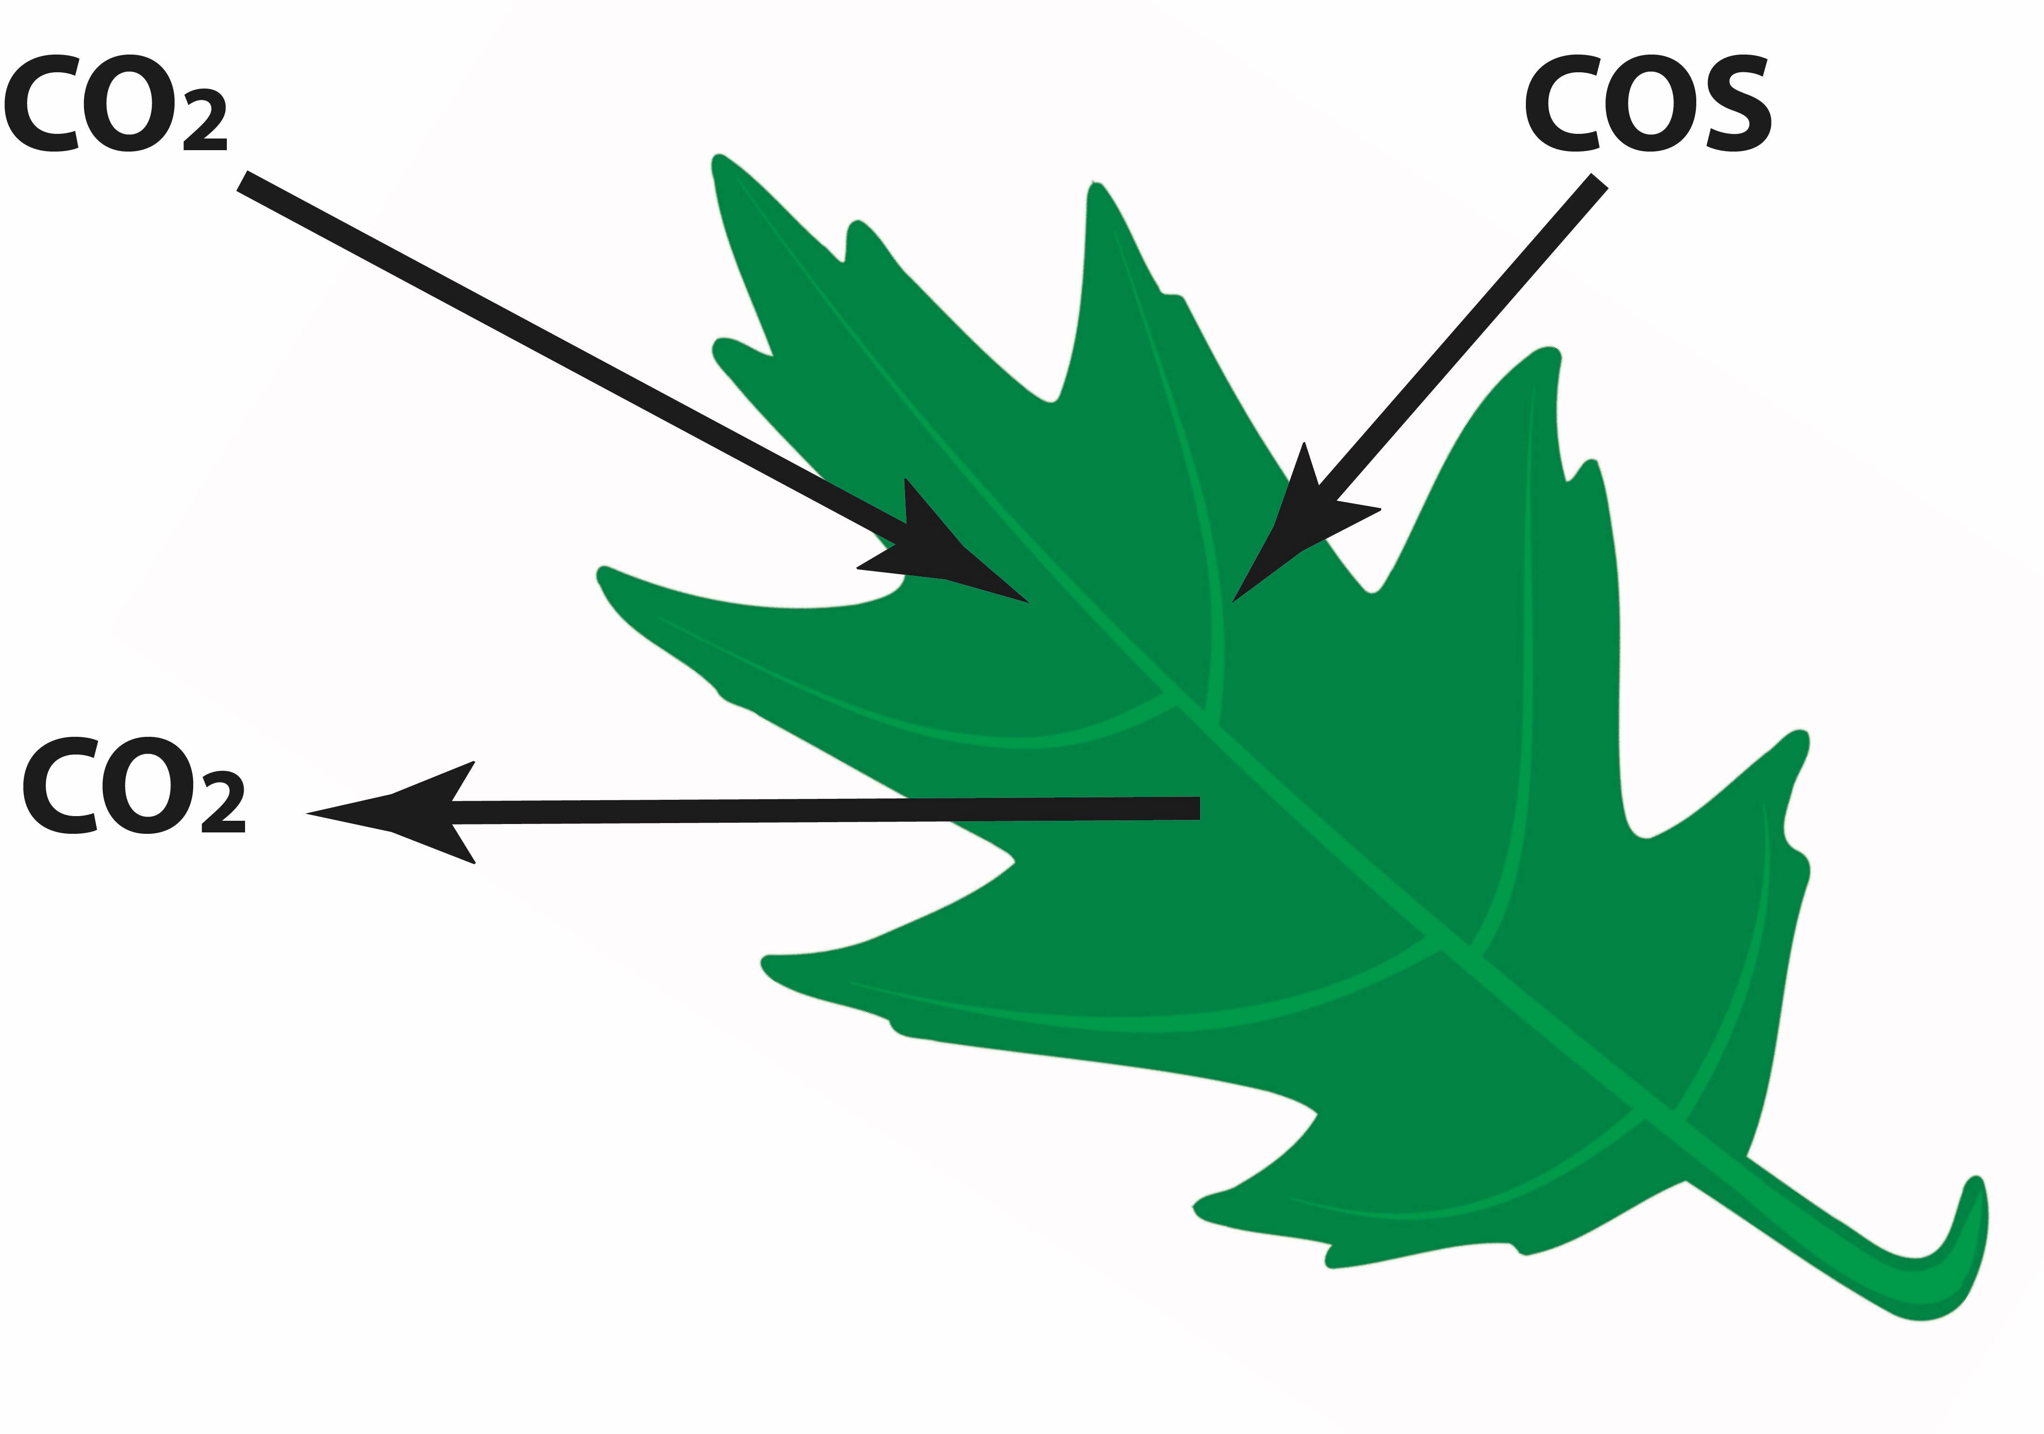
Carbonyl sulfide
Most abundant sulfur containing gas in atmosphere
Average tropospheric mixing ratio: 500 ppt
Lifetime of about 2 years
Proxy for GPP / stomatal conductance
Transported into stratosphere

Slide 3
Methods
Measure S⁺ and CO⁺ fragments with GC-IRMS
2 – 4 L samples
Current 4L 500 ppt precision
  ³³S: 2.1‰
  ³⁴S: 0.9‰
  ¹³C: 2.5‰

Slide 4
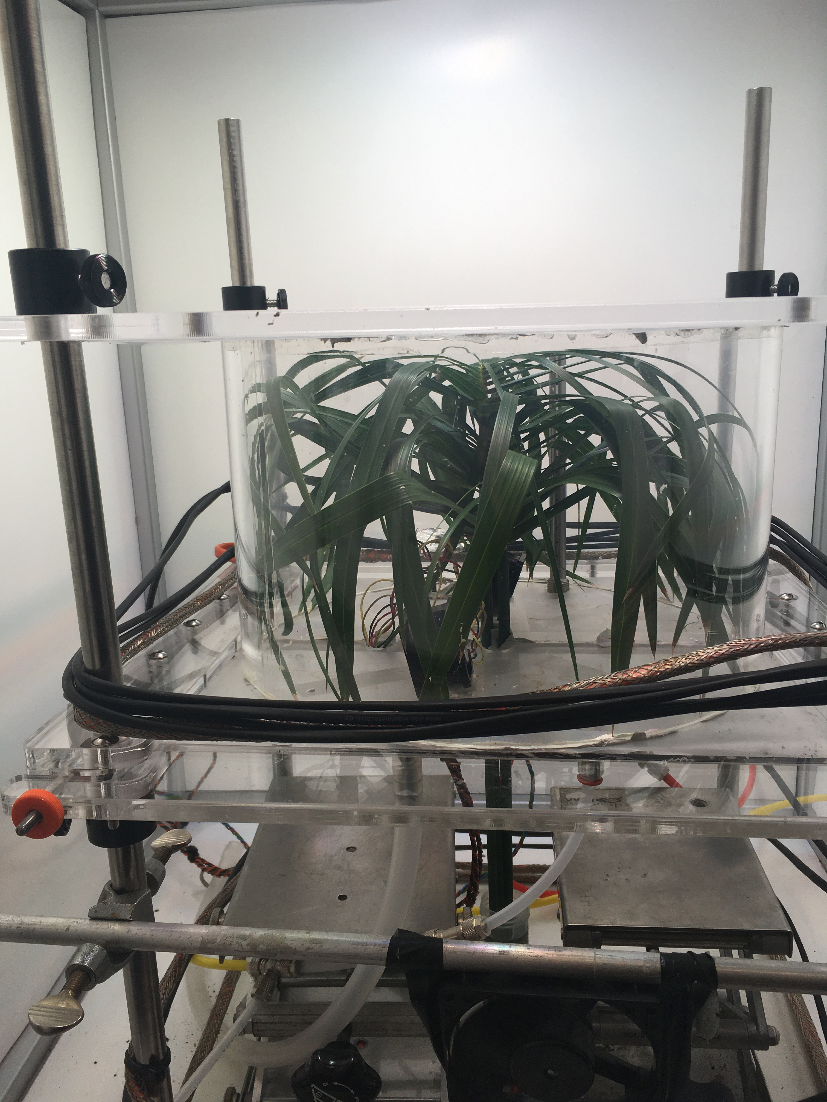
Plant chamber experiments
Light settings 200 – 600 μmol m⁻² s⁻¹ + dark
3 plants:
  Sunflower (C3)
  Sage (C3)
  Papyrus (C4)

Slide 5
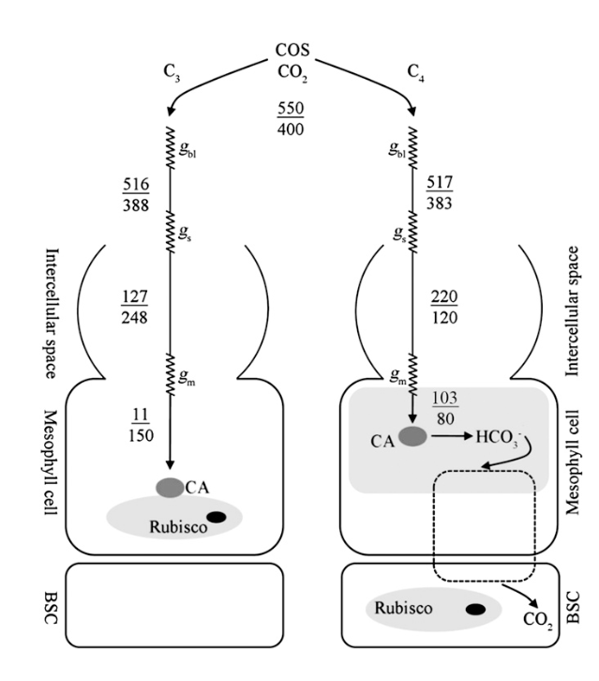

Fractionation during plant uptake
Diffusion: stomatal conductance & mesophyll conductance
Biochechemical reaction:
$H_{2}O+COS \underset{→}{CA} CO_{2}+H_{2}S$
Lower C_{i}^{cos}/C_{a}^{cos}
higher C_{i}^{cos}/C_{a}^{cos}
Lower CA activity
Higher CA activity
Previous measurements:
α = 1.9 ‰ (Davidson et al., 2021)
Expect higher fractionation
Stimler et al. (2011)
Notes:
Isotopic fractionation: where one isotopologue is preferred over the other (usually the lighter of the heavier one)
During uptake by plants can occur in two ways: during diffusion into the plant and during the biochemical reaction where the COS is converted into CO2 and H2S
This process is slightly different for different plant species, C3 and C4 because the diffusion rates are different and the CA is located differently and the CA activity is lower in CA. From this theory we expect higher fractionation to occur during COS uptake in C4 plants → internal COS concentration is higher → CA can differentiate easier between the isotopologues
From theoretical calculations we expect a fractionation factor of around 5 permil, The first published value from a chamber experiment on a C3 plant conducted by Davidson et al yielded a fractionation factor or 1.9 per mil

Slide 6
Preliminary results
Notes:
- These are Rayleigh fractionation plots where we plot the d values against the natural log of the remaining fraction of COS. When fitting a line from the data, the slope gives us the fractionation
- Different species in the different colors, no Sunflower June for d13C because those measurements were not available yet then
- Small, maybe not significant tre
Fractionation for d34S is unclear. Probably not a significant signal → more data needed
Larger signal for d13C (not because of nonlinearity). Unsure why → suggestions?
If d34S fractionation is around 5 for C3 (theory) → d13C should be around 10 for same species, from mass dependent processes alone.

Slide 7
Take-home messages
First measurements of δ¹³C from COS
Plant chamber experiments C3 and C4 plants
  More data needed to better characterize (small) ³⁴S fractionation
  Fractionation of 9 – 12.5 ‰ found for ¹³C in COS during uptake
  Follow-up experiments are planned

