Slide 1

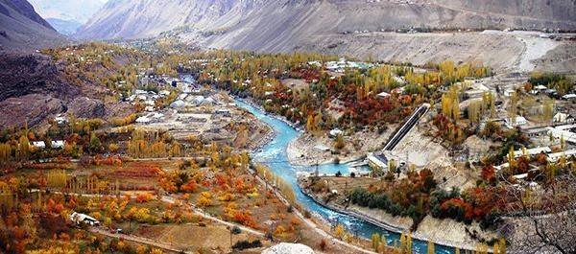
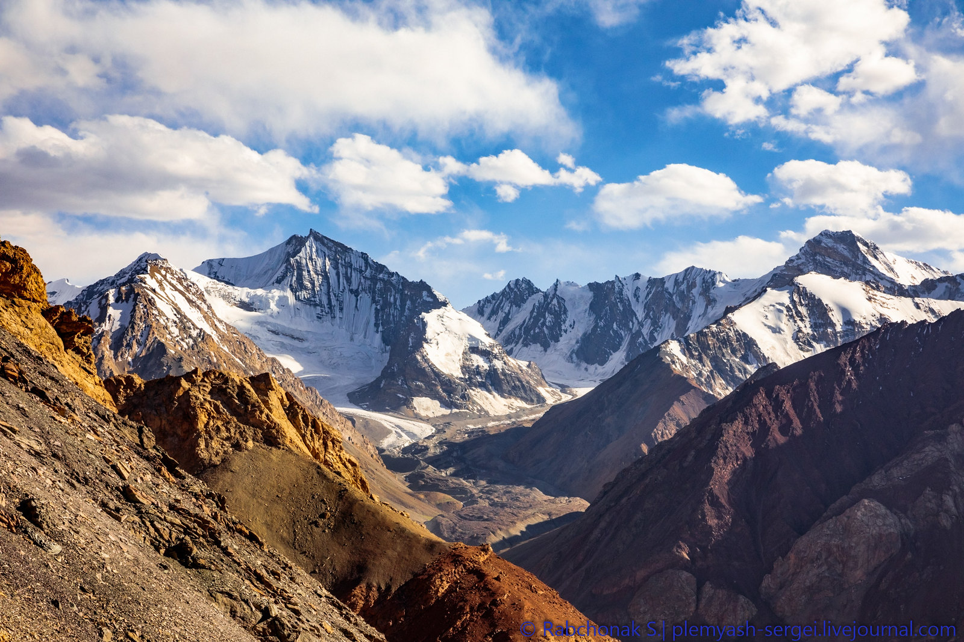
Simulation of river flow in the Gunt River basin in Tajikistan
Ben Jarihani^{1,2}, Anastasiia Zemlianskova^{3,4}, Olga Makarieva^{3,4}
¹Earth and Environmental Sciences Department, University of Central Asia, Khorog, Tajikistan
²School of Science, Technology and Engineering, University of Sunshine Coast, Australia
³St. Petersburg State University, St. Petersburg, ⁴Melnikov Permafrost Institute SB RAS, Yakutsk, Russia
The study was carried out with the support of St. Petersburg State University (project 75295776) and RFBR (project 19-55-80028) .

Slide 2
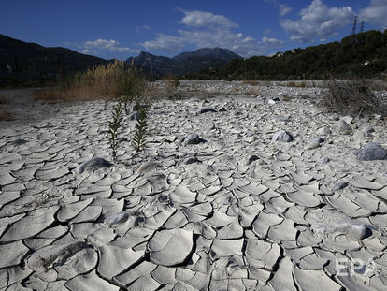
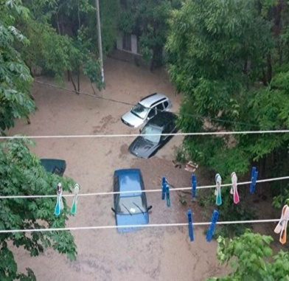
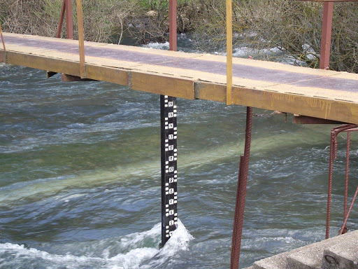
Relevance
Scarce area in terms of water resources
Demand to irrigation water and electricity is rising
Climate change
Water supply from glacier systems is uncertain and evaporative losses increase
Decrease of monitoring gauges in mountains of Central Asia
Practically ungauged rivers

Slide 3
Aim and tasks of the study
The aim of the study is to develop the model to be applied in the Gunt River basin.
Tasks:
Parameterize and verify hydrological model using available historical data of observations.
Conduct hydrological modelling in the conditions of input data uncertainty.
Assess the possibilities of the model to be applied in water resource management and planning.

Slide 4

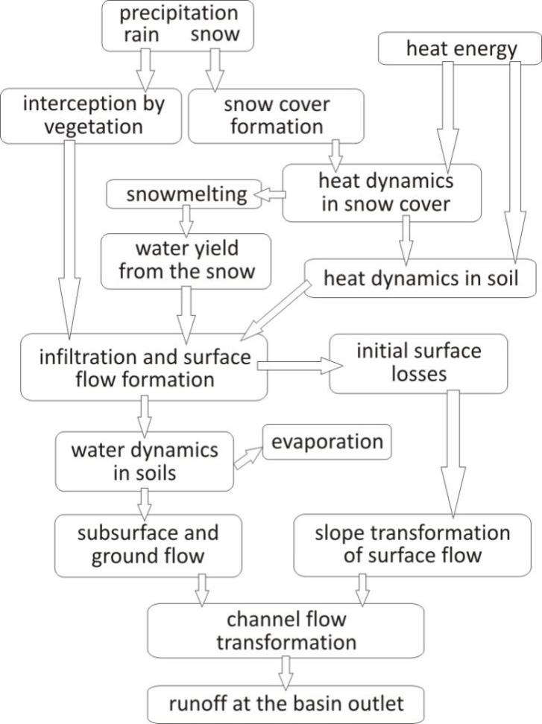

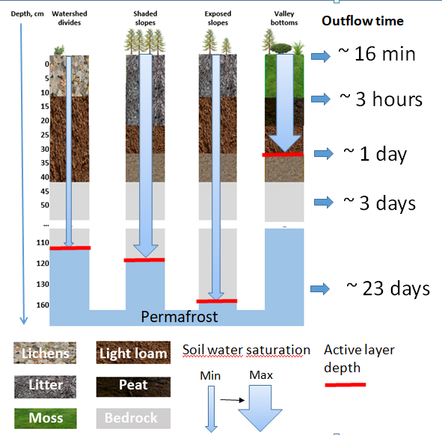
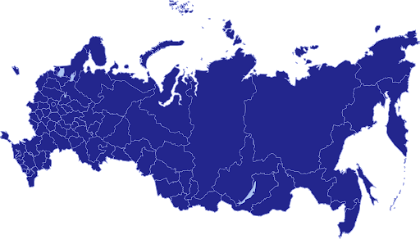
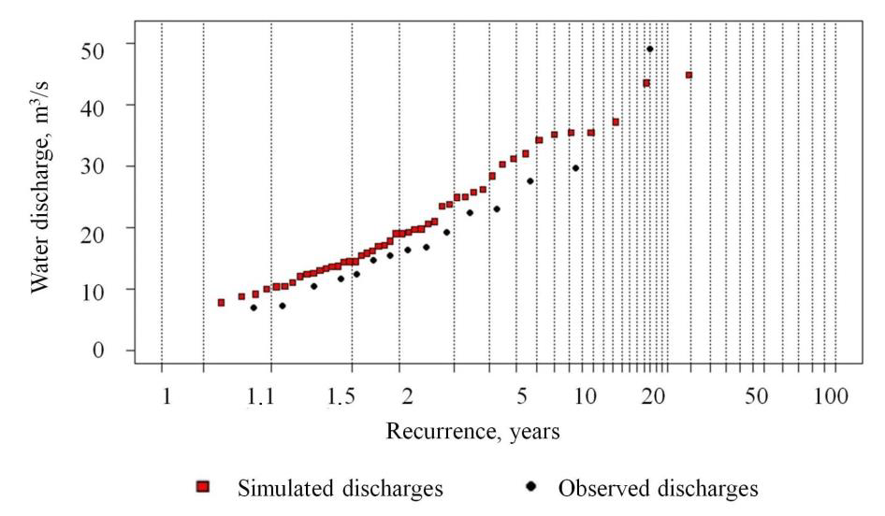
Methods
Landscapes govern specific hydrological processes. The set of model parameters is developed for each of them.
Hydrograph model
Distributed hydrological process-based model with single structure for watersheds of any scale.
Most parameters are transferrable to other basins with similar landscapes
Limited input data: daily data of air temperature, air moisture deficit and precipitation
Glaciers are presented in a conceptual way
Soil parameters
Density, kg/m³
Porosity, m³/ m³
Maximum water holding capacity, m³/ m³
Infiltration coefficient, mm/min
Specific heat capacity, J/(kgºC)
Specific heat conductivity, W/(mºC)
Hydraulic parameter of soil runoff elements, m³/s
Verification of the model by flood-frequency analysis
ainthe different regions->

Slide 5
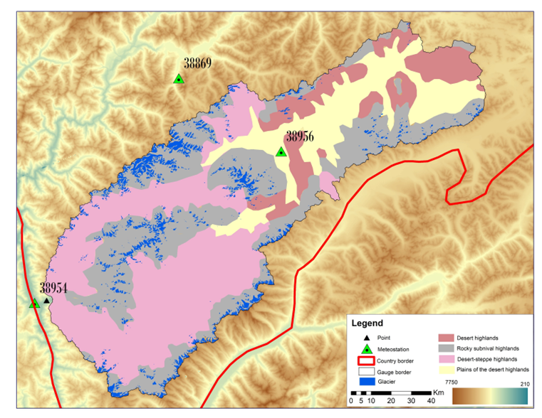
Study area
The Gunt River – Horog (area 13,700 km²)
2 types of climate: cold summers and very low humidity (Eastern Pamirs)moderately warm summers and very low humidity (Western Pamirs)
Altitude: 2063 – 6683 m (average 4170 m).
The average annual temperature:
-2.0˚C at Dzhavshangoz (3410 m),
+8.7˚C at Khorog (2075 m)
Precipitation: 145 mm at Dzhavshangoz, 285 mm at Khorog.
Precipitation during the cold period (October-April) exceeds the amount of precipitation during the warm period (May-September) by several times, depending on altitude.
Glacier-snow-fed river
Average annual river flow 104 m³/s
The area of glaciation 826 km² (6%)
The runoff formation complexes (RFC):
homogeneous in soil, vegetation and landscape characteristics:
Desert;
Highlands
Glacier
Each RFC has its own set of soil and vegetation parameters.
The parameters were adopted from the study:
Scheme of the catchment area of the Gunt River

Slide 6
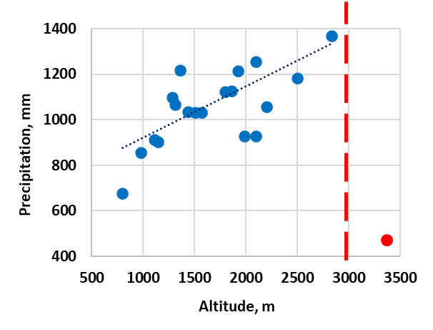
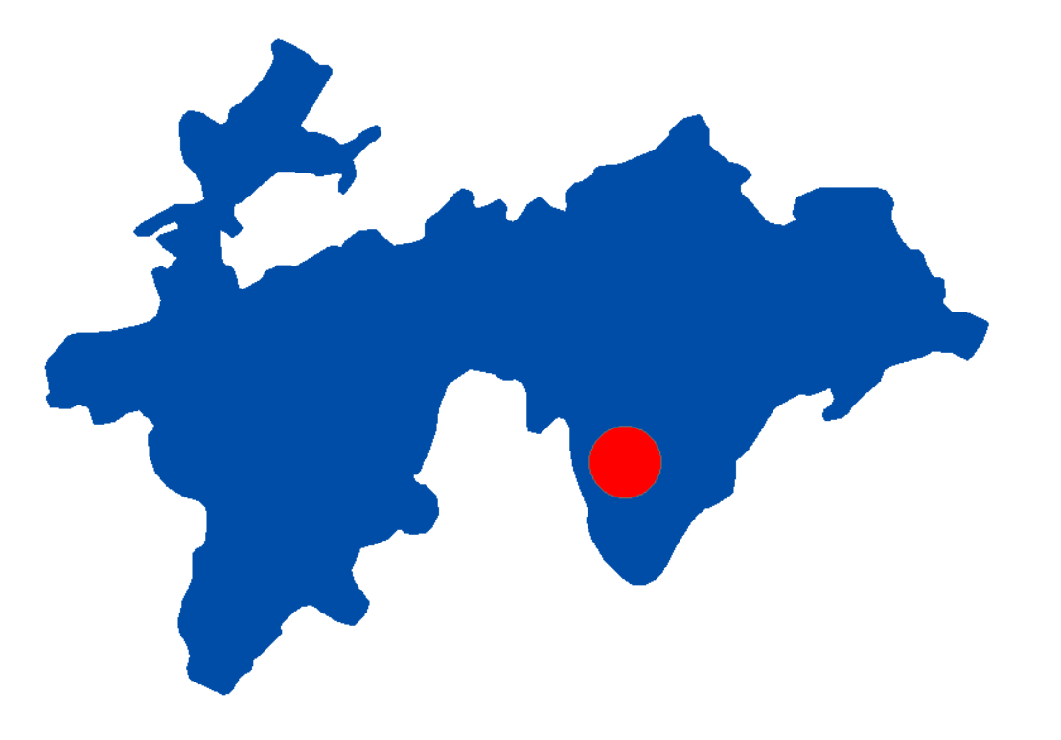
Hydrometeorological data
 | Meteorological data |  | Hydrological data
Name | Dzhavshangoz (3410 m) | Khorog (2075 m) | The Gunt River – Horog
Period | 1936-1997 with gaps (daily) | 1898-2020 with gaps (daily) | 1965-1986 (daily) 1940-2020 (monthly)
Element | precipitation | temperature, precipitation, humidity | Discharge
Meteorological information does not fully reflect the change in characteristics with altitude
Special experimental river watershed for detailed observations of meteorological parameters
The Varzob River - the village Dagana (1270 km²), 1965-1981
Altitude: 900 - 4500 m (the highest point is the Gaznok Peak is 4881 m)
According to the altitude characteristics, the basin of the Varzob River is typical for the region of Central Asia.
6 meteorological station (temperature, precipitation, humidity)
14 precipitation station
Up to 3000 m the amount of precipitation increases, after - decreases
Reason: underestimation of precipitation due to wind blowing
Precipitation distribution with altitude

Slide 7
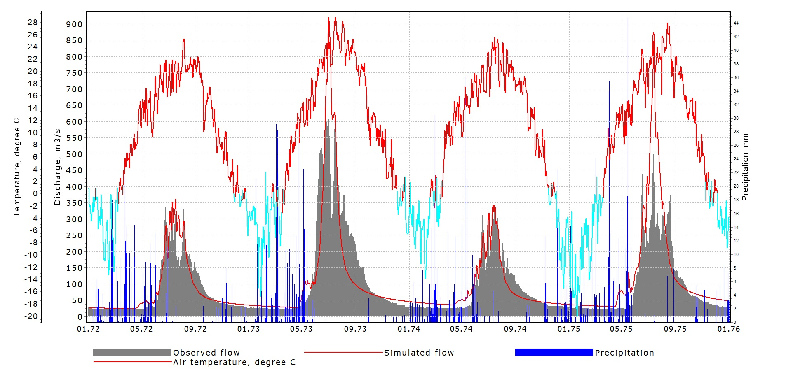
Results of model verification in historical period
 | 1972 | 1973 | 1974 | 1975
Simulated flow, mm | 185 | 297 | 186 | 296
Observed flow, mm | 185 | 325 | 184 | 231
Precipitation, mm | 412 | 479 | 462 | 484
Total ET, mm | 184 | 184 | 196 | 192
Nash-Sutcliffe | 0.88 | 0.70 | 0.89 | 0.39
The model was verified in historical period: daily streamflow in 1972-1975
Two meteorological stations were used
Thought the model captures the annual volume of runoff, as well as the streamflow in low-water period, it wrongly redistributes the streamflow during warm season in wet years.
Lack of input data is critical.

Slide 8
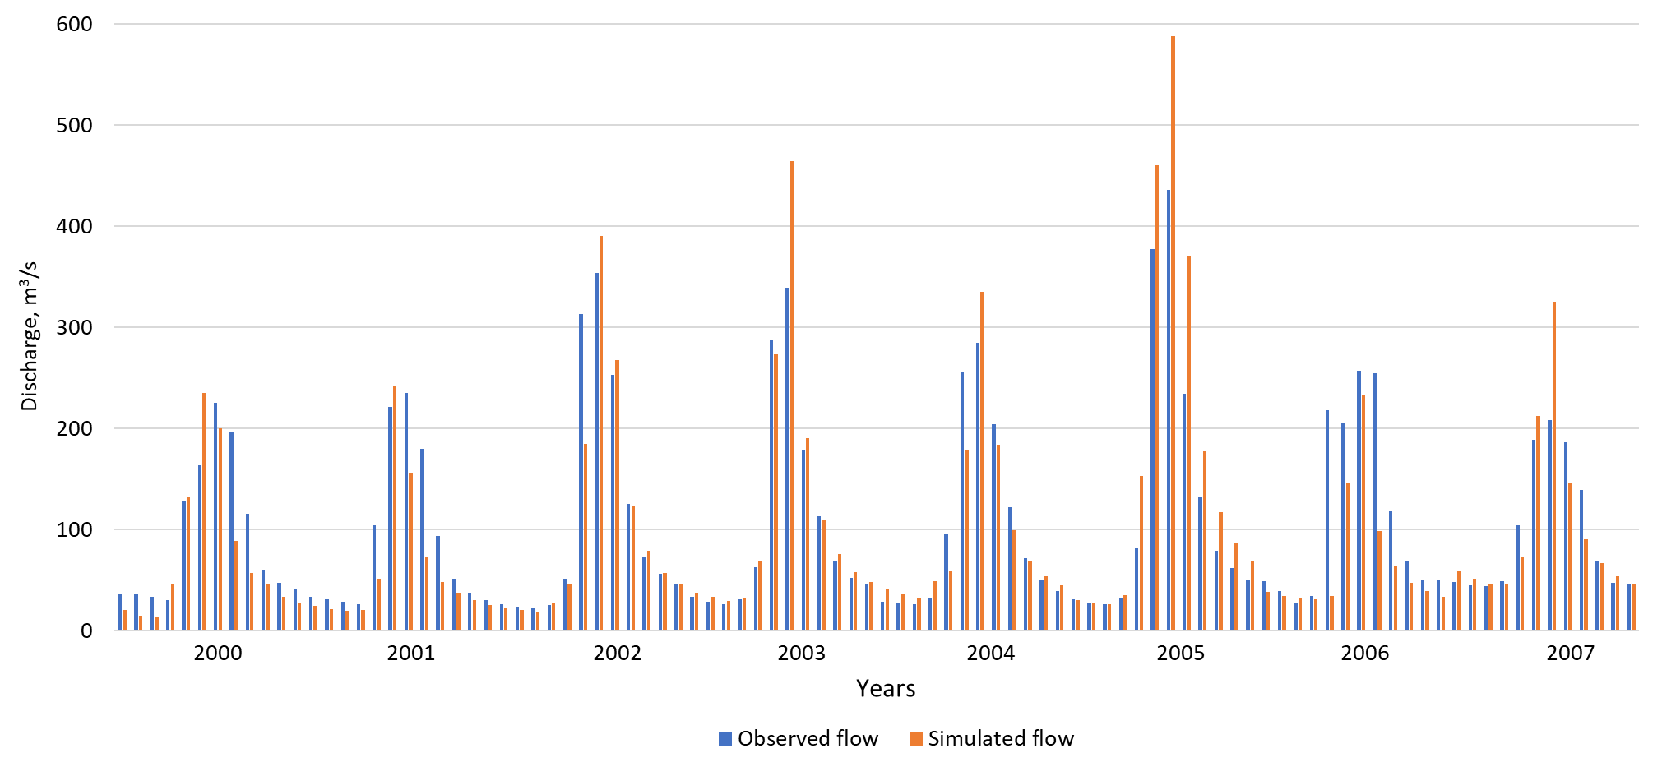
Results of model verification in current period
 | 2000 | 2001 | 2002 | 2003 | 2004 | 2005 | 2006 | 2007
Simulated flow, mm | 177 | 144 | 248 | 275 | 229 | 413 | 160 | 235
Observed flow, mm | 215 | 206 | 263 | 244 | 238 | 301 | 264 | 225
Precipitation, mm | 422 | 270 | 424 | 443 | 459 | 264 | 488 | 310
Total ET, mm | 164 | 177 | 152 | 148 | 149 | 156 | 162 | 170
Error, % | 18 | 30 | 6 | -13 | 4 | -37 | 39 | -4
Nash-Sutcliffe | 0.73
The model was verified in recent period: monthly streamflow in 2000-2007
One meteorological station was available for input data
Monthly NS = 0.73
Annual error varies from -37 to 39%.
Uncertainty of input data is high and impacts the results of modelling.

Slide 9
Conclusions
Schematization of the Gunt River basin was performed, five runoff formation complexes were identified, and the parameters of the hydrological model were estimated.
Modeling of flow formation processes in the Gunt River basin for the period 1972-1976 and 2000-2007 was carried out.
Daily flow hydrographs and the distribution of water balance elements were obtained. The results were verified using observed data and given the uncertainty of input data evaluated as satisfactory.
The ongoing deterioration of the quantity and quality of the hydrometeorological data in the region have become critical for management of water resources.
Overall the results confirm the possibility to apply the hydrological model Hydrograph to assess the water balance and hydrological characteristics in the mountainous part of Tajikistan. Provided by proper precipitation data the model can be used for forecasts and projections of water resources and hazardous floods in the region.

