Slide 1

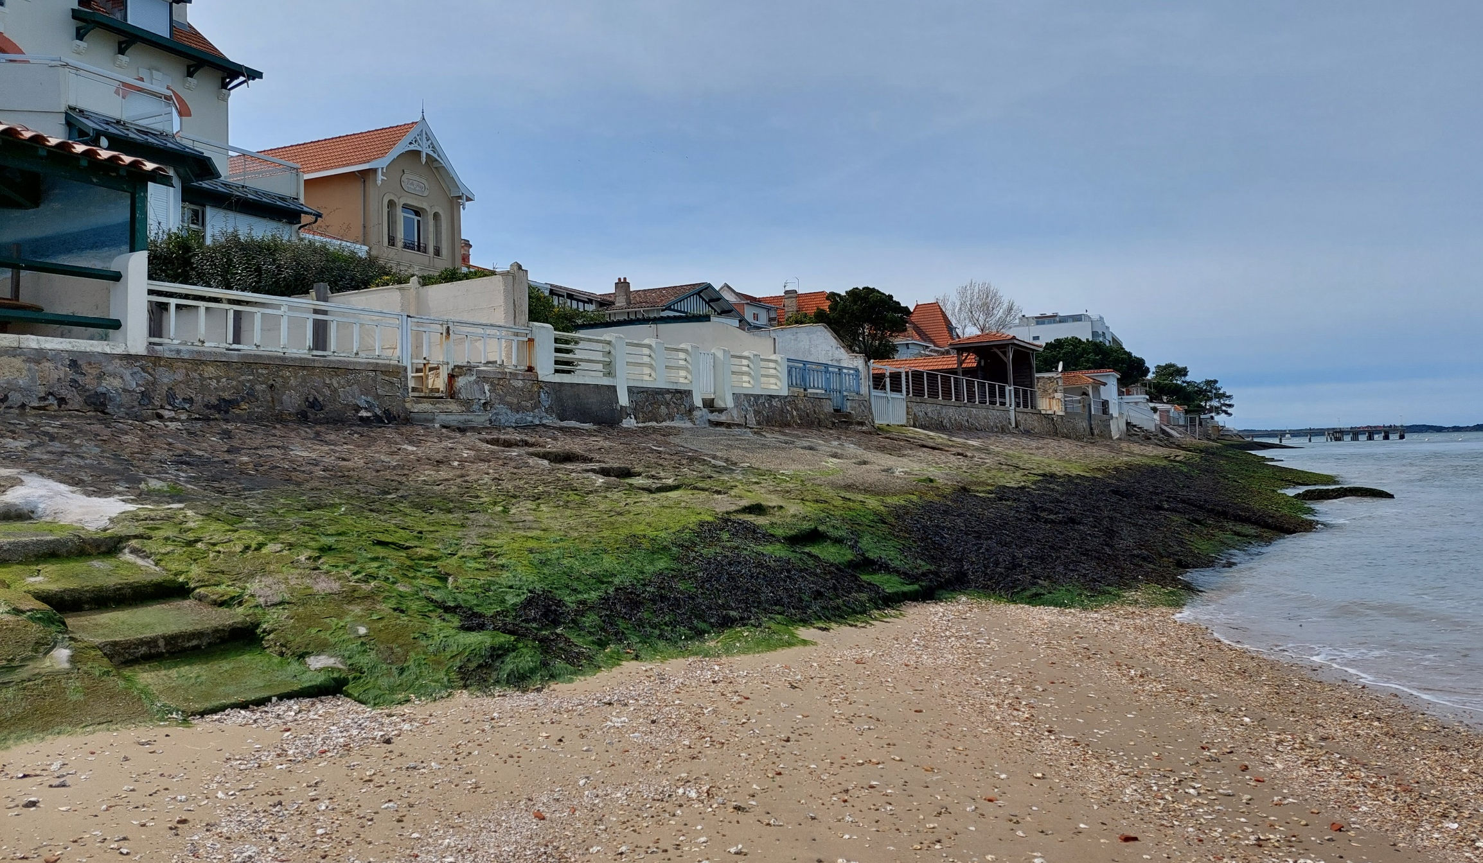

COASTMOVE: A global agent-based model of adaptation and migration decisions in face of sea level rise
Arcachon, France
Sem Duijndam
Lars Tierolf, Toon Haer, Jens de Bruijn, Wouter Botzen, Lena Reimann, Marijn Ton, and Jeroen Aerts

Slide 2
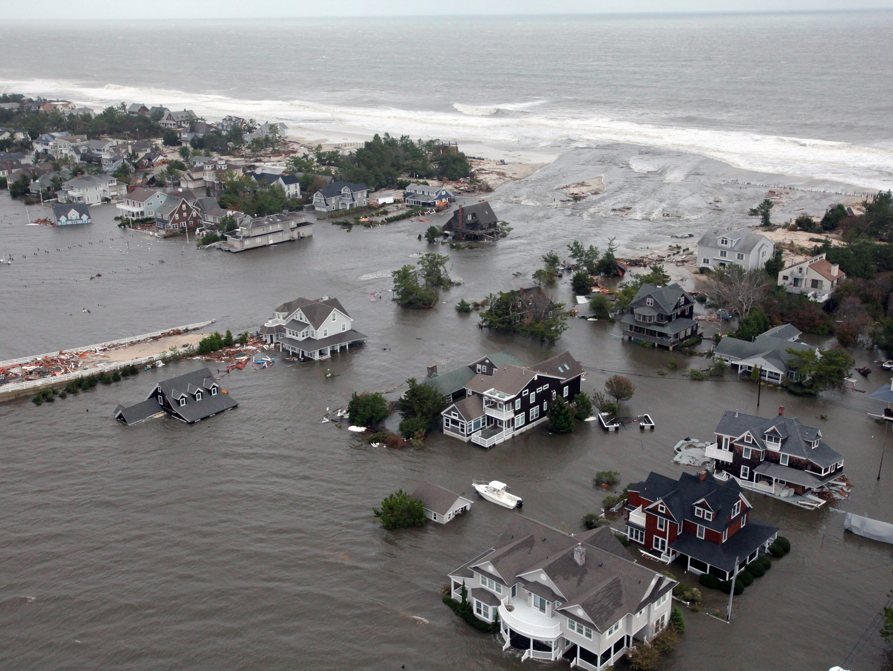
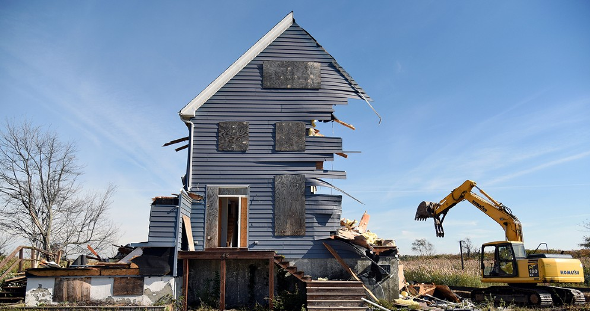
Notes:
Foto: New Jersey, 2012 (Sandy) Foto vol in beeld.
Zoek naar Plaatje adapt migrate stay. Meer foto voor opties

Slide 3
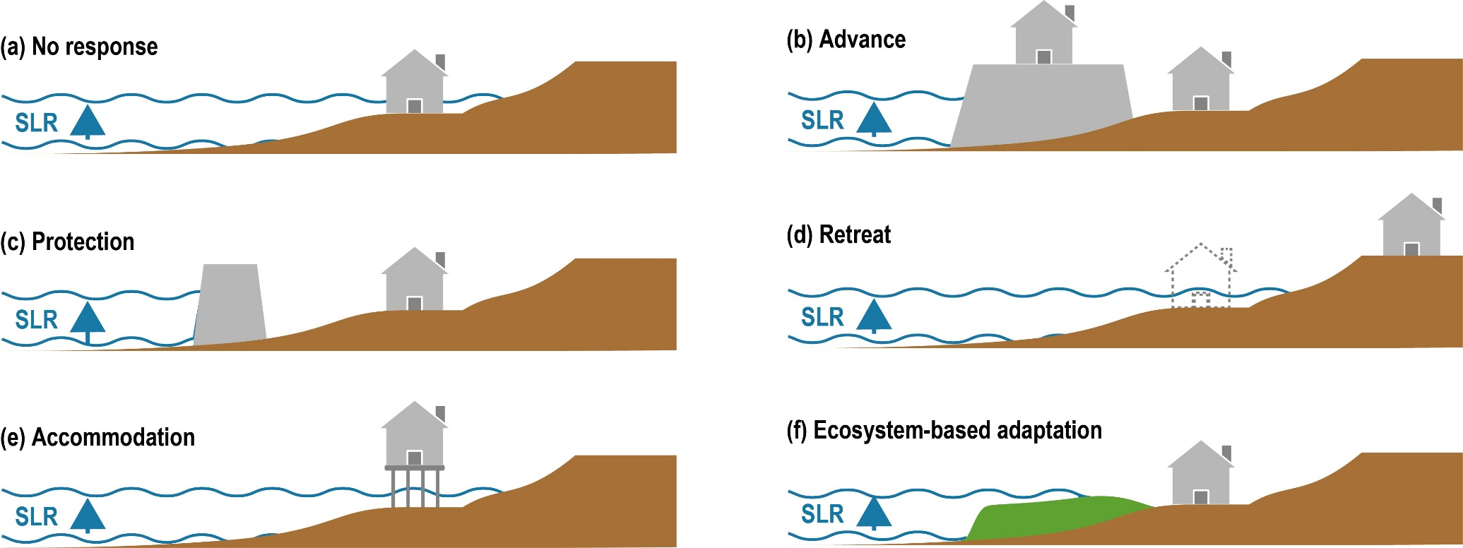
Introduction
Risk perception
Wealth
Income
Place attachment
Age
Education
Occupation
Sex
…
1) Do nothing
2) Accommodate
3) Retreat
Based on IPCC 2022 Chapter 4

Slide 4
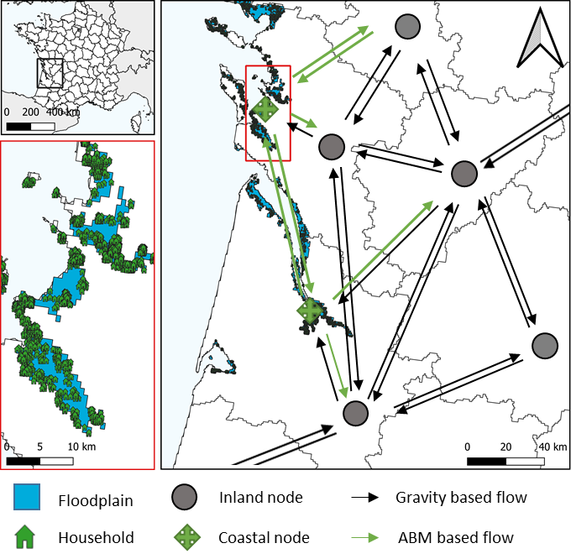
DYNAMO: ABM + Gravity model
Modelling setup for France
1/100-year floodplain in 2080
NUTS 3 regions
GOAL: to capture and understand local decision-making under sea level rise
Risk perception
Wealth
Income
Place attachment
Notes:
Minder tekst figuur groter. Coastal ABM+Gravity in title. Plaatje uitleggen. 1 in 100 in 2080 erin laten, rest vertellen. Onder bullets household vier favtoren plotten.
Wat is het DOEL: balk -> capturing and understanding how local decision making under SLR

Slide 5
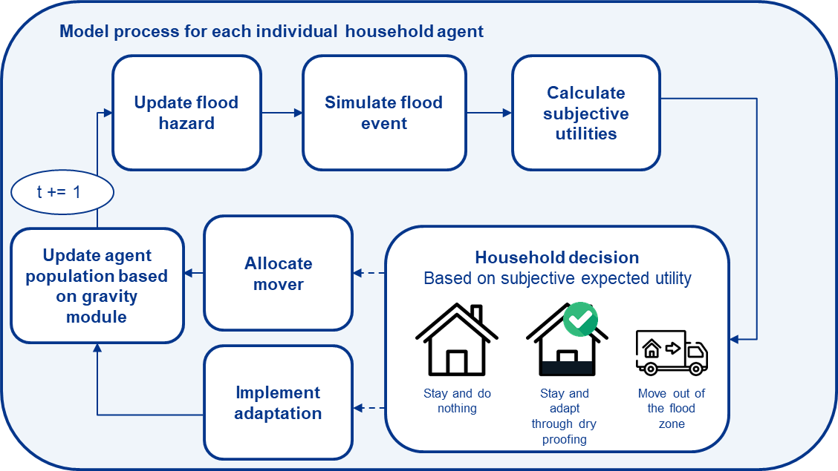
Modelling schedule
Notes:
Hierna Plaatje floodplain met regio. Grafieken van maken. Daarna regios, daarna Frankrijk

Slide 6
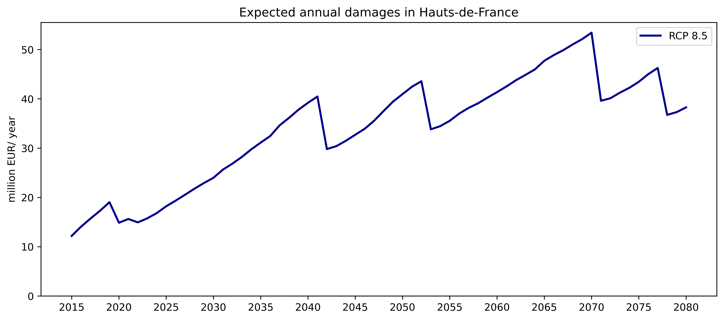
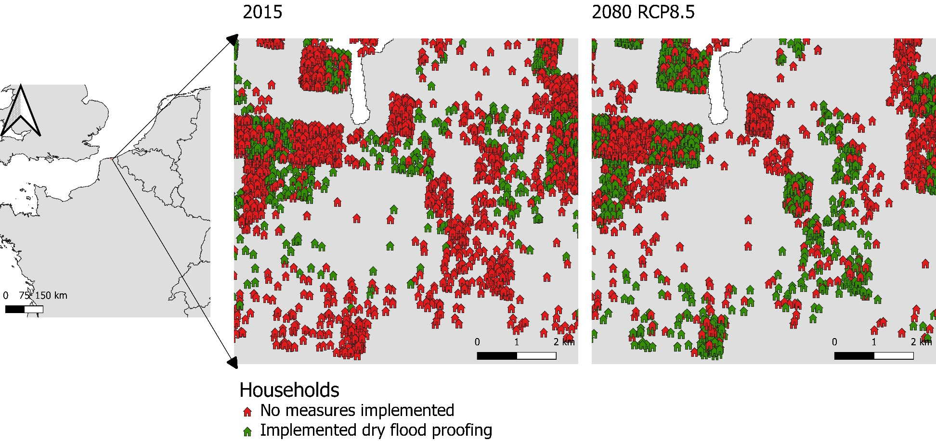
Results: Adaptation uptake

Slide 7
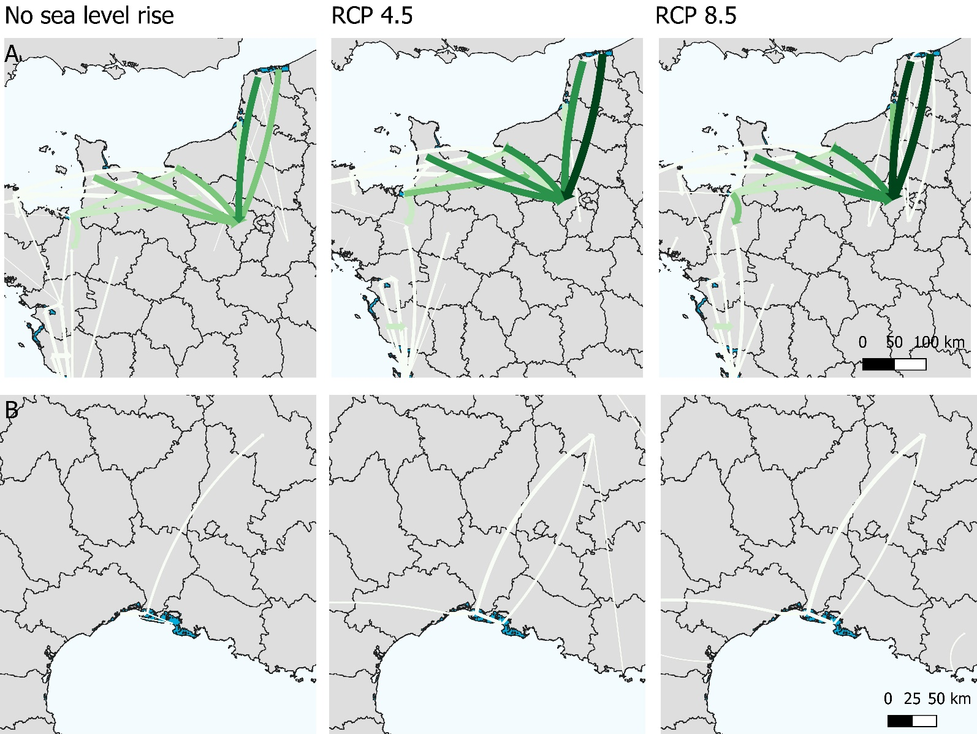
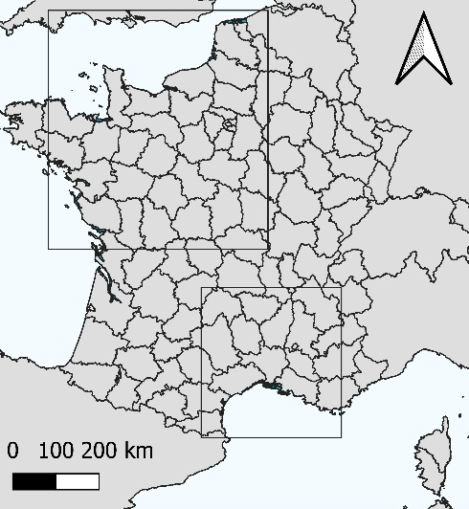
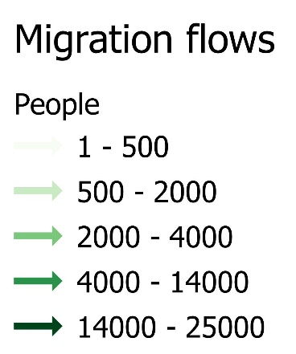
Results: Migration flows
Notes:
Naar voren na EAD en population.

Slide 8
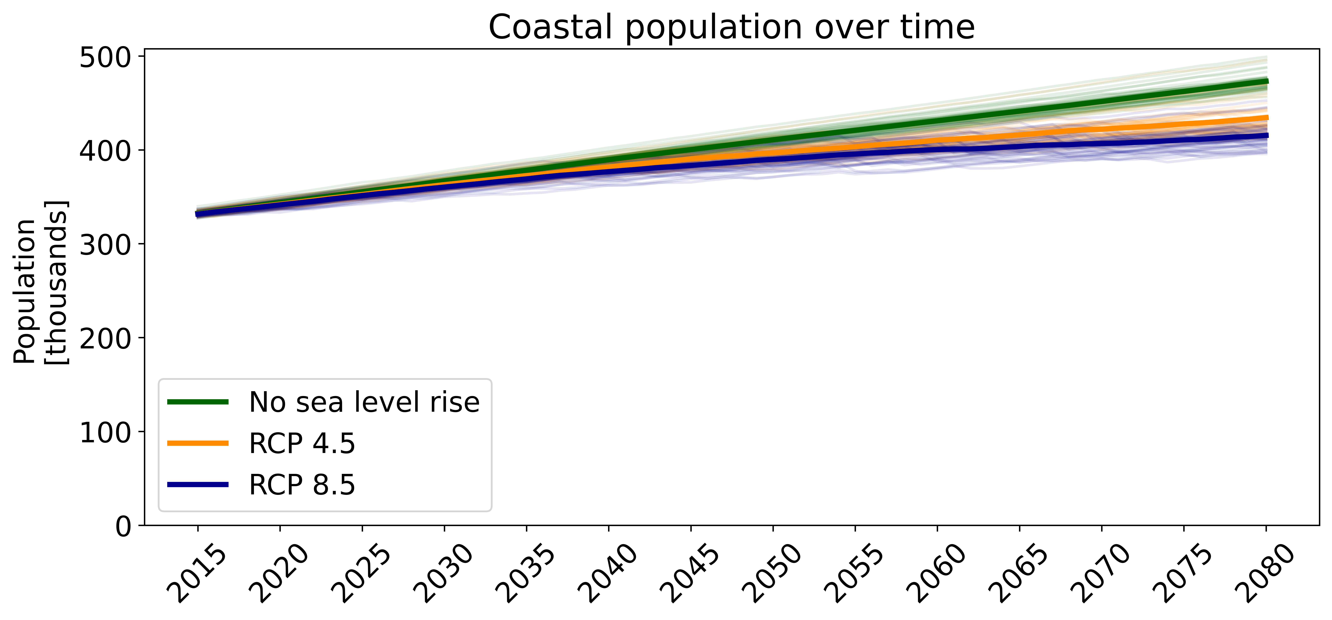
Results: Population in the 1/100-year floodplain
Notes:
Leesbaarheid

Slide 9
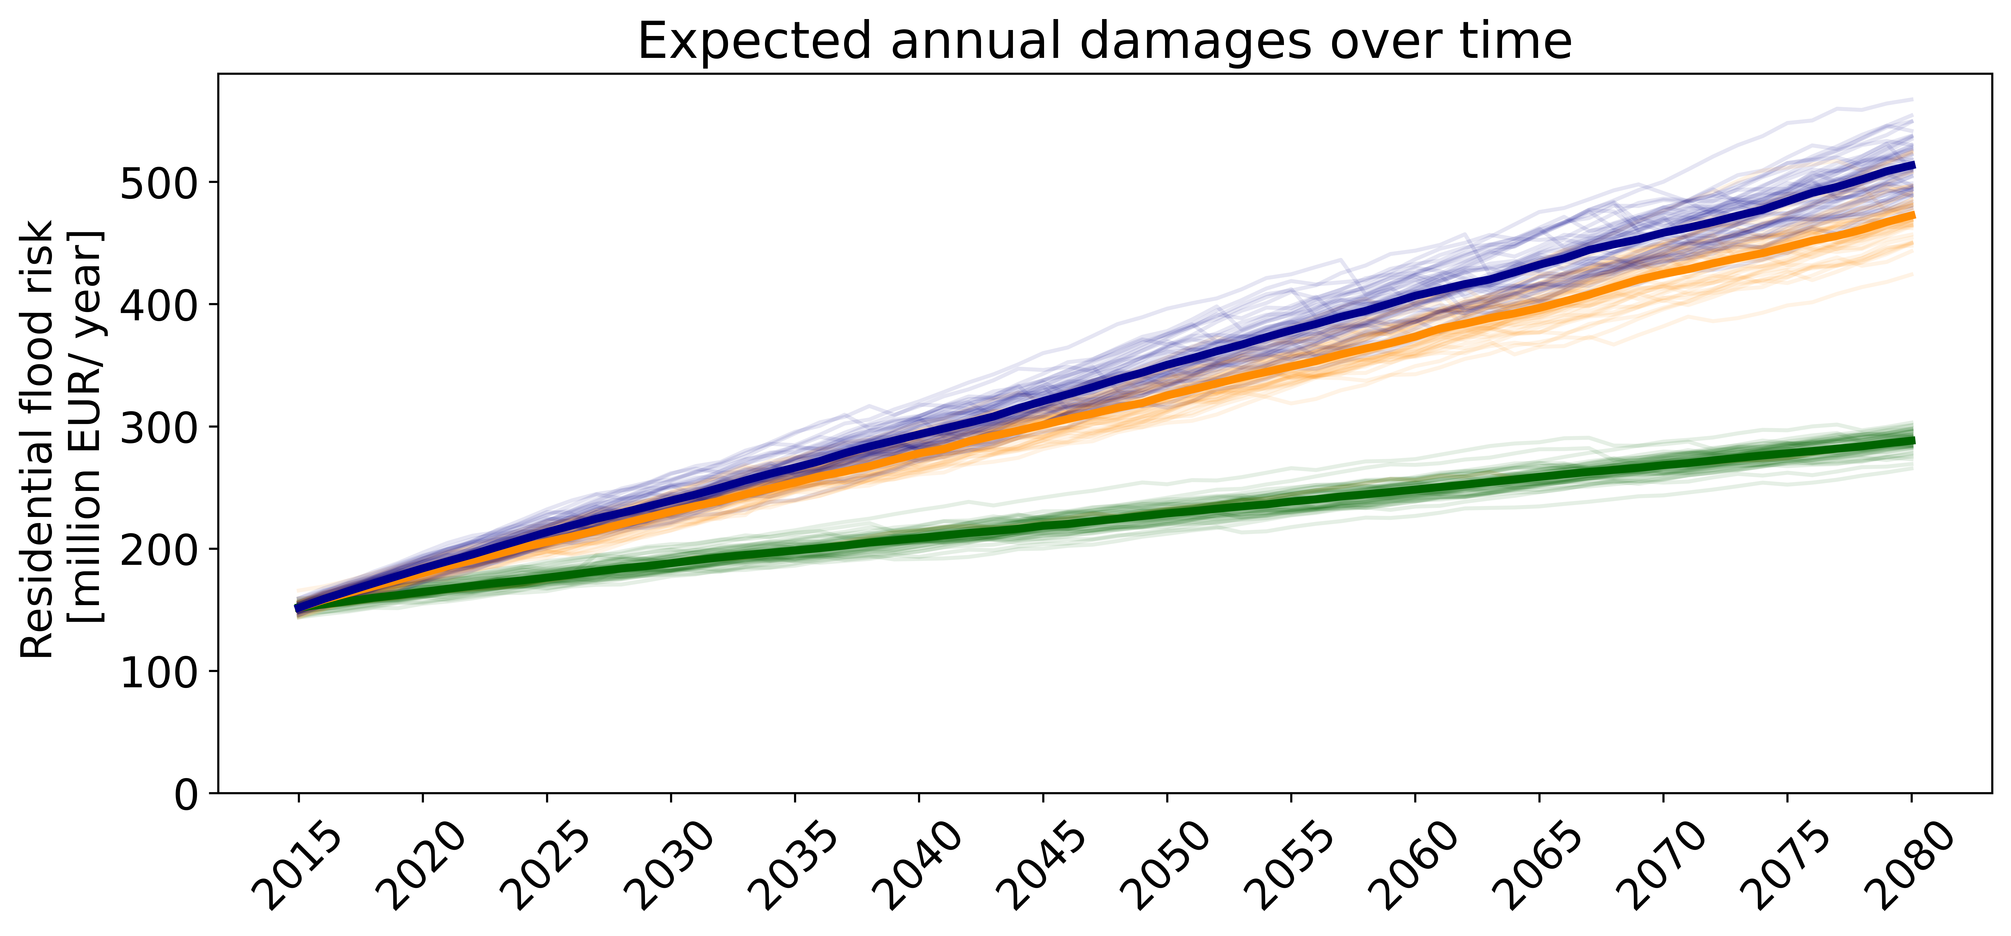
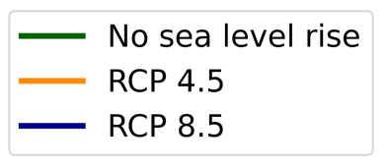
Results: Residential flood risk
Notes:
Legenda weet toevoegen

Slide 10
Outlook
Surveys to calibrate and validate the ABM
  France
  United States (New York + Florida)
  Mozambique
  Brazil (Buenos Aires)
  Marshall Islands
Global upscaling of the agent population
Integrate SSP scenarios
Include government/ insurer agents
Include coastal erosion and saltwater intrusion
Notes:
Wat moet er nog gebueren→ surveys. Conclussies, belangrijke referentie .Upscaling, validatie surveys, landen van Sem, mailadres, groter coastmove figuur.

Slide 11

Contact and further references
DYNAMO: a global modelling approach of both coastal adaptation and migration under projections of future development
Simulating local decision making under scenarios of global change
Further references
Duijndam, S. J., Botzen, W. J., Hagedoorn, L. C., & Aerts, J. C. (2022). Anticipating sea‐level rise and human migration: A review of empirical evidence and avenues for future research. Wiley Interdisciplinary Reviews: Climate Change, 13(1), e747.
Aerts, J. C. J. H. (2020). Integrating agent-based approaches with flood risk models: A review and perspective. Water Security, 11, 100076.
Ruig, L. T. de, Haer, T., Moel, H. de, Orton, P., Botzen, W. J. W., & Aerts, J. C. J. H. (2022). An agent-based model for evaluating reforms of the National Flood Insurance Program: A benchmarked model applied to Jamaica Bay, NYC. Risk Analysis. https://doi.org/10.1111/RISA.13905
Haer, T., Botzen, W. J. W., & Aerts, J. C. J. H. (2019). Advancing disaster policies by integrating dynamic adaptive behaviour in risk assessments using an agent-based modelling approach. Environmental Research Letters, 14(4). https://doi.org/10.1088/1748-9326/ab0770
Link to abstract
Contact
lars.tierolf@vu.nl

