Slide 1
Monitoring climate related risk and opportunities for wine sector: the MED-GOLD Pilot Service.
Alessandro Dell’Aquila , António Graça, Marta Teixeira, Natacha Fontes, Nube Gonzalez, Raul Marcos, Chihchung Chou, Marta Terrado, Christos Giannakopoulos,, Federico Caboni - Riccardo Locci- Martina Nanu - Sara Porru- Giulia Argiolas Marta Bruno Soares, Michael Sanderson

Slide 2
Results
Co-development methodology tested successfully
Proof-of-concept of climate services for the agri-food sector demonstrated

Slide 3

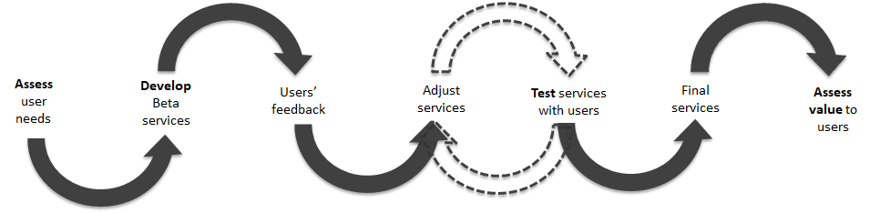
MED-GOLD co-developement methodology
Assessing users’ needs
Development of the service
Testing the service
Assessment of the added value for the decision-making process
Thanks to Marta Bruno Soares, UniLeeds

Slide 4
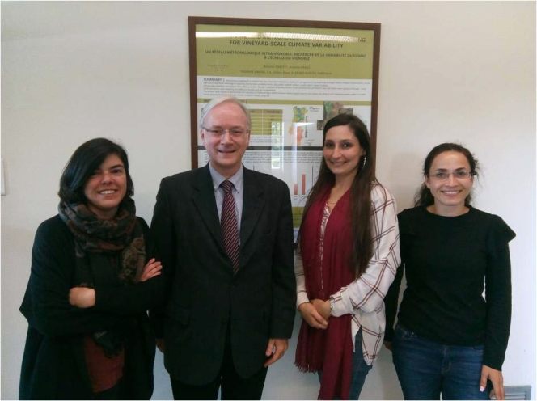
Grape/wine: key actions
Weather forecast
Climate predictions
Climate projections
Sub-
seasonal
Seasonal
Decadal
1-15 days
10-60 days
1-15 months
2-30 years
20-100 years
Siting, choice of scion variety and rootstock.
Assessment of water needs
Grow cycle management
Pathogen pressure, abiotic stresses
Crop forcing
Productivity, quality
Wine style
Harvest date and duration
Adapted from: Antonio Graça, SOGRAPE VINHOS SA, 2014
Time
Sogrape Vinhos
Porto
PORTUGAL
May 2018, May 2019

Slide 5
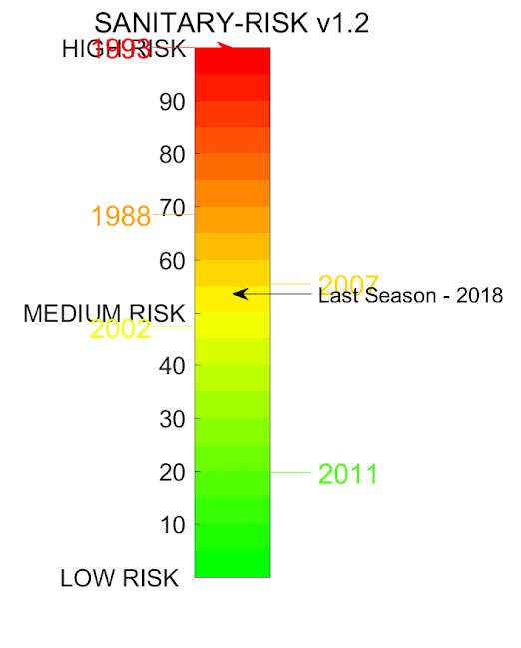
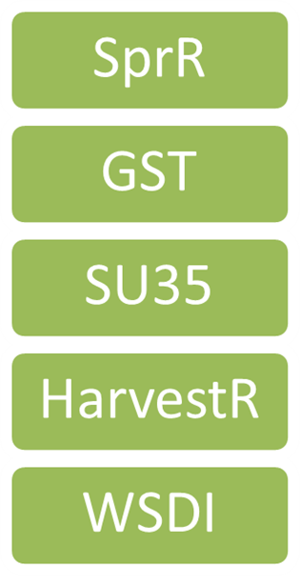
Identification of key bio-climatic indicators
Verification with users
Co-design & co-development of compound risk index
After collecting the key requirements, identifying the key decision, starting working on the trust/value
Input from users: bad vs good years: 1988,1993 2002 vs 2007-2011
Sources of risks for infestations identified:
High/Low Spring Precip (if high rainfall risk doubled!)
High Harvest Precip
Low Growing Season Temp
Spring Precipitation
Growing Season Temp
Summer days (>35°C)
Harvest Precipitation
Warm spell

Slide 6
PROOF OF CONCEPT

Slide 7
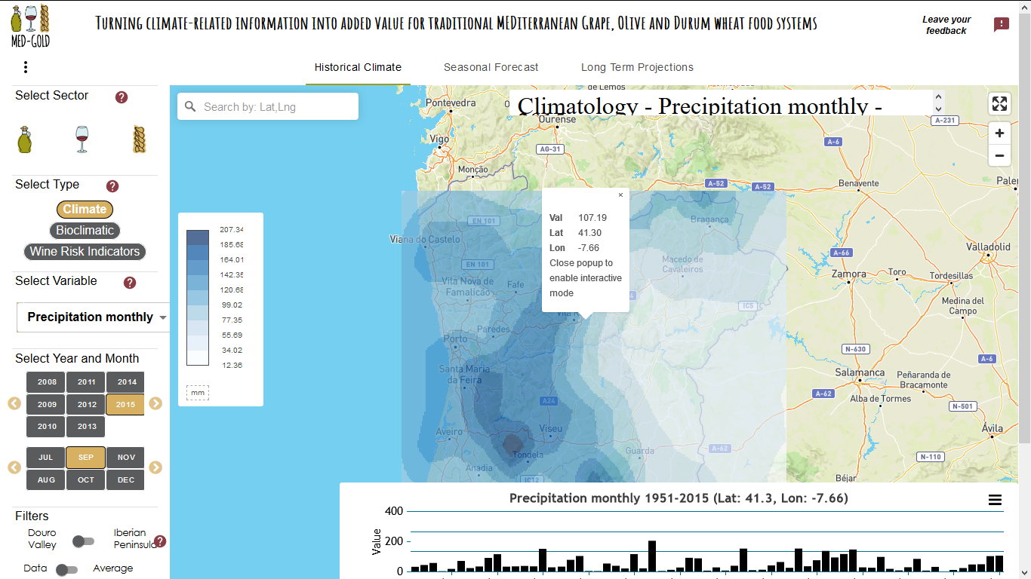
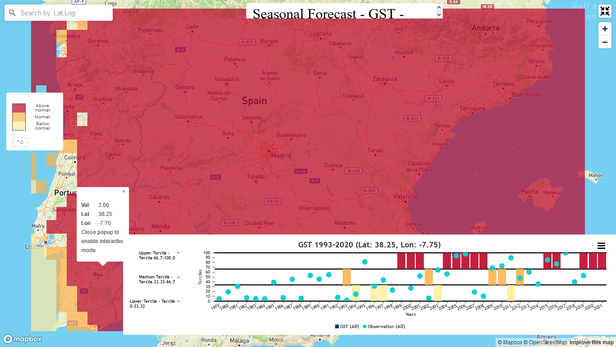
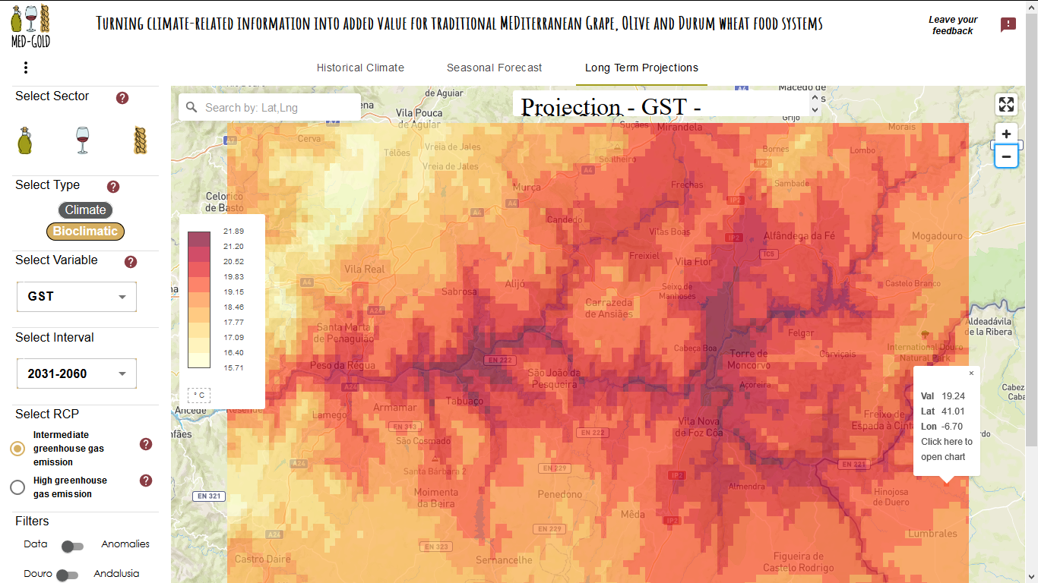
MED-GOLD Dashboard: a decision support tool for farmers, technical staff, advisors and policy-makers
HISTORICAL CLIMATE Understanding
SEASONAL FORECASTS
Operational planning
LONG-TERM PROJECTIONS
Strategic decision-making

Slide 8
OUTLOOK
Create operational services
Scale-up
Replicate to other sectors
Replicate to other geographical areas
Test the use /usability of the service

Slide 9



med-gold.project@enea.it
www.med-gold.eu
medgold_h2020
Thank you
Eυχαριστίες
Grazie
Gracias
Obrigado
Merci

Slide 10
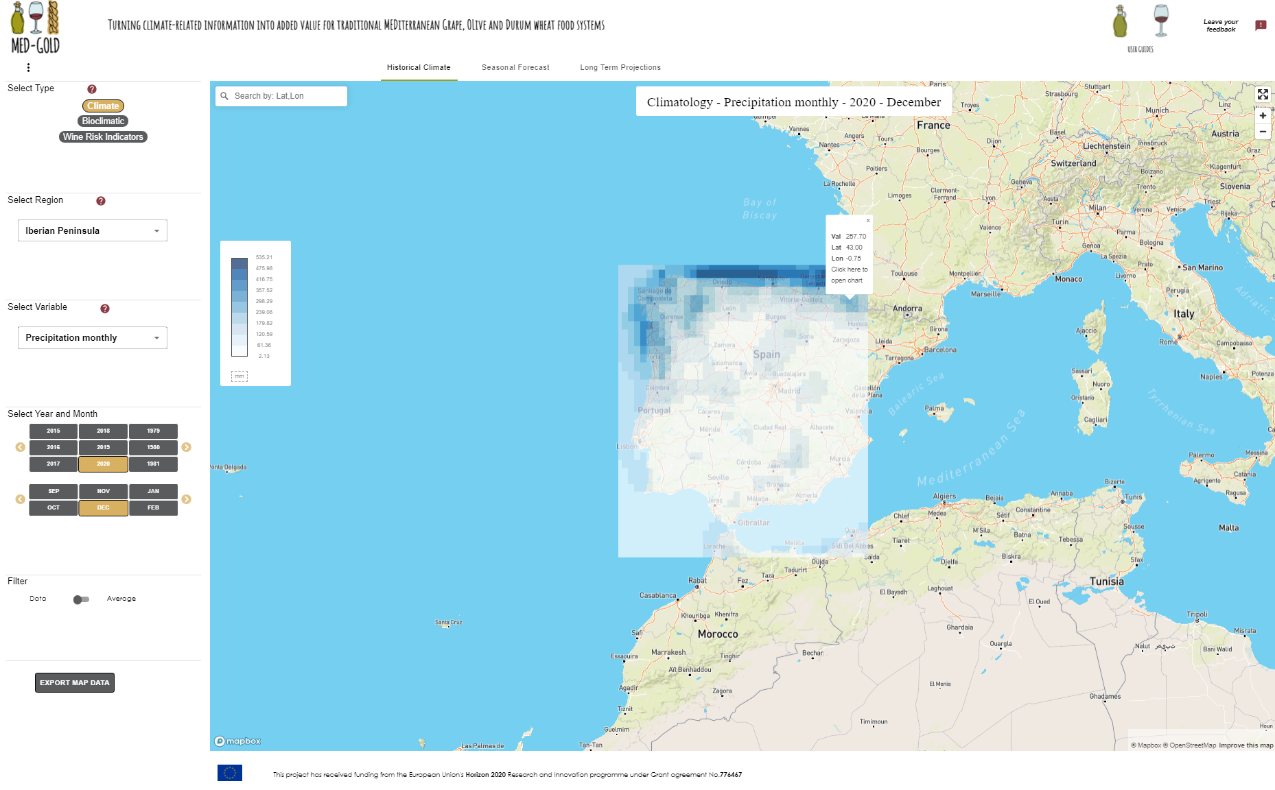



THE MED-GOLD DASHBOARD – A DECISION SUPPORT TOOL FOR FARMERS, TECHNICAL STAFF, ADVISORS AND POLICY-MAKERS
This project has received funding from the European Union’s Horizon 2020 research and innovation programme under grant agreement No 776467

Slide 11
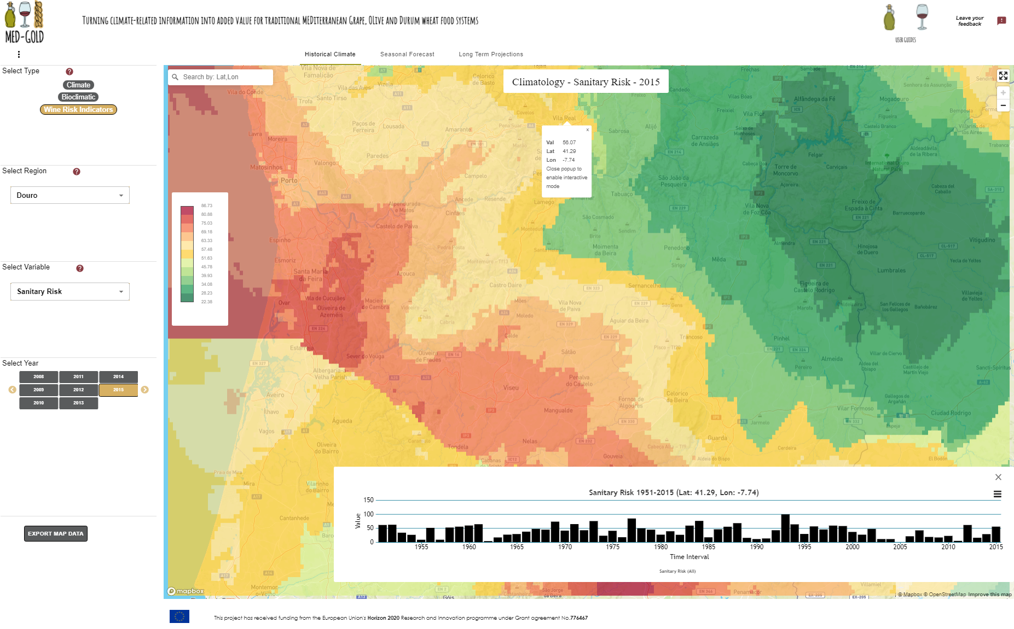
DETAILED HISTORICAL INFORMATION HELPS UNDERSTAND WHAT HAPPENED AND WHY
This project has received funding from the European Union’s Horizon 2020 research and innovation programme under grant agreement No 776467
High-resolution historical evoution for each climate variable indicator and index help explain changes observed in plant phenology, effects of extreme events and consequences over product yields, quality and profitability

Slide 12
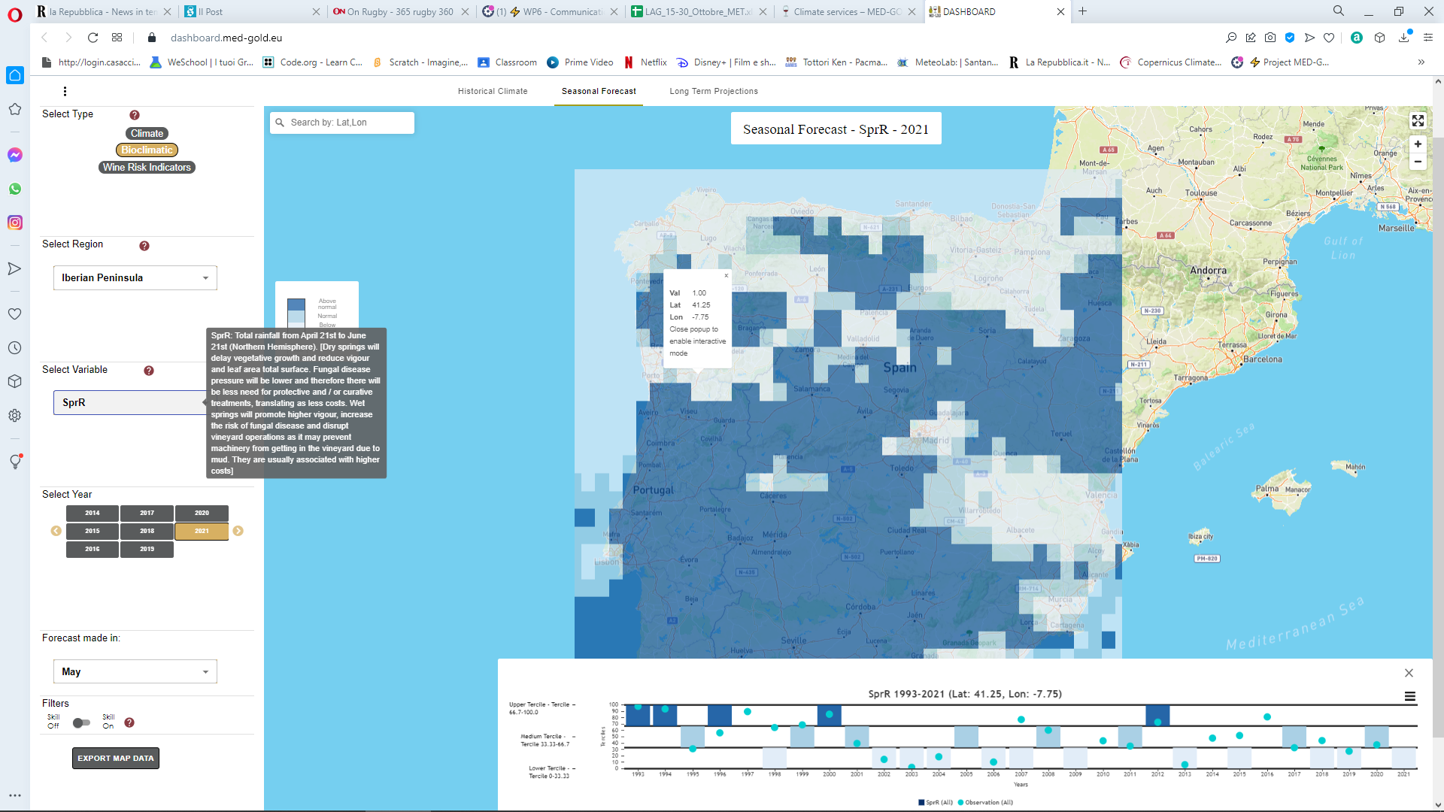
SKILFUL PREDICTIONS PROVIDE UNPRECEDENTED LEVEL OF RISK MANAGEMENT FOR CLIMATE IMPACTS
This project has received funding from the European Union’s Horizon 2020 research and innovation programme under grant agreement No 776467
Seasonal forecasts allow for anticipating high-pest pressure or earlier harvests adjusting expenditure and safeguarding overall profitability.

Slide 13
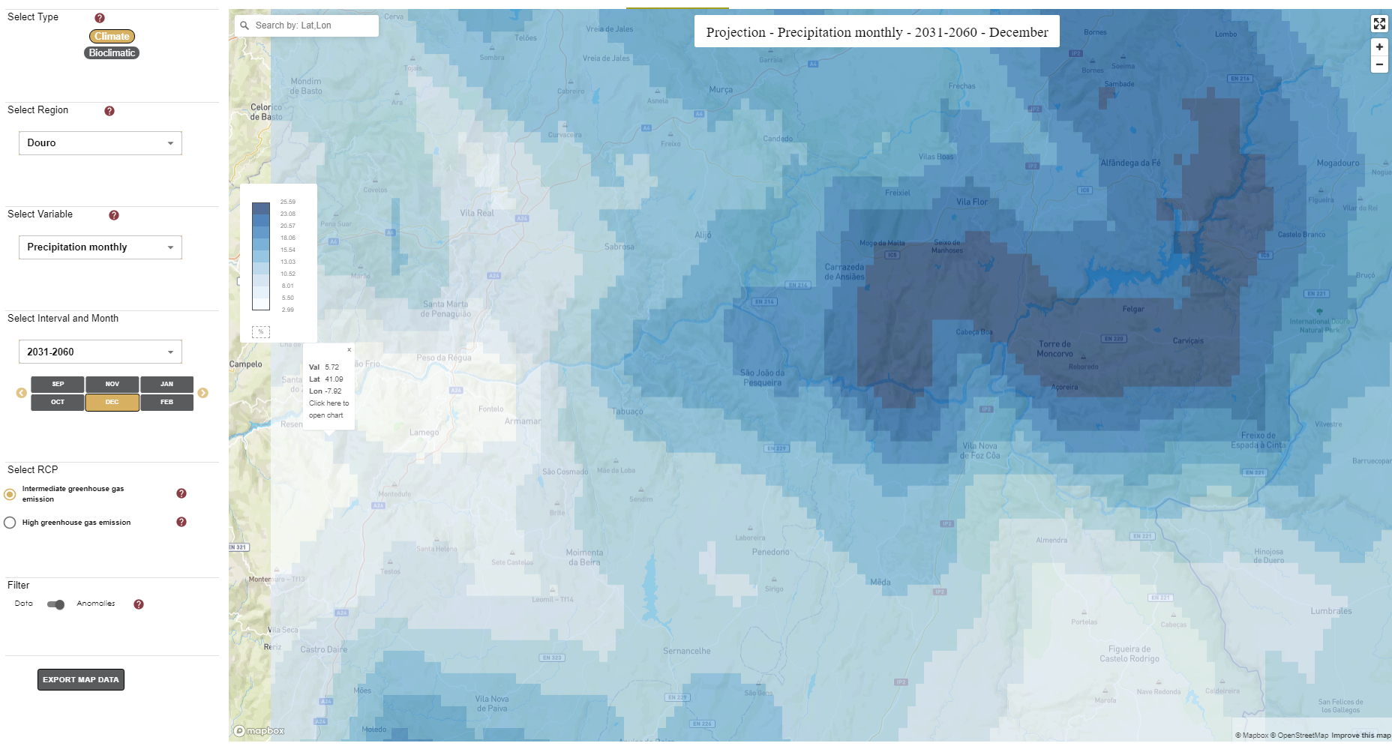
A COMPLETE PACKAGE OF CLIMATE INFORMATION, ACCESSIBLE, EASY, INTUITIVE AND INTEROPERABLE CREATED BY USERS FOR USERS
This project has received funding from the European Union’s Horizon 2020 research and innovation programme under grant agreement No 776467
Long-term projections help choose adapted varieties and decide on water availability for viability assessment of sites, supporting the future of investments, business models and policy-making.

