Slide 1


Memory effect of soil water regime in wet forests, Norther Europe, Latvia
Dr. geol. Andis Kalvāns
Andis.kalvans@lu.lv
University of Latvia

Slide 2
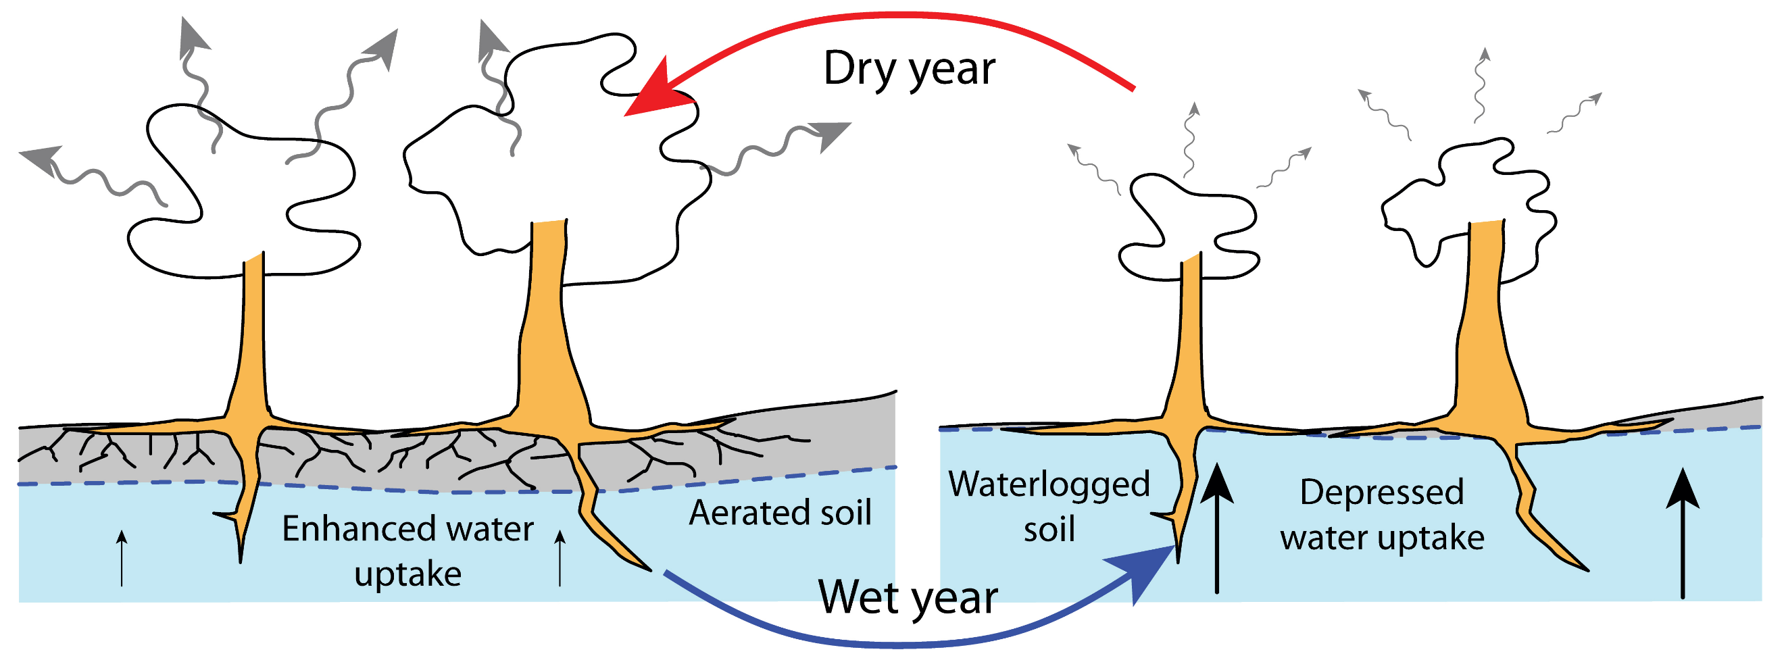
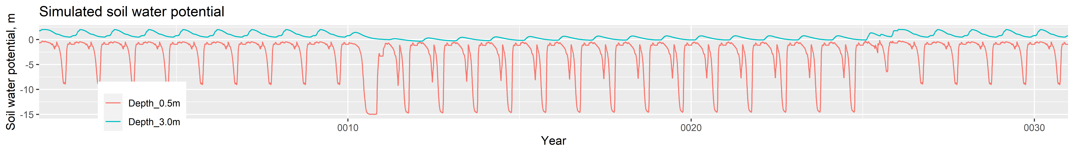
Working hypothesis: wet (hydric) forests, with seasonally waterlogged soil, can be in two alternative states – dry or wet
Wet-land conditions
Dry year:
precipitation / 2
Dry-land conditions
Wet year:
precipitation * 2
Wet-land conditions

Slide 3
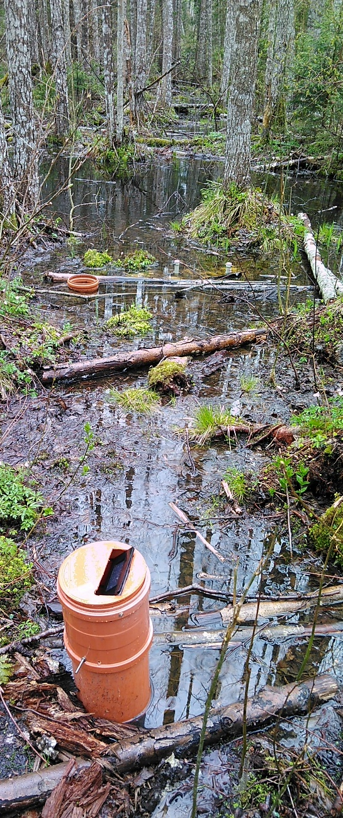
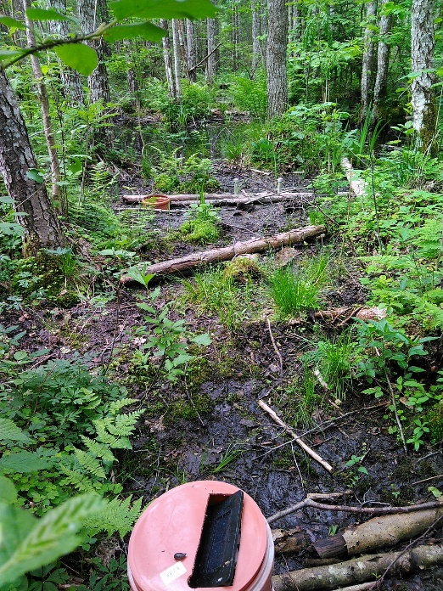
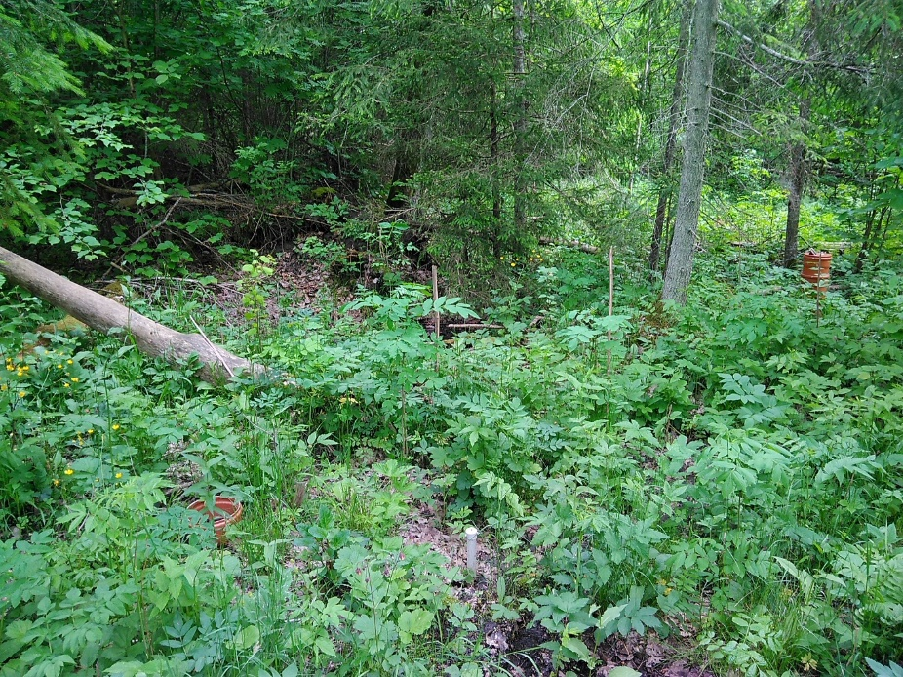
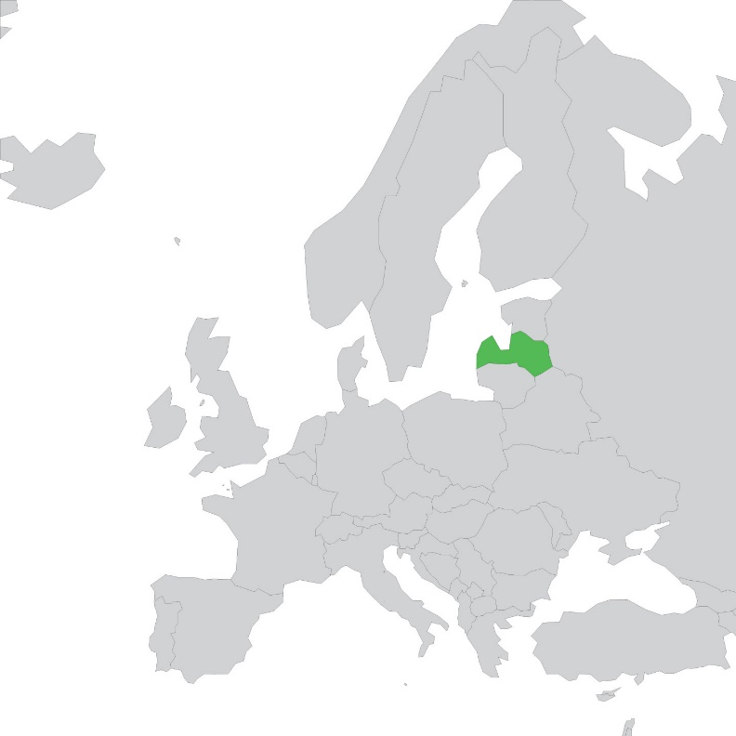
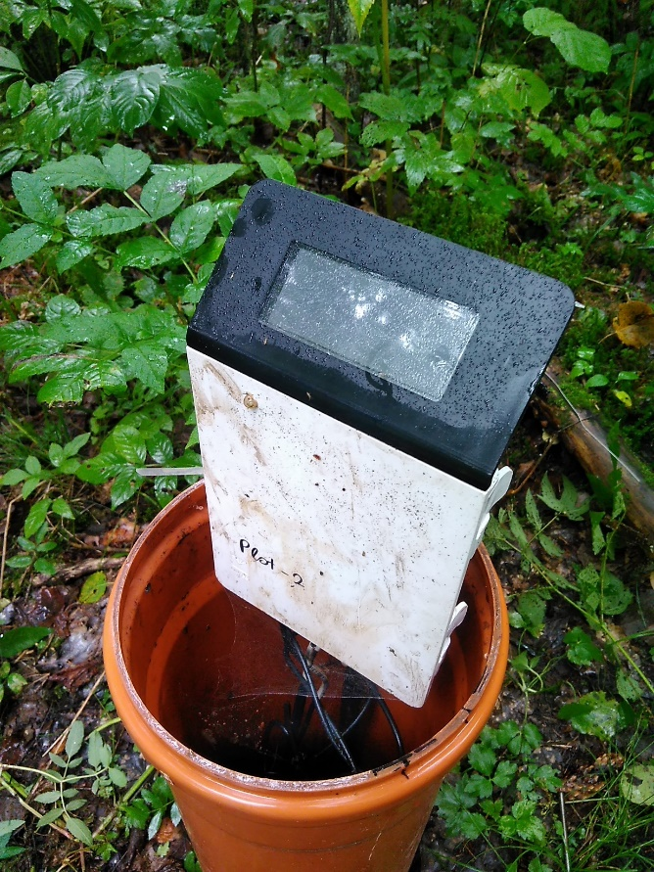
Field data
Three forest plots:
  Plot_1: black alder, heavy loam soil, regular flooding;
  Plot_2: oak, aspen, heavy loam soil;
  Plot_3: black alder, Norway spruce, sandy soil.
Measurements:
  Groundwater level, soil water potential and content, pH, EC, O2, alkalinity, dissolved Fe.
  Since November 2020

Slide 4
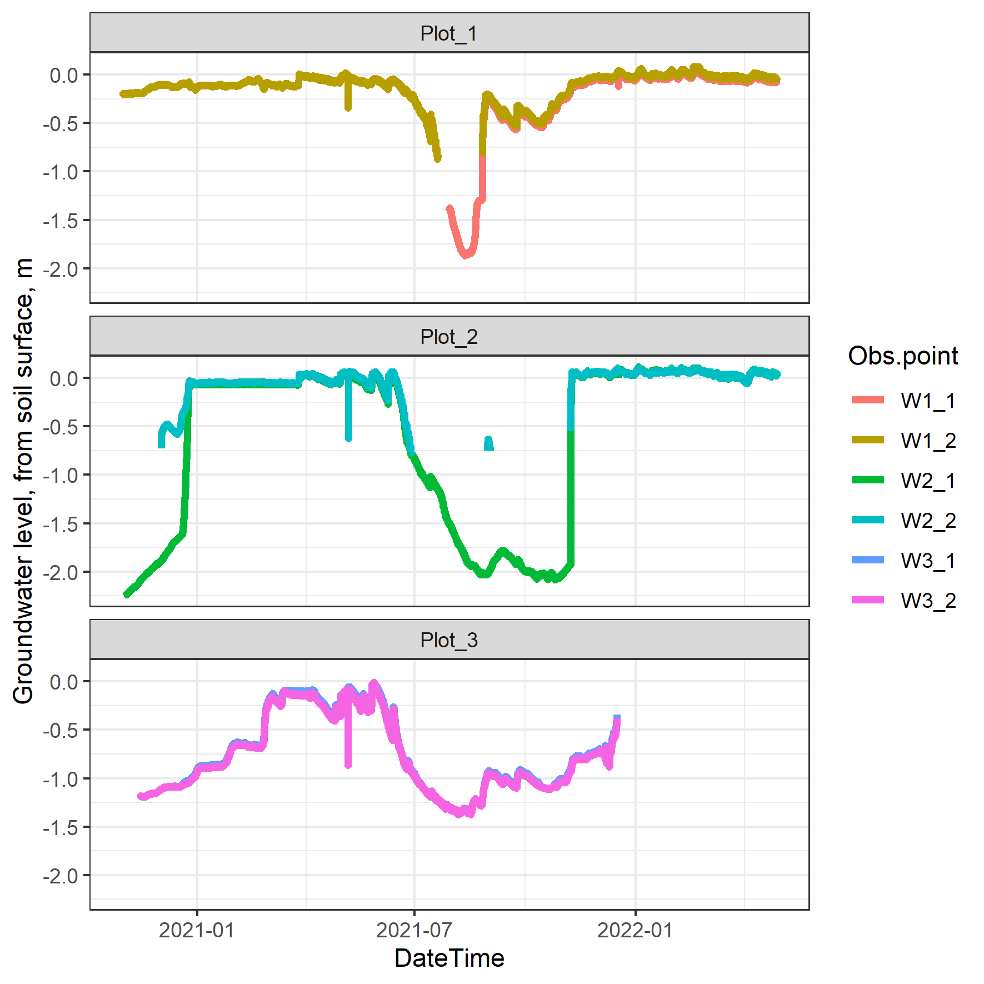
Groundwater level

Slide 5
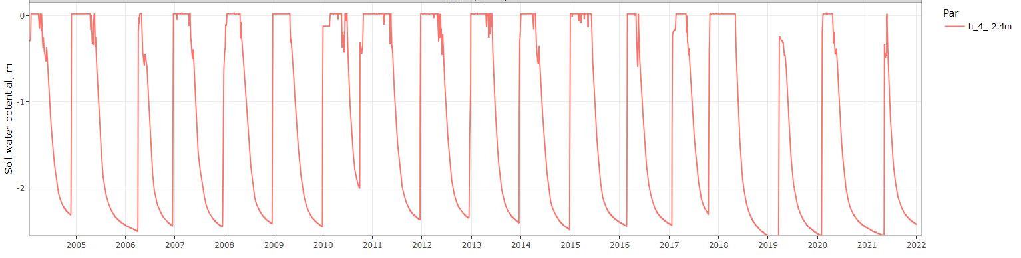
Hydrus-1D soil water model supported with field data
Hydrus-1D: soil water model numerically solving the Richards equation of unsaturated flow with dynamic meteorological forcing
Soil data from field observations
E-obs grided meteorological observations
Šimůnek, J.; Šejna, M.; Saitoh, T.M.; Sakai, M.; van Genuchten, M.T. The HYDRUS-1D Software Package for Simulating the One-Dimensional Movement of Water, Heat, and Multiple Solutes in Variably-Saturated Media, Version 4.17 June 2013 2013, 343.
Cornes, R.C.; van der Schrier, G.; van den Besselaar, E.J.M.; Jones, P.D. An Ensemble Version of the E-OBS Temperature and Precipitation Data Sets. J. Geophys. Res. Atmos. 2018, 123, 9391–9409, doi:10.1029/2017JD028200.

Slide 6
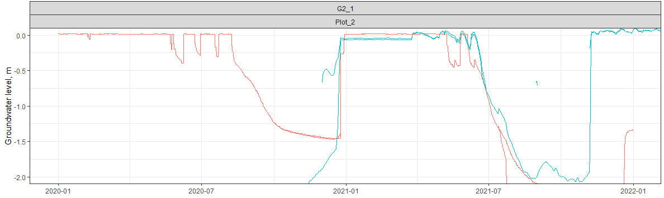
Groundwater level: model vs. observations
Model
Observation

Slide 7
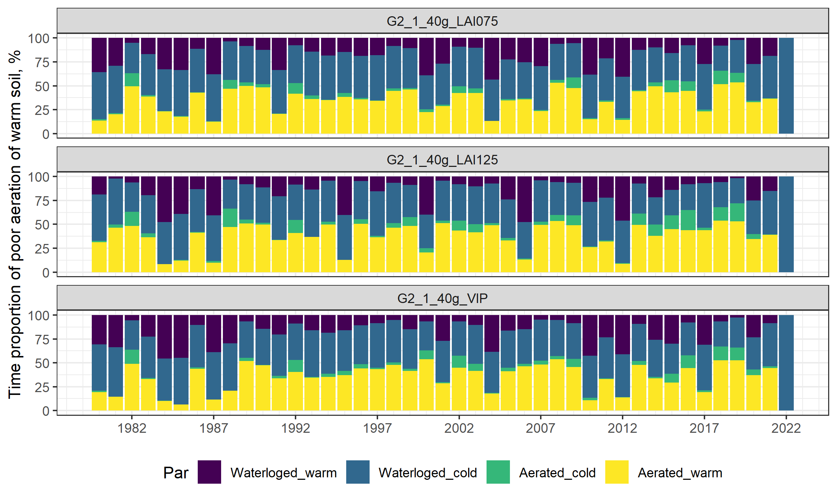
Soil water-temperature seasonality
Warm, waterlogged
Cold, waterlogged
Cold, aerated
Warm, aerated

Slide 8
How do I know that my model is any good?
Dendrochronology – work in progress!

Slide 9
Conclusions
Preliminary model analysis shows that soil water regime can switch from wet to dry state and back for multi-year periods due to root water uptake feedback, thus climate variability can have non-linear impact on hydric forest;
The concept needs to be proved by real-life observations.

Slide 10

Project agreement No 1.1.1.2/VIAA/3/19/524
Andis Kalvāns
Andis.kalvans@lu.lv

Slide 11
Scenario analysis
Scenario | Parameter | Parameter base scenario | Modificatory | Proportion of good soil aeration
Saknes2-3Rx |  |  | base | 21%
Saknes2-3Rx_LAIsez_long | Length of growing season | ~151 days | .+23% | 24%
Saknes2-3Rx_LAIsez_short |  |  | .-21% | 17%
Saknes2-3Rx_LAIval_max | LAI max value | 3 | 6 | 29%
Saknes2-3Rx_LAIval_min |  |  | 1.5 | 35%
Saknes2-3Rx_Root_04 | Root critical stress index | 0.75 | 0.4 | 31%
Saknes2-3Rx_Root_09 |  |  | 0.9 | 16%
Saknes2-3Rx_RR_max | Precipitation | E-obs | .+20% | 11%
Saknes2-3Rx_RR_min |  |  | .-20% | 38%
Saknes2-3Rx_Soil_clay | Soil composition | Loam | Sandy loam | 25%
Saknes2-3Rx_Soil_sand |  |  | Clay loam | 16%
Saknes2-3Rx_T_max | Air temperature | e-obs | .+2C | 31%
Saknes2-3Rx_T_min |  |  | .-2C | 12%

