Slide 1







Characterising the multi-decadal evolution of highland ecosystems,
Sibinacocha, Peru, using Google Earth Engine
Joshua Castro (joshuaj.cas@gmail.com)
Nilton Montoya, Duncan Quincey, Emily Potter

Slide 2
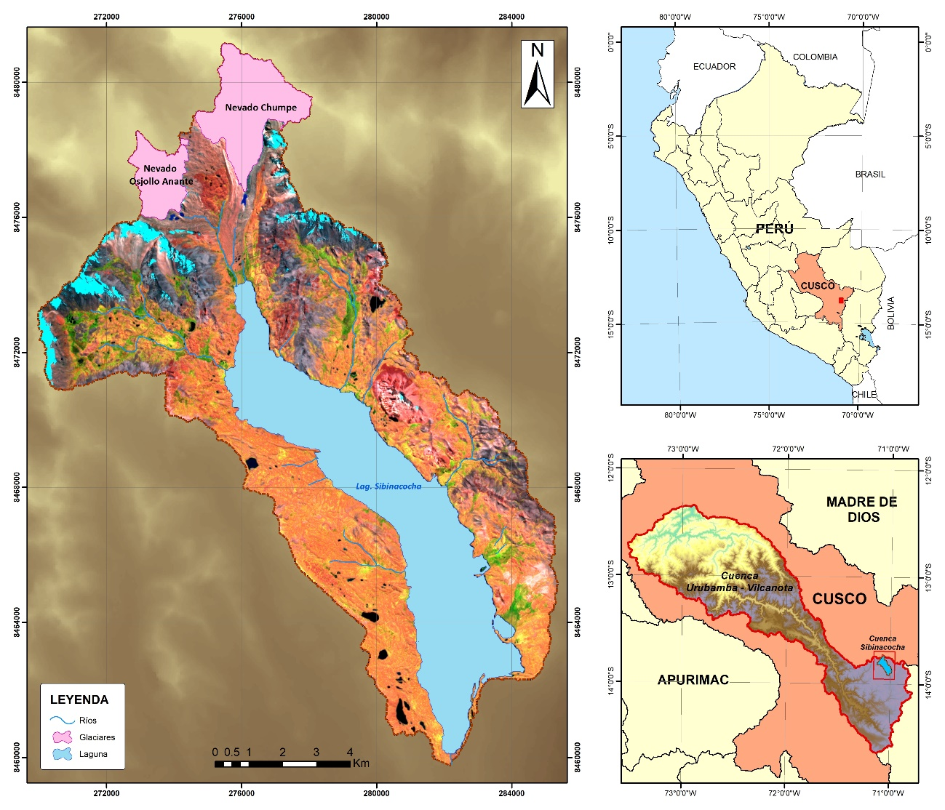
AIMS
STUDY SITE
To determine the land cover changes on the ecosystems of Sibinacocha basin from 1984 to 2020.
To improve the understanding of the processes of land cover changes by Climate Change.
Notes:
Southest región of Peru, Cordillera Vilcanota
Above 4800 (forty eight hundred) masl

Slide 3
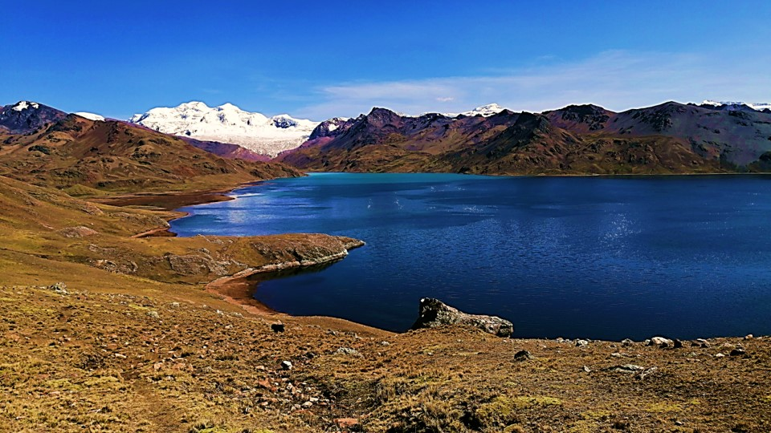
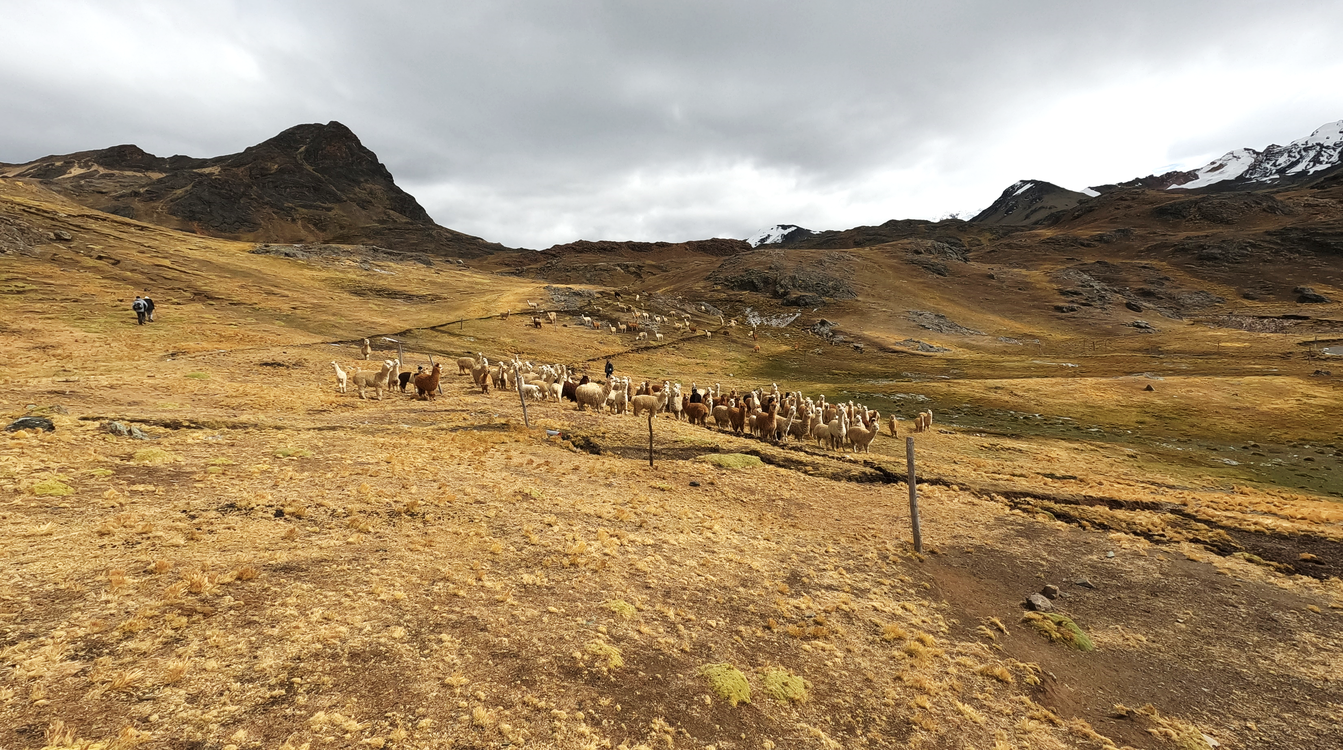
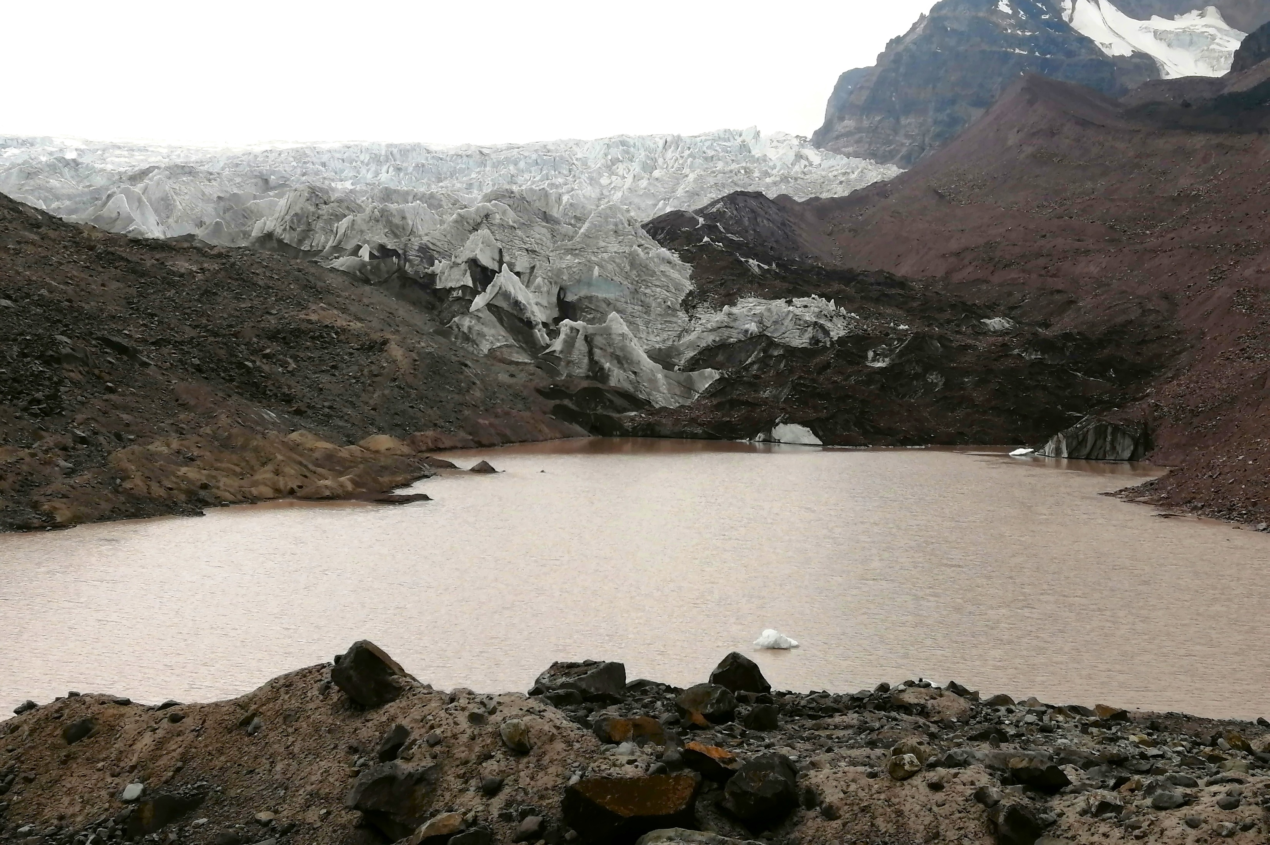
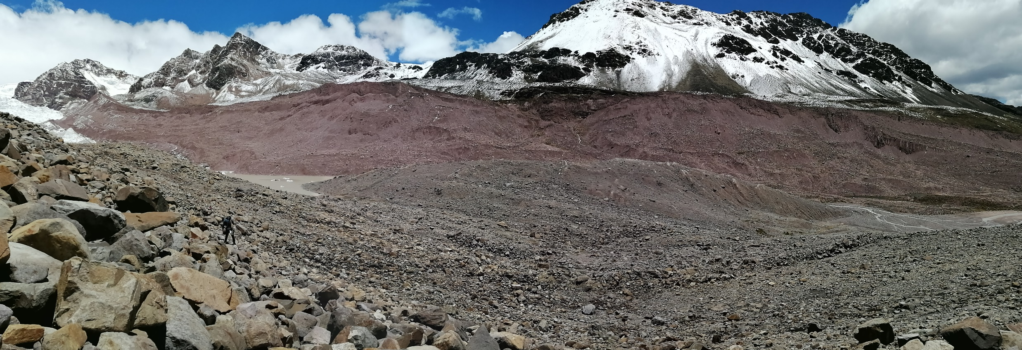
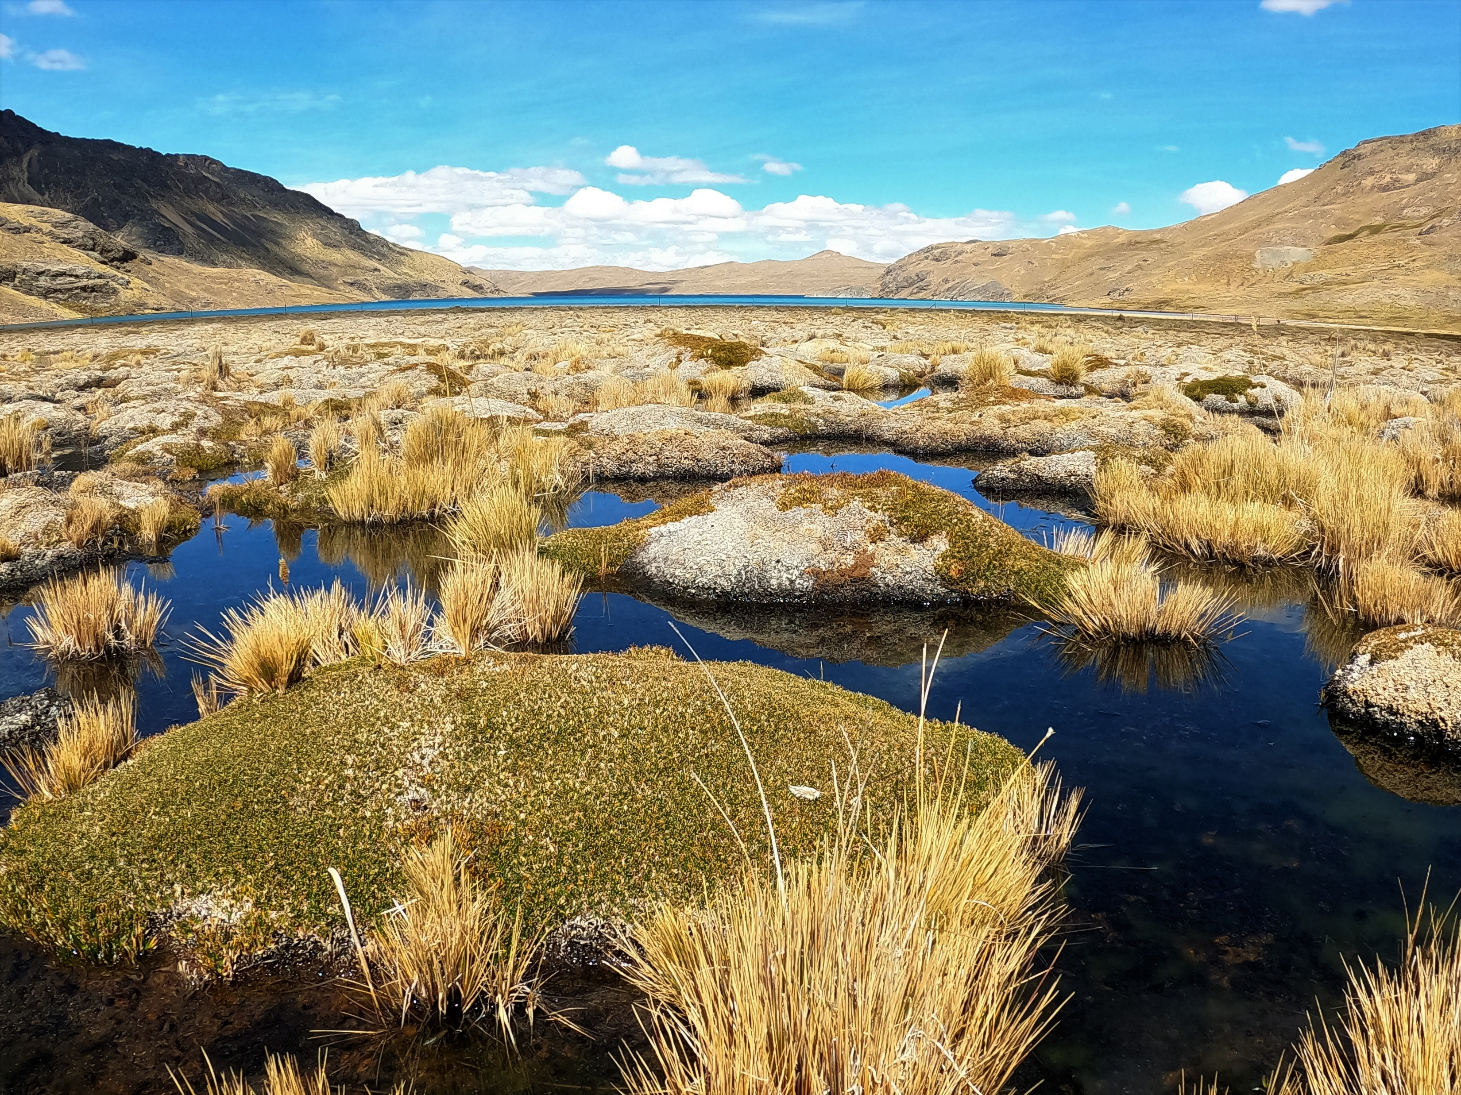
STUDY SITE
PASTURE
GLACIER
WATER
LOW VEGETATION
WETLAND

Slide 4

LAND COVER DATA
CLIMATE DATA
IMAGERY COLLECTION
SAMPLE
POINTS
WRF (Weather Research Forecast) model downscaled.
Outputs compared and bias-corrected with local metherogolical stations.
200 meters resolutions and a daily register.
Maximum, medium, minimum Temperature, and Precipitation.
NDSI
NDWI
Glacier
Pastures
CRITERIAS
Water
NDVI
EVI2
LAND COVER ECOSYSTEMS
Low Vegetation
SAVI
Slope
Wetlands
RANDOM FOREST
MODEL
GIS
&
VALIDATION
Land cover ecosystems classification 1984 - 2020
Notes:
Analysis months: Abril – August (after rainy season).
Cloud Cover: Under 20%

Slide 5
RESULTS

Slide 6
ECOSYSTEM CHANGES
Notes:
Under the premise of :
Climate change affects over high mountain ecosystems, where these could suffer alterations due to glacial loss and its effect on the hydrological cycle. (Uribe, 2015)
We priorize the glaciers as the main control for ecossytems in a landscape context

Slide 7
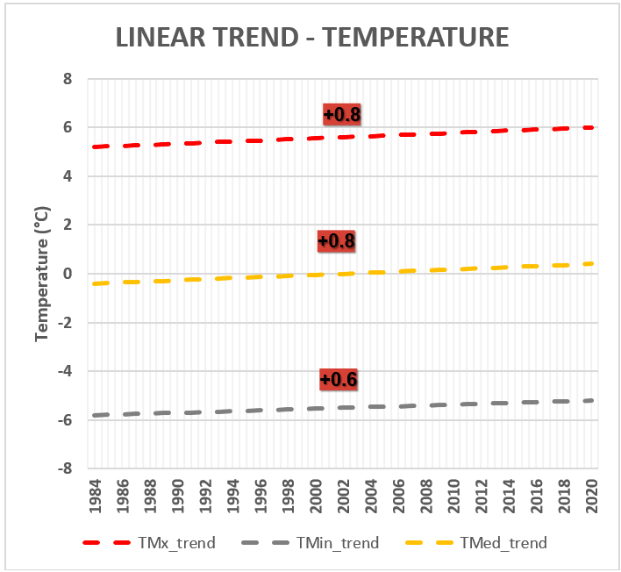
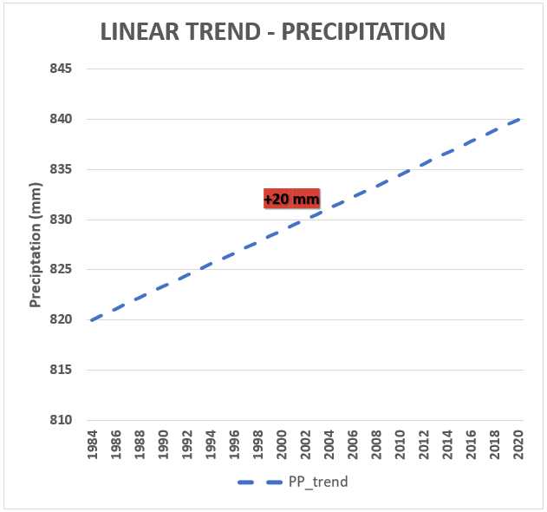
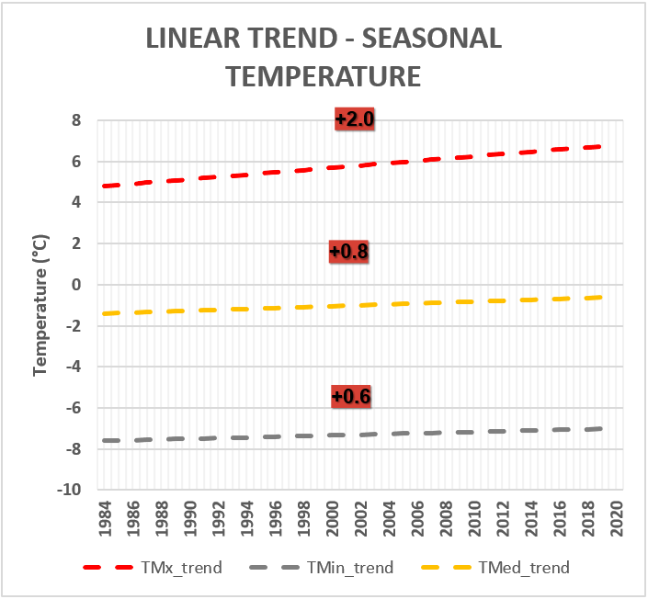
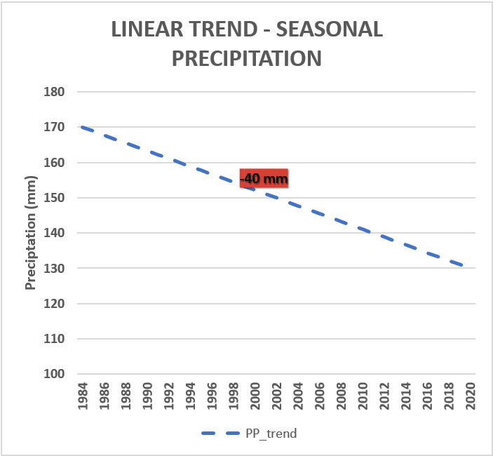
CLIMATE CHANGES
ANNUAL
JAN
FEB
MAR
APR
MAY
JUN
JUL
AUG
SEP
OCT
NOV
DEC
SEASONAL
(APRIL – AUGUST)
Notes:
Changes on Tmax
All temperaturas postive change
Anual PP increase
Seasonal PP decrease
GENERAL ANALYSIS

Slide 8
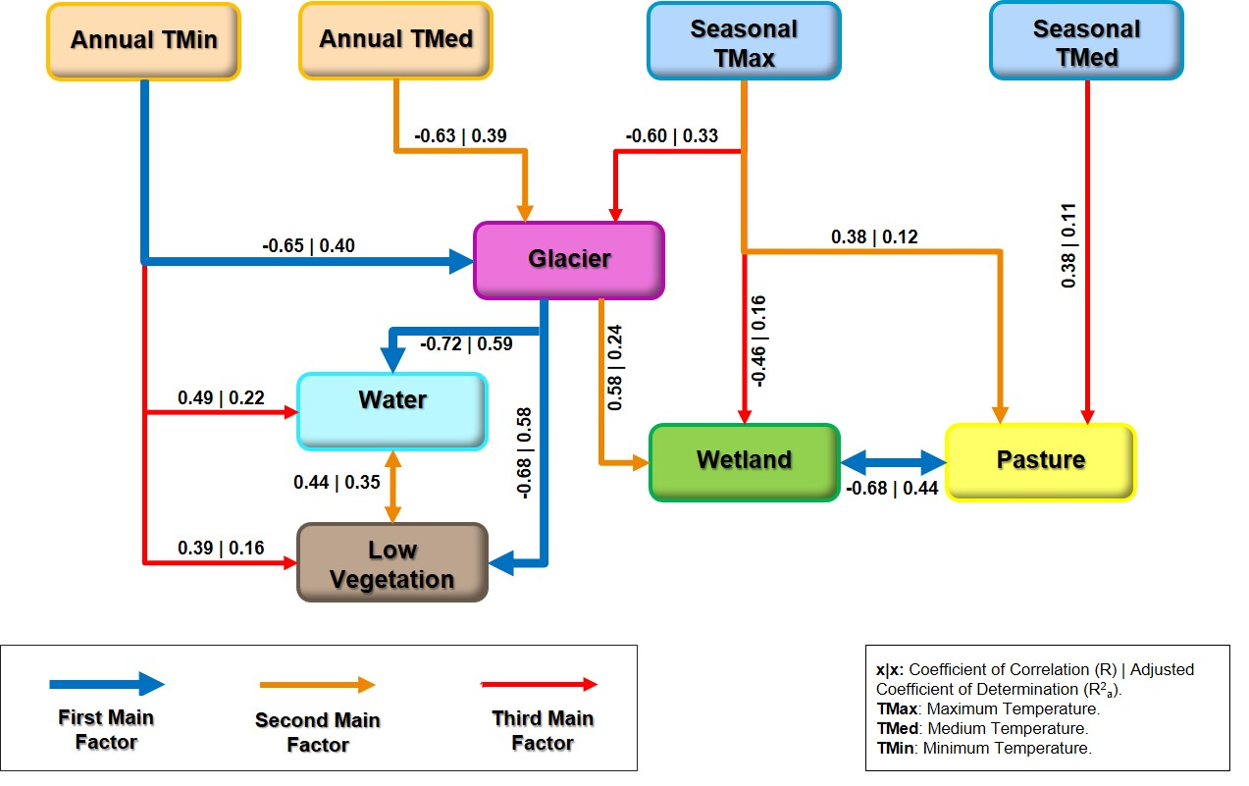
CORRELATION ANALYSIS – CLIMATE AND ECOSYSTEMS
Notes:
Application of Coefficient of Correlation and Coefficient of Determination Adjusted

Slide 9
SUMMARY
The land cover changes on the ecosystems of Sibinacocha using Random Forest through Google Earth Engine has a Kappa Coefficient 0.97.
Glaciers and wetlands are the most affected ecosystems (-35% and -17%), and .
Increase in Annual Tmax (+0.8°C), and decrease in Seasonal Precipitation (-40mm).
Using regression and correlation analysis, explains that ecosystems are responding to a external factors such as warming climate and accelerated glacier retreat.
Notes:
The land cover changes on the ecosystems of Sibinacocha has a good classification using Random Forest and through Google Earth Engine with a Kappa Coefficient 0.97.
- Respectivilly
- Mention “In Sibinacocha”

Slide 10
ACKNOWLEDGEMENTS
FONDECYT: Fondo Nacional de Desarrollo Científico, Tecnológico y de Innovación Tecnológica.
Newton Fund
NERC funding.

