Slide 1




MOBILITY AND HAZARD ANALYSIS OF SELECTED LANDSLIDES IN LOWER AUSTRIA
Maria Isabel Arango^{3,1}, Pedro Lima¹ , Martin Mergilli², Thomas Glade¹
¹ Department of Geography and Regional Research, University of Vienna, Austria
² Institute of Geography and Regional Science, University of Graz, Graz, Austria
³ Institute of Environmental Sciences and Geography University of Potsdam, Potsdam, Germany
Corresponding author’s email: thomas.glade@univie.ac.at

Slide 2
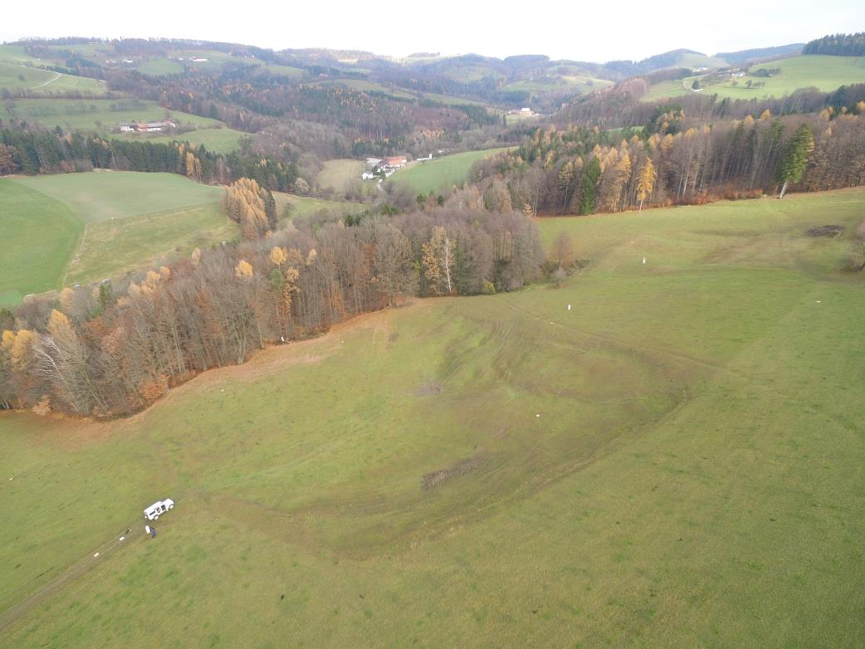
INTRODUCTION AND OBJECTIVES
Evaluate potential mobility of mass movements at three selected locations in Lower Austria.
Physically-based model
Scenario-based
Notes:
Landslide processes are very diverse, and may be shallow or deep, slow, or fast, with translational or rotational movements and sometimes can evolve in a compound nature, with a single event behaving in different ways along time or space. Under certain internal and external conditions, slow-moving landslides can increase their speed, becoming flows with a large mobility range and destructive energy.
Methods for creating regional-scale landslide hazard maps don’t represent the diversity of this type of process, nor the different stages of land sliding sub-processes, like failure, movement, and deposition area. Achieving reliable hazard maps concerning concrete gravitational mass movements that account for their behaviour during mobilization still faces significant challenges.
These models are then able to consider/predict the landslide release, runout extent and also its depositional area based on the terrain geotechnical properties.
The central aim of this research project is to evaluate the mobility and risk of mass movements at three selected locations in Lower Austria. For this purpose, physically-based models are used to visualize the extent of events based on different scenarios and quantify their expected damages. The final goal is the creation of hazard maps on a scale of 1: 2,000–1: 5000, including information on potential frequencies and magnitudes for different ranges, the assessment of the potential impact on society and the evaluation of the corresponding uncertainties as well as recommendations for handling and the possible uses of the hazard maps.

Slide 3
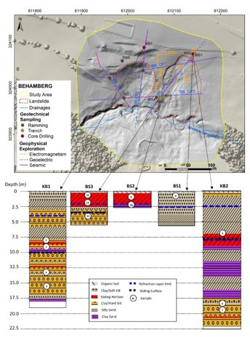
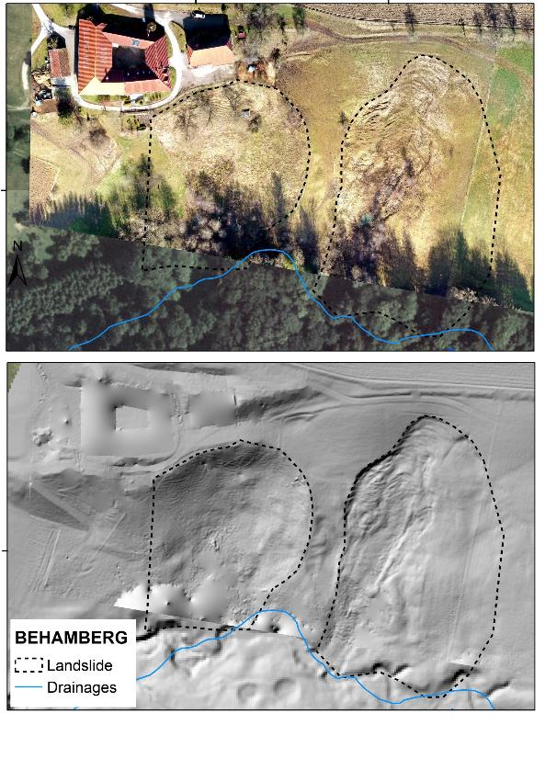
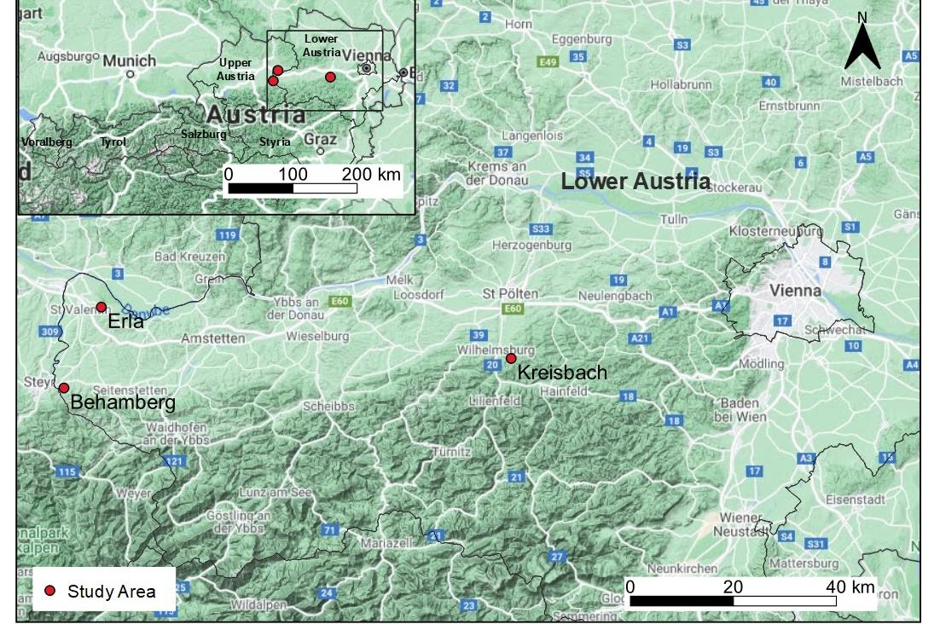
STUDY AREAS
Notes:
The selected landslides are located in the lower Austria state (Niederösterreich), in the region corresponding to the lower Austrian Alpine Foreland, between the northern foothills of the Alps in the South and the Danube River in the North. This region is characterized by gentle to hilly terrains created by soft, non-consolidated sediments. The natural conditions of the area, like the gentle slopes, good and fertile soils, and sufficient water availability, make it very suitable for agriculture, cattle raising, urbanization and road construction.
The alpine foothills correspond to the molasse zone, a geological unit constituted by a sequence of over 4 Km of Late Eocene to Middle Miocene detrital sediments, product of the erosion of the arising Alps in the South. To the South, the molasse zone is in faulted contact with the Flysh zone, an east-west trending belt with sediments from the Cretaceous and Paleogene, mostly marls and sandstones (Janoschek & Matura, 1980).

Slide 4

MODELLING
r.avaflow:
Open-source, GIS- and physically-based model and computational framework for routing flowing or moving masses from a defined release area to a deposition area.
One- and two-phase mass flow models for the solid and fluid components separately but simultaneously (Mergili, Fischer, Krenn, & Pudasaini, 2017).
Study areas: fine-grained (viscoplastic, frictional and viscous behaviour). For each sub-scenario, two parameters were modified to either simulate a flow or sliding process:
Kinematic Viscosity
Modelling time
Notes:
r.avaflow:
Open-source, GIS- and physically-based model and computational framework for routing flowing or moving masses from a defined release area to a deposition area.
One- and two-phase mass flow models for the solid and fluid components separately but simultaneously.
Considers the relationships between the solid and liquid phases in processes like entrainment, stopping and deposition.
Inputs: DTM of basal surface, spatial distribution of the release masses, depth and flow parameters (number of phases to be considered, their density, friction and viscosity)
Outputs: Flow height, flow velocity, pressure and kinetic energy, and changes in the basal topography (Mergili, Fischer, Krenn, & Pudasaini, 2017).
Study areas: fine-grained (viscoplastic, frictional and viscous behaviour). For each sub-scenario, two parameters were modified to either simulate a flow or sliding process:
Kinematic Viscosity:.
Modelling time

Slide 5
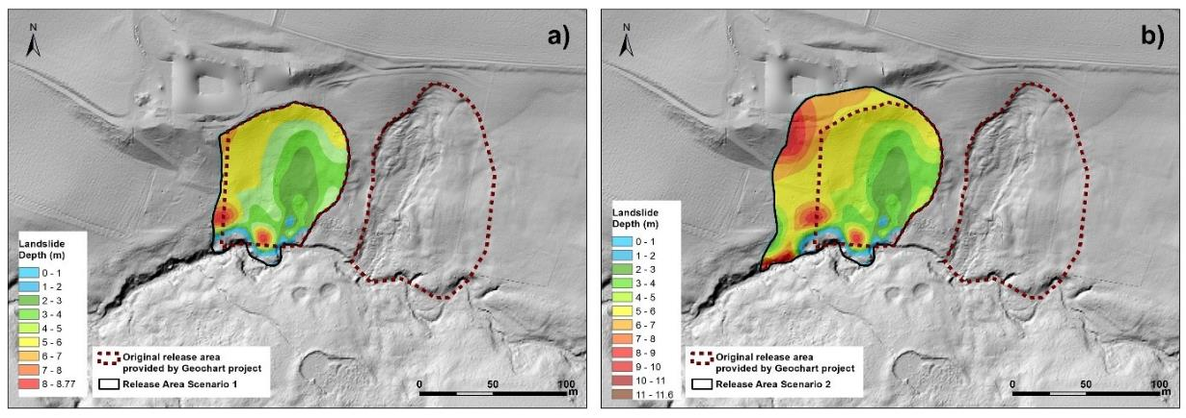
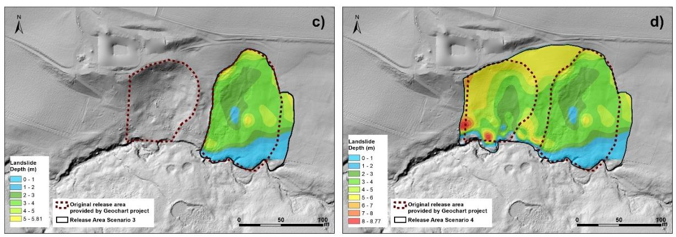
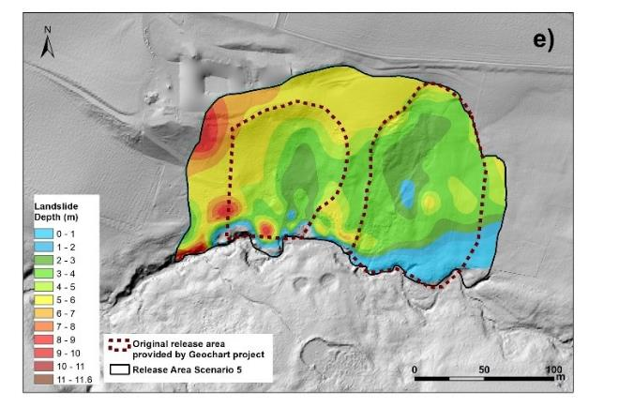
MODELLING SCENARIOS

Slide 6
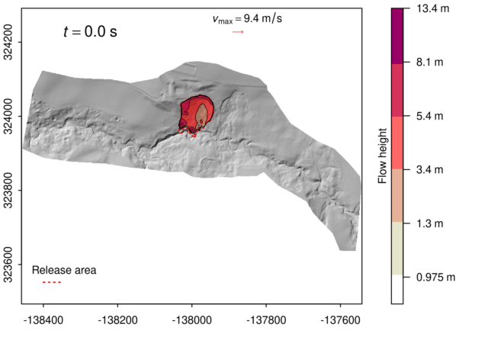
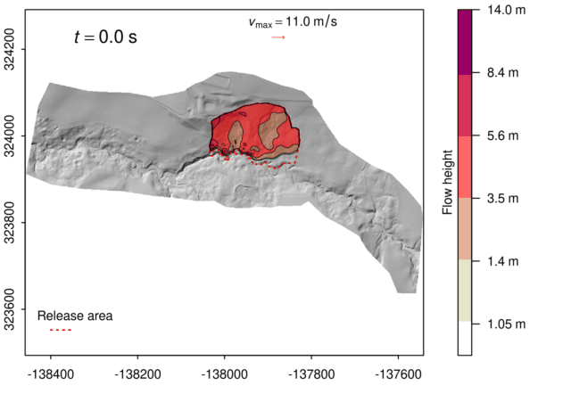
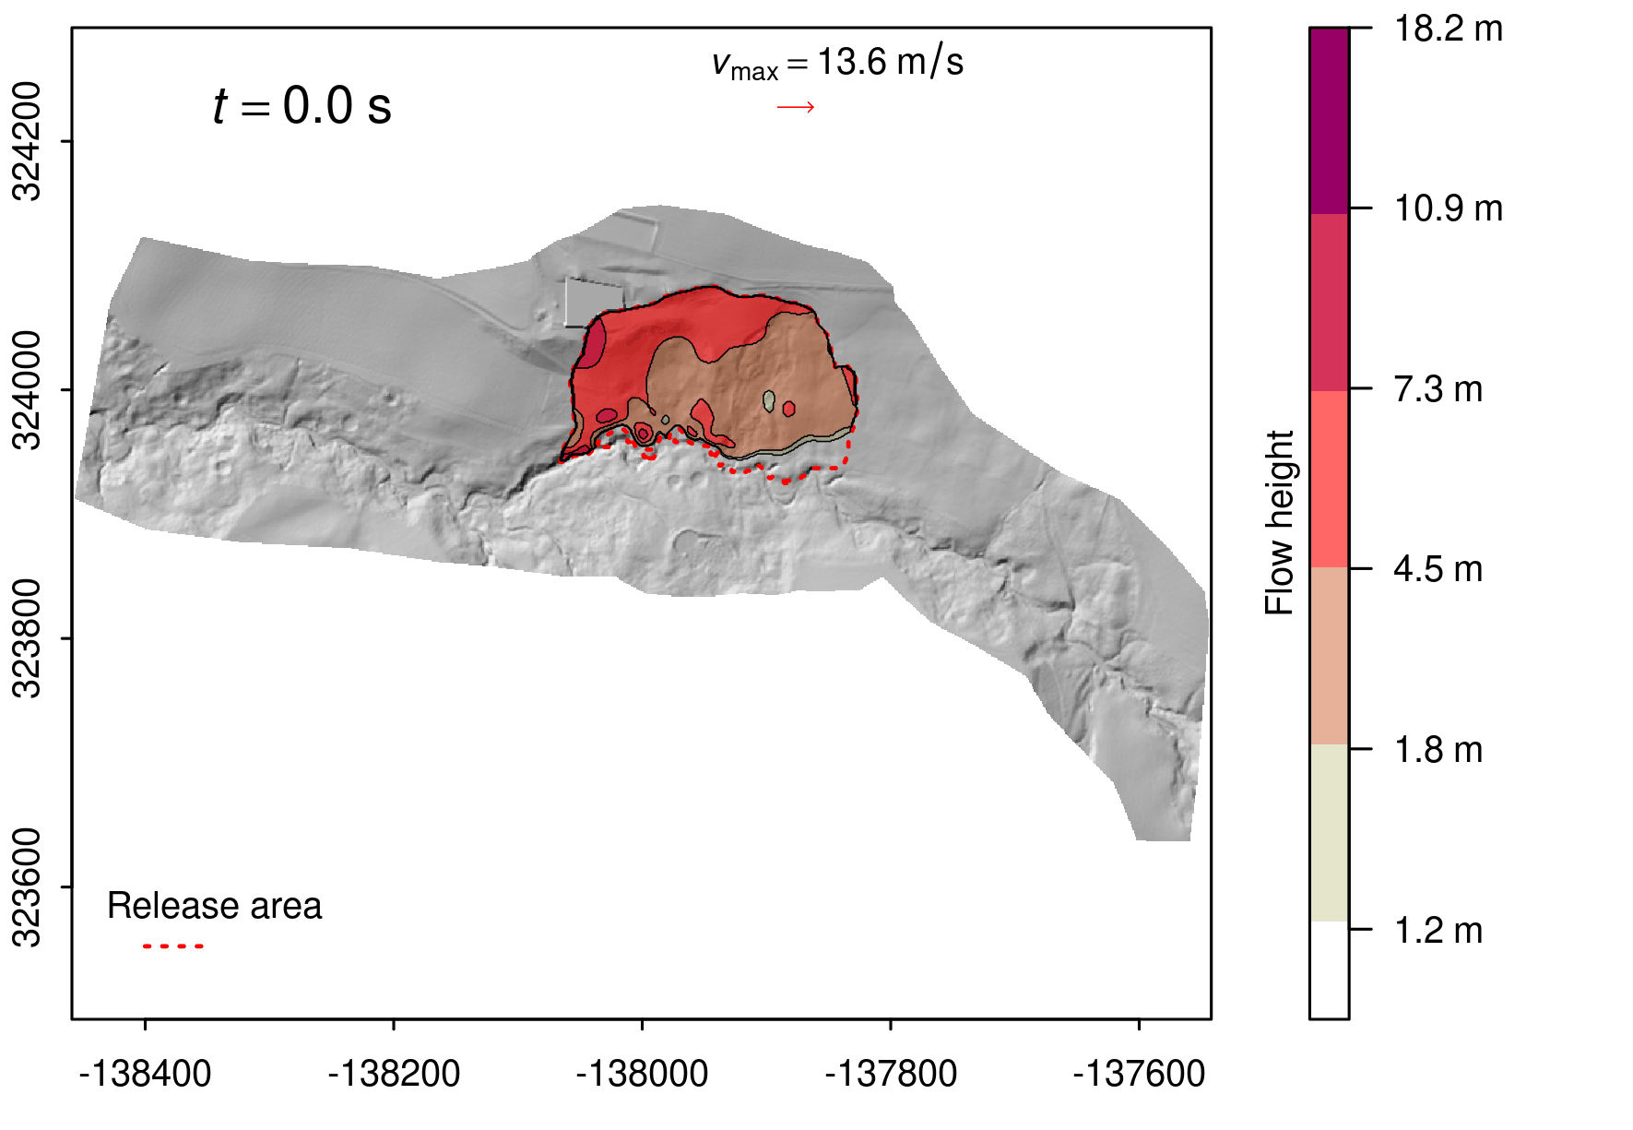
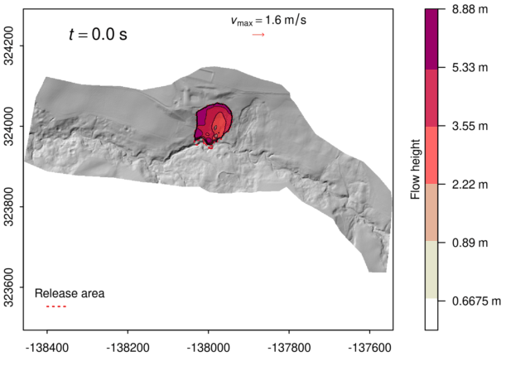
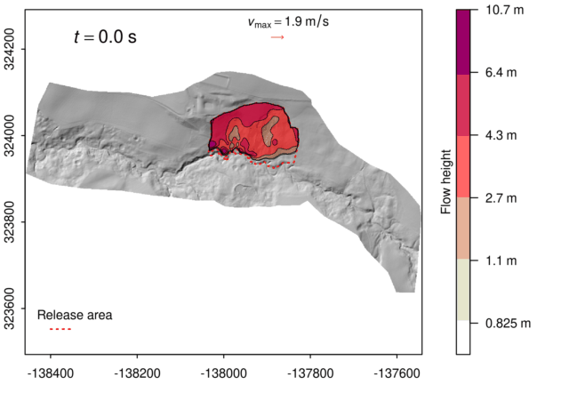

RESULTS
Flow
Slide

Slide 7
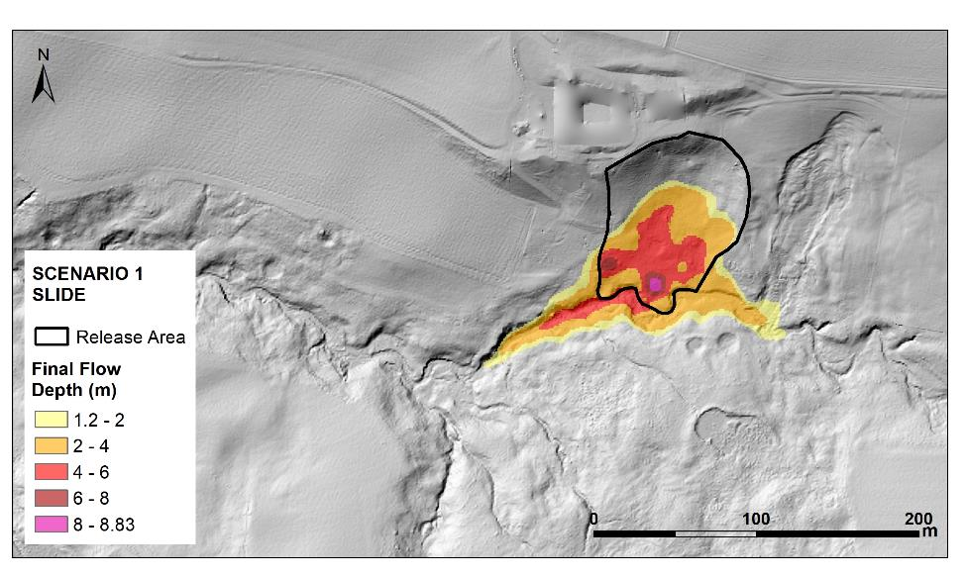
KEY POINTS
Reliable Hazard maps: different stages and types of landslides
Models like r.avaflow are very useful to simulate landslide runout
Scenario-based modelling accounts for uncertainties for better decision making

Slide 8
THANK YOU
Contact: maria.arango.carmona@uni-potsdam.de

