Slide 1


A Graph-based Fractality Index to Characterize Complexity of Urban Form Using Deep Graph Convolutional Neural Networks
Lei Ma
5/24/2022
Notes:
Hello, everyone. My name is Lei Ma.

Slide 2
Outline
Complexity of urban forms
Fractals
Deep Graph Convolutional Neural Networks (DGCNN)
Graph-based Fractality Index (GFI):
A Hybrid of Fractals and DGCNN
Results: complexity of building groups in London
Take-away messages

Slide 3
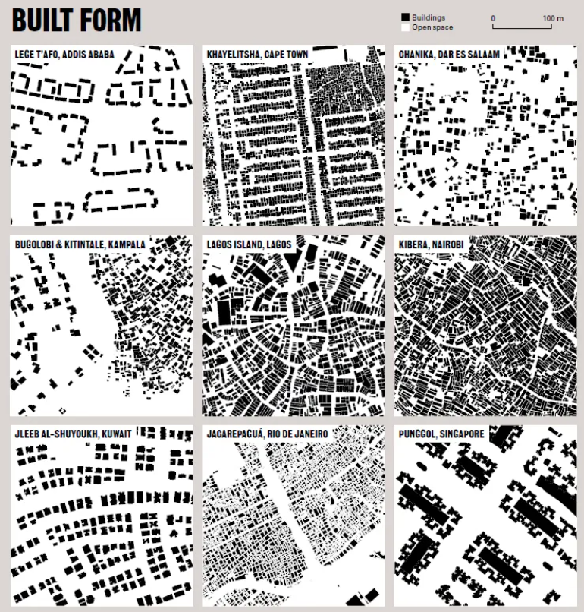
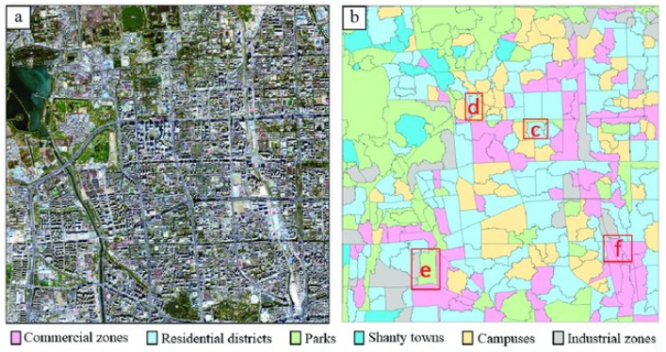
Complexity of urban forms
Complexity of urban forms: to indicate how complex do the urban features, e.g., building groups, distribute in the space?
Why the complexity matters? Evidence of human activities; Urban expansion; functional zones; social, economic, and environmental effects; livability and walkability; image of cities
How to indicate the complexity of urban forms?
https://lsecities.net/archives/delivering-housing-for-all-conversations-from-2018-urban-age/
DOI:10.3390/rs10020281
Notes:
Why does the complexity matter? As we know, the phenomena such as buildings, streets or any other artificial targets on the ground are the evidence of our human activities. Especially in the context of urban scenario,
It is also closely related to the livability and walkability towards the people living in this area, as well as the images of cities in our mind.

Slide 4
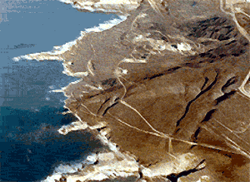
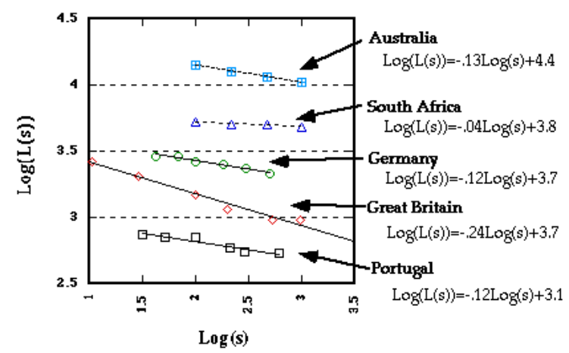
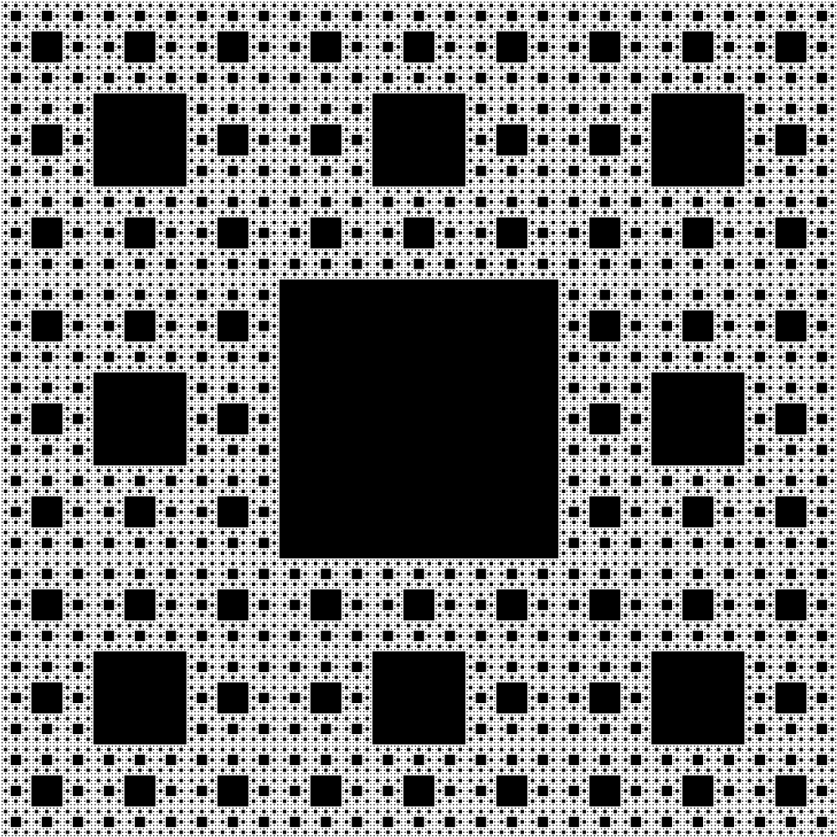
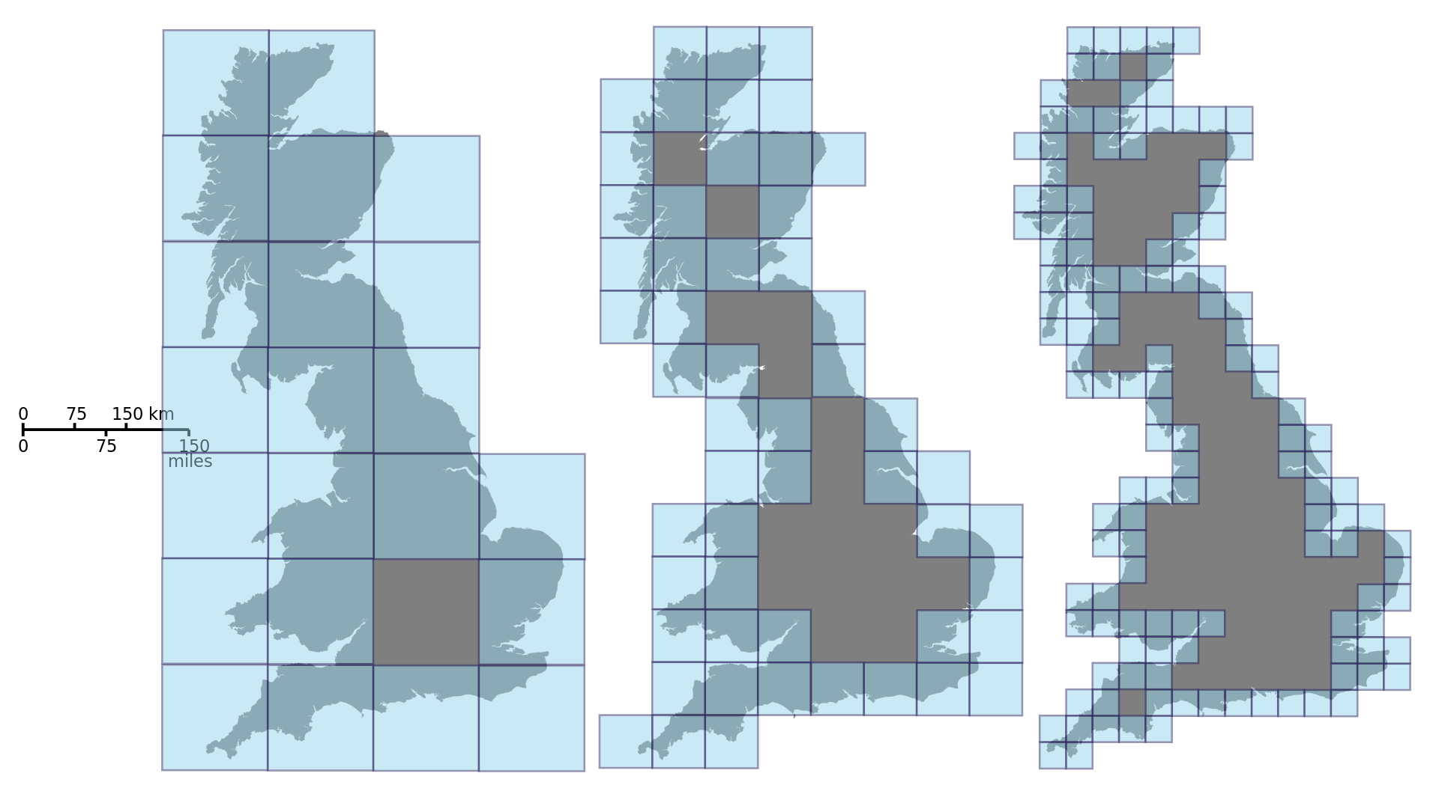
Fractals
Features of a complex phenomenon:
many details in many scales;
self-similarity ~ scale free;
heterogeneity ~ many small details and few large ones
Fractals
  are infinitely complex patterns that are self-similar across different scales;
  are created by repeating a simple process over and over in an ongoing feedback loop.
Index: fractal dimension (FD)/ Ht/ CRG index
  FD of Sierpinski carpet:
  1.89
Coastlines
https://giphy.com/gifs/loop-endless-orVa44Oav5WoF1LVOE
Sierpinski carpet
Notes:
Basically, there are three features of a complex target, including that there are many details in many scales, the patterns in small scales are similar to those in big scales, and the property of heterogeneity which means there are many small details and few large ones. Those features can be well described by a conceptual model called fractals. … Fractals are infinitely complex patterns that are self-similar across different scales… Here are two typical fractal patterns: the first one is fractal coastlines in natural phenomena and the second one is a pure conceptual fractal pattern called Sierpinski carpet. To date, there are basically three indicators to describe the complexity of fractals including the fractal dimension, Ht index and CRG index. I’m not going to deeper their details, but they all have similar problems.

Slide 5
Fractals
Problems:
  Statistical not spatial distribution of complex targets;
  Univariate; High-dimensional & non-linear spatial complexities
To solve those problems:
  Let the machine to learn the complex patterns and set a fractal pattern, Sierpinski carpet, as targets to compare with;
  Synthesize training dataset based on fractal patterns with randomness mechanisms
Coastlines
https://giphy.com/gifs/loop-endless-orVa44Oav5WoF1LVOE
Sierpinski carpet
Notes:
They are all describing the statistical rather than spatial distribution of the complex targets, and they are all univariate which means they cannot handle high-dimensional and non-linear spatial complexities.

Slide 6
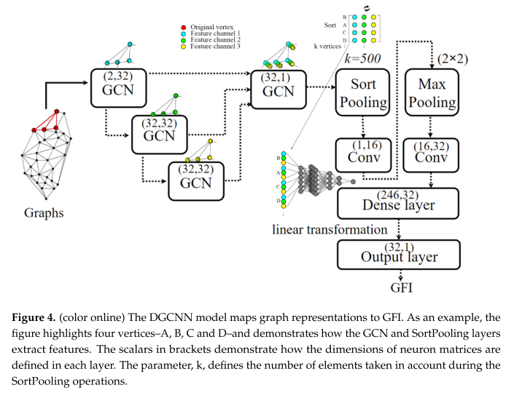
Deep Graph Convolutional Neural Networks (DGCNN)
DGCNN‘s advantages:
Convolutional operations to learn patterns in both small and big scales
Good at differentiating heterogeneity distribution
Zhang, M.; Cui, Z.; Neumann, M.; Chen, Y. An end-to-end deep learning architecture for graph classification. In Proceedings of
the Thirty-Second AAAI Conference on Artificial Intelligence, New Orleans, LA, USA, 2–7 February 2018; pp. 4438–4445.
Notes:
Here we implement the full-size DGCNN model which was proposed in 2018. It has two advantages: the first one is that it apply convolutional operations to learn patterns in both small and big scales, and second one is that it good at differentiating heterogeneity distributions thanks to the Sort Pooling layer they proposed.

Slide 7
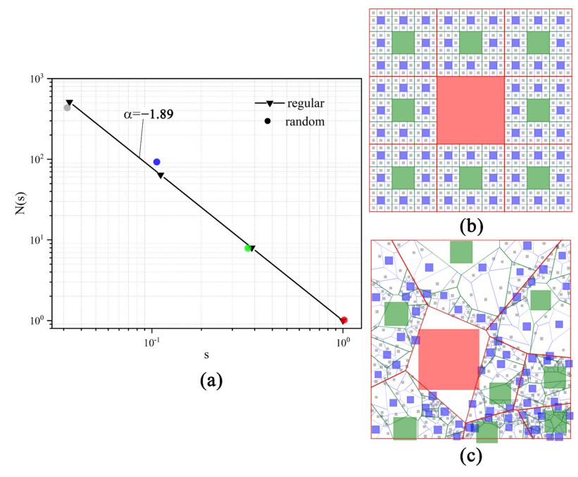
A Hybrid of Fractals and DGCNN:
Graph-based Fractality Index (GFI)
Synthetic dataset: Sierpinski carpet pattern + Randomness (statistically and spatially)

Slide 8
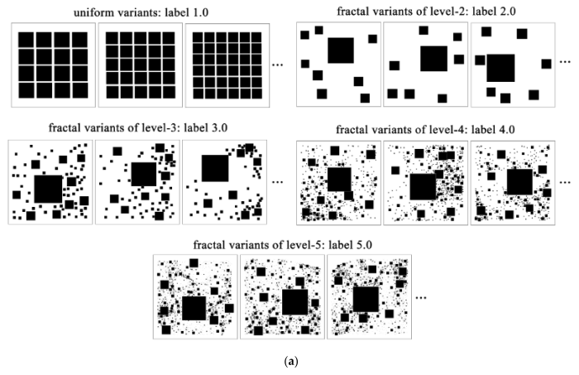

A Hybrid of Fractals and DGCNN:
Graph-based Fractality Index (GFI)
Training dataset: Sierpinski carpet pattern + Randomness

Slide 9
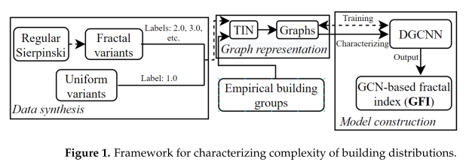
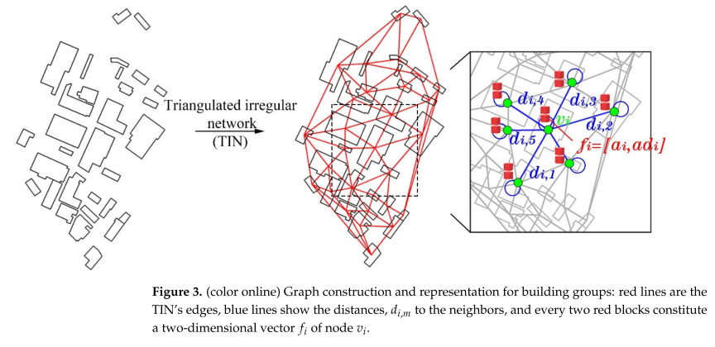
A Hybrid of Fractals and DGCNN:
Graph-based Fractality Index (GFI)
Notes:
Figure 3 show how the building groups are represented as graphs by the triangulated irregular networks.

Slide 10
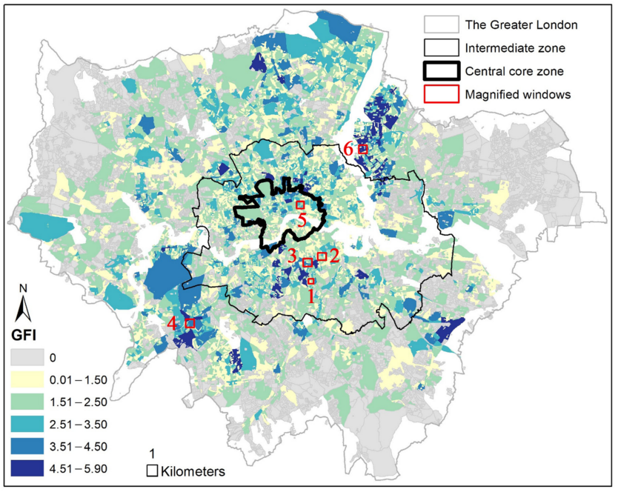
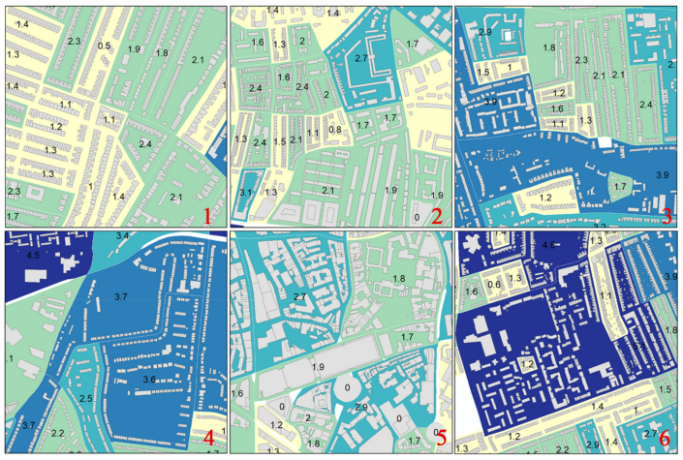
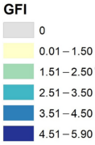
Results: complexity of building groups in London
Notes:
Here are some examples given GFI values to indicate the complexity of building groups in London.

Slide 11
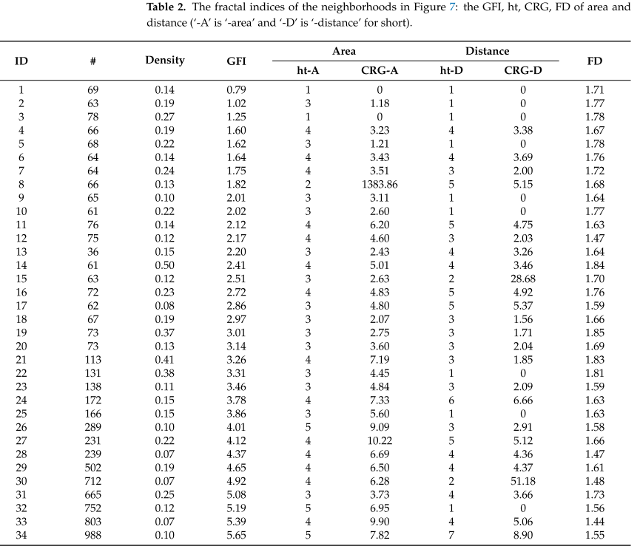
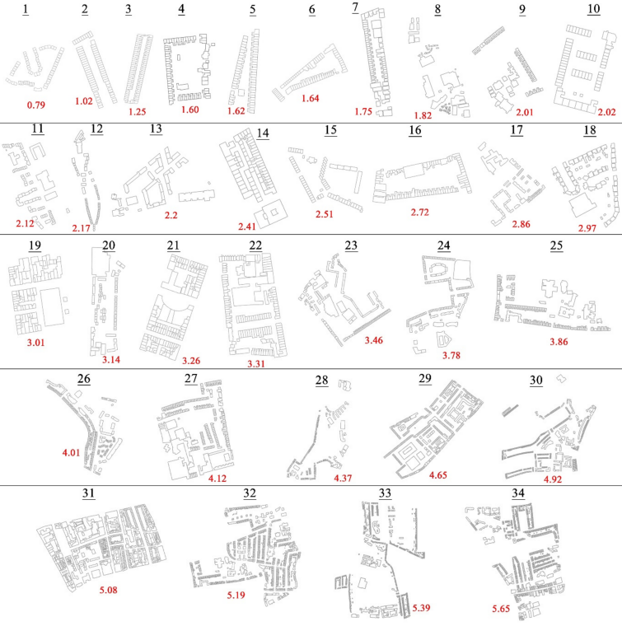
Results
Results: complexity of building groups in London
Ex. Building footprints in neighborhood labeled by GFI: from the simple uniforms
to complex fractals.

Slide 12
Take-away messages
The first attempt to take the advantages of deep learning models and fractal theories to solve the problem of complexity measurement;
This model can be extended to measure the complexity of high-dimensional targets with or without geospatial features like area and distance;
It is worthy to bridge theoretical and mathematical generated patterns with data-driven science under the current fourth GIScience paradigm.

Slide 13

Thank you for your attentions!
Ma, Lei, Stefan Seipel, Sven A. Brandt, and Ding Ma. 2022. "A New Graph-Based Fractality Index to Characterize Complexity of Urban Form" ISPRS International Journal of Geo-Information 11, no. 5: 287. https://doi.org/10.3390/ijgi11050287

