Slide 1
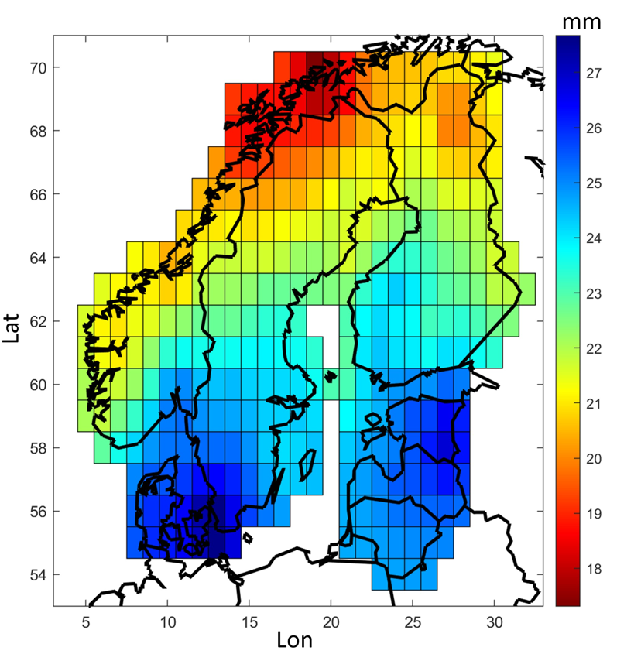
Rainfall extremes in the Nordic-Baltic region Jonas Olsson, Anita Verpe Dyrrdal, Erika Médus, Svetlana Aniskeviča, Karsten Arnbjerg-Nielsen, Eirik Førland, Viktorija Mačiulytė, Antti Mäkelä, Piia Post, Søren Liedke Thorndahl and Lennart Wern from different institutes and universities in the Nordic-Baltic region

Slide 2

Objectives
Collection, compilation and quality assurance of observed rainfall extremes in the Nordic-Baltic region
Consistent spatio-temporal analyses of daily and sub-daily data sets
Provision of open data

Slide 3
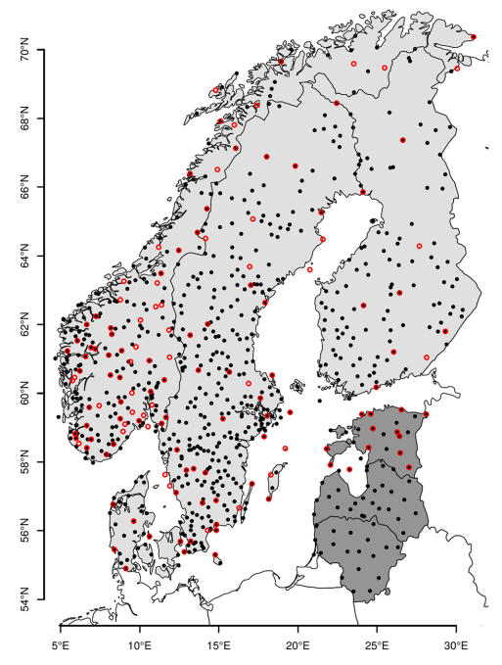

Daily data and analyses
Three data sets with daily annual maxima:
1969-2020: 724 stations
1901-2020: 138 stations
Records (maximum regardless of period): 5058 stations
Analyses:
Return levels
Time of maxima
Trends
Decadal variability
• Set 1
ο Set 2
Set 1 and 2

Slide 4
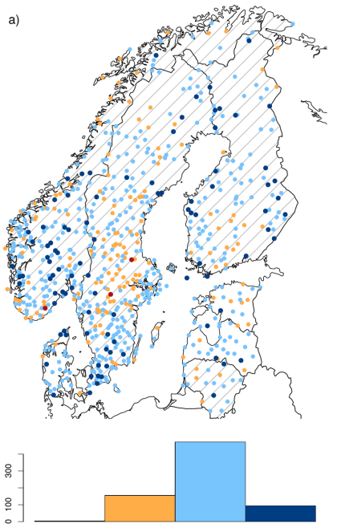

Daily result
Trend analysis of annual maxima (AM, Rx1d) by non-parametric Mann-Kendall
Period: 1969-2020
Predominantly positive trends
Positive hot spot: central NO
Negitive hot spot: central SE

Slide 5
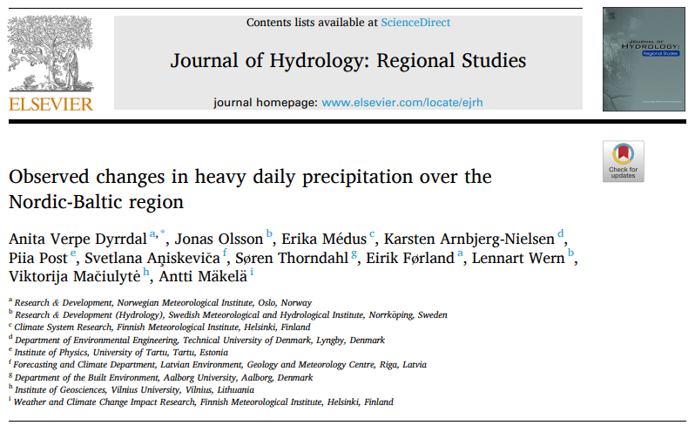
Daily paper
Dyrrdal et al., 2021:
Annual maximum daily precipitation for the Nordic-Baltic countries [data set]. NIRD Research Data Archive.
https://doi.org/10.11582/2020.00023

Slide 6
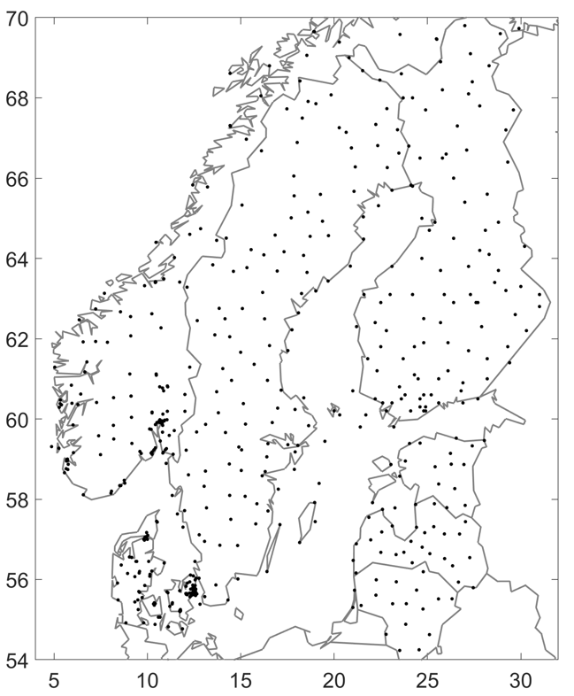
Sub-daily data and analyses
Three data sets with annual maxima for durations 1, 3, 6 and 12 h:
2000-2018: 370 stations
1981-2018: 47 stations (DK, NO)
Records (maximum regardless of period): 543 stations
Analyses
Return levels
Time of maxima
Geographical predictors
Trends

Slide 7
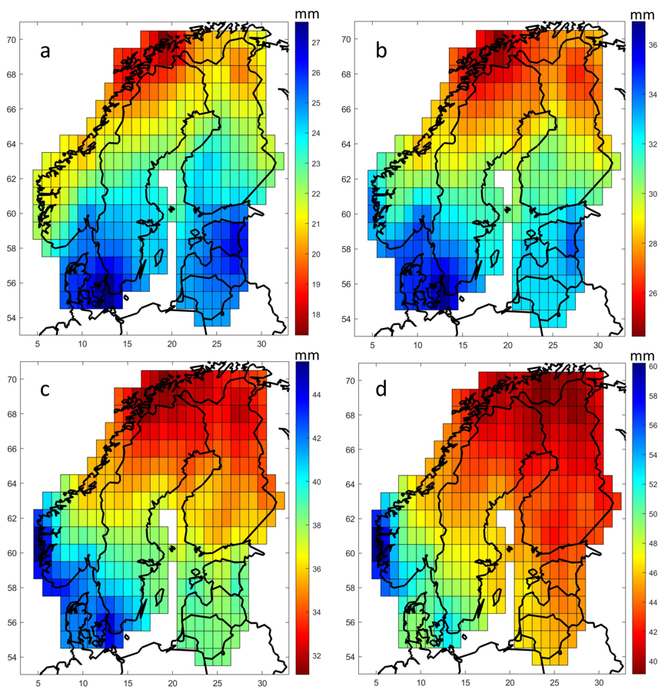
Sub-daily result
1 hour 3 hours
Extreme Value Analysis by AM/GEV at station level → 10-year return depth
Period: 1981-2018 (at least 11 years)
Gridding by inverse distance
Generally: A gradual change from a latitudinal dependence at 1 hour to a SW-NE pattern at 12 hours
6 hours 12 hours

Slide 8
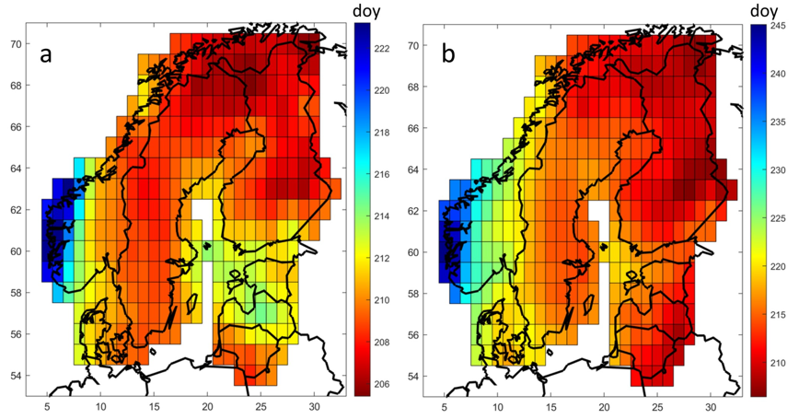
Sub-daily result
1 hour
Average Day of Year for the annual maximum
Gridding by inverse distance
Longitudinal dependence with some variations
12 hours

Slide 9
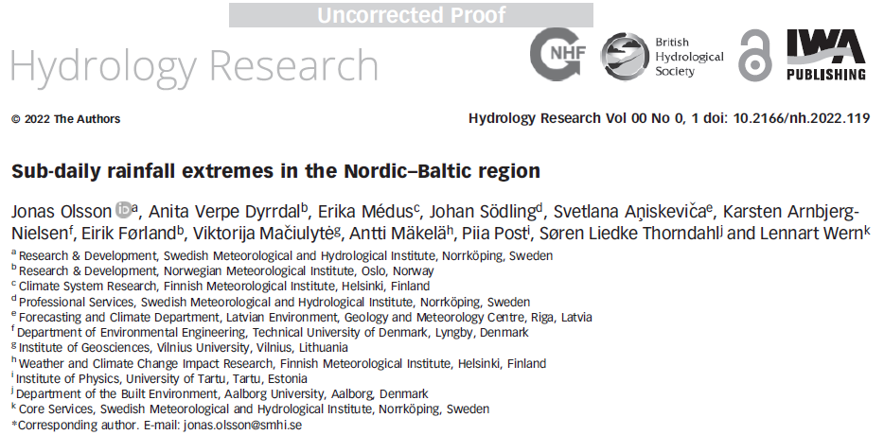
Sub-daily paper
Olsson et al., 2021:
Gridded return levels and maximum dates of short-duration rainfall extremes in the Nordic-Baltic region [data set]. NIRD Research Data Archive. https://doi.org/10.11582/2021.00094

Slide 10
Concluding remarks
Open data sets with daily annual maxima and sub-daily gridded characteristics
Spatio-temporal characterization and trends
Applications include climate model evaluation and regional harmonization
Thank you for listening!

