Slide 1







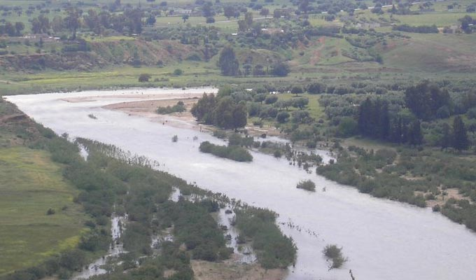
Climate change induced impacts on hydrological extremes at the catchment scale: case of Wadi Siliana (North western Tunisia)
Imen EL Ghoul
EGU session HS2.4.2 .Understanding and modelling hydrological
response under climate variability and change
23/05/2022

Slide 2



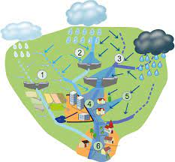
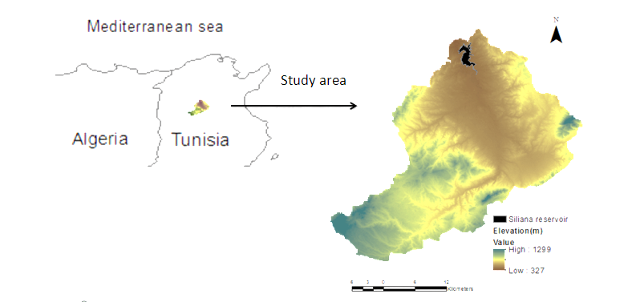
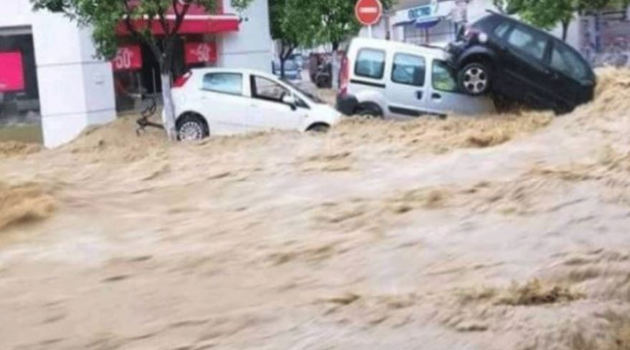
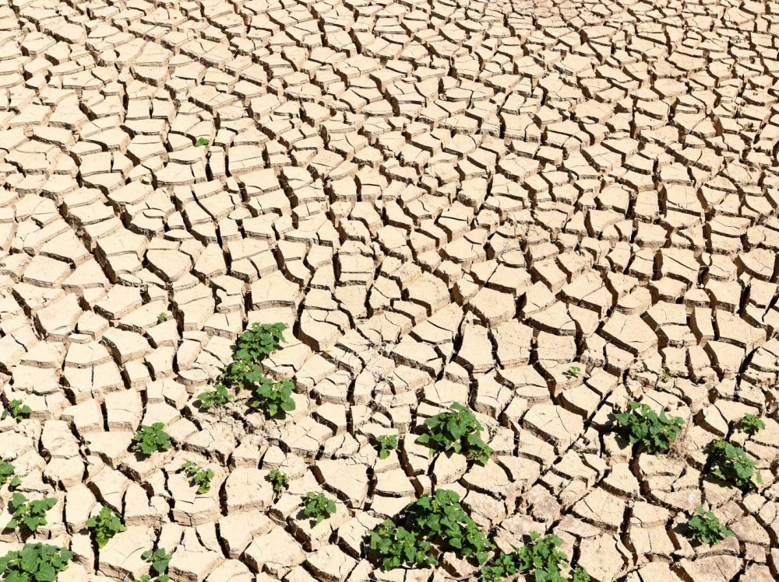
Context
Conclusion
Methodology
Results
Location: NW of Tunisia
Surface area: 1028 Km²
Annual precipitation is 580 mm/yr
1

Slide 3

Context
Methodology
Results
Conclusion
Hydrological modeling (SWAT,HBV)
Representative model of the basin response
Data collection
Swat simulation
Model calibration / validation
DEM
Land use map
Soil map
Meteorological data
Observed discharge
Climate change modeling
CORDEX data 11 km
Bias correction
Prediction of climate change scenarios
2
Notes:
Le modèle nécessite un ensemble spécifique de données d'entrée, y compris la topographie, Occupation de sol , type de sol et les données météorologiques, données climatiques.
Ces données seront utilisés pour l'exécution, l'étalonnage du modèle et la validation.

Slide 4
Context
Methodology
Methodology
Results
Conclusion
Projected change in monthly cumulative precipitation. Blue color is CME uncertainty intervals for the reference and future. Black line with squares refers to the CME mean .
Projected change in average monthly Temperature. Blue color is CME uncertainty intervals for the reference and future. Black line with squares refers to the CME mean values.
3

Slide 5
Context
Methodology
Results
Conclusion
FDCs as derived by the 6 models for the reference (Blue color) and the future (Pink color) periods for the Siliana catchment.
(a) CNRM-CERFACS-CNRM-CM5; (b) MPI-M-MPI-ESM-LR; (c) NCC-NorESM1-M; (d) ICHEC-EC-EARTH&;(e) MPI-M-MPI-ESM-LR; (f) IPSL-IPSL-C
Relative Change of Low and High Flows for the six models.
(a) CNRM-CERFACS-CNRM-CM5; (b) MPI-M-MPI-ESM-LR; (c) NCC-NorESM1-M; (d) ICHEC-EC-EARTH&;(e) MPI-M-MPI-ESM-LR; (f) IPSL-IPSL-C
4

Slide 6
Contexte
Methodology
Results
Conclusion
low flow frequency is expected to increase significantly as well as a decrease of their magnitudes.
high flows frequency and magnitudes are both projected to a decrease which may lead to more critical situation of Siliana Basin with a frequent hydrological drought.
Projected changes in precipitation and temperature show:
Tendency to a decrease in precipitation across all the months, especially in summer
Tendency towards warmer conditions in the future
5

Slide 7

imen.elghoul@uclouvain,be

