Slide 1



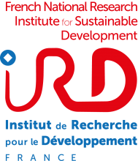


Recent changes in agrometeorological risks over the southern Mediterranean region, and its potential impacts on crop growth
Behnam Mirgol, Bastien Dieppois, Jessica Northey, Jonathan Eden, Lional Jarlan, Yves Tramblay, Gil Mahé

Slide 2
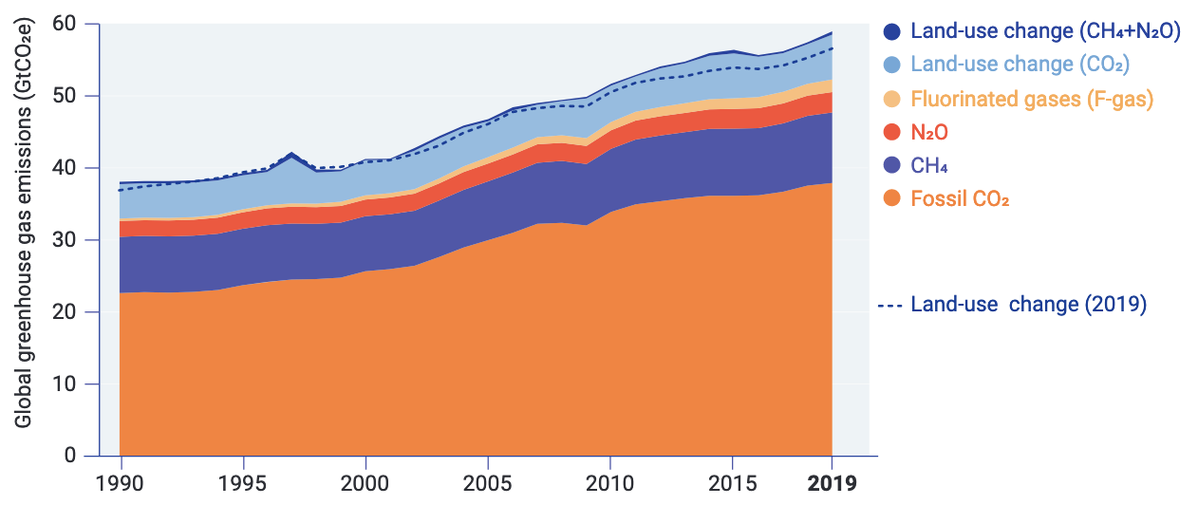
Introduction
The volume of greenhouse gas emissions has increased over the last decades, and this has an impact on regional climate patterns.
To date, the Southern Mediterranean region has received much less attention.
Agriculture sector strongly depends on climate, and climate change through altering crop growth period, photosynthesis procedure, etc., affects crop productivity.
Fig 1. Trends of global greenhouse gases emission in the atmosphere over the last decades
(Source: United Nations Environment Programme, 2020)

Slide 3
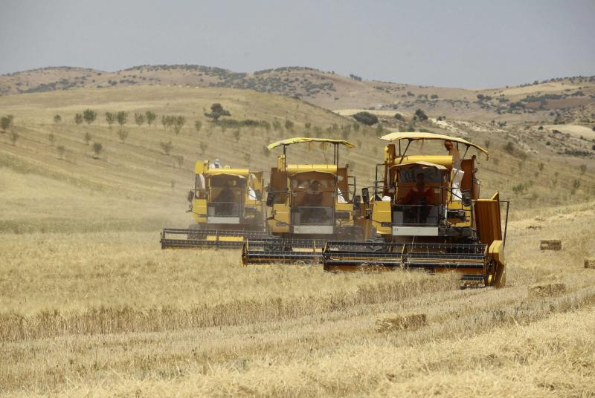
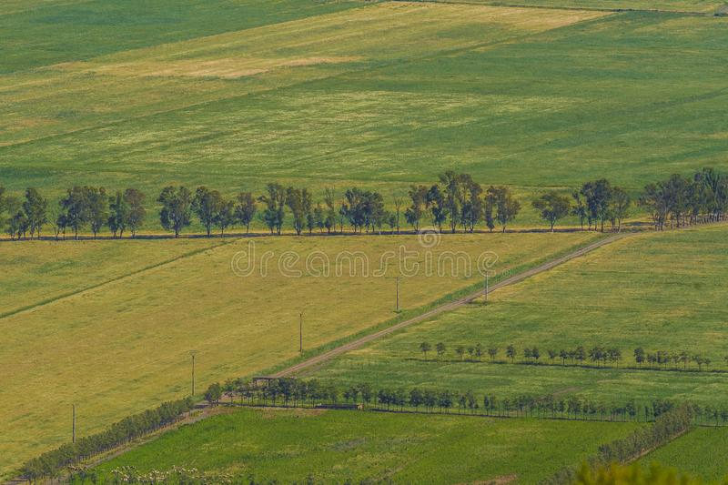
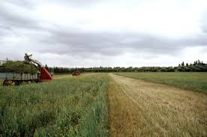
Introduction
The southern Mediterranean region is considered as one of the most vulnerable regions to climate change.
Agriculture plays an undeniable role in the region's local economies, which have been affected by climate change.
Thus, evaluation of the historical changes in agrometeorological risks can:
i) highlight the most affected areas by climate change.
ii) provides vital evidence for adaptation and mitigation plans in the region

Slide 4
70-year trend in ERA5-land
Annual mean temperature trend
In the last 70 years, ERA5-land shows a significant warming trend over the entire region.
During the same period, ERA5-land also shows a negative trend in precipitation over Morocco, and a positive trend northeastern Algeria and Tunisia.
Annual precipitation trend
Fig 2. Trends of annual mean temperature and precipitation
in the southern Mediterranean region in ERA5-land (1950-2019). Trend intensity are estimated using the Sen’s slope. Contours indicate regions where the Mann-Kendall trend analysis was significant at p=0.1.

Slide 5
20-year trend in ERA5-land
Annual mean temperature trend
In the last 20 years, most of the areas experienced upward trends in annual mean temperature, but negative trends are found over the South Morocco, Algeria and Southeast Libya (Desert regions).
Meanwhile, northern regions of Morocco, Algeria, Tunisia, Libya and Egypt show a positive trend in precipitation
As farmlands are mostly located in the northern parts of the region, more precipitation and rising temperature could influence crop productivity.
Annual precipitation trend
Fig 3. Trends of annual mean temperature and precipitation
in the southern Mediterranean region in ERA5 land (2000-2019). Trend intensity are estimated using the Sen’s slope. Contours indicate regions where the Mann-Kendall trend analysis was significant at p=0.1.

Slide 6
Seasonal trends in SPI (ERA5-land)
DJF
JFM
FMA
In the last 20 years, the trend toward wetter conditions primarily affects the warm seasons (late spring and summer).
Most of the significant drying trends are in the Sahara Desert, which is an uncultivated region.
The west half of the region was wetter than the east one.
MAM
AMJ
MJJ
JJA
JAS
ASO
SON
OND
NDJ
Fig 3. Seasonal SPI trend analysis in ERA5-land between 2000 and 2019. Trend intensity are estimated using the Sen’s slope. Only regions where the Mann-Kendall trend analysis was significant at p=0.1 are shown.

Slide 7
Seasonal trends in SPEI (ERA5-land)
DJF
JFM
FMA
Accounting for the effect of evapotranspiration, we note that the trend toward wetter conditions becomes even more pronounced.
Same as SPI, the West half experienced wetter conditions than the east one.
MAM
AMJ
MJJ
JJA
JAS
ASO
SON
OND
NDJ
Fig 4. Seasonal SPEI trend analysis between 2000 and 2019. Trend intensity are estimated using the Sen’s slope. Only regions where the Mann-Kendall trend analysis was significant at p=0.1 are shown.

Slide 8
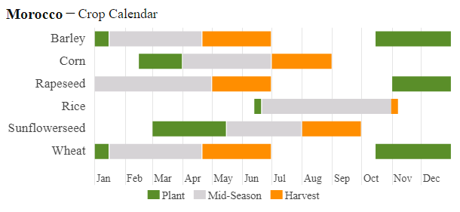
Potential impacts on crop productivity
https://ipad.fas.usda.gov
All the mentioned wetter/drier conditions and warmer/colder weathers can change crop growth periods, and then affect crop productivity.
Correlations between various phenological stages and agrometeorological indices can clarify more sensitive periods.

Slide 9
Summary
The cultivated regions (northern areas) experienced warming trends in both periods.
Significancy and intensity of the last 20-year analysis were more than 70-year one.
Warm seasons (late spring and summer) experienced wetting trends in SPI and SPEI indices.
As the discussed information were only based on the ERA5-land dataset, it is vital to be compared with other datasets such as REGEN, CRU, GPCC, weather stations, and satellite derived datasets (e.g., CHIRPS and PERSIAN) to have a reliable vision.

Slide 10
Thanks For your attentions

