Slide 1





Recovery of Te, Bi and W from mine tailings and concentrates using environmentally-benign Deep Eutectic Solvents at Björkdal Gold Mine, Sweden
Tritton LU¹, Jenkin GRT¹ and Smith DJ¹
¹University of Leicester, lt263@le.ac.uk
Notes:
Hi I’m Lara a first year PhD student from the University of Leicester and I’m going to be talking about the premise for and some early results for my PhD on the Recovery of tellurium tungsten and bismuth from mine tailings and concentrates using environmentally-benign Deep Eutectic Solvents at Björkdal Gold Mine, Sweden

Slide 2
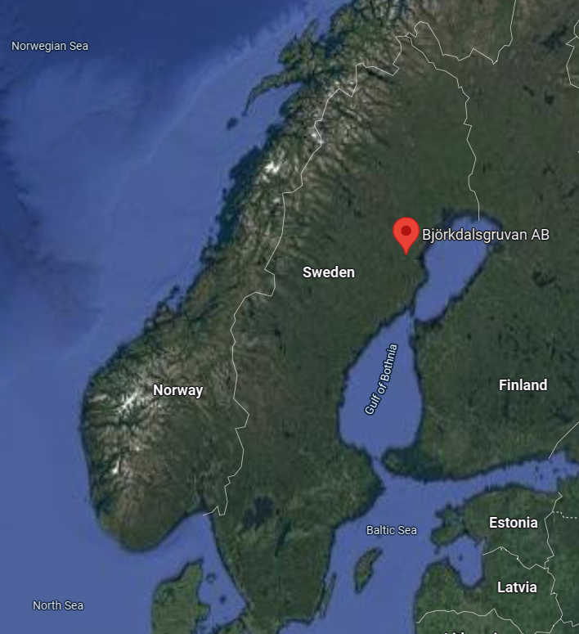
Aims and Overview
Björkdal Gold Mine is in the Skellefte Belt, Sweden, part of the Boliden Mining District, an orogenic gold deposit
Deposit also high in Te, W and Bi (mostly as tsumoite and scheelite) but these are not currently extracted, despite growing demand and need for these metals e.g.:
  Te - key component in Cd-Te solar cells (production of which is currently limited by Te scarcity)
  Bi – pharmaceuticals, alloys in photocatalytic production of green hydrogen, also thermoelectric generators
  W - high T and high strength applications e.g. tungsten carbide in drills
Recent work on ionometallurgy: low-energy leaching using Deep Eutectic Solvents (DES) could be applied to extract these metals
Notes:
Previous work by Björkdal and GTK has shown that the deposit and mined ore is additionally enriched in W, Bi and Te in the form of bismuth tellurides and scheelite
These metals are increasingly in demand, but are less valuable and there hasn’t historically been much of a case for extracting them alongside gold (most Te for example is a by-product of Cu mining)
Last two decades has seen innovations made in combining organic compounds to form Deep Eutectic Solvents (DES) which are environmentally-benign, cheap and can be used at room temperature to dissolve metals including Au, Ag, Te and Bi
Aim is to develop a feasible methodology for using DES to extract these by-products both in practice and as a proof-of-concept in conjunction with Björkdal

Slide 3
The current picture
Mining is responsible for 4-7% of global emissions, and gold mining for up to 0.35%¹
Largest energy usage is from crushing and grinding, therefore the more by-products from one mine the lower the carbon footprint for all products²
World Bank estimates >3 billion tons of minerals and metals needed for technologies for staying <2°C warming³.
Neither economical nor environmentally-friendly to open single-element mines for each tech metal
  By-product recovery!
¹ Reuters, 2021
² Norgate, T., & Haque, N. (2012). Using life cycle assessment to evaluate some environmental impacts of
gold production. Journal of Cleaner Production, 29–30, 53–63
³ World Bank Report, 2020
Notes:
e.g bismuth production dominated by Vietnam and China

Slide 4
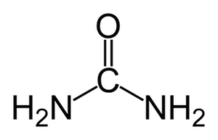
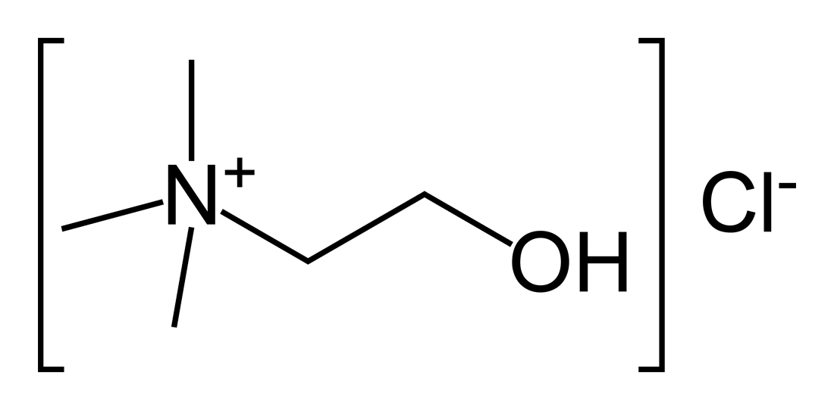
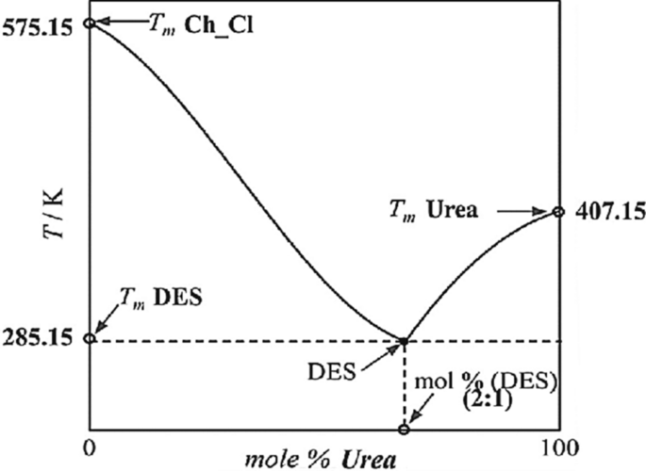
Deep Eutectic Solvents?
Combination of an organic (quaternary ammonium) salt with a hydrogen bond donor
E.g. choline chloride (organic salt) and urea or ethylene glycol (H-bond donor)
Key points:
  Environmentally-benign
  Cheap and produced at industrial quantities already
    Choline chloride = vitamin B4- used in chicken feed
    Urea- common fertiliser
  Powerful solvents, can dissolve Au, Ag, Te, Bi and others
  Are liquid and good solvents at room temperature, faster ~80 °C
Soltanmohammadi, F., Jouyban, A. & Shayanfar, A. New aspects of deep eutectic solvents: extraction, pharmaceutical applications, as catalyst and gas capture. Chem. Pap. 75, 439–453 (2021)
Notes:
Apologies again for those who know all this
These individual compounds are solids, but when mixed together they form a eutectic which has a lower melting point than the constituents, as shown on the figure, such that they form liquids at room temperature that are ionic, with high chlorinity.
Very powerful, anhydrous solvents developed at the University of Leicester
Proven to leach even unliberated gold from ore at low temperatures (experiments around 50C) and at much faster rates than cyanidation
Promising potential with other metals such as tellurides and selenides, but limited work on feasibility, pathways and

Slide 5
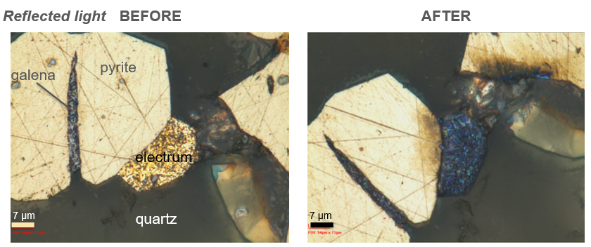
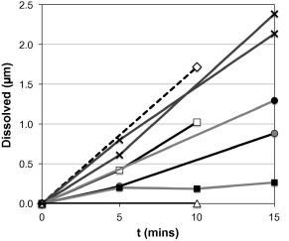
Dissolution Rates with Ethaline (2:1 ethylene glycol: choline chloride) and 0.1mol% iodine from Jenkin et al., 2016¹:
Tellurium 45°C
Electrum 50°C
Bi₂Te₃ \\c 45°C
Galena 50°C
Bi₂Te₃ Ͱc 45°C
Chalcopyrite 50°C
Pyrite 45°C
Note: pyrite does not dissolve/ is not etched
¹Gawen R.T. Jenkin, Ahmed Z.M. Al-Bassam, Robert C. Harris, Andrew P. Abbott, Daniel J. Smith, David A. Holwell, Robert J. Chapman, Christopher J. Stanley, (2016),
The application of deep eutectic solvent ionic liquids for environmentally-friendly dissolution and recovery of precious metals, Minerals Engineering, Vol. 87
Notes:
Two tellurium minerals. Put a polished block in DES for 5 min intervals and measure how much has been etched. Samples were a quartz-vein hosted orogenic gold deposit from the Cononish Gold Deposit, courtesy of Scotgold Resources Ltd. Thus similar deposit.

Slide 6
Actions and Objectives
1) Automated SEM analysis
  Mineralogical characterisation of ores, concentrates and mine tailings
  Understand element flows through the processing plant
2) Develop a protocol for leaching of by-products using DES
  Lab experiments for extent of leaching for each metal, and leaching rates at low temperatures (room to 50°C)
3) Consider economic feasibility and socio-environmental implications of a DES approach vs current/ traditional processing methods
Notes:
Disclaimer I have no background in ore deposits and have never looked at mining so my start has been doing a lot of training

Slide 7
Plant Input:
Plant Output:
Crushed ore
Flotation Concentrate
Knelson Concentrate
Sellable products
Middling Concentrate
Heavy Concentrate
Tailings
Björkdal produces four concentrates containing Au which are sold to smelters – where are Te, W and Bi are going?
Waste

Slide 8
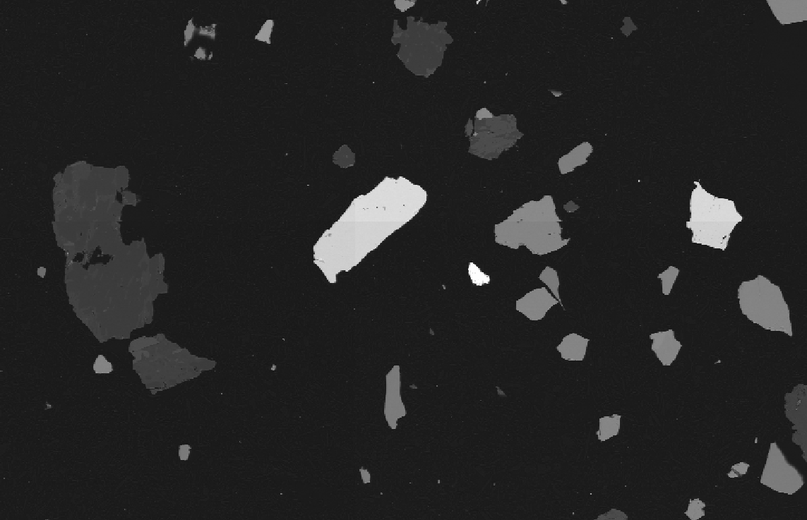
Preliminary Results
  Middling Concentrate:
  Has the highest amount of bismuth tellurides and scheelite
    4 mol% W (mean diameter 18µm)
    At least 1.4 wt% BiTe
  Tailings (prior GTK analysis):
    -63µm size fraction highest in scheelite
    0.94 wt% W
  Deportment:
  Bi is 98.6% hosted in bismuth tellurides
  Te is 97.6% hosted in bismuth tellurides
  W is 99.8% hosted in scheelite
  Target metals all almost solely hosted in well-liberated,
  single phases so should be readily dissolvable and accessible to DES
sch
sch
BiTe
Notes:
SEM has been having a lot of issues and our XRF is broken so I haven’t yet analysed the tailings but the high proportions of scheelite are extremely promising

Slide 9
Middling Mineralogy of Bright (Heavy) Phases:
Flotation Concentrate Mineralogy of Heavy Phases:
Notes:
This represents proportion of non-silicates and excluding pyrite and pyrrhotite which make up nearly 50% of the sample

Slide 10
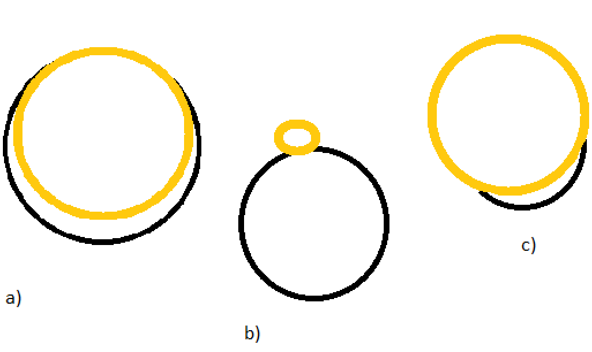
Mineral Associations:
Mineral association is the total percentage perimeter where a phase is touching another phase (cumulative across all grains). In b) the gold is 20% associated with the black but the black is only 5% associated with the gold
Notes:
Well-liberated for both – BiTe is 86% associated with background (ie liberated by the milling process) and unclassified which is usually overlapping pixels with the background, and scheelite is almost 100% liberated
Association: Mineral associations are done by either area or perimeter. For the same
grain/ particle in Fig.3 b), T is 20% associated with G (as 20% of the perimeter of T is
touching G) but the gangue particle G is more like 5% associated with T as only 5% of the
perimeter is touching T. This is called perimeter association.
• For each individual mineral, the associations will add up to 100% (as a sort of cumulative
length thing, so all the perimeter lengths are added up as if there is one long line of perimeter
and each bit of other thing touching it is taken as a percentage). Thus, bigger grains have
more of an impact on the association data (one massive grain sharing a side with a garnet
and six tiny grains sharing a side with a biotite will return a higher association with garnet
than biotite.

Slide 11

Contact email: lt263@le.ac.uk
Summary:
BiTe available in two concentrates
Scheelite available in one concentrate and tailings (waste)
BiTe proven amenable to DES leaching
Scheelite suggested susceptibility but underexplored
Further Work:
Analysis of newly collected samples (and comparison to previous)
Improved characterisation of tailings
DES leaching experiments
Experimentation with scheelite for a W product
If successful in lab work, discuss implementation with Björkdal and promote worldwide!

