Slide 1
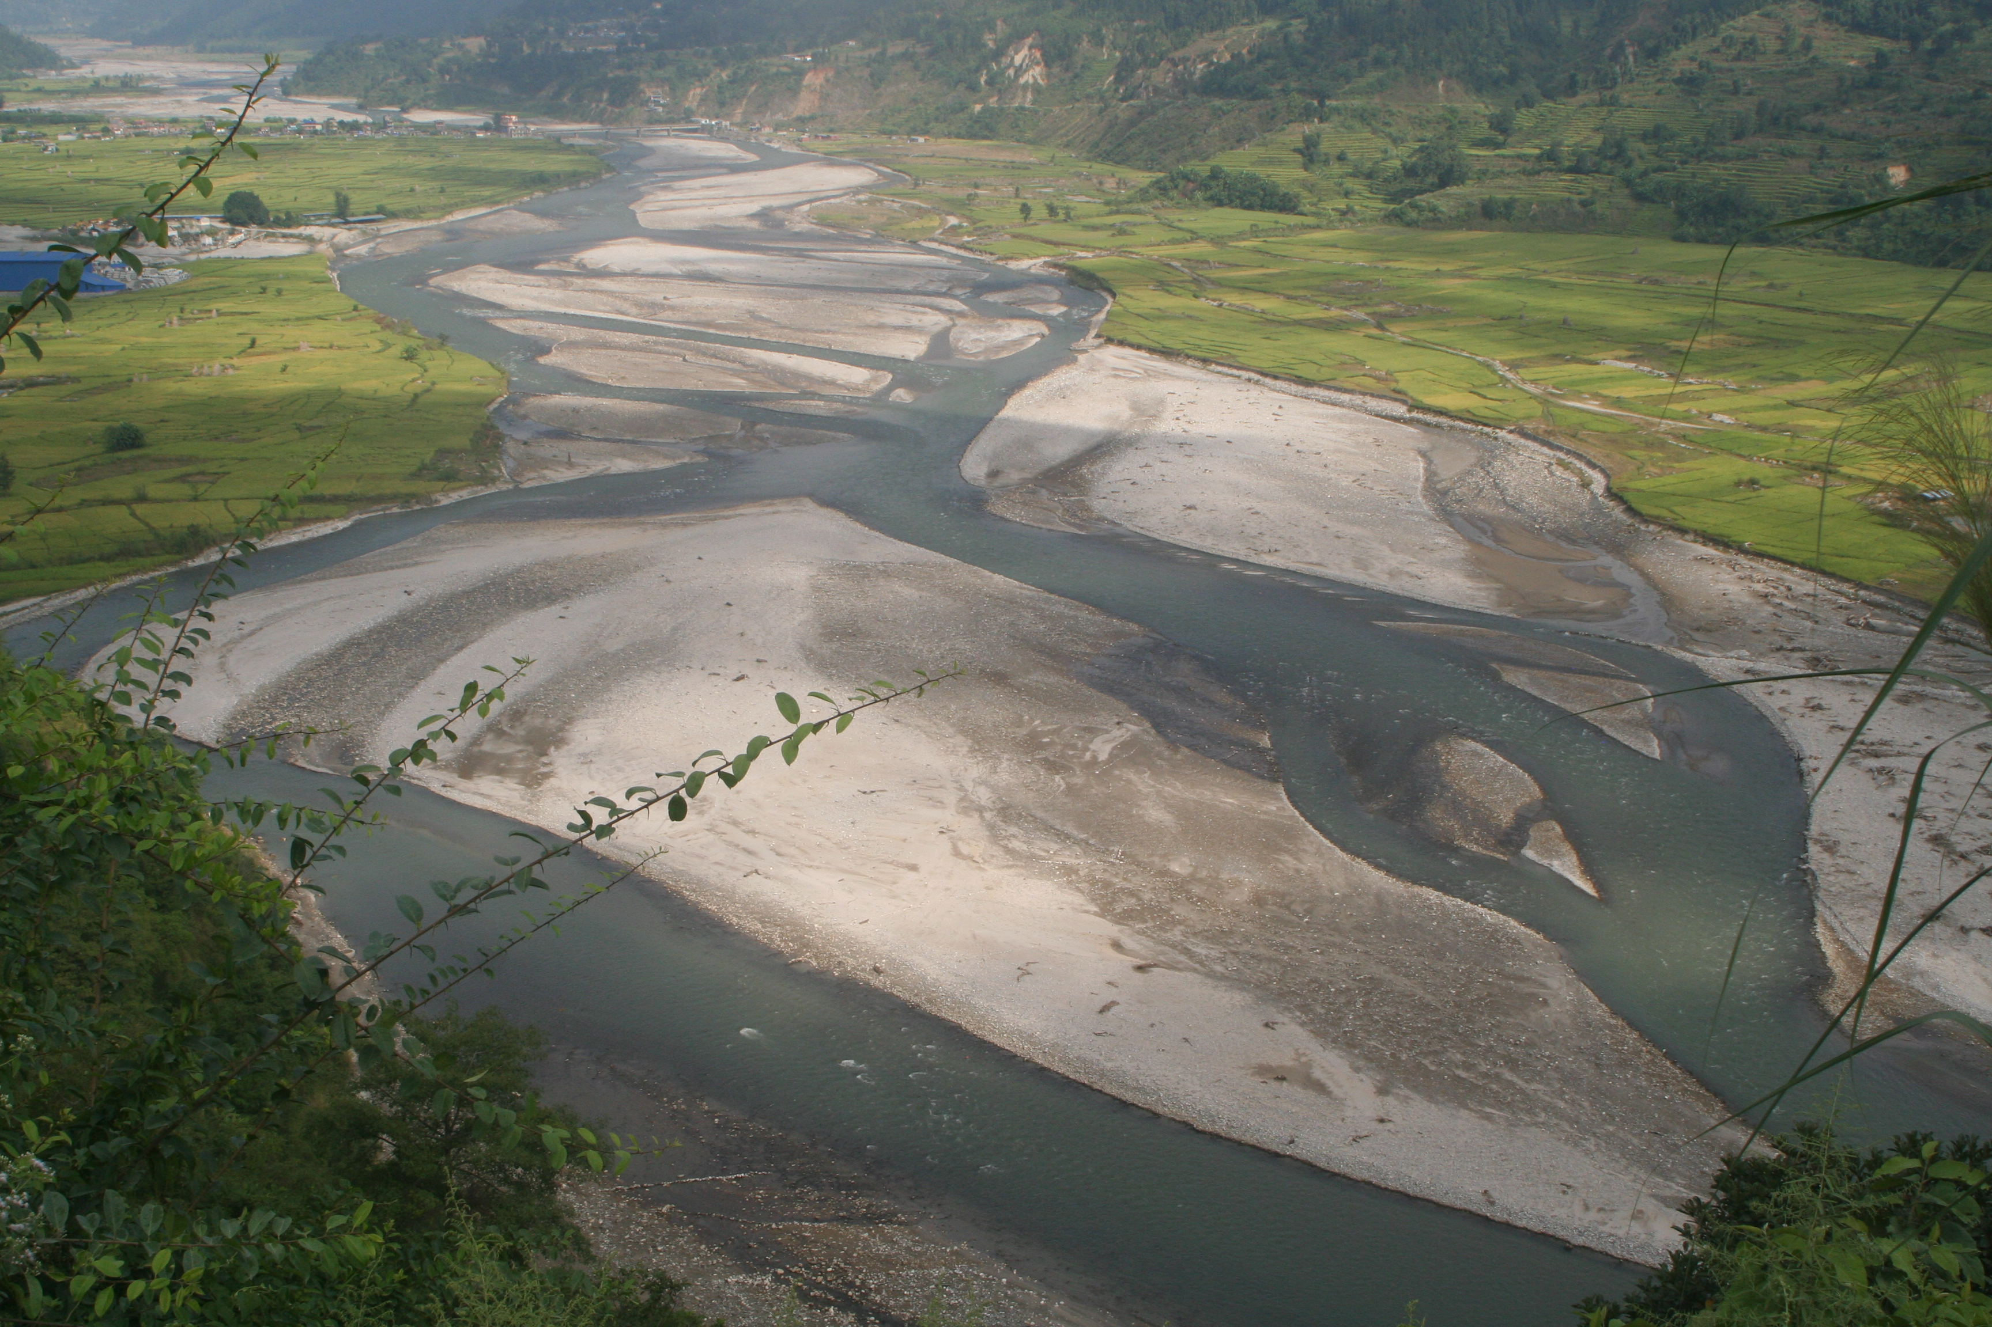







Lag time in evacuation of coarse sediment generated by large earthquakes: a case study from central Nepal following the 2015 Gorkha earthquake
E. Graf¹, H. D. Sinclair¹, M. Attal¹ and B. Gailleton²
¹University of Edinburgh, UK | ²GFZ Potsdam, Germany
EGU General Assembly 2022| 23rd May 2022

Slide 2
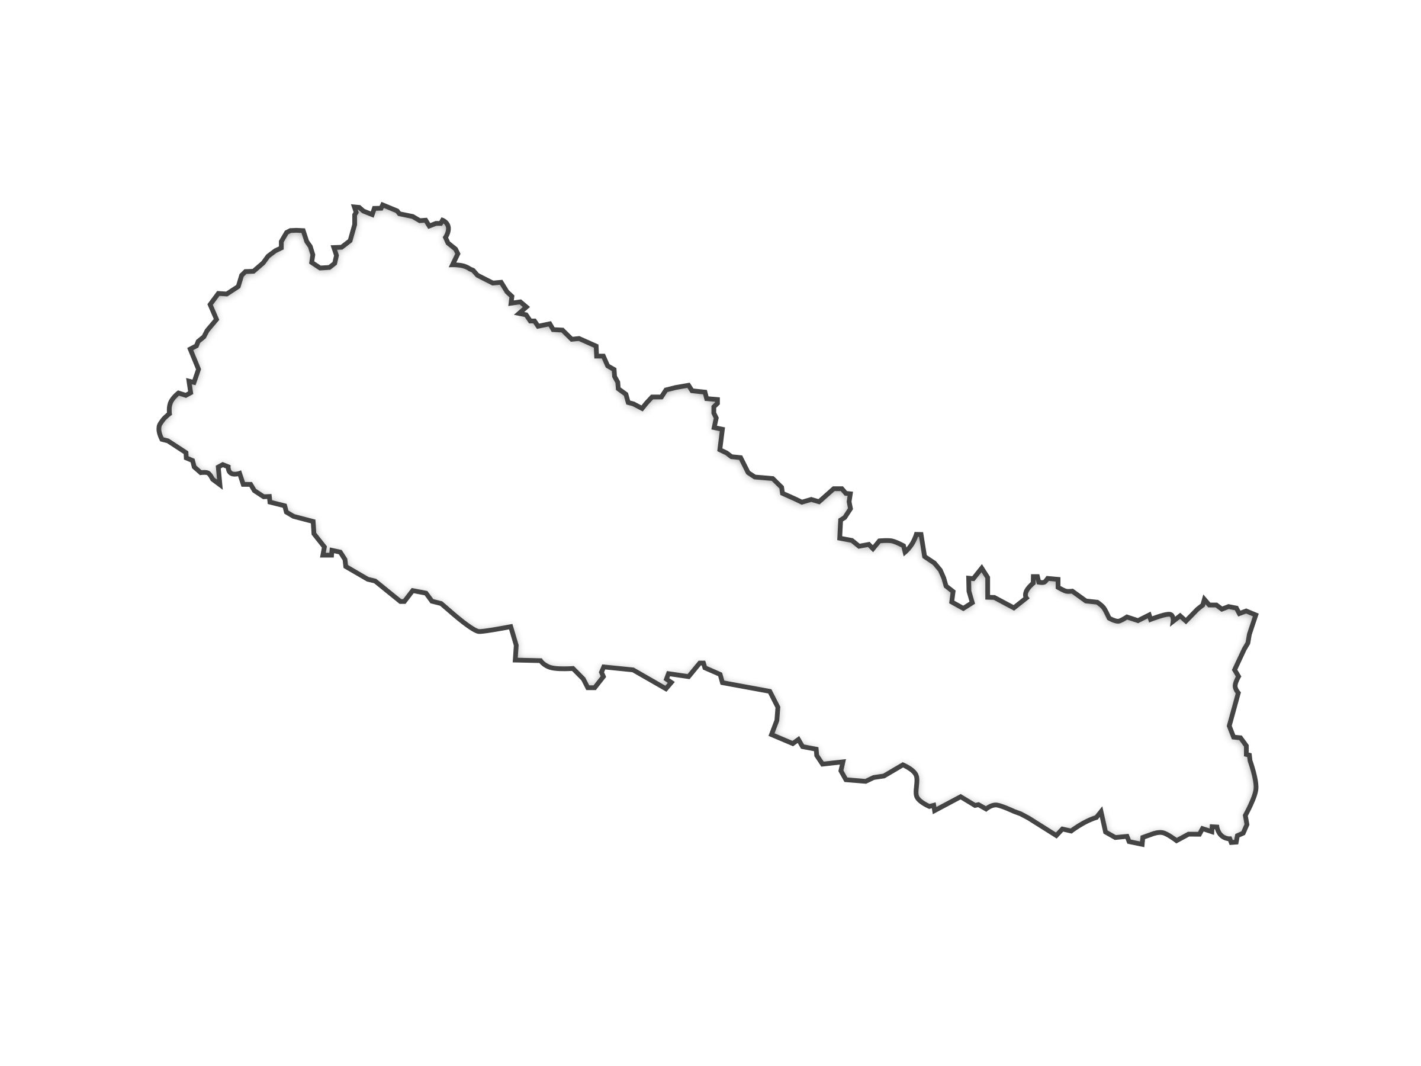
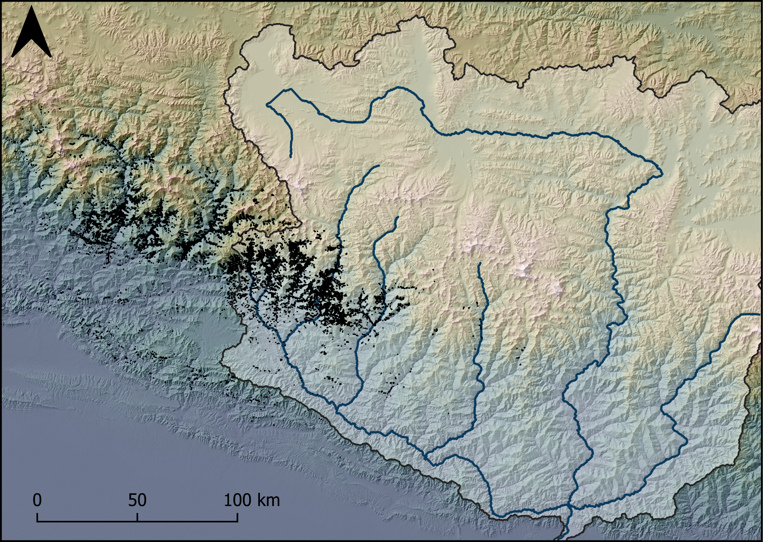
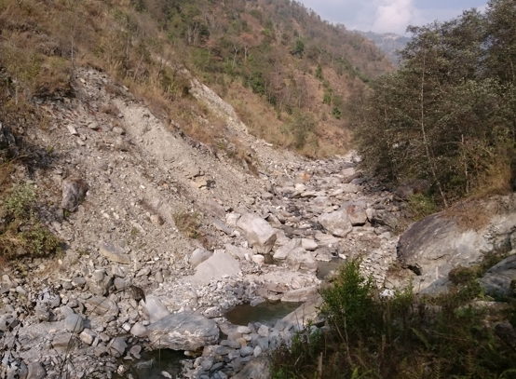
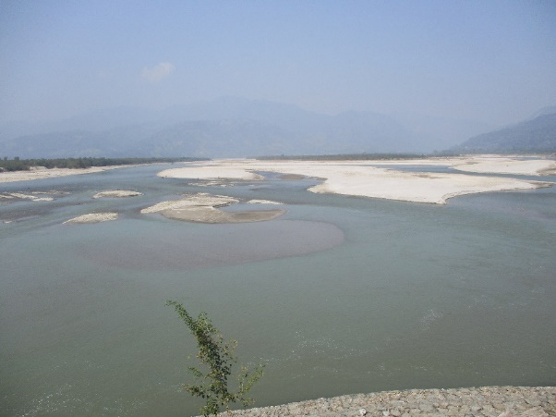
Nepal
Kathmandu
Landslides mapped by Roback et al. (2018)

Slide 3
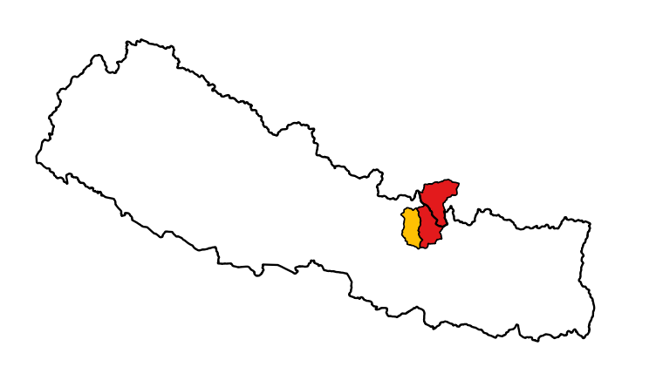
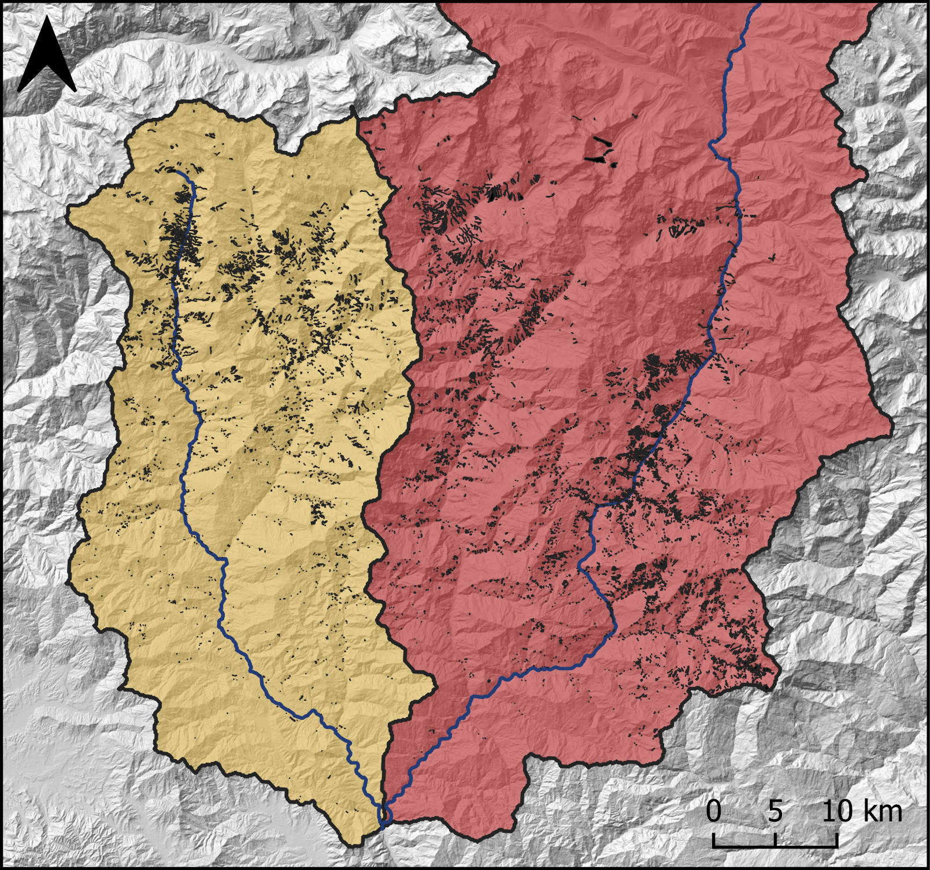
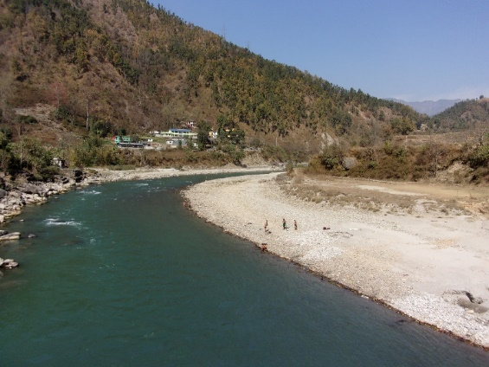
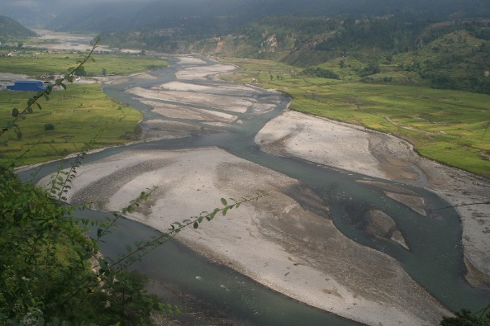
Melamchi-Indrawati
Bhote Koshi
Photo credit: Hugh Sinclair

Slide 4

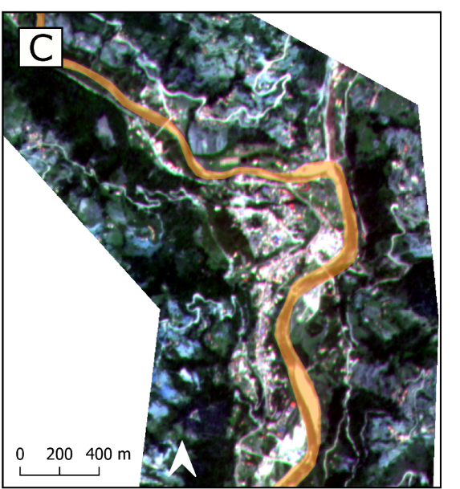
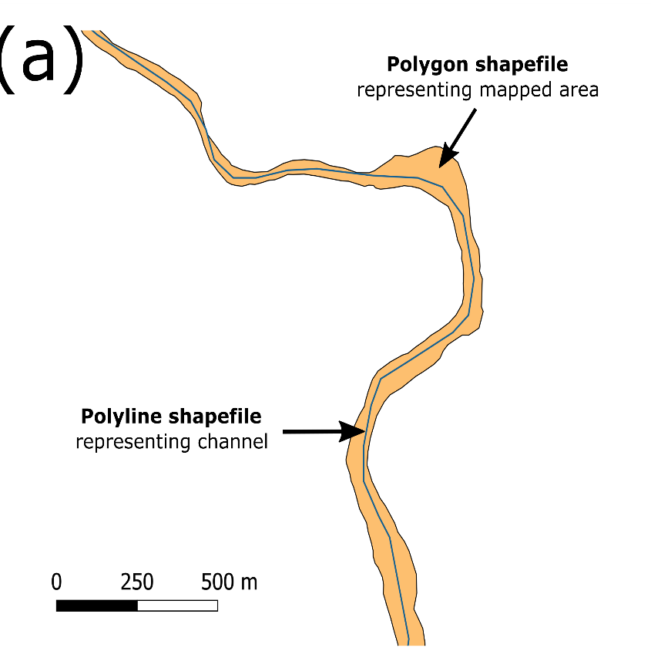
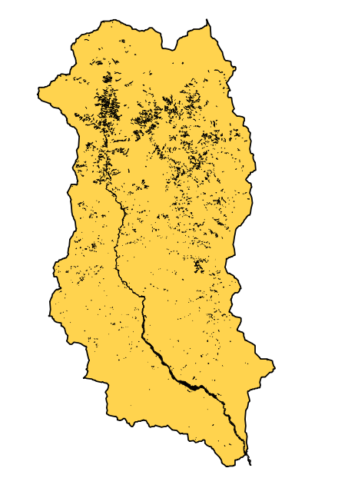
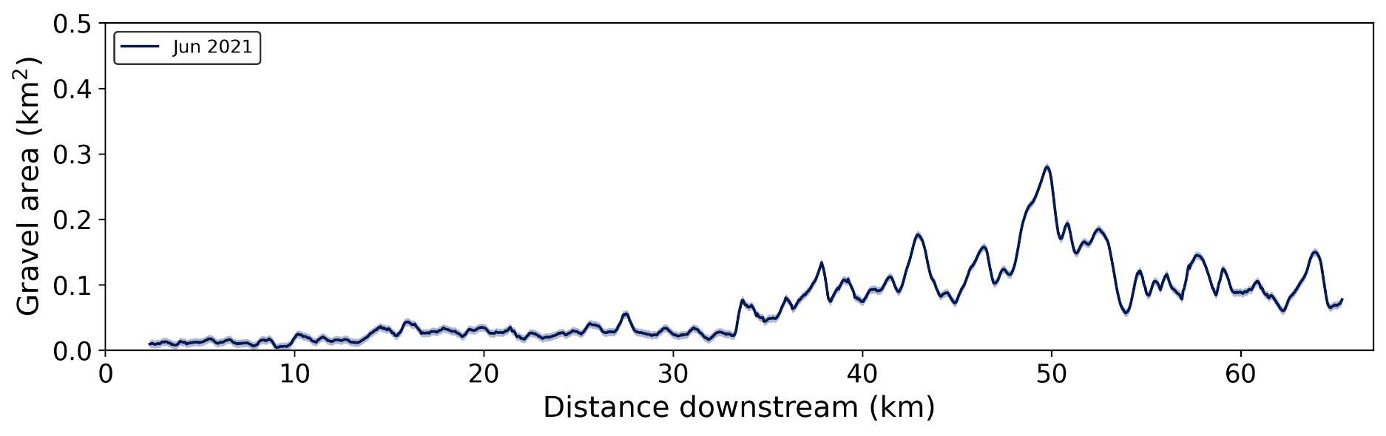
1
2 June 2021
2
3

Slide 5
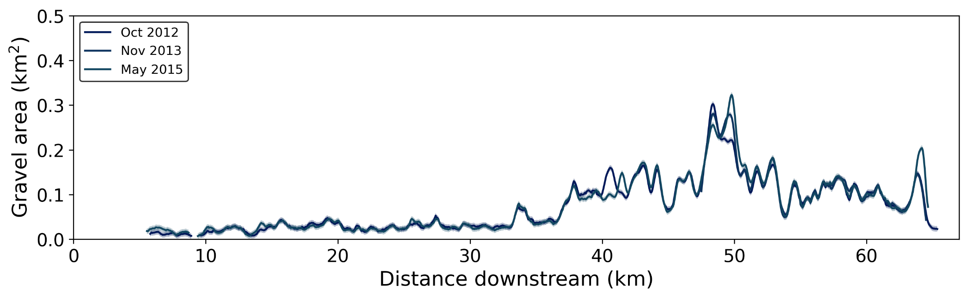
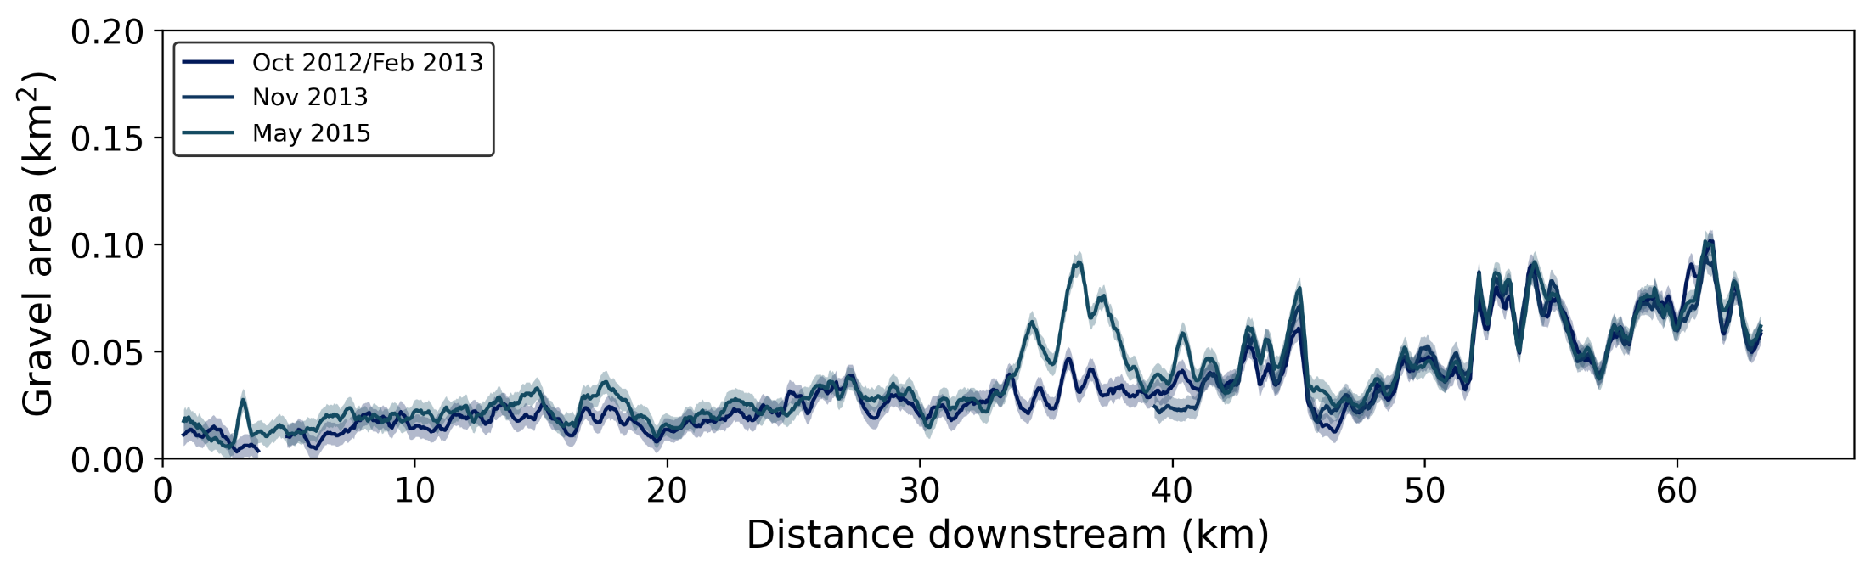
Pre-earthquake (2012 – early 2015)
Melamchi Bazaar
Melamchi-Indrawati
Jure landslide
Bhote Koshi

Slide 6
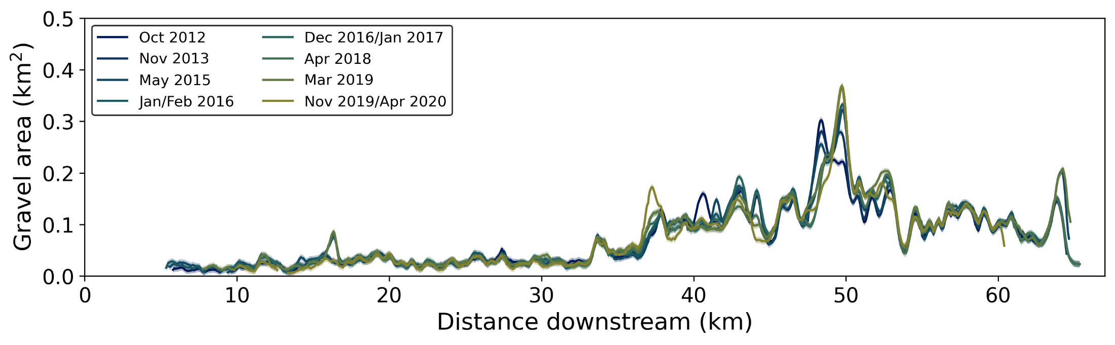
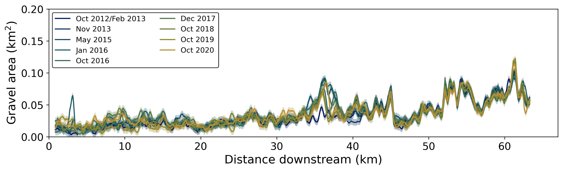
Post-earthquake (2015-2020)
Melamchi Bazaar
Melamchi-Indrawati
Timbu
Jure landslide
Bhote Koshi

Slide 7
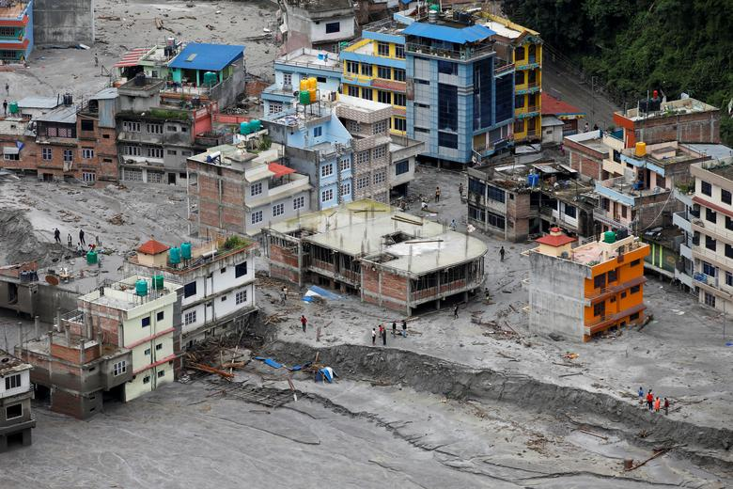
Melamchi disaster (June 2021)
REUTERS/Navesh Chitrakar

Slide 8
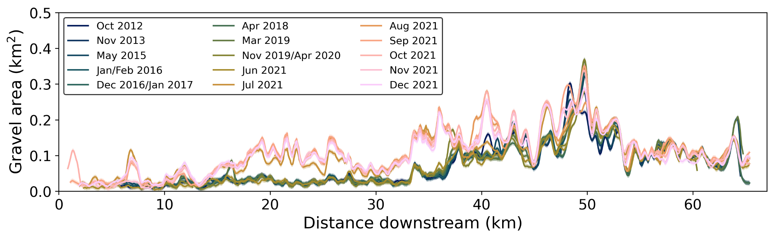
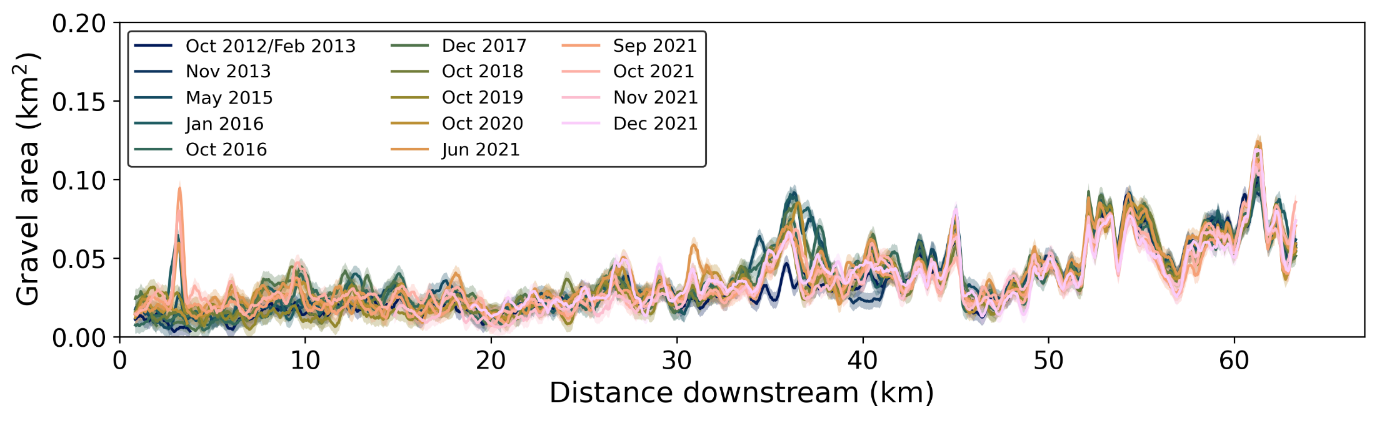
Post-Melamchi disaster (2021)
Melamchi-Indrawati
Timbu
M. B.
Jure landslide
Bhote Koshi

Slide 9


Conclusions
Localised and small signals linked to Gorkha earthquake
Clear, reach-scale signal following Melamchi disaster
Did the earthquake prepare the landscape?
Talk to me!
@elsgraf
emma.graf@ed.ac.uk
Roback et al. (2018): The size, distribution, and mobility of landslides caused by the 2015 Mw7.8 Gorkha earthquake, Nepal, Geomorphology, 301, 121–138

