Slide 1


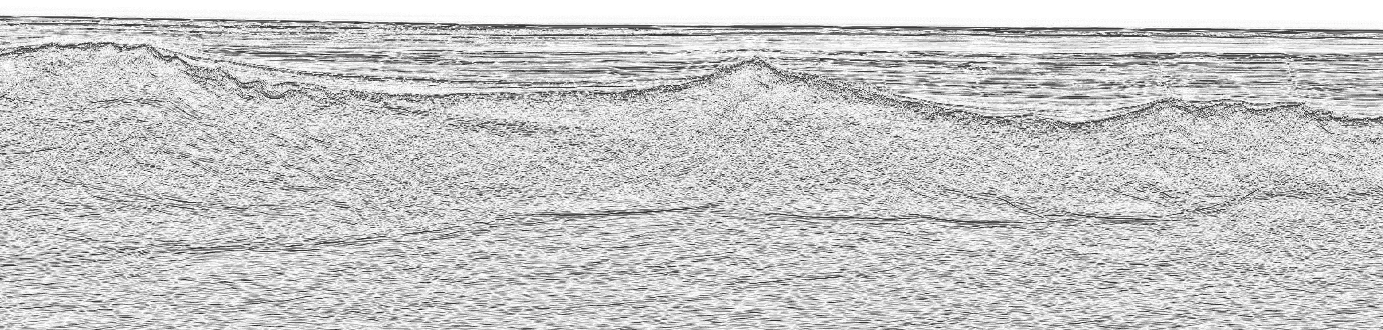


Continental breakup style of Marginal Seas Geoffroy Mohn, Jean-Claude Ringenbach, Michael Nirrengarten, Julie Tugend, Anders McCarthy and Chao Lei

Slide 2
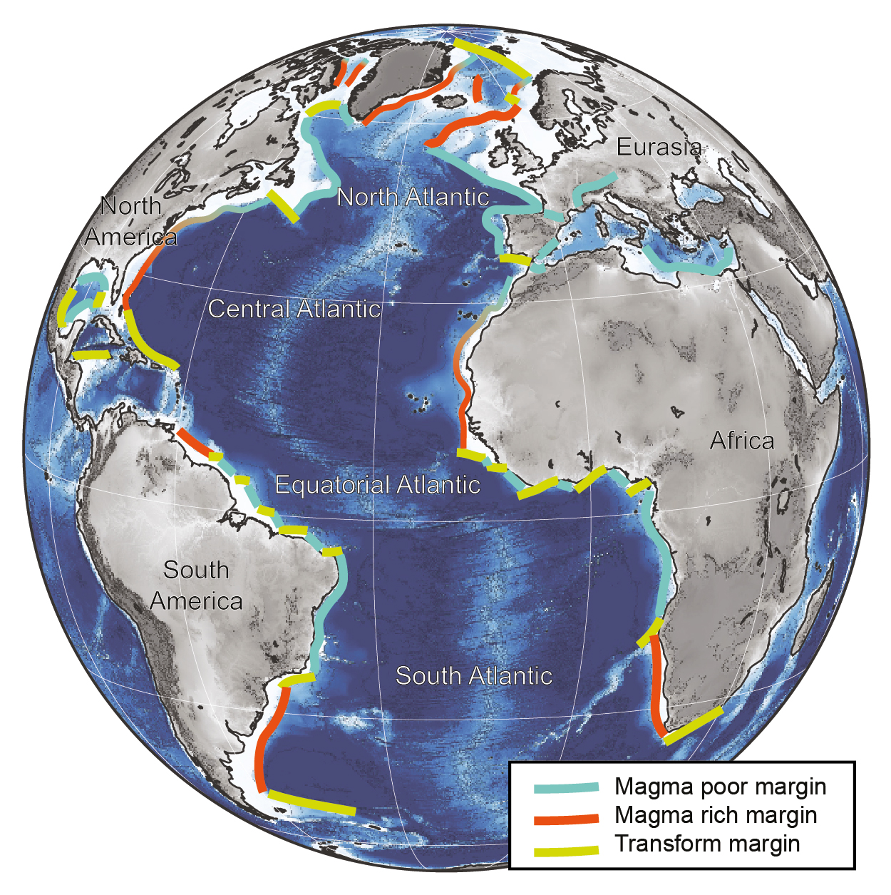
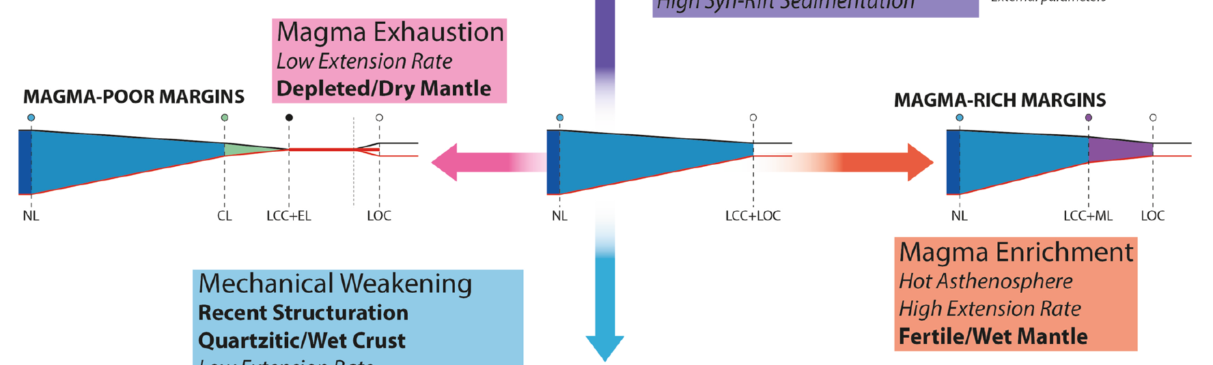
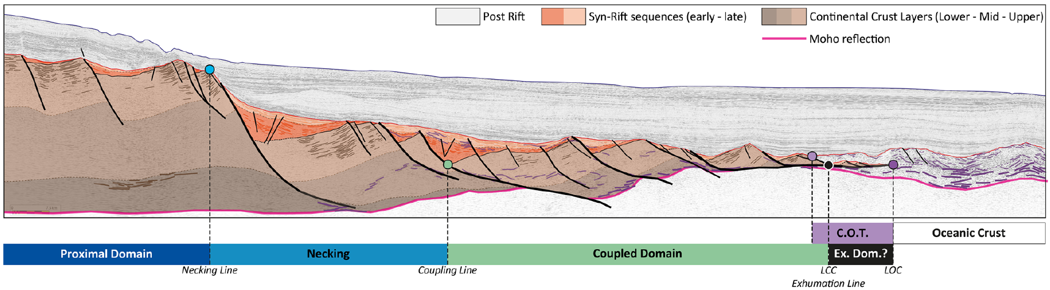
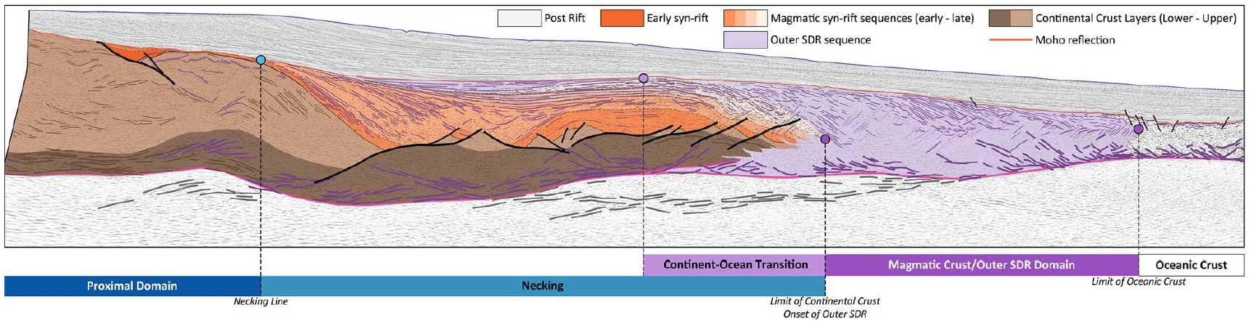
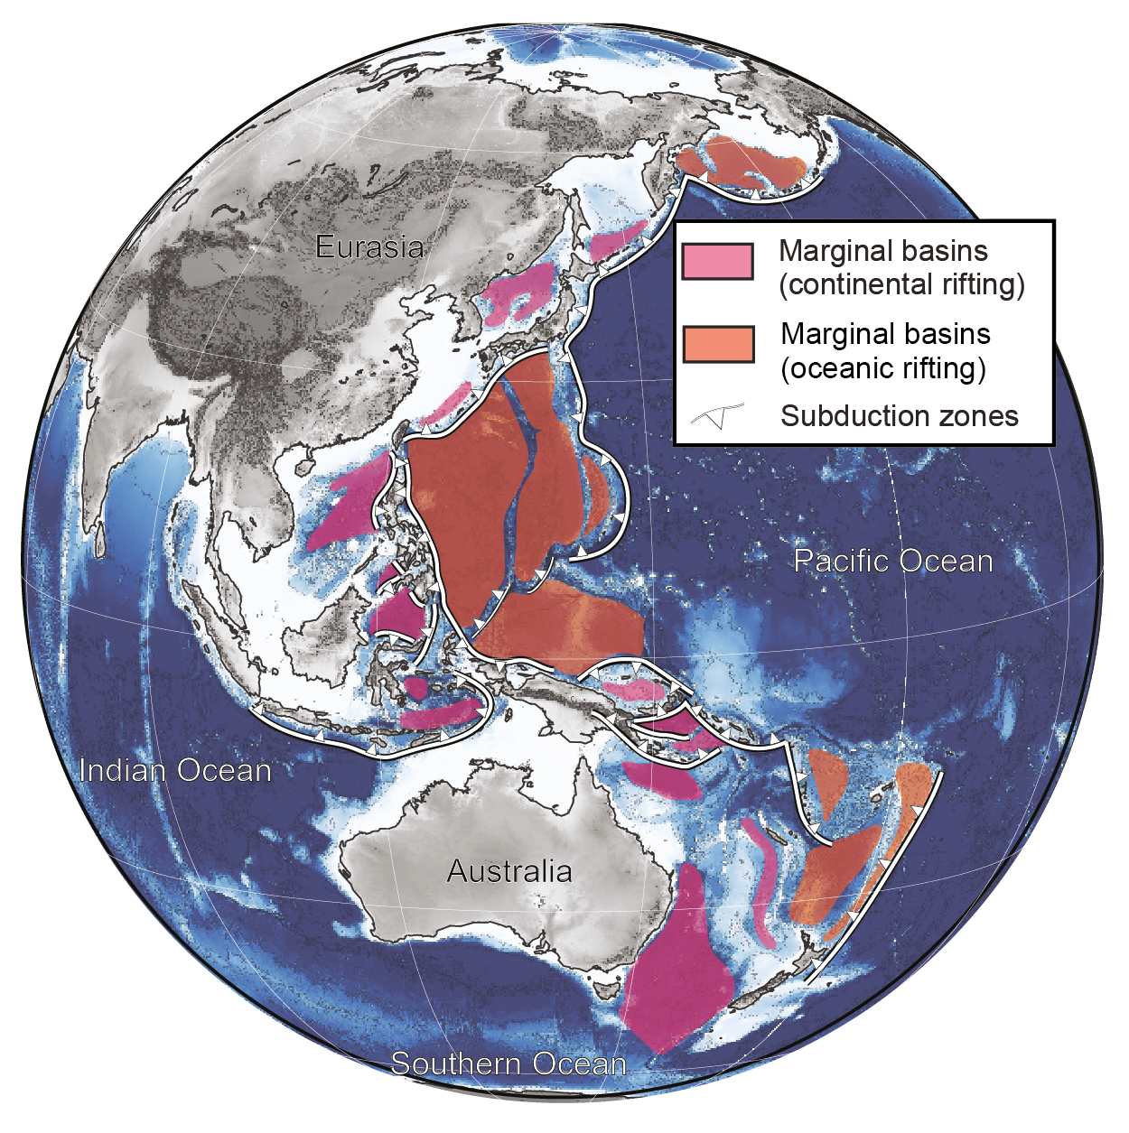
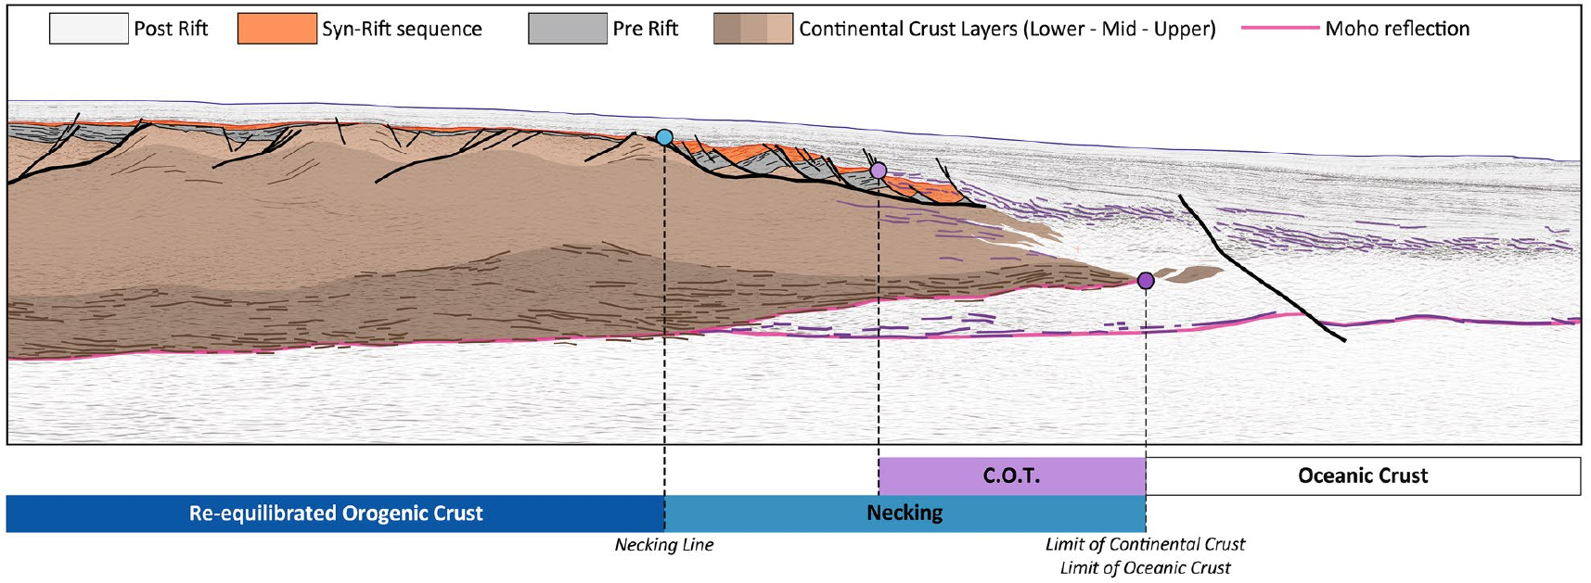
Atlantic domain vs Marginal basins
Somalia
Based on the Atlantic domain, rifted margins are commonly classified as magma-poor or magma-rich archetypes using a number of morphological features considered as characteristic (e.g. SDRs, HVLCB, exhumed mantle)
Atlantic domain
Sapin et al., 2021. Talk to follow
Namibia
Their COT structure differs from Atlantic-derived end members archetypes:
What is the mode of continental breakup of Marginal Seas?
Coral Sea
SE Asia – Marginal Sea
Not all back-arc!

Slide 3
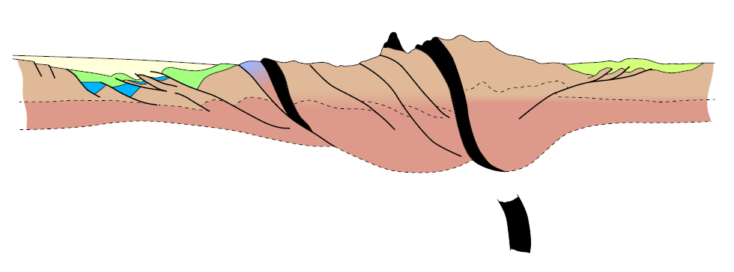
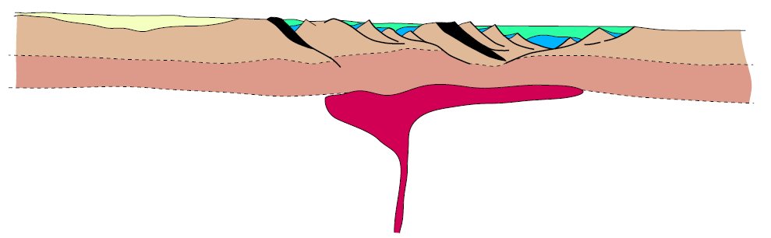
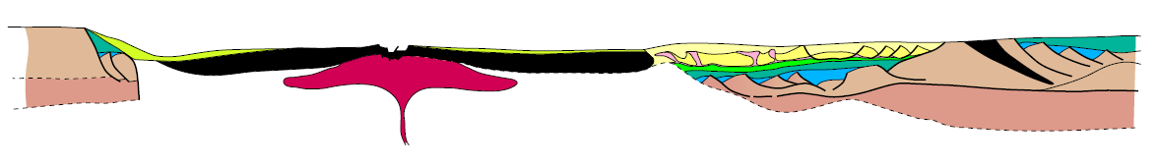
Regional setting of the South China, Coral Sea and Woodlark Basin
Similar geodynamic succession passing from orogen,
post-orogenic collapse, rifting and eventually continental breakup
Orogenesis
Post-orogenic extension
From orogenesis to continental breakup
Rifting and continental breakup
Mohn et al. In revision

Slide 4
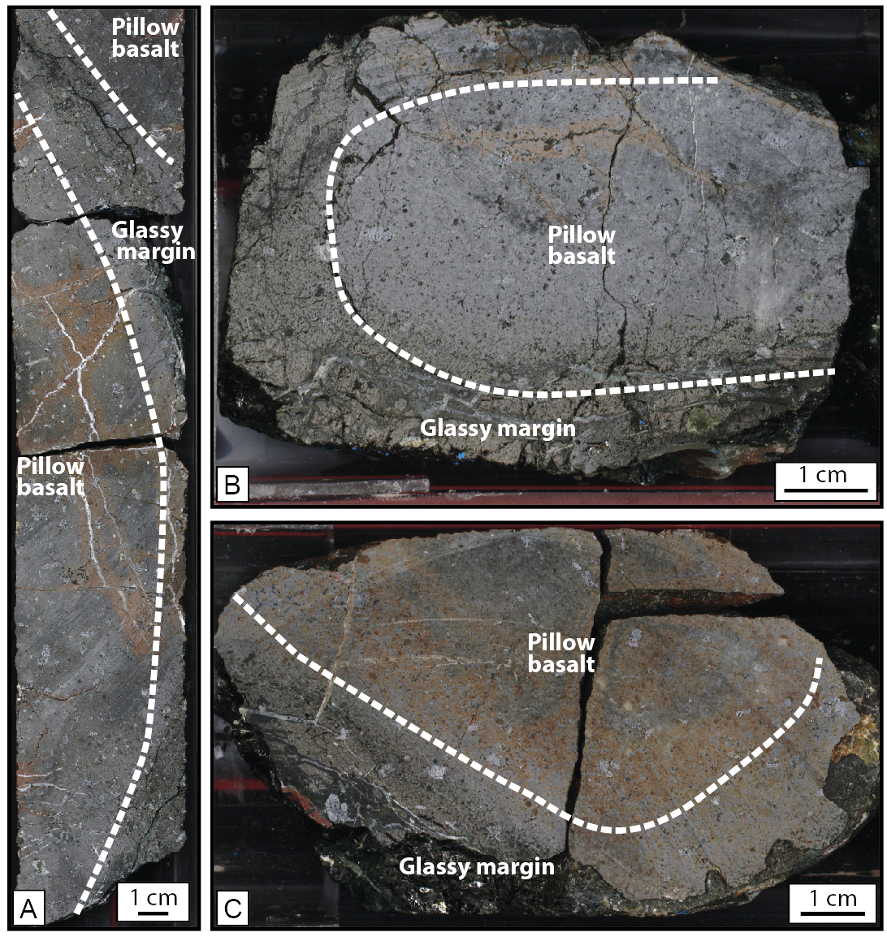
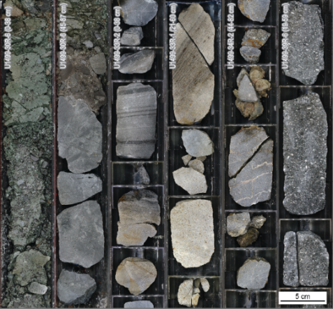
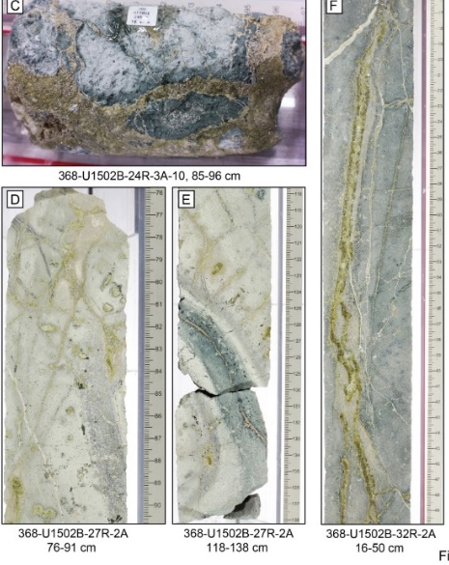
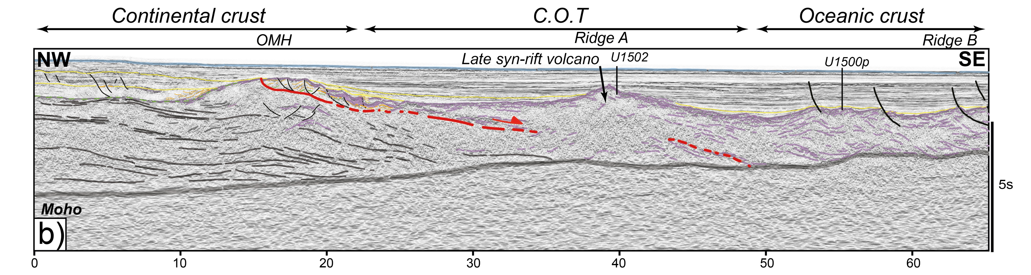
The South China Sea Continent-Ocean Transition
Ridge A
Ridge B
Final rifting is accommodated by a major low-angle extensional fault
Site U1502 sampling late syn-rift MORB pillow basalts affected by
a pervasive hydrothermal alteration over thinned continental crust
Sharp transition between continental basement and oceanic crust (U1500)
U1499: Undated
conglomerates
U1500: Fresh basalts
U1502: Altered basalts
Larsen et al., 2018
Profile from Zhang et al. 2021 and modified by Mohn et al. in revision
Notes:
Seismic section from the distal SE China margin offshore Hong Kong, this area was the focused of the IODP expeditions 367/368
Distal margin is characterized by distinct structural domains including: the Outer Margin High, Ridges A, B, C.
Ridge A was drilled two times recovering in Site U1499 post-rift succession passing downward to syn or pre-rift breccias in contrast Site U1502 sampled late syn-rift hydrothermally altered pillow basalt overlain by late Eocene claystone.
Ridge B sampled at U1500 consists of unaltered to poorly altered basalt showing a typical MORB signature.
Based on drilling results combined geophysical quantitative analysis, Ridge A was interpreted as a block of continental crust while ridge B corresponds to the oceanic crust.
Overall the structure of COT is characterized by a sharp transition between CC and OC.
The domal shape OMH is limited to the SE edge by a succession of extensional structures soling on a low angle normal fault cutting the residual crust. This structure is associated with magmatic and hydrothermal activities (Site U1502) emplacement over thinned continental crust. The interaction of tectonic extension with magmatism will trigger continental breakup leading to sharp TOC with jno evidence for exhumed mantle

Slide 5
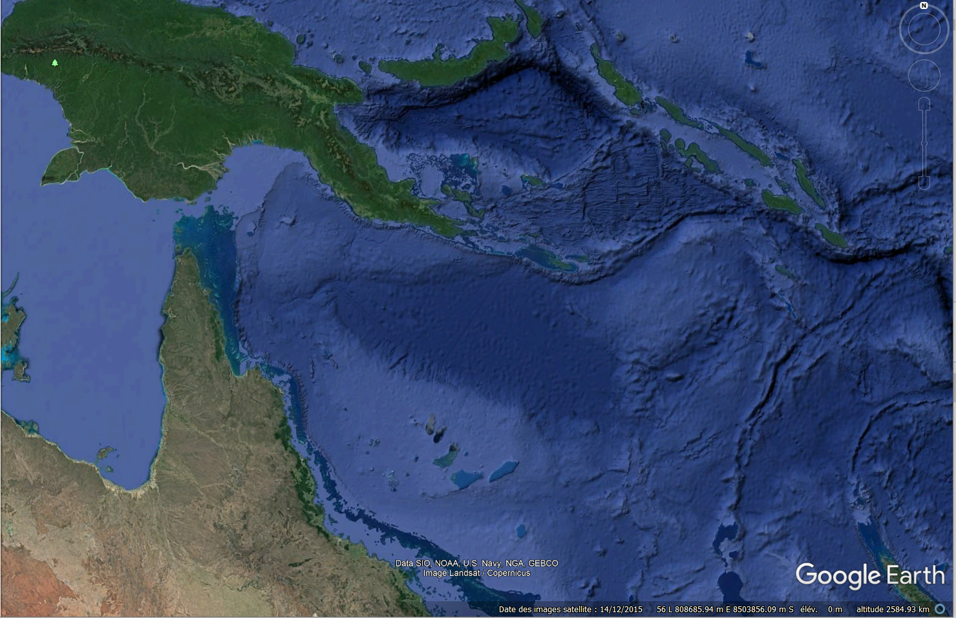
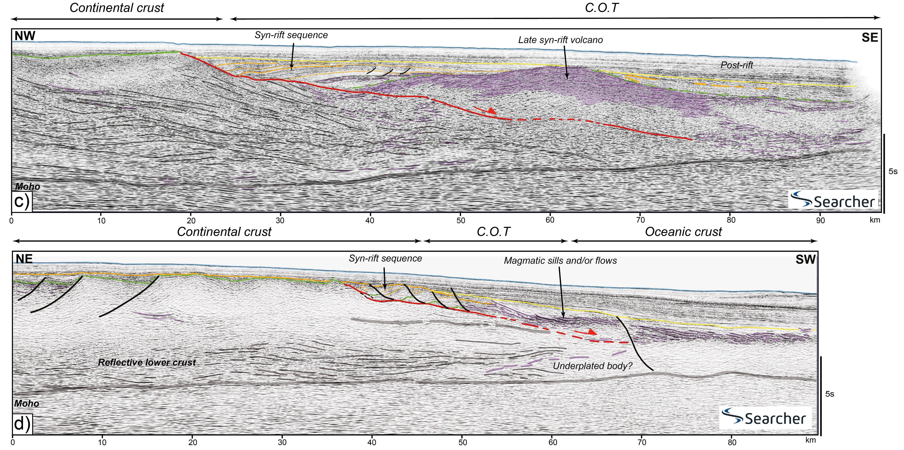
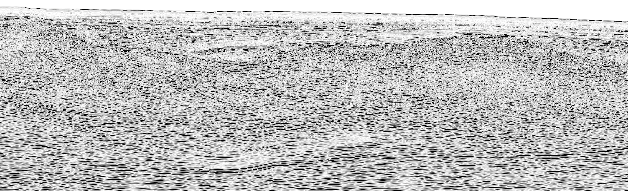
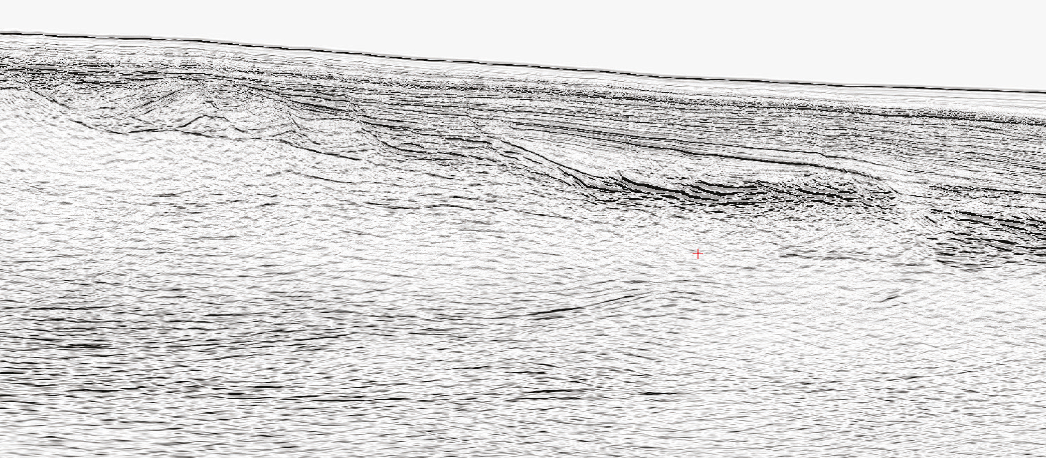
The Coral Sea Continent-Ocean Transition
Rifting and continental breakup during the Late Cretaceous to early Paleogene
Evidence for a major low-angle extensional fault with rider blocks in the hanging wall associated with late syn-rift magmatism

Slide 6
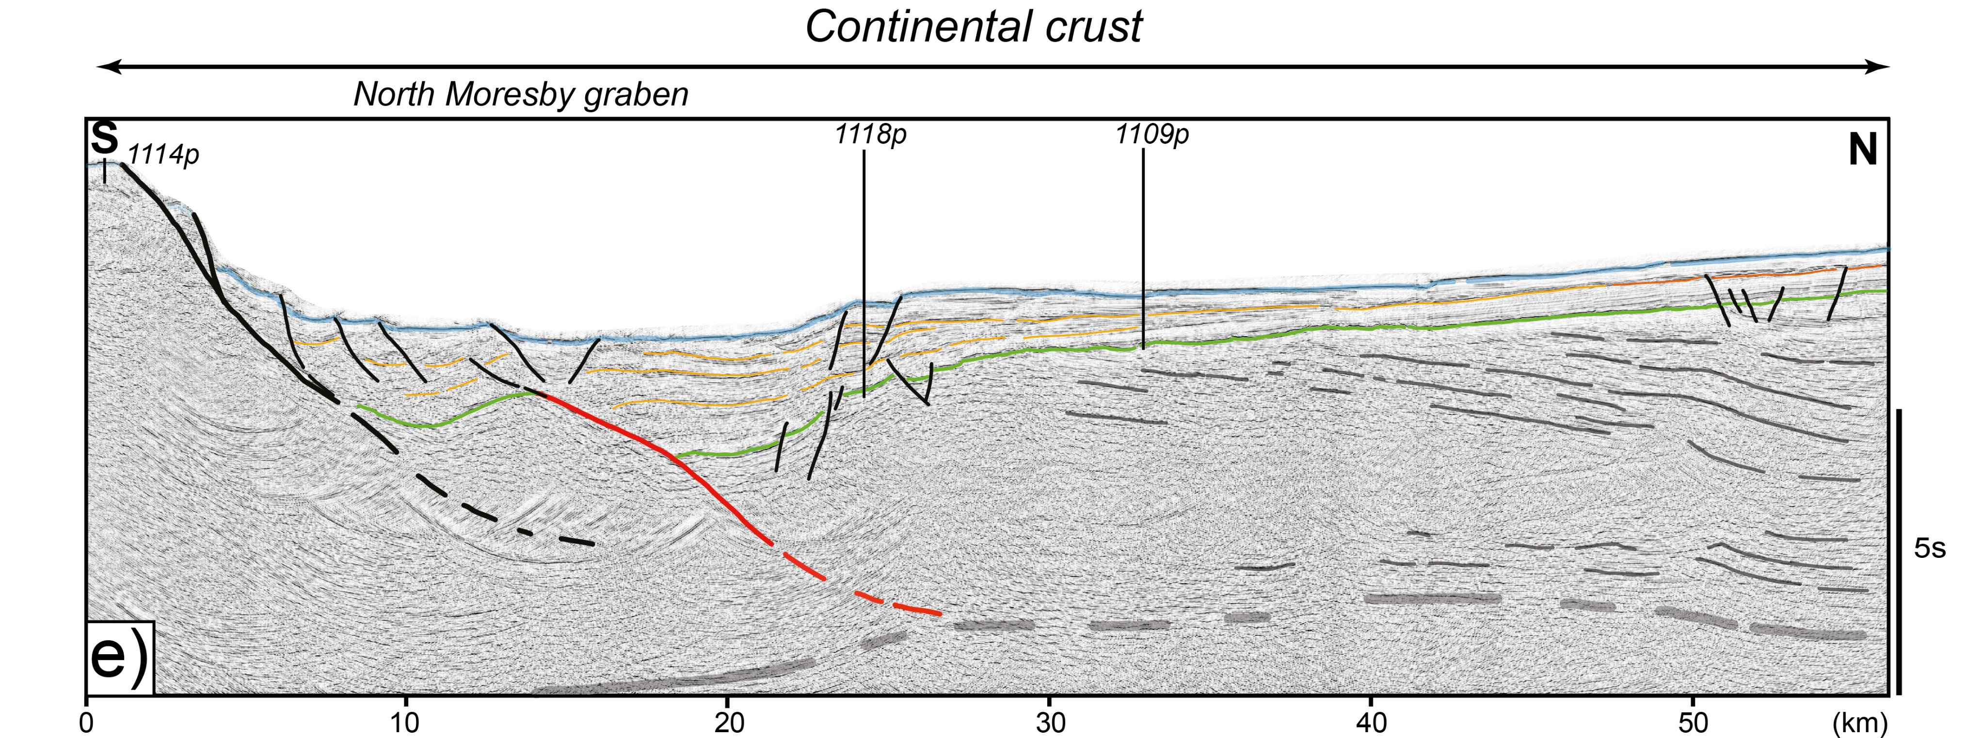
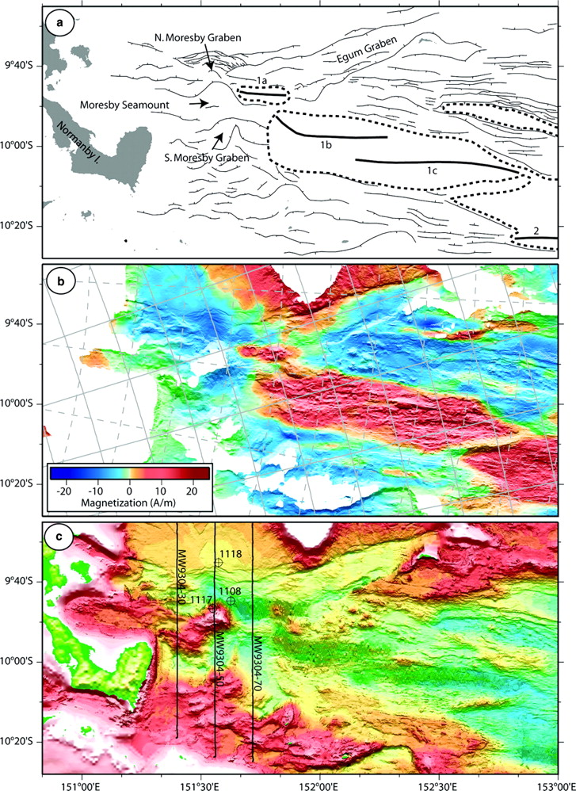
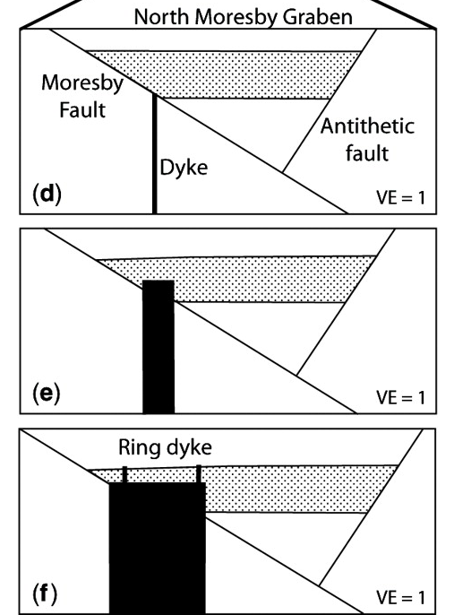

The Woodlark Basin Continent-Ocean Transition
Structural map
Moresby extensional fault actives at low-angle (30°)
Sea-floor magnetization map
Goodliffe and Taylor, 2007
Notes:
The Woodlark Basin documents a Current Rifting-to-Spreading Transition at the Tip of V-shaped propagator.
The first profile (blue square) document the final rifting stage focusing on the North Moresby Graben. Extension is accommodated by a major seismogenic fault, the so called Moresby fault.
This seismogenic normal faults is active at low-angle (23-35°) likely due to low frictional coefficients and is associated with high slip rates.
Here, this major extensional fault is associated with another faulted block controlling a sedimentary wedge in the adjacent Miocene to Present sediments.
The basement of the basin has been sampled by ODP Leg 180 (Taylor and Huchon 2002) consisting of mafic rocks of Late Cretaceous to Paleogene Age at Sites 1117, 1114, 1118 and 1109 (Taylor and Huchon 2002). These magmatic rocks might represent the eastward continuation of the Papuan Ultramafic.
The Second profile (red square) is located further to the West at the tip of the seafloor spreading segment 1 that record ongoing continental breakup.
The magnetic, bathymetric and seismic data reveal that the boundary between continental rifting and sea-floor spreading in the Woodlark Basin is spatially very sharp.
The currently forming continent–ocean boundary involves igneous intrusions penetrating the shallow-angle normal fault of an asymmetric rift graben. Moresby Fault is cut by an approximately 5 km-wide intrusive body that is overlain by subhorizontal sediments that have been cross-cut by a ring dyke.
Magmatic rocks have sampled by dredging showing heterogeneous signature including N-MORB signature.
Magma arrival is interpreted to accommodate the initiation of seafloor spreading in the North Moresby Graben.

Slide 7
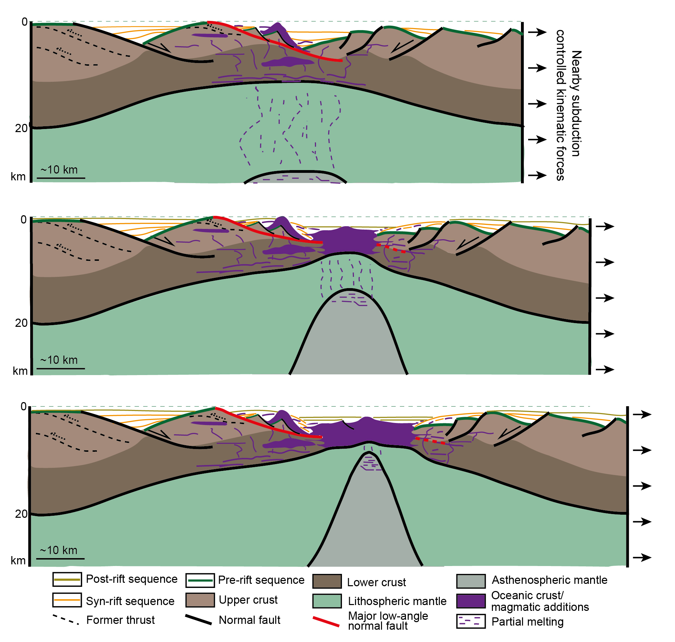
Conclusions - Implications
Mode of breakup of the SCS, Coral Sea and Woodlark Basin appears similar
Continental breakup is accommodated by the activity of one main crustal scale low-angle normal fault during the emplacement of MORB-type magmatism
Fast extension rates control the dynamics of continental breakup in Marginal Seas
Kinematic boundary conditions directly or indirectly controlled by nearby subduction zones

