Slide 1

Role of soil biofilms in the transport processes of emerging organic contaminants: A laboratory experimental study
Edinsson Muñoz-Vega¹, Lucas Spada², Stephan Schulz¹, Christoph Schüth¹
¹Technical University Darmstadt, Institute of Applied Geosciences, Hydrogeology Group, Darmstadt, Germany
²Goethe University Frankfurt, Institute for Atmospheric and Environmental Sciences, Frankfurt, Germany
26.05.2022. EGU Conference, Vienna, Austria.

Slide 2
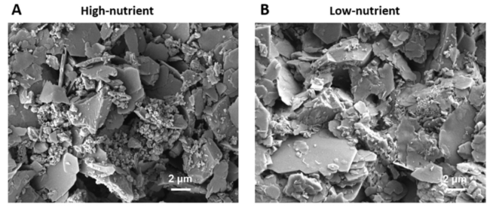
Introduction: Natural attenuation of EOCs
Sorptive processes
Biodegradation
Both processes depend on the soil, composition of water, physicochemical properties of EOCs and ambient conditions (pH, redox, T°)
Biofilm: Aggregates of microorganisms in which cells are frequently embedded in a self-produced matrix of extracellular polymeric substances (EPS) (Flemming et al., 2016).
Biofilms can cover the underlying material (soil), being able to change sorption behavior.
Multicellular biofilm under diferente nutrients condition. Wu et al., 2019.
26.05.2022. EGU Conference, Vienna, Austria.

Slide 3
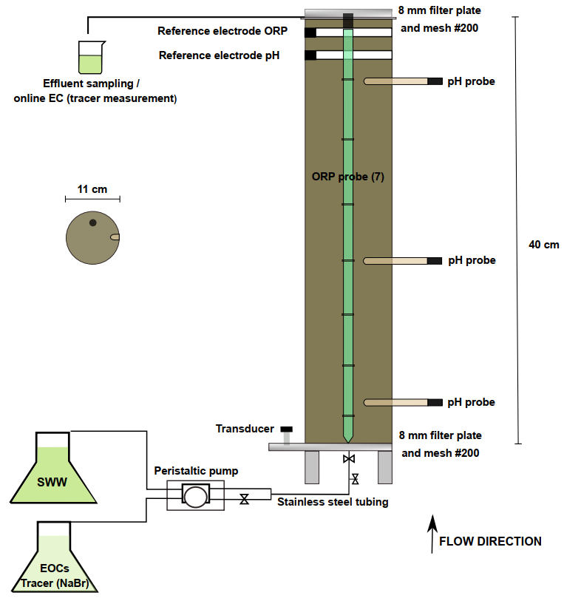
Methods: Experimental setup
3 SATURATED COLUMNS
Influent water: Synthetic wastewater (SWW) diluted 10x. Not containing EOCs.
C1: Organic soil. Biotic.
C2: Muffled soil. Biotic.
C3: Organic soil. Abiotic (NaN₃ 1g/L).
Soil: Loamy sand from Hessian Ried. 0.6% OC. 3% OM.
Continuous monitoring of pH, redox potential and pressure.
Continuos tracer by means of flow through cell.
EVENT | C1 | C2 | C3
PV SWW before injection of EOCs | 215 | 167 | 150
Injected PV EOCs | 44 | 46 | 42
PV SWW after EOCs | 37 | 43 | 10
26.05.2022. EGU Conference, Vienna, Austria.

Slide 4
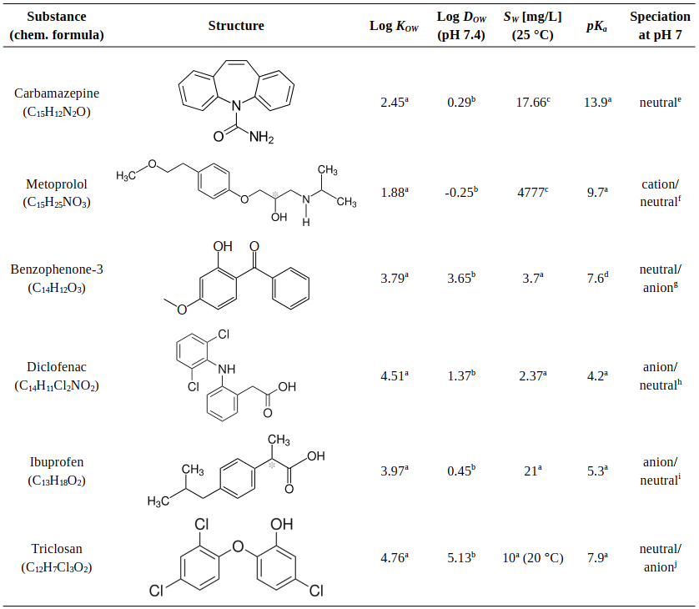
Methods: EOCs
Analyzed by SPE and UHPLC-MS
26.05.2022. EGU Conference, Vienna, Austria.

Slide 5
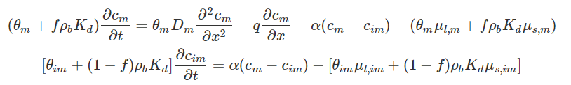
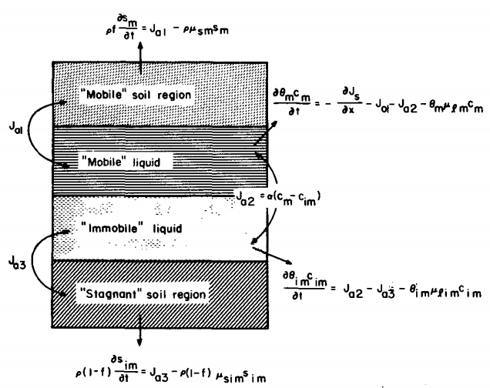

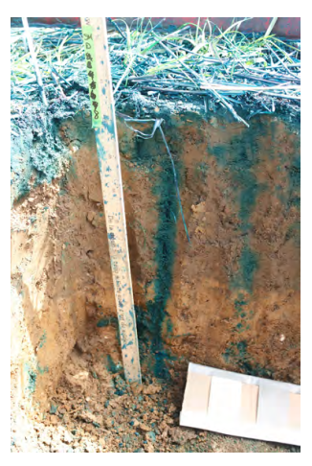

Methods: Analyses of tracers and BC’s EOCs
Two region transport model with degradation. van Genuchten, 1989. “Dual porosity”.
calibrated with information
of conservative tracer
Retardation factor to
quantify sorption
van Genuchten & Wagenet, 1989.
26.05.2022. EGU Conference, Vienna, Austria.

Slide 6
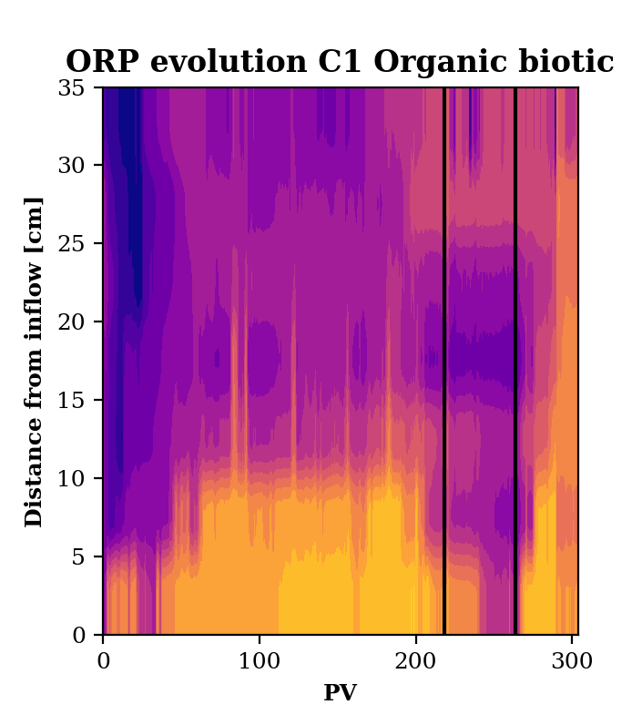
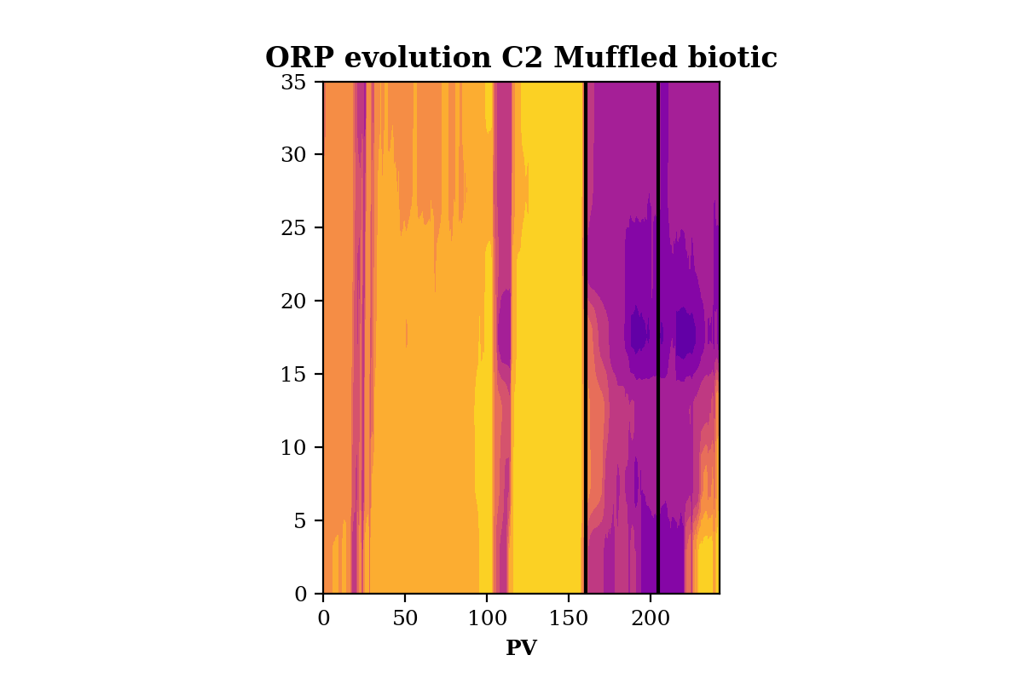
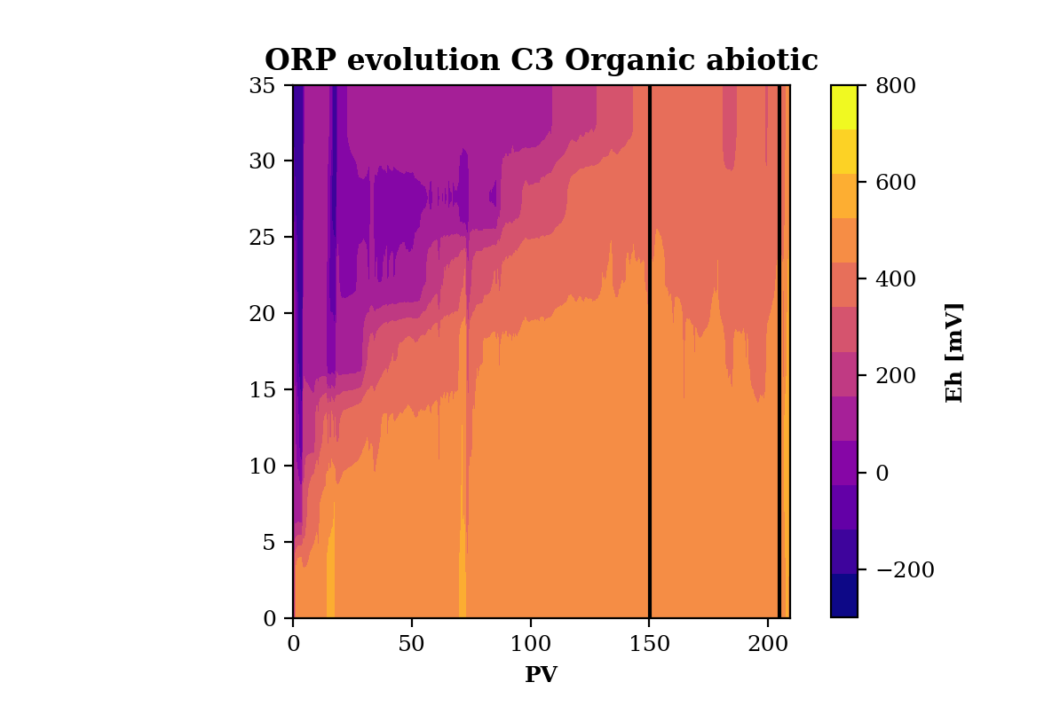
Results: Redox data
Black lines represent start and end of injection of EOCs.
ORP measurements in agreement with concentration of major ions (NO₃⁻, Mn, SO₄⁻²)
Enhanced reducing conditions during injection of EOCs, except in organic abiotic system..
26.05.2022. EGU Conference, Vienna, Austria.

Slide 7
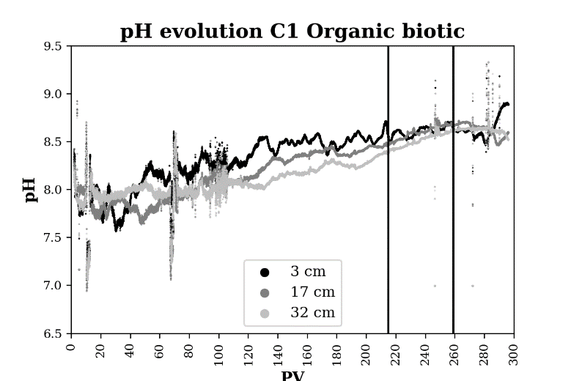
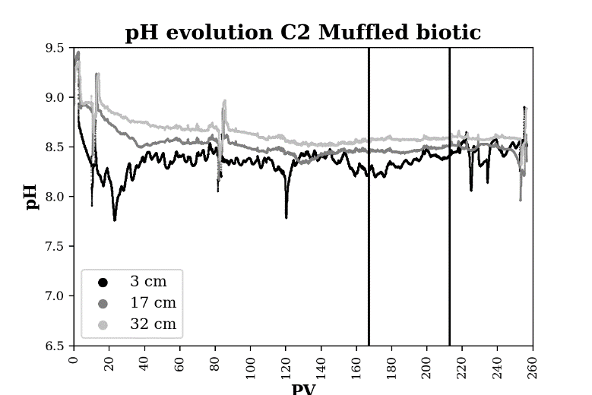
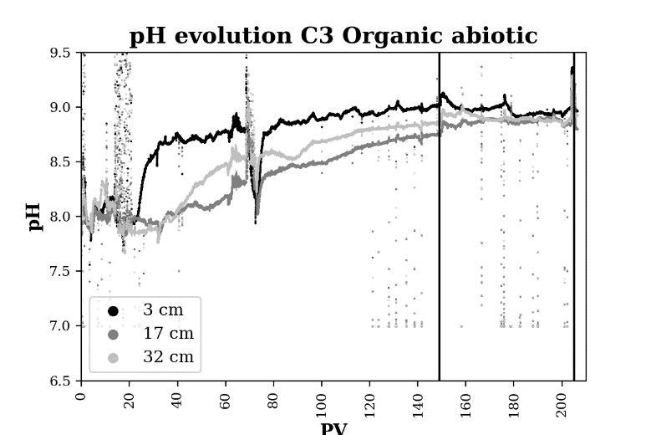
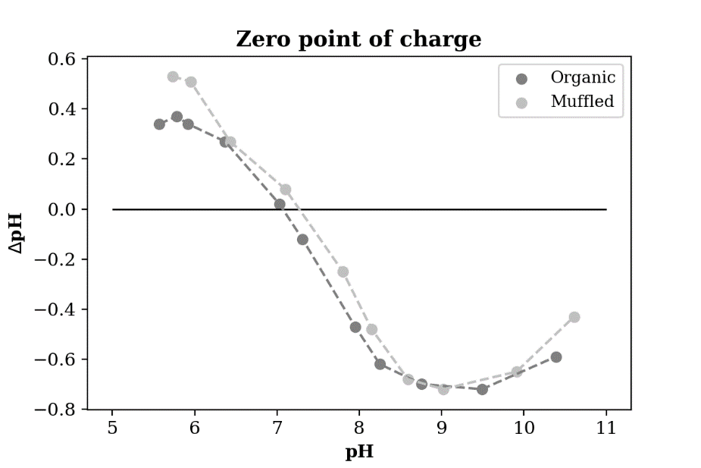
Results: pH data
Point of zero charge soil: Organic = 7.1. Muffled = 7.3
Net charge of the soil is negative, and constant in depth.
pH inflow water biotic = 8.5 – 8.6.
pH inflow water abiotic = 8.7 – 8.8.
Method from Anda et al., 2008.
26.05.2022. EGU Conference, Vienna, Austria.

Slide 8
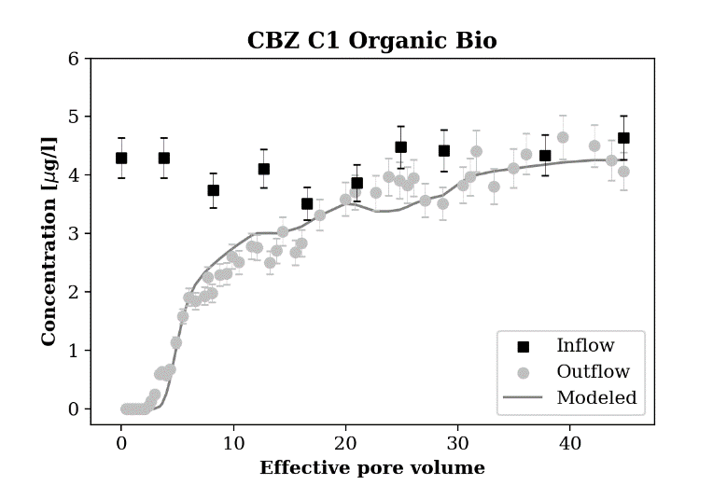
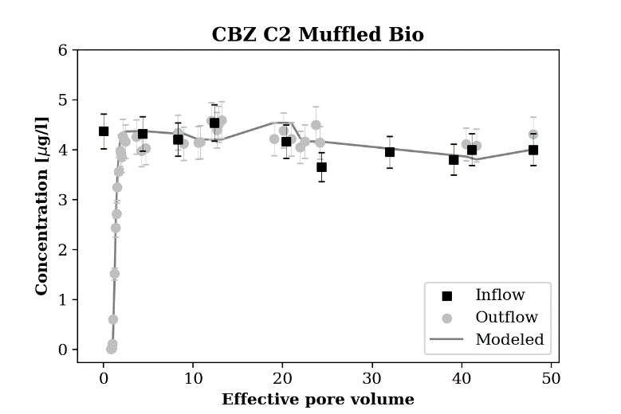
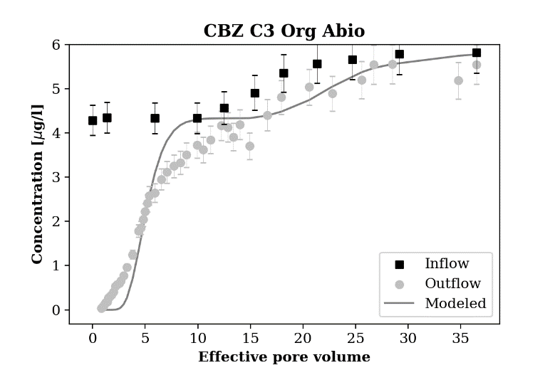
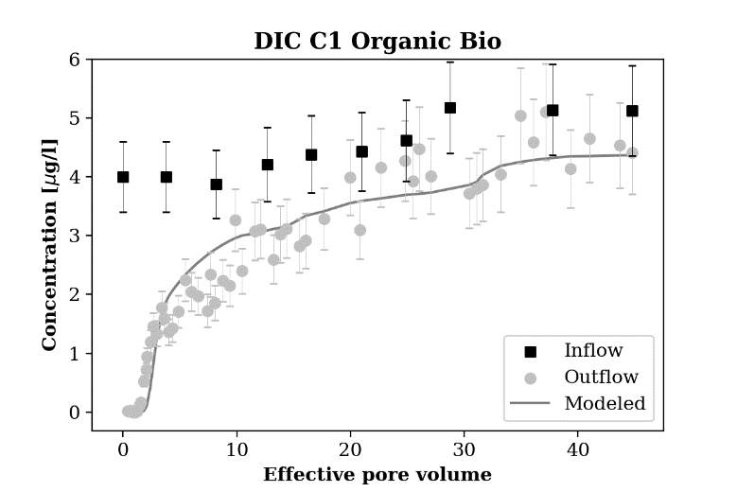
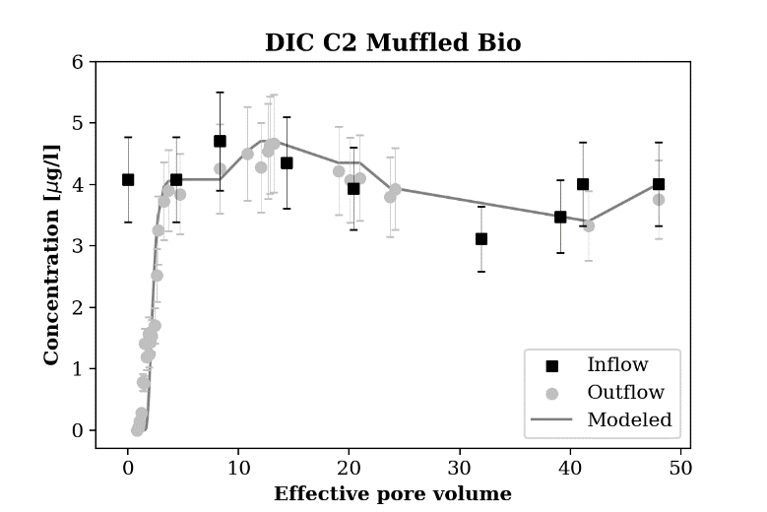
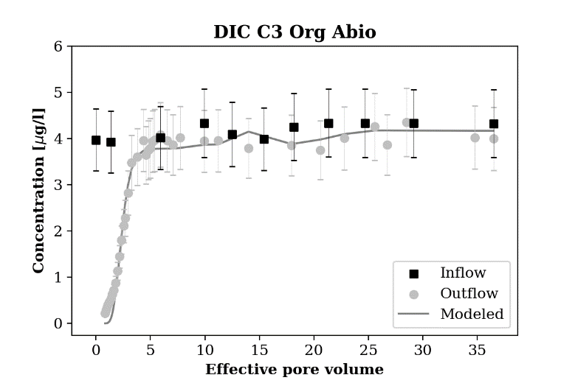
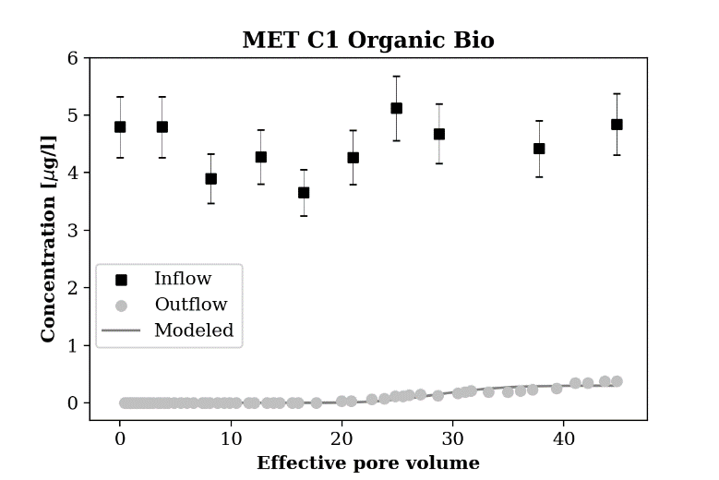
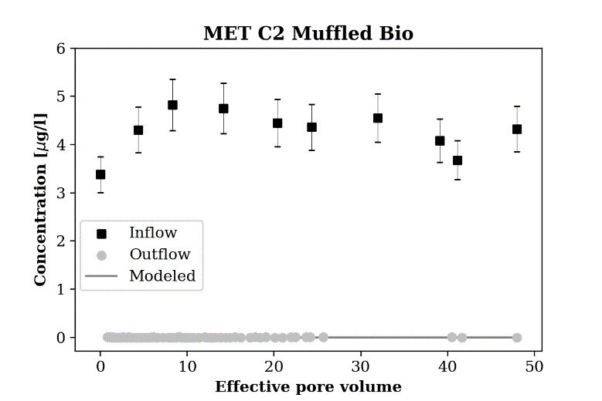
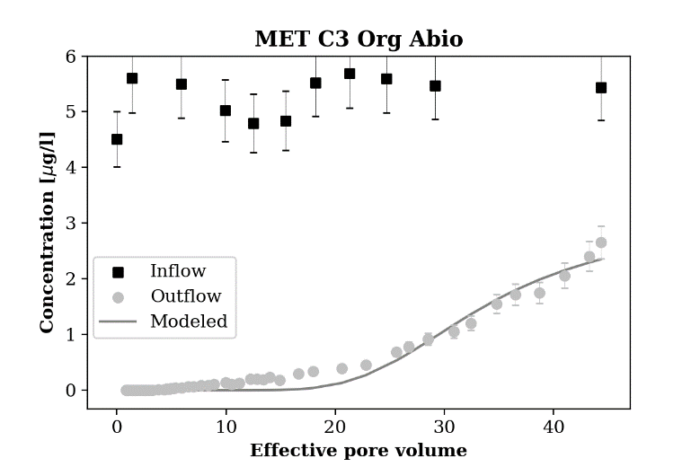
Results: BC’s EOCs double porosity model (CXTFIT. Toride et al., 1995)
26.05.2022. EGU Conference, Vienna, Austria.

Slide 9
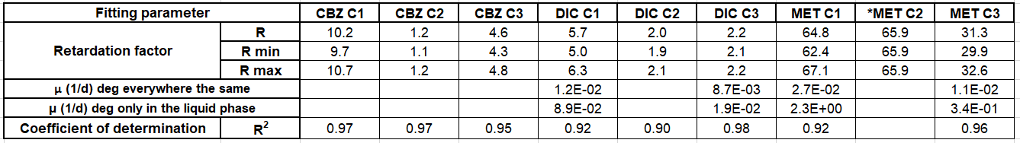
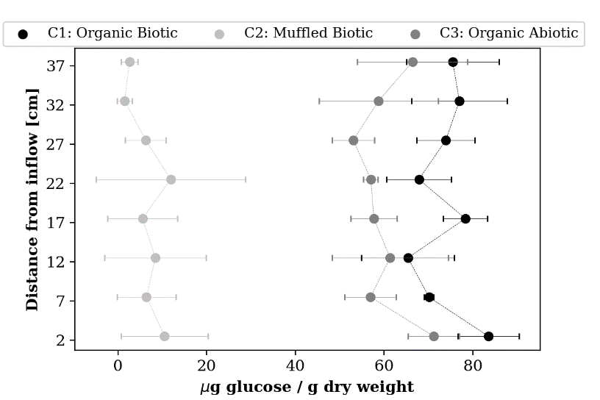
Results: Retardation factors and EPS content
EPS content
C1 > C3 > C2
Sorption
CBZ: C1 > C3 > C2
DIC: C1 > C3 ~ C2
MET: C2 > C1 > C3
MET > CBZ > DIC
Method from Redmile-Gordon et al., 2014.
26.05.2022. EGU Conference, Vienna, Austria.

Slide 10


Summary and conclusions
Sorption of CBZ (0) exhibits the most important influence of the organic matter content. No sorption in muffled system.
DIC (-) shows similar sorption between muffled column and organic abiotic system. No influence of organic matter. Sorption most likely on mineral sites of positive charge at the pH of the experiment (calcite and some inorganic oxides).
MET (+) has highest sorption in muffled column, corroborated with batch experiments (not shown). Higher sorption on mineral phases with sites negatively charged than in organic matter.
The three compounds studied in this work exhibit higher sorption (more than 2x retardation factor) in the organic biotic system compared to the abiotic, revealing an influence of the biofilm content in the sorption processes.
The MARSoluT ITN has received funding from the European Union’s Horizon 2020 research and innovation programme under the Marie Skłodowska Curie grant agreement No 814066.
26.05.2022. EGU Conference, Vienna, Austria.

