Slide 1






Dolomite- and magnesite-bearing pelites: poorly investigated, yet significant, sources of CO₂ in collisional orogens
PRESENTER
Shashi TAMANG
Department of Earth Sciences – University of Torino
Chiara GROPPO, Franco ROLFO
Department of Earth Sciences – University of Torino
Frédéric GIRAULT
IPGP – Université Paris Cité
23 – 27 May, 2022

Slide 2
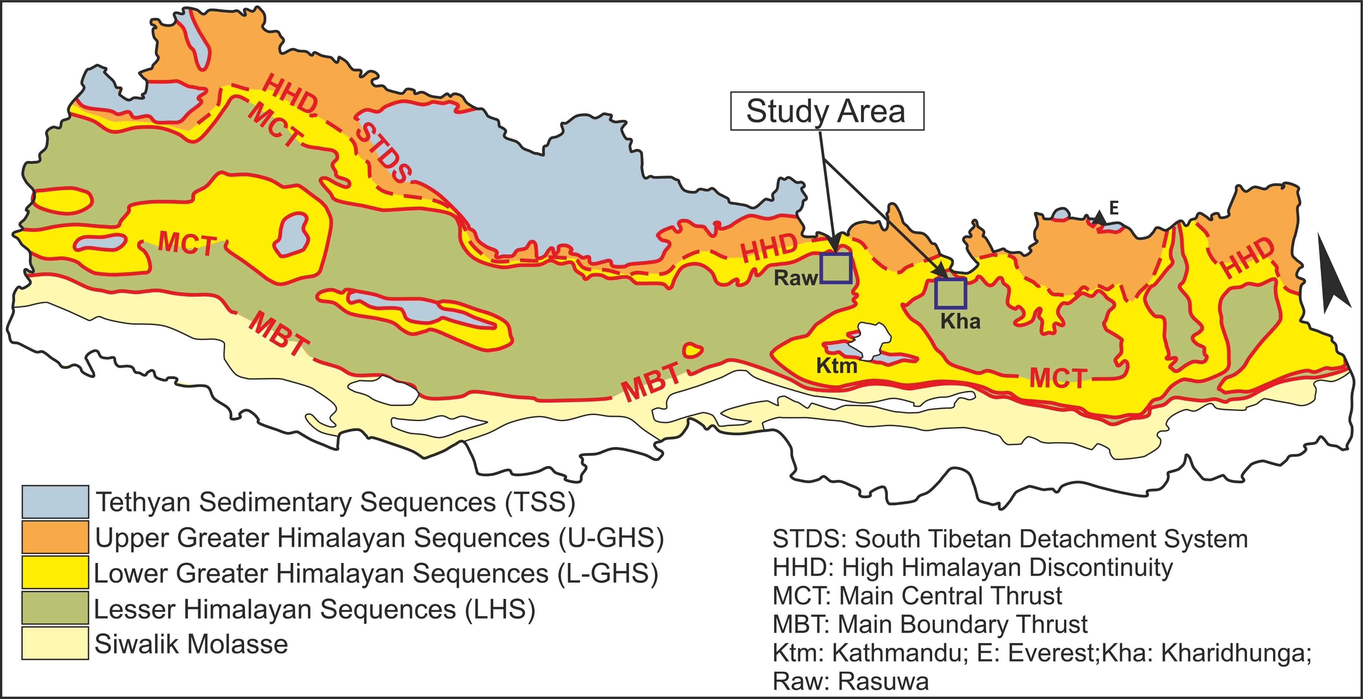
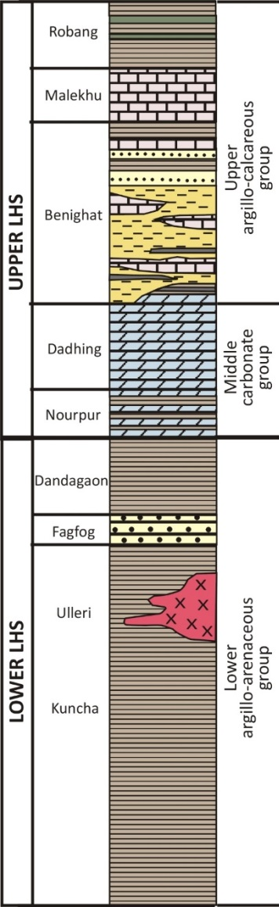
Introduction Aims/Methods Petrography PT-X(CO₂) Pseudosection Conclusion
DECARBONATION IN THE LHS OF NEPAL HIMALAYA
Production of CO₂-rich fluid in the collisional orogens e.g. Nepal Himalaya
Decarbonation reactions in dolomite- and magnesite-bearing rocks rarely investigated
The LESSER HIMALAYAN SEQUENCE (LHS) of the Nepal Himalaya is a thick sedimentary sequence consisting of low to medium grade lithologies.
Geological sketch map of Nepal Himalaya modified from Dhital (2015) and He et al. (2015)
Includes different types of carbonate-bearing lithologies mostly derived from:
dolomite-bearing protoliths (DOLOMITE SERIES): dolostones, dolomitic marls, dolomitic pelites
magnesite-bearing protoliths (MAGNESITE SERIES): magnesite-ores, magnesitic pelites
Modified after
Stöcklin (1980)
2

Slide 3
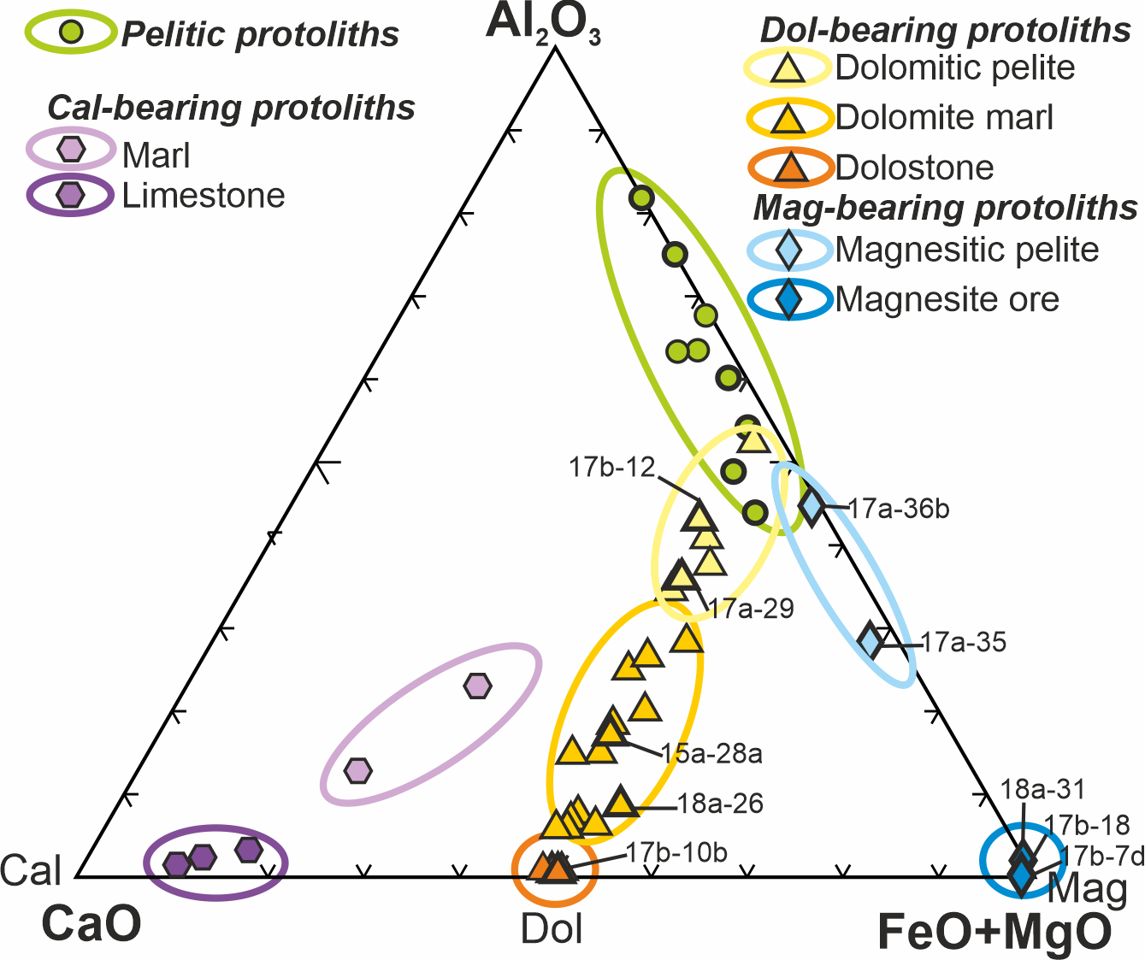
Introduction Aims/Methods Petrography PT-X(CO₂) Pseudosection Conclusion
Approach
Understanding the nature of decarbonation reactions in the LHS lithologies
Constraining the P-T conditions at which these reactions occurred
Estimating the amounts of dolomite/magnesite consumed and associated CO₂ released
Methods
Petrography, microstructural analysis and mineral
chemistry on 10 carbonate-rich lithology (Central Nepal)
Thermodynamic modeling
P/T-X(CO₂) pseudosection calculated in the system NKCFMAST-HC using Perplex 6.9.0, HP04 database, H₂O in excess
P/T gradient defined based on the P-T evolution
constrained from the associated metapelites
CAF diagram
3

Slide 4
Introduction Aims/Methods Petrography PT-X(CO₂) Pseudosection Conclusion
RESULTS: Petrographic & Microstructural analysis
PROTOLITHS: DOLOMITE SERIES
PROTOLITHS: MAGNESITE SERIES
Dolomitic marl (31% Dol)
Dolomitic pelite (7% Dol)
Magnesite ore (84% Mag)
Magnesitic pelite (18% Mag)
15a-28a: Amp+Pl-bearing carbonatic-phlogopitic schist
17b-12: two-mica Pl+Grt
-bearing graphitic schist
17b-7d: Tlc + Mg-Chl bearing magnesite ore
17a-35: Amp+Ky+Grt+Crd –
bearing phlogopitic schist
Dol+Cal = 21%
Porphyroblastic Amp (MgHbl) overgrows the Sm
No Dol relics
Post-kinematic growth of strongly zoned Pl (Na-rich core, Ca-rich rim)
Mag = 73%
Mag partially replaced by 2nd generation of Mag associated with Tlc and Mg-Chl
No Mag relics
Phl-rich and Amp-rich domains
Grt
Bt
Mu
Plg
Dol
Cal
Chl
Mag
Amp
4

Slide 5
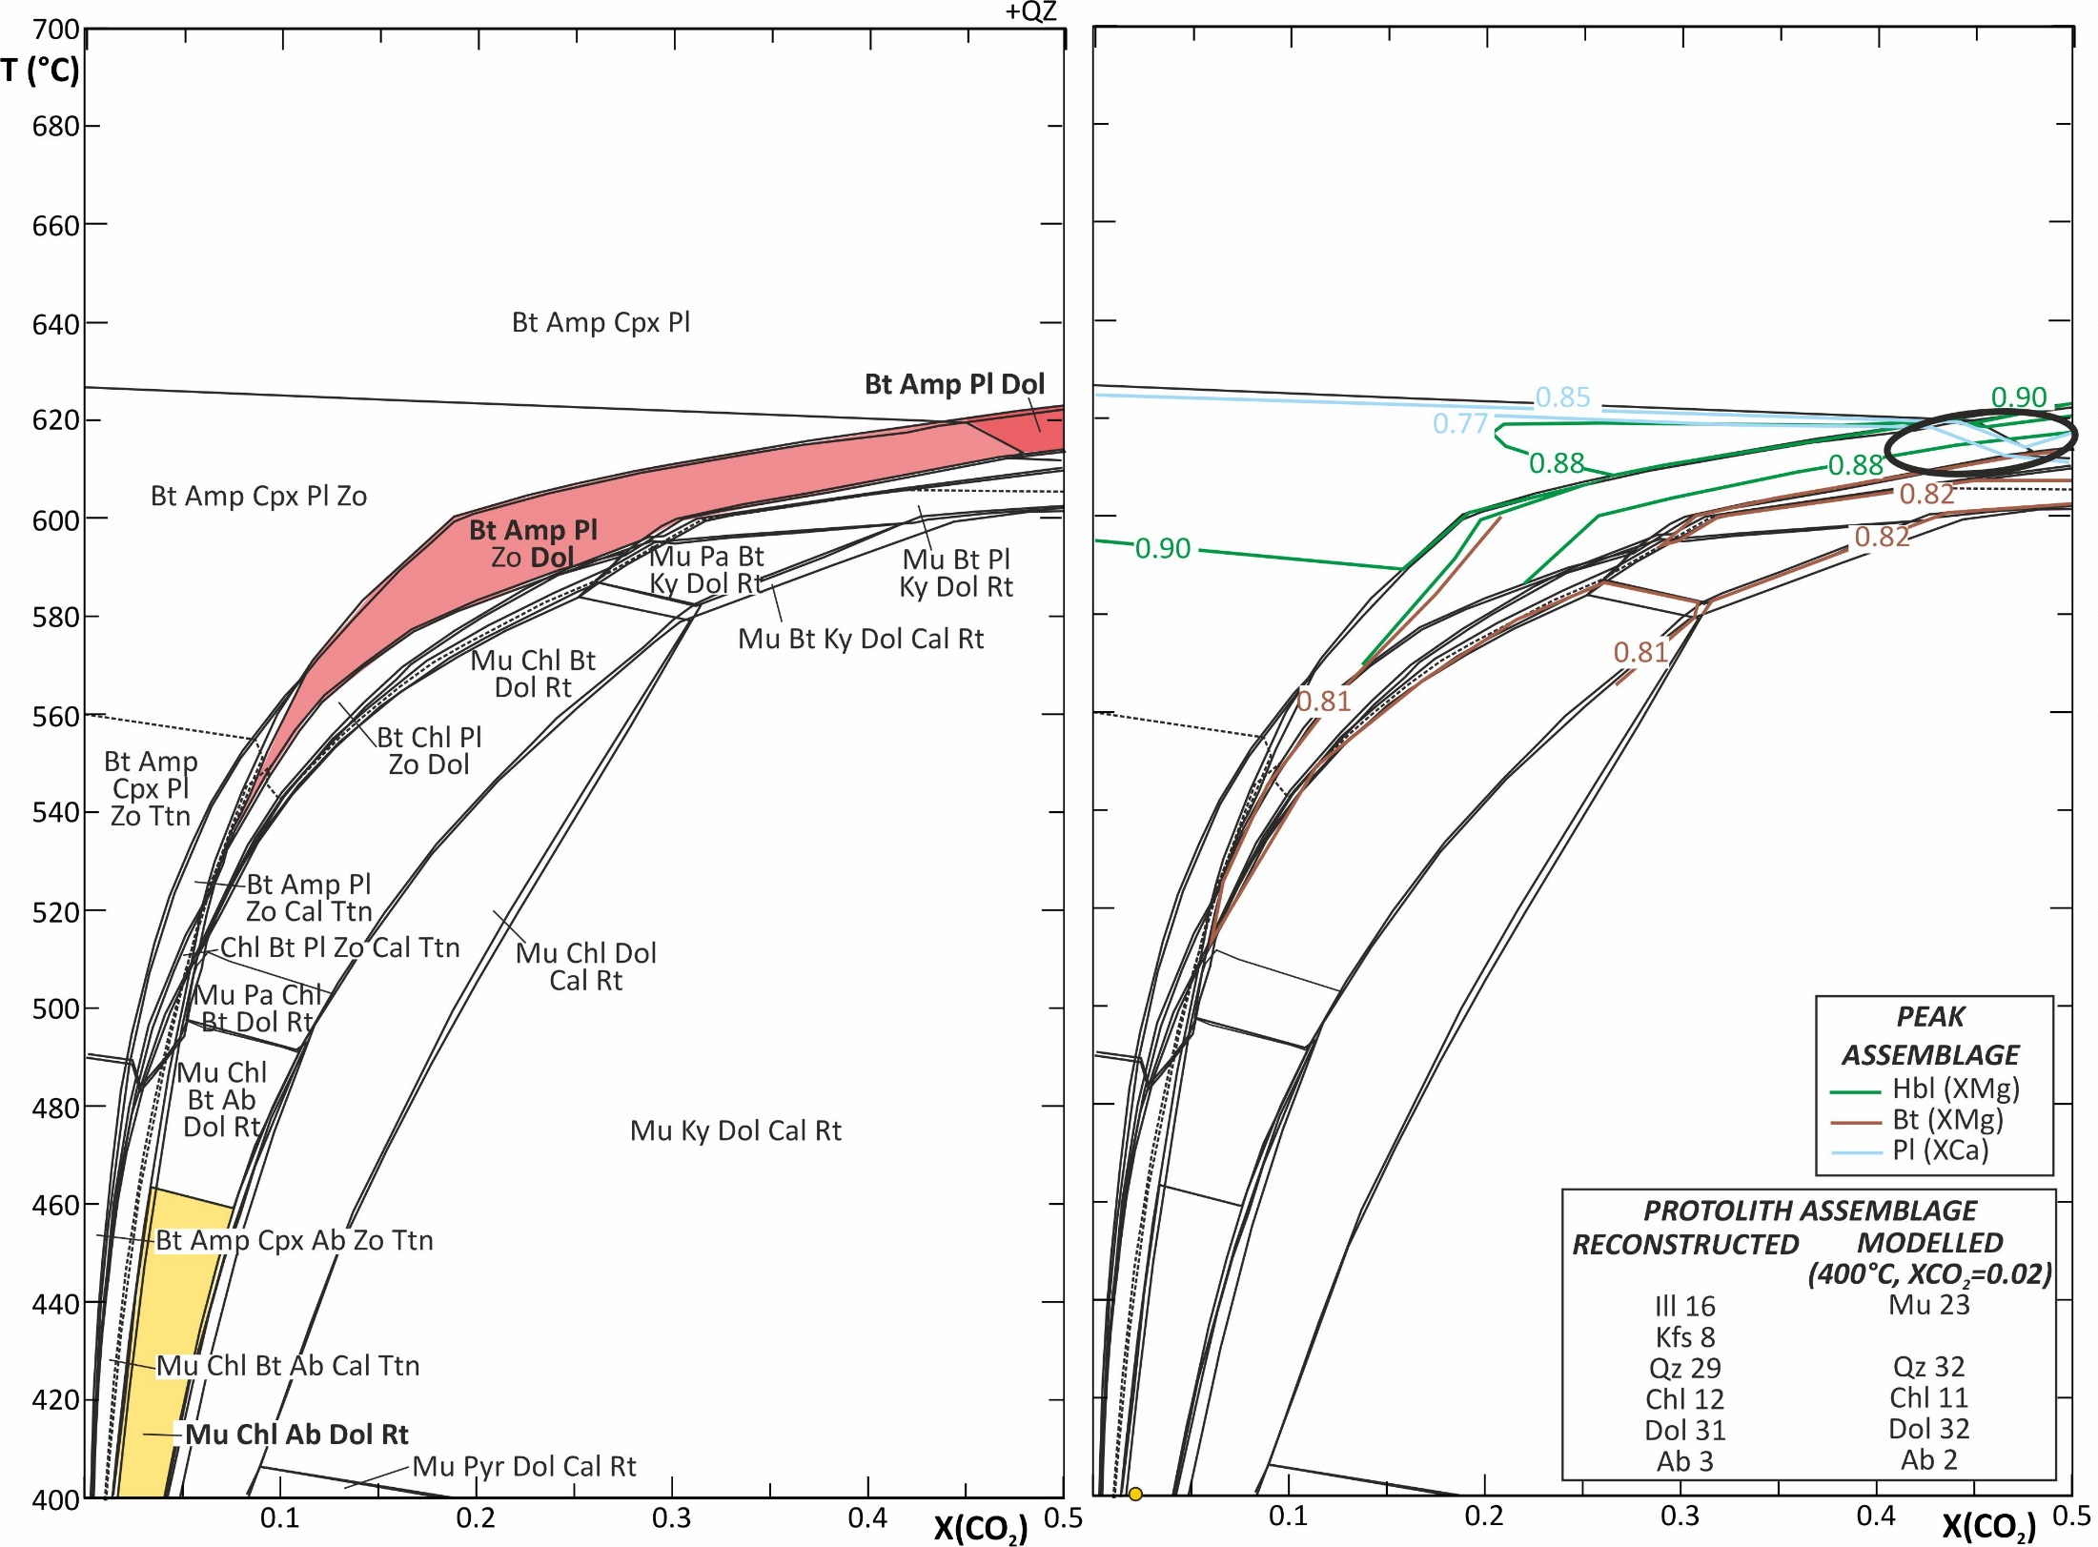
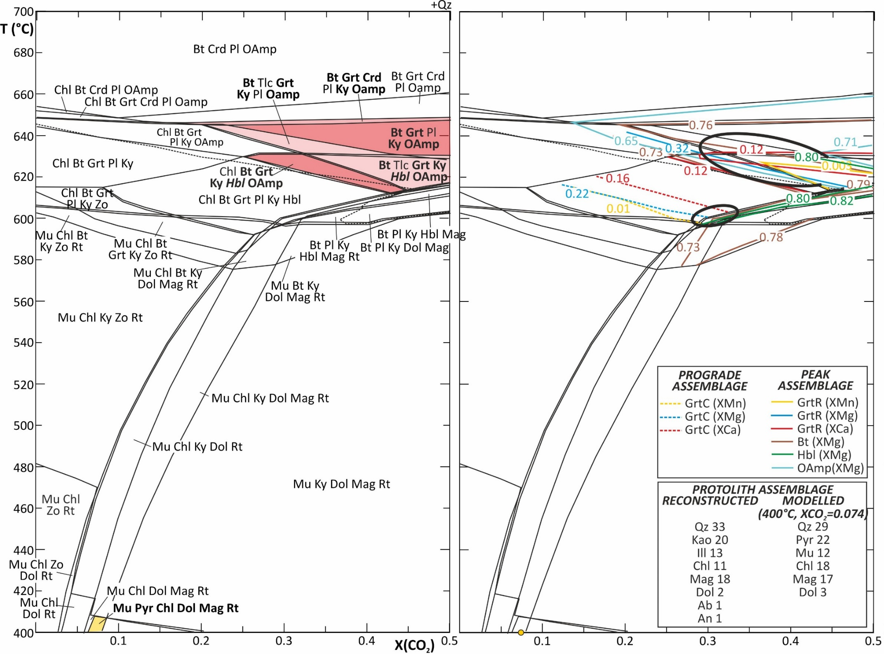
Introduction Aims/Methods Petrography PT-X(CO₂) Pseudosection Conclusion
RESULTS: Pseudosections
DOLOMITE SERIES
MAGNESITE SERIES
15a-28a: Amp+Pl-bearing carbonatic-phlogopitic schist
17a-35: Amp+Ky+Grt+Crd -bearing phlogopitic schist
Observed assemblage grew at T=610ºC-620ºC
Amount of dolomite consumed: 10 vol%
Observed assemblage grew at T=630ºC-650ºC
Amount of magnesite consumed: 18 vol%
Dol+Ky+Mu+Qz = Bt+Pl+Zo
Dol+Ky+Pl+Qz = Bt+Hbl+Zo
Mag+Ky+Qz = Chl+Grt
Chl+Pl+Qz = Hbl+Ky+Oamp
Chl+Hbl+Qz = Ky+Oamp+Tlc
Grt+Hbl+Qz+Tlc=Oamp+Pl
5

Slide 6
Introduction Aims/Methods Petrography PT-X(CO₂) Pseudosection Conclusion
CONCLUSIONS
Mineral assemblages formed during a heating decompression stage at P-T conditions of 620±20ºC, 8.5±0.2 kbar.
Peak assemblages are predicted to be stable in equilibrium with a CO₂ bearing fluid.
In general, the result points to an internally buffered P/T-X(CO₂) evolution.
Total amount of 7-20 vol% of carbonates was consumed, corresponding to 3-10 wt% of CO₂.
First step towards tentative comparison of the past CO₂ production (GHS & LHS)
with the present CO₂ emission in the Nepal Himalaya.
6

