Slide 1





Mediterranean soils under climate change: a drying-rewetting experiment with ¹⁴C-labelled glucose
Layla M. San Emeterio¹, González-Pérez J.A.¹, Chen, J.^{2,3}, Pérez-Ramos I.¹, Domínguez M.T.⁴, Kuzyakov, Y.^{5,6}, Gunina, A.³
¹Institute of Natural Resources and Agrobiology of Seville, Biogeochemistry and Microbial and Plant Ecology, Spain
²South China Botanical Garden, China.
³Dept. Environmental Chemistry, University of Kassel, Germany
⁴Dept. Crystallography, Mineralogy and Agricultural Chemistry, University of Seville, Spain
⁵Dept. Soil Science of Temperate Ecosystems, Department of Agricultural Soil Science, Georg August University of Göttingen, Germany
⁶Agrarian & Tech. Institute, RUDN University, Russia

Slide 2
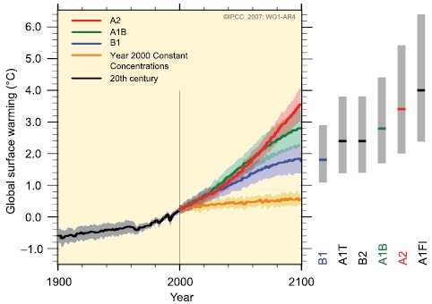
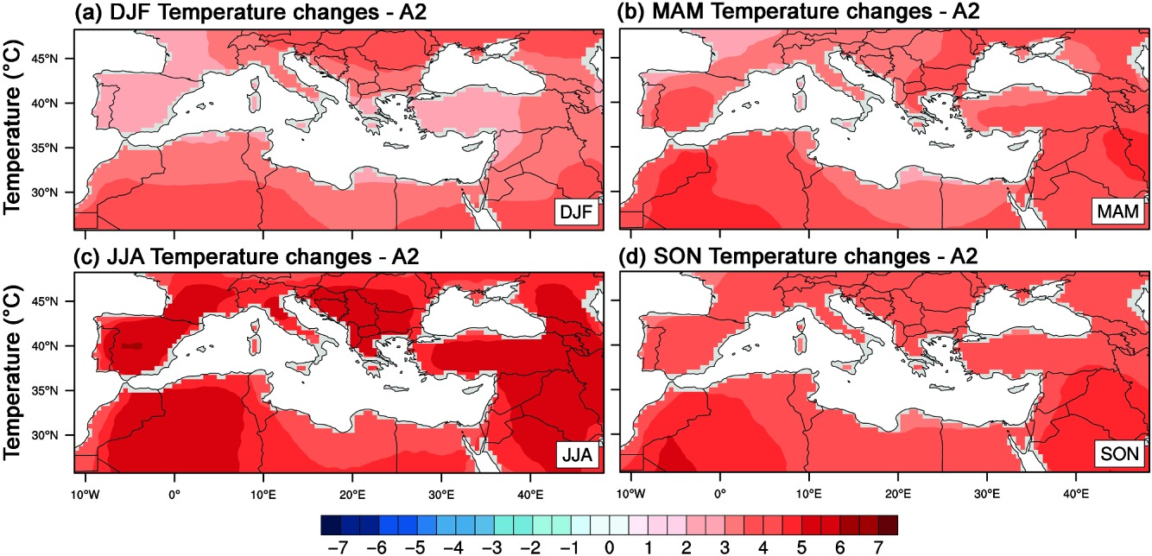
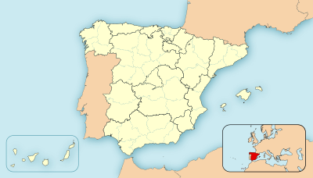
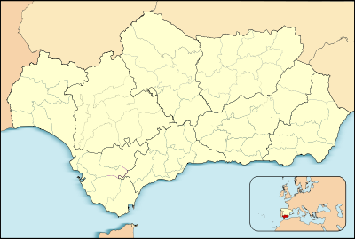
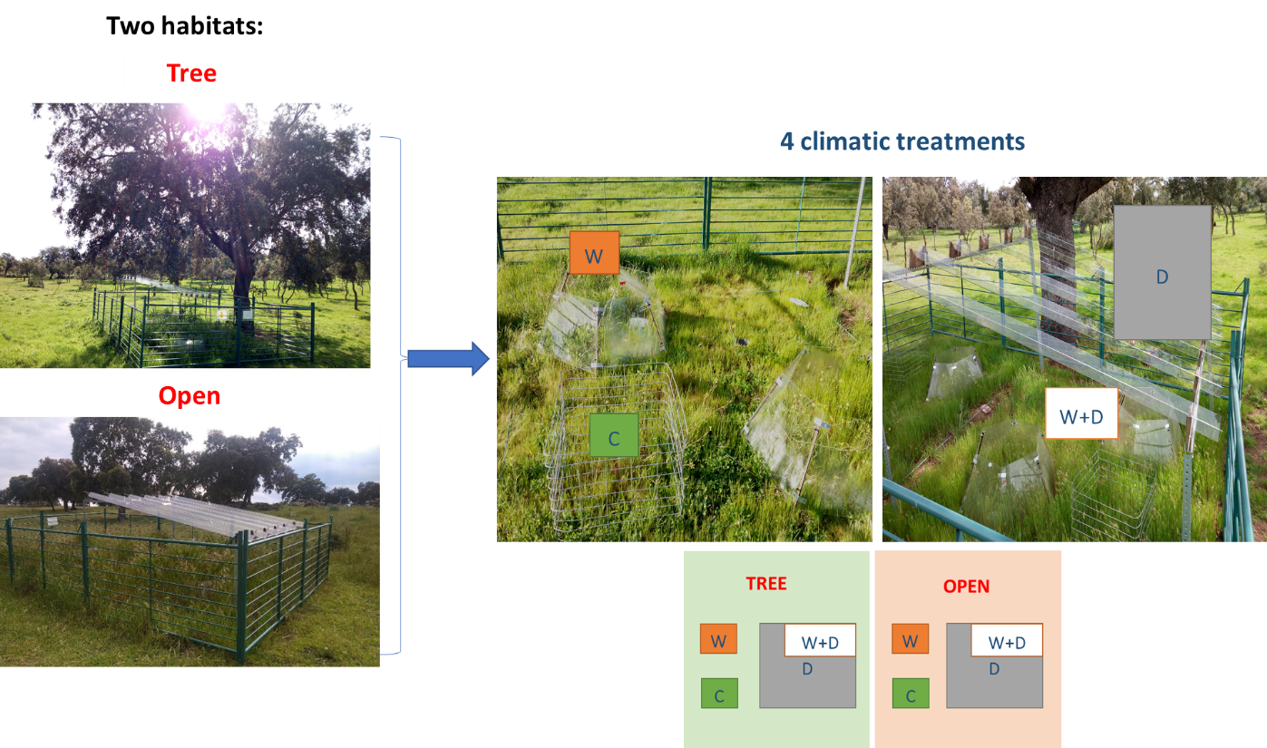
Forecasted climate change in Mediterranean ecosystems
Composite dehesa surface (0-10 cm) soil samples (Pozoblanco, Córdoba, Spain)
Ozturk et al., 2015
IPCC, 2013
Climate extremes: more frequent and prolonged, especially in Mediterranean ecosystems.
Drying-rewetting cycles (DWC) in soils can influence decomposition of litter and soil organic carbon (SOC) and their mineralization.
Determine the effects of climate-change factors (increasing temperature and drought events) on carbon turnover rates based on a DWC approach.
warming (W), an increase of 2 ºC induced according IPCC.
drought (D), excluding up for 30% of total precipitation
control (C)
Notes:
Drought coupled with high temperature has dramatic impacts on soil biogeochemical cycling in forest ecosystems, and it can even induce tree mortality and reduce forest ecosystem productivity (Schlesinger et al., 2016).
In a 2021 survey of 92 IPCC scientists, based on current rates of progress in reducing GHG emissions, 60% expected the world to warm by at least 3 °C
Ozturk, T., Ceber, Z. P., Türkeş, M., & Kurnaz, M. L. (2015). Projections of climate change in the Mediterranean Basin by using downscaled global climate model outputs. International Journal of Climatology, 35(14), 4276-4292.

Slide 3
Drying-rewetting experiment: 26-days incubation
x3 types of soil
1. Preincubation
2. Drying
3. Rewetting
Control (C)
Drought (D)
Warming (W)
Total CO₂
¹⁴C CO₂
3 days every day
2 times/1st day; 2 times/ every 2 days, every 5 day
addition of ¹⁴C-labelled glucose
x4 rewetting treatments
Constant-moisture (no drying)
Dry (7 days drying and no rew.)
Slow (5-days H₂O addition to 40%)
Fast (H₂O added to 40% at the 1st day)
For each sampling point (T1, 2 & 3)
DOC, MBC (fumigation extraction).
NH₄⁺, NO₃⁻
Enzyme activity:
BG: β-glucosidase (C-acquiring enzyme)
NAG: N-acetylglucosaminidase (N-acquiring enzyme)
ACP: acid phosphatase (organic P acquiring enzyme)
3 days, 50% MBC/day till constant WHC (40 %)
All jars except for the ‘constant’ rewetting ones were dried at 40ºC for 5 days
Treatments
T0
Constant moisture
CO₂
T1
T2
T3
x3 sampling points
T1: 3 days
T2: 6 days
T3: 26 days
- 12
- 9
- 5
0
3
6
26
Time (days)
Notes:
Therefore, we conducted a 26-day incubation experiment with soils from this field experiment. Firstly, soil jars were preincubated for three days at which we assigned to constant moisture treatments (40% soil water-holding capacity, WHC) and labelled each day with 14C-glucose. The experiment included four rewetting treatments: 1) constant-moisture at 40% WHC, 2) slow DWC with 5-days water addition to 40% WHC, 3) fast DWC with all water added during the first day of the experiment, and 4) dry DWC with 7-days drying and no rewetting. Following DWC period, there was a 26-d extended incubation, where destructive samples were taken at three different times (T1: 3 days; T2: 6 days; T: 26 days).
Other analysis were conducted but not shown here given the great amount of data generated.
Enzyme activities for b-1,4-glucosidase (BG), b -1,4-N-acetylglucosaminidase (NAG), and acid phosphatase (aP) were determined; these enzymes are commonly used to assess the investment of the overall microbial community (fungi and bacteria) in the acquisition of the limiting elements C, N, and P (Sinsabaugh et al., 2008).

Slide 4
Mineralization of newly incorporated glucose-derive C from MB pool (T3)
The total CO₂ efflux was lower in open habitat compared to tree.
No differences were found in total CO₂ efflux for the field-induced treatments in open habitat → more adaptation.
Lower values under dry rewetting → use of recently produced metabolites for survival.
Open
Tree
Control
Warming
Drought
Control
Warming
Drought
*
*
*
*
¹²CO₂
*
*
¹⁴CO₂

Slide 5
Dissolved organic C, N and glucose-derived ¹⁴C-DOC (T3)
Total DOC
¹⁴C-DOC
Total DON
Control
Warming
Drought
Control
Warming
Drought
Control
Warming
Drought
*
*
*
*
*
*
*
*
*
*
Higher values under tree canopy than in open pasture for all data.
Total DOC and ¹⁴C-DOC did not change over rewetting or field-induced treatments.
Only DON showed effects regarding rewetting, lower values under dry → microbial accumulation of N-derived compounds to mitigate the drought.
Habitat
open
tree
Notes:
Data presented only for T3 sampling point (after 26 days of incubation)
Discrepancy of DON and DOC -> due to differences in the pathways of C and N mineralization after drought

Slide 6
Microbial-derived C, N and glucose-derived ¹⁴C-MBC (T3)
Total MBC
¹⁴C-MBC
Total MBN
Control
Warming
Drought
Control
Warming
Drought
Control
Warming
Drought
*
*
*
Higher values under tree canopy than in open pasture for all data.
Lesser differences in total MBC under control soils → faster recovering, more adaptation to dry cycles.
Greater total MBC values under constant rewetting → non-disturbance.
¹⁴C-MBC showed no influence of habitat under field-induced drought.
Total MBN was affected by all factors: higher values in soils from field-induced drought and under constant moisture.
Habitat
open
tree
Notes:
faster recovering, more adaptation to dry cycles.
than those field-induced drought and warming.

Slide 7
Activities of enzymes from open habitat (T3)
Acid phosphatase
β-glucosidase
N-acetylglucosaminidase
Rewetting
250
250
100
constant
dry
200
200
80
slow
fast
150
150
60
*
nMol g⁻¹ dry soil h⁻¹
*
*
100
100
40
50
50
20
C
W
D
Control
Warming
Drought
Control
Warming
Drought
Control
Warming
Drought
C
W
D
C
W
D
Higher values under tree canopy than in open pasture for all substrates.
Minor differences in control soils according to rewetting, higher general values.
Higher values under constant & fast rewetting in drought-induced soils → microbes recover their functions faster.
Notes:
b-glucosidase (BG, C-acquiring enzyme), N-acetylglucosaminidase (NAG, N-acquiring enzymes), and acid phosphatase (AP, organic P acquiring enzyme)

Slide 8
Activities of enzymes from tree habitat (T3)
Acid phosphatase
β-glucosidase
N-acetylglucosaminidase
Rewetting
300
200
constant
300
dry
slow
150
fast
200
*
200
nMol g⁻¹ dry soil h⁻¹
*
100
*
*
*
100
*
100
*
50
C
W
D
C
W
D
C
W
D
Control Warming Drought Control Warming Drought Control Warming Drought
Control
Warming
Drought
Control
Warming
Drought
Control
Warming
Drought
Overall higher activity in ACP and BGLU under drought-induced soils.
Lower values under dry rewetting.
NAG activity is not affected by field treatments under tree → symbioses effects by roots to cover N supply?

Slide 9



Concluding remarks
Future scenarios of climate change in Med. Soils will shift the cycles of C, N and P, but the effects will be mainly driven by the habitat; in this case, the effect of tree canopy.
Habitat will determine the input of C for microorganisms and their further functioning under drought stress and mineralization of SOM for nutrients mininig.
The activity of microorganisms under drought-rewetting and utilization of metabolites will be determined by the previous climate history/adaption.
Acknowledgements
Contact
@LaylaMSE
EU-EJC 2nd Call Projects MIXROOT-C and MAXROOT-C. Research stay funded by Short-Term Grants Programme (2021) from the German Academic Exchange Service (DAAD, No. 91799199). L.M. San Emeterio thanks Ministerio de Ciencia Innovación y Universidades (MICIU) FPI research grant (BES-2017-07968) for funding. A.M. Carmona, M.D. Hidalgo and P. Campos are acknowledged for technical assistance.
lmarsan@irnas.csic.es

