Slide 1
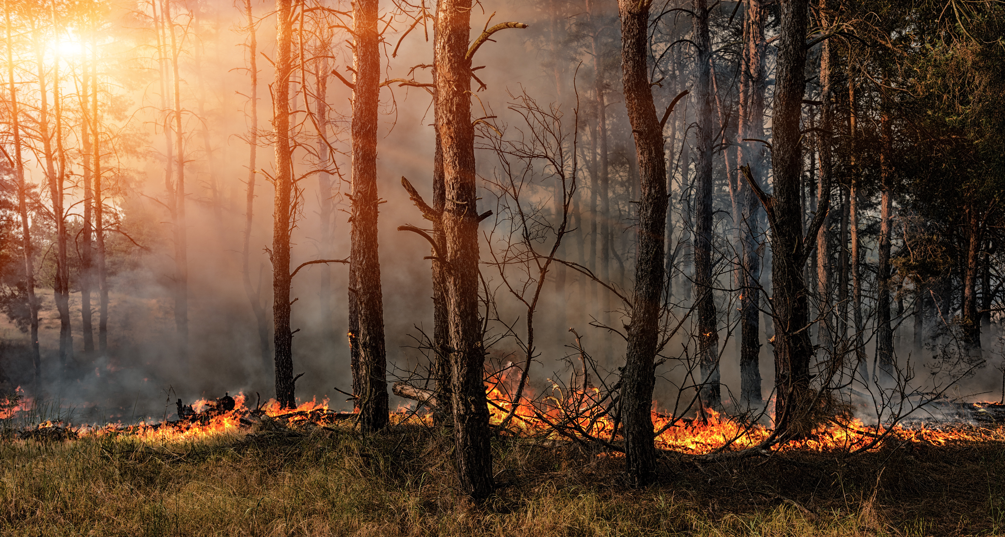




THE IMPACTS OF THE 2017 CATASTROPHIC FIRE SEASON IN PORTUGAL ON VEGETATION PRODUCTIVITY
Tiago Ermitão¹, Célia Gouveia^{1,2} and Ana C. Russo¹
¹ Instituto Dom Luiz, Faculdade de Ciências da Universidade de Lisboa, 1749-016 Lisboa, Portugal
² Instituto Português do Mar e da Atmosfera, I.P., Rua C do Aeroporto, 1749-077 Lisboa, Portugal

Slide 2
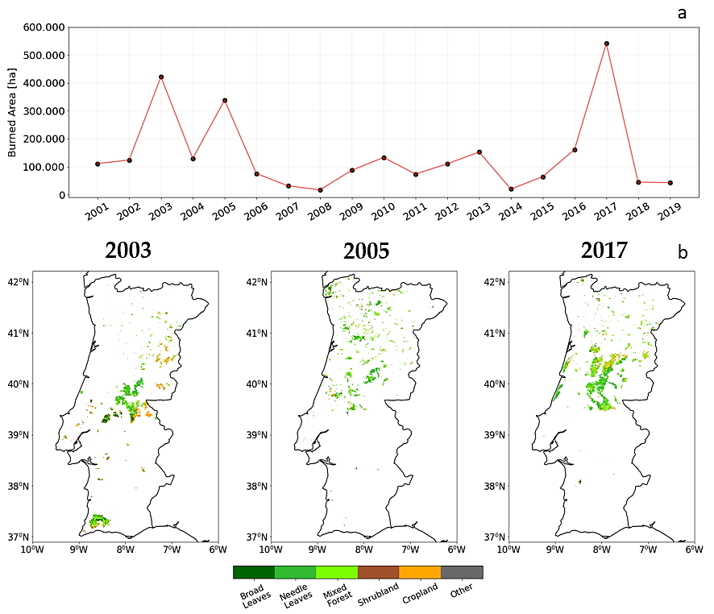

BURNED AREAS (BA)

Slide 3



MAIN GOAL
Role of vegetation activity in conjunction with hot/dry conditions on wildfires of 2017
LAND SURFACE TEMPERATURE (LST)
GROSS PRIMARY PRODUCTIVITY (GPP)
BURNED AREAS (BA)
WATER AVAILABILITY ON VEGETATION (NDWI)

Slide 4

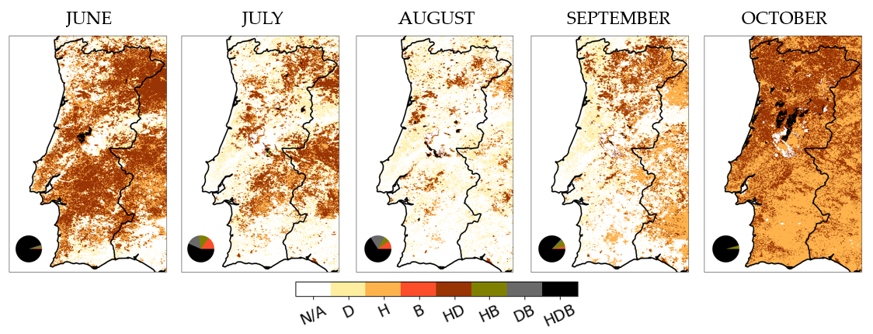

TASK 2
FINAL REMARKS
HOT / DRY CONDITIONS ON BURNED AREAS
TASK 1
Burned only, B (${LST}_{ANOM}<1σ$ and ${NDWI}_{ANOM}>−1σ$)
Hot and Burned, HB (${LST}_{ANOM}>1σ$)
Dry and Burned, DB (${NDWI}_{ANOM}<−1σ$)
Hot, Dry and Burned, HDB (${LST}_{ANOM}>1σ$ and ${NDWI}_{ANOM}<−1σ$)

Slide 5
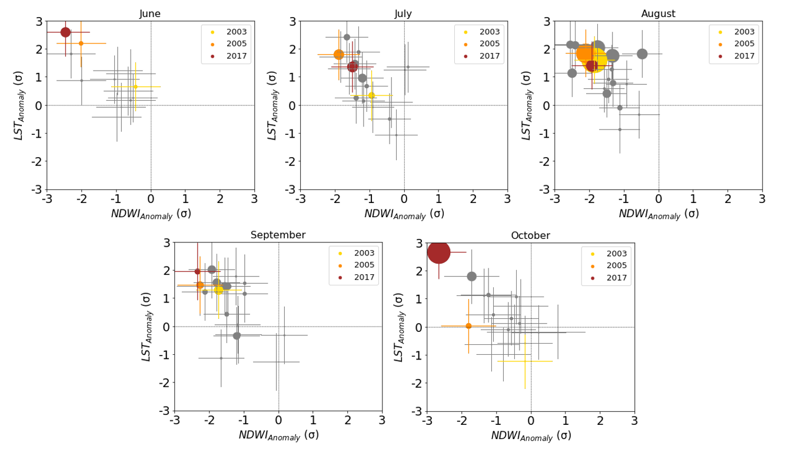
TASK 2
FINAL REMARKS
HOT / DRY CONDITIONS ON BURNED AREAS
TASK 1

Slide 6
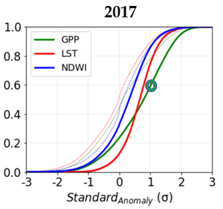
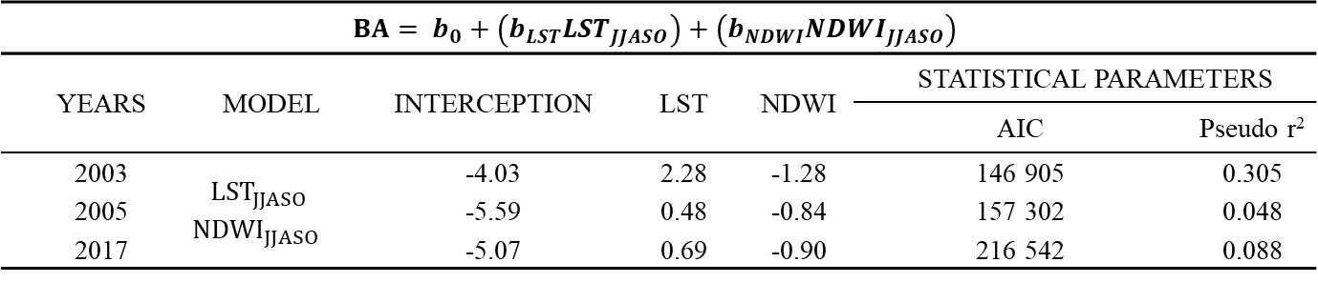
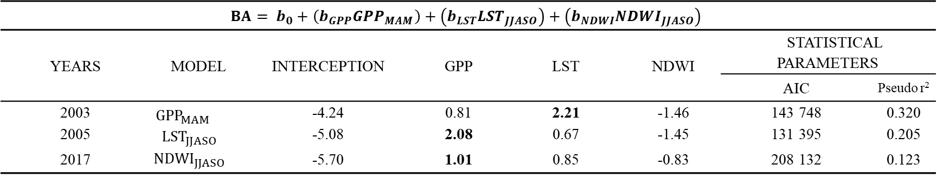
TASK 2
FINAL REMARKS
LOGISTIC REGRESSIONS MODELS
TASK 1
$$BA= b_{0}+\left(b_{LST}{LST}_{JJASO}\right)+\left(b_{NDWI}{NDWI}_{JJASO}\right)$$
YEARS | MODEL | INTERCEPTION | LST | NDWI | STATISTICAL PARAMETERS
 |  |  |  |  | AIC | Pseudo r²
2003 | $${LST}_{JJASO}$$ $${NDWI}_{JJASO}$$ | -4.03 | 2.28 | -1.28 | 146 905 | 0.305
2005 |  | -5.59 | 0.48 | -0.84 | 157 302 | 0.048
2017 |  | -5.07 | 0.69 | -0.90 | 216 542 | 0.088
$$BA= b_{0}+\left(b_{GPP}{GPP}_{MAM}\right)+\left(b_{LST}{LST}_{JJASO}\right)+\left(b_{NDWI}{NDWI}_{JJASO}\right)$$
YEARS | MODEL | INTERCEPTION | GPP | LST | NDWI | STATISTICAL PARAMETERS
 |  |  |  |  |  | AIC | Pseudo r²
2003 | $${GPP}_{MAM}$$ $${LST}_{JJASO}$$ $${NDWI}_{JJASO}$$ | -4.24 | 0.81 | 2.21 | -1.46 | 143 748 | 0.320
2005 |  | -5.08 | 2.08 | 0.67 | -1.45 | 131 395 | 0.205
2017 |  | -5.70 | 1.01 | 0.85 | -0.83 | 208 132 | 0.123

Slide 7
TASK 1
TASK 2
FINAL REMARKS
FINAL REMARKS
Selectivity of fires over areas simultaneously under the effect of hot/dry conditions.
Role of vegetation activity in spring was the most influent driver on BA of 2017 fire season.
Two different regimes: preconditioning effects of vegetation in spring and early summer / predominance of fuel dryness in summer.
Future projections show the increasing likelihood of fire seasons’ like the 2017 one occurred in Portugal.

Slide 8
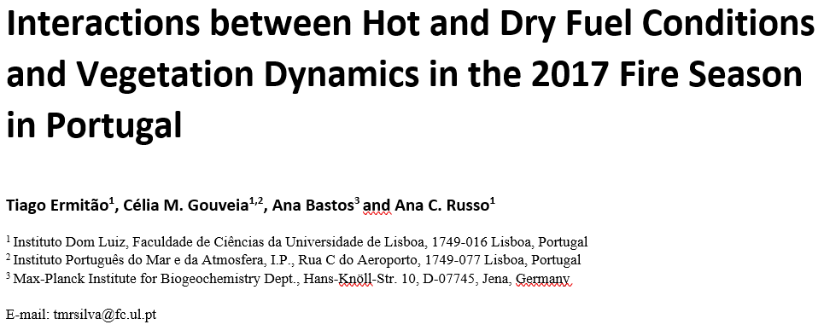
THANK YOU !
WORK UNDER REVIEW ON ENVIRONMENTAL RESEARCH LETTERS

Slide 9
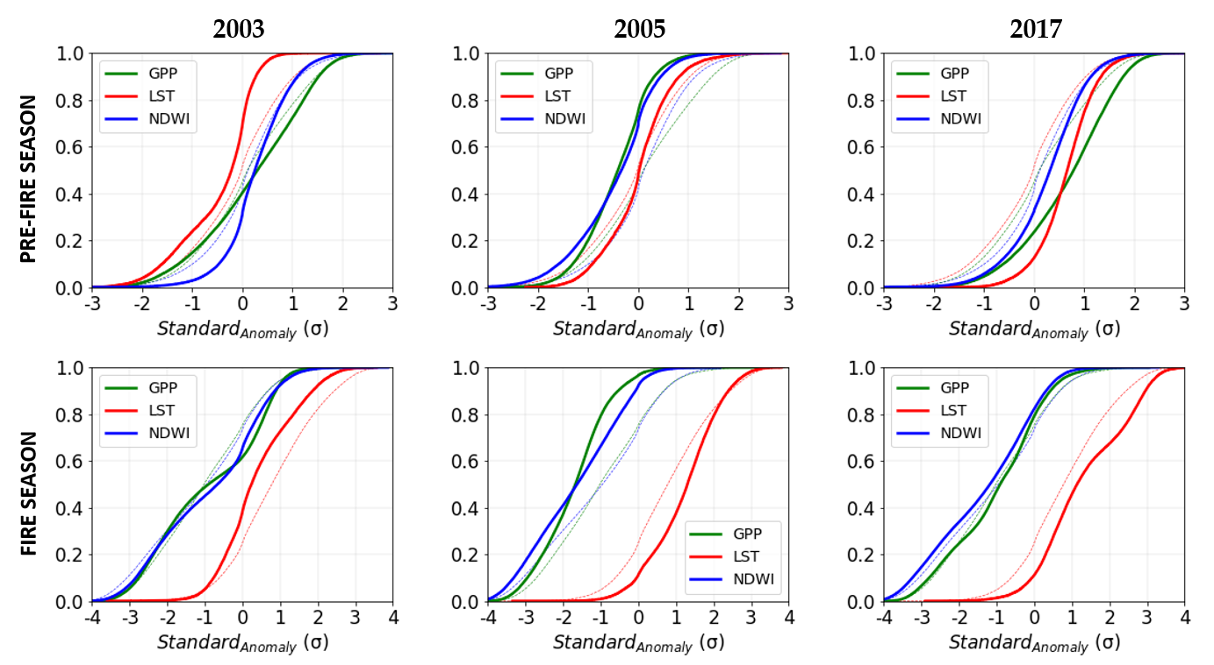
PRE-FIRE & FIRE SEASON CONDITIONS

