Slide 1



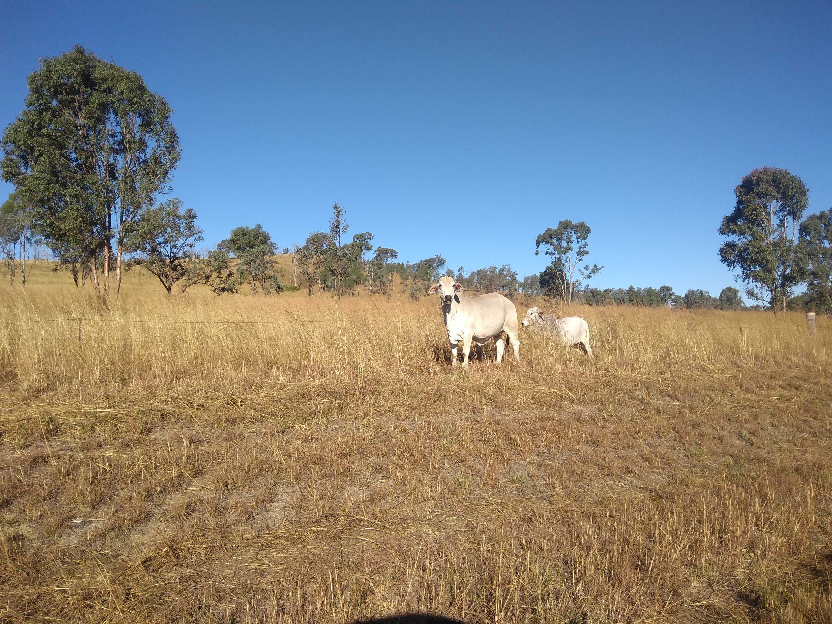
Comparing sediment yield models in grazing land
Jagriti Tiwariª, Bofu Yuª, D Mark Silburn^{b}, Rebecca Bartley^{c}, Jo Owens^{d}, Craig Matthew Thornton ^{e}, Andrew Brooksª
ªAustralian River Institute, School of Engineering and Built Environment, Griffith University, Nathan, Queensland, 4111, Australia
^{b}Agricultural Production Systems Research Unit, Department of Environment and Resource Management, Toowoomba, Qld 4350, Australia
^{c}CSIRO, Brisbane, Queensland 4068, Australia
^{d}Centre for Agricultural Engineering, University of Southern Queensland, Toowoomba, Queensland
^{e}Department of Resources, Mines, and Energy, PO Box 1762, Rockhampton, Queensland, 4700, Australia

Slide 2
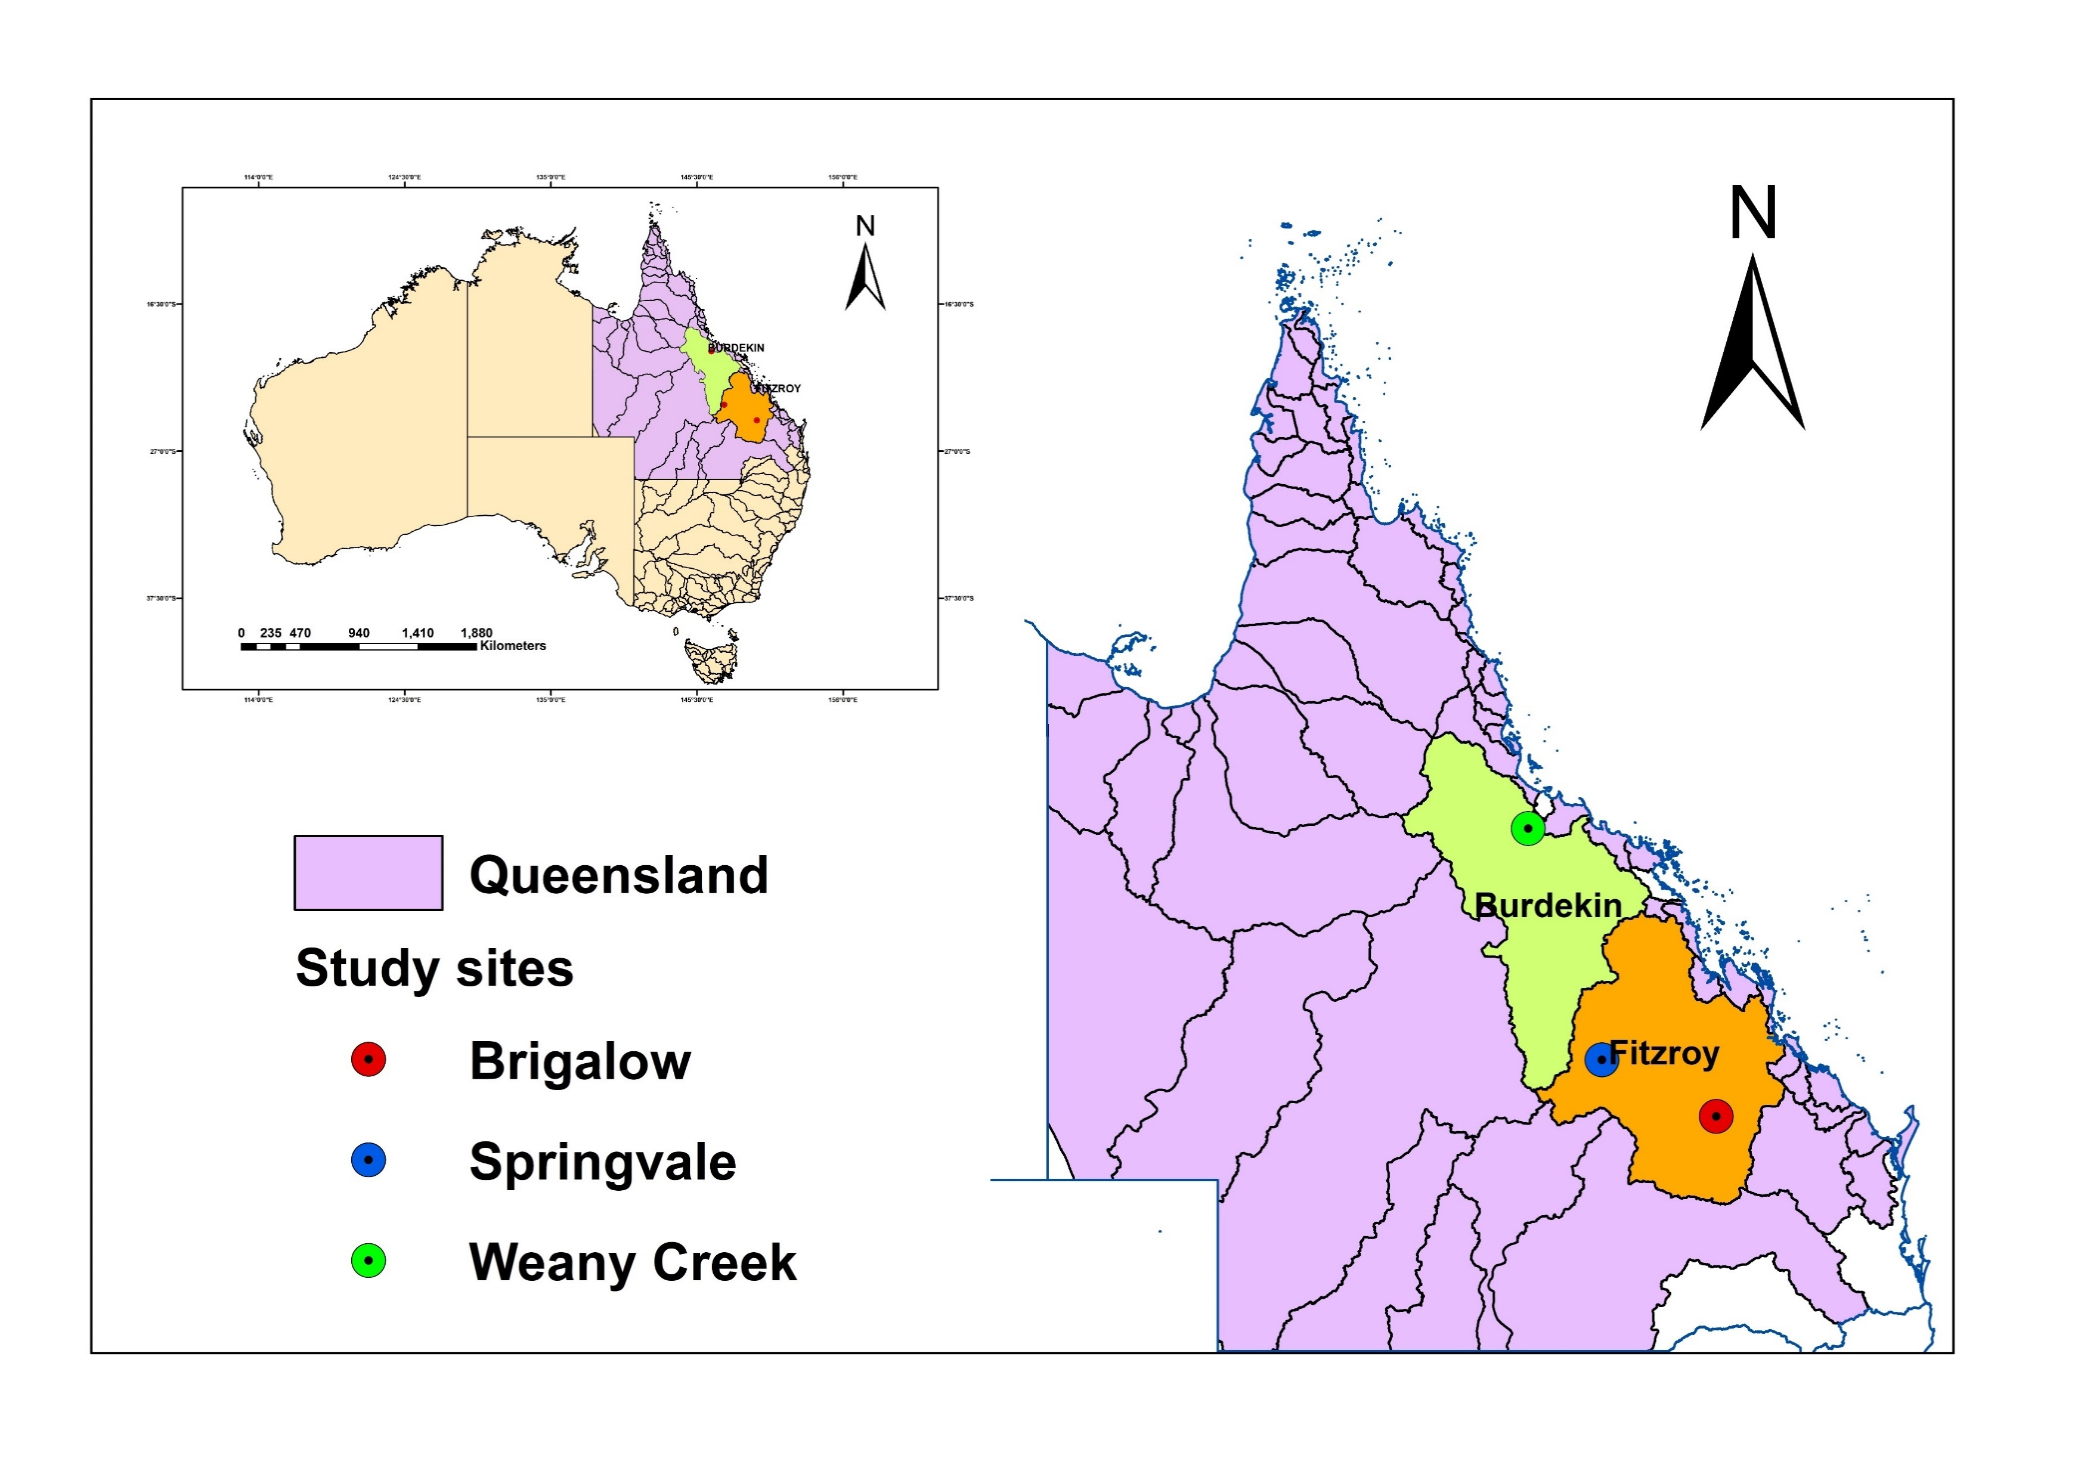
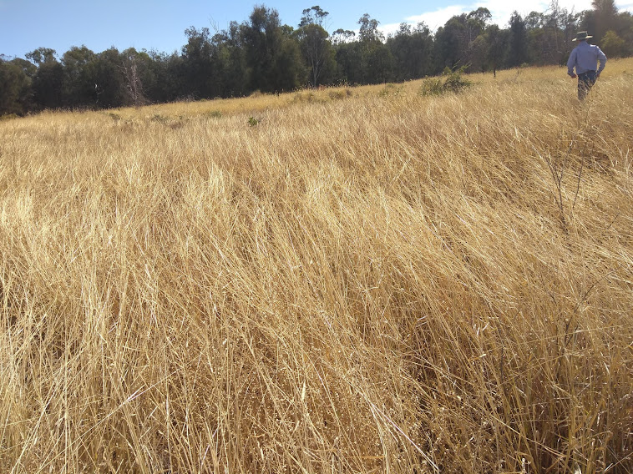
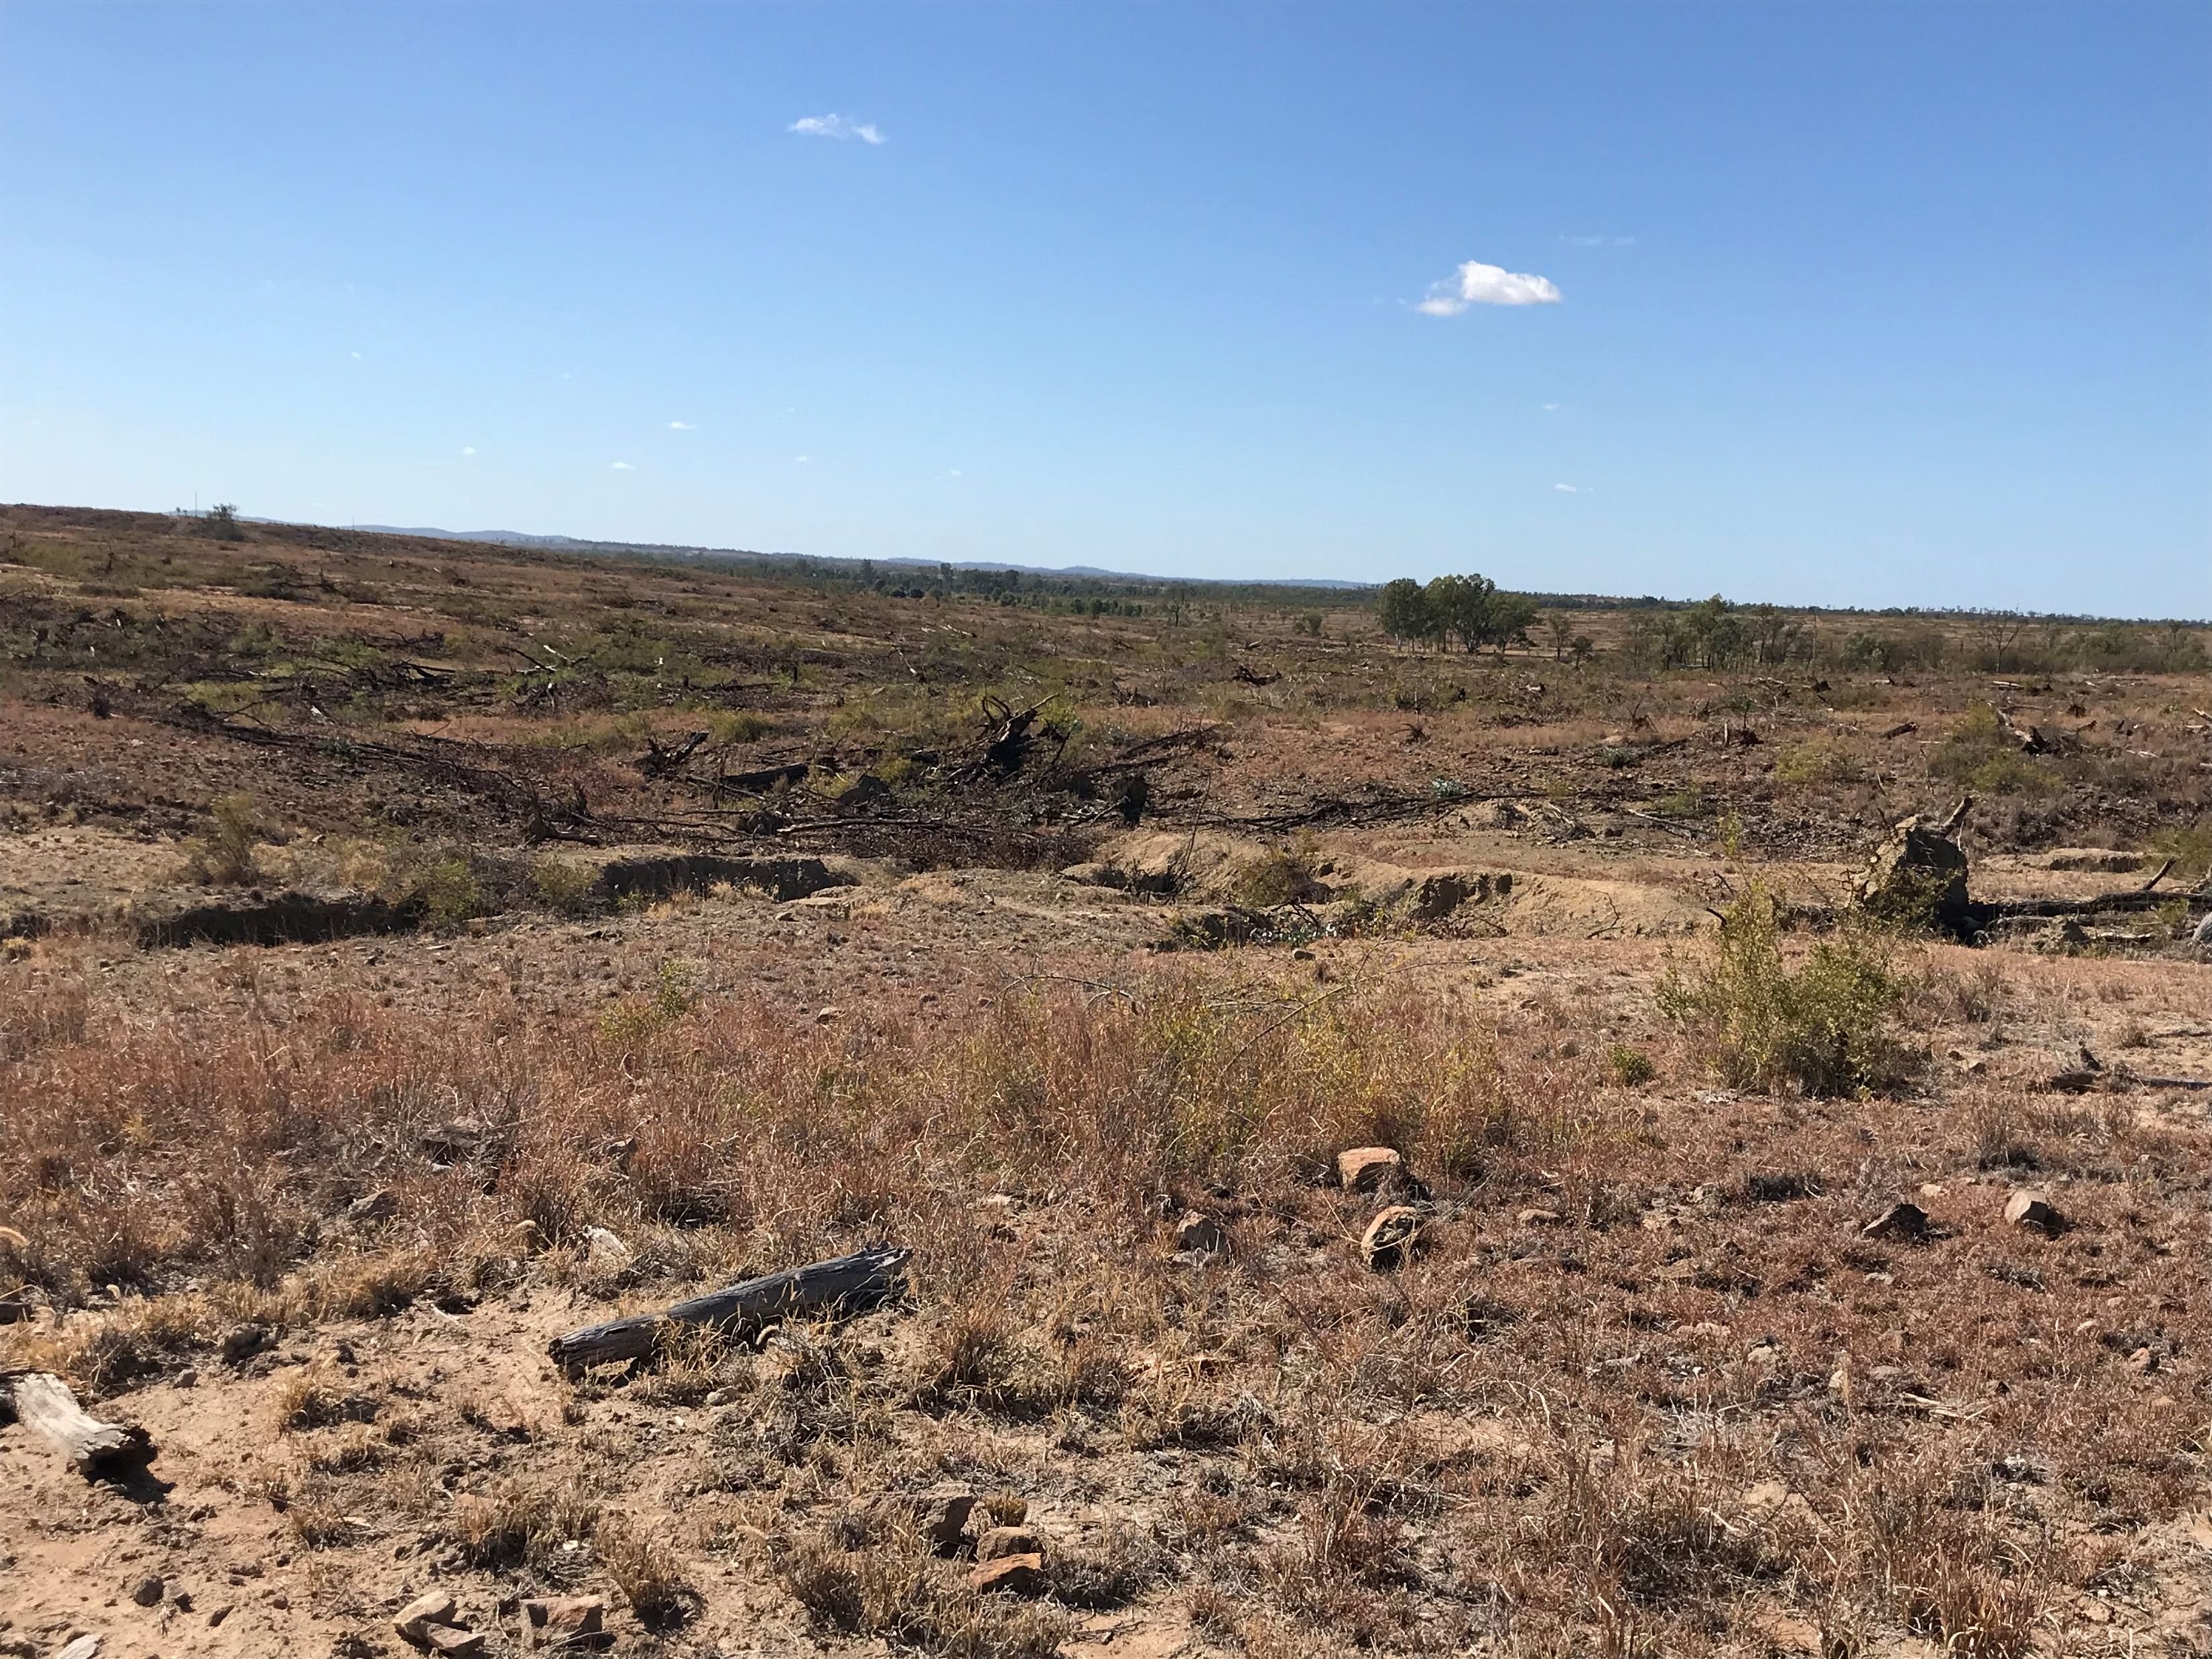
Springvale, Brigalow, and Weany Creek catchments in Queensland
(a)
The Springvale (9.6 ha), Brigalow (12.7 ha), and the Weany creek (1400 ha) catchments
They are predominantly covered with grass and experienced hillslope erosion and sediment deposition
(b)
(a) Brigalow grazed, (b) Springvale, Central QLD (Images taken in June 2018)

Slide 3
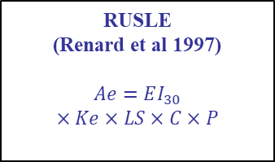
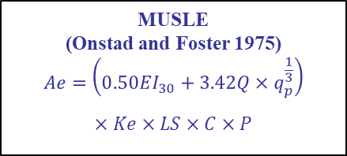
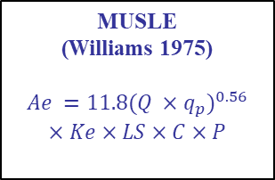
Performance evaluation of soil loss models
Models evaluated
Evaluation of the RUSLE/MUSLE without calibration,
Analysis of effect of EI₃₀, runoff, peak runoff rate, and the C-factor on annual sediment yield,
Estimation of soil erodibility factor (K)
RUSLE
(Renard et al 1997)
$$Ae=EI_{30}$$
$$×Ke×LS×C×P$$
MUSLE
(Williams 1975)
$$Ae =11.8{(Q ×q_{p})}^{0.56}$$
$$×Ke×LS×C×P$$
MUSLE
(Onstad and Foster 1975)
$$Ae=\left(0.50EI_{30}+3.42Q×q_{p}^{\frac{1}{3}}\right)$$
$$×Ke×LS×C×P$$
Total soil loss
Observed soil loss
Comparison
Estimated soil loss
Observed soil loss
Regression analysis
EI₃₀, Q, Qp and C-factor
RUSLE
Observed soil loss
Slope of Regression analysis
MUSLE
(Williams 1975)
MUSLE
(Onstad and Foster 1975)

Slide 4
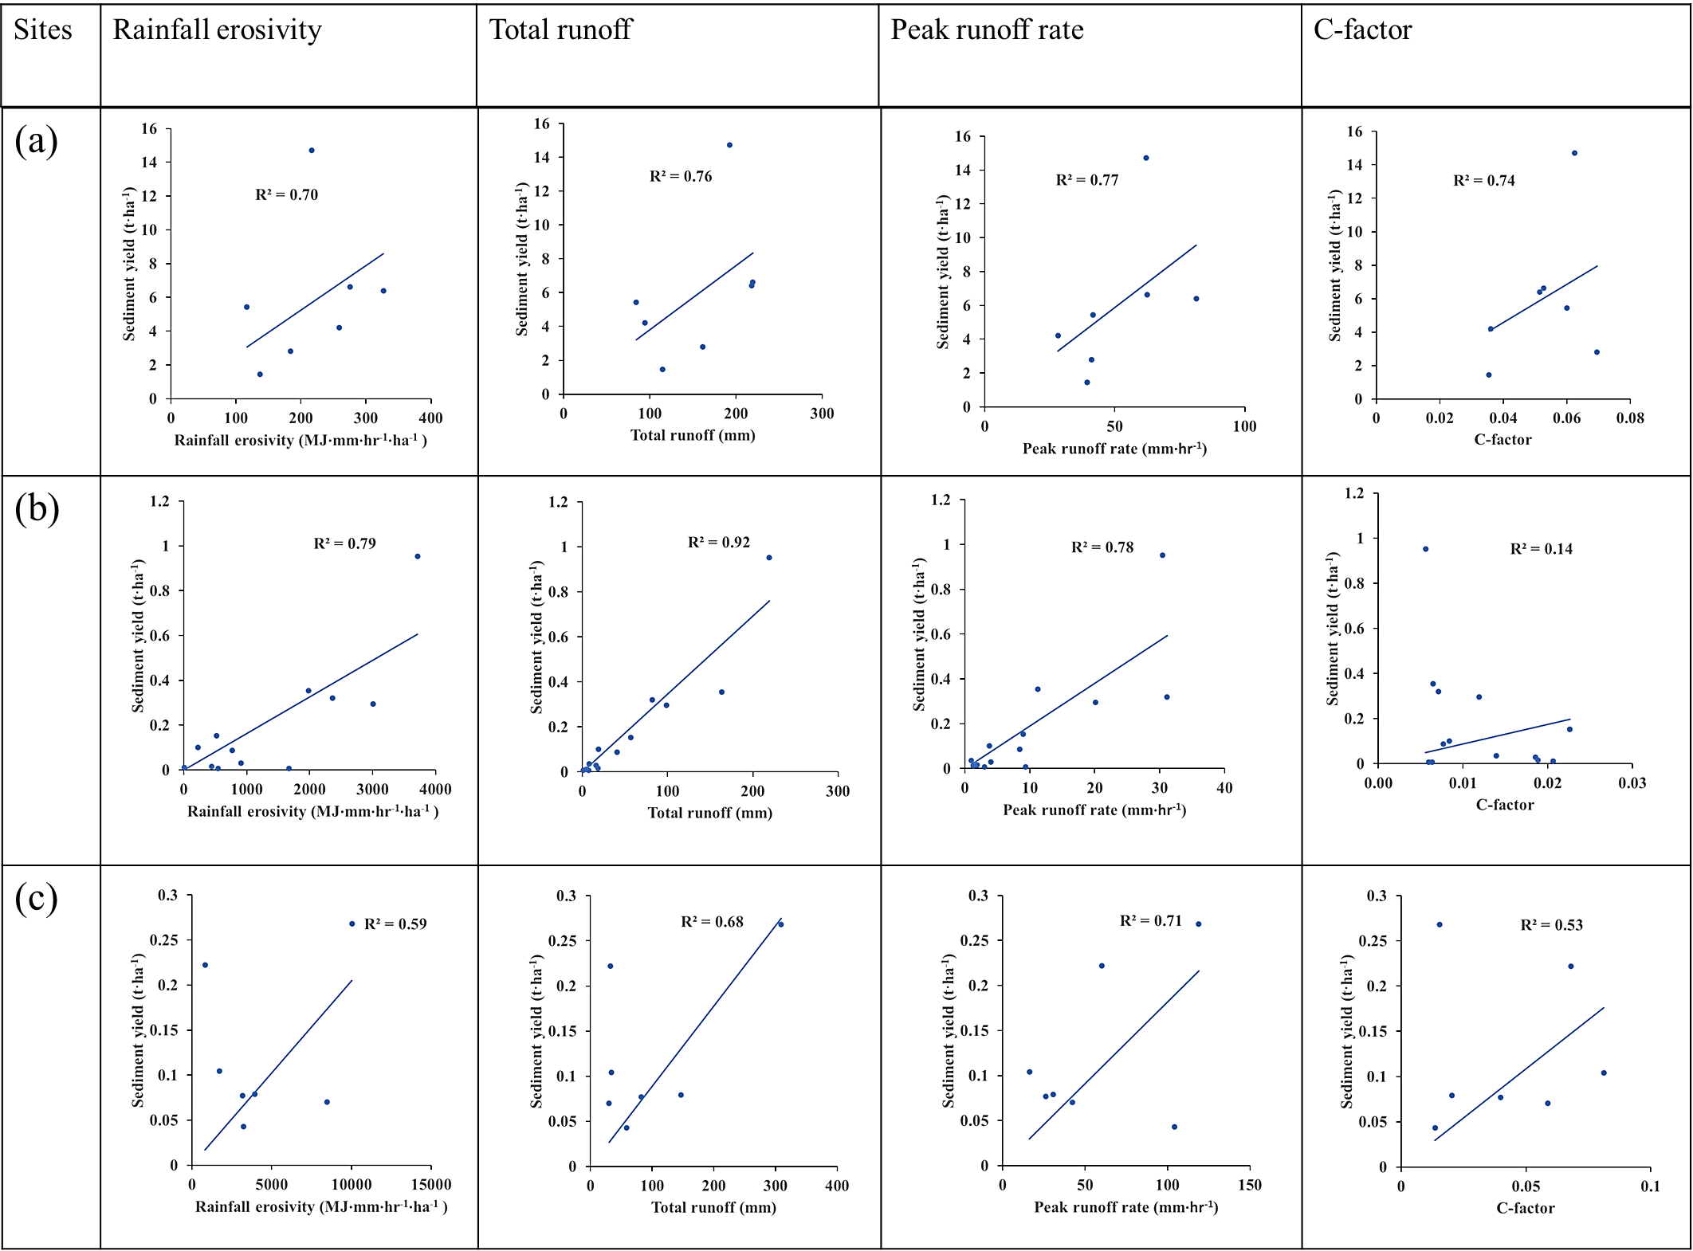
Regression analysis between observed annual sediment yield (t·ha⁻¹) and relevant variables and factors for the three grazing catchments (a) Springvale, (b) Brigalow, and (c) Weany Creek in Queensland, Australia

Slide 5
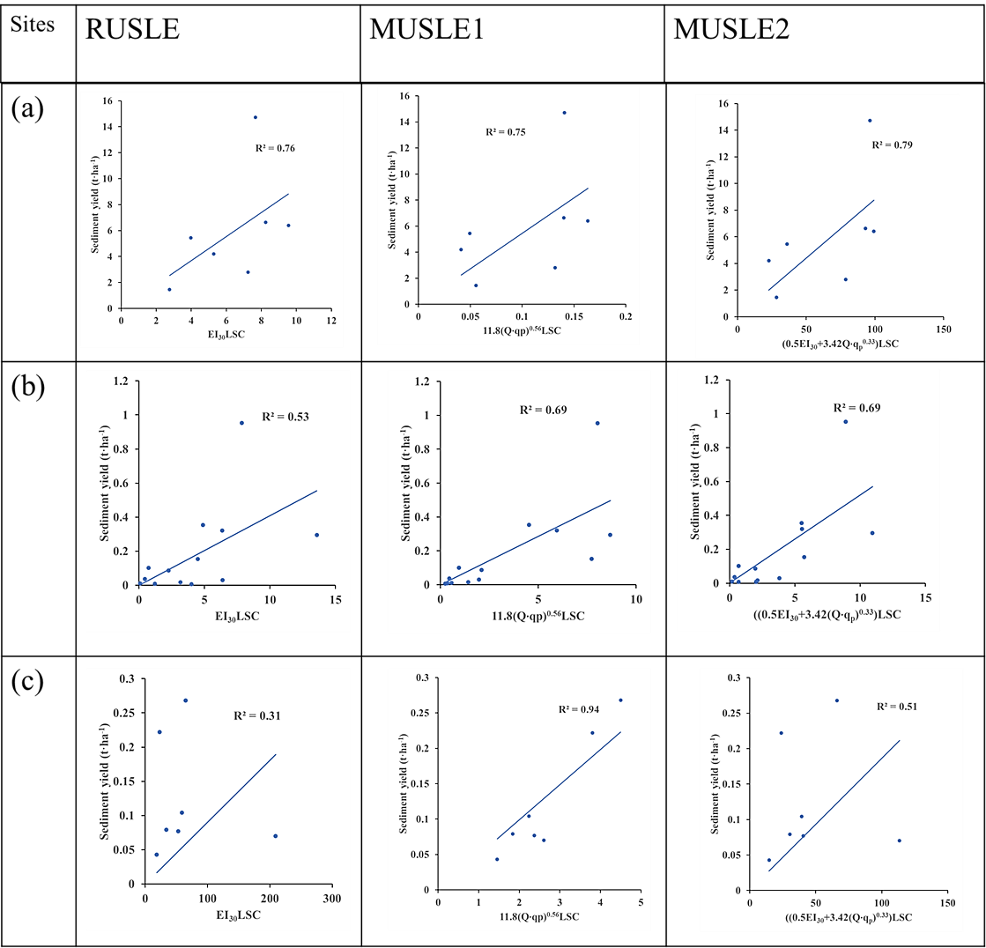
Regression analyses between observed and predicted annual sediment yield without calibration (t·ha⁻¹) using three catchments (a) Springvale, (b) Brigalow, and (c) Weany Creek in Queensland, Australia.

Slide 6
Comparison of annual sediment yield prediction models without model calibration
Catchments | Total observed sediment yield | Total predicted sediment yield | RUSLE |  | MUSLE(Williams 1975) |  | MUSLE(Onstad and Foster 1975)
 | (t·ha⁻¹·yr⁻¹) | (t·ha⁻¹·yr⁻¹) | NSE | PBIAS (%) | NSE | PBIAS | NSE | PBIAS
Springvale | 41.60 | 24.97 | -1.94 | -94 | -2.22 | -100 | -0.03 | -40
Brigalow | 2.37 | 2.22 | 0.27 | -8 | 0.48 | 17 | 0.51 | 6
Weany creek | 1.53 | 0.80 | -2E+05 | 2E+04 | 0.73 | 6 | -843 | 100
The K-factor ± one standard error estimated using the best correlated model for three catchments. ASRIS – Australian Soil Resource Information System, MUSLE (Williams 1975) and MUSLE (Onstad and Foster 1975)
Catchments | Best estimate of the K-factor ± Standard error | Best correlated model | ASRIS K-factor
Springvale | 0.088±0.005 | MUSLE (Onstad and Foster 1975) | 0.055
Brigalow | 0.057±0.011; 0.054±0.011 | Both MUSLE | 0.046
Weany creek | 0.049±0.018 | MUSLE (Williams 1975) | 0.043

Slide 7
Conclusions
The MUSLE framework is useful and more efficient for sediment yield prediction from grazing at plot scale.
The runoff and peak runoff rate alone or in combination with rainfall erosivity are critical as determinant of sediment yield.
The K-factor calculated using soil properties cannot be used directly without adjustment for bias.

Slide 8
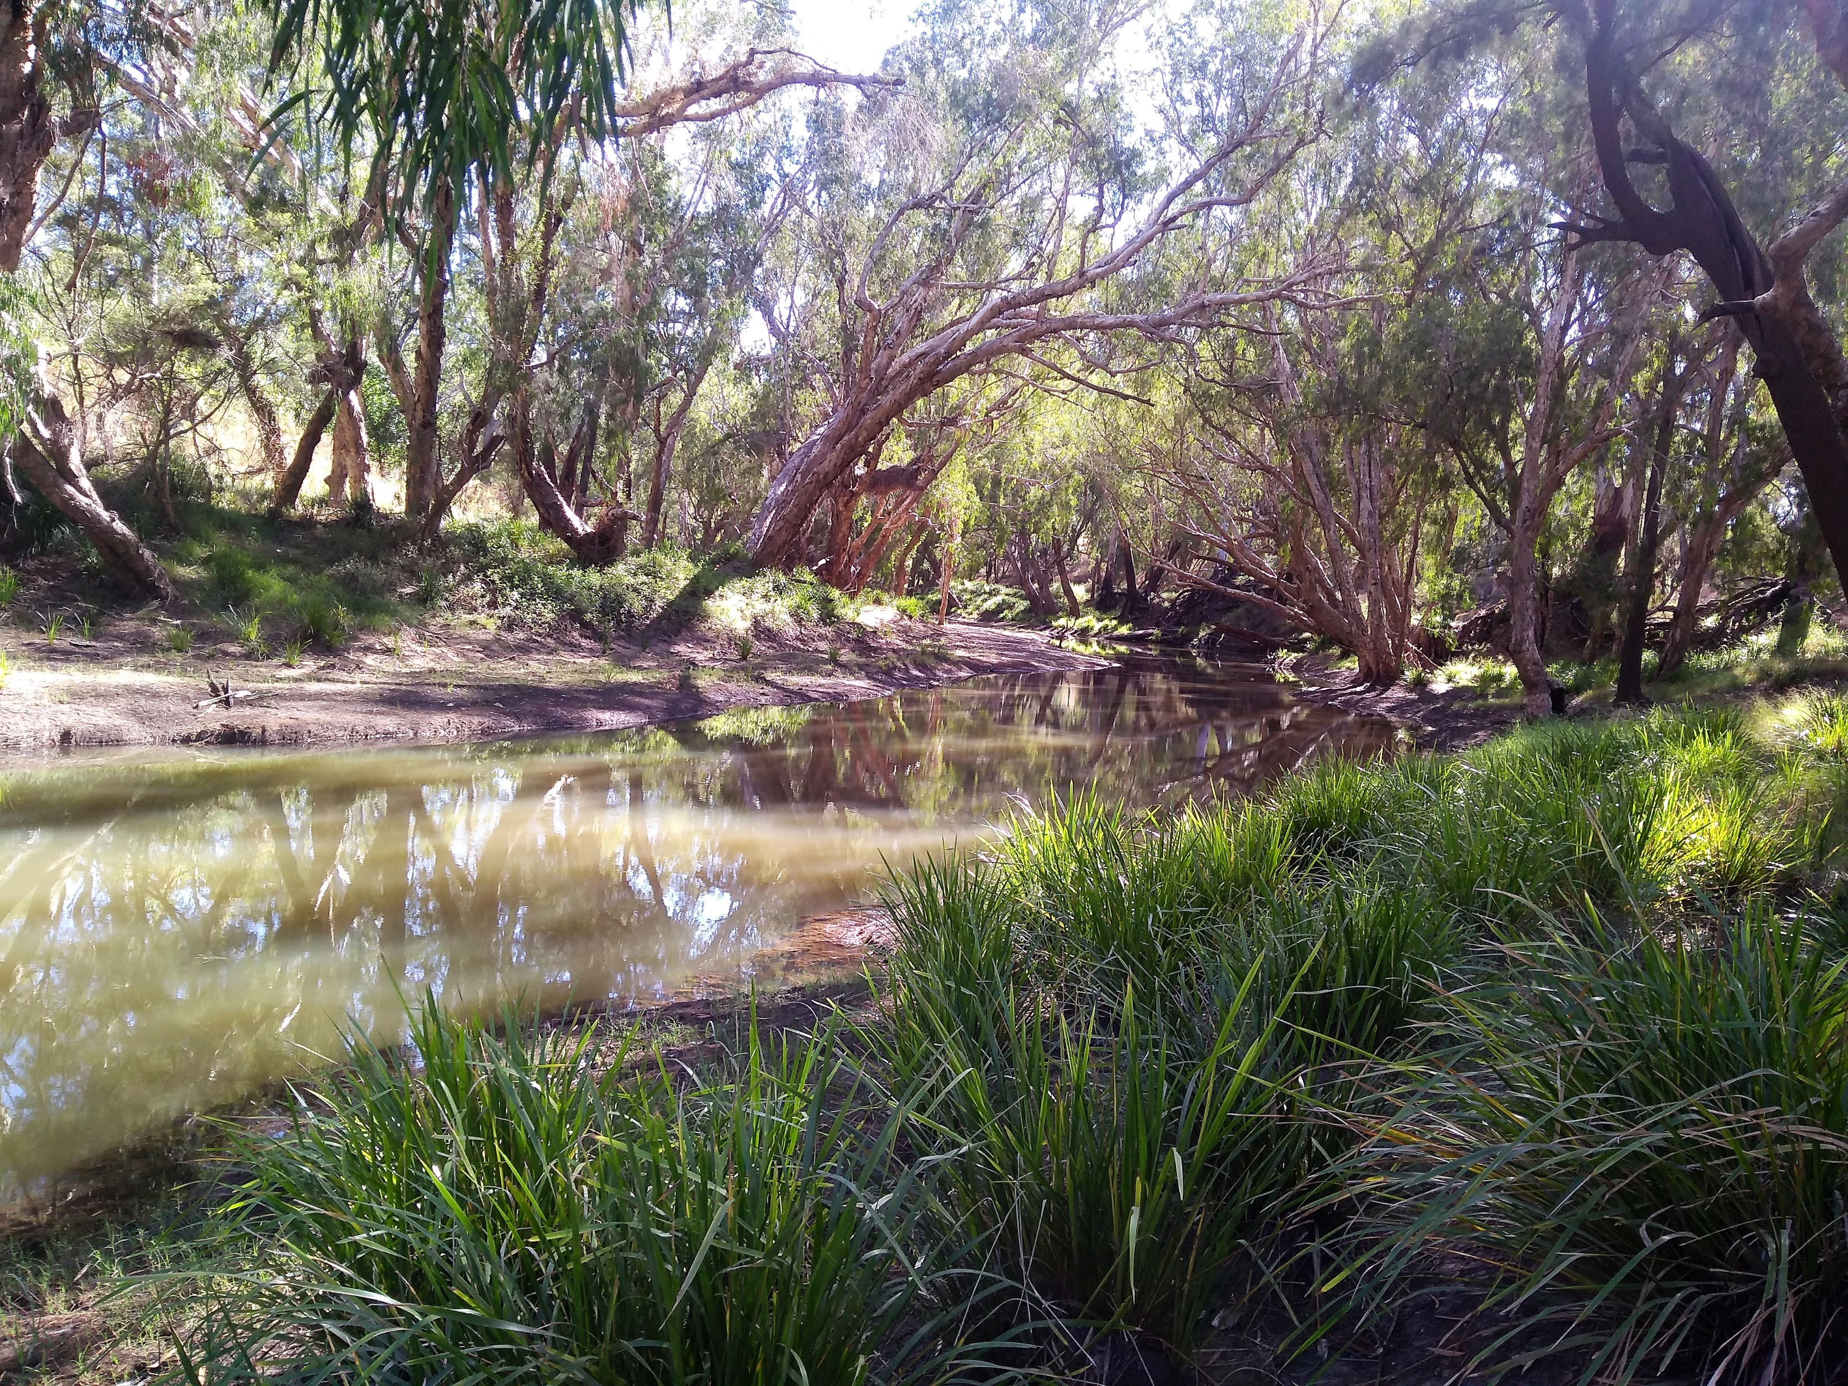
Thank you for your attention!!!

