Slide 1
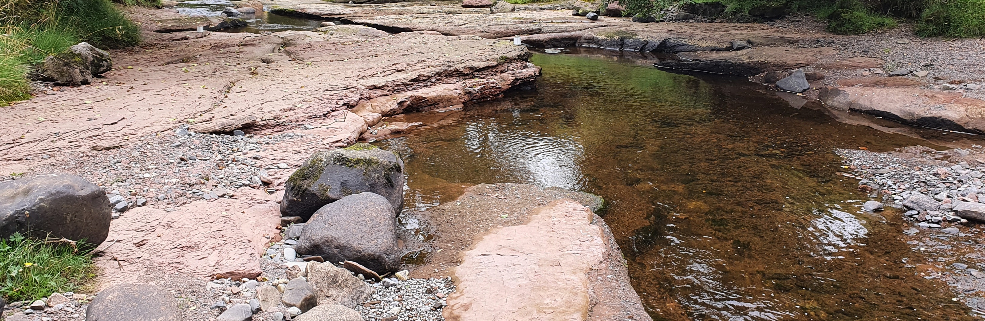
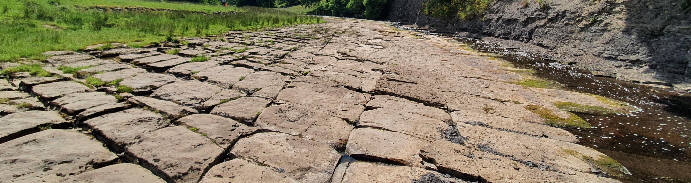
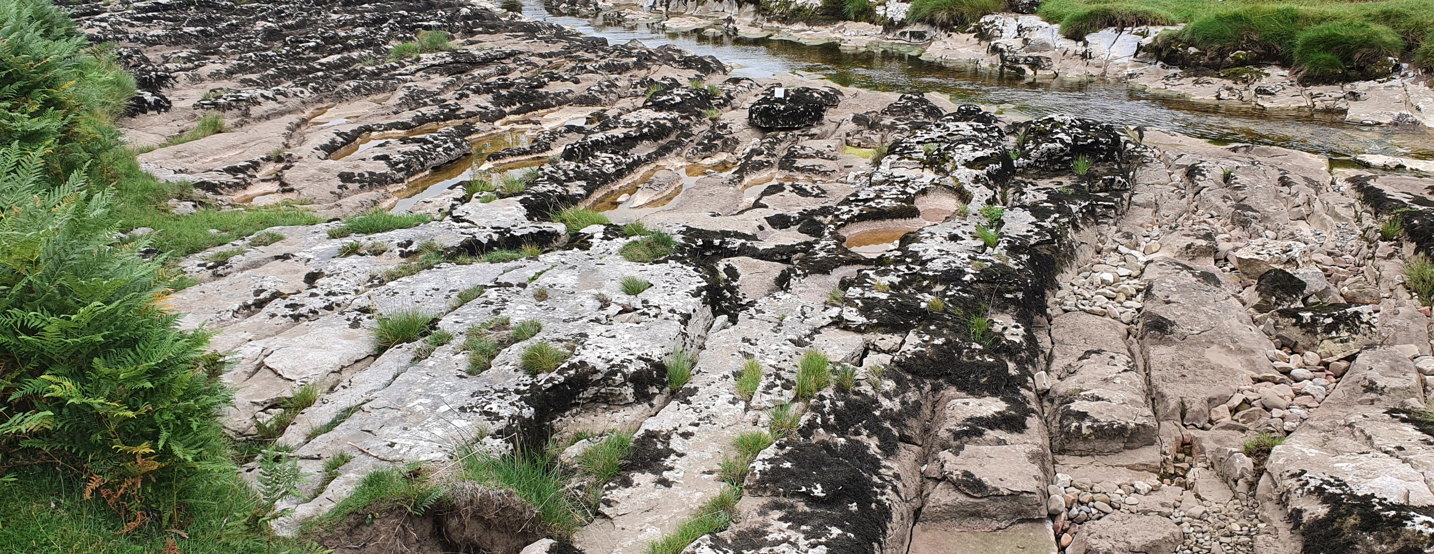



Decoding bedrock channel morphology using high-resolution topographic data
Rebecca Hodge, Alex Beer and Ben Asher

Slide 2

Introduction
3D channel morphology controls flow resistance, and hence flood conveyance, sediment transport and in-stream habitats
In alluvial channels, D₈₄ is a reasonable predictor for flow resistance
But what about bedrock channels?
Birk Beck (sandstone)
Sleightholme Beck (limestone)
River Wharfe (limestone)

Slide 3
Introduction
Bedrock morphology will depend on lithology, rock structure and the dominant erosion processes
Channel morphology can also include overlying sediment cover, boulders, and banks
Our overall aim is to improve predictions of flow resistance in bedrock channels
But, we first need to understand the range of variation that is found in bedrock channels
Birk Beck (sandstone)
Sleightholme Beck (limestone)
River Wharfe (limestone)

Slide 4
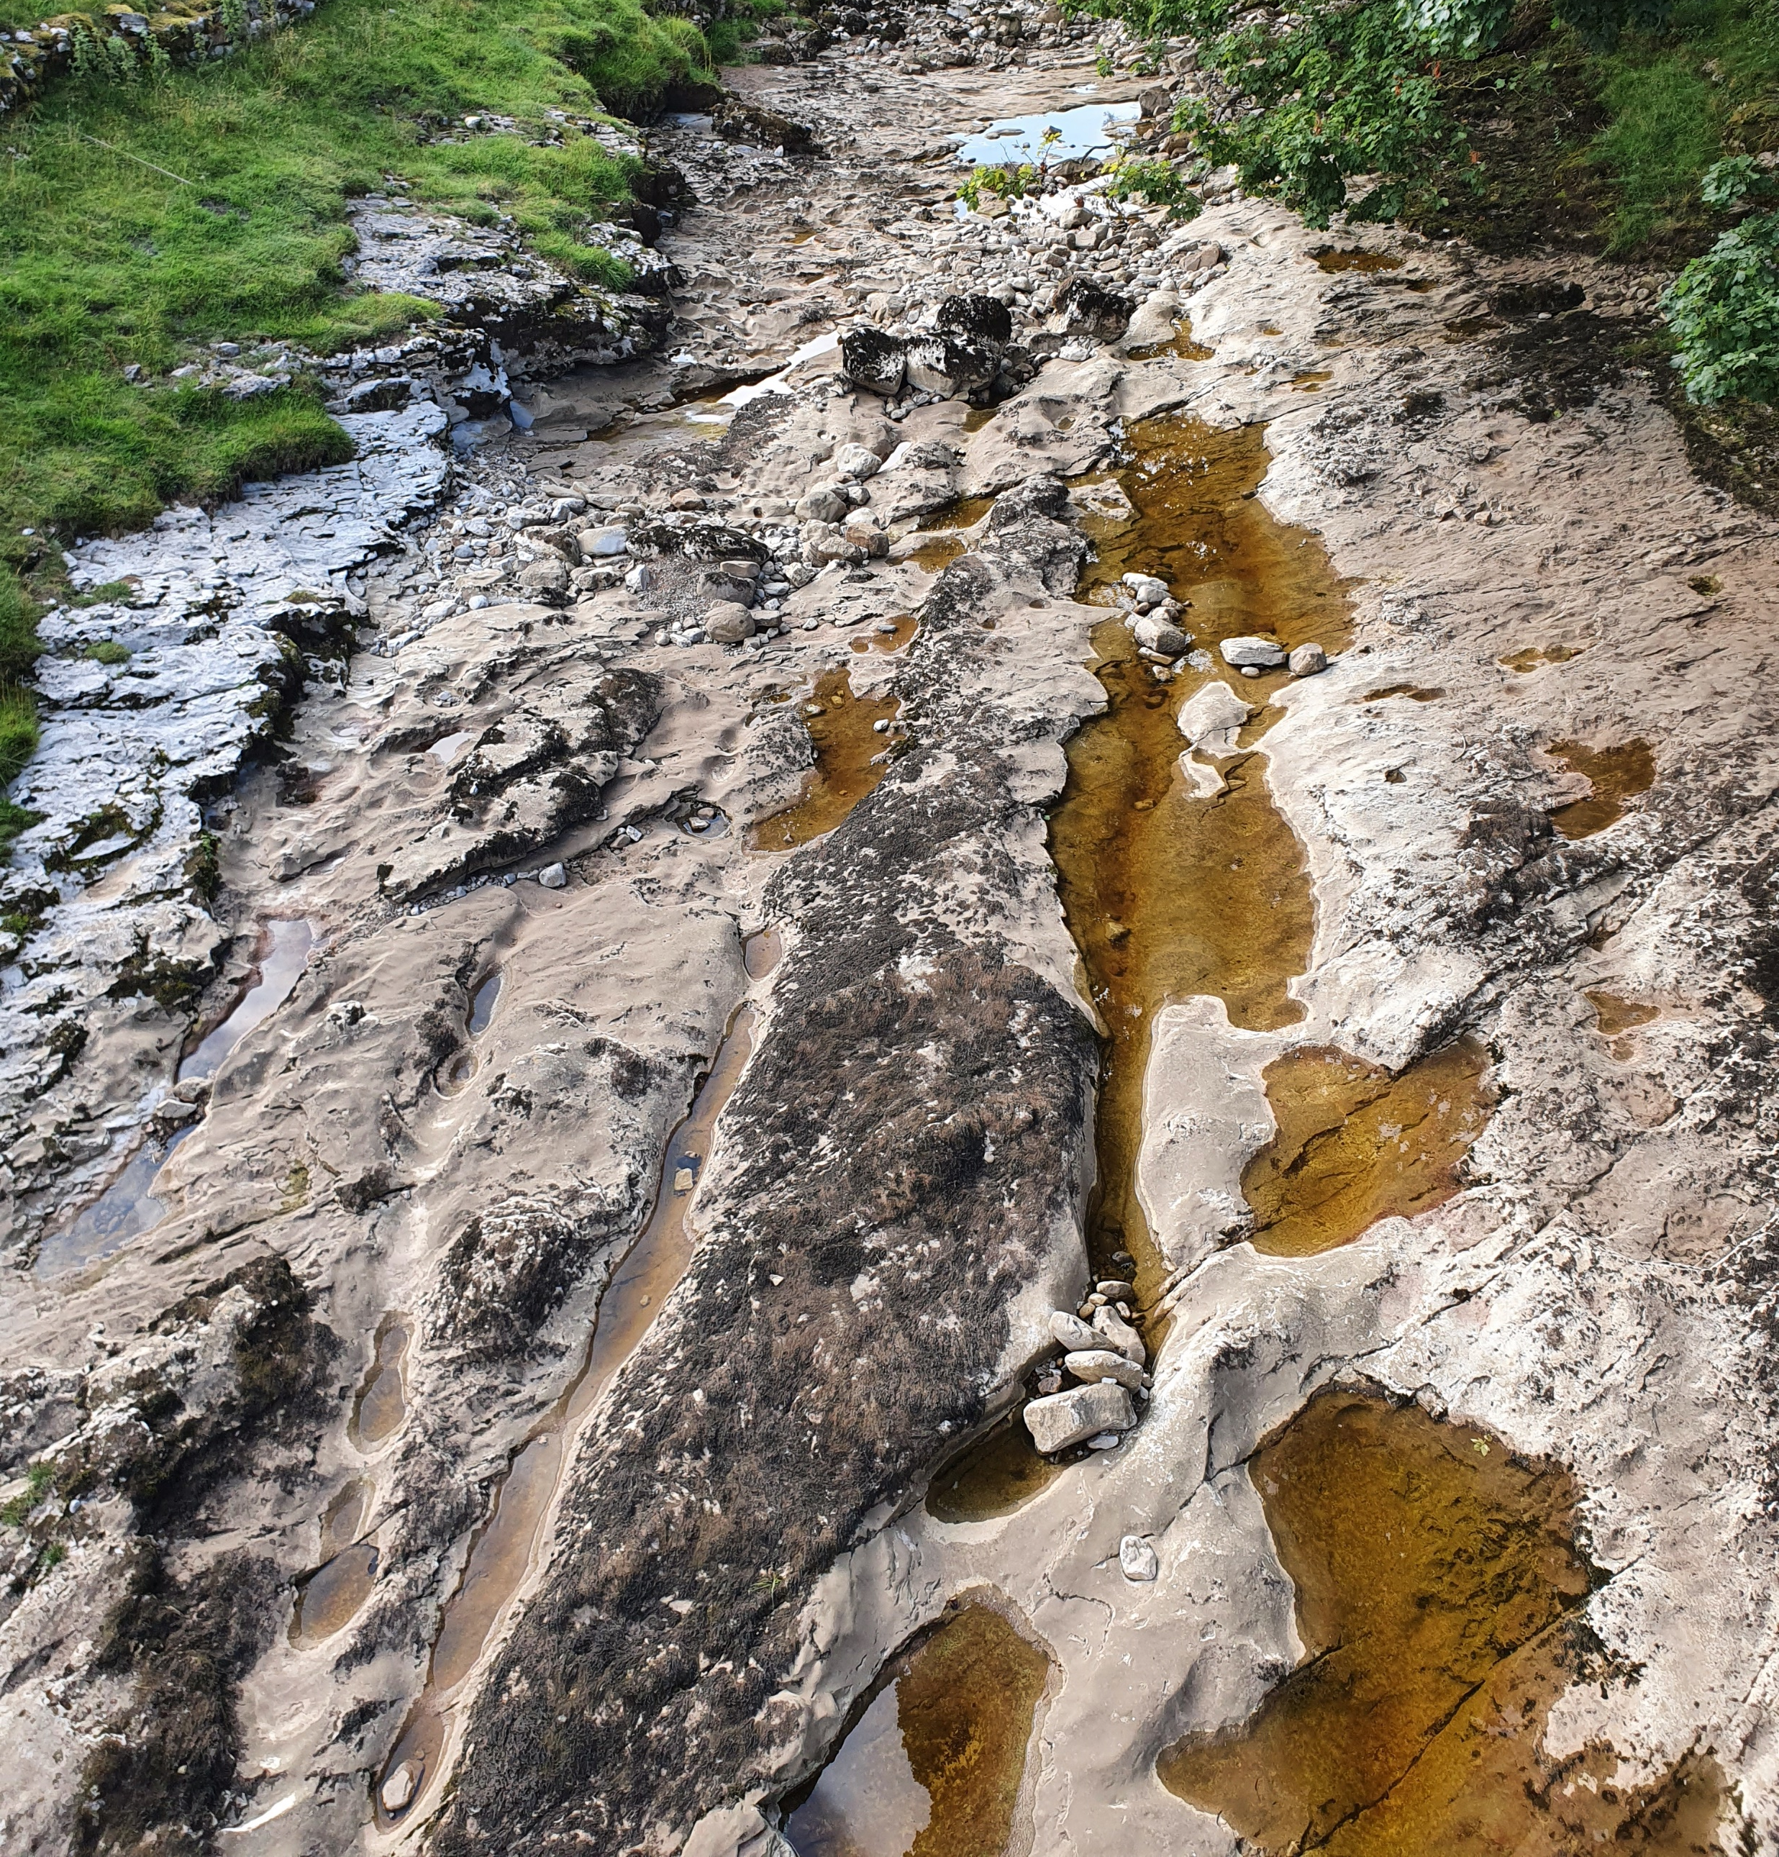
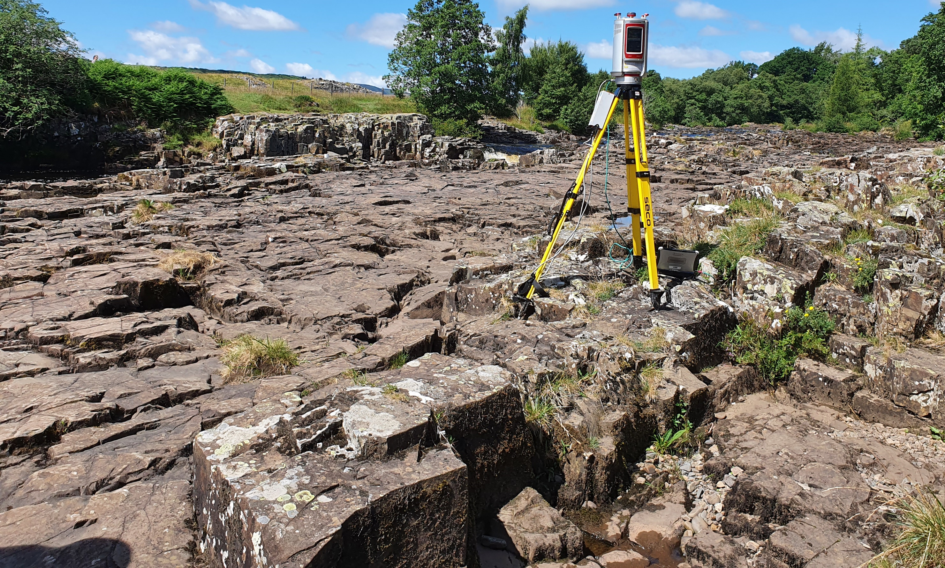
Field data collection
River Wharfe 3 (limestone)
Rivers in northern England, during low flow conditions
High-resolution Terrestrial Laser Scan data
Multiple scans registered, vegetation removed, and point cloud sampled at 0.01 m
Aligned to flow direction, and interpolated onto 0.02 m grid
River Tees (igneous)

Slide 5
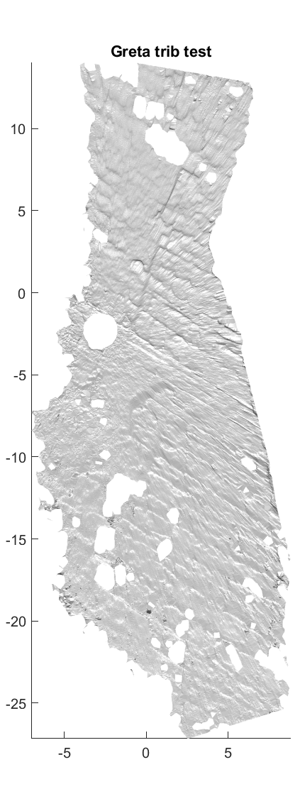
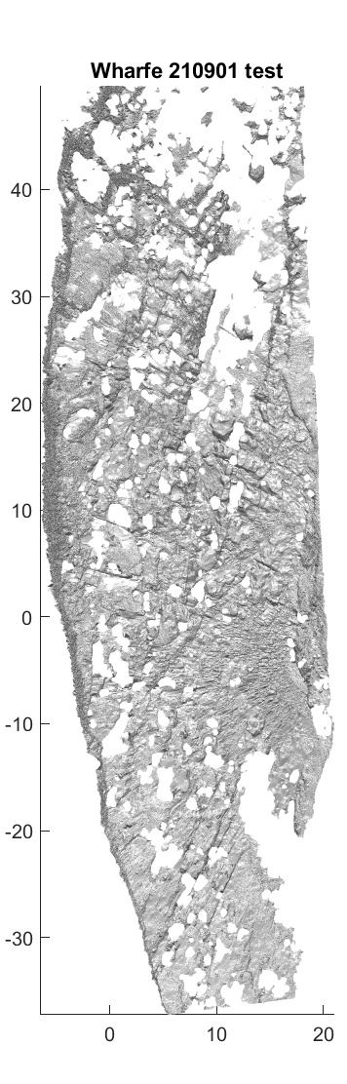
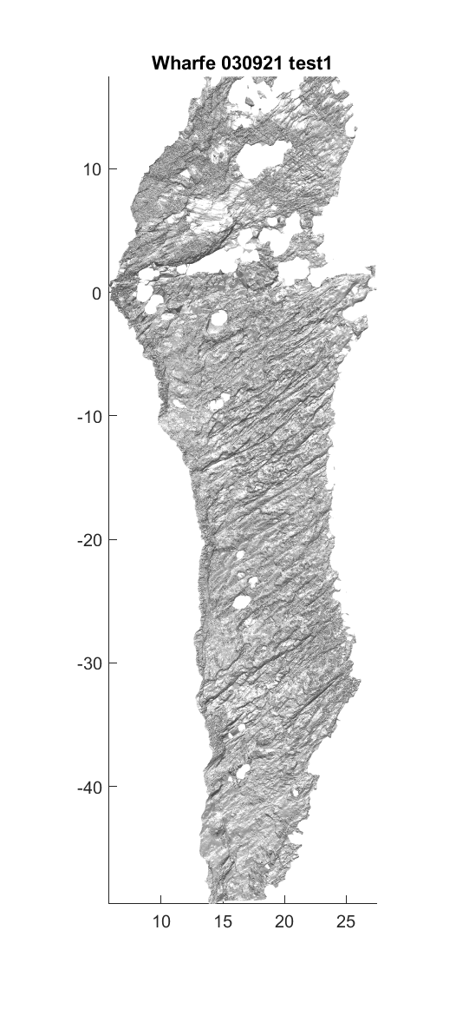
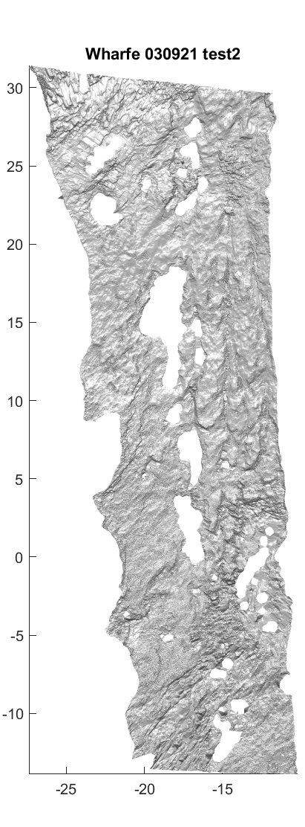
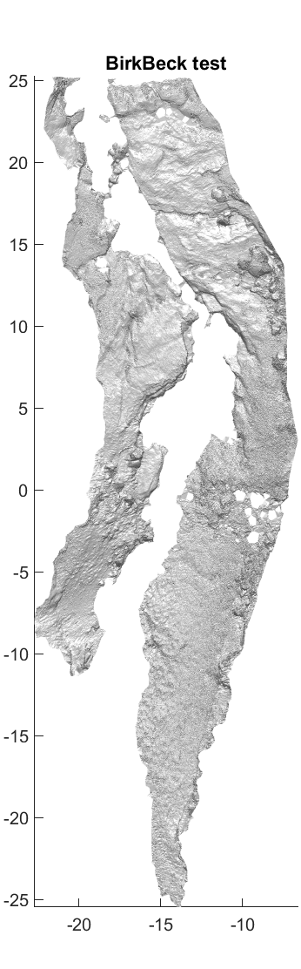
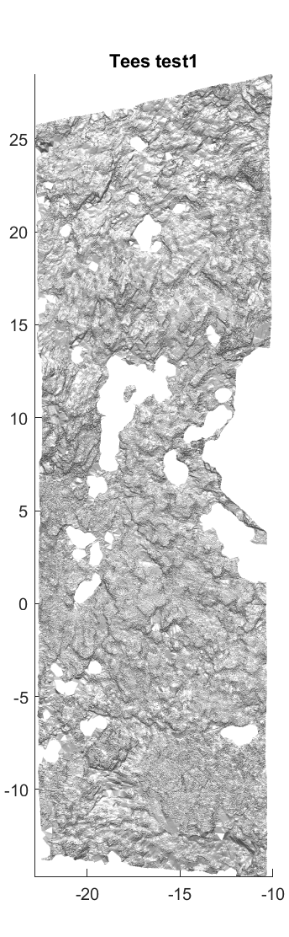
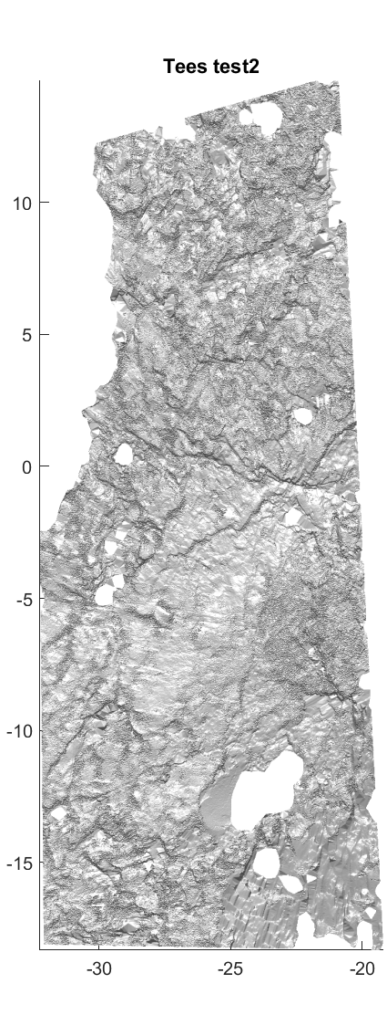
Channel topographies
Limestone
Sandstone
Igneous
Sleightholme Beck
River Wharfe 1
River Wharfe 2
River Wharfe 3
Birk Beck
River Tees 1
River Tees 2
Images of different sites
FLOW
Distance (m)

Slide 6
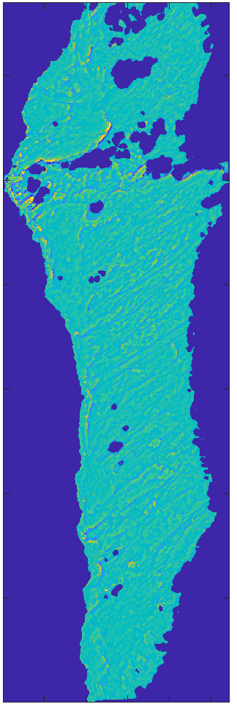
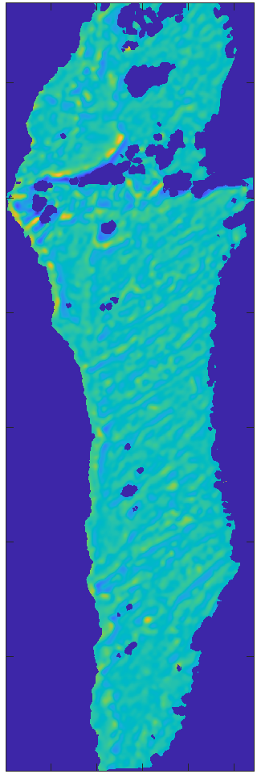
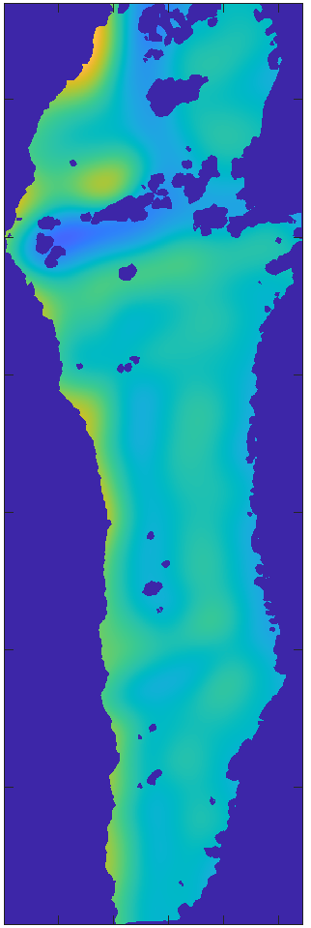
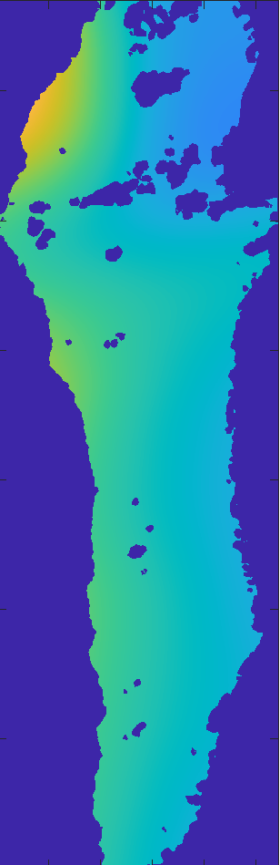
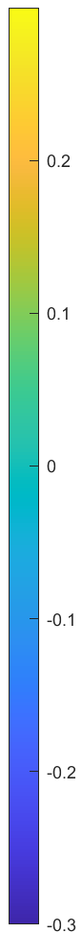
Analysis
Bandpass filter size
0 – 1 m
1 – 2 m
9 – 10 m
29 – 30 m
Use bandpass filters to isolate different wavelengths
Calculate roughness metric
Distance (m)
Elevation (m)

Slide 7
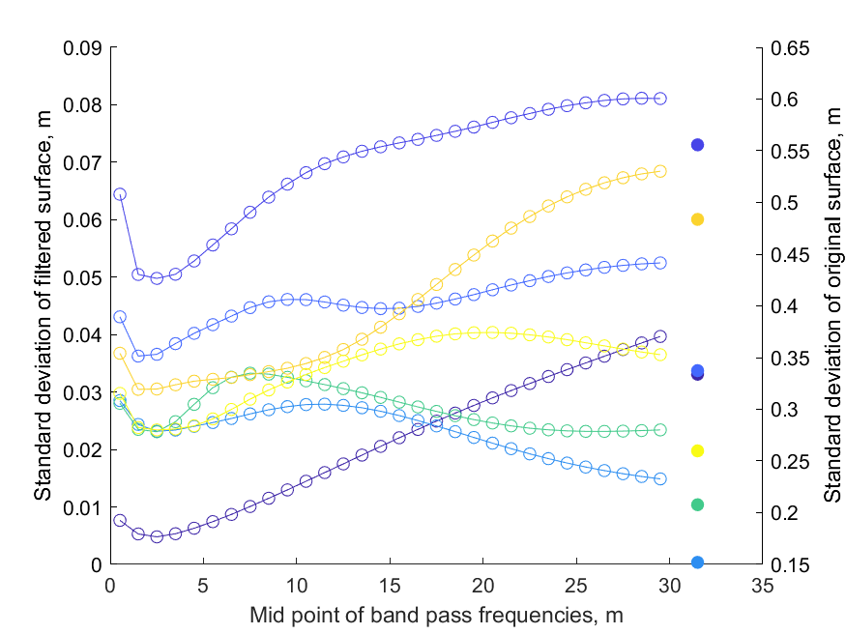
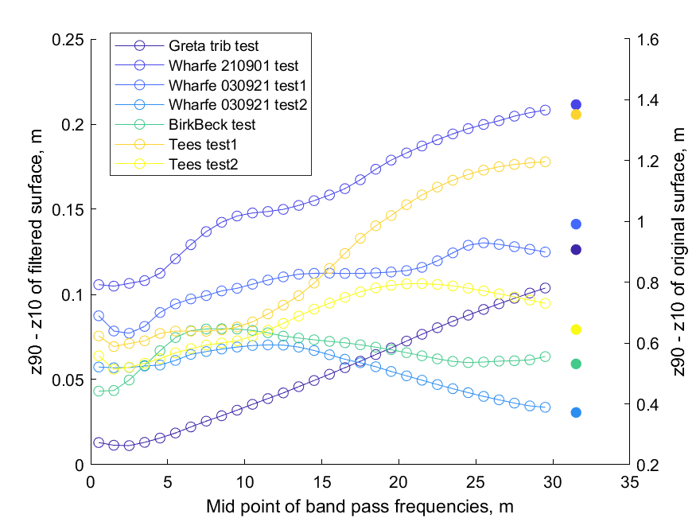
Standard deviation
Sleightholme Beck
Wharfe 1
Wharfe 2
Wharfe 3
Birk Beck
Tees 1
Tees 2
Original surface
Standard measure used to quantify roughness
High standard deviations at smallest wavelengths
Caused by noise in the point clouds?

Slide 8
10th to 90th percentiles of elevation
Sleightholme Beck
Wharfe 1
Wharfe 2
Wharfe 3
Birk Beck
Tees 1
Tees 2
Original surface
High values at 0-1 m wavelengths at 5 locations, which all have prominent jointing
Peak roughness at 20+ m wavelengths
At other two sites, peak is at ~10 m

Slide 9
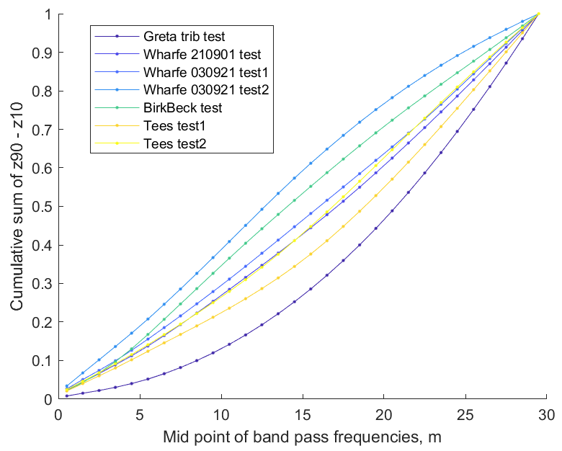
Cumulative elevations
Sleightholme Beck
Wharfe 1
Wharfe 2
Wharfe 3
Birk Beck
Tees 1
Tees 2
At sites with prominent jointing, longer wavelengths contribute most to total roughness
At other two sites, shorter wavelengths contribute more
Shorter wavelengths contribute more to total roughness
Longer wavelengths contribute more to total roughness

Slide 10
Conclusions
Lithological properties influences surface structure; specifically, presence/absence of prominent jointing
First step in trying to produce a parameter space of bedrock river topography
Plan to apply a wider range of metrics to measure other aspects of channel topography
Explore influence of sediment cover and boulders on roughness
Need to extend to a wider variety of bedrock and rough-bed channels – please get in touch if you have/know of other datasets we could use
This work will feed into a wider project on flow resistance in rough-bed channels

