Slide 1









Stress state and patterns at the upper plate of
Hikurangi Subduction Margin
Effat Behboudi, David McNamara, Ivan Lokmer
@effat_behboudi
effat.behboudi@ucdconnect.ie

Slide 2
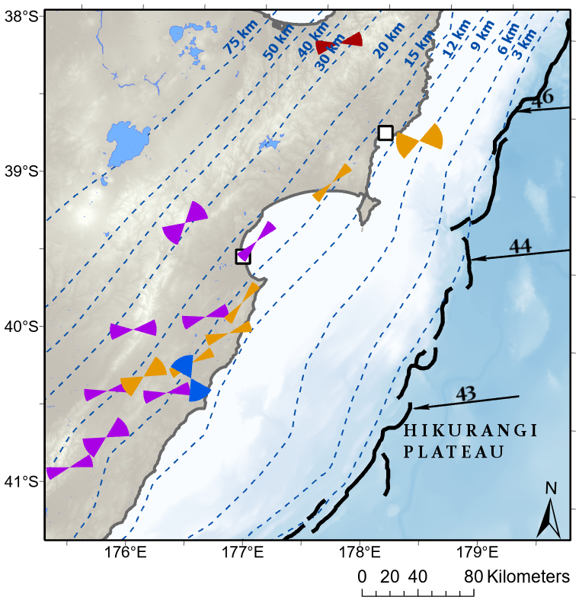
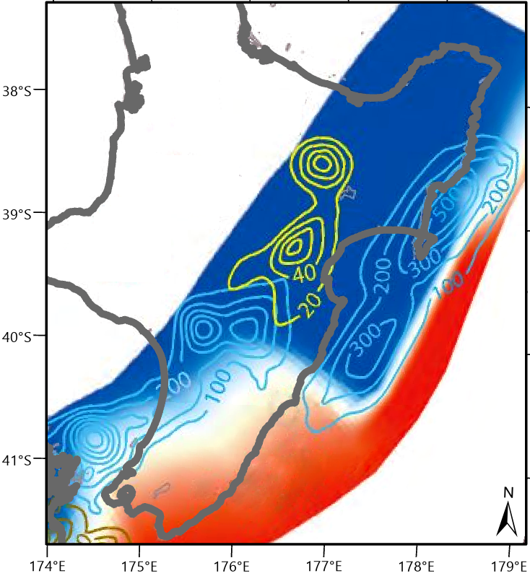


Motivation
1/5
Coupling Coefficient
What is the tectonic stress within the overriding plate of HSM?
0 1
Northern and Central HSM
Mostly creeping with quite shallow (<15 km), short (two-three weeks) SSEs
Southern HSM
deeply locked with deep (>30 km), long-term (one year) SSEs
45 mm/yr
Pacific
Plate
East Coast SSE
Australian
Plate
Subduction interfaces from sea level
Hikurangi Trough
$S_{Hmax}$ orientation from focal
mechanisms
Depth (km)
0
15
30
45
37 mm/yr
60
Focal mechanism data from Townend et al. (2012)
Subduction interface from Williams et al. (2013)
Wallace (2020)

Slide 3
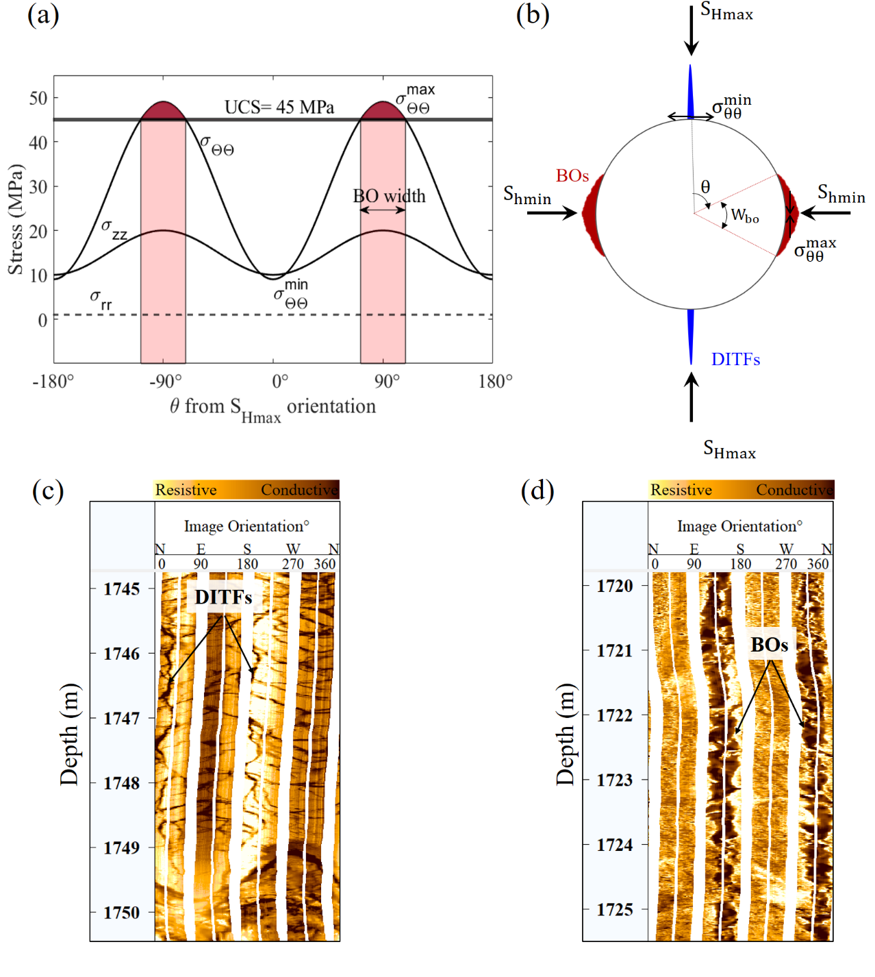
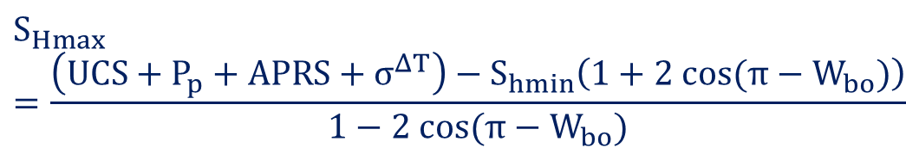
Methodology and Data
2/5
Drilling-Induced Tensile Fractures (DITFs) develop parallel to the contemporary S_{Hmax} orientation (e.g. Zoback, 2007).
$$3S_{hmin}−T_{0}−P_{p}−APRS−σ^{∆T}{≤S}_{Hmax}$$
Borehole breakouts (BOs) develop perpendicular to the contemporary S_{Hmax} orientation (e.g. Zoback, 2007)..
$$S_{Hmax}=\frac{\left(UCS+P_{p}+APRS+σ^{ΔT}\right)−S_{hmin}\left(1+2 cos(π−W_{bo})\right)}{1−2 cos(π−W_{bo})}$$

Slide 4
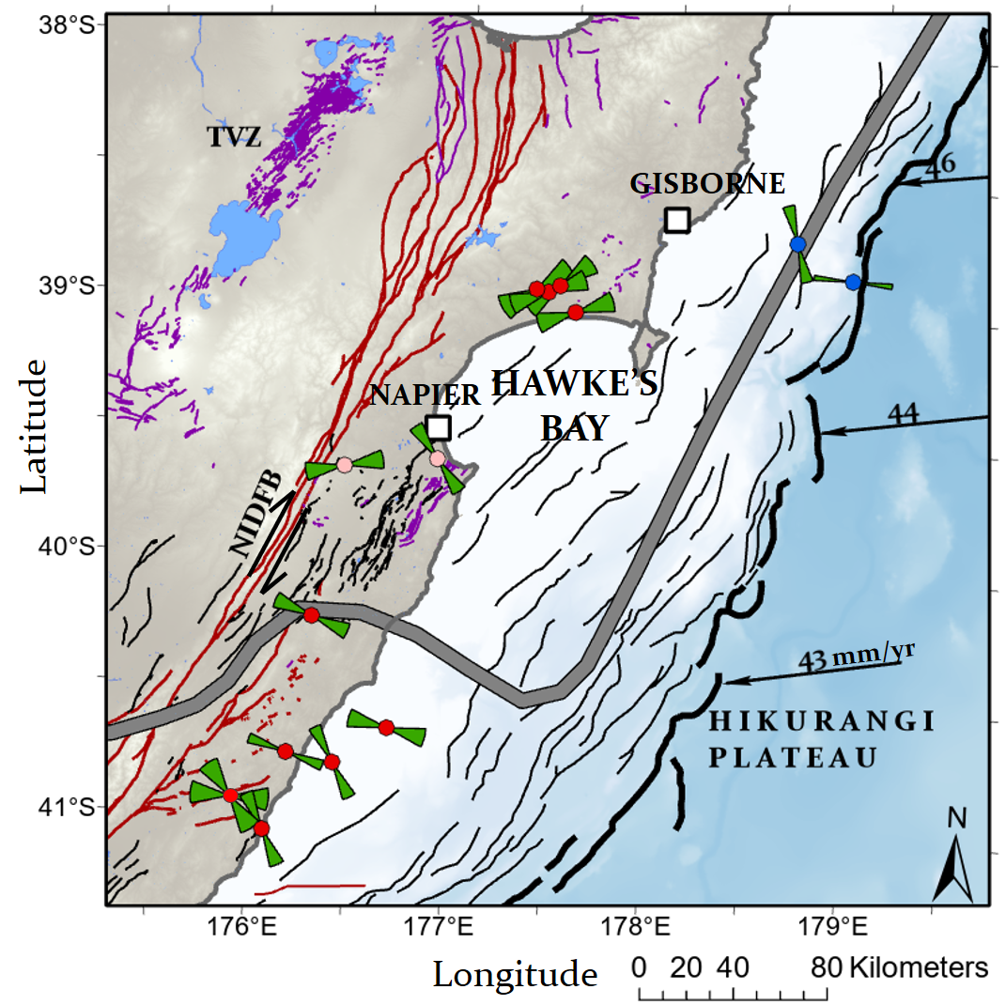
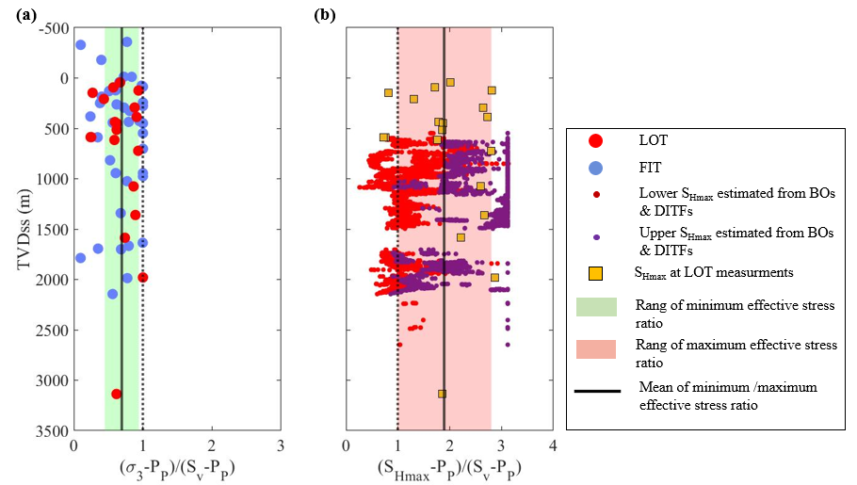

Stress State within HSM
3/5
Stress regime at shallow depths (< 3 km), along the HSM is dominantly in favor of a thrust or strike-slip faulting regime (S_{hmin} $≤$ S_{v} $≤$ S_{Hmax}) with some normal faulting component.
Central HSM
S_{Hmax} is predominantly oriented NE-SW
Southern HSM
S_{Hmax} is dominantly oriented WNW-ESE to NW-SE
Coupling Coefficient
0 1
Wallace (2020)
Behboudi et al., (2022)

Slide 5
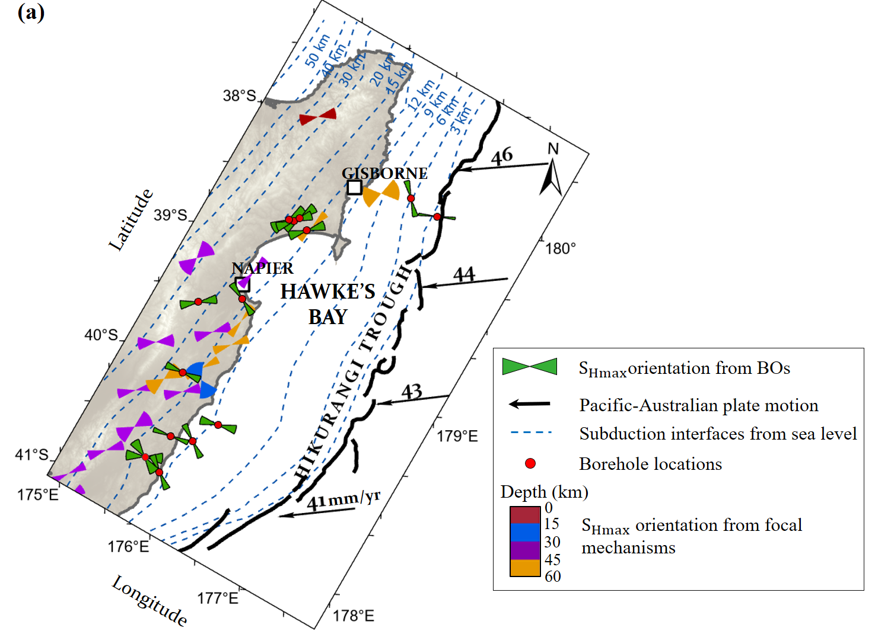
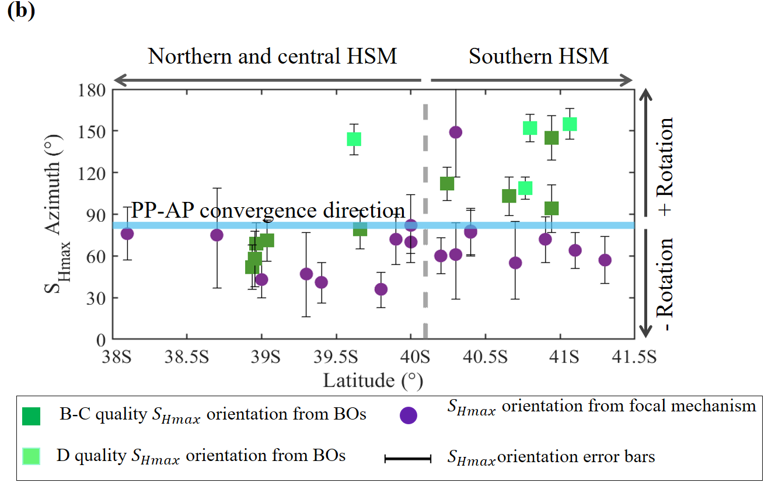
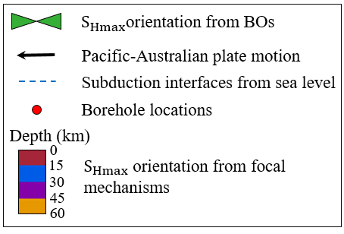
Variation of Stress State With Depth
4/5
Borehole-derived and focal mechanism-derived S_{Hmax} are:
Aligned in the central HSM
Oblique (46°–74°) to each other in the southern HSM
Behboudi et al., (2022)

Slide 6
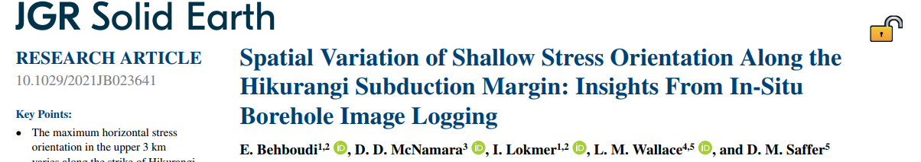
Summary
5/5
S_{Hmax} orientations is better understood in the upper plate of HSM
S_{Hmax} orientations in the central HSM are predominately NE-SW (sub-parallel to plate boundary), which rotates to a dominantly WNW-ESE S_{Hmax} orientation in the southern HSM (approximately perpendicular to the plate boundary).
Stress state is dominantly strike-slip to thrust faulting regime with local normal faultings.
Rrapid rotation of the Hikurangi forearc has a big impact in changing the stress regime in the central HSM
Variation of stress orientation along depth in the southern Hikurangi margin may reflect low shear stress on the subduction interface
Futur works
Investigating the slip tendency of HSM interface and upper plate faults using measured stresses
@effat_behboudi
effat.behboudi@ucdconnect.ie

Slide 7
References
Behboudi, E., McNamara, D. D., Lokmer, I., Wallace, L. M., & Saffer, D. M. (2022). Spatial variation of shallow stress orientation along the Hikurangi Subduction Margin: Insights from in-situ borehole image logging. Journal of Geophysical Research: Solid Earth, 127, e2021JB023641. https://doi. org/10.1029/2021JB023641
Townend, J., Sherburn, S., Arnold, R., Boese, C., & Woods, L. (2012). Three-dimensional variations in present-day tectonic stress along the Australia-Pacific plate boundary in New Zealand. Earth and Planetary Science Letters, 353–354, 47–59. https://doi.org/10.1016/j.epsl.2012.08.003
Wallace, L. M. (2020). Slow slip events in New Zealand. Annual Review of Earth and Planetary Sciences, 48(1), 175–203. https://doi.org/10.1146/annurev-earth-071719-055104
Williams, C. A., Eberhart-Phillips, D., Bannister, S., Barker, D. H. N., Henrys, S., Reyners, M., & Sutherland, R. (2013). Revised interface geometry for the Hikurangi subduction zone. New Zealand. Seismological Research Letters, 84(6), 1066–1073. https://doi.org/10.1785/0220130035
Zoback, M. D. (2007). Reservoir geomechanics. Cambridge University Press.

