Slide 1
The challenge of measuring rock moisture: A laboratory experiment using eight types of sensors
Tomáš Weiss & Oliver Sass
Charles University & University of Bayreuth
Tomas.weiss@natur.cuni.cz
Oliver.Sass@uni-bayreuth.de

Slide 2
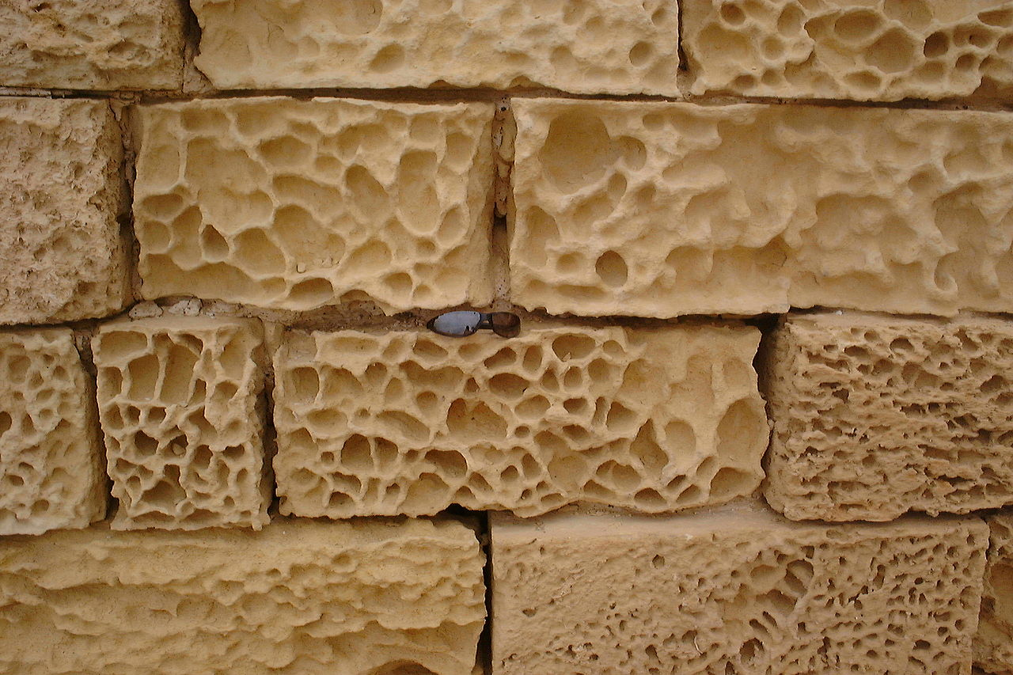
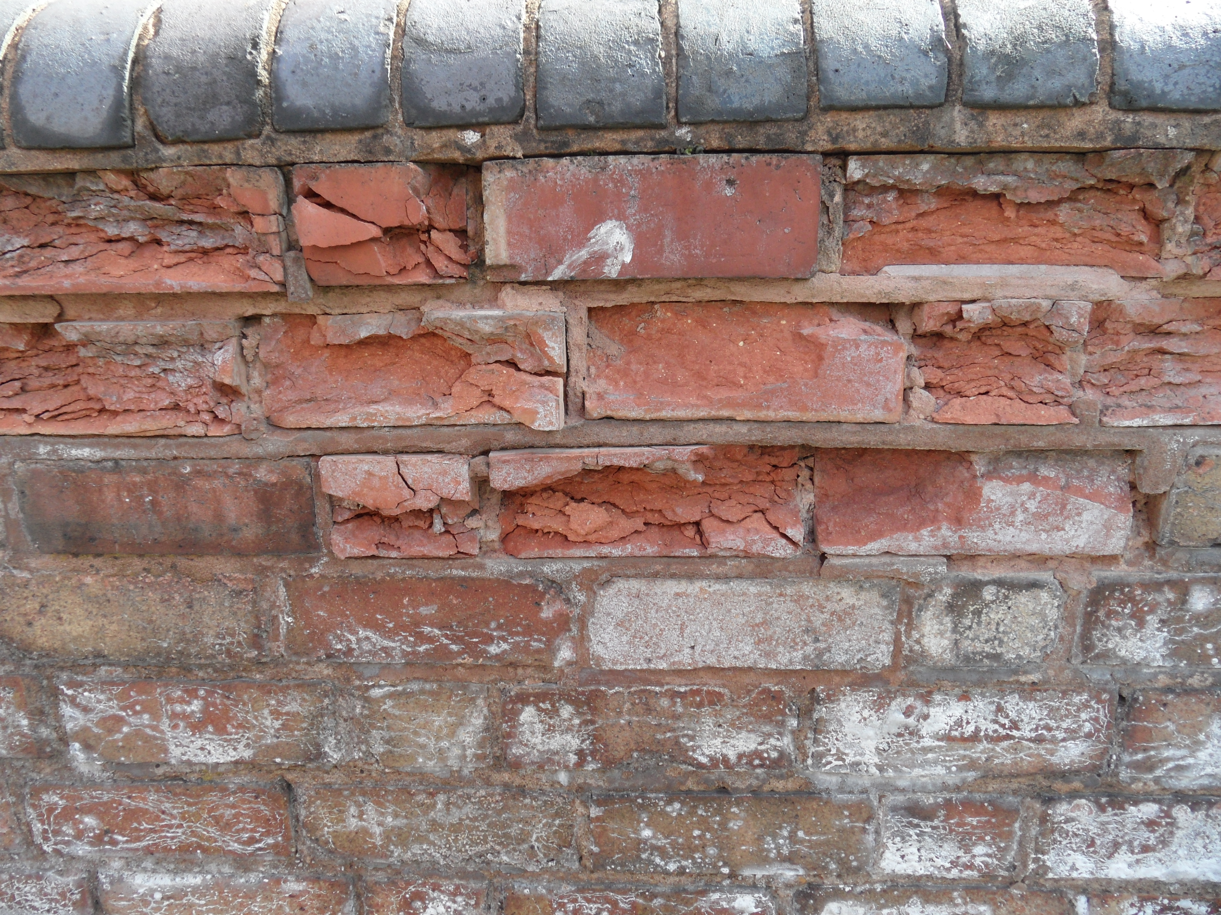
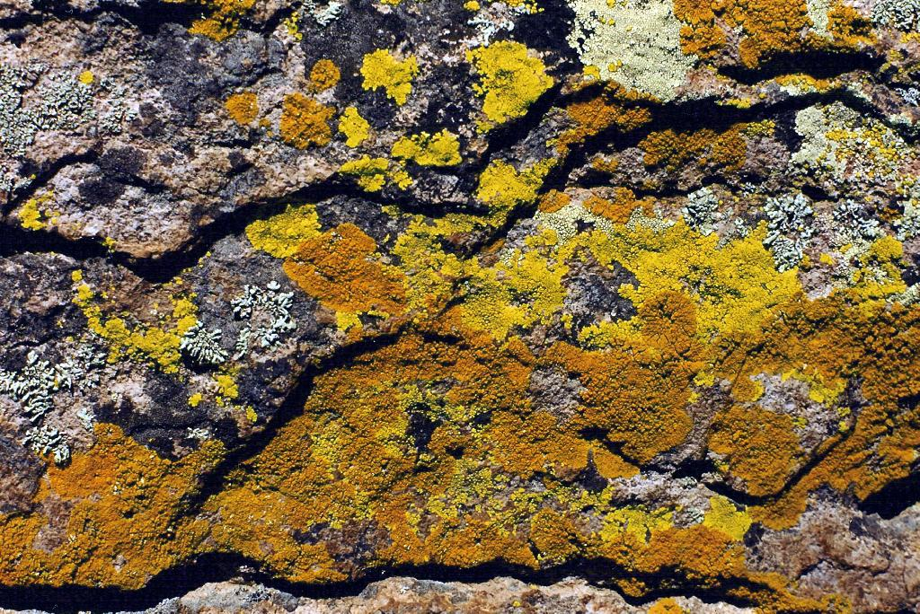
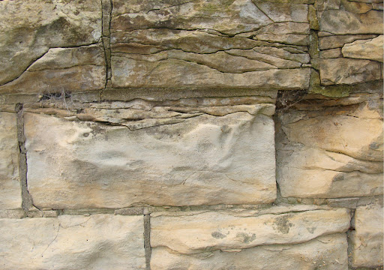
Moisture augments weathering
Weathering - threat to cultural heritage & key component of geomorphological process system
Almost all rock decay enhanced by water presence
Measuring rock moisture and its fluctuations difficult - no universally used sensor meeting requirements of non-destructiveness, reliability, repeatability, and applicability at field sites

Slide 3
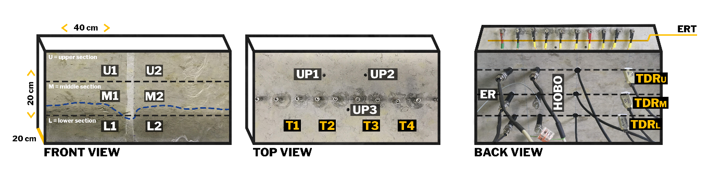
8 types of sensors – various conditions
Evaluate several moisture measurement techniques under different natural conditions and to provide recommendations for their use
Sandstone block under controlled conditions
1D resistivity (surface+inside)
2D resistivity (ERT)
TDR
borehole humidity
microwave reflectance
IR thermography
uranine probes
Wetting and drying cycle
series of freeze-thaw cycles.

Slide 4
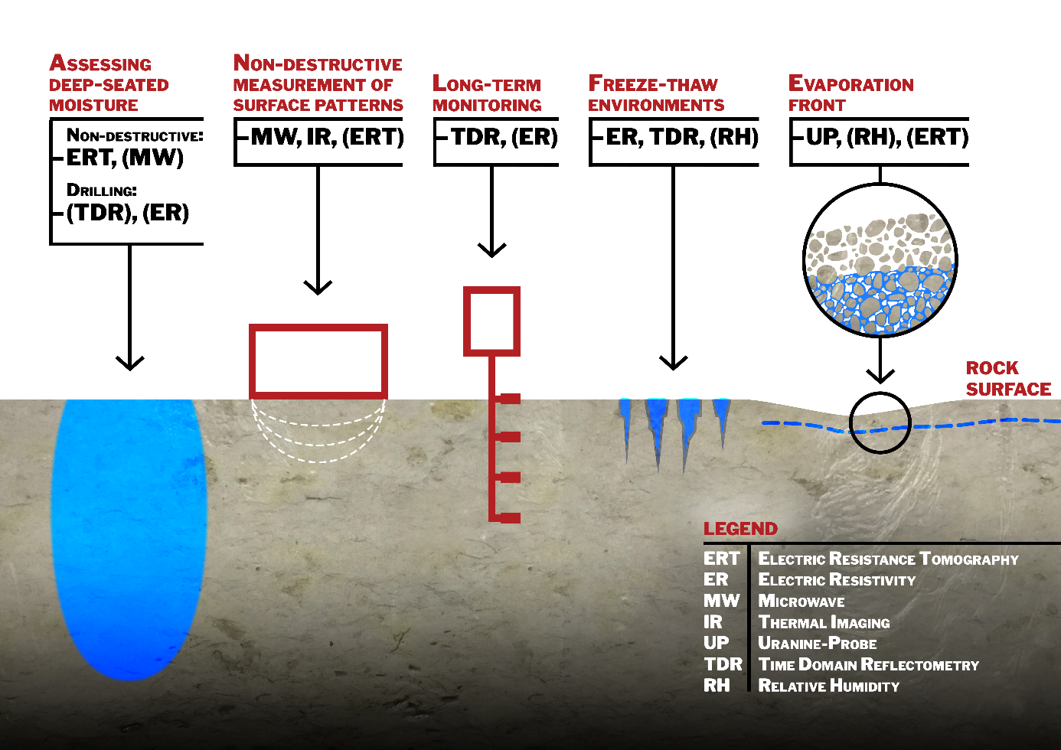
Dielectric (TDR, MW)
Surface moisture roughness sensitivity
Inside better than surface
ER limited: calibration, salts
IR needs controlled environment
Future work: subsurface moisture, calibration

Slide 5
Thanks to
Manfred Fischer for the incredible amount of work in the laboratory
Andrew Mitchell and Lukas Schwab for their help with sensor calibration
Jana Schweigstillová for measuring the material diffusion parameters
Michal Filippi for the porosimetry measurements
Blanka Adlerová for help with the graphics
Technology Agency of the Czech Republic [project no. TL03000603] and Erasmus that helped to finance the work
You for attention

