Slide 1


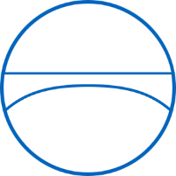

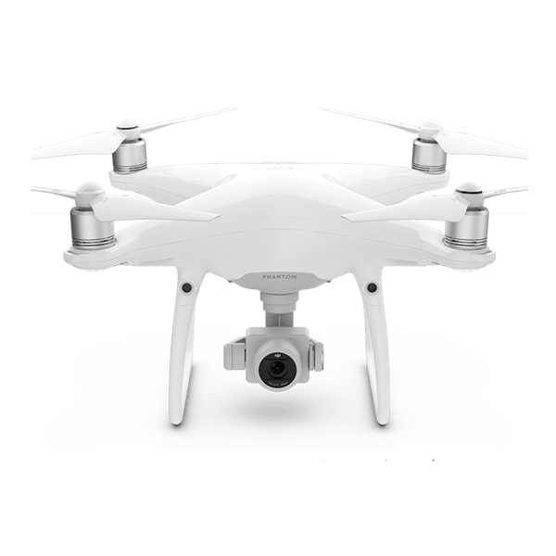
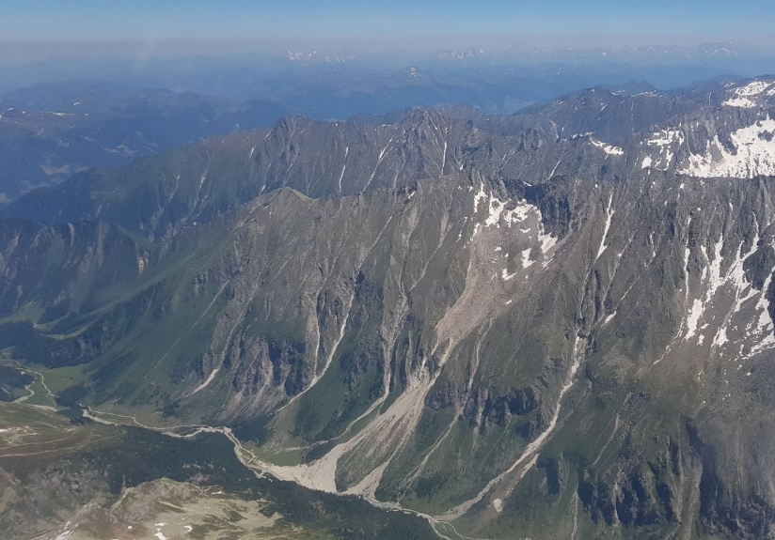

Performance testing of optical flow time series analyses based on a fast, high–alpine landslide
ttps://mk0dronepartsce3qt48.kinstacdn.com/wp-content/uploads/2020/01/dji-phantom-4-pro-v2-4.jpg;
Doris Hermle¹, Michele Gaeta², Michael Krautblatter¹ Paolo Mazzanti² and Markus Keuschnig³
¹Technical University of Munich, TUM School of Engineering and Design, Landslides Research Group, Munich; ²NHAZCA S.r.l., Rome; ³GEORESEARCH Forschungsgesellschaft mbH, Puch, Austria
European Geosciences Union General Assembly 2022,
Vienna, Austria

Slide 2
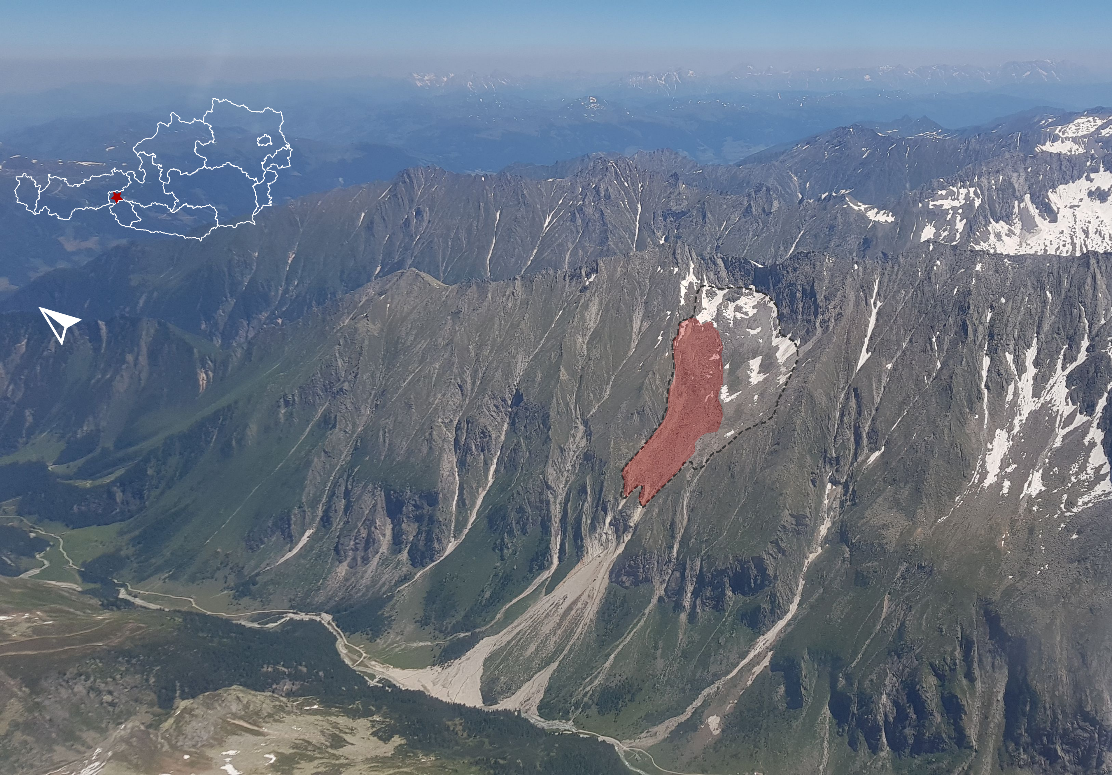
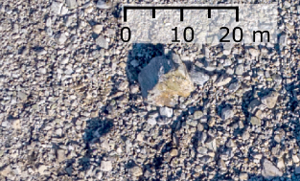
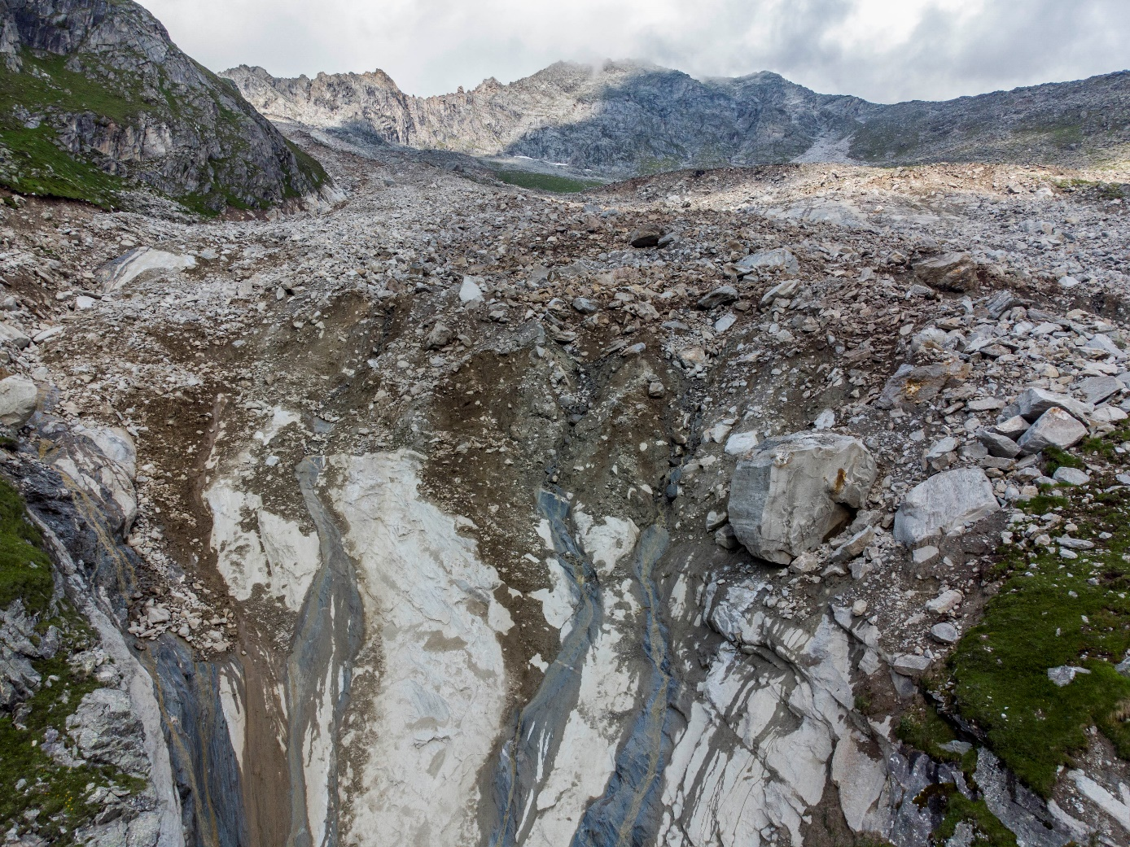
2014: 170.000 m³ debris flow event
Anker et al., 2016; GeoResearch, 2018)
Cirque
(390,000 m²)
Process
(130,000 m²)

Slide 3
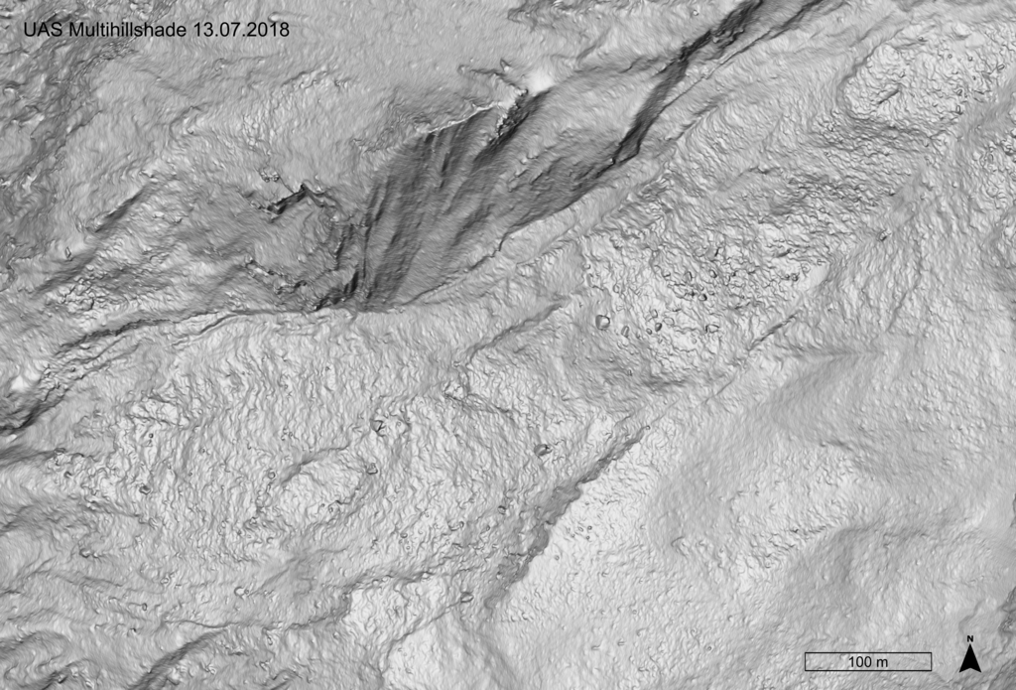
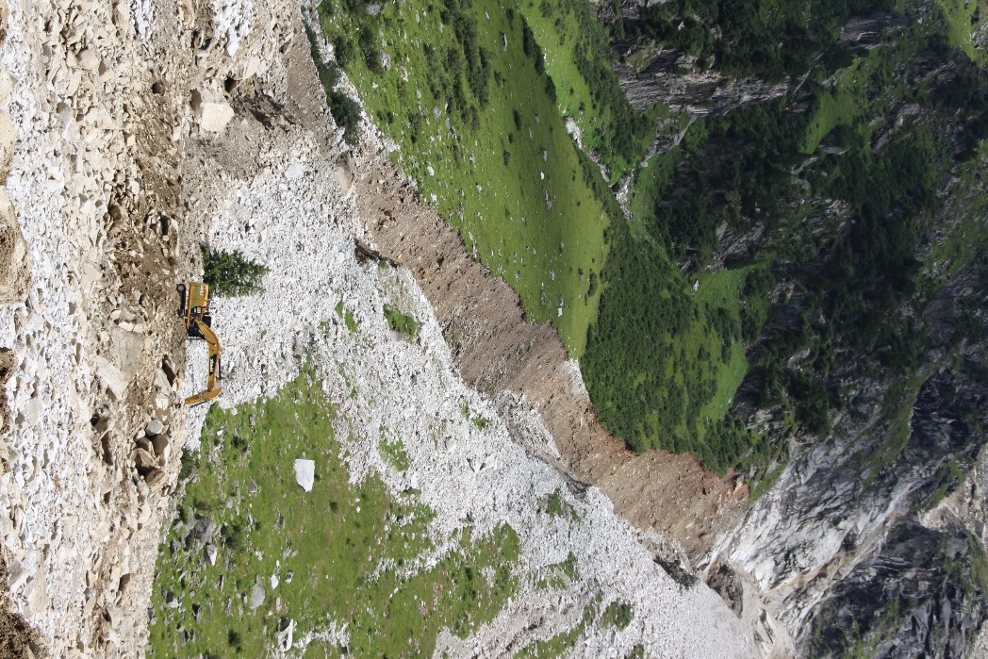
VERY
ACTIVE
High dynamic & variable activity
2012-2015: ≤ 30ma-1,
07/2018-07/2019: 31 m
07/2019-09/2019: 18 m

Slide 4
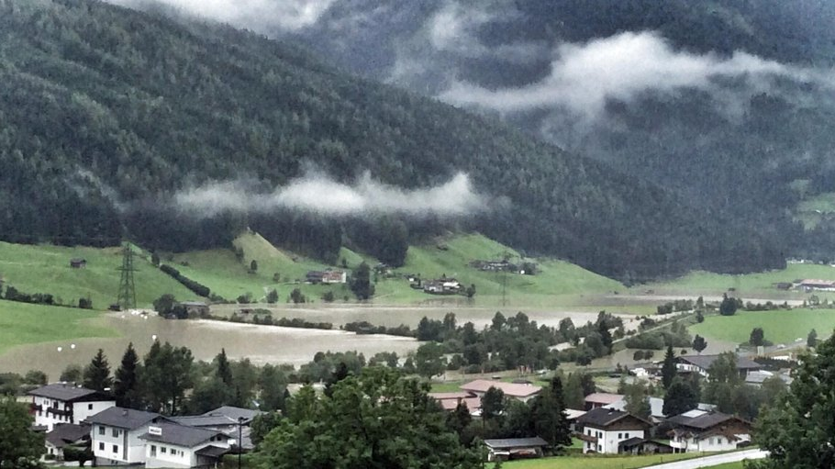
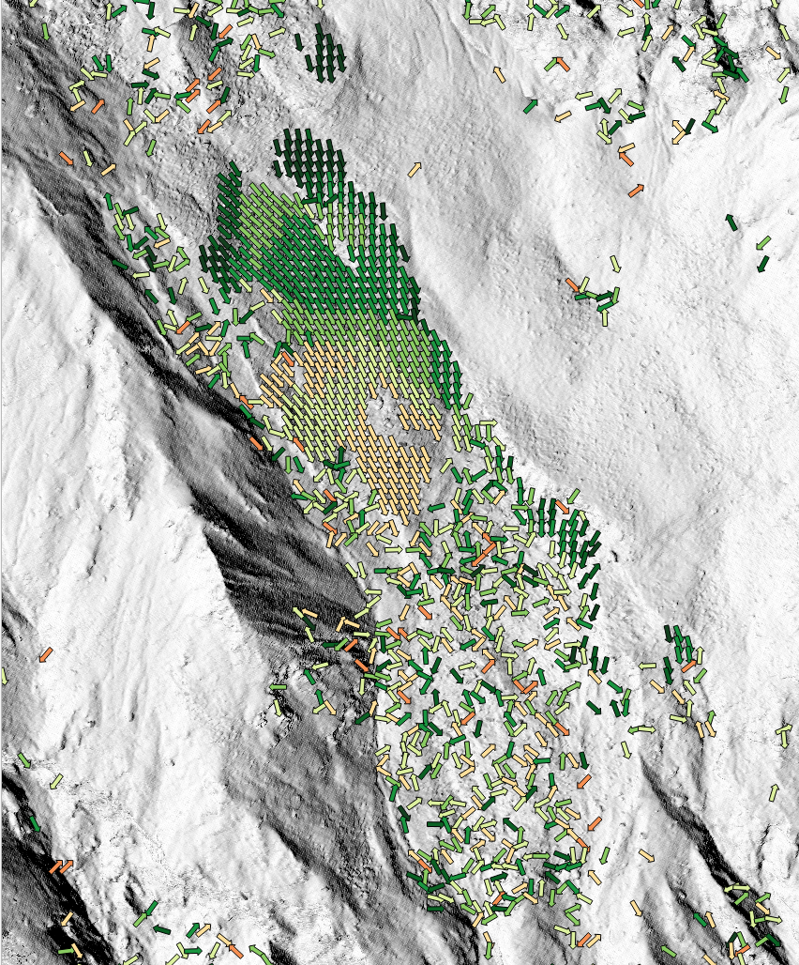
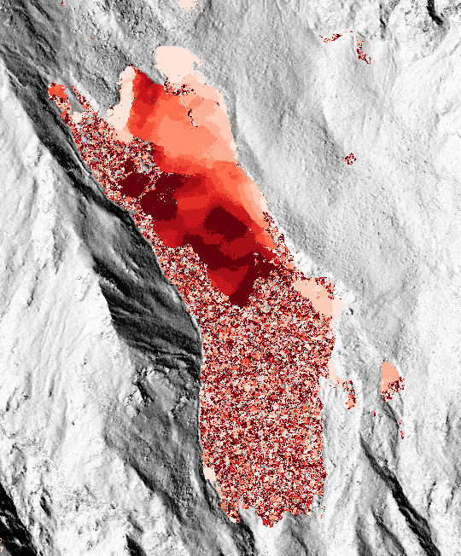
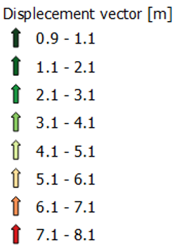
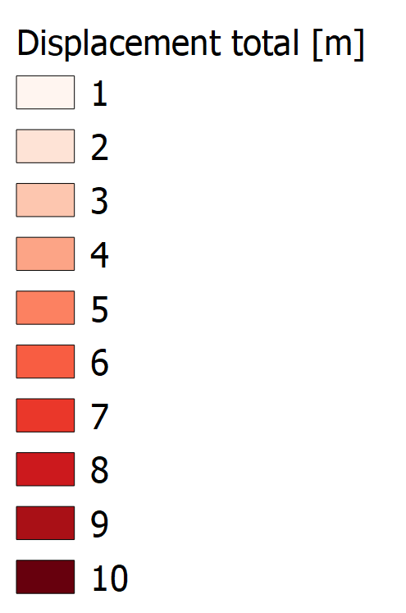
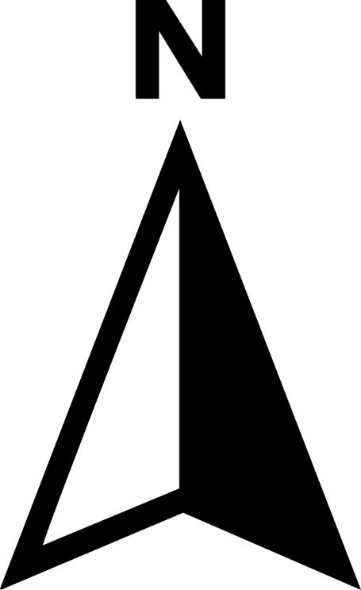
WHY
Climate sensitive alpine cirques
Otto and Keuschnig, 2014
Mobilisation due to heavy precipitation
Dietrich and Krautblatter, 2018
Detection and monitoring for LEWS
Metternicht et al., 2005; Michoud et al., 2014
Limitation to classical DIC approaches (cross- and phase correlation techniques)
Delacourt et al., 2007; Travelletti et al., 2012; Stumpf et al., 2016; Hermle et al., 2021;

Slide 5
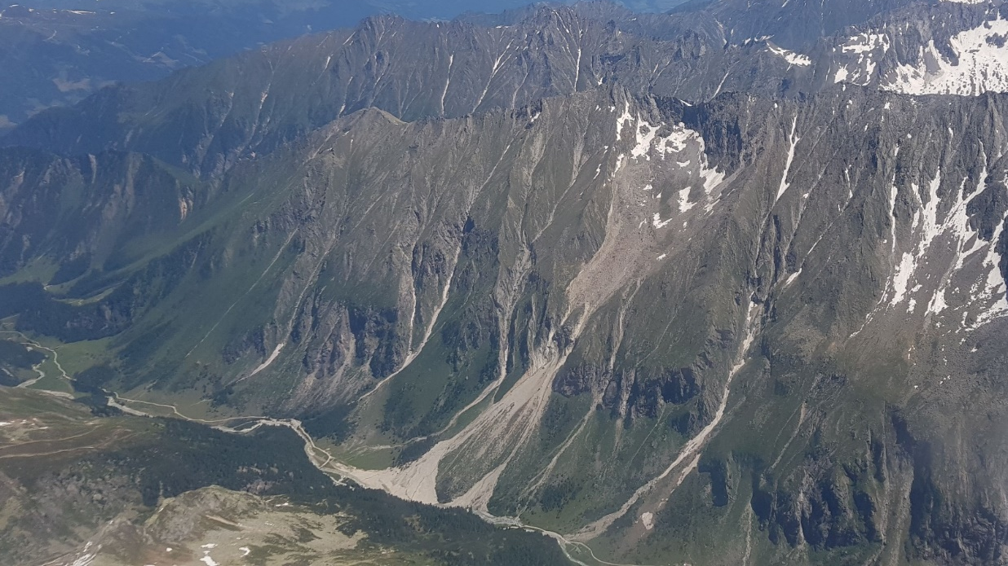
AIM
Delineate ground motion
Calculate time series displacement curves
Extend velocity range of detection
Employ optical flow for landslide detection

Slide 6
?
Can the method phase correlation investigate both slow and moderate velocities between repeated intervals?
How does the optical flow algorithm dense inverse search perform in comparison to the well-established phase correlation algorithm?
Notes:
In this presentation I have the following research questions,
first, can the method phase correlation investigate both slow and moderate velocities between repeated intervals?
and second, how does the optical flow algorithm dense inverse search perform in comparison to the well-established phase correlation algorithm?

Slide 7
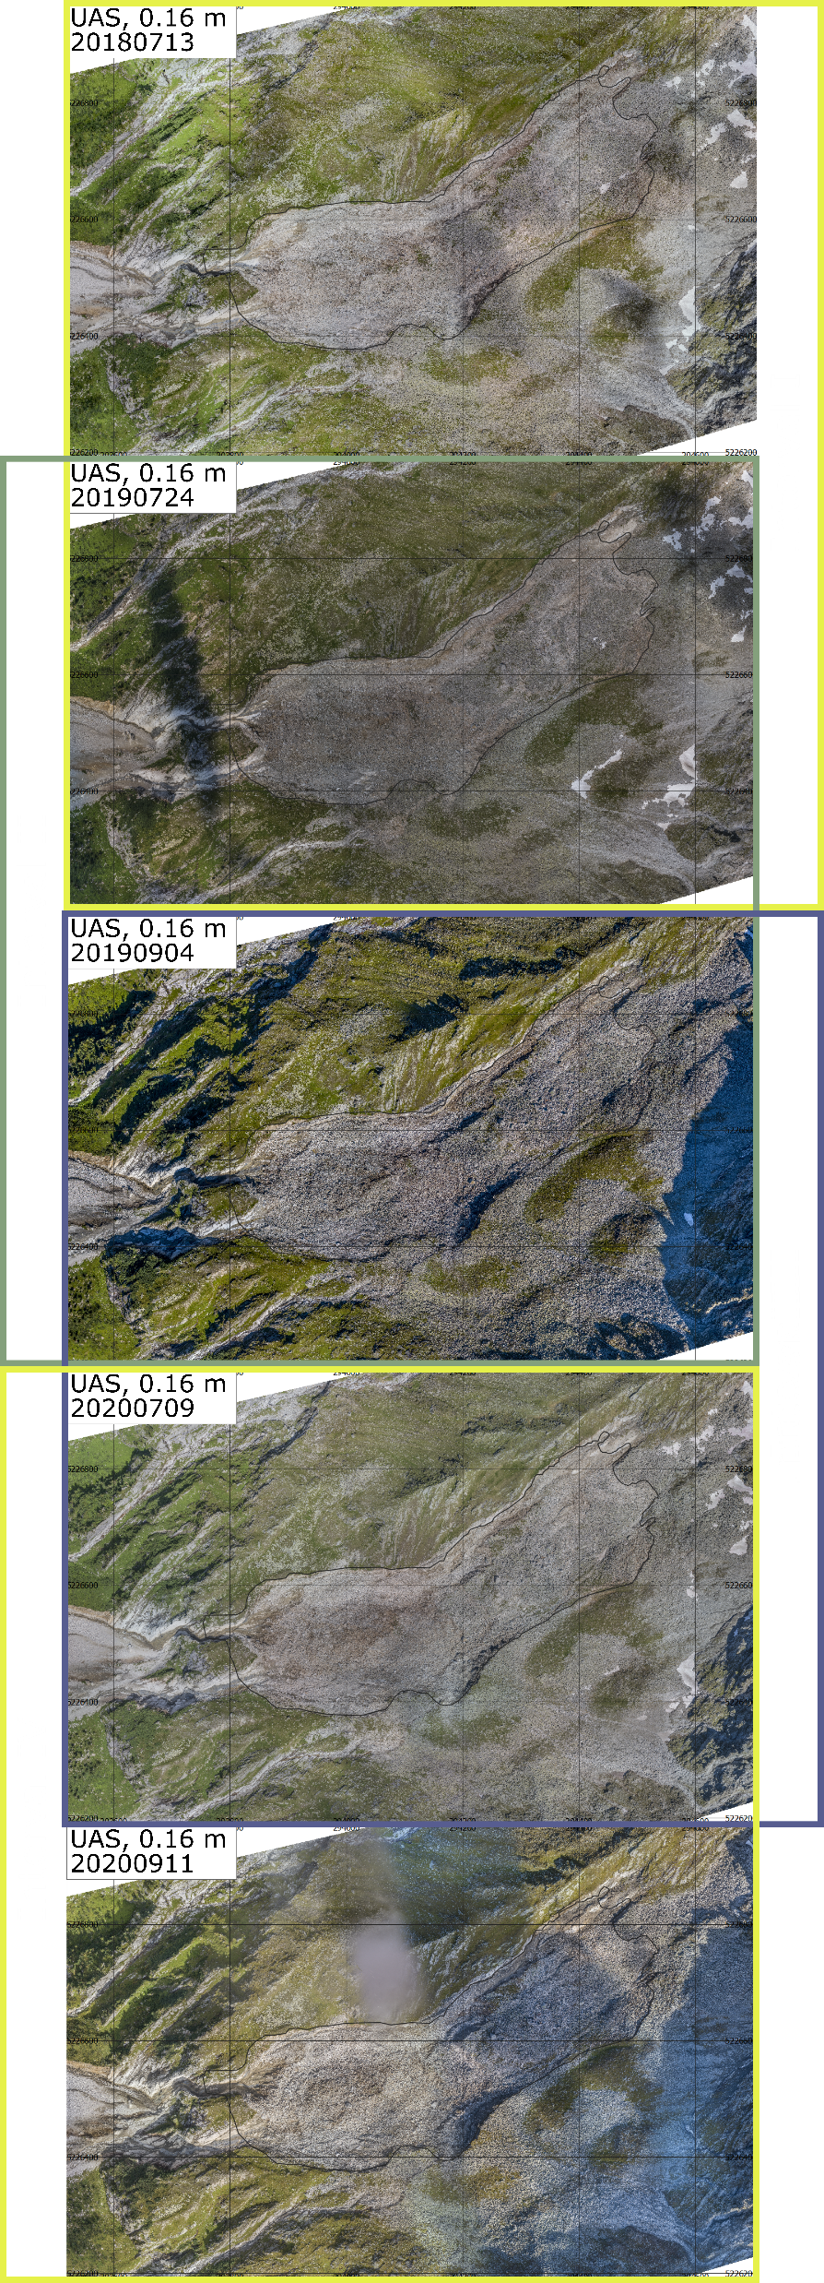
UAS
flexibility e.g. weather, snow cover, daytime
flight planning: UgCS, 4 flight paths, 8 GCPs
image processing: Pix4Dmapper
very high resolution 0.16 m orthophotos, DEM
DATA
UAS

Slide 8
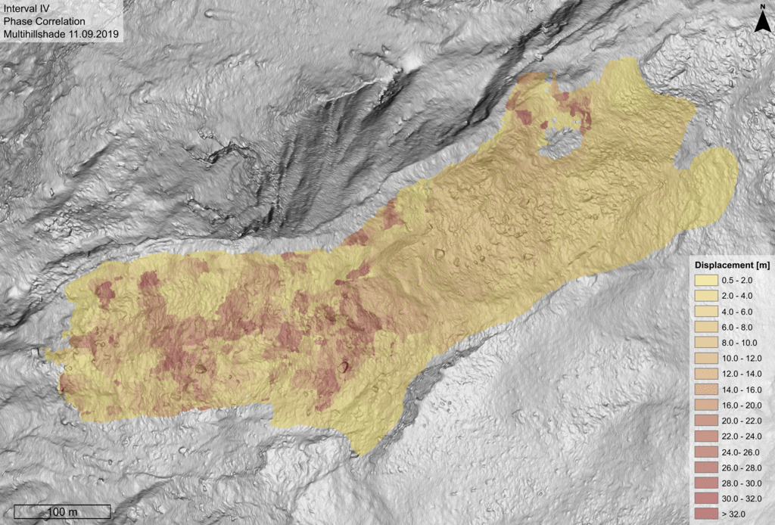
RESULT
SINGLE
PC
High dynamic & variable activity
2012-2015: ≤ 30ma-1,
07/2018-07/2019: 31 m
07/2019-09/2019: 18 m

Slide 9
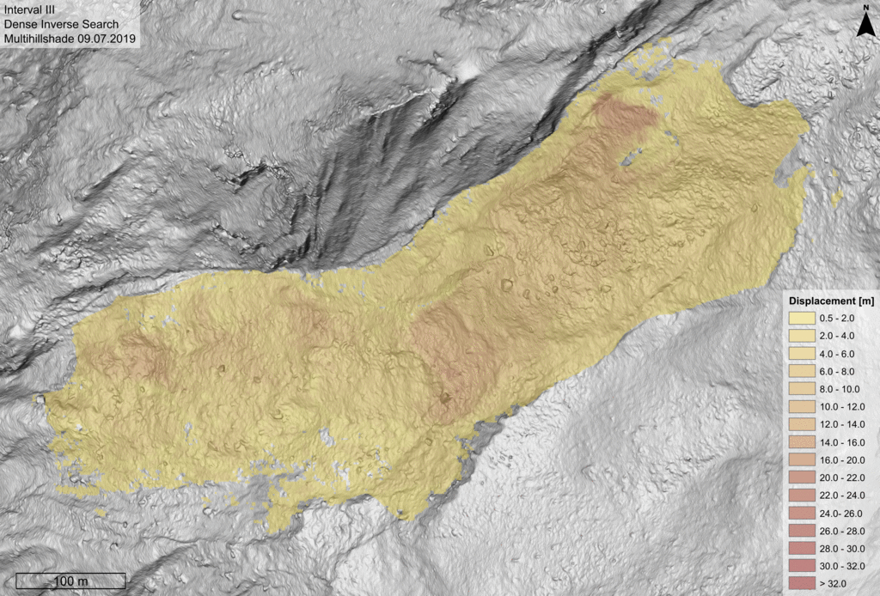
RESULT SINGLE DIS
High dynamic & variable activity
2012-2015: ≤ 30ma-1,
07/2018-07/2019: 31 m
07/2019-09/2019: 18 m

Slide 10
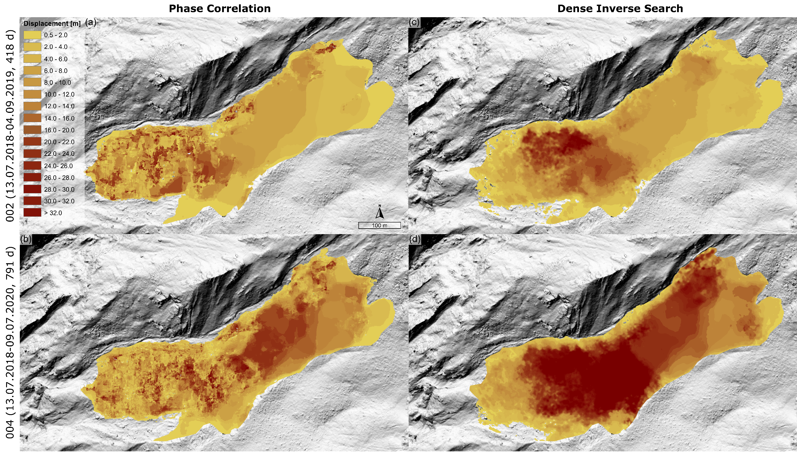
IRIS Phase Correlation
IRIS Optical Flow (DIS)
RESULTS
MULTIPLE

Slide 11
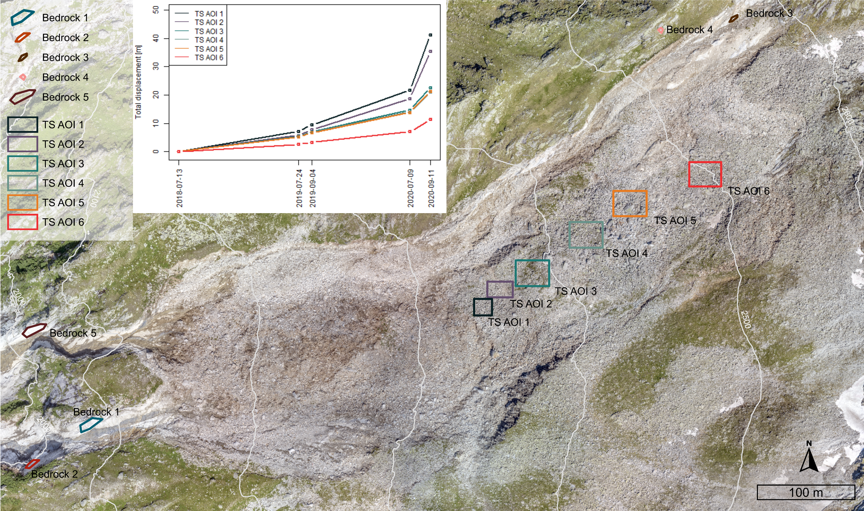
TIME SERIES

Slide 12
Can the method phase correlation investigate both slow and moderate velocities between repeated intervals?
  Yes, the area-based phase correlation algorithm can investigate these velocities.
How does the optical flow algorithm dense inverse search perform in comparison to the well-established phase correlation algorithm?
  Optical flow does not have an upper limit of displacements and performs very well compared to phase correlation.
  However severe surface changes leading to decorrelation with phase correlation are underrepresented with no sign of noise, thus must be handled with caution.
!
Notes:
In this presentation I have the following research questions,
first, can the method phase correlation investigate both slow and moderate velocities between repeated intervals?
and second, how does the optical flow algorithm dense inverse search perform in comparison to the well-established phase correlation algorithm?

Slide 13
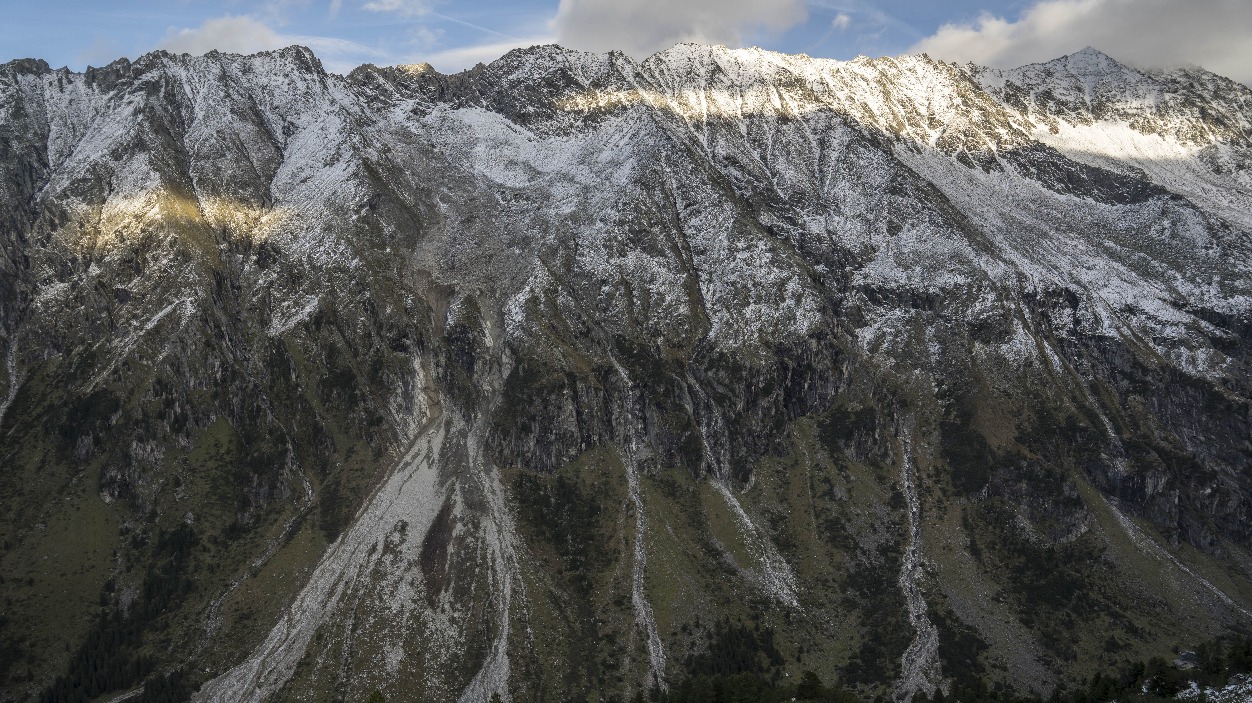
THANK YOU FOR YOUR ATTENTION
https://www.cee.ed.tum.de/landslides/staff/phd-students/doris-hermle/
https://www.photomonitoring.com/iris/

