Slide 1



Improved flood predictions by combining satellite observations, topographic information and rainfall spatial data using deep learning
Rocco Palmitessa, Oliver Gyldenberg Hjermitslev, Heidi Egeberg Johansen, Karsten Arnbjerg-Nielsen, Peter Bauer‐Gottwein, Peter Steen Mikkelsen, and Roland Löwe* *rolo@env.dtu.dk, Technical University of Denmark, Department of Environmental and Resource Engineering

Slide 2
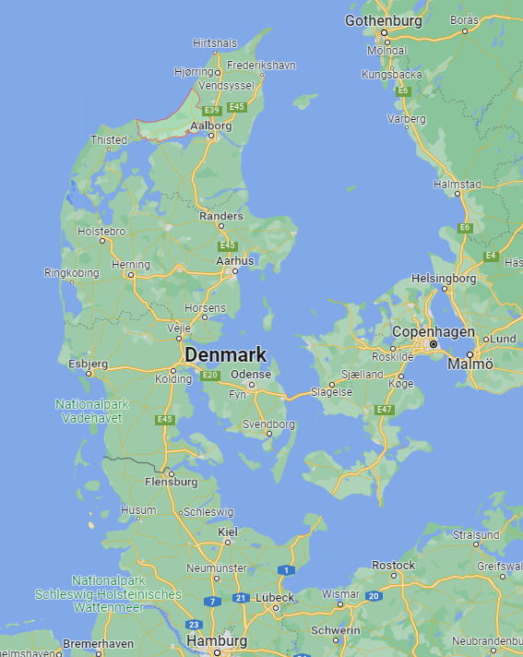
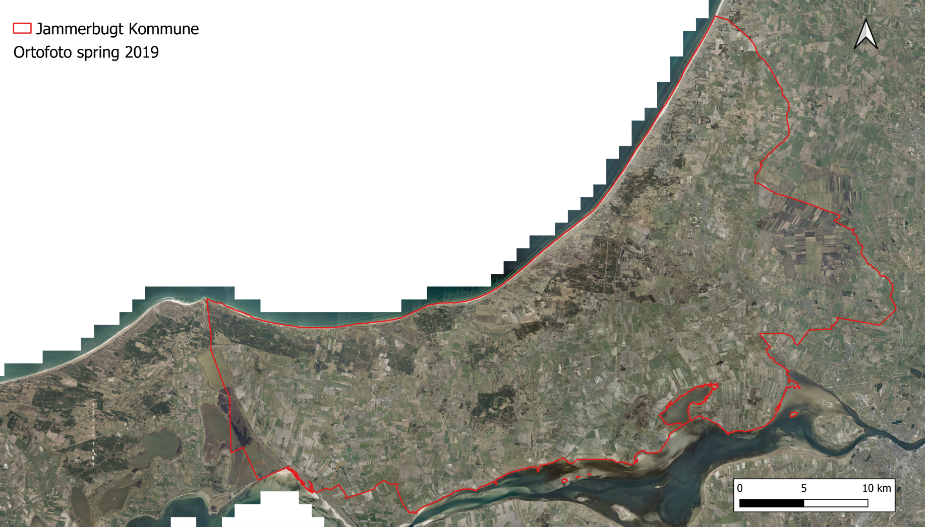
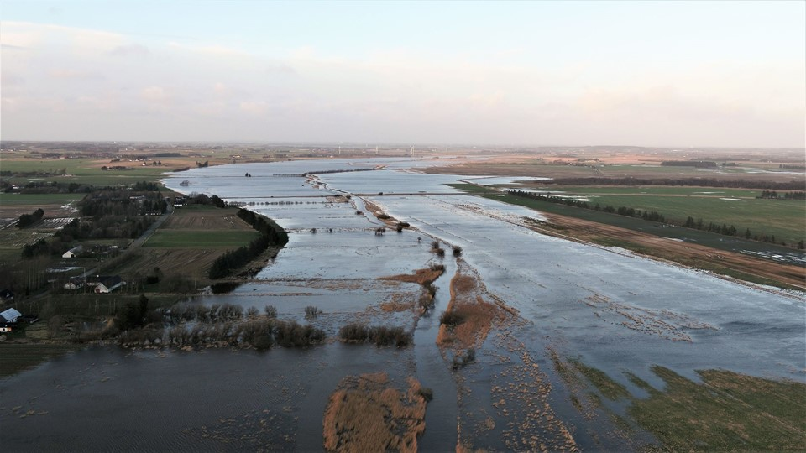
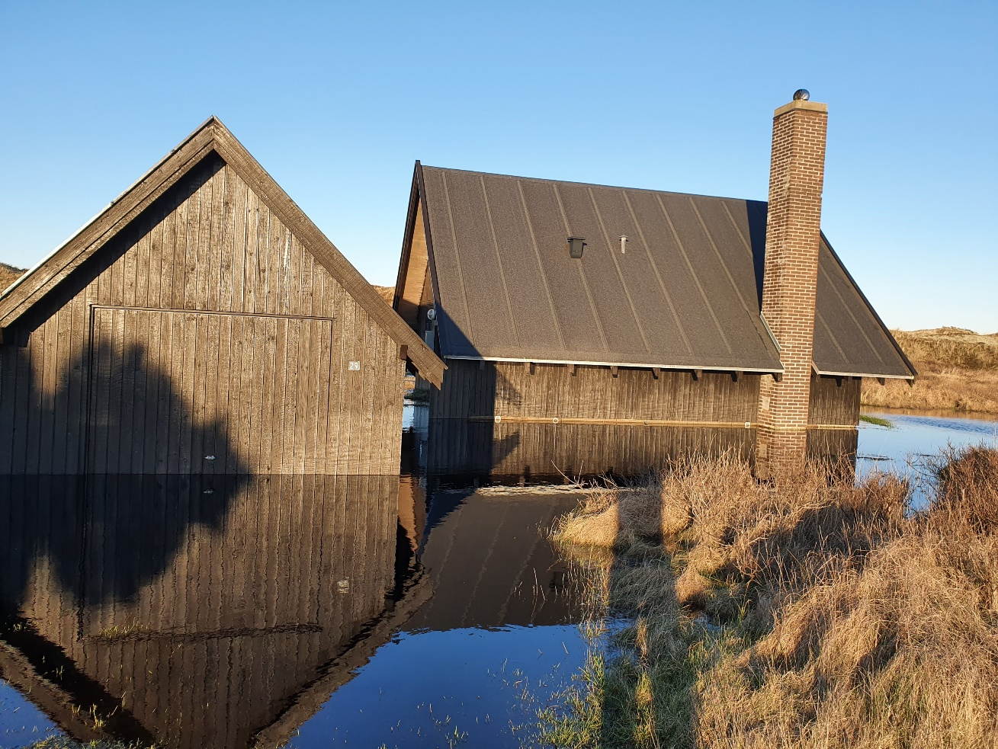
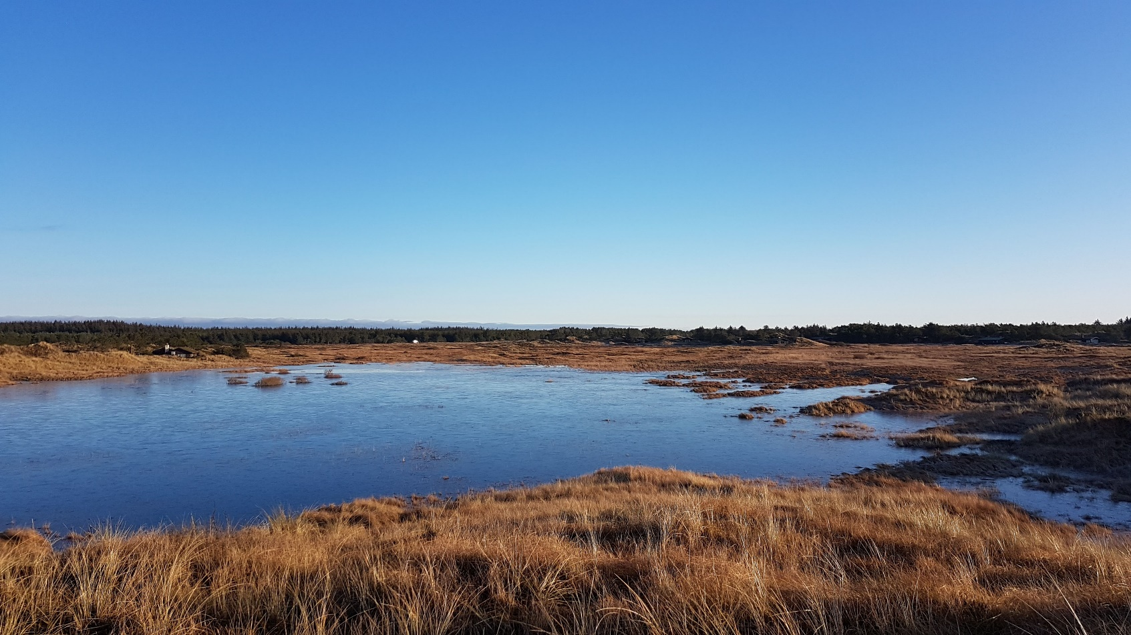
Objective (for warning and long-term planning)
Predict areas that will be “wet” or inundated in a given meteorological situation, by combining open data and satellite observations of surface water.
Area
Population
Avg elevation
866.25 km²
38,175
4 m

Slide 3
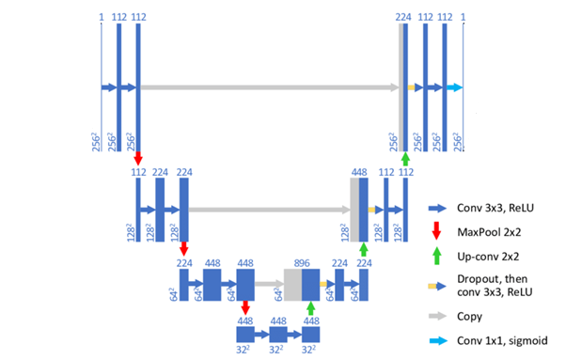
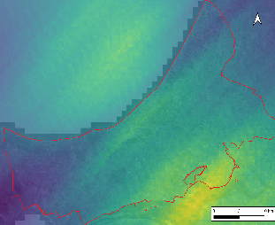
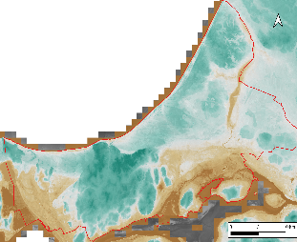
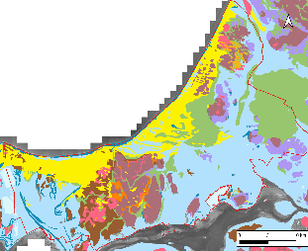
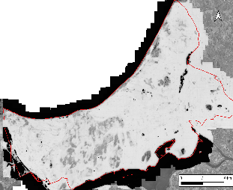
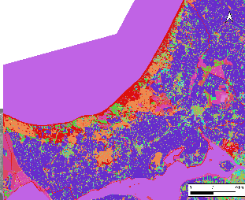
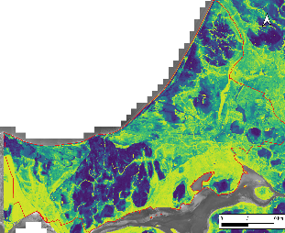
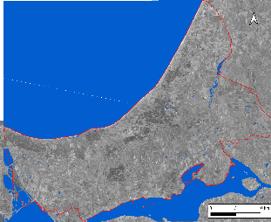
Model architecture
Input data
U-net model
Rainfall
Topography
Surface water
Geology
Prediction
Land use
Groundwater
Observation
Meteorological data provided by DMI Open geodata provided by GEUS, Agency for Data Supply and Efficiency, and Danish Municipalities
Satellite observations provided by DHI-GRAS

Slide 4
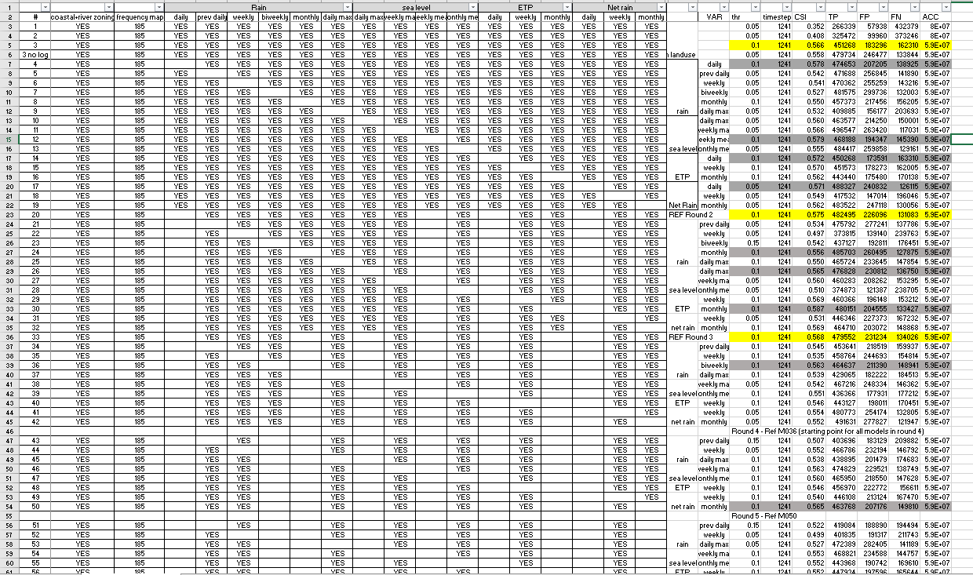
Model development - systematic input selection
Backward selection
Meteorology
rain | prev daily
 | weekly
 | daily max
sea level | weekly max
 | monthly mean
ETP | weekly
net rain | weekly
Topography
Bluespot
Aspect
Flow accumulation
TWI
Relative elevation 100m
Relative elevation 500m
Relative elevation 1000m
Sink depth

Slide 5
Key findings
provide topographic and terrain properties in various formulations
tell model which areas are affected by coastal and fluvial flooding (input zoning layers)
careful filtering of satellite data required during training (satellite cannot see under vegetation)

Slide 6
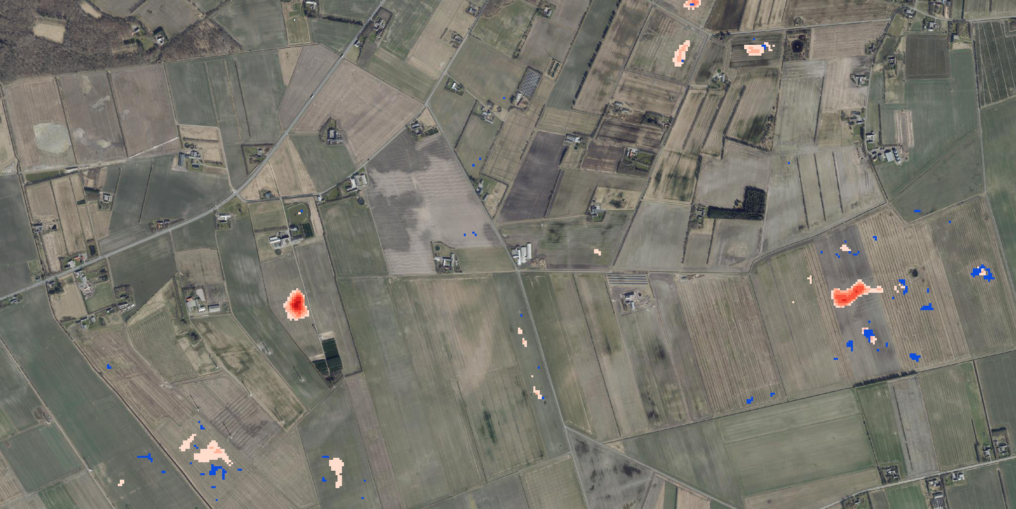
Surface water predictions (independent test data)
55% correct predictions BUT – satellite is wrong as well
On-going:
Validation with drone data and interviews
Upscaling to 3 municipalities
Using weather forecasts

Slide 7
Funded by the Danish Government through the Signature Project Jammerbugt Kommune
Meteorological data provided by DMI
Open geodata provided by GEUS, Agency for Data Supply and Efficiency, and Danish Municipalities
Satellite data provided by DHI-GRAS
Thank you!

