Slide 1

Quality check
of ground-based hourly measurements
of downwelling surface solar irradiance in China
Xuemei Chen, Benoît Tournadre, Yves-Marie Saint-Drenan, Benoît Gschwind, Kai Qin, Philippe Blanc
Observation, Impacts, Energy (O.I.E.), Mines Paris – PSL, France
School of Environment and Spatial Informatics, China University of Mining and Technology, China
24 May, 2022

Slide 2
Motivation
Estimating downwelling surface solar irradiance from satellite sensors
→ Validation by ground-based measurements
Reference: Heliosat-V
Benoît Tournadre, Benoît Gschwind, Yves-Marie Saint-Drenan, Xuemei Chen, Rodrigo Silva, and Philippe Blanc, "An alternative cloud index for estimating downwelling surface solar irradiance from various satellite imagers in the framework of a Heliosat-V method," Atmospheric Measurement Techniques, 2022.

Slide 3
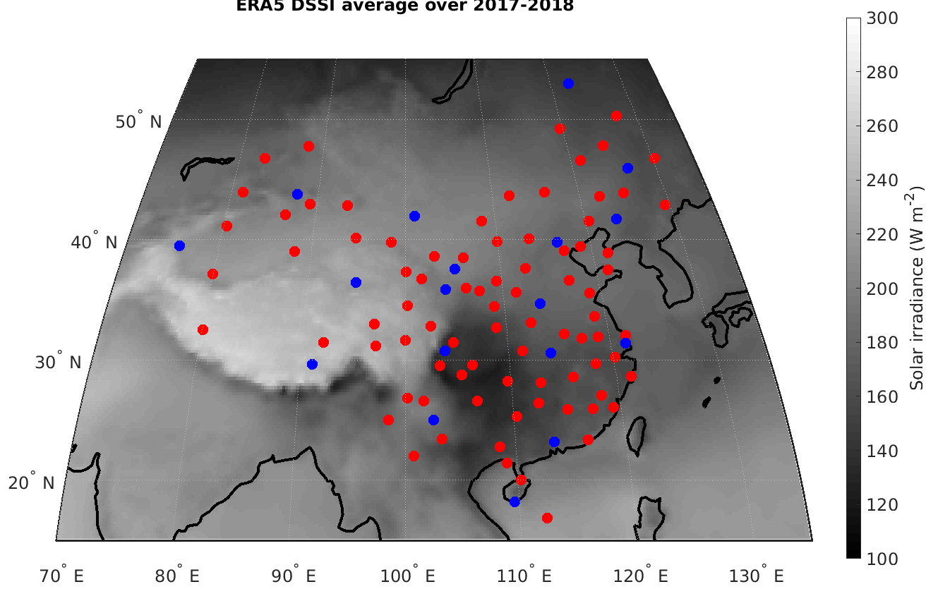
CMA network of irradiance measurements
Background: ERA5 mean GHI (2017-2018)
101 stations
  - Only global: 83 stations
  - Direct and diffuse: 18 stations

Slide 4
Visual quality-check procedure: global
Good quality

Slide 5
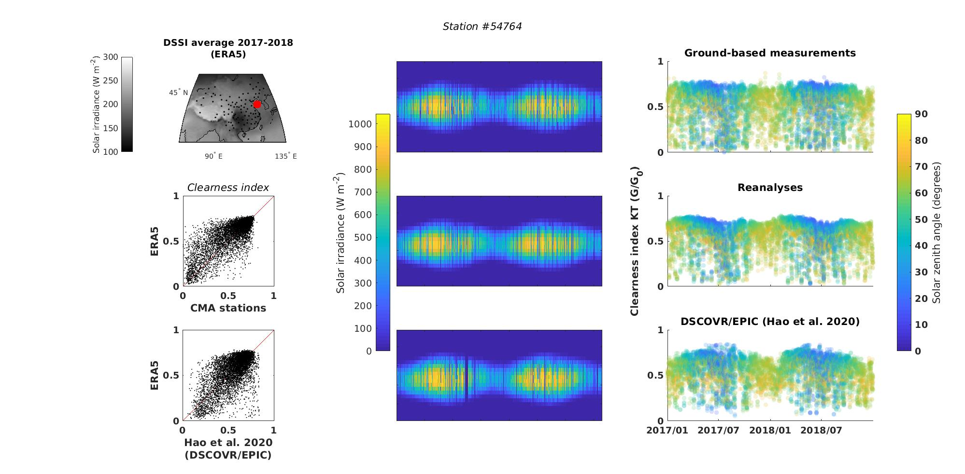
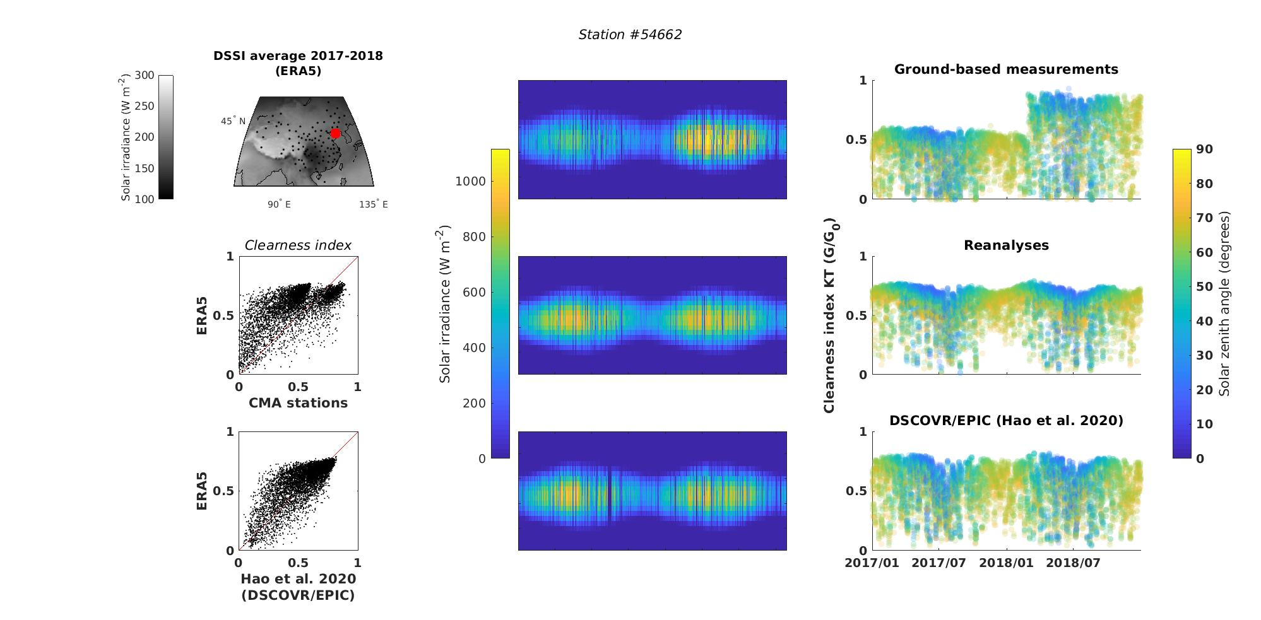
Visual quality-check procedure: global
Station #54764 (Fushan)
Good quality

Slide 6
Visual quality-check procedure: global
Partly good

Slide 7
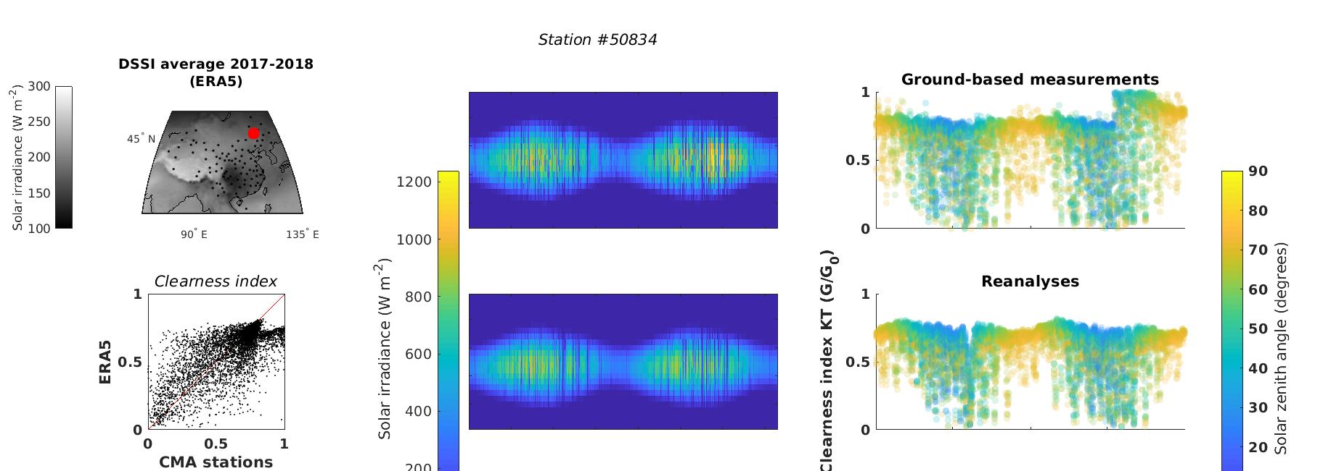
Visual quality-check procedure: global
Station #50834 (Suolun)
Partly good

Slide 8
Visual quality-check procedure: global
Bad quality

Slide 9
Visual quality-check procedure: global
Station #54662 (Dalian)
Bad quality

Slide 10
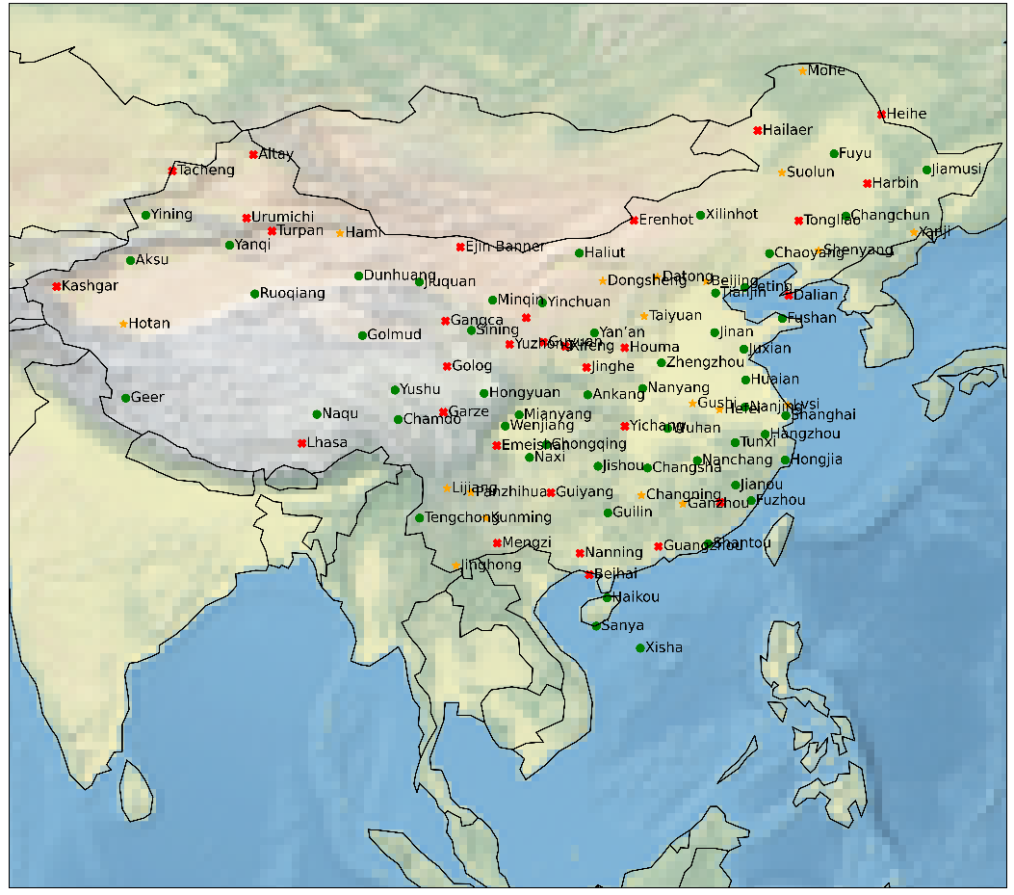
Summary of validation: global
71 stations usable over 101 for global:
- 52 full time series
- 19 part time series
(- 30 stations not usable)

Slide 11
Summary of validation: 3 components
Applied to 18 stations:
→ with diffuse, direct and global measurements
6 stations usable over 18 for 3 components:
- 4 full time series
- 2 part time series

Slide 12
Conclusions
CMA hourly data of variable quality
For years 2017-2018:
      71 stations over 101 usable for global irradiance
      6 stations over 18 usable for three components

Slide 13
Quality check of ground-based hourly measurements of
downwelling surface solar irradiance in China
Xuemei Chen, Benoît Tournadre, Yves-Marie Saint-Drenan, Benoît Gschwind, Kai Qin, Philippe Blanc
Thank you
xuemei.chen@mines-paristech.fr
philippe.blanc@minesparis.psl.eu

Slide 14
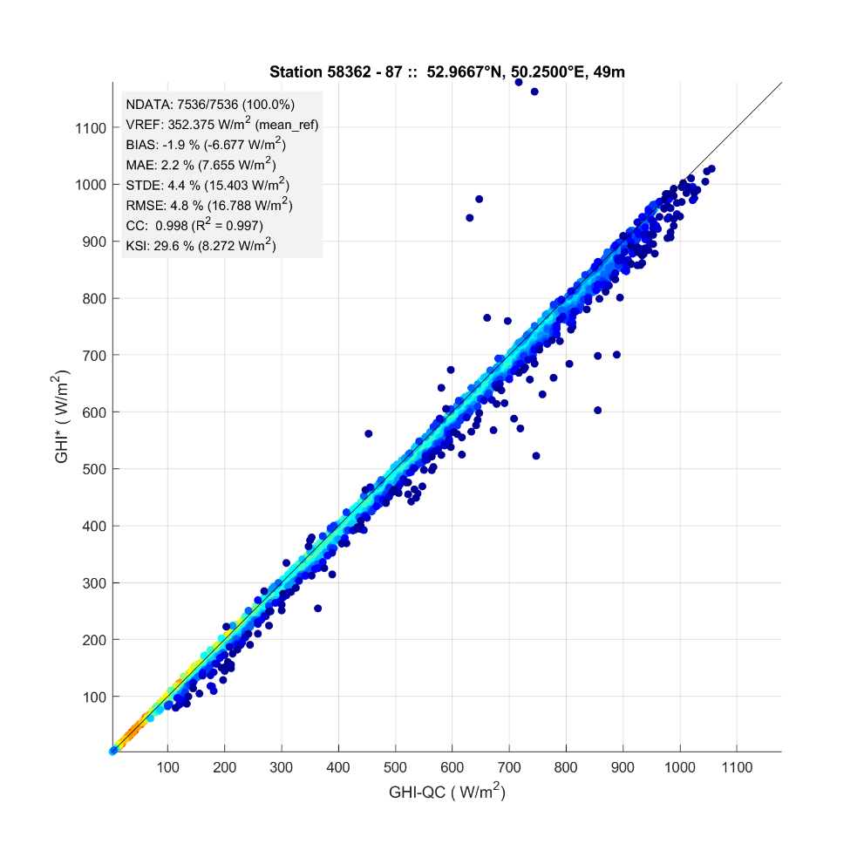
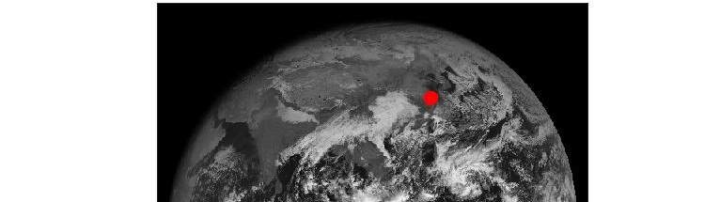
Visual quality-check procedure: 3 components
Station #58362 (Shanghai)
Good quality
Direct + diffuse (W m⁻²)
Global (W m⁻²)

Slide 15
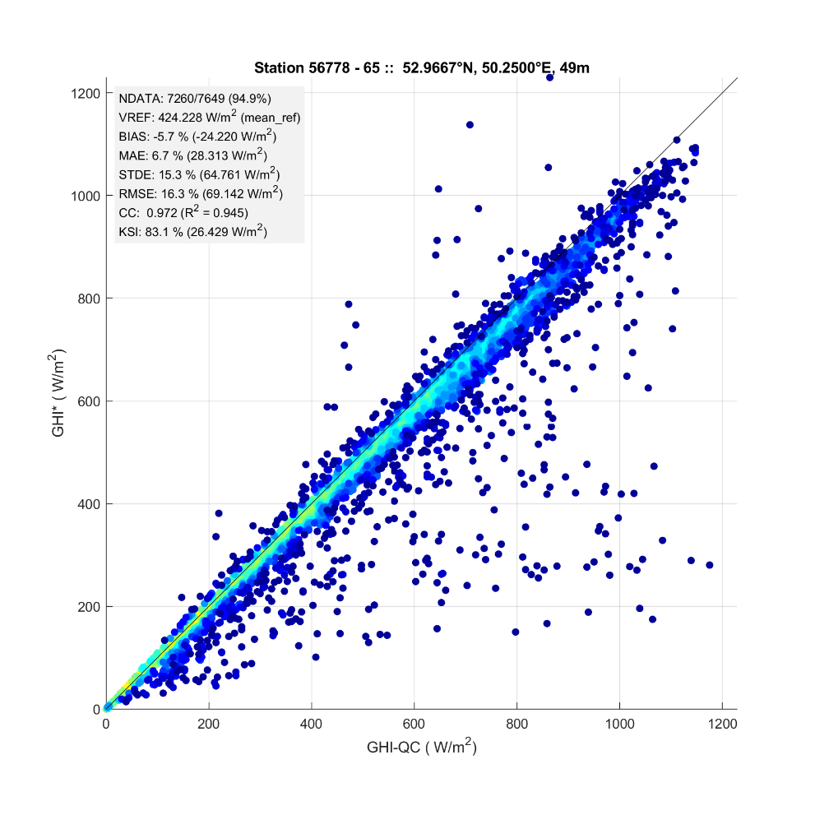
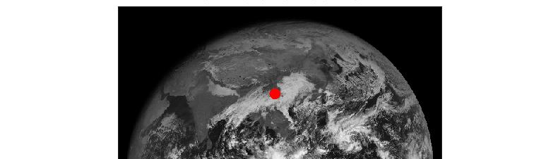
Visual quality-check procedure: 3 components
Station #56778 (Kunming)
Direct + diffuse (W m⁻²)
Global (W m⁻²)

Slide 16
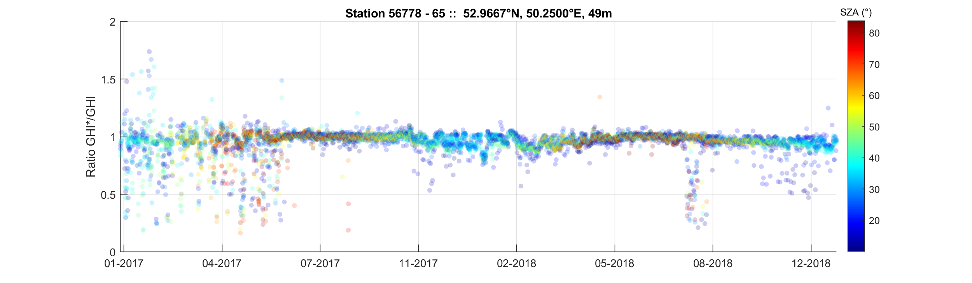
Visual quality-check procedure: 3 components
Station #56778 (Kunming)
Partly good
(Direct+diffuse)/GHI
Solar zenith angle (degrees)

Slide 17
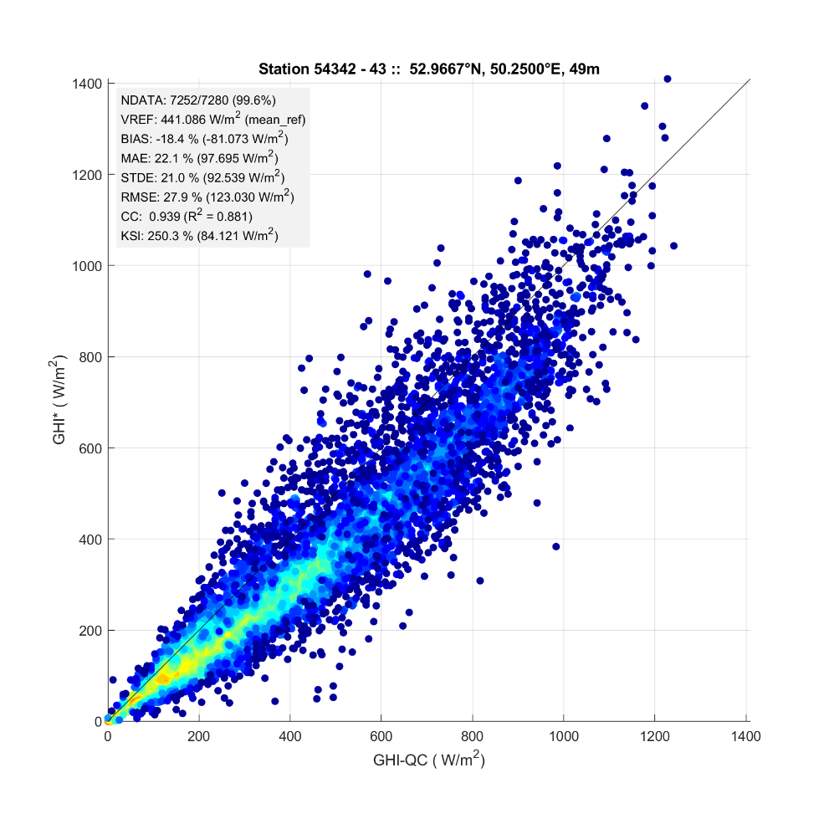
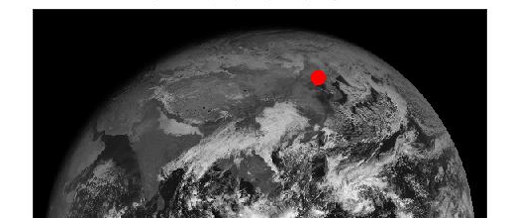
Visual quality-check procedure: 3 components
Station #54342 (Shenyang)
Bad quality
Direct + diffuse (W m⁻²)
Global(W m⁻²)

