Slide 1
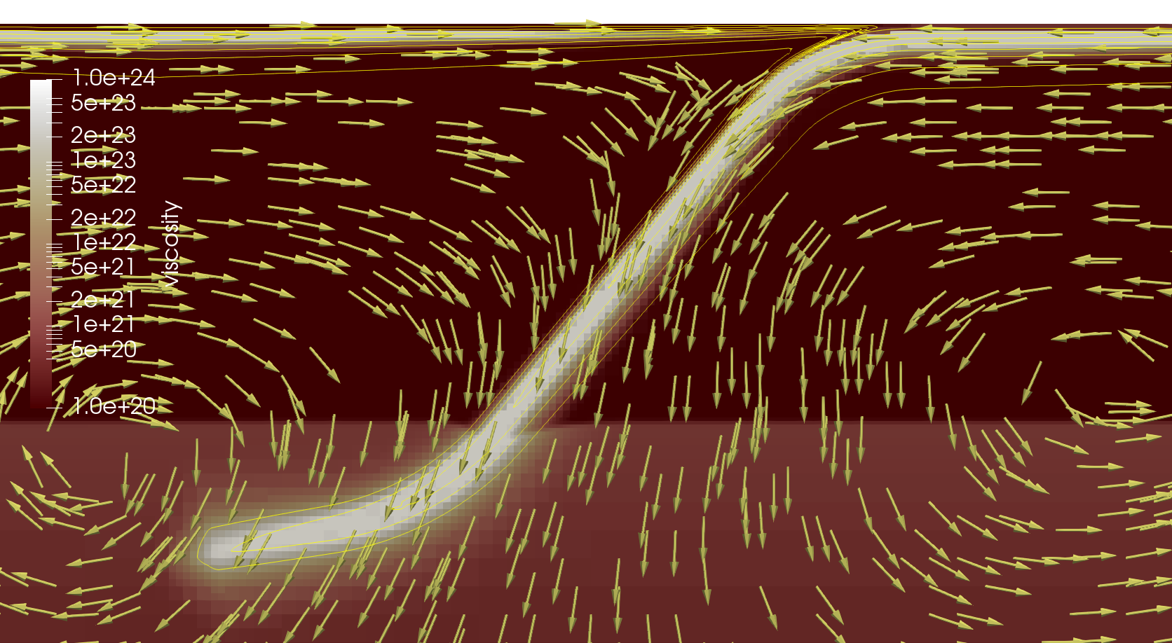
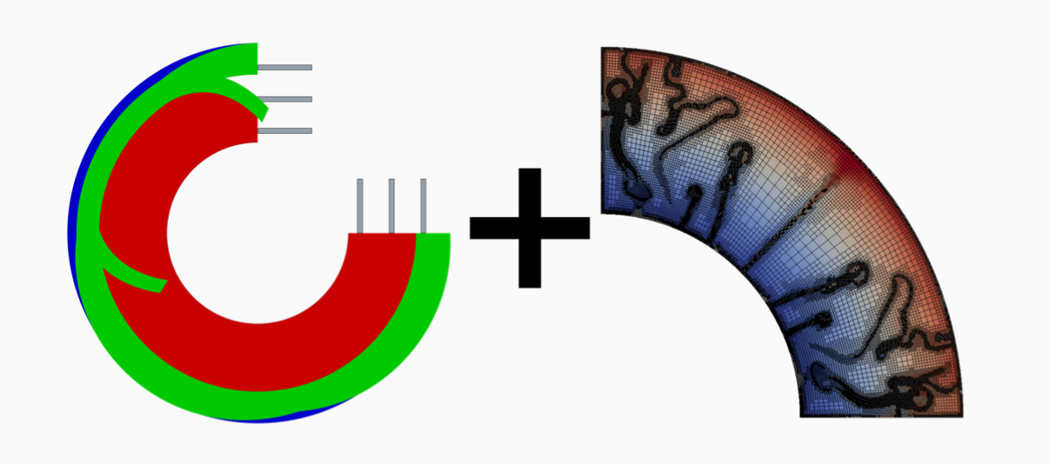

Mass-conserving thermal structure for slabs in Instantaneous Models of Subduction
Magali I. Billen
Menno R.T. Fraters

Slide 2
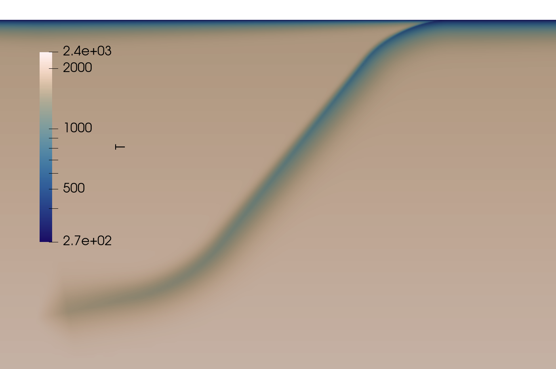
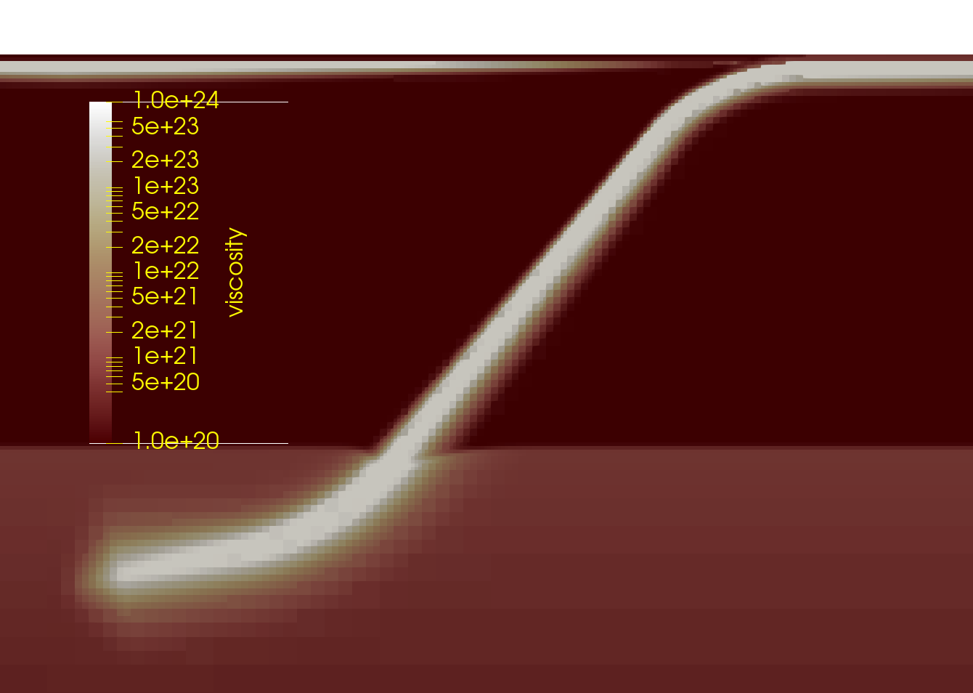
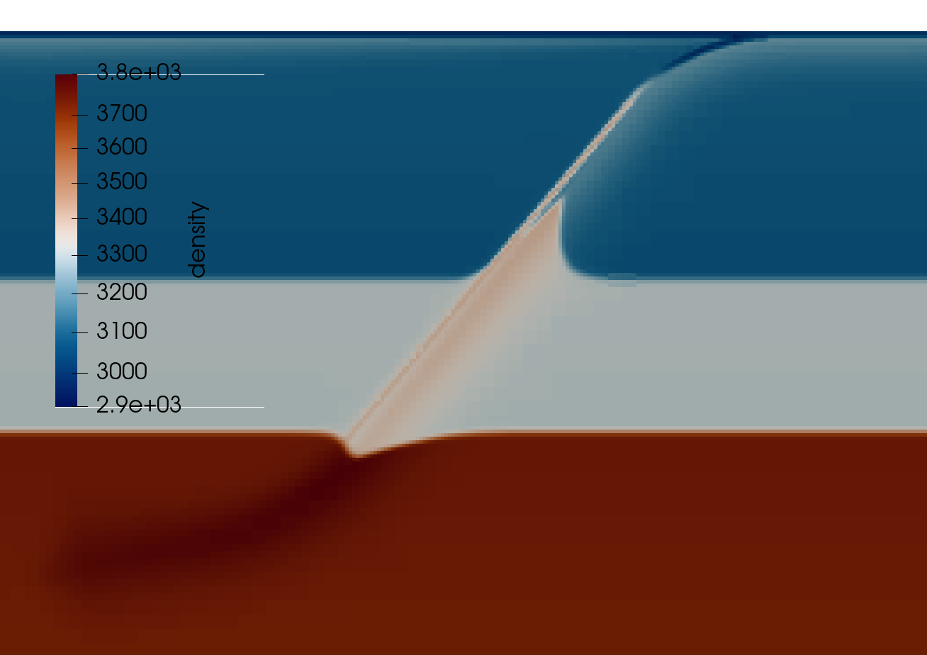
Dynamics = Driving Forces + Resisting Forces getting both right matters
Viscosity
Temperature
Density
Notes:
Usually I’m standing up here talking about all the complexity and uncertainty related to integrating laboratory constraints on rheology and how that affects the forces resisting subduction. But today I’m going to turn my attention to the driving forces, and in particular the thermal structure: affects thermal buoyancy, but also impacts driving forces related to phase transitions and feeds back into resisting forces through temperature-dependence of viscosity in the slab.

Slide 3
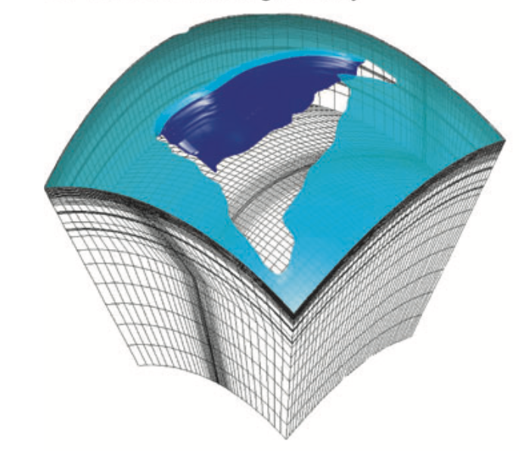
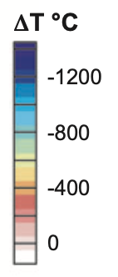
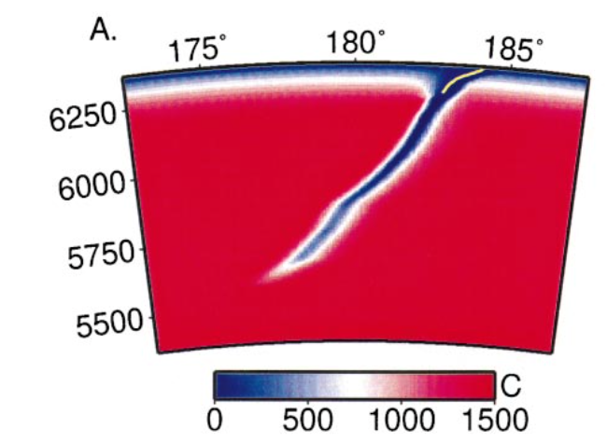
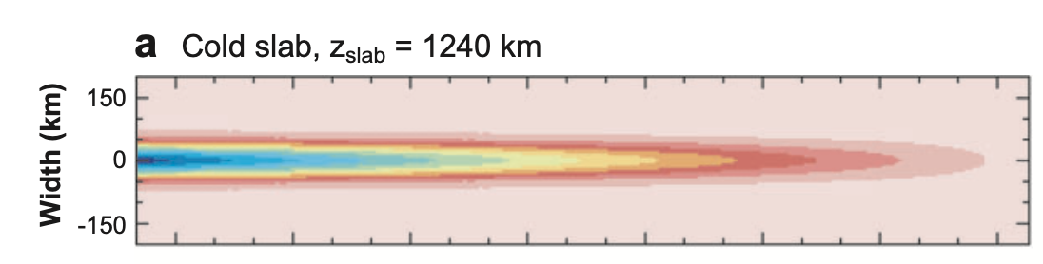
Slab Temperature: Many approaches for present-day regional models
Pre-run model with fixed slab velocity
Analytic solution
“McKenzie” Model
complicated to do for 3D regional & global models
no diffusion into surrounding mantle
does not conserve mass!
Notes:
So, the challenge is that we want something that doesn’t require pre-running models, but also something is does a better job of producing a physically consistent temperature structure

Slide 4
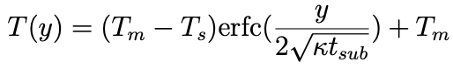
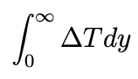
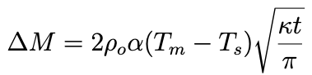


Mass-Conserving Slab Temperature: Approach
T(y)
Smooth & Conserve Mass
Know mass at trench (half-space) → heat content
Heat Content

Slide 5
Mass-Conserving Slab Temperature: Approach
T(y)
Smooth & Conserve Mass
Know mass at trench (half-space) → heat content
Slab warms up & cools off mantle
T_{min}(v_{sub}, age, L)
Min temperature migrates into to slab
steeper gradient, faster cooling
Δz(v_{sub}, age, L)
Calibrate T_{min} and Δz using time-dependent models
Grow thermal boundary layer to conserve mass as slab heats up
L
T_{min}
z
Δz
Heat Content

Slide 6
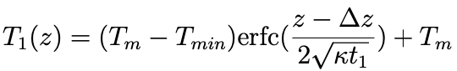
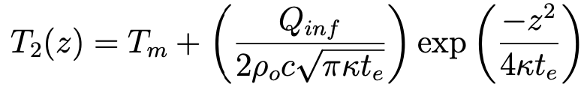



Mass-Conserving Slab Temperature: Implementation
Conserve heat content → Conserve mass
Keep half-space
on bottom side, but ages
and T_{min} increases
Side 2
(top)
Use infinite-space
solution of top side
why? slope = 0 at T_{min}
Side 1
(bottom)
z
Slab surface
Δz(L)
T_{min}(L)
t_{e} = ?

Slide 7
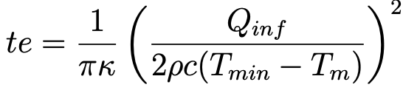



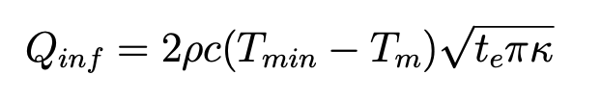
Mass-Conserving Slab Temperature: Implementation
Conserve heat content → Conserve mass
Half-space solution
Infinite-space solution
Side 1
(bottom)
Side 2
(top)
z
Slab surface
Δz(L)
T_{min}(L)
t_{e} = ?

Slide 8
Dynamics = Driving Forces + Resisting Forces Mass-conserving slab temperature structure helps to gets both right
Uses Two analytic expressions
Calibrate T_{min} and Δz
Enforces conservation of mass & heat
Available in Geodynamic WorldBuilder
Example run in Aspect
Notes:
Usually I’m standing up here talking about all the complexity and uncertainty related to integrating laboratory constraints on rheology and how that affects the forces resisting subduction. But today I’m going to turn my attention to the driving forces, and in particular the thermal structure: affects thermal buoyancy, but also impacts driving forces related to phase transitions and feeds back into resisting forces through temperature-dependence of viscosity in the slab.

