Slide 1



Geostationary or not: can we consider Meteosat-8 viewing geometries as stationary?
Benoît TOURNADRE, Xuemei CHEN, Benoît GSCHWIND, and Philippe BLANC

Slide 2

Meteosat-8 or « Indian Ocean » (41.5°East)
Level 1.5 Meteosat/SEVIRI data : no visible motion (fixed lat/lon grid)
Sorry, video too heavy…
And yet…

Slide 3
Without reprojection: level 1.0 data
0.6 µm
12 µm
Sorry, videos too heavy…
Meteosat-8 at 41.5°E

Slide 4
Meteosat-8 or « Indian Ocean »
Good to have a reference lat-lon grid for analyses but…
What if we think Meteosat-8 was geostationary ?
Sorry, videos too heavy…

Slide 5
Meteosat-8 or « Indian Ocean »
Good to have a reference lat-lon grid for analyses but…
What if we think Meteosat-8 was geostationary ?
Sorry, videos too heavy…

Slide 6
Meteosat-8 or « Indian Ocean »
Wrong viewing geometries ➔ wrong radiative transfer simulations ➔ wrong data products
?
Sorry, videos too heavy…

Slide 7
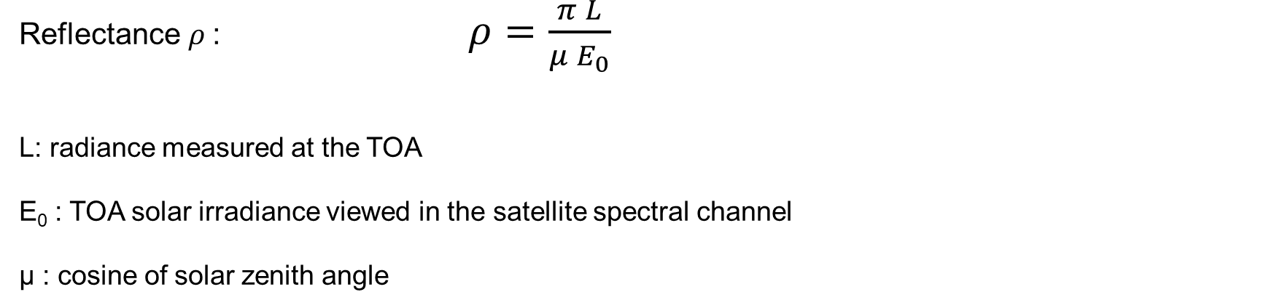
What impact on reflectances at the top of the atmosphere (TOA)?
Reflectance $ρ$: $ρ=\frac{π L}{{μ E}_{0}}$
L: radiance measured at the TOA
E₀ : TOA solar irradiance viewed in the satellite spectral channel
µ : cosine of solar zenith angle

Slide 8
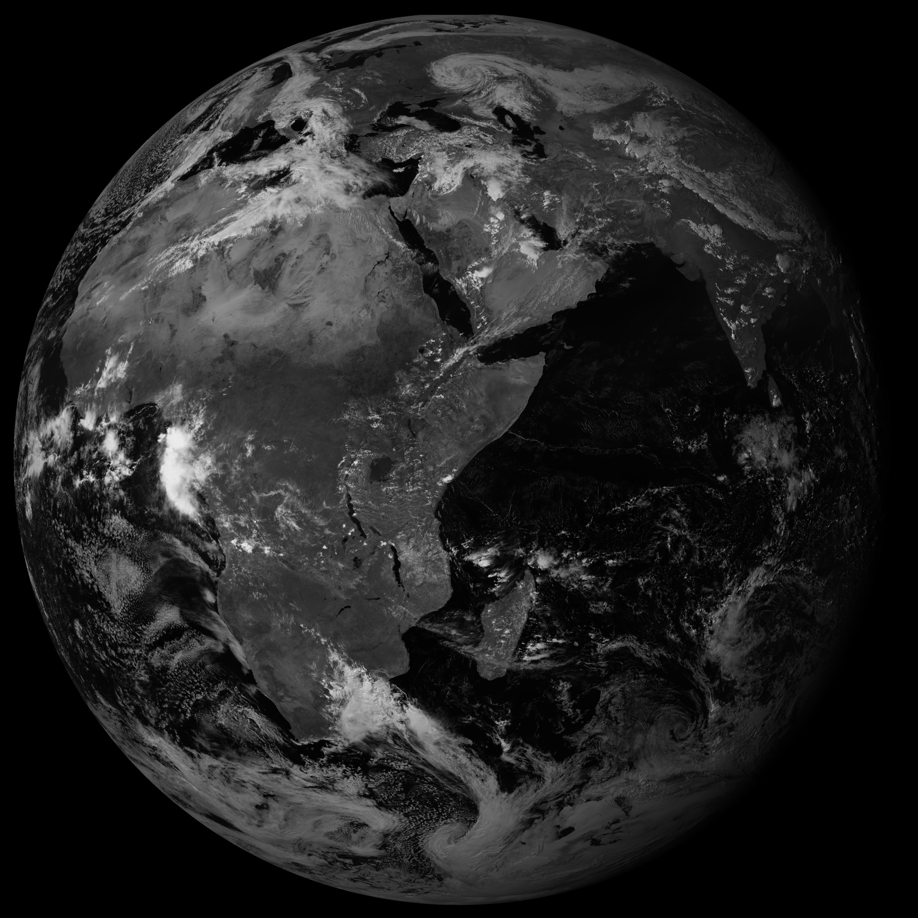
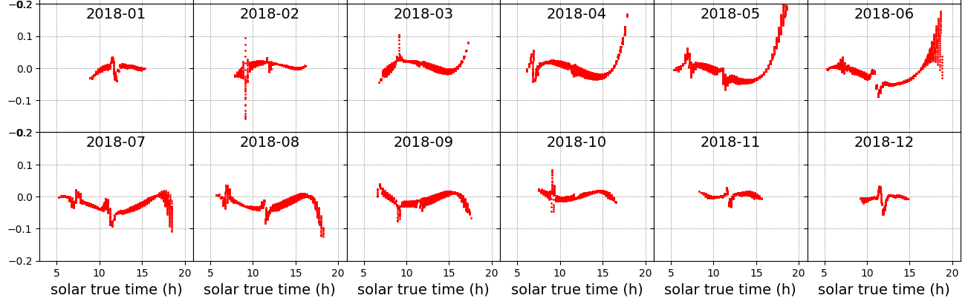
What impact on reflectances at the top of the atmosphere (TOA)?
1) Overcast conditions (DISORT, 32 streams, plane-parallel high liquid cloud)
Palaiseau
Error on reflectance at the TOA

Slide 9
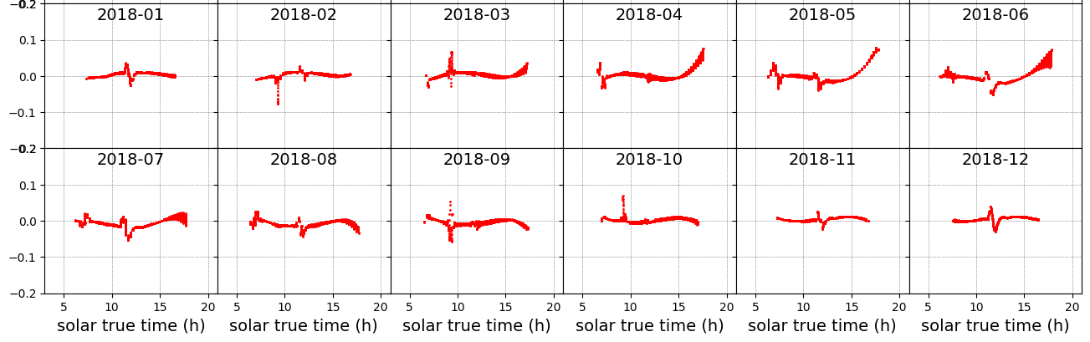
What impact on reflectances at the top of the atmosphere (TOA)?
1) Overcast conditions (DISORT, 32 streams, plane-parallel high liquid cloud)
Tamanrasset
Error on reflectance at the TOA

Slide 10
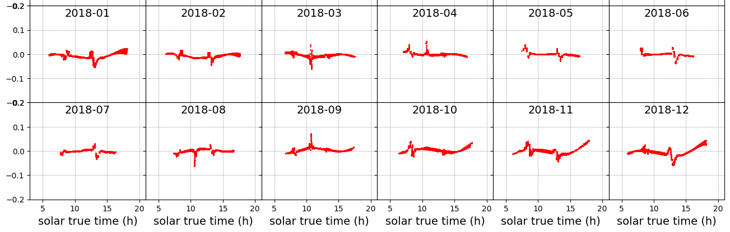
What impact on reflectances at the top of the atmosphere (TOA)?
1) Overcast conditions (DISORT, 32 streams, plane-parallel high liquid cloud)
De Aar
Error on reflectance at the TOA

Slide 11
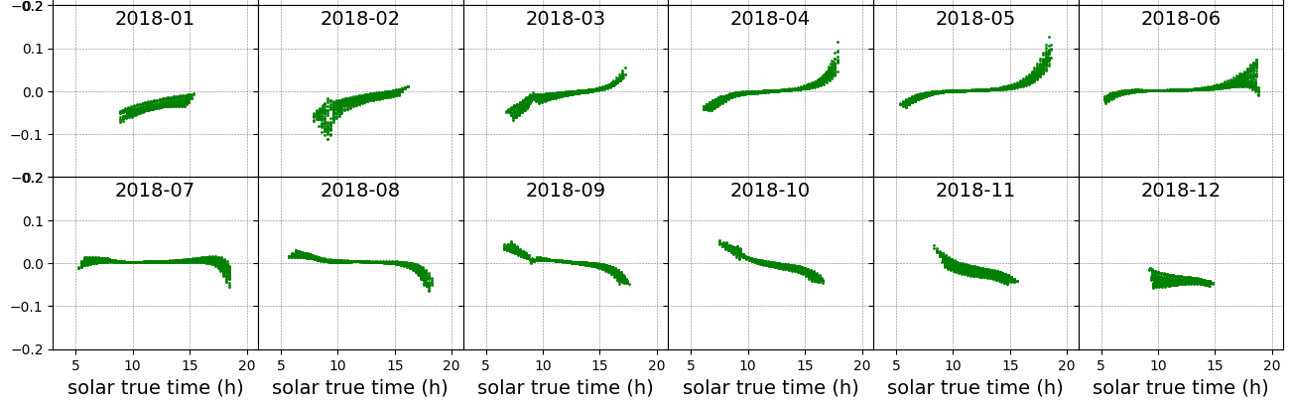
What impact on reflectances at the top of the atmosphere (TOA)?
2) Clear-sky conditions (DISORT, 32 streams, MODIS surface BRDF)
Palaiseau
Error on reflectance at the TOA

Slide 12
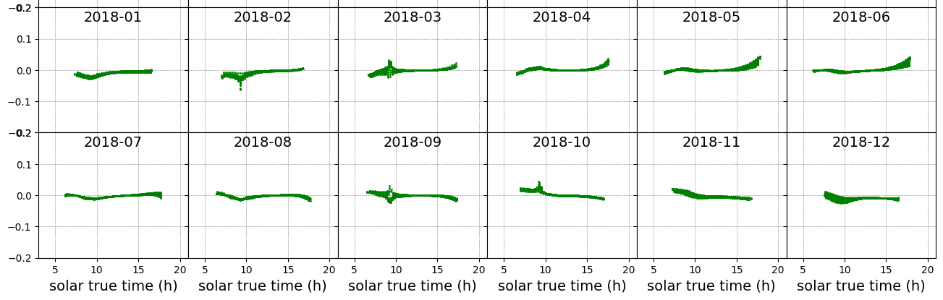
What impact on reflectances at the top of the atmosphere (TOA)?
2) Clear-sky conditions (DISORT, 32 streams, MODIS surface BRDF)
Tamanrasset
Error on reflectance at the TOA

Slide 13
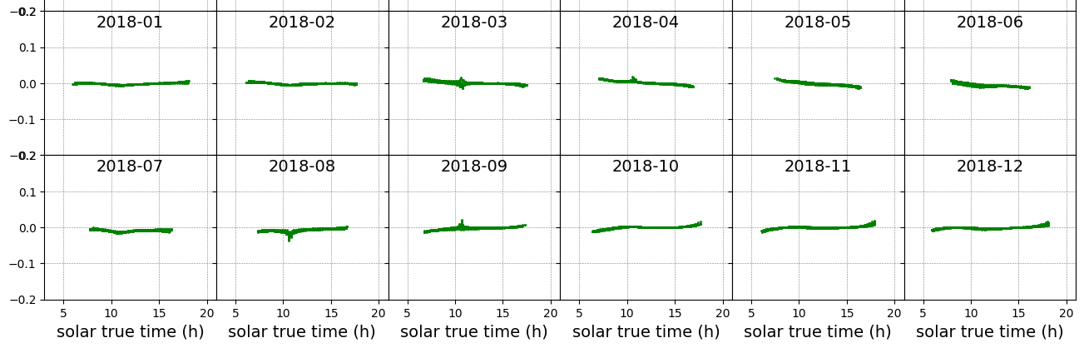
What impact on reflectances at the top of the atmosphere (TOA)?
2) Clear-sky conditions (DISORT, 32 streams, MODIS surface BRDF)
De Aar
Error on reflectance at the TOA

Slide 14
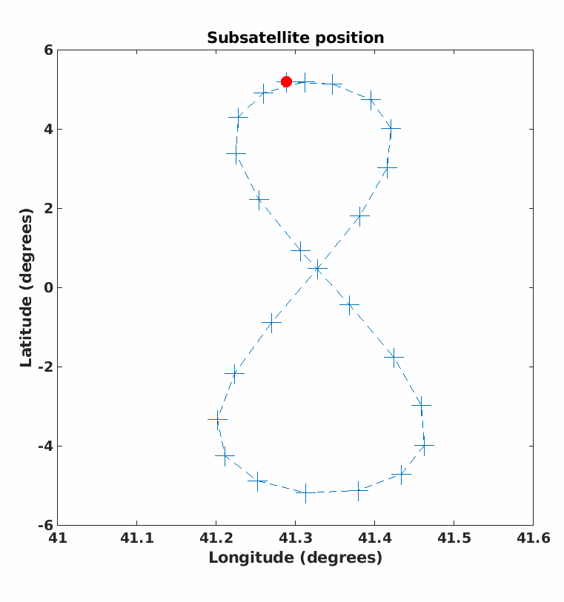
Can we consider Meteosat-8 viewing geometries as stationary?
In a nutshell:
- For inclined pseudo-geostationary satellites, viewing geometry changes can matter
- Be aware of the inclination of the geostationary satellite you use

Slide 15
Thank you!
0.6 µm
12 µm
Sorry, videos too heavy…
Geostationary or not: can we consider Meteosat-8 viewing geometries as stationary?
Benoît TOURNADRE, Xuemei CHEN, Benoît GSCHWIND, and Philippe BLANC
benoit.tournadre@laposte.net
With acknowledgements to David Doelling for providing Meteosat-8 subsatellite coordinates
and EUMETSAT for Meteosat-8 imagery

