Slide 1






Relationship between the time series of cosmic ray data and aerosol optical properties: (Case study: southern Italy, 2005-2021)
Faezeh Karimian Sarakhs,
PhD student in Physics, University of Salerno, Italy
Prof. Salvatore De Pasquale,
Professor (Full) at University of Salerno, Italy
Dr. Fabio Madonna,
Researcher in CNR-IMAA Atmospheric Observatory
Dr. Marco Rosoldi
Researcher in CNR-IMAA Atmospheric Observatory

Slide 2




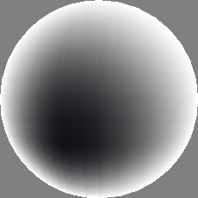
1
Hypotheses for Coupling between Galactic Cosmic Rays and Climate
2
Datasets
Overview of the presentation
3
Methodology
4
Statistical analysis and
Initial results

Slide 3
Hypothesis
1
Cosmic rays are modulated the solar- and geomagnetic by field (fact)
2
Cosmic rays are the main source of ionization in the lower atmosphere (fact)
.
3
Ionization may be important in aerosol nucleation processes in the atmosphere (contentious)
4
Aerosols are important for the creation of clouds (fact)
This chain of reactions will be referred to as the GCR-Ion-Aerosol-Cloud link or in short GCR-Aerosol-Cloud link.

Slide 4
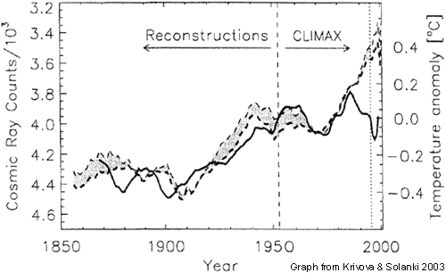


Hypotheses for Coupling between Galactic Cosmic Rays and Climate
Cloud cover versus Earth temprature
Galactic cosmic rays (GCRs) counts versus Temprature
Galactic cosmic rays (GCRs) versus Cloud cover
Net Radiation Balance Sensitivity (W/m2) to a change in fractional cloud cover of 0.1(Ringer and
Shine, 1997).
reconstructed cosmic radiation (solid line before 1952) and directly observed cosmic radiation (solid line after 1952) compared to global temperature (dotted line). All curves have been smoothed by an 11-year running mean (Krivova 2003).
Low cloud cover and cosmic rays from 1982 to 2002. (Marsh and Svensmark, 2003).

Slide 5
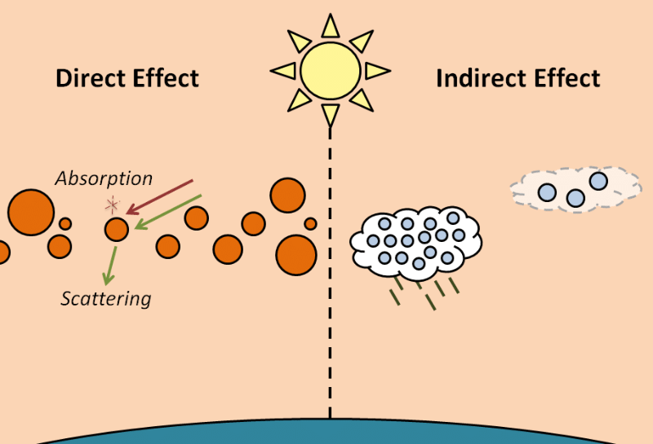
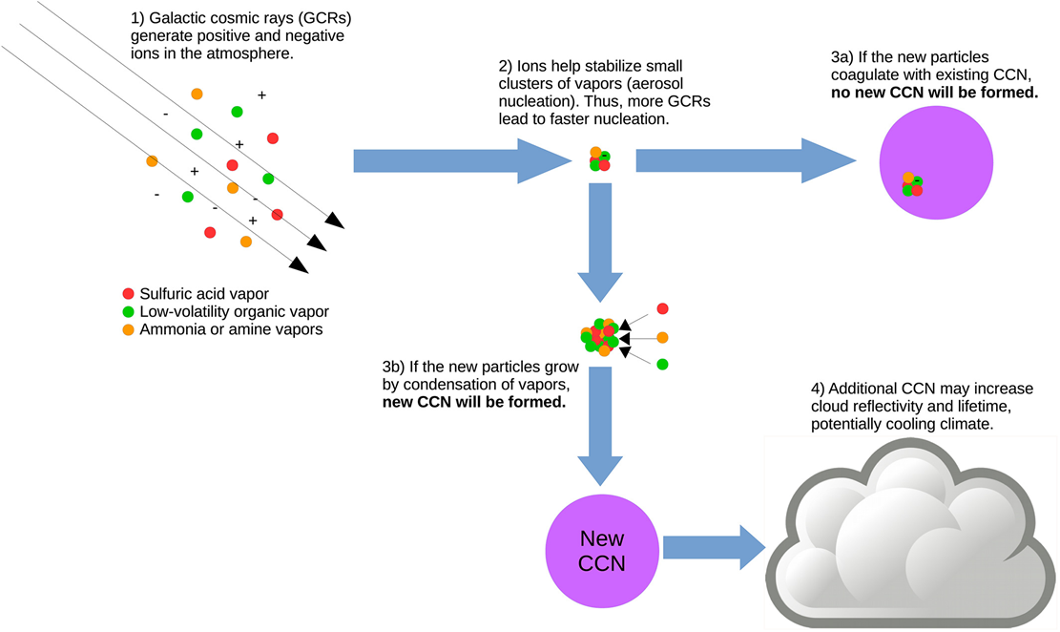
Impact of AEROSOLS in Cloud formation
English, J.M., 2011. A Sectional Microphysical Model to Study Stratospheric Aerosol: Ions, Geoengineering and Large Volcanic Eruptions (Doctoral dissertation, University of Colorado at Boulder).
Figure2: Pierce, J.R., 2017. Cosmic rays, aerosols, clouds, and climate: Recent findings from the CLOUD experiment. Journal of Geophysical Research: Atmospheres, 122(15), pp.8051-8055.

Slide 6
Datasets
Ground-based monitoring networks worldwide; the Aerosol Robotic Network (AERONET; Holben et al., 1998) for aerosol measurements
The European aerosol Lidar Network (EARLINET; Pappalardo et al., 2014)
The Neutron Monitor Space Weather Prediction Center (IZMIRAN) (Space Weather Prediction Center (IZMIRAN))
EEE Monitor - Progetto Extreme Energy Events - La Scienza nelle Scuole
Air mass back trajectories from HYPSLIT
http://ready.arl.noaa.gov/HYSPLIT_traj.php
https://cosmicrays.oulu.fi/

Slide 7
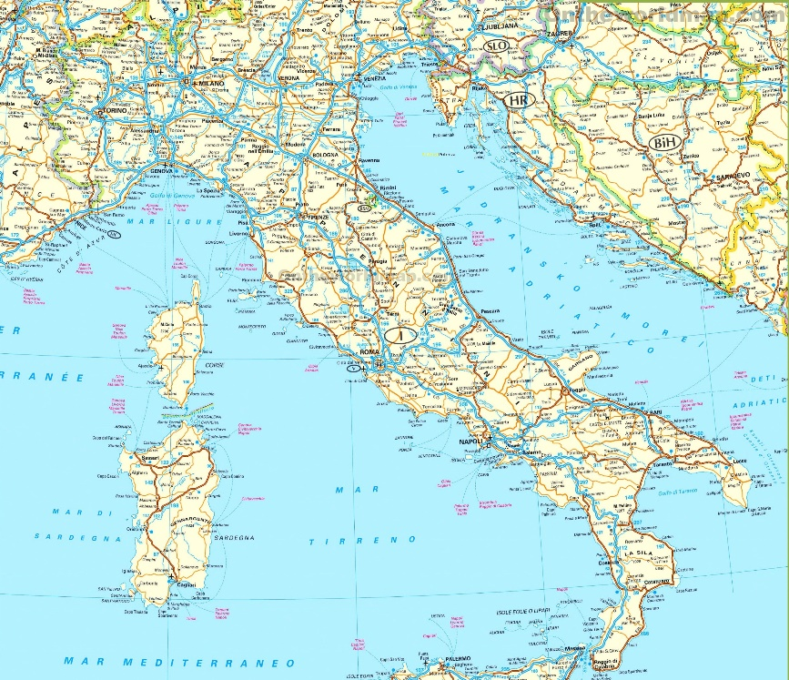
Methodology
Daily averages of AOD,FineModeAOD,CoarseModeAOD, AE and PWV were obtained from AERONET database for 6 stations located in Italy for a period of 2005-2019.
Corresponding FDs magnitude data from IZMIRAN site and CR intensity data from OULU database were obtained.
Different statistical indices such as correlation, cross/correlation at different aggregation levels have been calculated for different studied parameters.
for modelling the relationship between FDs and AEROSOL Properties a llinear regression was performed.
Different aggregation levels applied on daily averages data of aerosol optical properties as well as on FD Magnitude.
LAQUILA
Rome
Naples
Bari
Potenza
Lecce
Geographical map of the studied region, in which locations of the selected AERONET stations are shown by red triangles.

Slide 8
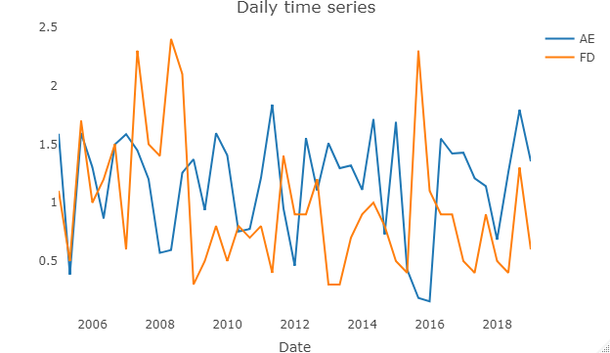
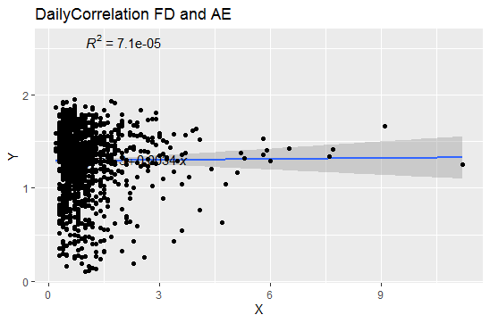
Initial results
Daily Correlation between AE and FD
AE
FD

Slide 9
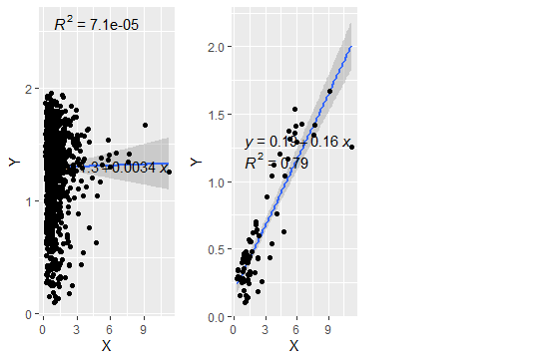

Linear correlation between daily aggregation of AE and FD for the period 2005_2019 for southern Italy. a)For all FD events b)For FD >3
Initial results
a
b
1
AE
AE
2
FD
FD
${\text{R}}^{2}$= 0.79 for FDMagnitude>3

Slide 10
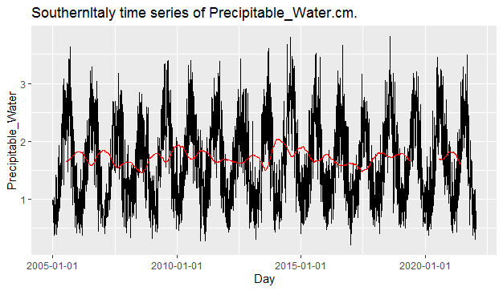
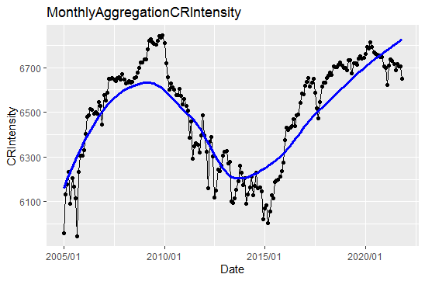
Initial results
Time series of monthly mean PWV during the period 1985–2016. The solid blue line is the TWO-month running mean.

Slide 11
Summary and outlook
Include cloud measurements
Useing EEE Database for FD and CR data
Elaborate a statistical model and perform partial correlation analysis between aerosol and cloud properties, respectively, and the electric field.

Slide 12
Questions?

