Slide 1



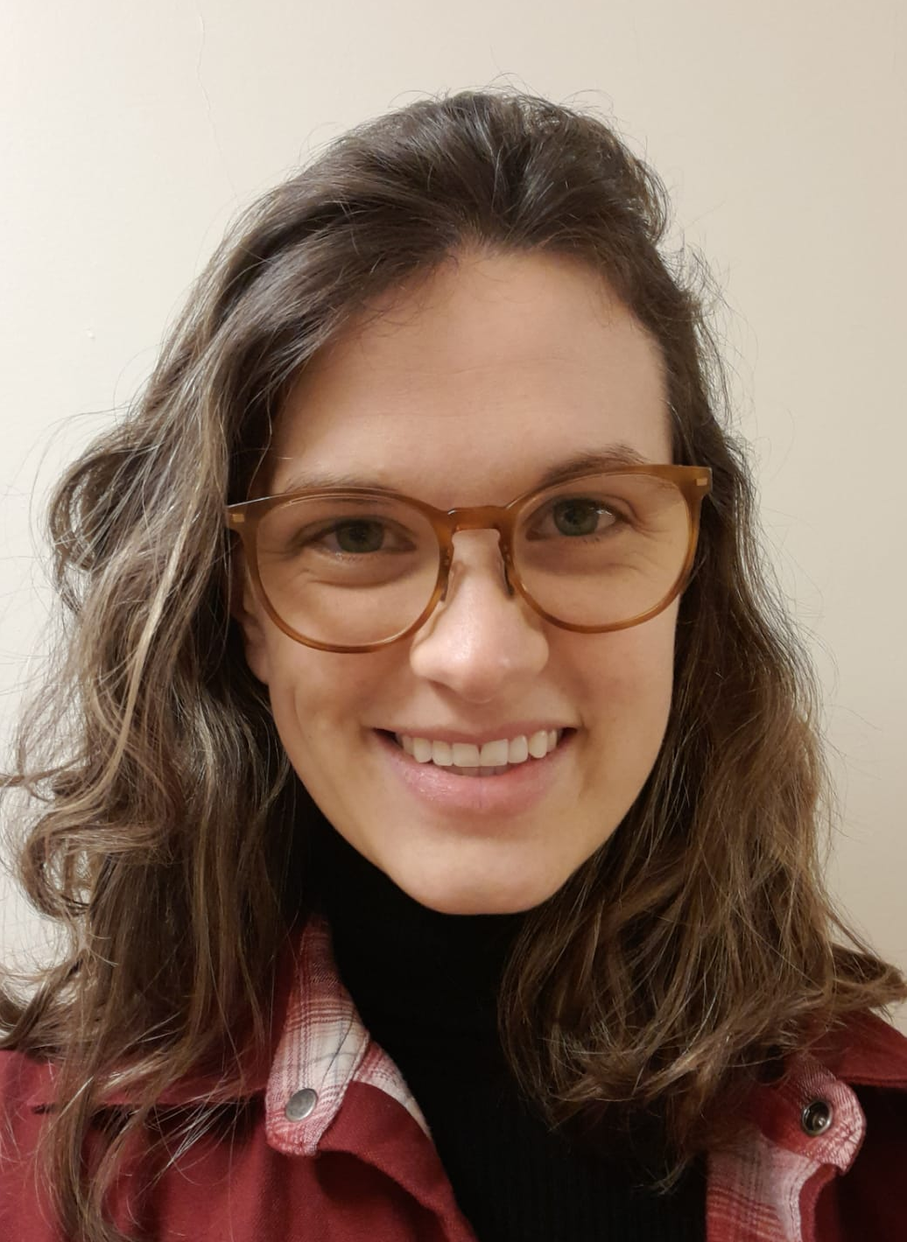
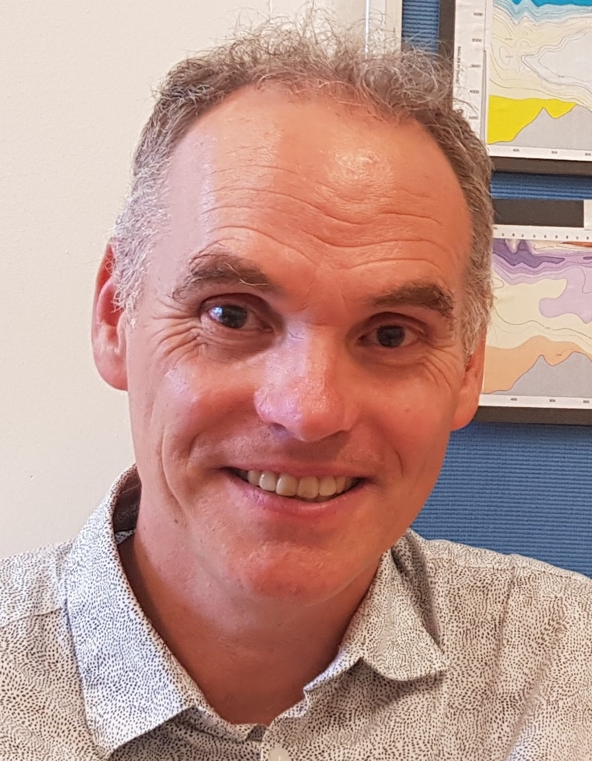
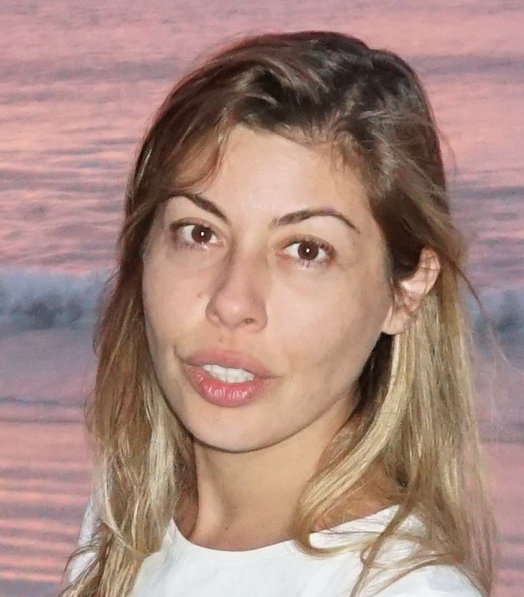
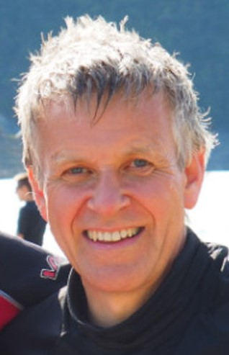

Reconstructing upper ocean carbon variability using Argo profiles and CMIP6 models
Katherine Turner, Ric Williams, Anna Katavouta, Doug Smith
EGU General Meeting
27 May 2022
*Note: this is a pre-recorded presentation, please contact me via email (last slide) with questions or comments!
Notes:
Hello everyone, my name is Katherine Turner and the work I am presenting today is a collaboration with Ric Williams, Anna Katavouta, and Doug Smith. For my presentation, I will be showing how we have used physical relationships within the CMIP6 models to create synthetic reconstructions of ocean carbon with Argo-style measurements.

Slide 2
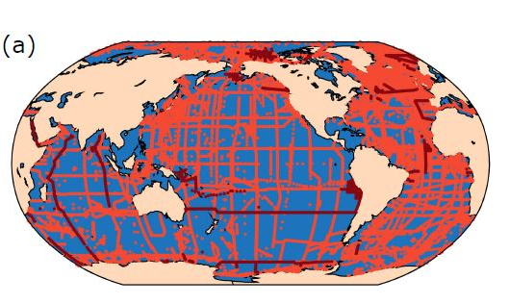
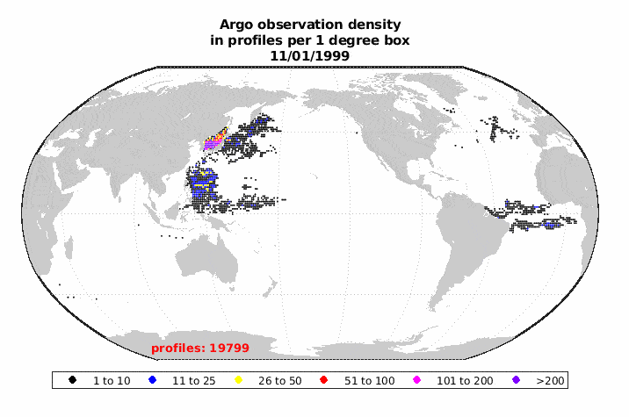
Making up for sparse DIC data with relationships between carbon, temperature, and salinity
All GLODAPv2.2021 station locations (Carbon)
Argo observation density (Temperature and Salinity)
Versus
(Lauvset et al.)
(Cora Hersch)
Ensemble Optimal Interpolation: use CMIP6 model covariances to relate information from Argo observations to carbon content and propagate information into unobserved regions
Notes:
Understanding ocean carbon is incredibly important for understanding the historical response to emissions; however, the logistical difficulties associated with interior ocean carbon measurements means that these observations are sparse in space and time.
Dissolved inorganic carbon is related to both temperature and salinity through solubility and alkalinity arguments. In this work, we have explored if it is possible to create reconstructions of upper-ocean DIC using these relationships. The Argo programme has led to over 2 million profiles of upper-ocean temperature and salinity, and so if these relationships are rigorous, there should be skill in reconstructing carbon for most of the ocean.
Mapping techniques can create reconstructions by propagating information from observations to regions without data. In this work, we have been exploring how we can use the information in CMIP6 models to propagate and translate information from Argo measurements into ocean carbon reconstructions. As a proof of concept, I will be showing some results from synthetic reconstructions of model data, which simplifies the problem by ignoring sources of observational error.

Slide 3
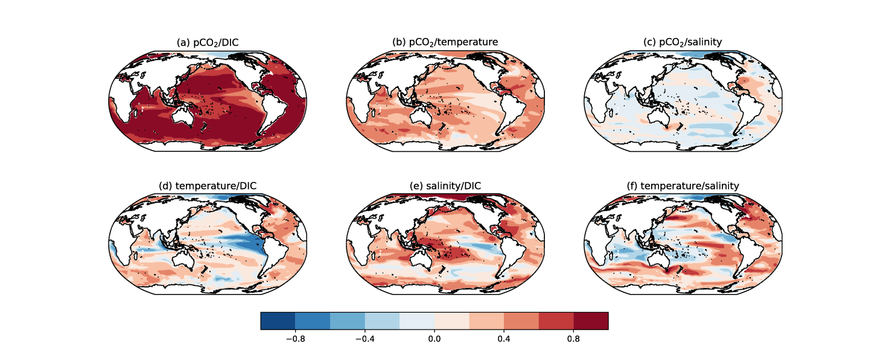
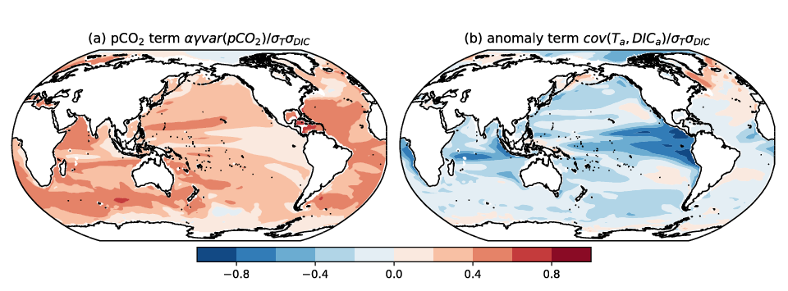
Correlations between DIC, T, and S show consistent solubility and alkalinity controls
Added heat/DIC correlation
Residual heat/DIC correlation
Ensemble correlations
Notes:
I’d like to first show how the CMIP6 models relate carbon to hydrographic measurements. These pointwise correlation fields have been taken from an ensemble of Earth System Models forced with historical atmospheric CO2 concentrations. Regions of strong positive or negative correlation show regions where the models agree strongly on the relationship between DIC and hydrography; regions of weak correlations show areas where there is either uncertainty within the ensemble or more complex relationships.
We can see regional structure in the ensemble correlation fields. The spatial heterogeneity in the correlations between temperature and DIC is effectively the sum of the positive correlations between added heat and added DIC, and negative residual correlations from the solubility effect. Correlations between salinity and DIC largely reflect the alkalinity control on carbon storage. Lastly, the correlations between temperature and salinity show more structure. The noncompeting regions where correlations between the three values provides a good basis for our desired reconstruction.

Slide 4
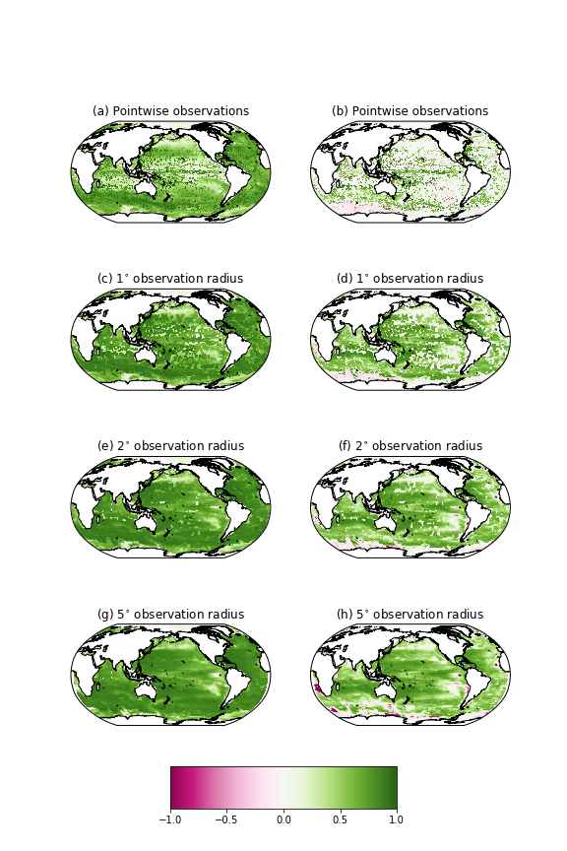
Current day Argo profiles allow for near-global ocean DIC reconstructions
Example reconstruction of NorESM upper-ocean carbon:
(Perfect reconstruction)
RMSE increase
RMSE reduction
Increasing the radius of influence of Argo observations leads to broad RMSE reductions for most of the globe; errors in the covariance fields result in mainly local regions with RMSE increases
Notes:
Here, we have explored how the pointwise relationships between DIC, temperature, and salinity may be expanded to account for irregular Argo sampling. In these figures, green regions indicate where the reconstruction reduces the Root Mean Squared Error, or RMSE, with the darkest green indicating a perfect model DIC reconstruction. Pink and magenta areas indicate errors where the covariances introduce additional errors in the reconstruction.
If we restrict ourselves to reconstructing DIC at the exact points we have temperature and salinity measurements, we find that there is indeed skill in the regions where sufficient Argo profiles exist, but coverage remains patchy and regional. When we allow Argo observations to influence the reconstruction within a larger area, we find that most of the global ocean can be reconstructed with skill. There are small regions in which the RMSE increases, but these remain locally-confined and are model-dependent as well. Thus, in the model world, there is substantial skill in reconstructing ocean carbon with hydrography measurements for most of the upper ocean.

Slide 5
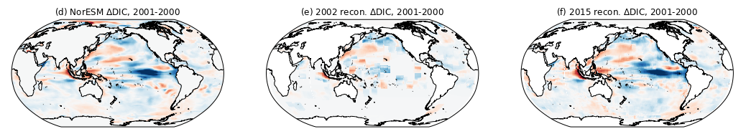
Take home messages
Reconstructing upper-ocean DIC via optimal interpolation with temperature and salinity measurements
Physical solubility and alkalinity controls allow for pointwise reconstructions of DIC
Argo measurements can provide information for nearby DIC behaviour – current distributions of Argo measurements lead to near-global coverage
My email: K.E.Turner2@liverpool.ac.uk
Notes:
And with this I’d like to conclude my short presentation with a few take-home messages.
First, we’ve been working on using Ensemble Optimal Interpolation to reconstruct ocean carbon from first-principle relationships with temperature and salinity.
Using covariances and correlations from a CMIP6 ensemble, we find that the physical controls of temperature and salinity on carbon hold on global scales with some regional variability, allowing us to create pointwise reconstructions of DIC using Argo measurements at the same location.
Expanding the method to take nearby Argo observations allows for us to create near-global coverage in our reconstruction, with most regions retaining or improving on the skill seen in the pointwise reconstructions.
And with that I’d like to thank you all for listening! As this presentation is recorded, please feel free to email me if you have any comments or questions.

