Slide 1



Impact of sewage sludge and digestate soil amendment on the phytoaccumulation of potentially toxic elements in Alyssum murale, Fagopyrum esculentum, and Carthamus tinctorius
Nazia Zaffar, Dominic Shirmer, and Oliver Wiche
Institute of Biosciences
Biology/Ecology Unit
TU Bergakademie Freiberg

Slide 2
Objective of the Study
How does the use of sewage sludge and digestate as soil additives affect the accumulation of potentially toxic elements in the shoots of A. murale, F. esculentum, C. tinctorius
How do the species differ among themselves in the accumulation of potentially toxic elements in the shoot on the different substrates?

Slide 3
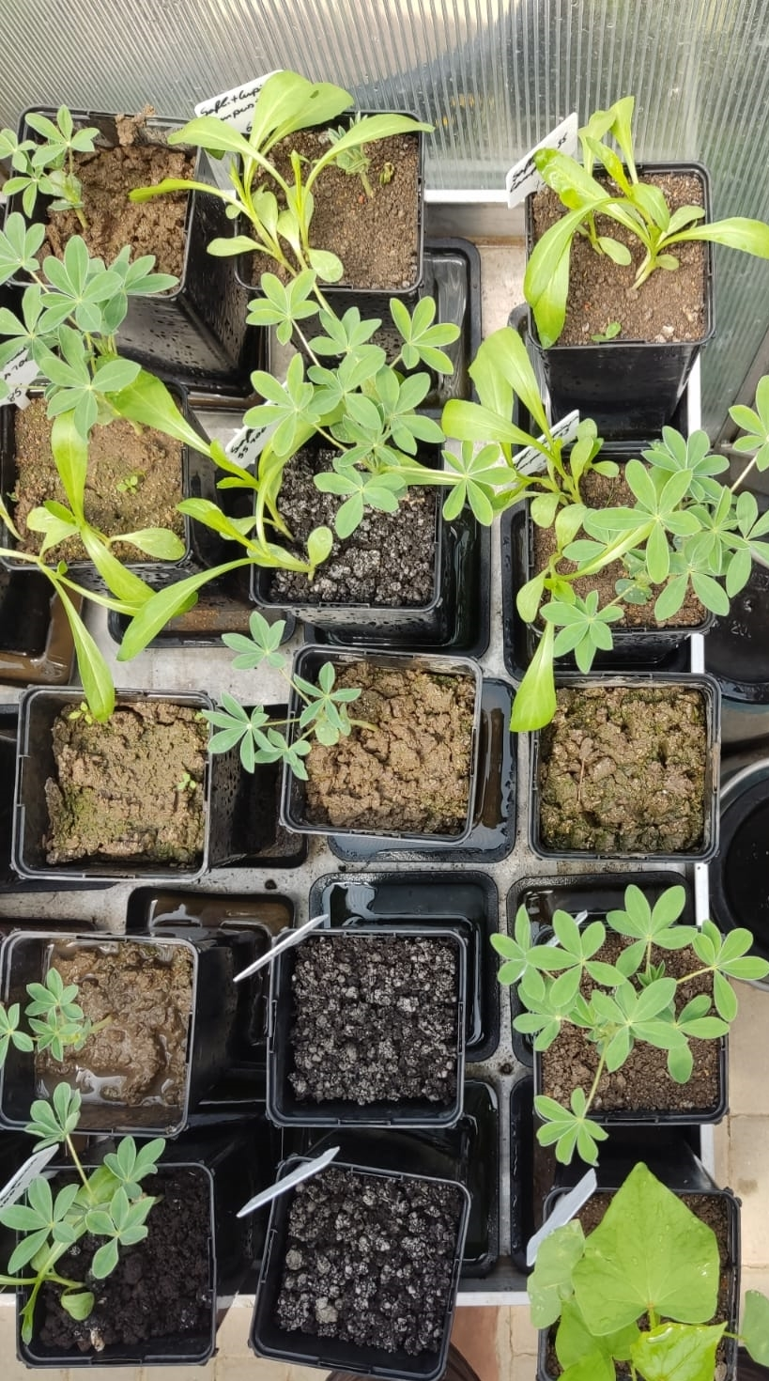
Materials and Method
5 replicates of Soil (Alyssum murale, Fagopyrum esculentum, and Carthamus tinctorius)
5 replicates of Soil+ Sewege sludge (Alyssum murale, Fagopyrum esculentum, and Carthamus tinctorius)
5 replicates of Soil+ Digestate (Alyssum murale, Fagopyrum esculentum, and Carthamus tinctorius)

Slide 4
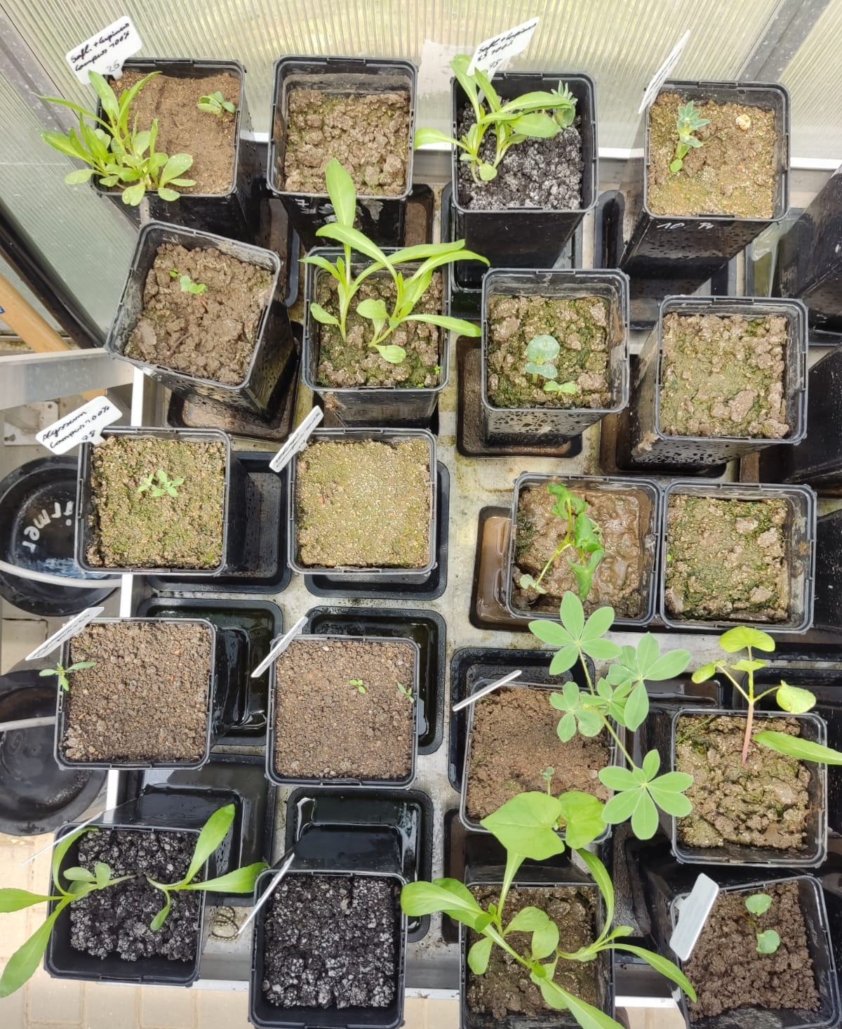
Greenhouse experiment
Alyssum murale, Fagopyrum esculentum and Carthamus tinctorius cultivated on heavy metal polluted soil from the post-mining area of Freiberg Germany, treated with 10% (dw basis) sewage sludge or 1% digestate.
Parameter | Fraction | Soil | Sludge | Digestate
pH (H₂O) |  | 6.5 ± 0.1 | 7.2 ± 0.1 | 8.2 ± 0.1
P (mg kg⁻¹) | Total | 709 ± 46 | 22,376 ± 3,199 | 9,636 ± 682
 | F1 | < 5 | 222 ± 16 | 3,853 ± 196
 | F2 | NA | NA | 3,974 ± 433
Fe (mg kg¹) | Total | 31,465 ± 2,718 | 9.006 ±1.35 | 11.684 ± 2.1
 | F1 | 5 ± 1 | 12 ± 1 | 198 ± 55
 | F2 | NA | NA | 143 ± 50
Mn (mg kg⁻¹) | Total | 794 ± 152 | 102 ± 111 | 380 ± 167
 | F1 | 17 ± 2 | 25 ± 3 | 77 ± 7
 | F2 | NA | NA | 187 ± 21
Cu (mg kg⁻¹) | Total | 125 ± 21 | 43 ± 6 | 261 ± 31
 | F1 | < 1 | 18 ± 3 | 3.2 ± 0.3
 | F2 | NA | NA | 1.5 ± 0.3
Zn (mg kg⁻¹) | Total | 239 ± 57 | 748 ± 50 | 1063 ± 109
 | F1 | 9.4 ± 0.8 | 55 ± 4 | 84 ± 7
 | F2 | NA | NA | 480 ± 92
Ni (mg kg⁻¹) | Total | NA | NA | 81 ± 7
 | F1 | < 0.5 | 4.7 ± 0.6 | 11 ± 1
 | F2 | NA | NA | 14 ± 2
Pb (mg kg⁻¹) | Total | 177 ± 40 | 232 ± 43 | 40 ± 10
 | F1 | 5.0 ± 1.4 | 5.9 ± 0.3 | 0.34 ± 0.18
 | F2 | NA | NA | 3.8 ± 0.7
Cd (mg kg⁻¹) | Total | 1.8 ± 0.6 | 1.2 ± 0.6 | 4.8 ± 0.3
 | F1 | 0.62 ± 0.04 | 1.2 ± 0.2 | 0.28 ± 0.07
 | F2 | NA | NA | 0.86 ± 0.37

Slide 5
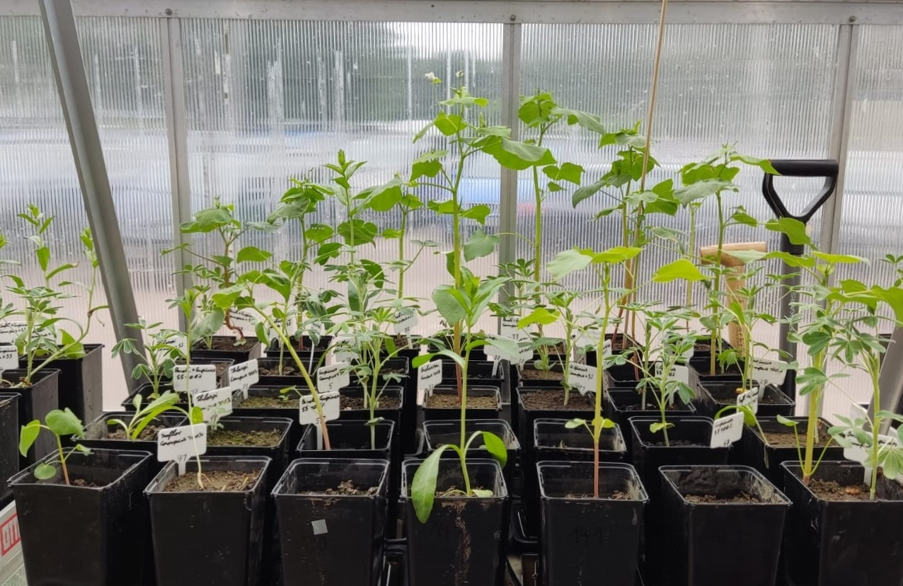
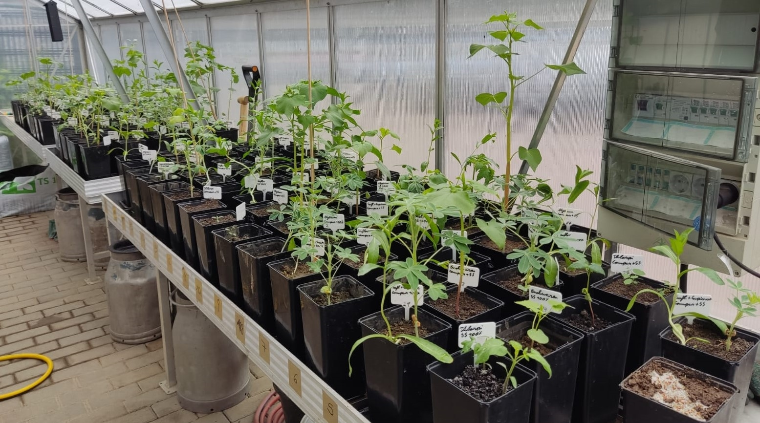
 |  | Biomass (g shoot⁻¹) | P (g kg⁻¹) | Mn (mg kg⁻¹) | Fe (mg kg⁻¹) | Zn (mg kg⁻¹) | Cu (mg kg⁻¹)
A. murale
Soil | 0.4 ± 0.2 |  | 2.3 ± 0.2 | 24 ± 4 | 78 ± 23 | 63 ± 12 | 4.3 ± 0.4
Digestate | 0.2 ± 0.1 |  | 2.5 ± 0.6 | 224 ± 91 | 252 ± 117 | 174 ± 87 | 5.6 ± 1.7
Sludge | 0.3 ± 0.1 |  | 4.4 ± 1.1 | 231 ± 34 | 135 ± 57 | 1072 ± 639 | 13 ± 4
p-value | 0.05 |  | 0.004 | < 0.001 | 0.013 | < 0.001 | < 0.001
F. esculentum
Soil | 7.4 ± 1.0 |  | 2.5 ± 0.4 | 37 ± 22 | 31 ± 10 | 54 ± 10 | 5.2 ± 2.0
Digestate | 3.6 ± 3.1 |  | 2.2 ± 0.7 | 163 ± 160 | 100 ± 81 | 38 ± 16 | 7.1 ± 2.6
Sludge | 14 ± 2 |  | 6.9 ± 1.4 | 632 ± 262 | 132 ± 63 | 482 ± 133 | 19 ± 6
p-value | < 0.001 |  | < 0.001 | < 0.001 | 0.003 | < 0.001 | < 0.001
C. tinctorius
Soil | 1.4 ± 0.9 |  | 2.0 ± 0.4 | 27 ± 5 | 98 ± 75 | 80 ± 13 | 14 ± 4
Digestate | 1.8 ± 0.6 |  | 2.3 ± 0.1 | 82 ± 5 | 46 ± 5 | 71 ± 10 | 12 ± 2
Sludge | 3.8 ± 0.7 |  | 3.0 ± 0.5 | 216 ± 22 | 55 ± 10 | 152 ± 25 | 9.7 ± 1.3
p-value | 0.007 |  | 0.007 | < 0.001 | 0.153 | < 0.001 | 0.149
Results 1

Slide 6
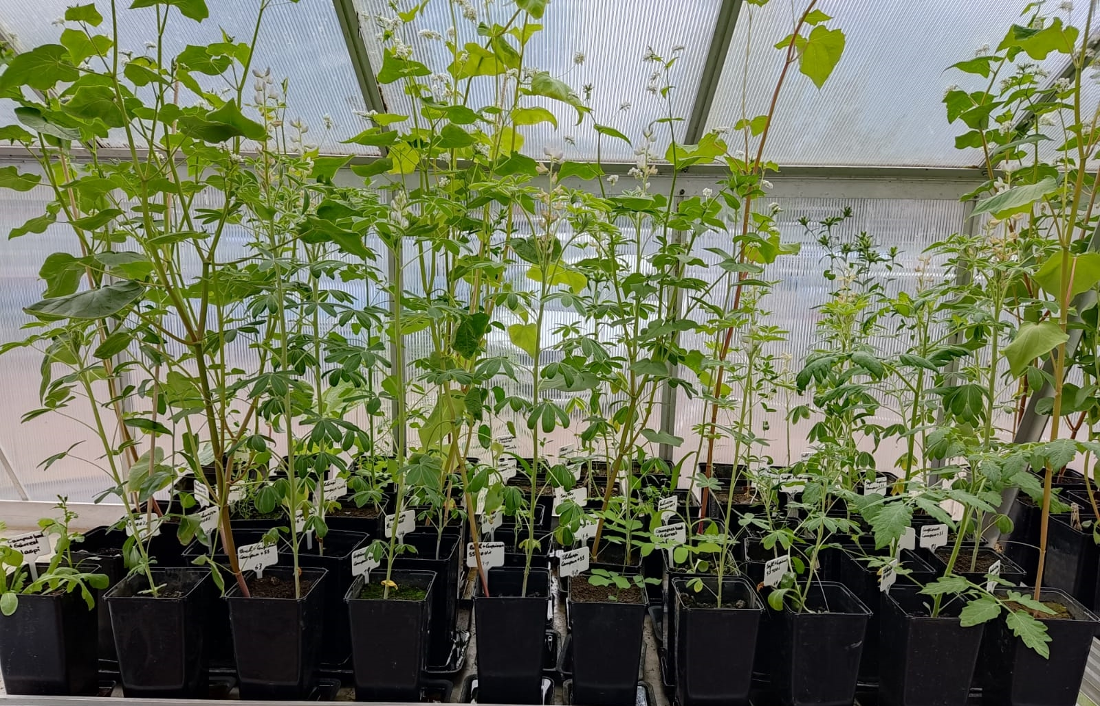
 | Ni (mg kg⁻¹) |  | Cd (mg kg⁻¹) | Pb (mg kg⁻¹) | Co (mg kg⁻¹) | As (mg kg⁻¹) | Cr (mg kg⁻¹)
A. murale
Soil | 1.8 ± 0.3 | 1.8 ± 0.3 | 0.62 ± 0.11 | < 0.5 | 0.34 ± 0.07 | 0.12 ± 0.02 | < 0.1
Digestate | 1.8 ± 0.2 | 1.8 ± 0.2 | 2.8 ± 2.1 | 1.5 ± 0.8 | 3.2 ± 1.1 | 0.23 ± 0.14 | 0.21 ± 0.12
Sludge | 6.3 ± 2.7 | 6.3 ± 2.7 | 10 ± 6 | 0.96 ± 0.51 | 1.0 ± 0.1 | 0.17 ± 0.07 | 0.24 ± 0.08
p-value | 0.007 | 0.007 | < 0.001 | 0.516 | < 0.001 | 0.266 | 0.203
F. esculentum
Soil | 1.2 ± 0.2 | 1.2 ± 0.2 | 1.1 ± 0.3 | 1.2 ± 0.8 | 0.08 ± 0.04 | 0.05 ± 0.02 | 1.0 ± 0.7
Digestate | 1.4 ± 0.1 | 1.4 ± 0.1 | 0.84 ± 0.57 | 0.74 ± 0.14 | 0.25 ± 0.28 | 0.10 ± 0.05 | 0.97 ± 0.54
Sludge | 4.1 ± 0.9 | 4.1 ± 0.9 | 7.1 ± 1.4 | 1.2 ± 0.6 | 0.27 ± 0.08 | 0.06 ± 0.04 | 0.98 ± 0.28
p-value | < 0.001 | < 0.001 | < 0.001 | 0.530 | 0.022 | 0.117 | 0.944
C. tinctorius
Soil | 2.7 ± 1.2 | 2.7 ± 1.2 | 4.7 ± 1.4 | 0.71 ± 0.24 | 0.07 ± 0.03 | 0.13 ± 0.02 | 2.9 ± 2.9
Digestate | 1.7 ± 0.5 | 1.7 ± 0.5 | 3.6 ± 1.0 | 0.49 ± 0.06 | 0.06 ± 0.01 | 0.08 ± 0.02 | 1.0 ± 0.6
Sludge | 1.3 ± 0.3 | 1.3 ± 0.3 | 4.3 ± 1.0 | < 0.5 | 0.11 ± 0.03 | 0.10 ± 0.08 | 1.1 ± 0.6
p-value | 0.074 | 0.074 | 0.309 | 0.182 | 0.056 | 0.274 | 0.703
Results II

Slide 7
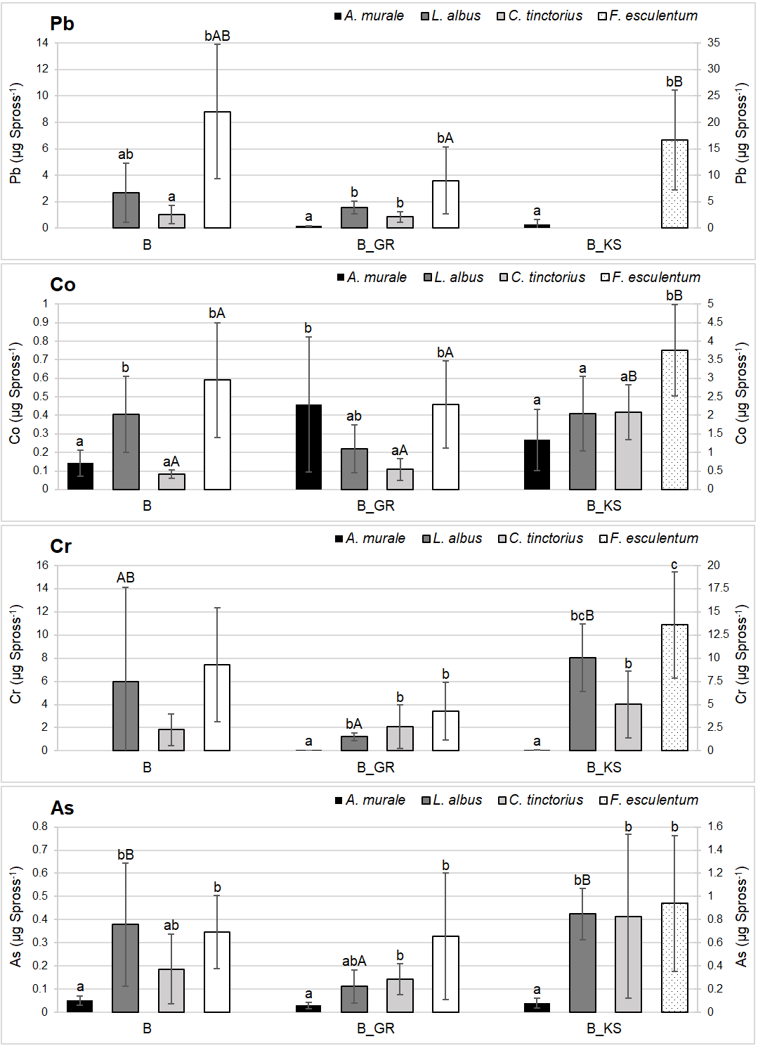
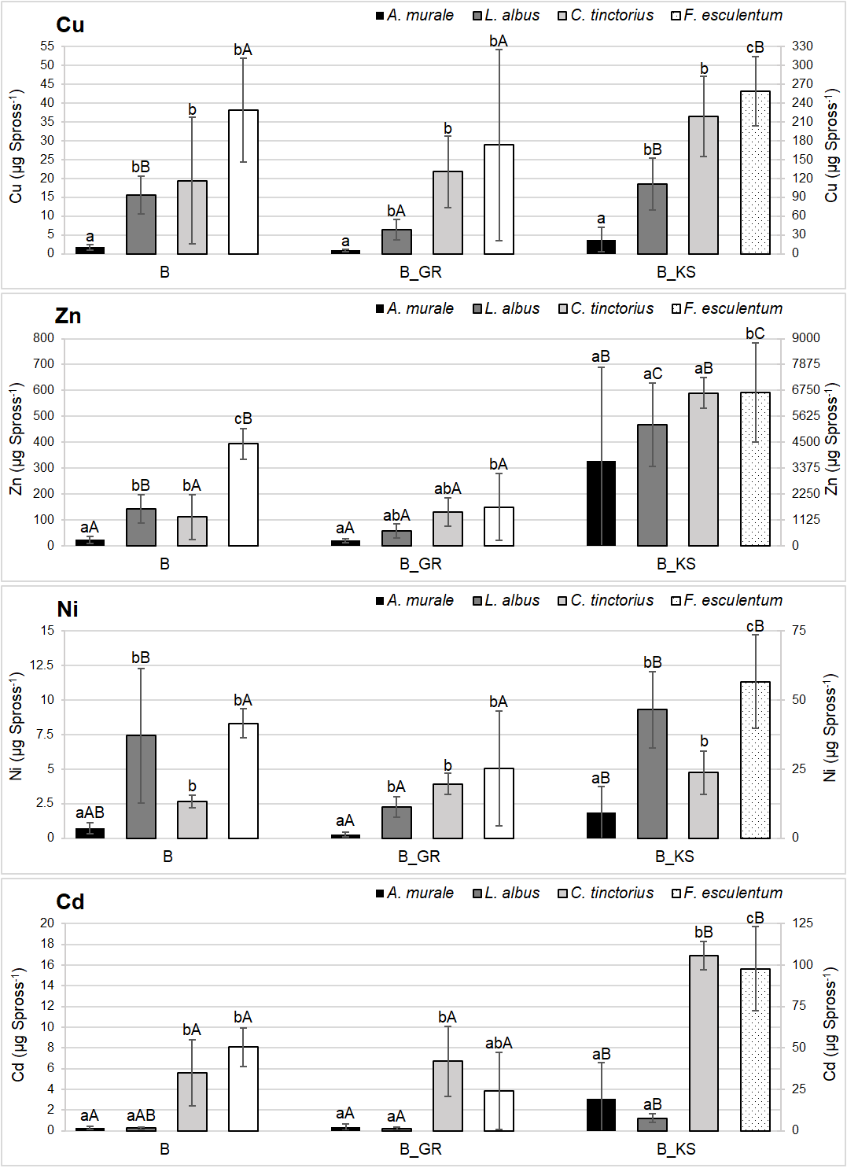
Results III
Soil
Digestate
Sludge
Soil
Digestate
Sludge
Soil
Digestate
Sludge
Soil
Digestate
Sludge
Soil
Digestate
Sludge
Soil
Digestate
Sludge
Soil
Digestate
Sludge
Soil
Digestate
Sludge

Slide 8
Conclusion
Sewage sludge amendment increased phytoaccumulation of Cu, Zn, Ni, Cd and Cr, while there was no effect of digestate
Phytoaccumulation decreased in the order F. esculentum > C. tinctorius > A. murale.
The mass balance of elements calculated based on element amounts in the growth substrate and elements transferred into plant biomass revealed that plants accumulated 1% of total P.
Concommitantly, a single plant of F. esculentum accumulated 16% and 5% of plant-available Zn and Cd.
High biomass metal-accumulators like F. esculentum could be used for industrial pretreatment of sewage sludge to remove toxic elements

