Slide 1



The vegetation-elevation relationship in salt marshes
Zhicheng Yang¹, Davide Tognin², Enrica Belluco², Alice Puppin¹, Alvise Finotello³, Sonia Silvestri⁴,
Marco Marani², Andrea D’Alpaos¹
University of Padova, Department of Geosciences, Italy
University of Padova, Department ICEA , Italy
University of Padova, Center for Lagoon Hydrodynamics and Morphodynamics (C.I.Mo.La.), Italy.
Department of Biological, Geological, and Environmental Sciences, University of Bologna, Italy
Contact: zhicheng.yang@phd.unipd.it

Slide 2
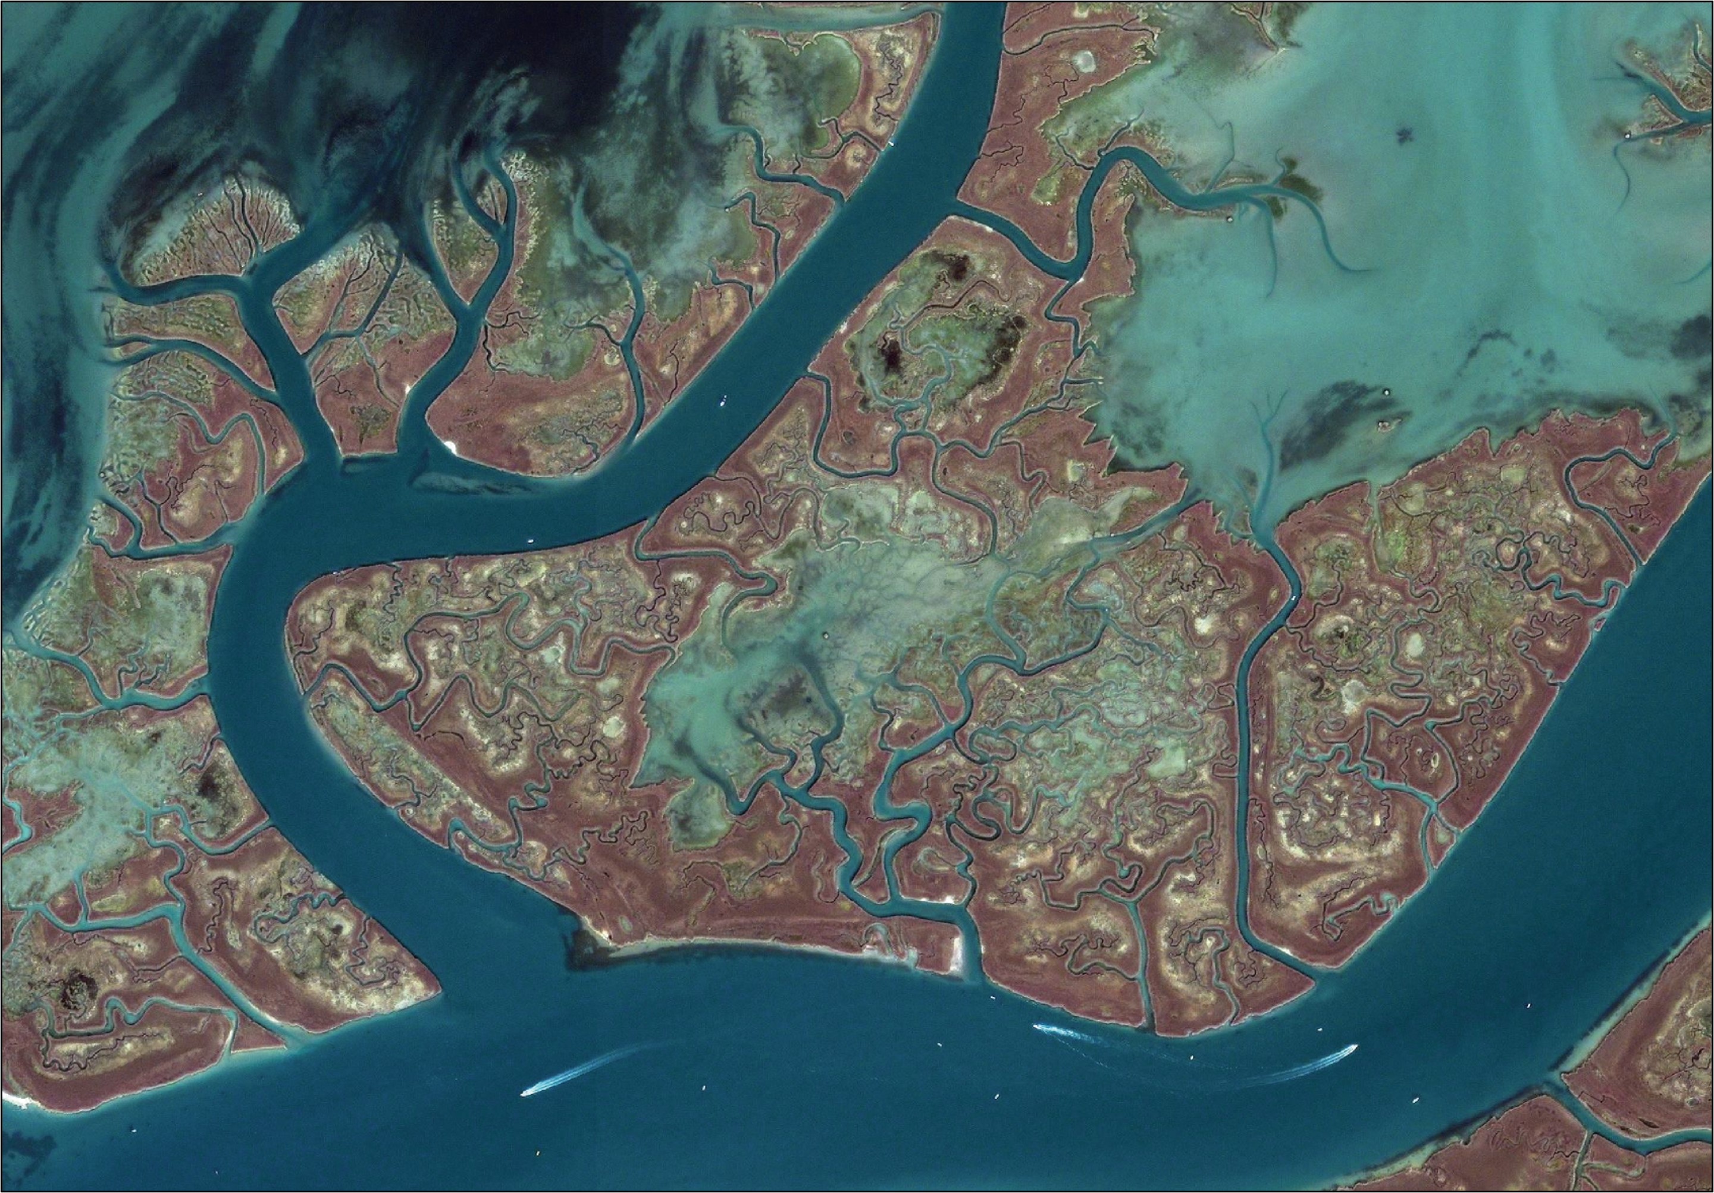
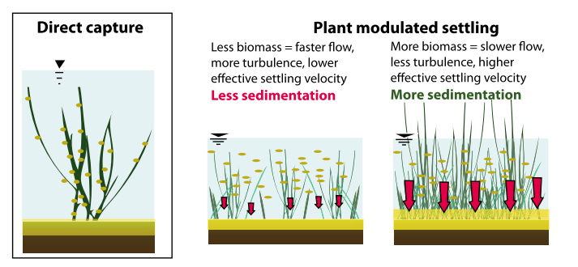
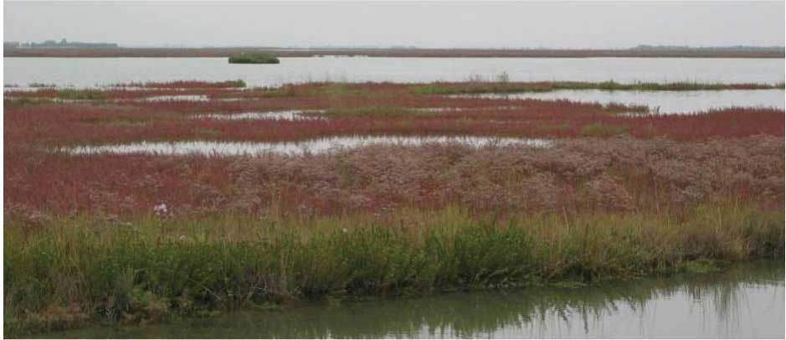
Introduction: Salt marshes
Located between MSL and MHWL
Encroached by halophytic vegetation
Currently disappearing fast, being threatened by increasing rates of relative sea level rise (RSLR), erosion due to waves & human pressure.
Their evolution and survival are controlled by complex eco-morphodynamic feedbacks.
Fig from Fagherazzi et al., 2012
Halophytic vegetation can support marsh survival through biomorphic feedbacks.
Yang et al., 2022, EGU
Introduction
Methods
Results
Conclusions

Slide 3
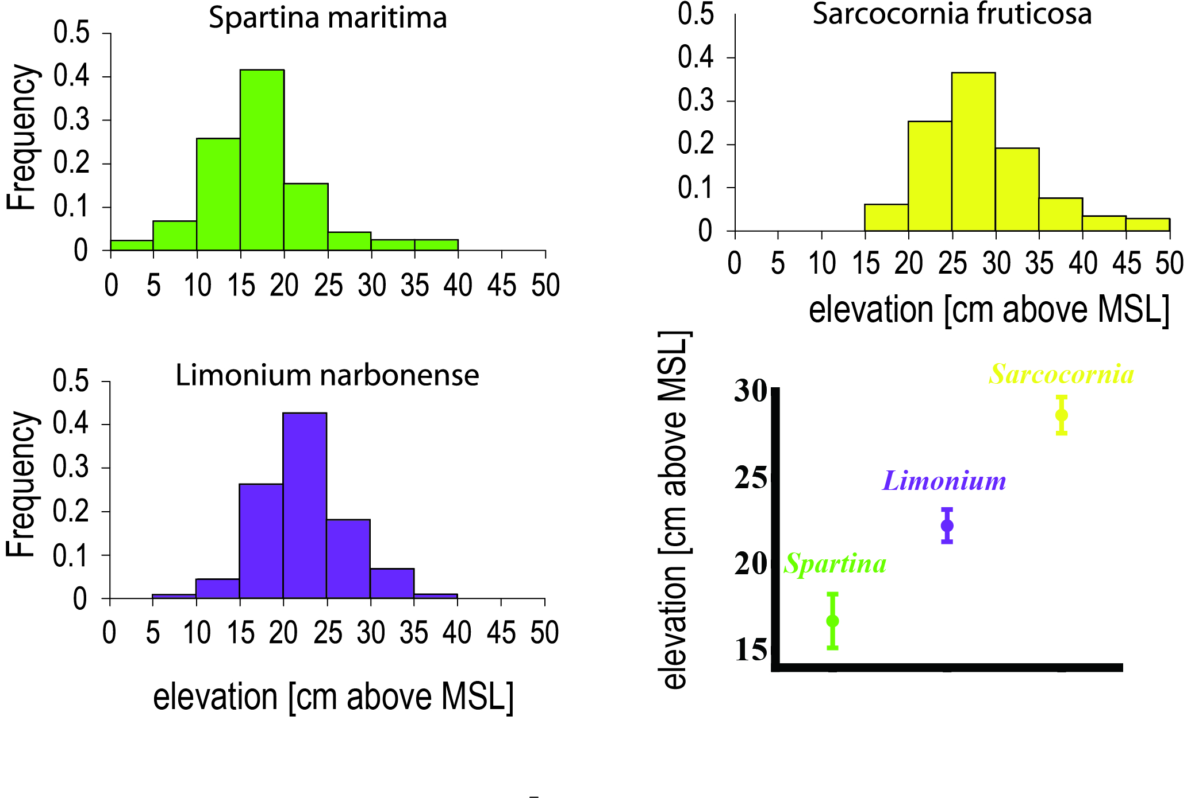
Introduction: Halophytic vegetation
ISSUE 1.
Can this species sequence maintain constant over a period of multiple years?
ISSUE 2.
Can this in-situ measured species sequence maintain constant at a large spatial scale?
ISSUE 3.
How does above-ground biomass change with increasing elevations?
Fig from Silvestri et al., 2005
Halophytic vegetation distribution is controlled by marsh topography. Each species live within specific elevation ranges (ecological niches), displaying a species sequence with increasing elevations.
Yang et al., 2022, EGU
Introduction
Methods
Results
Conclusions

Slide 4
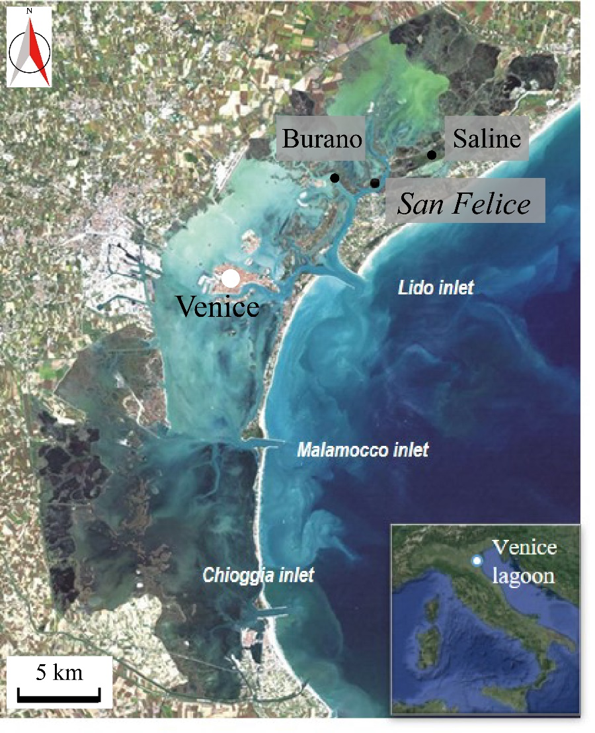
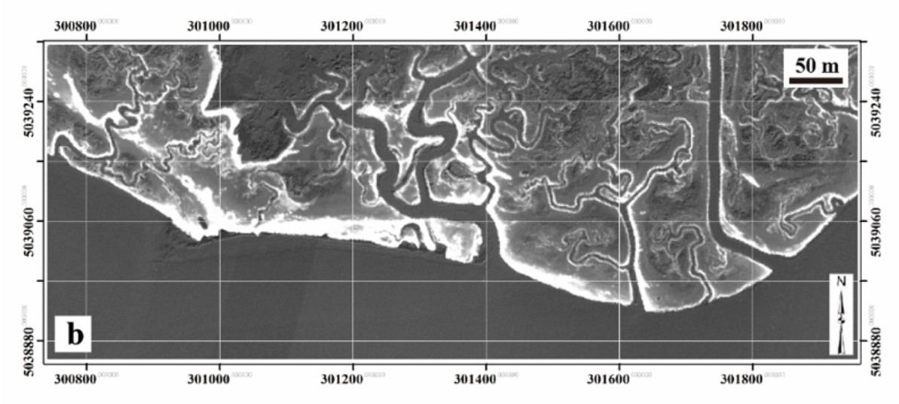
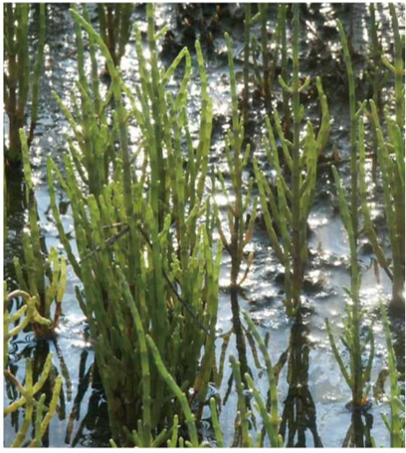
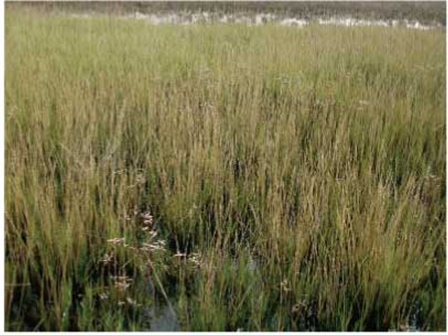
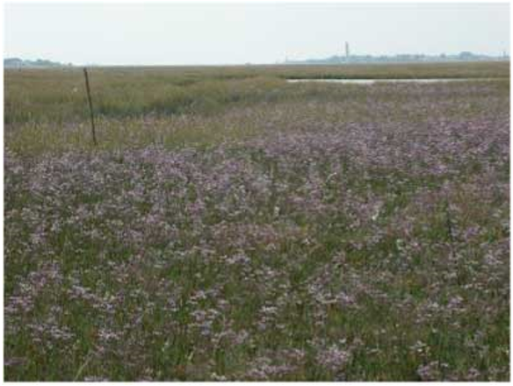
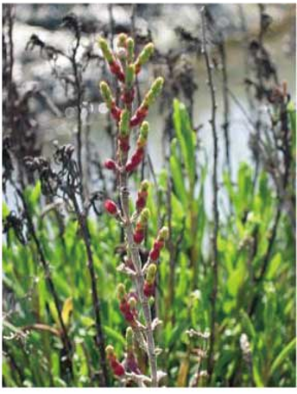
Research area
San Felice marsh
Area ≈ 550 km², Mean water depth ≈ 1.5 m
Semi-diurnal micro-tidal regime.
Main Species
San Felice marsh
Salicornia
Fig from Yang et al., 2020
Spartina
Limonium
Sarcocornia
Yang et al., 2022, EGU
Introduction
Methods
Results
Conclusions

Slide 5
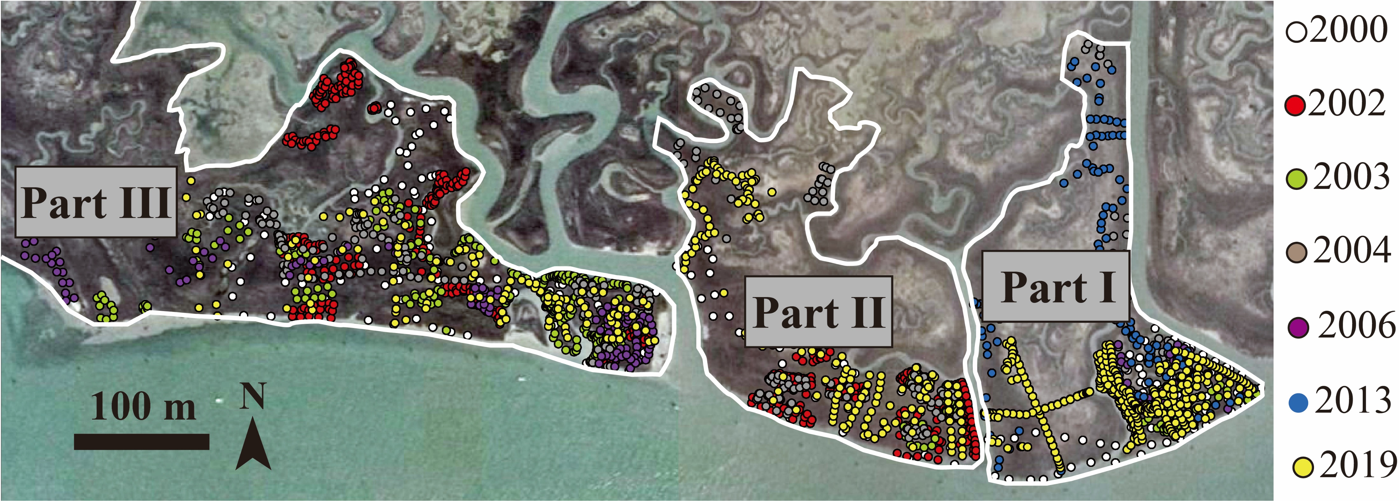
ISSUE 1: Species-sequence in multiple years
We analyzed elevation-vegetation data from the San Felice marsh including 7-times revisitation data between 2000 and 2019 (e.g., 2000, 2002, 2003, 2004, 2006, 2013 and 2019). In every year, accurate elevation (above IGM datum) and halophytic vegetation data were recorded on randomly selected sites.
We considered 3 different parts, divided by main channels.
Yang et al, JGR-Biogeo, under-review
Yang et al., 2022, EGU
Introduction
Methods
Results
Conclusions

Slide 6
ISSUE 2: Extend local observations on vegetation vertical distribution to a large scale
Vegetation species map
Data: multi-spectral data (Quick-bird II) acquired in 2003.
Method: Random forest soft classification (RFSC) method was used to estimate the fractional abundance (FA) of each species (Yang et al., 2020, RS). Then we determined the most abundant species as the one with the highest FA in each pixel.
Elevation data (DEM)
Data: Lidar data collected in 2003.
Method: we corrected the lidar-derived DEM over the marsh with high accuracy (RMSE=4.18 cm, MAE=3.15 cm) (In preparation to MEE).
Statistical analyses
We analyzed the vertical distribution of species by coupling the most abundant species maps and FA maps with corrected DEM. We calculated the frequency distribution of elevation encroached by each most abundant species species and average FA (mFA) of each species at each elevation interval.
Yang et al., 2022, EGU
Introduction
Methods
Results
Conclusions
Notes:
We use vegetation species map and a dem with high accuracy to carry out.

Slide 7
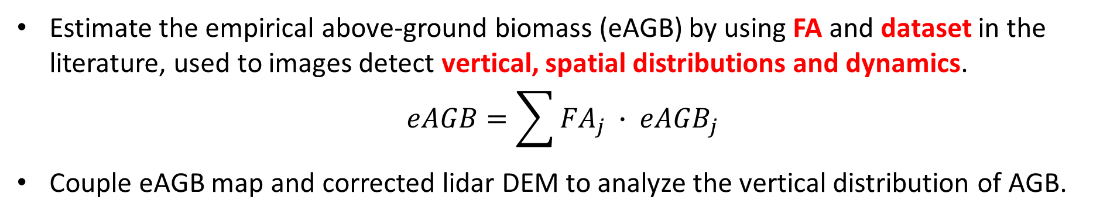
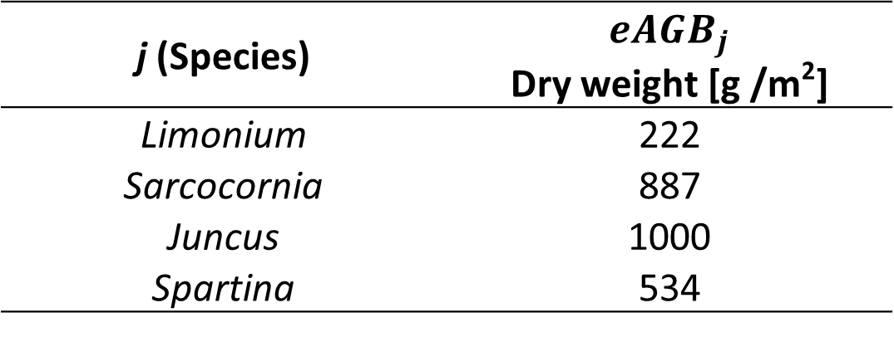
ISSUE 3: Vertical distribution of above-ground biomass (AGB)
Estimate the empirical above-ground biomass (eAGB) by using FA and dataset in the literature, used to images detect vertical, spatial distributions and dynamics.
$$eAGB=\sum{{FA}_{j} ∙ {eAGB}_{j}}$$
Couple eAGB map and corrected lidar DEM to analyze the vertical distribution of AGB.
j (Species) | $${eAGB}_{j}$$ Dry weight [g /m²]
Limonium | 222
Sarcocornia | 887
Juncus | 1000
Spartina | 534
We also used the average values of NDVI (mNDVI) at each elevation interval to show AGB vertical distribution.
Yang et al., 2022, EGU
Introduction
Methods
Results
Conclusions

Slide 8
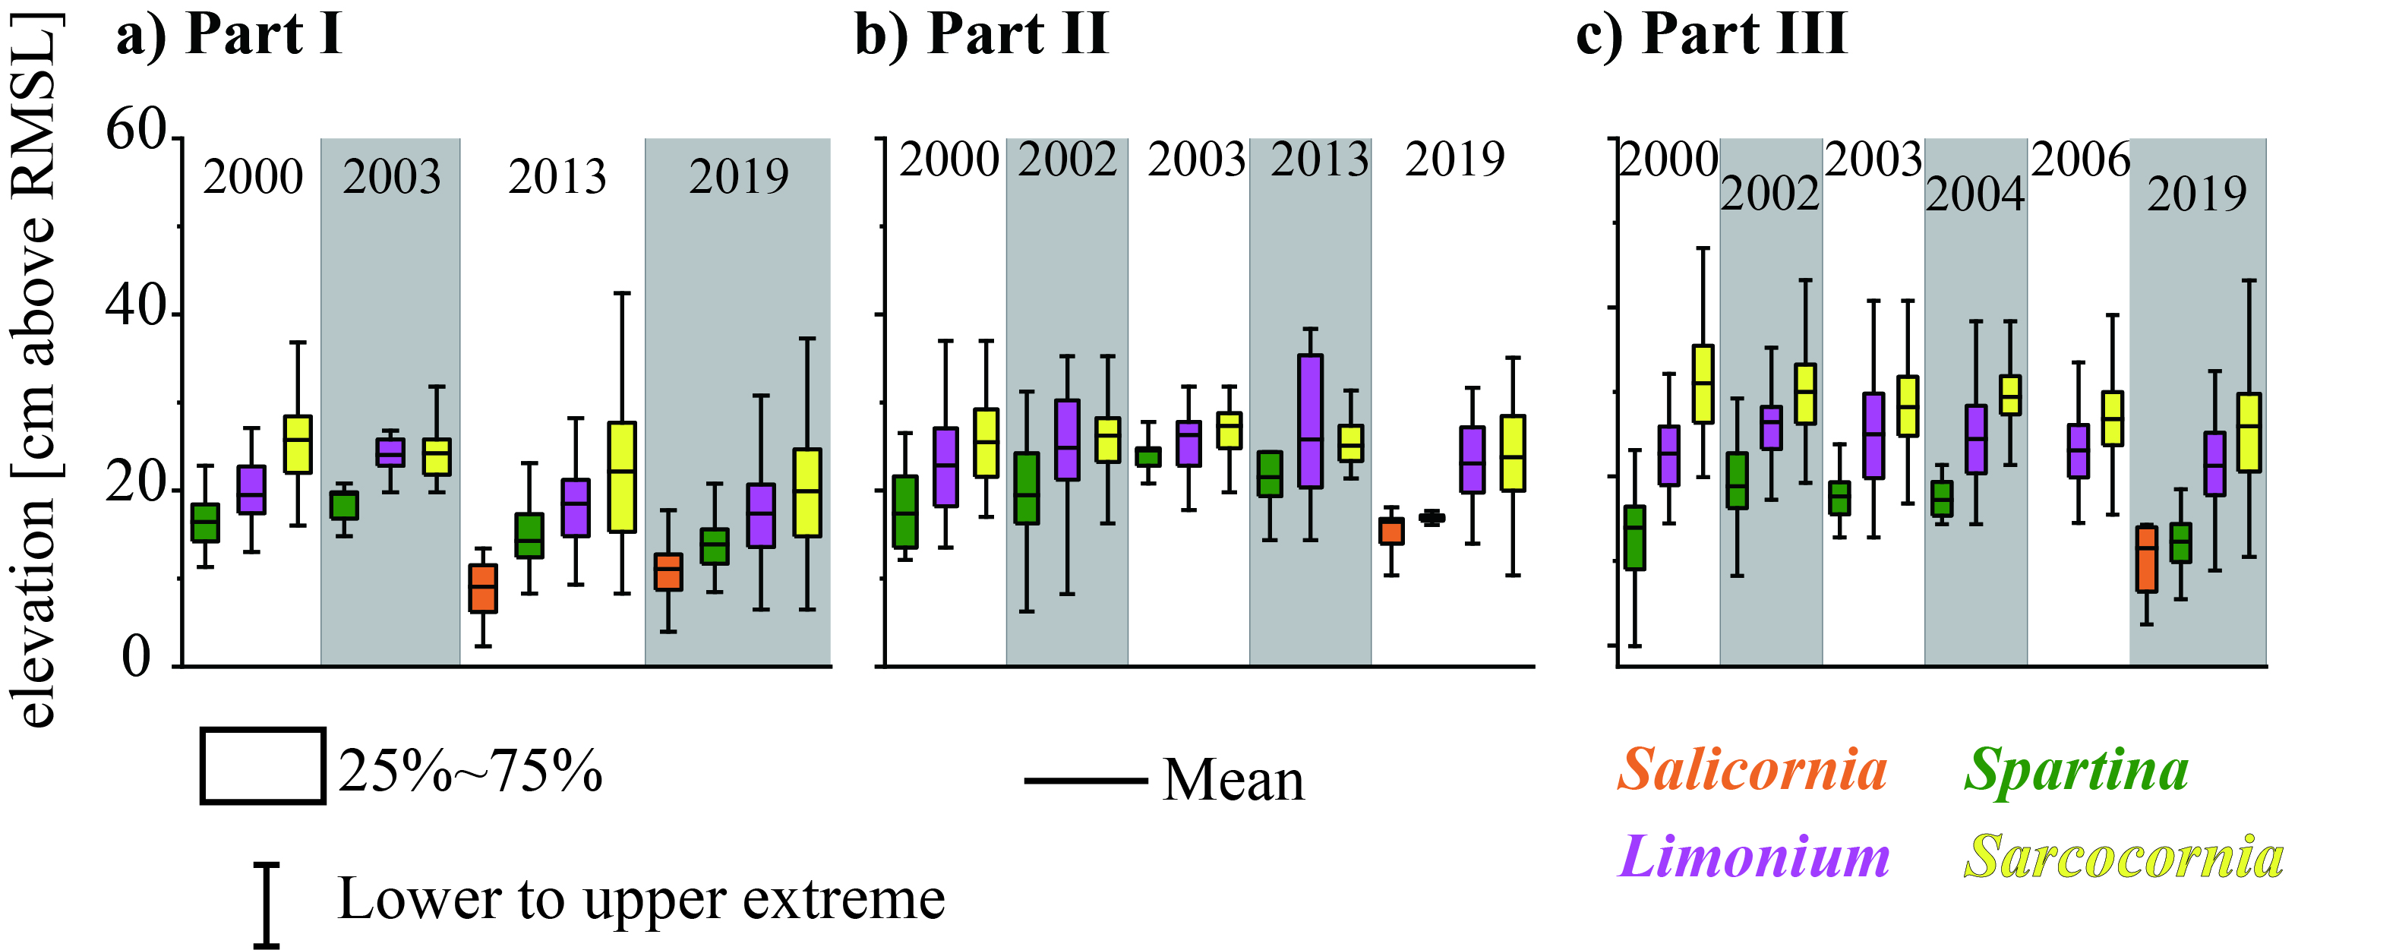
Result: vegetation vertical distriubion in time
Local scale
We showed, for the first time, the consistency of the species sequence over a period of in 20 years.
Yang et al, JGR-Biogeo, under-review
Yang et al., 2022, EGU
Introduction
Methods
Results
Conclusions

Slide 9
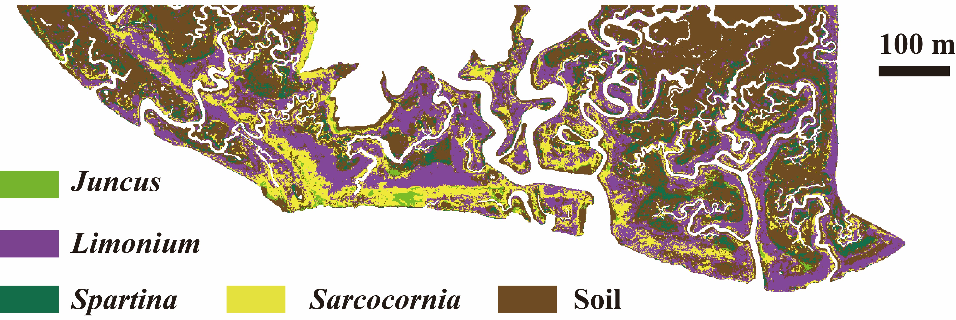
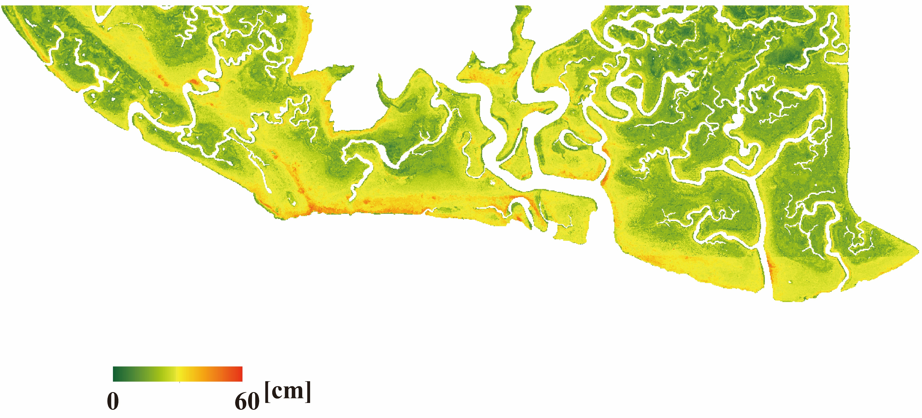
Result: Large scale vertical distribution of halophytic vegetation
Most abundant species map in 2003
DEM over the San Felice marsh in 2003 (above IGM datum)
Fig from Yang et al., in preparation to MEE
Yang et al., 2022, EGU
Introduction
Methods
Results
Conclusions

Slide 10
Result: Large scale vertical distribution of halophytic vegetation
Each species has its preferable living elevation range (left panel), and the species sequence also can be observed in the right panel.
The vegetation-elevation relationship is also reliable at the a large spatial scale.
Fig from Yang et al., in preparation to MEE
Yang et al., 2022, EGU
Introduction
Methods
Results
Conclusions

Slide 11
Result: vertical distribution of fractional abundance
mFA of each species approaches the peak value in species-specific elevation ranges, which can be characterized as the ecological niche of each species.
“Sum value of Fractional abundance of Vegetation” (SFV) generally increases with elevations while the FA of bare soil displays a decreasing trend.
Fig from Yang et al., in preparation to MEE
Yang et al., 2022, EGU
Introduction
Methods
Results
Conclusions

Slide 12
Result: Large scale vertical distribution of halophytic vegetation
The average NDVI (mNDVI) generally increases with higher elevations.
The average meAGB also generally increases with elevations.
These suggest that the AGB generally higher in higher marsh portions.
Fig from Yang et al., in preparation to MEE
Yang et al., 2022, EGU
Introduction
Methods
Results
Conclusions

Slide 13
TAKE HOME MESSAGES
Each halophytic vegetation species has its preferable elevation range to encroach, thus constituting a species sequence with increasing elevation. All those field observations are reliable at a large spatial scale.
AGB increases with marsh elevations, because NDVI and eAGB are generally higher in higher marsh portions.
Yang et al., 2022, EGU
Introduction
Methods
Results
Conclusions

Slide 14
Thanks for your attention and suggestions
Zhicheng Yang
05/24/2022
zhicheng.yang@phd.unipd.it

