Slide 1

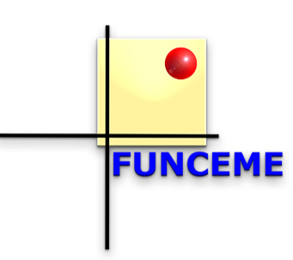


Drought Cycle Analysis to evaluate the influence of a dense network of small reservoirs on drought evolution
G. G. Ribeiro Neto, L. A. Melsen, E. S. P. R. Martins, D. W. Walker, and P. R. van Oel

Slide 2
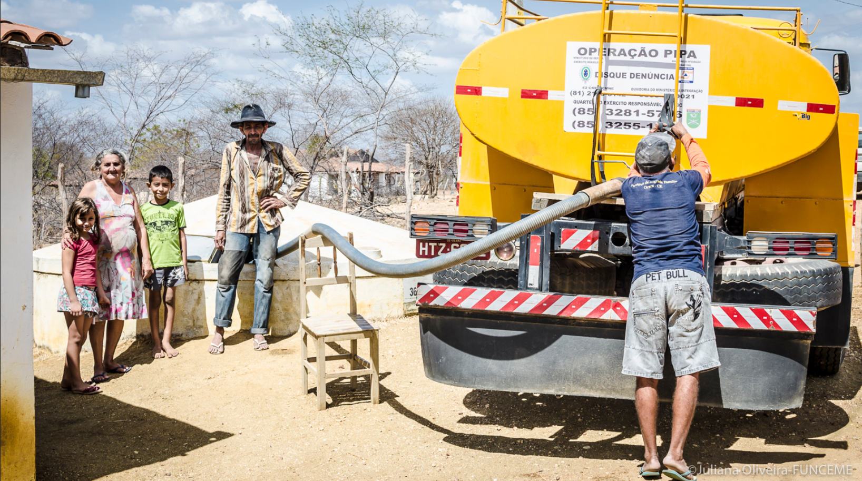
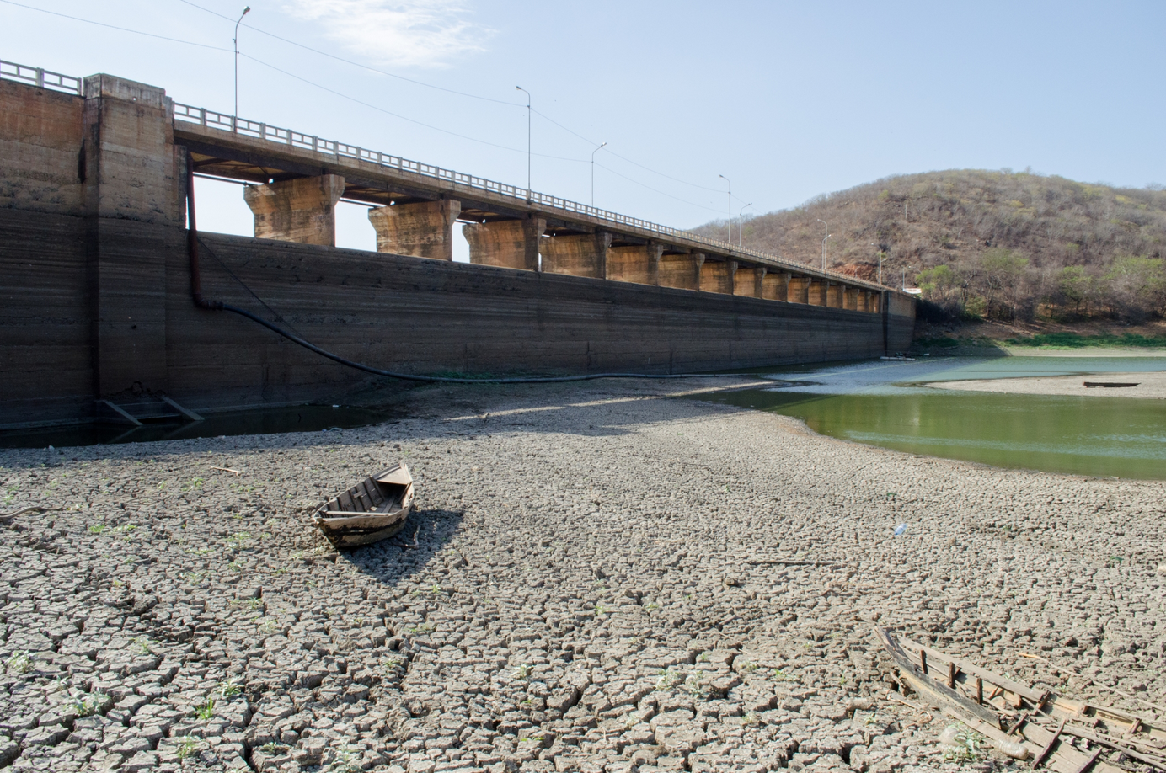
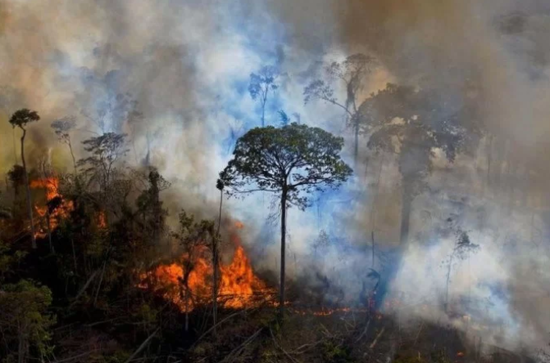
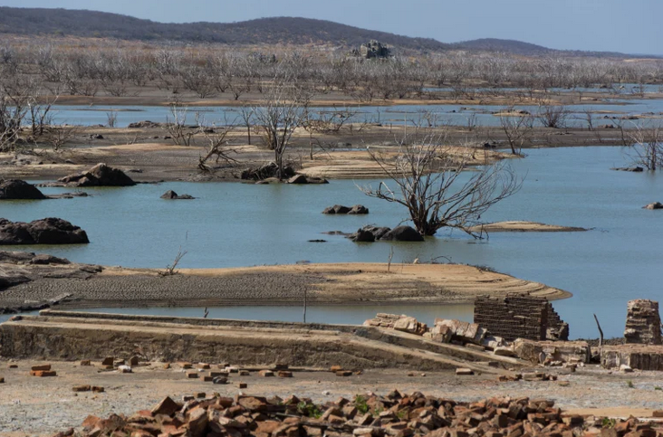
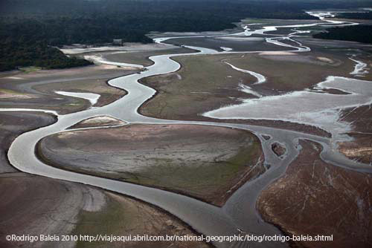
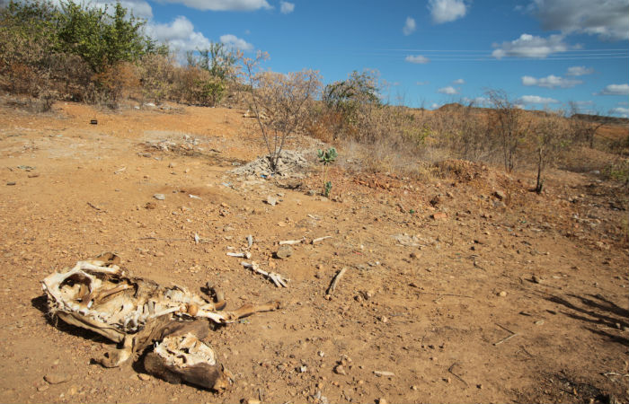
Droughts in Brazil
Energy supply reduction
Decrease in water security
DROUGHT IMPACTS IN BRAZIL
Increase in forest fires
Decrease in food security
Limitation in the transport of people/goods
Biodiversity reduction
Ribeiro Neto, G. G., et al. "Drought Cycle Analysis to evaluate the influence of a dense network of small reservoirs on drought evolution." Water Resources Research: e2021WR030799.

Slide 3
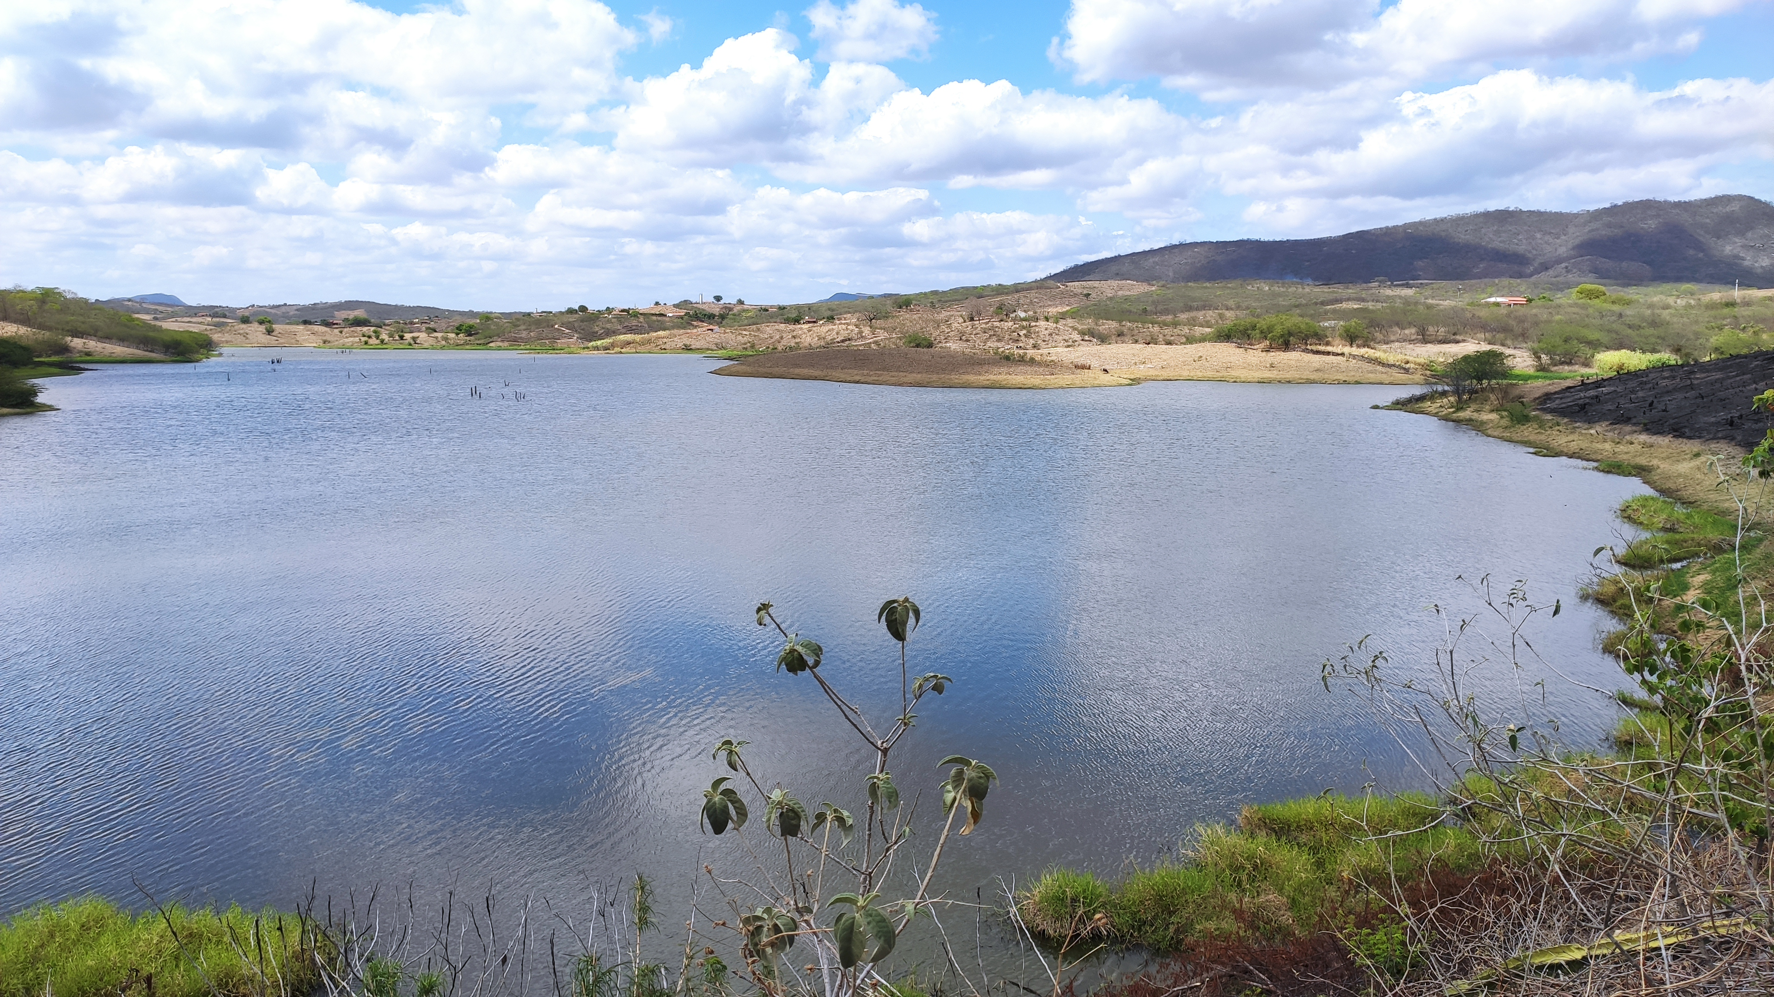
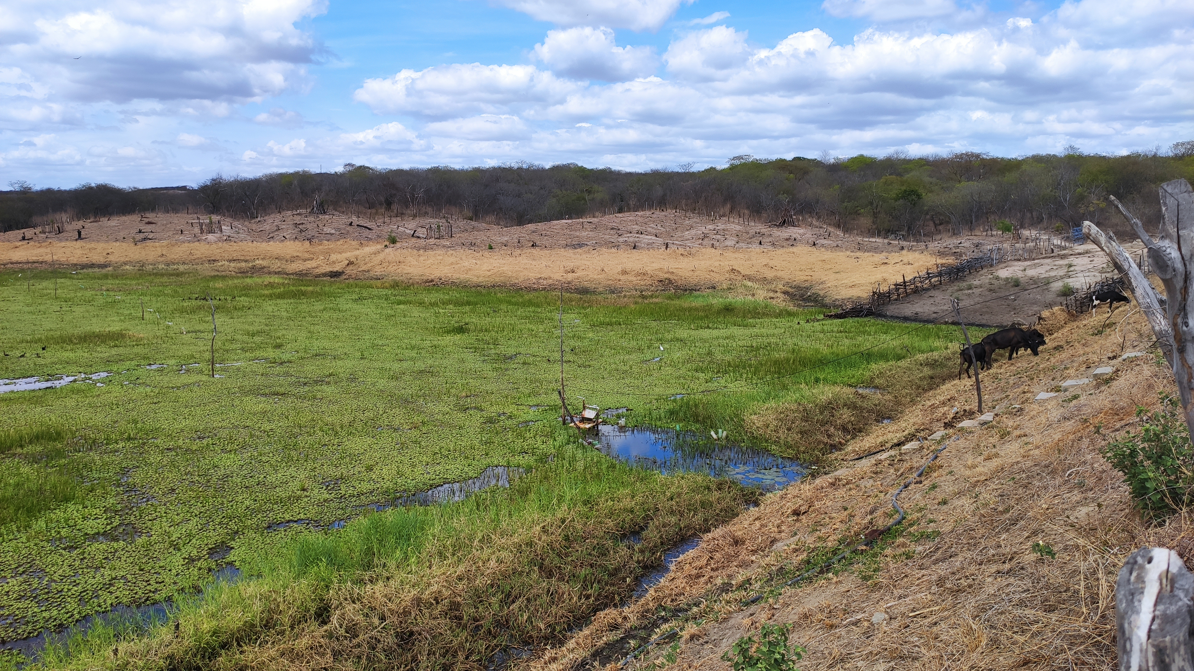
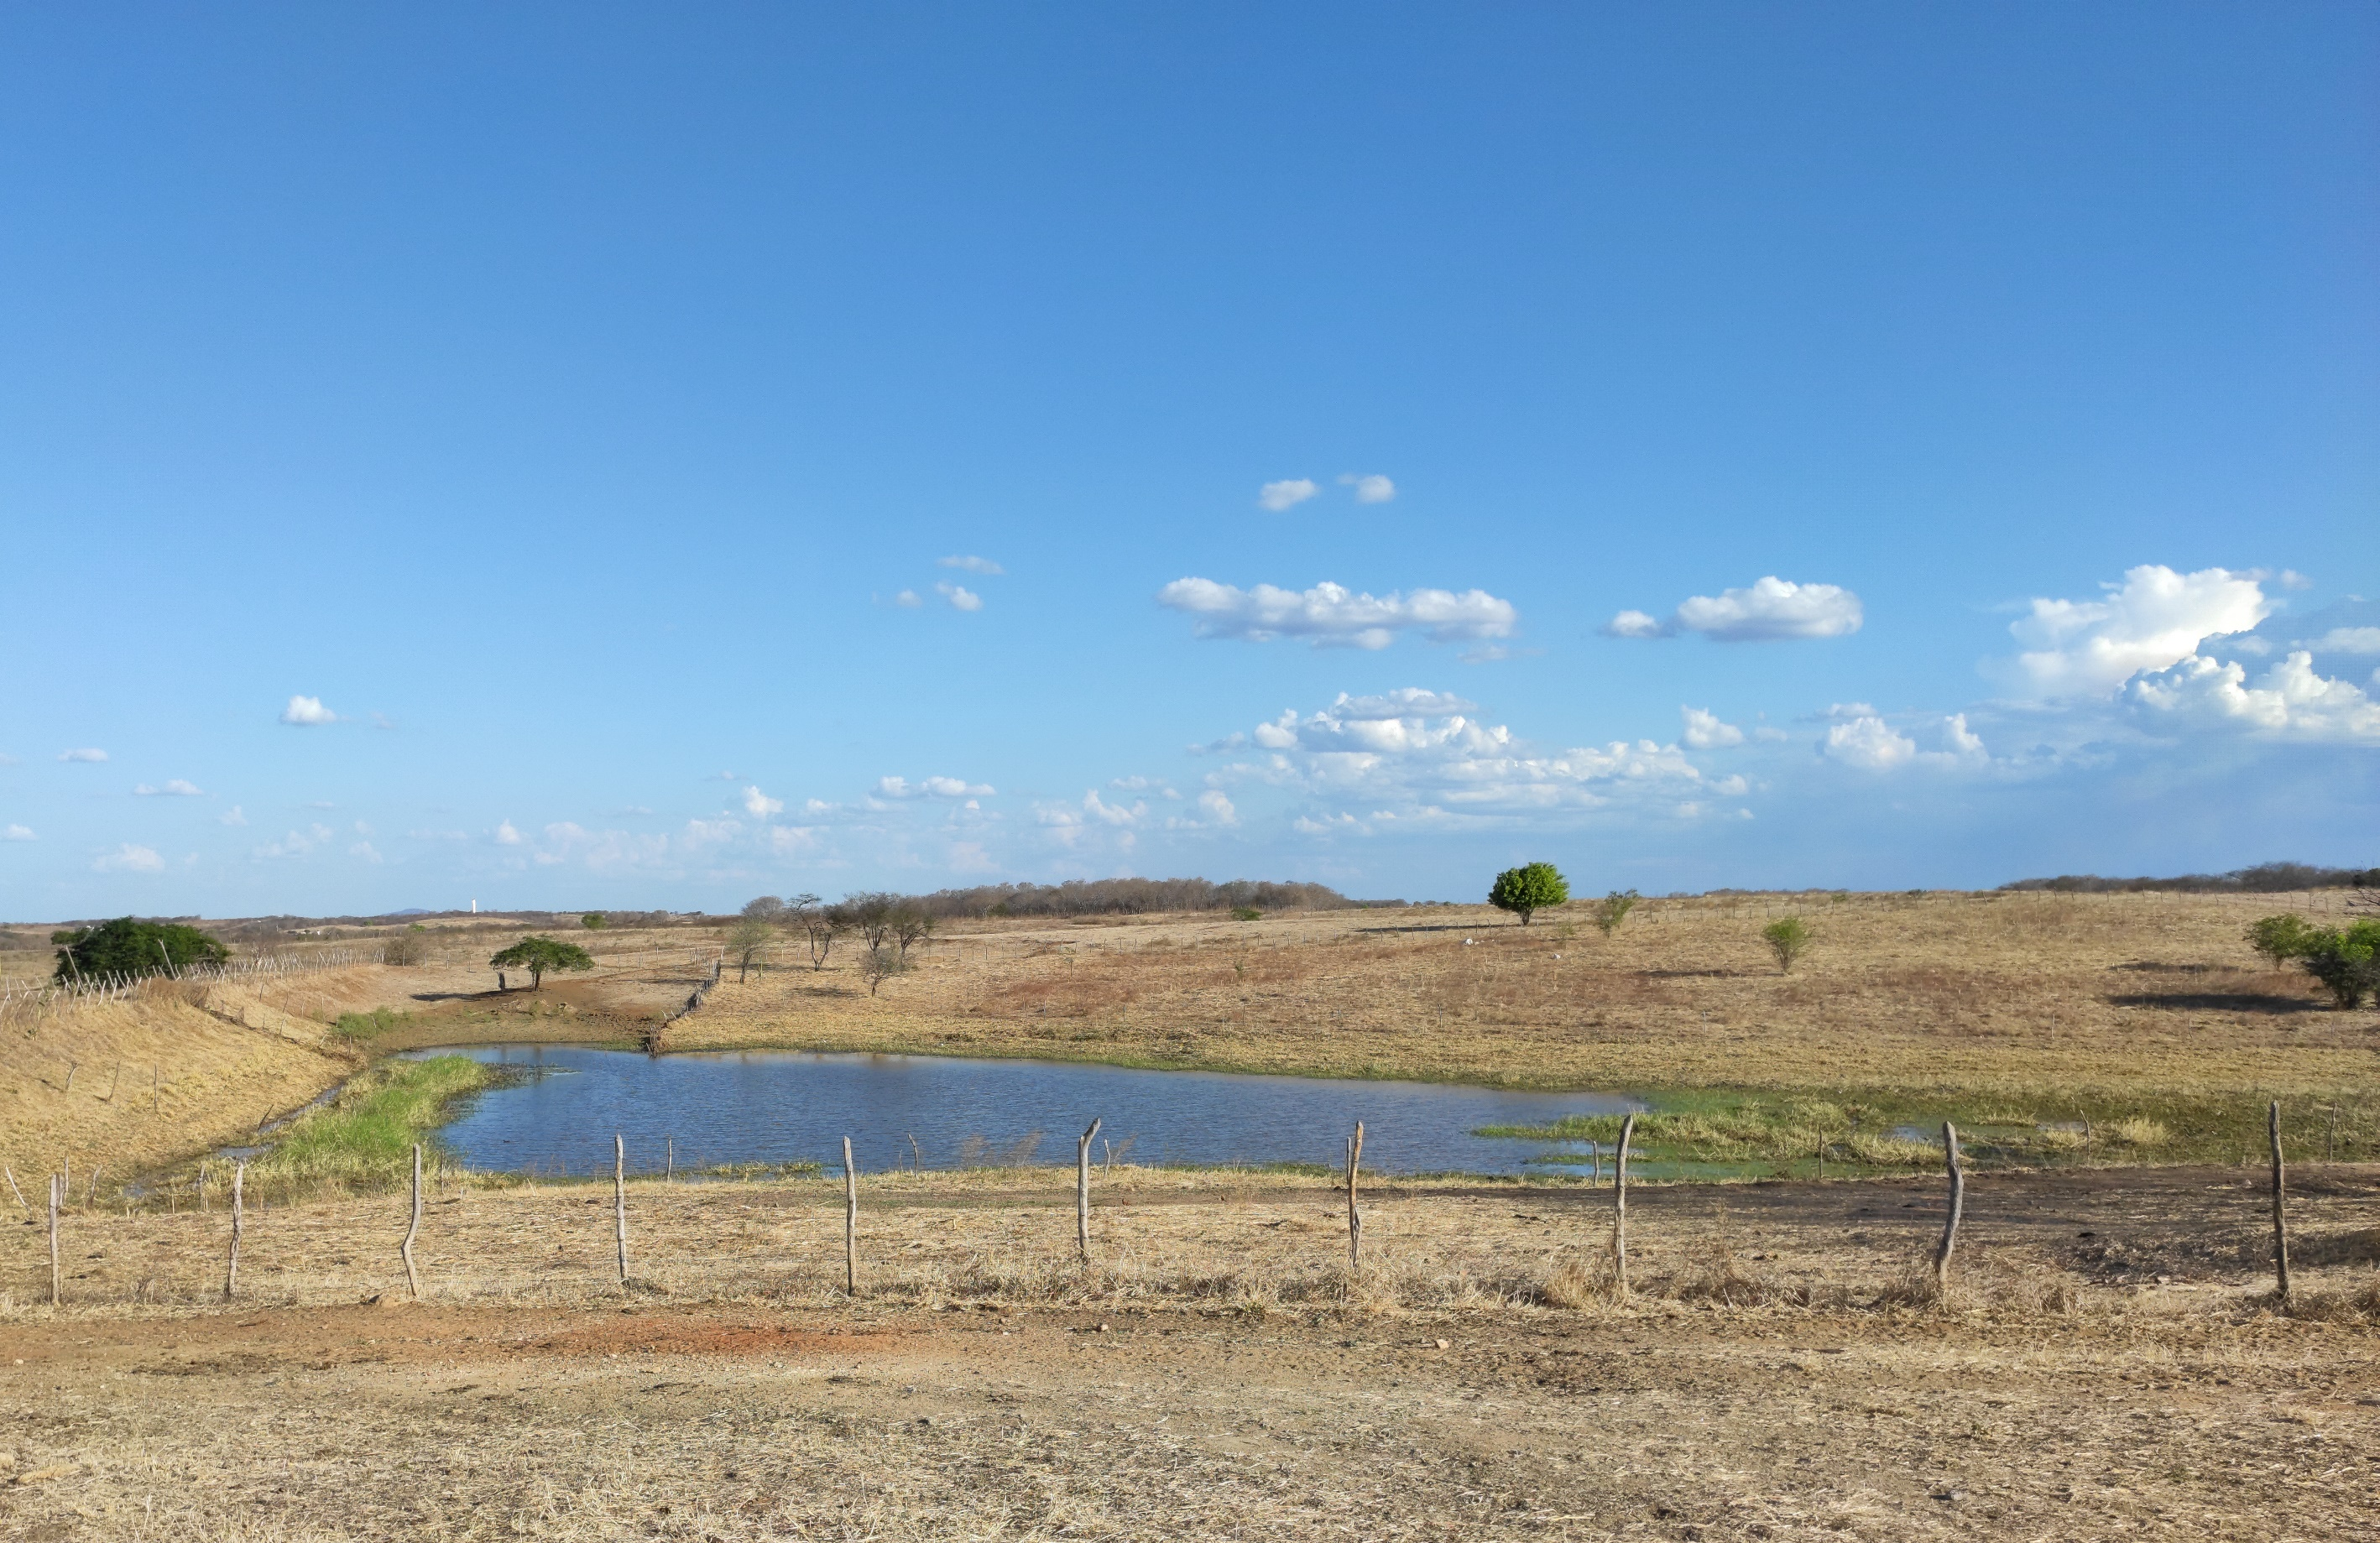
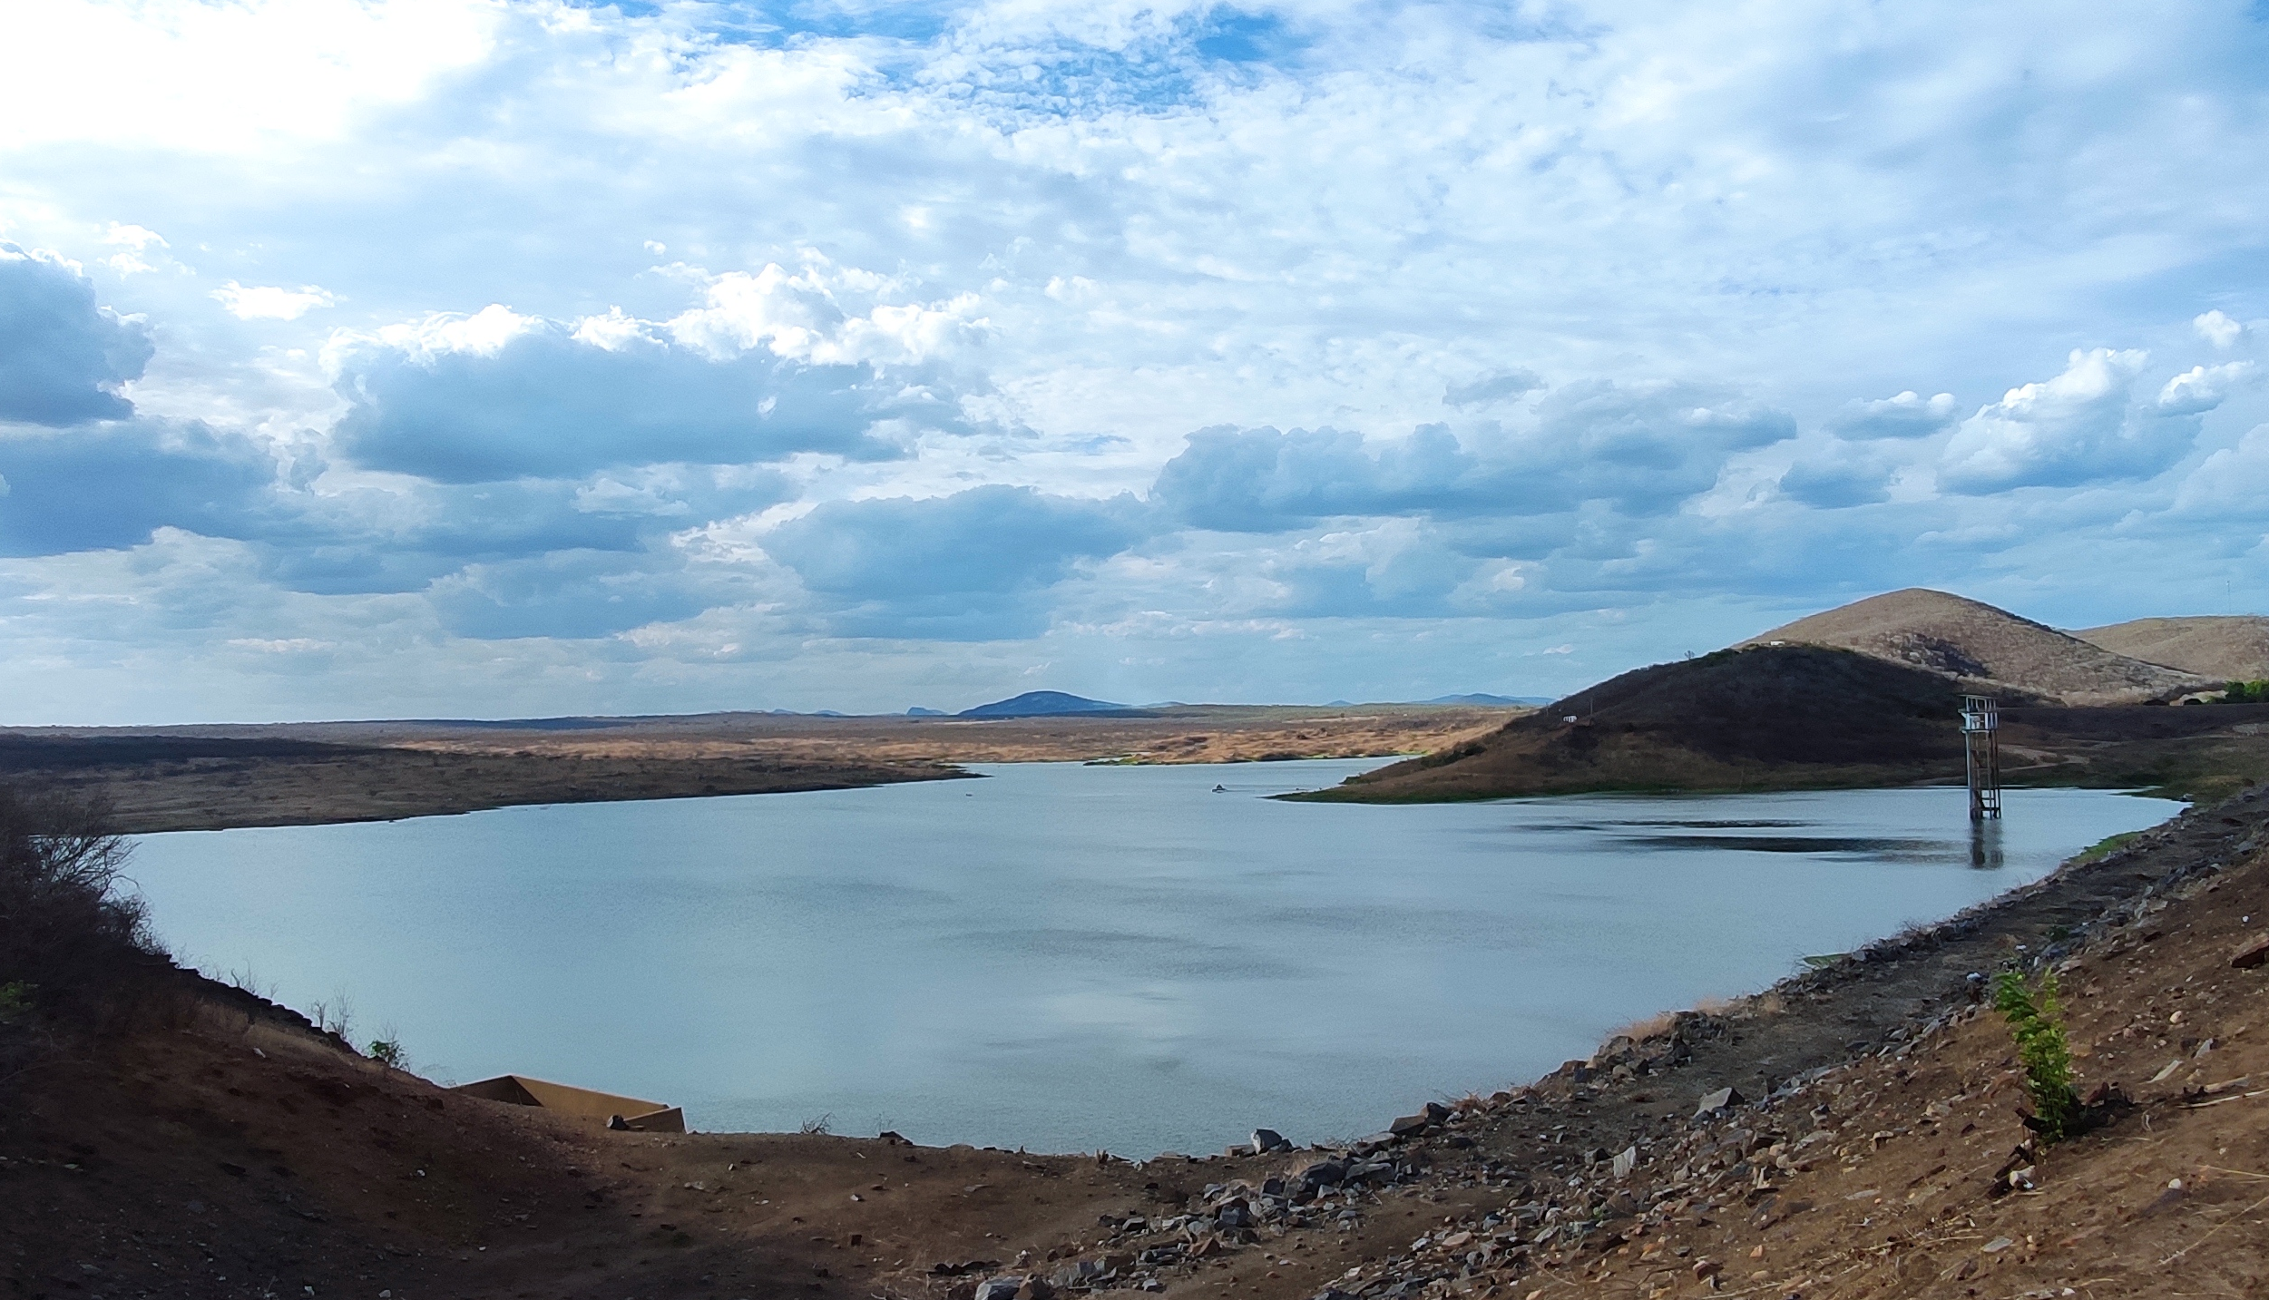
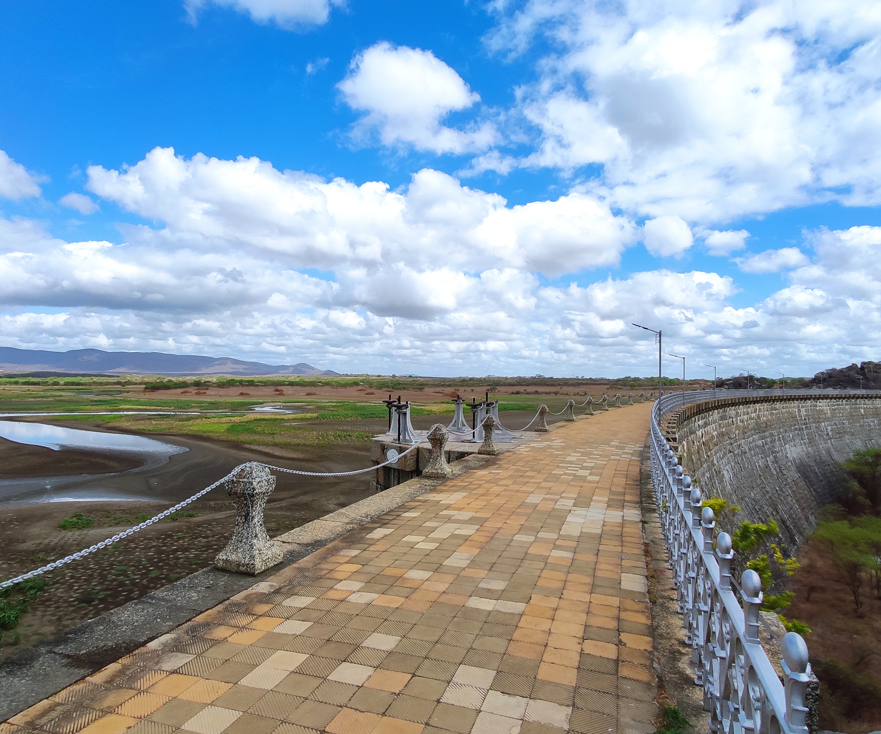
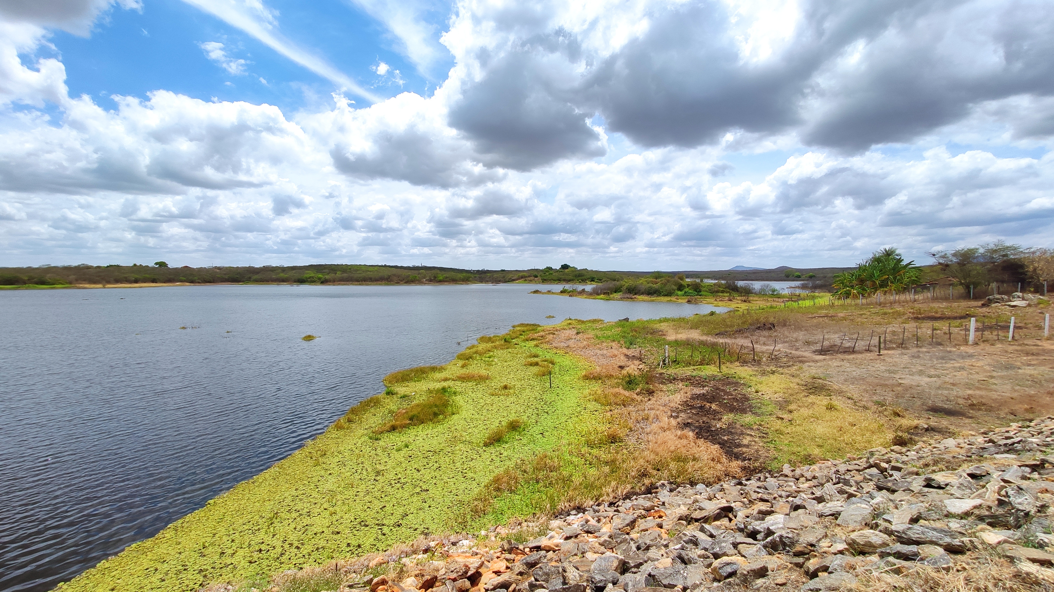
Drought response
Ribeiro Neto, G. G., et al. "Drought Cycle Analysis to evaluate the influence of a dense network of small reservoirs on drought evolution." Water Resources Research: e2021WR030799.

Slide 4
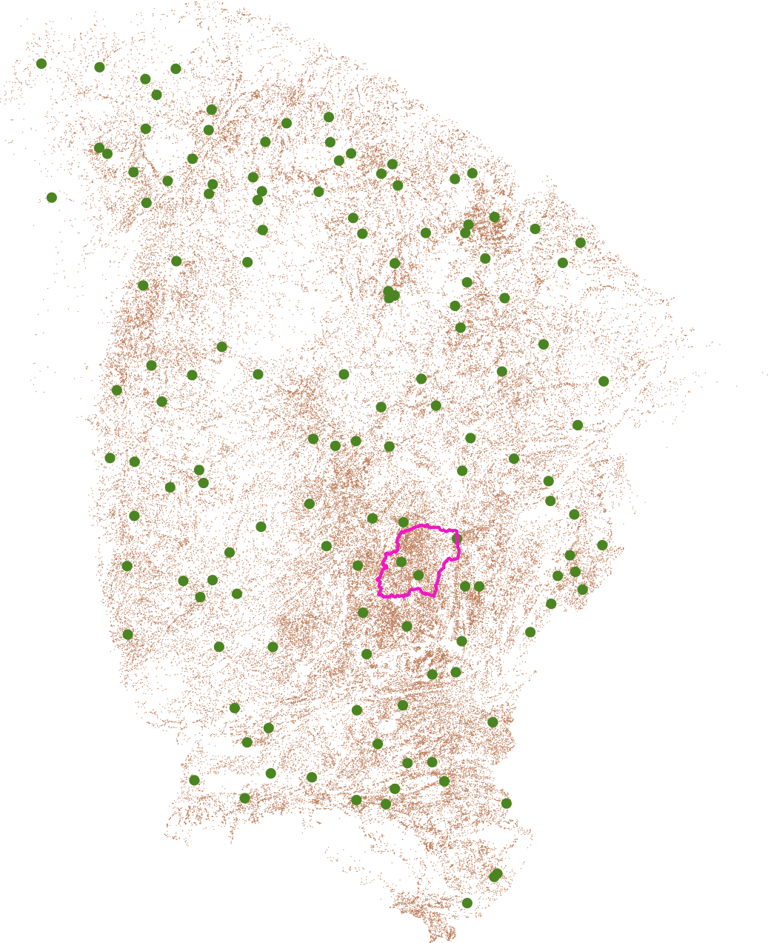
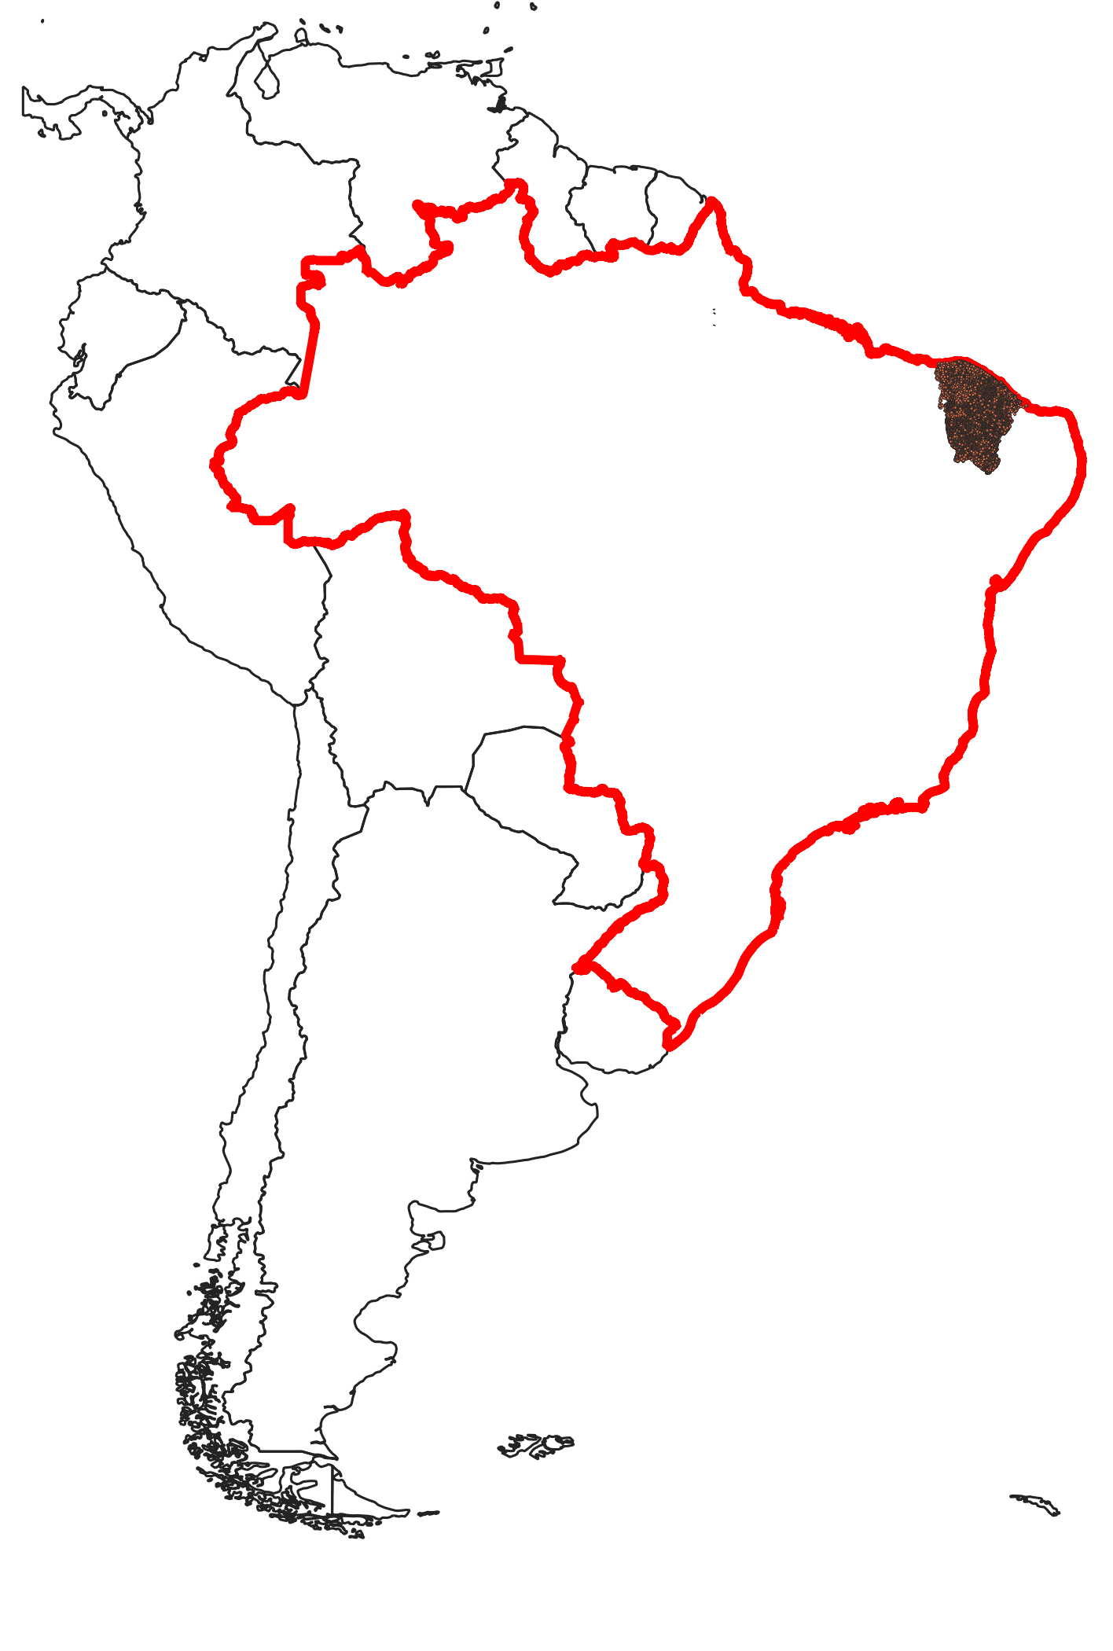
Droughts response
Unmonitored (no-estrategic) reservoirs >100k
Monitored (estrategic) reservoirs = 153
Ribeiro Neto, G. G., et al. "Drought Cycle Analysis to evaluate the influence of a dense network of small reservoirs on drought evolution." Water Resources Research: e2021WR030799.

Slide 5
What is the influence of a dense network of (non-strategic) reservoirs on the evolution and intensification of drought events?
Ribeiro Neto, G. G., et al. "Drought Cycle Analysis to evaluate the influence of a dense network of small reservoirs on drought evolution." Water Resources Research: e2021WR030799.

Slide 6
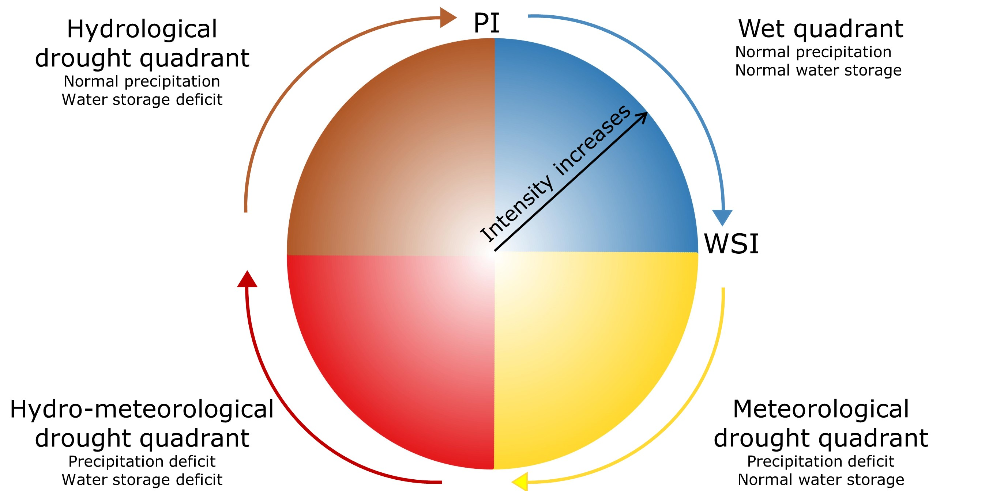

Methods : Drought Cycle Analysis
SPI
Intensity increases
Volume Deviation
Ribeiro Neto, G. G., et al. "Drought Cycle Analysis to evaluate the influence of a dense network of small reservoirs on drought evolution." Water Resources Research: e2021WR030799.

Slide 7

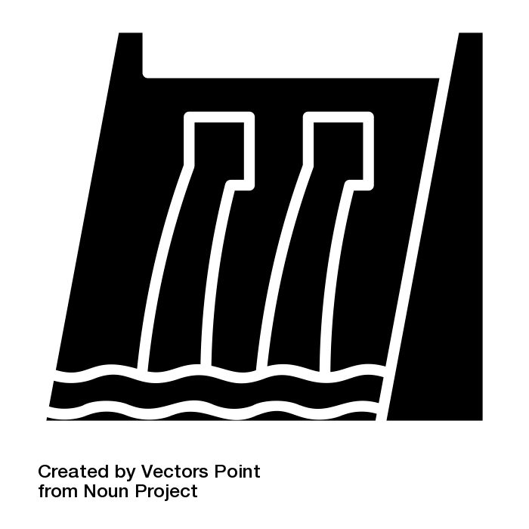

Droughts event attribution
All Reservoirs Scenario (ARS)
Large Reservoir Scenario (LRS)
Ribeiro Neto, G. G., et al. "Drought Cycle Analysis to evaluate the influence of a dense network of small reservoirs on drought evolution." Water Resources Research: e2021WR030799.

Slide 8
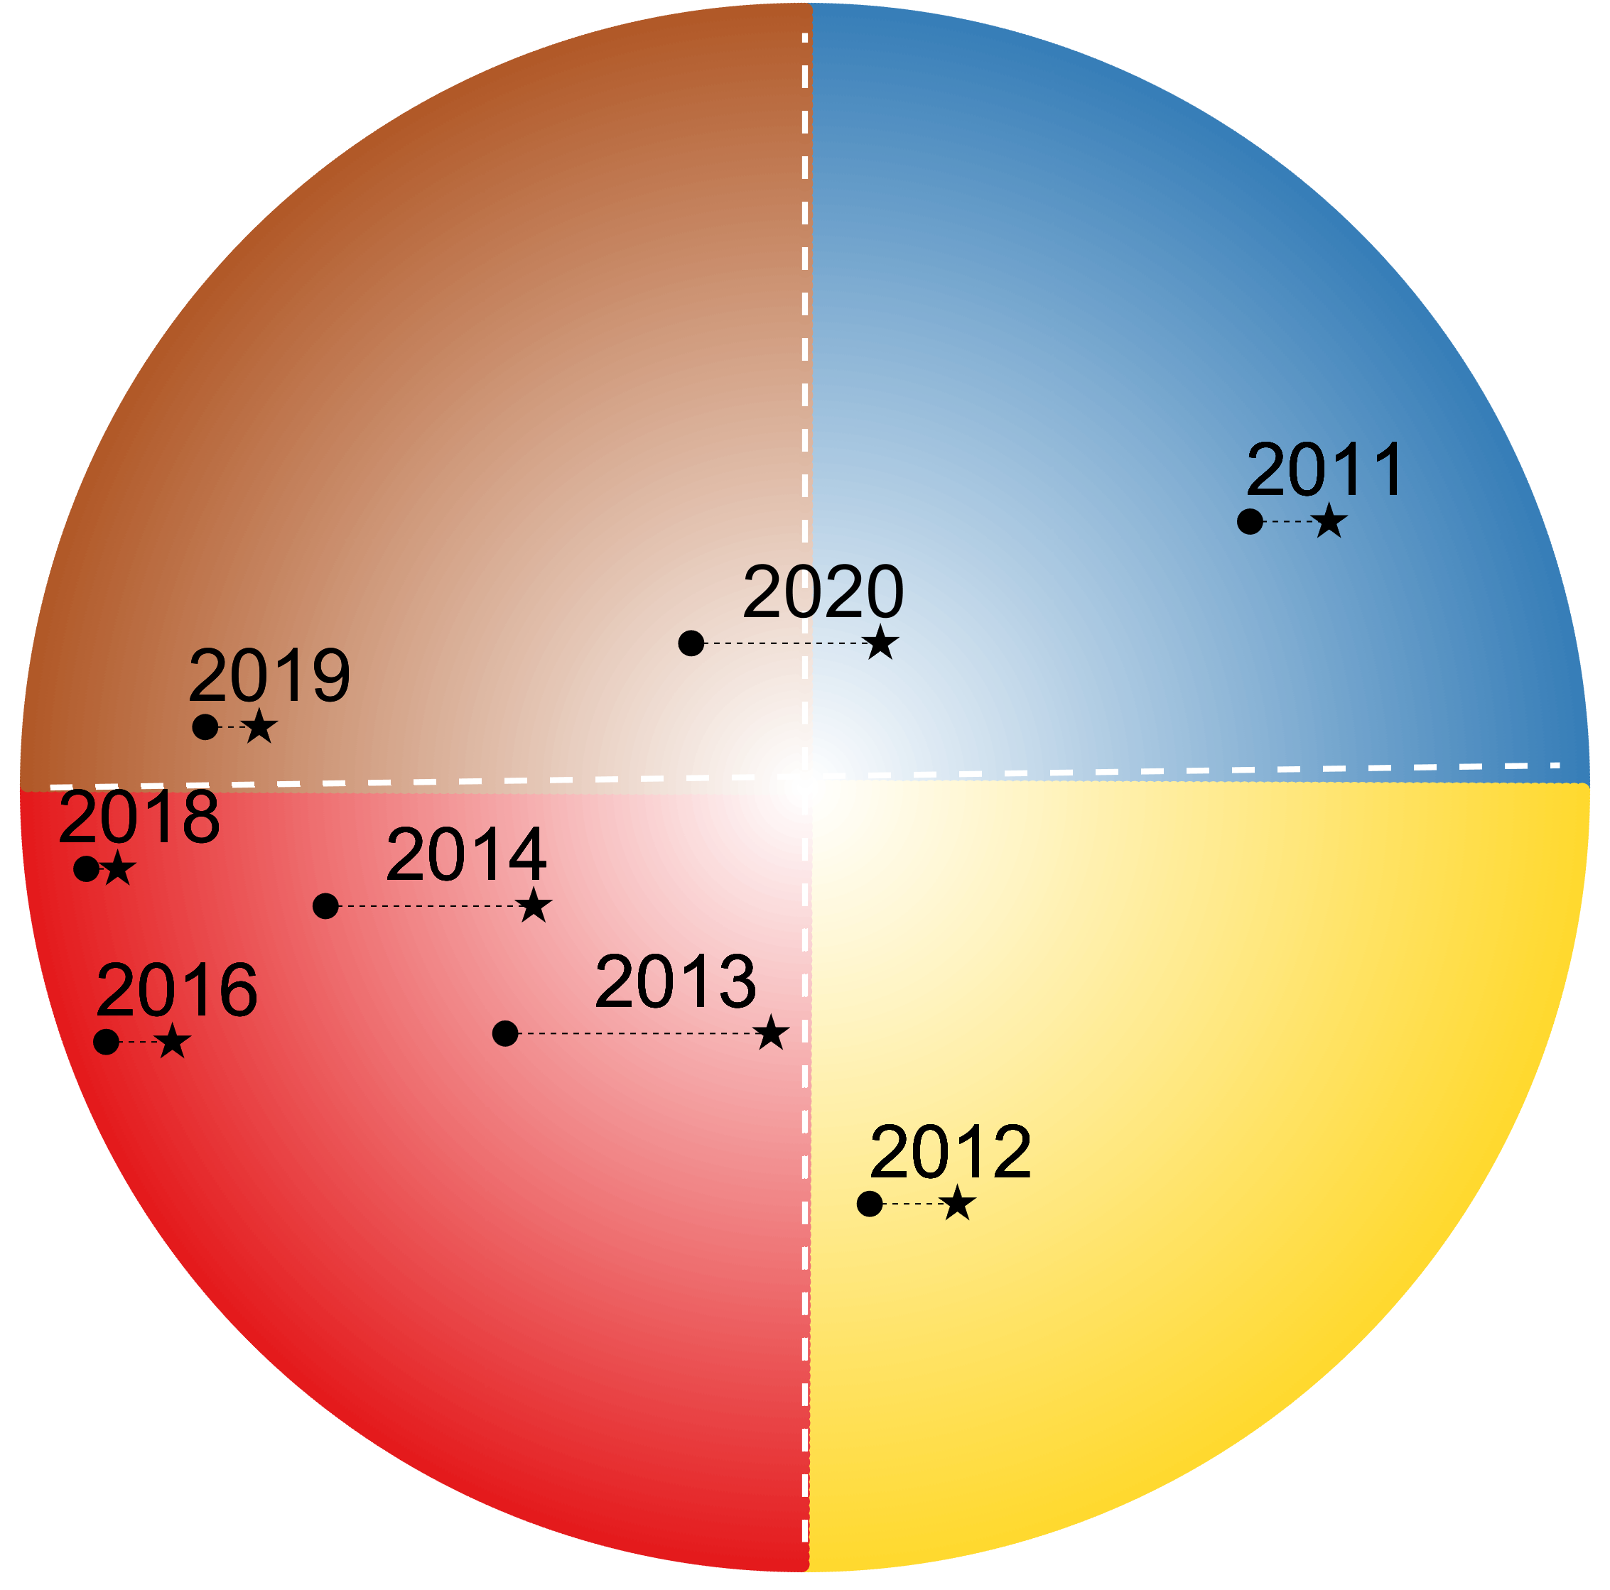
Results
2012 – 2020 Drought event
Hydrological drought quadrant
Wet quadrant
Hydro-meteorological drought quadrant
Meteorological drought quadrant
Large Reservoir Scenario (LRS)
All Reservoir Scenario (ARS)
Ribeiro Neto, G. G., et al. "Drought Cycle Analysis to evaluate the influence of a dense network of small reservoirs on drought evolution." Water Resources Research: e2021WR030799.

Slide 9
Conclusions
Drought Cycle Analysis can improve water resource management by accounting for the effect of dense network of (small) reservoirs;
A high concentration of small reservoirs can induce and modify drought events ( advance, extend and intensify);
Small reservoirs are invaluable for smallholder livelihoods as drought coping strategy .
Ribeiro Neto, G. G., et al. "Drought Cycle Analysis to evaluate the influence of a dense network of small reservoirs on drought evolution." Water Resources Research: e2021WR030799.

Slide 10
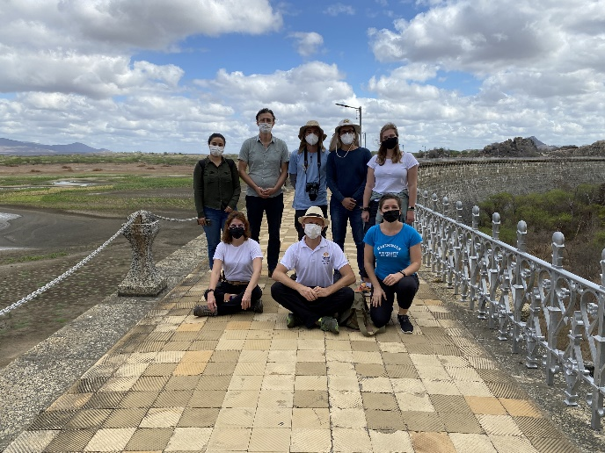
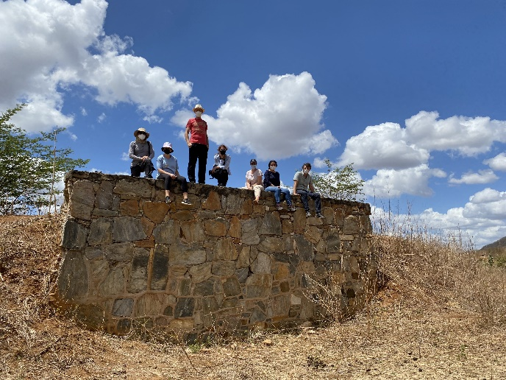

Thank you for watching!
germano.gondimribeironeto@wur.nl
3ddd-project.org
@3DDD_drought

