Slide 1





Historical analysis of large reservoir storage resilience and vulnerabilities in CONUS
Presented by ${\text{Jennie} \text{C}\text{. }\text{Steyaert}}^{1} \&$ ${\text{Laura} \text{E}\text{. }\text{Condon}}^{1}$
1. University of Arizona

Slide 2
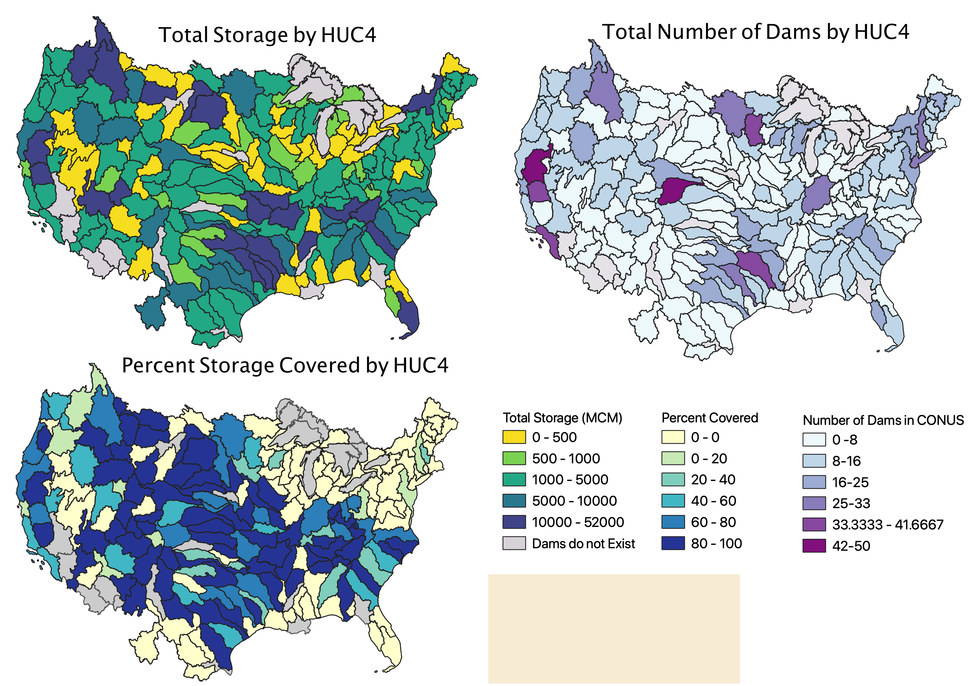
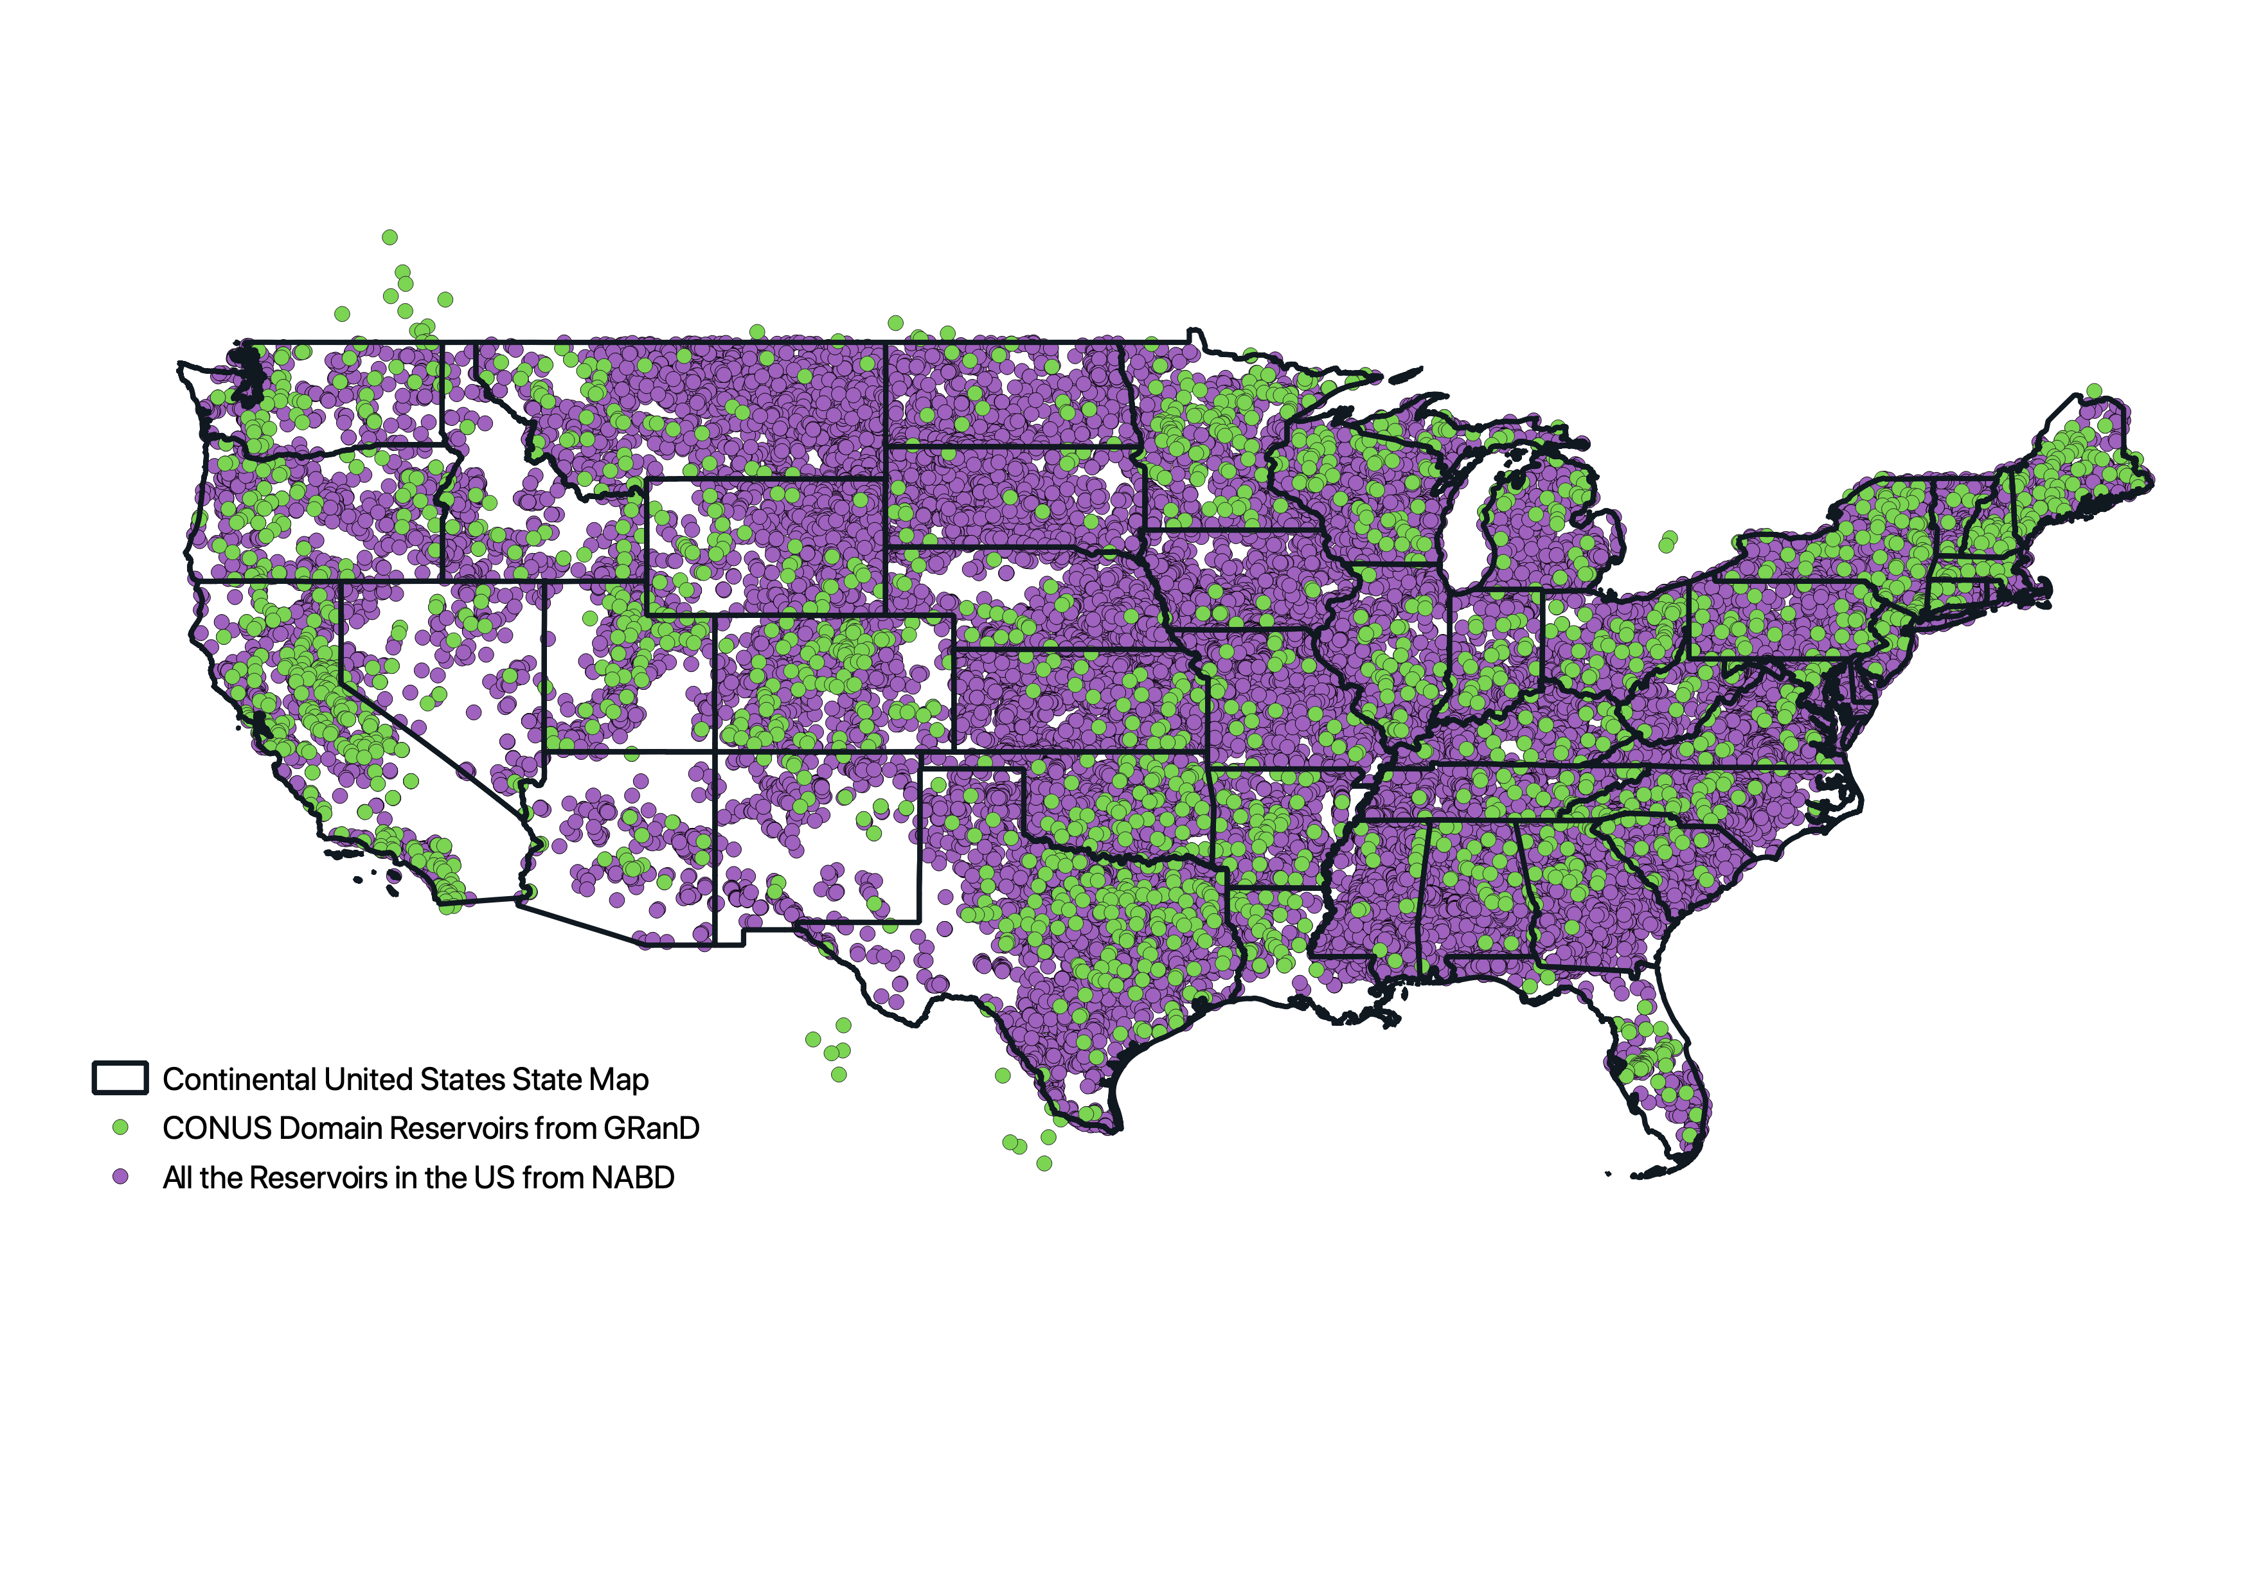
The continental US (CONUS) has over 2000 large dams and 800,000 MCM of storage
  Dams in CONUS
Total Storage of Large Dams
Contiguous United States
Large Dams in CONUS
All Dams in CONUS

Slide 3
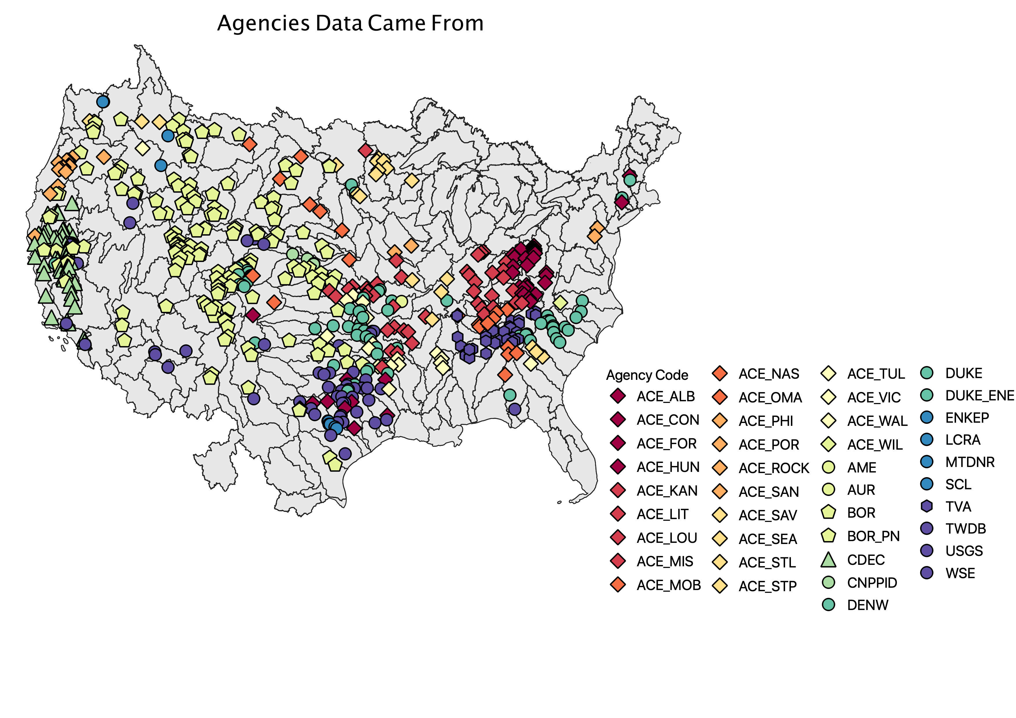
The US contains over 100 agencies without a unified dataset of reservoir operations
Agencies in the US

Slide 4
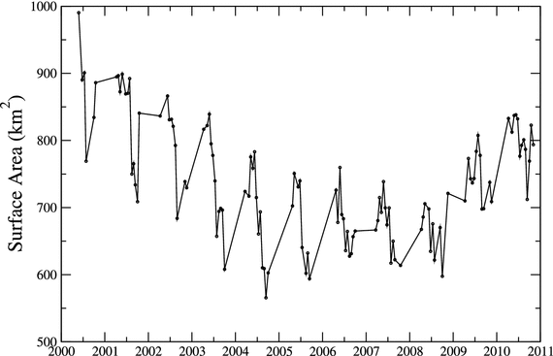
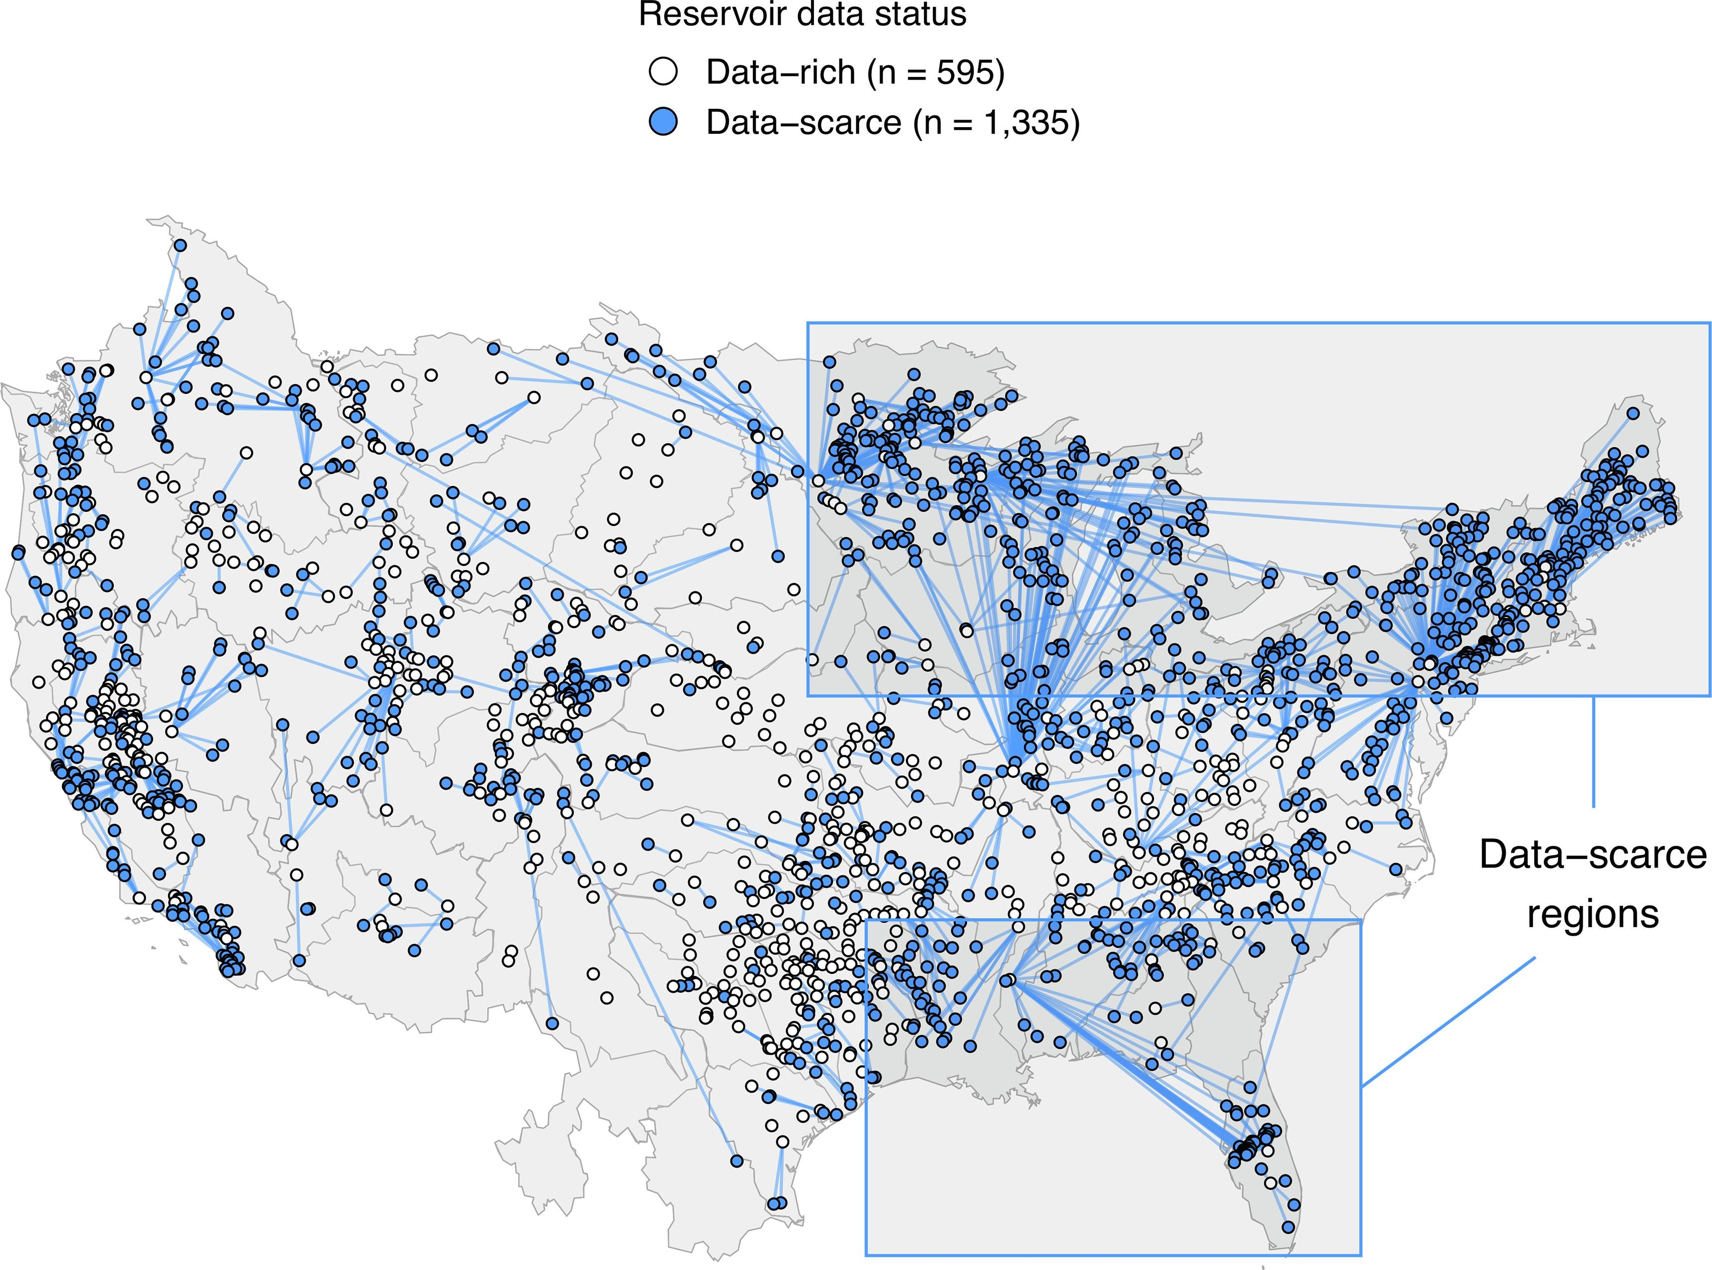
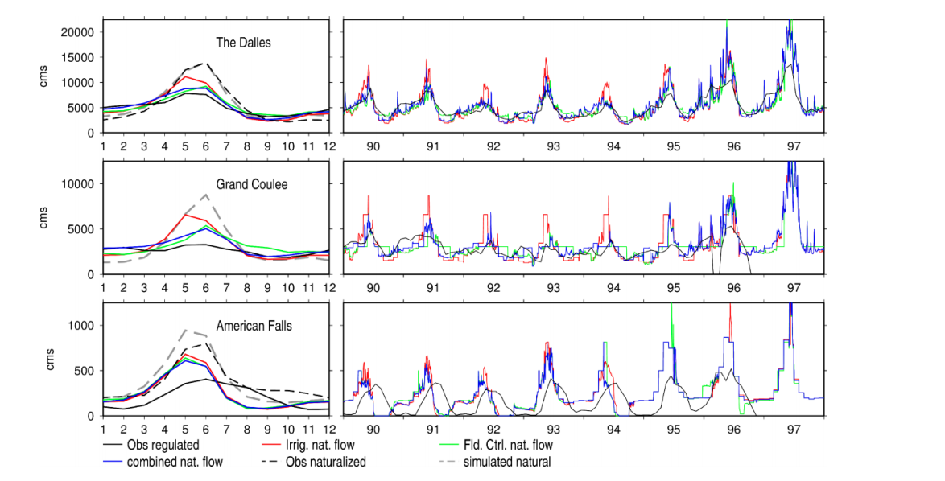
Therefore, many analyses rely on…
Gao et al., 2012
Inferred rule curves which are data limited by real time inflow, outflow and storage values
Data driven operations which are limited by data availability
Remote sensing which are limited by spatial and temporal resolutions
Voisin et al 2013a
Turner et al., 2021

Slide 5
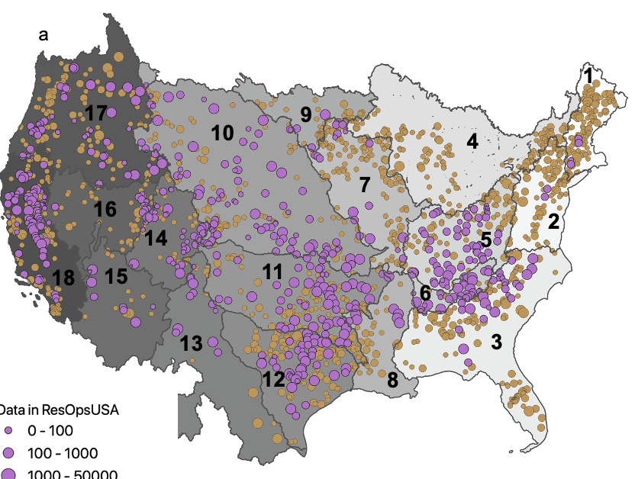
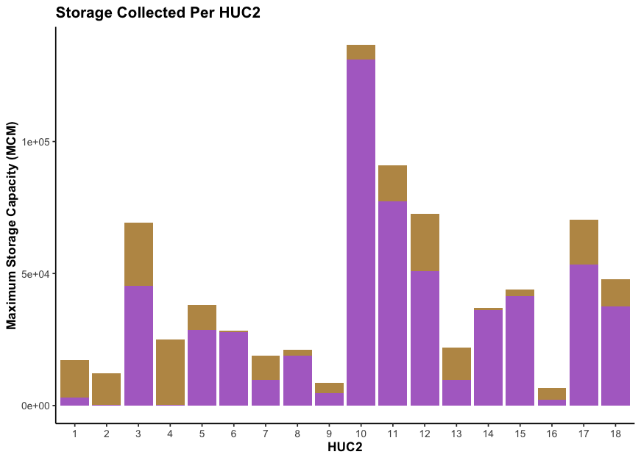
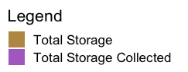
Gathered real time reservoir operations for 678 dams to form ResOpsUS
Have majority of storage in the US
Contains daily storage, inflow and outflow timeseries
Steyaert, J. C., Condon, L. E., Turner, S. W. D., & Voisin, N. (2022)
Notes:
2 min

Slide 6
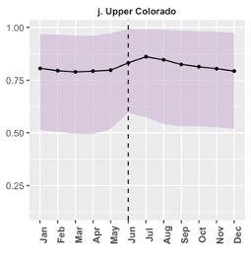
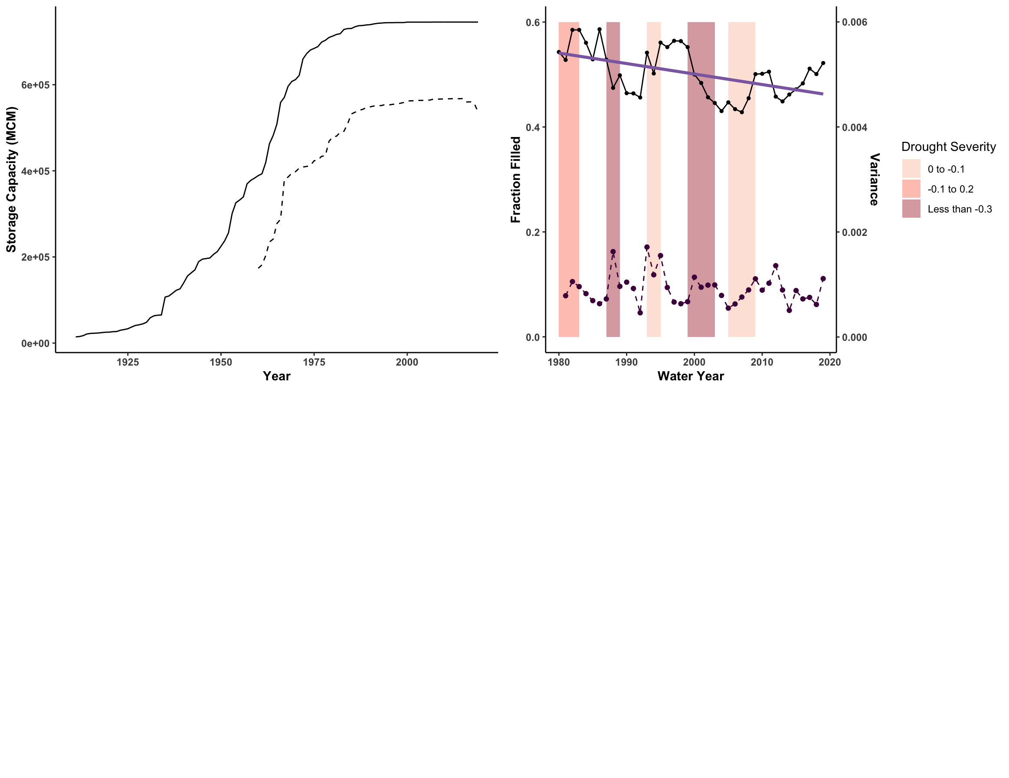
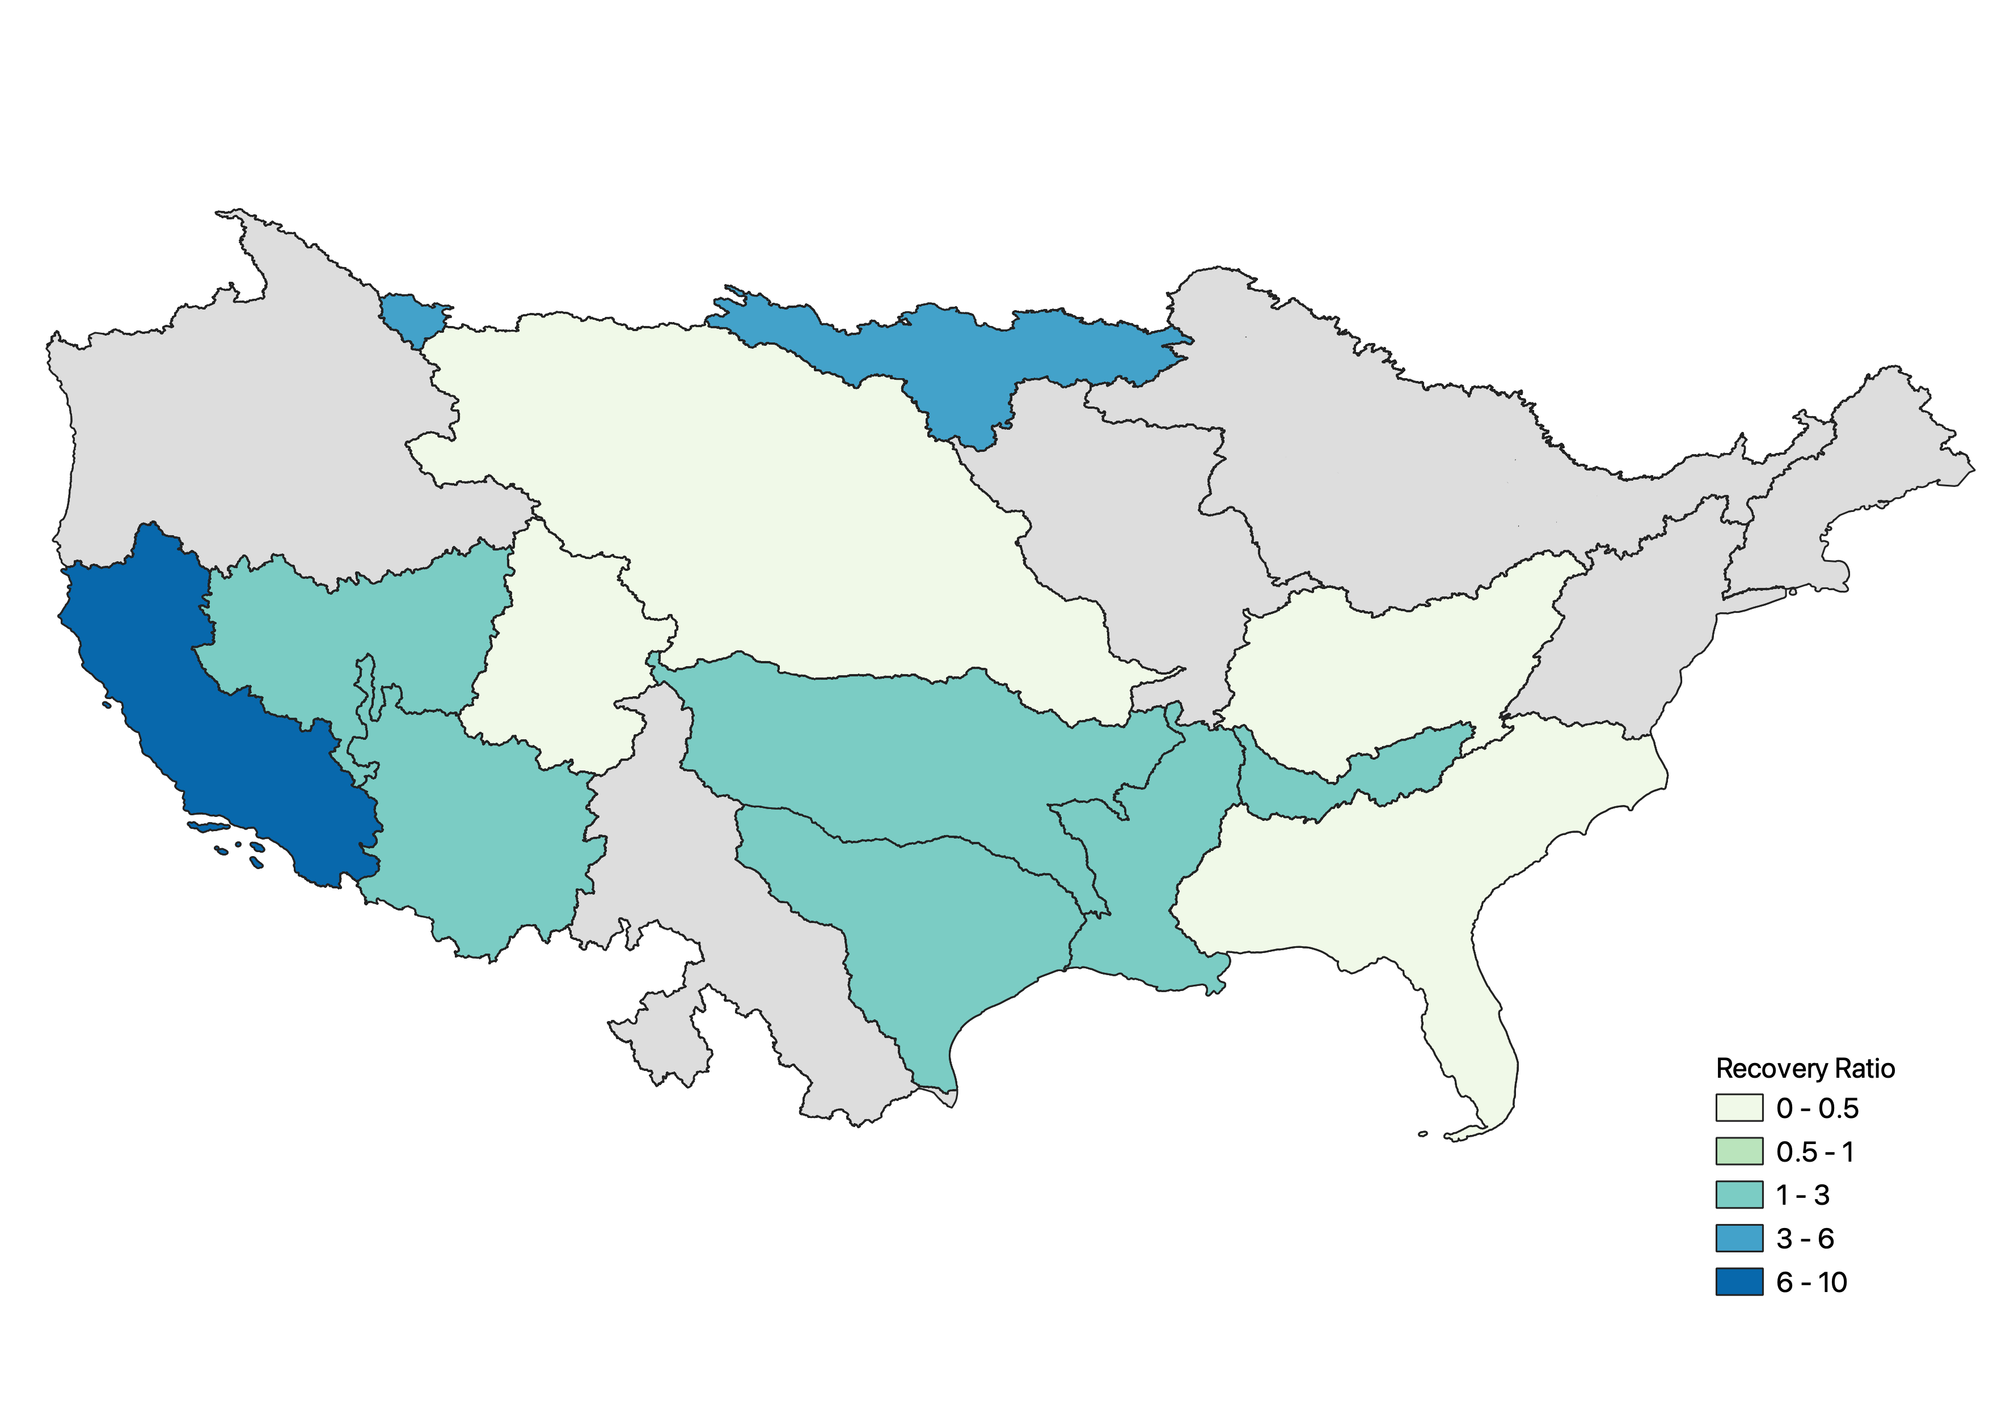
We want to understand spatial reservoir operations using ResOpsUS:
Seasonal reservoir storage dynamics
Regional historical storage trends
Reservoir sensitivity to drought periods

Slide 7
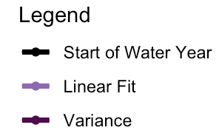
Reservoir storage capacity has held constant since the 1980s while reservoir storage has decreased
1980
All large dams
ResOpsUS

Slide 8
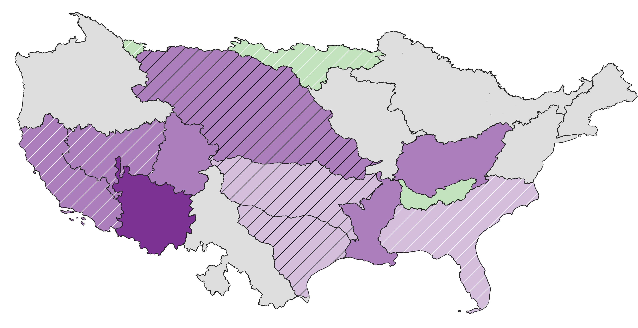
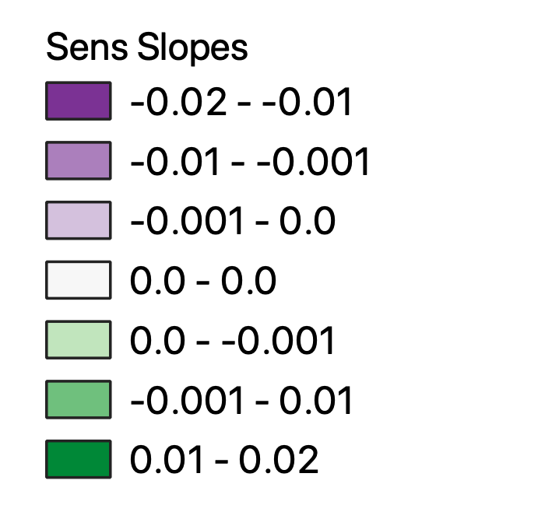
83% of data rich regions have decreasing storage trends
Upper and Lower Colorado, Ohio and Lower Mississippi significant decreasing storage trends
More arid regions (Lower Colorado) have sharper decrease in storage
Flood control dominated basin (Tennessee) has only significant increasing storage trend
Note: hashing denotes statistically insignificant regions

Slide 9
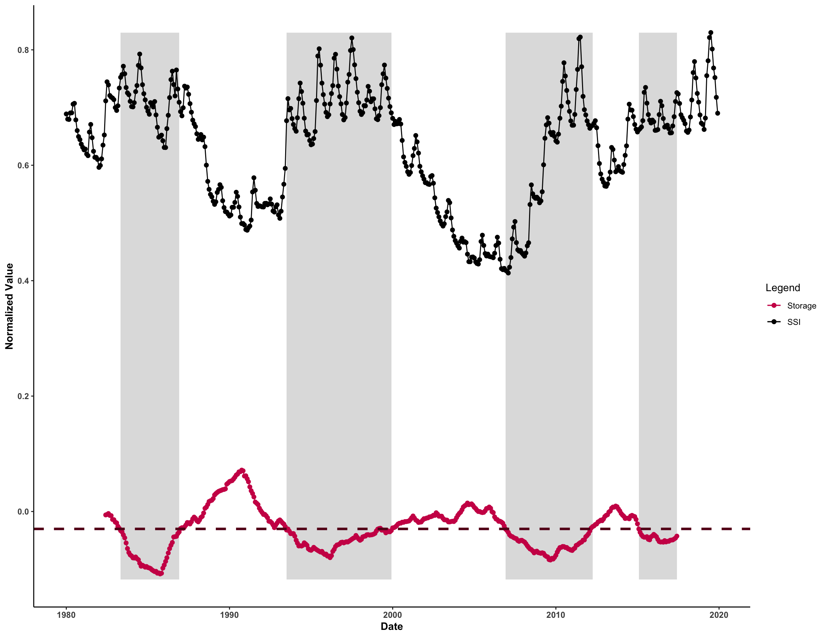
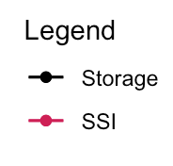

Used USGS reference gages to calculate Standardized Streamflow Index (SSI) and quantified time to recover for both SSI and storage
Recovery Ratio: $\frac{recovery_{stor}}{recovery_{SSI}}$
Recovery Ratio
Storage recovery time
Normalized Value
Recovery Ratio
SSI recovery time
Date
Notes:
Longest slide 1:40

Slide 10
The Western US’s storage ratio is 1.4 times more than the Eastern US
Average US recovery ratio is 2.3
More arid Western US had drought periods without storage recovery
Headwater and more humid regions that have more access to water supply recover much quicker than more downstream regions
Note: this data is preliminary
Notes:
Pick one main title point, spend time focused on the recovery ratio

Slide 11
Conclusion
Storage has declined in US over the past 40 years with more arid regions having sharper decreases
Across the US, storage takes longer to recover from drought and in the Western US many regions do not recover after a drought period
This historic analysis suggests that most regions in the US have lower resilience to drought and there is a potential for increased vulnerabilities in these regions

Slide 12


Thank you!
Please reach out to Jennie Steyaert: steyaertj@email.arizona.edu with questions

