Slide 1
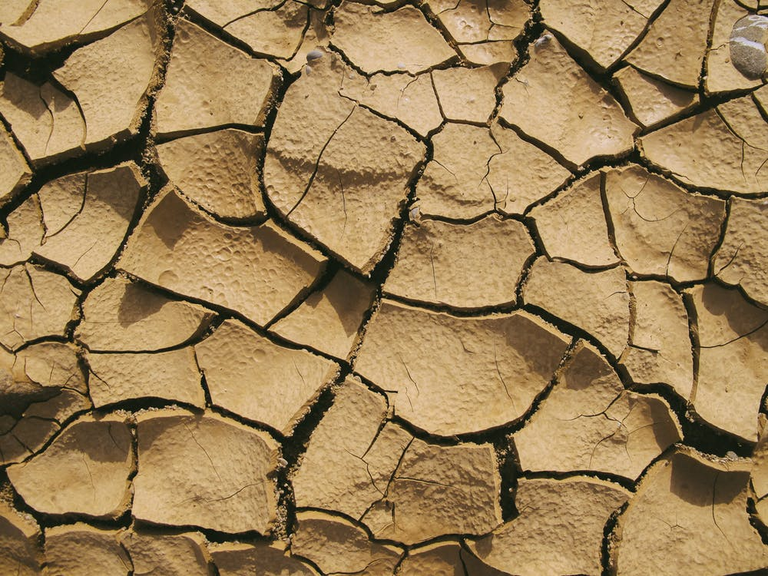
Aquifer Response Lag to Meteorological Droughts from GRACE Satellites

Slide 2
Background
Humans across the globe rely on groundwater for approximately 30% of our freshwater supply. In the United States, a third of the population relies on ground water for drinking water, and 60% of crop irrigation is sourced from ground water.
Drought events can increase our reliance on ground water through several avenues. Drought events reduce the amount of surface water available for use, as well as recharge for both surface and ground water. The reduction in surface water availability increases demand on ground water.
Climate change has added another layer to an already complicated issue. It has caused the frequency, duration, and intensity of drought to increase.
Background

Slide 3
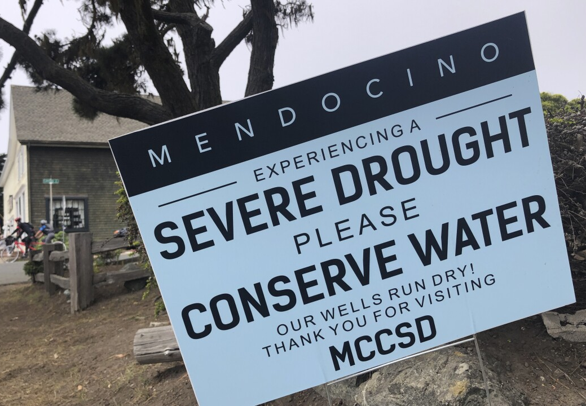
Previous Work
Previous works relating to droughts and groundwater have defined groundwater as a separate drought type from meteorological, hydrological, agricultural, and socio-economic droughts (Mishra & Singh., 2010).
Investigations of the propagation of droughts through the hydrologic system suggests the recharge time of groundwater following drought varies with the hydrogeologic characteristics of the area under examination (Motlagh et al., 2016).
While groundwater recharge rates are very important, there has been a lack of work using GRACE data to estimate groundwater recharge times after meteorological drought.
GRACE has been used to evaluate existing drought indices (Cammalleri et al., 2019) and create GRACE integrated drought indices (Meng et al., 2017), to assess the amount of water contained in aquifers and to identify groundwater depletion rates (Thomas and Famiglietti., 2019)., and to indicate when groundwater drought begins (Houborg et al., 2012).
Photo: Haven Daley, 2022

Slide 4
Research Questions
What is the lag time between the onset (and end) of meteorological and ground water droughts for major U.S. aquifer systems?
What are the main physical and anthropogenic factors controlling the nature of that gap?

Slide 5
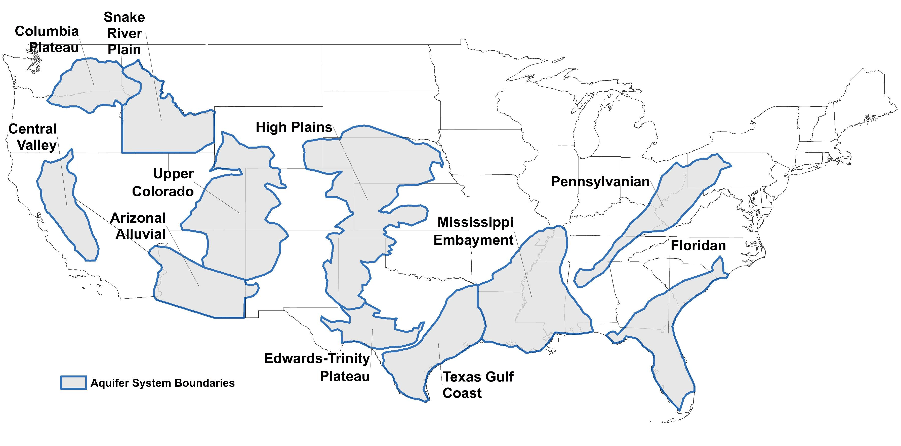
Study Area
We are applying these techniques to 11 major aquifer systems across the continental United States, representing some of the largest and most important aquifer systems in the United States, supporting many people through drinking water, irrigation, and other uses. In many of these systems humans and climate change have had a tremendous impact. These aquifer systems consist of:
Columbia Plateau
Arizona Alluvial
Snake River Plateau
Upper Colorado
Pennsylvanian
Mississippi Embayment
Texas Gulf Coast
Edwards-Trinity
Floridan
Central Valley
High Plains

Slide 6
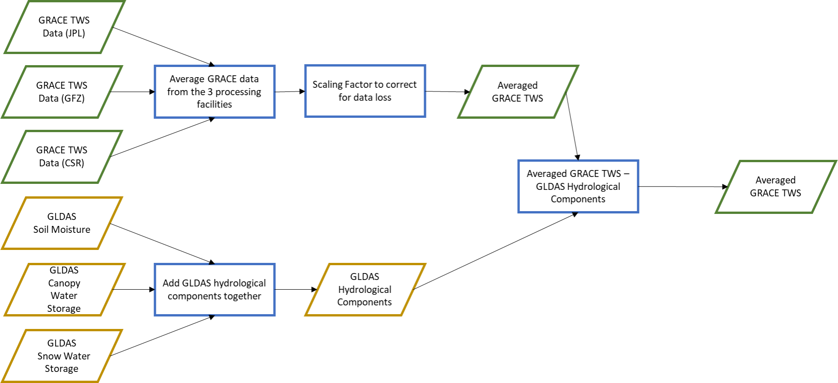
Methodology
We utilized the one-month Standardized Precipitation and Evapotranspiration (SPEI) data to identify the onset and end of meteorological drought during the study period in the aquifer systems. This was compared to the groundwater storage anomaly data, which was isolated by subtracting away GLDAS derived hydrological components from the Gravity Recovery and Climate Experiment (GRACE)’s total water storage anomaly.

Slide 7
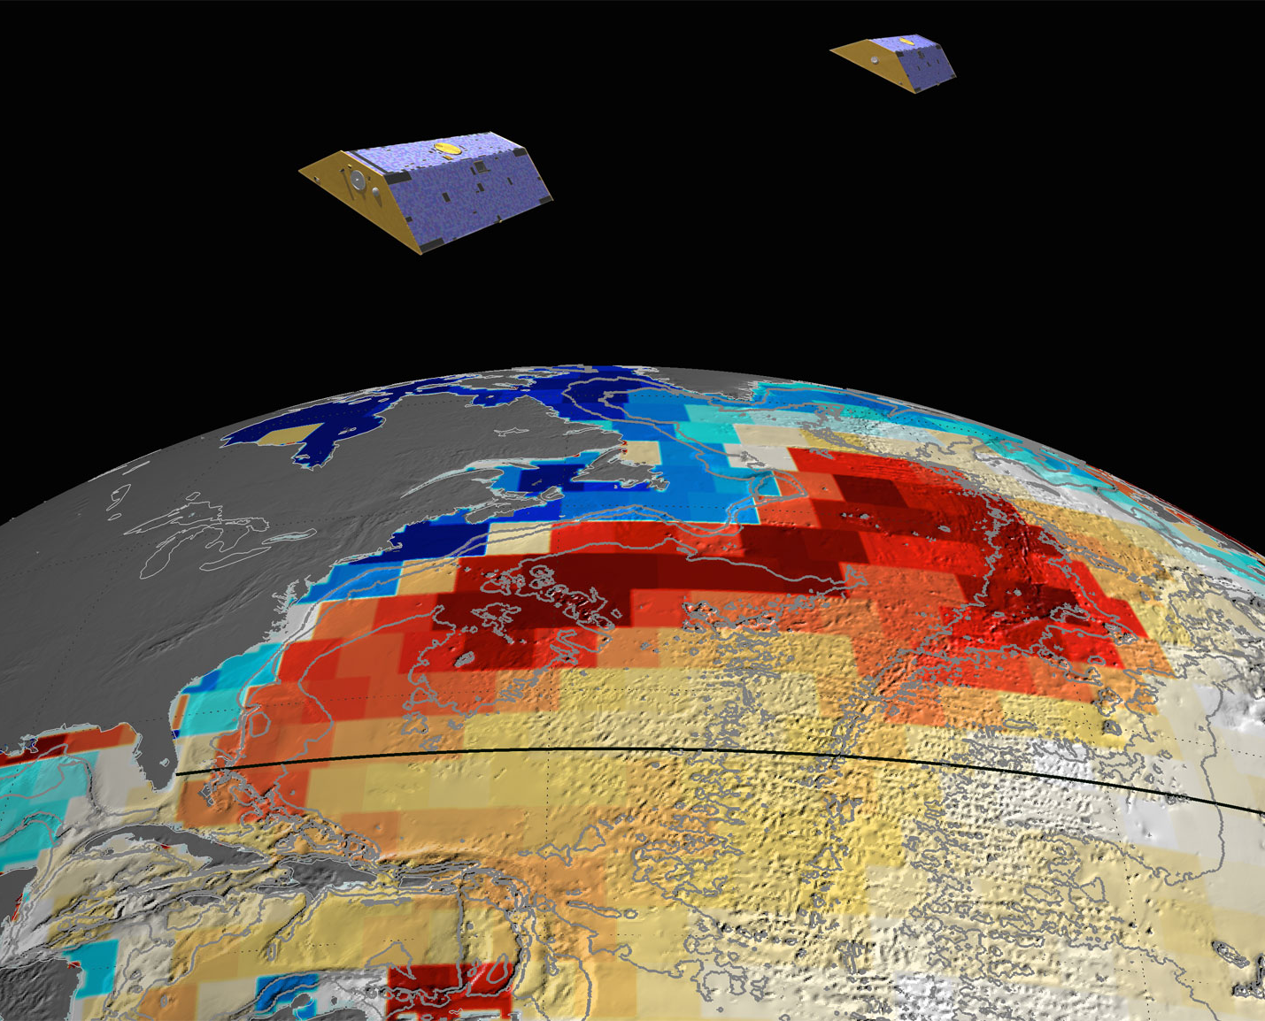
Preliminary Results
Every aquifer system except the Pennsylvanian (zero SPEI indicated drought events) had meteorological drought occur on a one-month scale at least three times, with the Central Valley aquifer system of California topping out at 15 drought events.
There is a temporal gap in GRACE and its successors (GRACE-FO) data from June 2017 to June 2018, and five of the selected aquifer systems had drought events within this timeframe.

Slide 8
Preliminary Results
Aquifer System | Drought Start Lag Mean | Drought Start Lag Standard Deviation | Drought End Lag Mean | Drought End Lag Standard Deviation
Central Valley | 0.4 | 0.8 | 0.2 | 1.7
Texas Gulf Coast | 0.4 | 0.5 | 0.2 | 2.3
Arizona Alluvial | 0.5 | 0.5 | 0.5 | 1.6
Edwards-Trinity | 0.7 | 0.5 | 0.6 | 1.3
Columbia Plateau | 0.0 | 0.0 | 1.0 | 1.4
Floridan | 1.0 |  | 1.0
High plains | 0.5 | 0.6 | 1.5 | 1.3
Mississippi Embayment | 0.3 | 0.5 | 1.8 | 3.1
Snake River Plain | 0.0 | 0.0 | 2.5 | 2.1
Upper Colorado | 0.7 | 0.6 | 4.3 | 4.0
Ground water response to the metrological drought is characterized by the ground water storage drought start, the lag time between meteorological drought start and ground water drought start, the ground water drought end and the lag time between meteorological drought end and ground water drought end.
The Central Valley, Texas Gulf Coast, Arizona Alluvial and the Edwards-Trinity aquifer systems all resulted in ending lag times with a mean of under 0.6.
All but the Texas Gulf Coast aquifer system resulted in similar standard deviations for the lag time between drought end and aquifer system recharge.

Slide 9
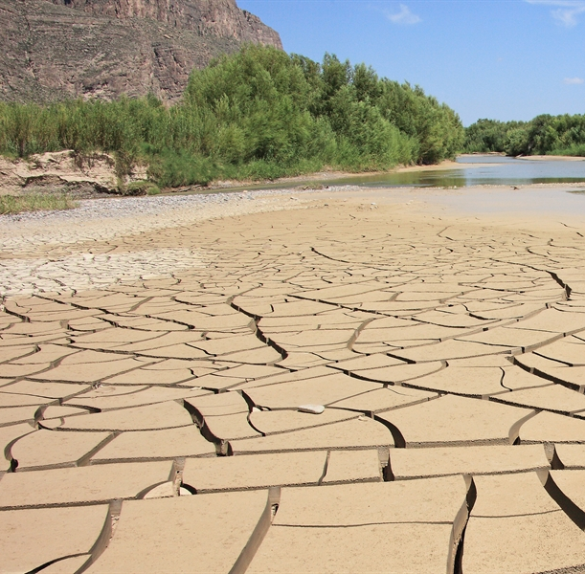
Next Steps
Results are varied, which was expected. All aquifer systems differ spatially and lithologically, as well as undergo differing amounts of human withdrawal of ground water.
From this point, we will be examining the aquifer systems and will attempt to relate aquifer system characteristics to our results.

Slide 10

Contact Information
Brielle Paladino, Department of Geosciences, Middle Tennessee State University
bkp3j@mtmail.mtsu.edu

