Slide 1
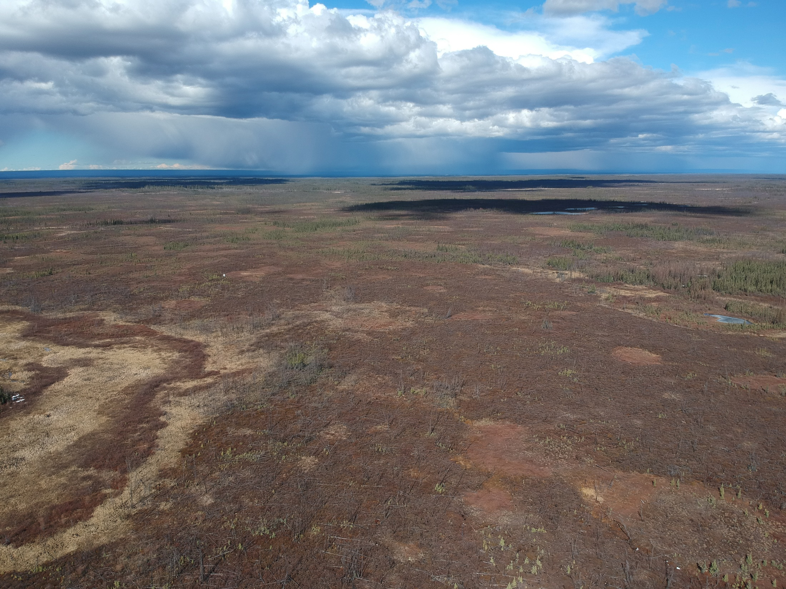





Out of the Dark, into the Light? Influence of Wildfire and Thermokarst on CO2 Fluxes from Boreal Peat Landscapes near the southern Limit of Permafrost in northwestern Canada
Christopher Schulze^{1,2} (cschulze@ualberta.ca), David Olefeldt², Craig Emmerton^{2,3}, Lorna Harris², Natascha Kljun⁴, Laura Chasmer⁵, Chris Hopkinson⁵, Matteo Detto⁶, Manuel Helbig¹, Gabriel Hould Gosselin¹, & Oliver Sonnentag¹
¹Université de Montréal ²University of Alberta ³Alberta Environment and Parks ⁴Lund University ⁵University of Lethbridge ⁶Princeton University
EGU General Assembly
May 26th, 2022
@rappeatloaf
Notes:
Out of the Dark, into the Light? I named my presentation here and my PhD thesis at University of Alberta according to a song from a famous musician from Vienna, called Falco. Our piece of research here aimes at quantifying how much carbon is lost from the dark ground, into the light atmosphere.

Slide 2
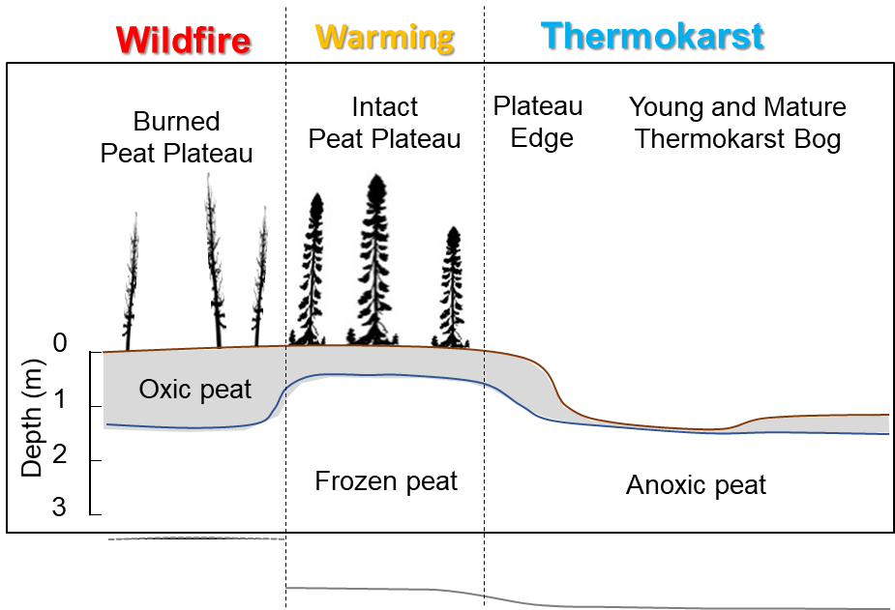
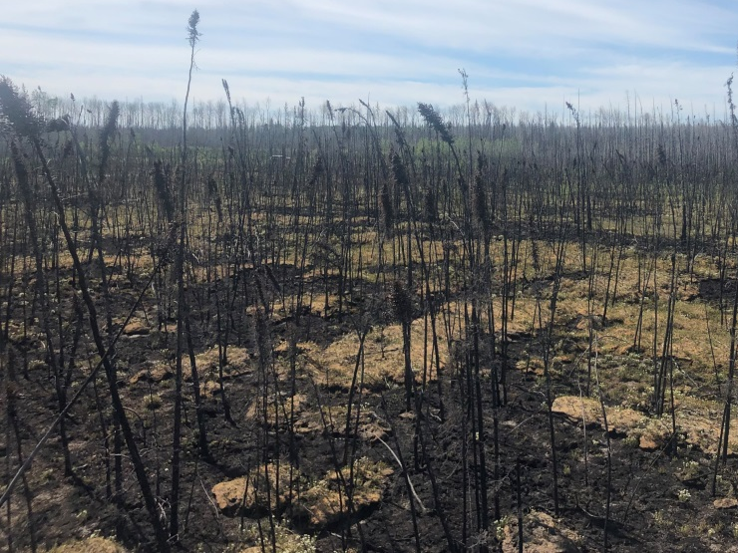
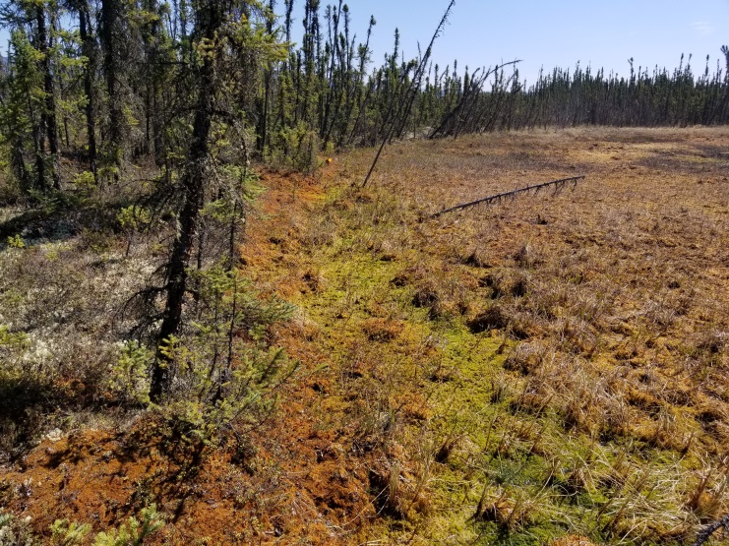
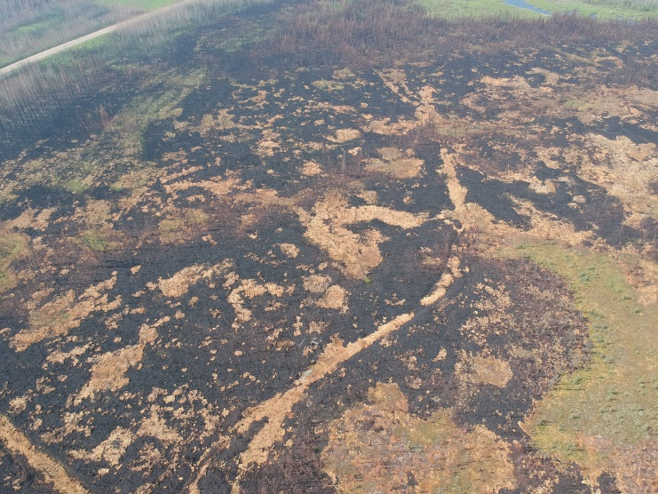
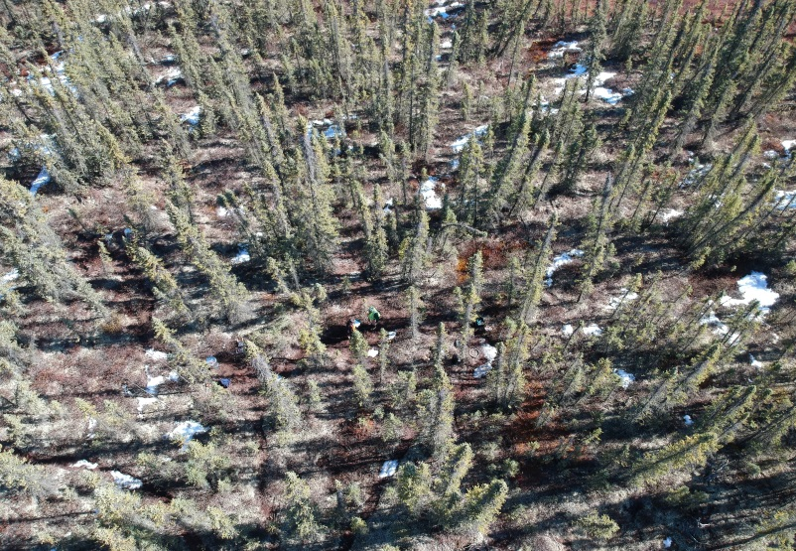
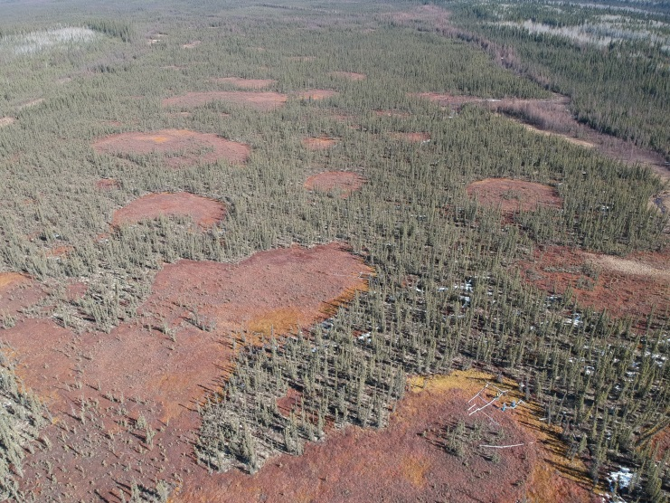
Introduction
Agents of Changes in Boreal Peat Landscapes
Intact
Wildfire
Intact
Thermokarst
Notes:
With ongoing climate warming which is particularly pronounced in the northern circumpolar region, two agents of change are currently transforming the Boreal Peat Landscapes of northwestern Canada: wildfire and permafrost thaw or Thermokarst. Obvious consequences after wildfire are that there is almost no living vegetation left, soil temperatures are higher as there is no shading anymore and the oxic peat layer is deeper compared to intact peat plateaus towards the end of the growing season. In contrast, following thermokarst, the peat is rather anoxic due to a high water table but there is active live vegetation, mostly Sphagnum mosses.

Slide 3
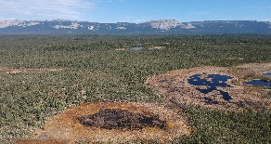
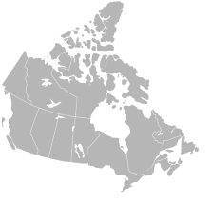
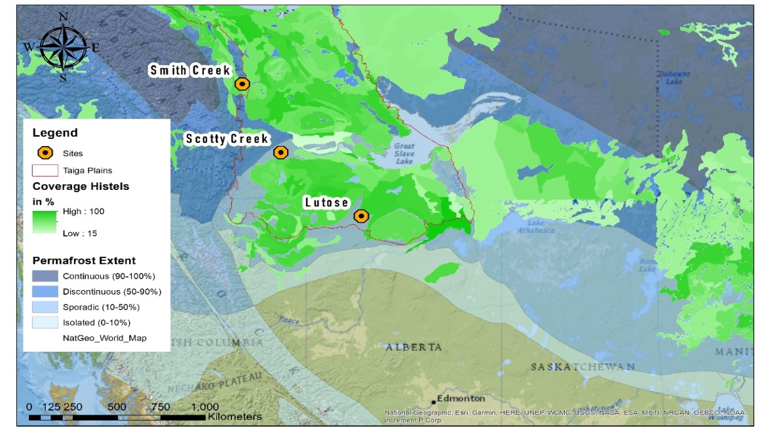
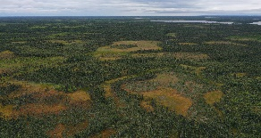
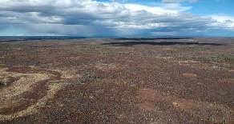
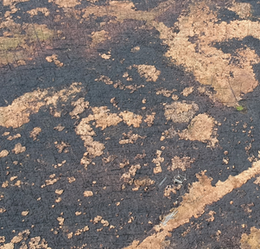
Introduction
Four Peatland Sites with Eddy Covariance in Canada
Smith Creek
Discontinuous Permafrost
Scotty Creek
Sporadic Permafrost
Lutose
Thermokarst landscape
Thermokarst landscape
Burned in 2007
Burned in 2019
Notes:
And we acknowledge that these studies were carried out on lands of Indigenous peoples including the Pen-zaa-key First Nation and Lid-lee-Quay First Nation Communities who allowed us to install and run four Eddy Covariance Towers on their land at all four sites. All of these four research sites are also within the same Ecozone, called Taiga Plains. This Ecozone has a lot of Permafrost Peatlands which store vast amounts of carbon.

Slide 4
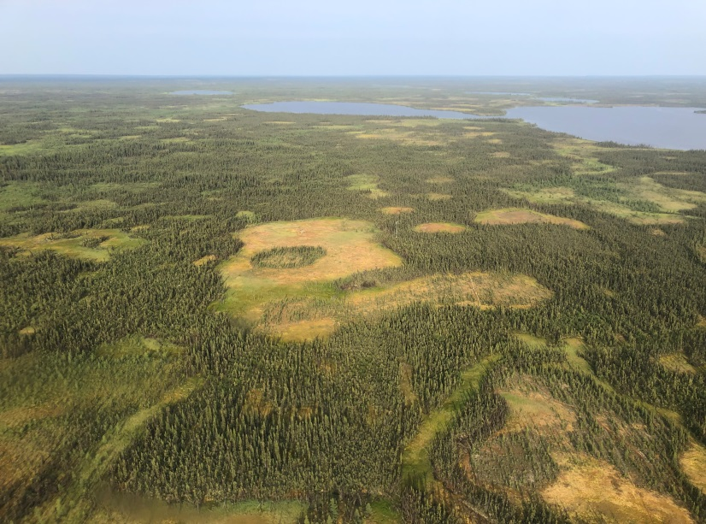
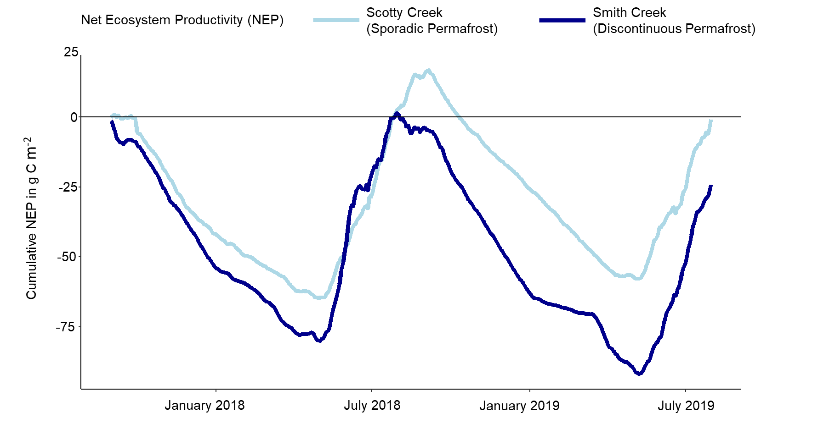
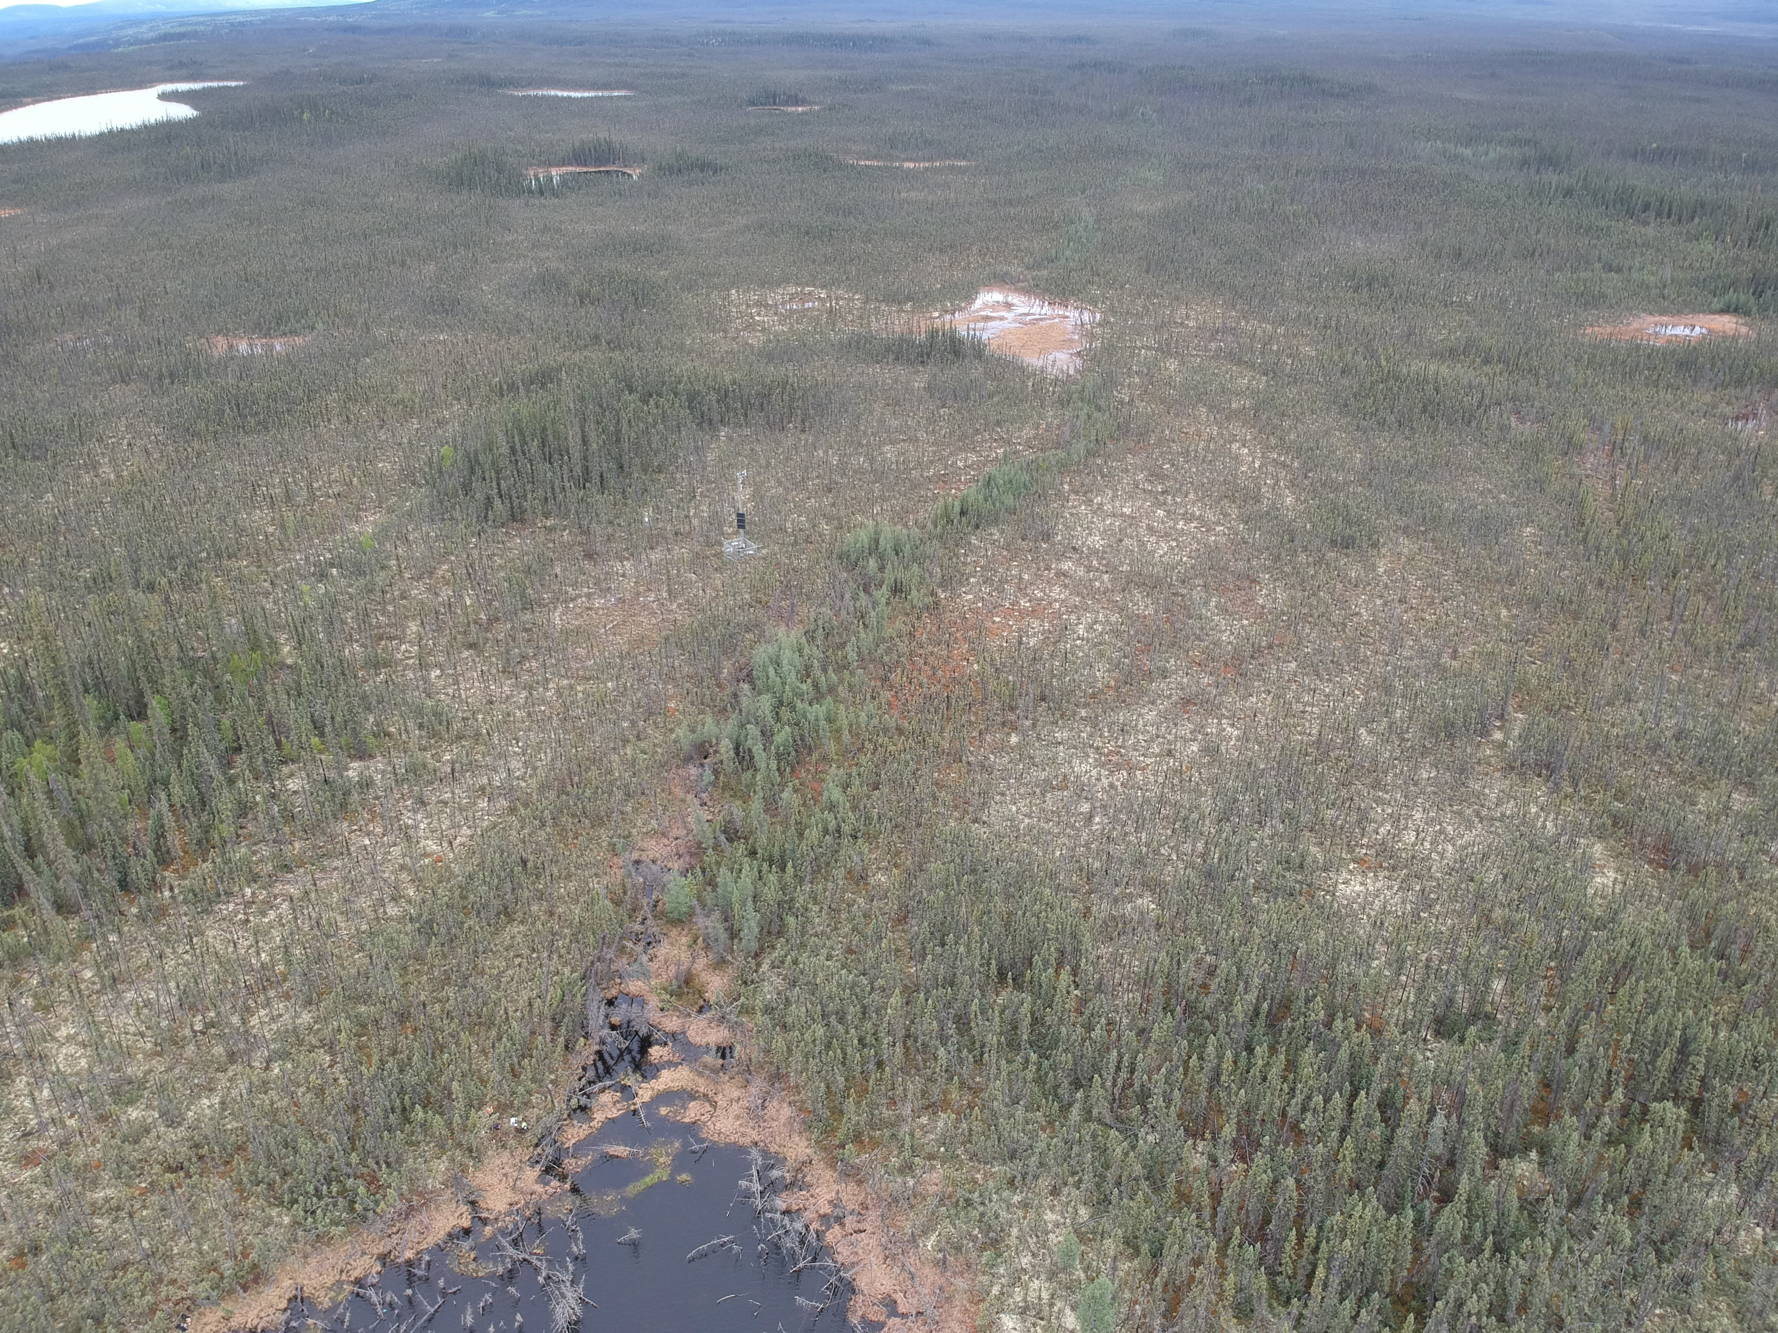
Introduction
Results
Influence of Permafrost Extent
Scotty Creek
Sporadic Permafrost
Smith Creek
Discontinuous Permafrost
Notes:
In a first study, we investigated the difference in Net Ecosystem Productivity between two sites with different extends of permafrost, the more northern, discontinuous site Smith Creek which was established in 2017 against the sporadic permafrost site Scotty Creek where research has been going for over 30 years. Smith Creek has more of these intact permafrost peat plateaus in the landscape whereas Scotty Creek has more of these treeless, permafrost-free bogs in the eddy covariance tower fetch. First and main point is that both sites are very similar in NEP over two years.
Smith Creek has a steeper increase in NEP during spring as well as higher decrease in NEP in fall due to the shorter growing season and light limitation towards fall, as it is just further north.

Slide 5
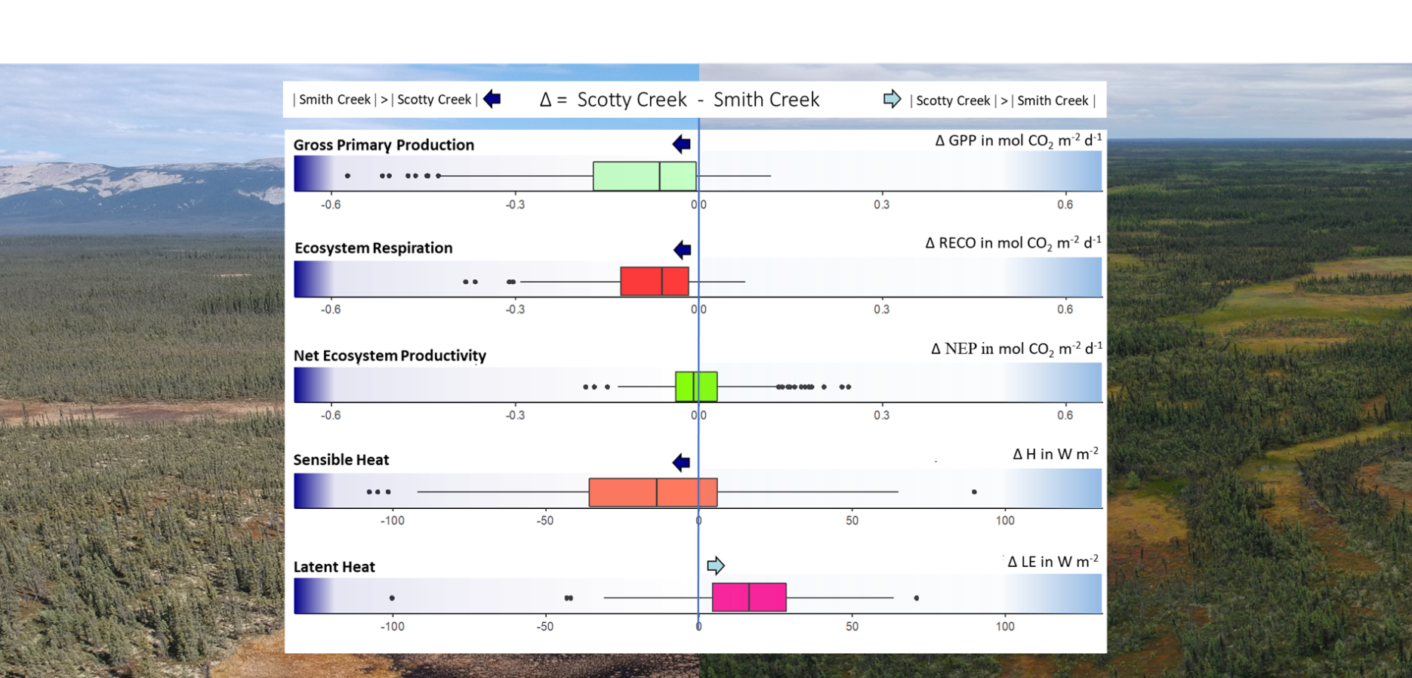
Introduction
Results
Similar NEP – but Component Fluxes were distinct
Smith Creek (discontinuous permafrost) had
Greater Gross Primary Production (GPP)
Greater Ecosystem Respiration (ER)
Greater Sensible Heat Flux
Lower Latent Heat Flux
than Scotty Creek (sporadic permafrost)
5
Notes:
However, there is no major significant difference in NEP between the two sites whereas all other component fluxes were distinct. GPP, ER and Sensible Heat Flux were larger at Smith Creek, only the latent heat flux was higher at Scotty Creek due to the larger extent of thermokarst wetlands in the landscape. The higher soil moisture in the thermokarst bogs that are more prevalent at Scotty Creek is the reason for this. With more moisture available for evaporation, we have the shift from sensible to latent heat. All of this is in agreement with former studies from Manuel Helbig et al. who used a nested eddy covariance to compare wetland vs overall landscape at Scotty Creek.

Slide 6
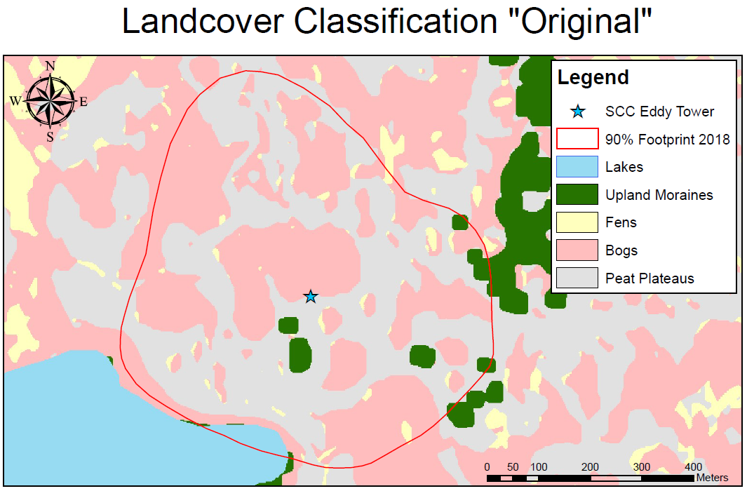
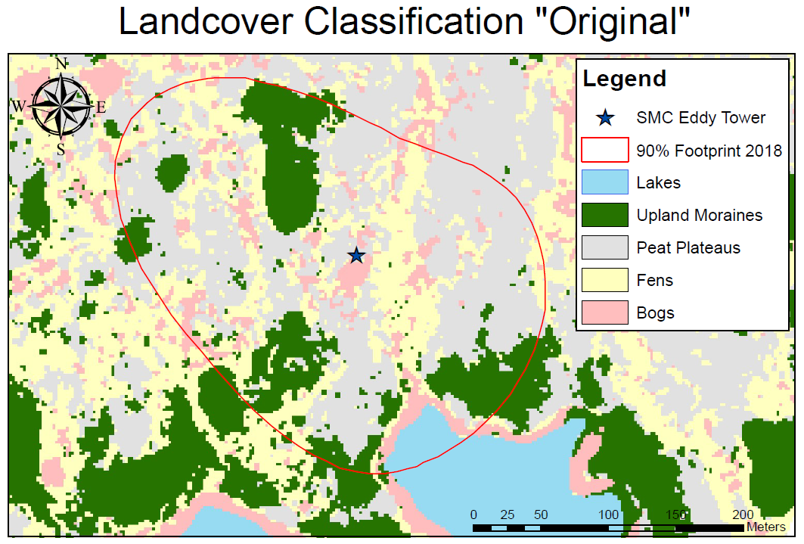
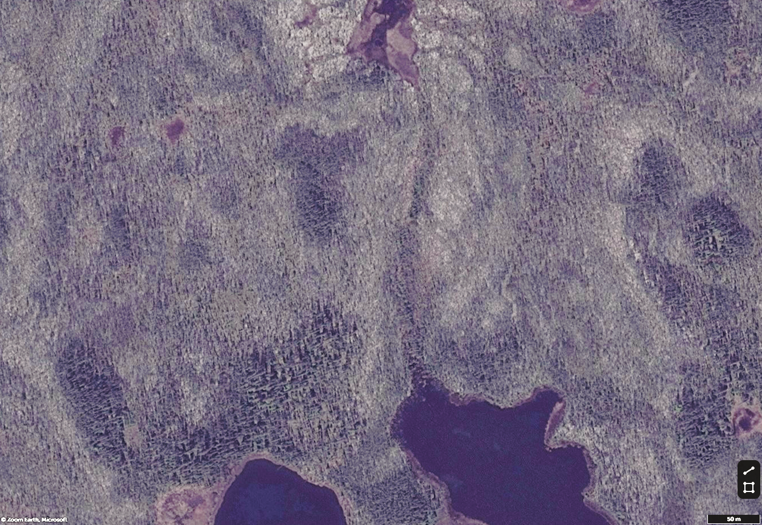
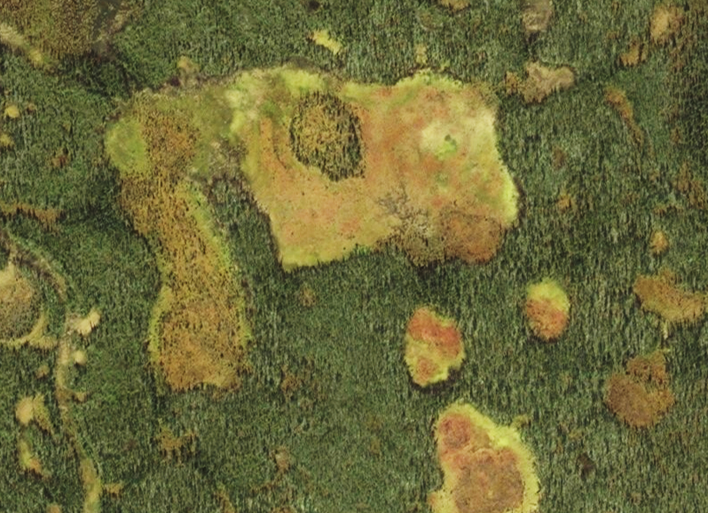
Introduction
Results
Flux Footprint at Smith Creek (Discontinuous Permafrost)
a) Satellite Image
b) Drone Image
c) Landcover Classification
d) Smith Creek Light Response Curves during June & July
20
15
Contribution of Upland Moraines to Flux
30 %
10
GPP in umol CO2 m⁻² s⁻¹
20 %
20 %
10 %
10 %
5
> 25 %
15 - 25 %
5 - 15 %
0
< 5 %
0
500
1000
1500
PPFD in umol m⁻² s⁻¹
Notes:
The minor differences in 2 year NEP between the two sites may actually be linked to the role of these upland moraines and thus that the peatland NEP is even more similar than you would expect given the north-south gradient. At Smith Creek, the peat layer is more shallow at certain places so we have upland moraines with larger trees in the footprint that have higher photosynthetic capacities than the surrounding landscape, visible in these steeper light response curves with increasing contribution of upland moraines to the landscape flux. So this likely led to the higher GPP and Ecosystem Respiration compared to Scotty Creek. However, these upland moraines did not cause a higher net productivity of Smith Creek compared to Scotty Creek.

Slide 7
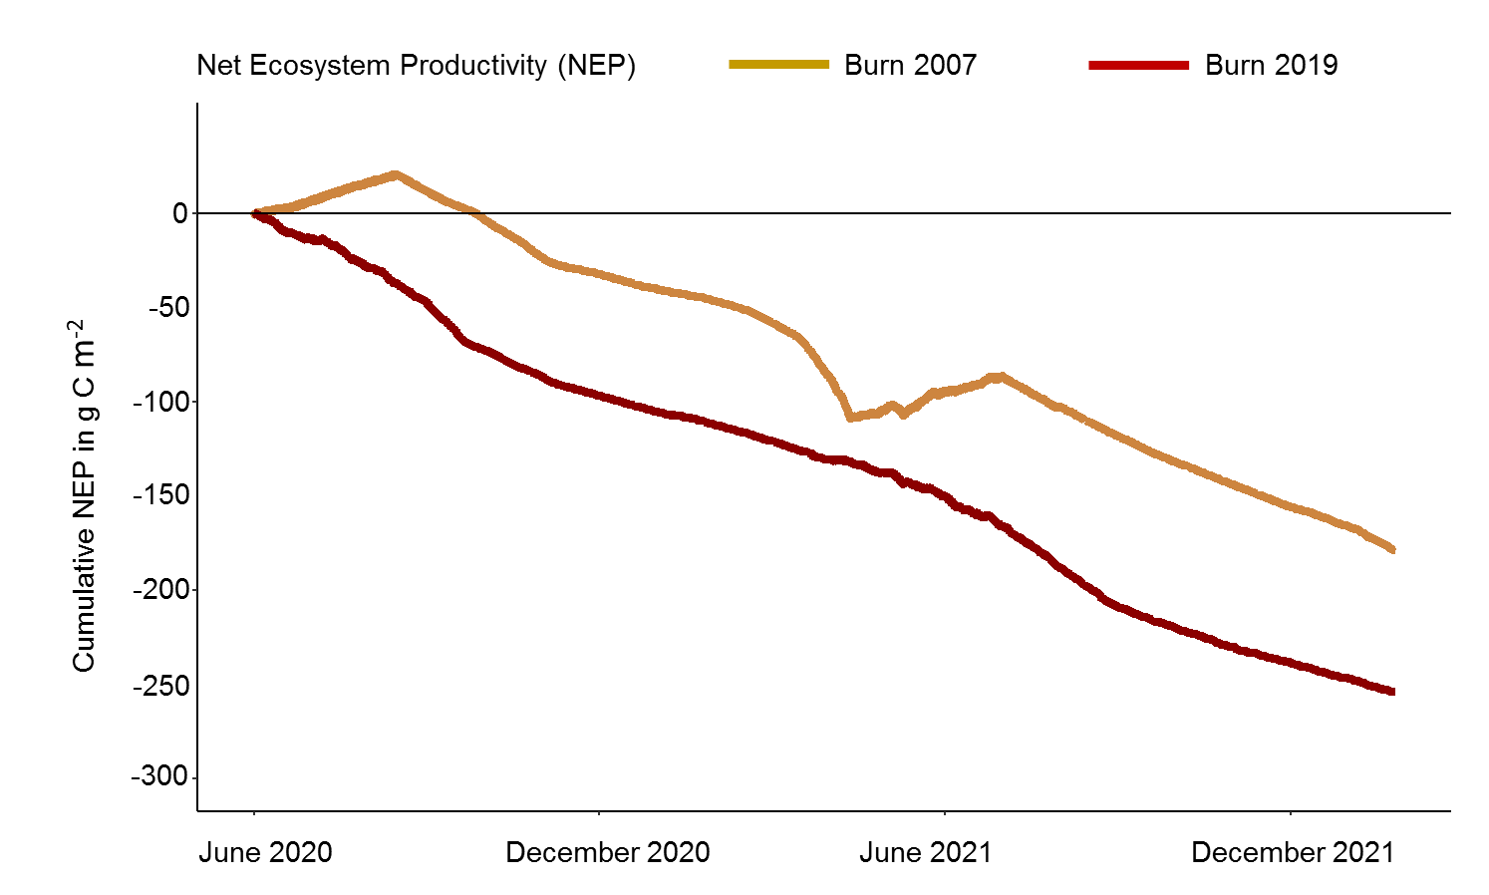
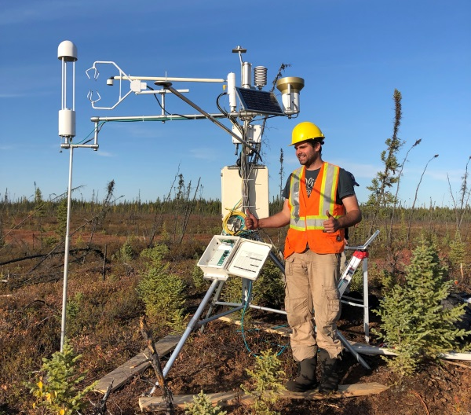
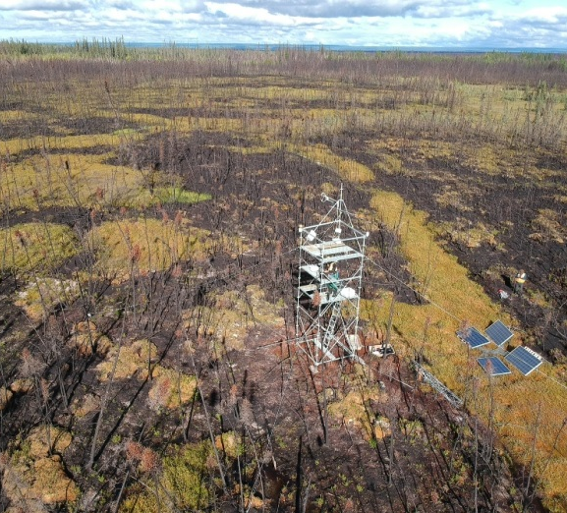
Introduction
Results
Impact of Wildfire on NEP
Burned in 2007
Large CO₂ losses from burned Permafrost Peatlands,
sustained for >15 years after fire.
Burned in 2019
Notes:
So now to the wildfire-affected sites around our third research site Lutose. These two sites are only 15 km apart from each other, but they burned in different years. As soon as we saw the recent fire in 2019, we established one eddy tower at the recent burn sites, and another one on a long-term research site of my lab group, which had burned in 2007 already. Both wildfire-affected peatlands were major carbon sources. 15 Years after Wildfire, the 2007 Burn Site has at least slowly recovered to a carbon sink during peak season in June and July. But the vegetation recovery after wildfire is very slow due to the nutrient poor conditions - and that those black spruce trees on the right top image are almost 15 years old. At both sites, we measured the largest carbon losses during fall, where soil temperatures are still high, the active layer is deep and sunlight yields are low. Compared to intact unburned sites, the burned sites’ active layer is much deeper and warmer - which we know from other studies leads to release of old carbon.

Slide 8
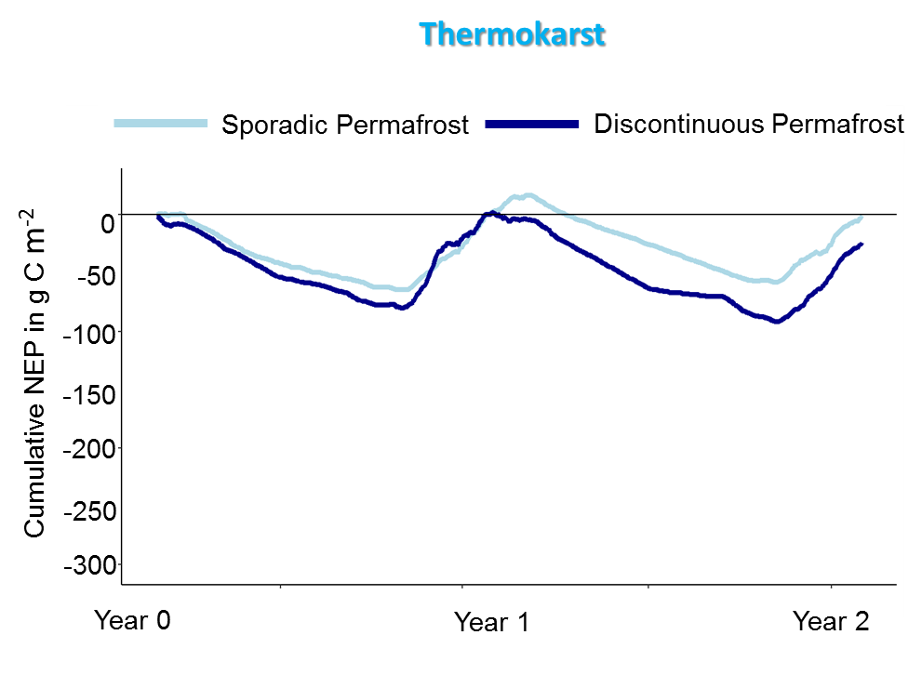
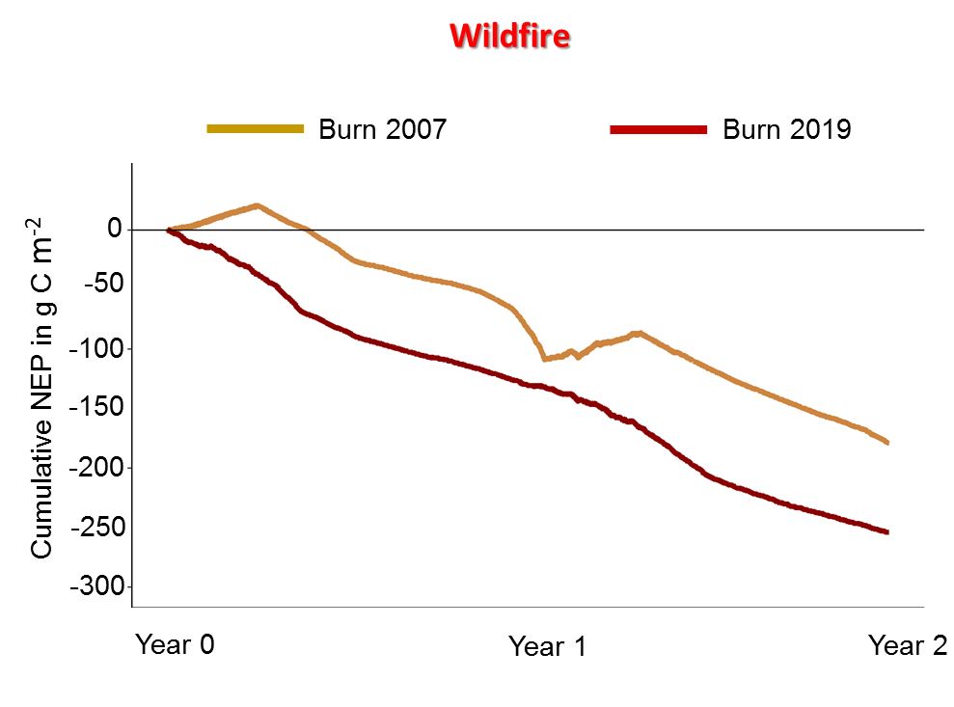
Introduction
Results
Conclusions
Conclusions
Minor Influence of Permafrost Extent on NEP
- However, Component Fluxes (GPP, ER) differed
- Greater Impact on Energy Balance than NEP from Thermokarst
Wildfire leads to >15 years of CO₂ Losses
- Estimated Carbon Losses of 130 g C m⁻² year⁻¹
- Cumulative losses similar to Combustion during Wildfire
Overall: in these permafrost peatland ecosystems in northwestern Canada,
Thermokarst has less effect on the CO2 balance than Wildfire
Notes:
Long-term Net Ecosystem Productivity is the same for the two sites with different extends of permafrost, suggesting that Thermokarst does not have a huge impact on the Carbon dioxide balance but it has other implications (Latent Heat Flux; Sensible Heat Flux). Even though the sites have differences, further thermokarst at Smith Creek is unlikely to have a big impact on the Net Ecosystem Productivity. In contrast, sites affected by wildfire turn into long-term carbon sources and we quantified losses as high as 260 g C m2 in the first two years. With the fact that these sites only recover slowly and still emit around 100 g Carbon per year 15 years after fire, we can say with confidence that these ecosystems lose more carbon in the years after fire than in the actual wildfire itself.

Slide 9
Thank you all for your attention
Christopher Schulze^{1,2} (cschulze@ualberta.ca), David Olefeldt², Craig Emmerton^{2,3}, Lorna Harris², Natascha Kljun⁴, Laura Chasmer⁵, Chris Hopkinson⁵, Matteo Detto⁶, Manuel Helbig¹, Gabriel Hould Gosselin¹, & Oliver Sonnentag¹
¹Université de Montréal ²University of Alberta ³Alberta Environment and Parks ⁴Lund University ⁵University of Lethbridge ⁶Princeton University
EGU General Assembly
May 26th, 2022
@rappeatloaf
Notes:
Out of the Dark, into the Light? I named my presentation here and my PhD thesis at University of Alberta according to a song from a famous musician from Vienna, called Falco. Our piece of research here aimes at quantifying how much carbon is lost from the dark ground, into the light atmosphere.

