Slide 1
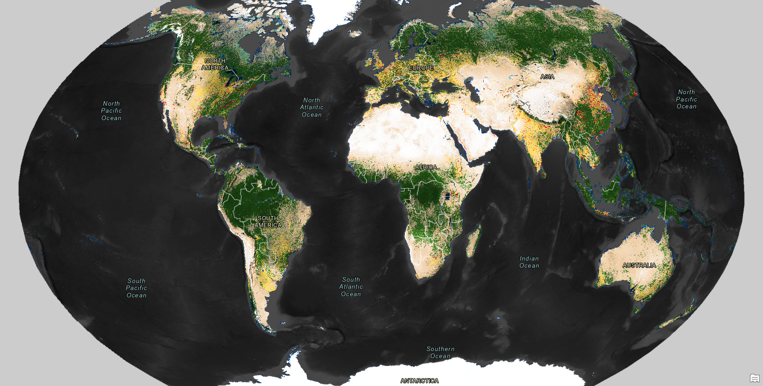
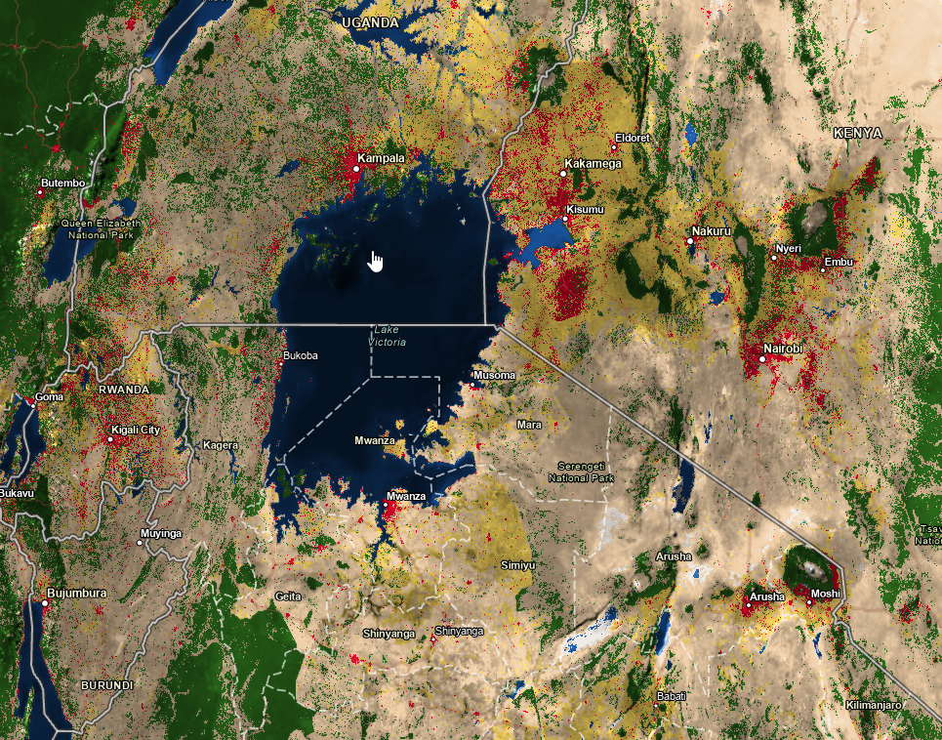
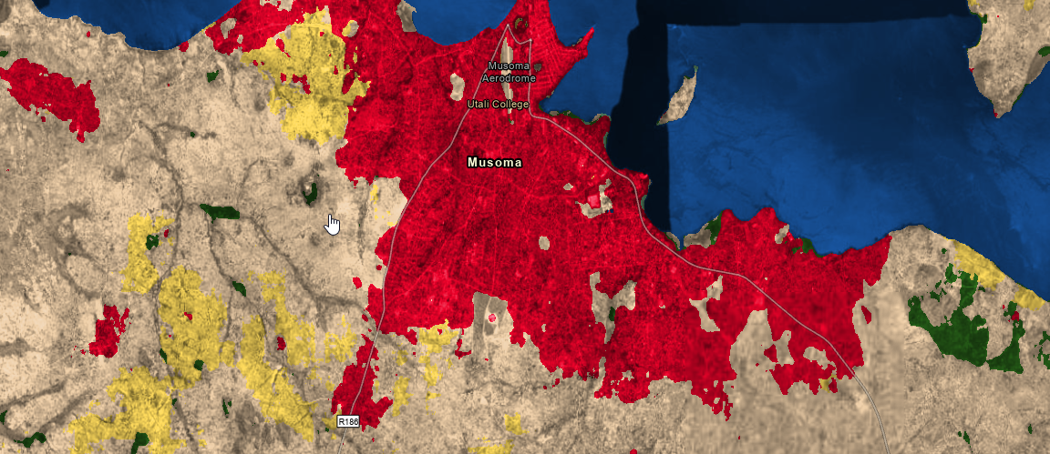
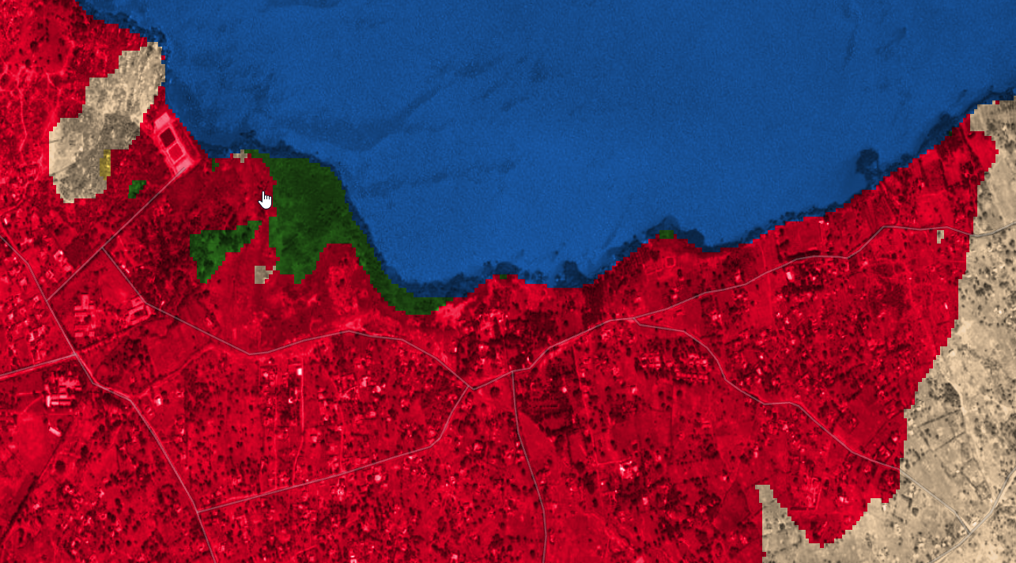

Mapping the World at 10m: A Novel Deep-Learning Land Use Land Cover Product and Beyond
Sean Breyer, Esri Living Atlas Program Manager
Notes:
Esri Corporate Template-Dark v3.4
16:9 version – January 29, 2017
For more templates, sample files, and icons, see https://compass.esri.com/resources/presentations/Pages/Main.aspx
To add footer text in Windows
On the Home tab, under Insert, click Text, and then click Header and Footer.
Click the Slide tab, select the Footer check box, and then type the footer text that you want.
Click either Apply or Apply to All.
To add footer text on a Mac
On the View menu, select Header and Footer.
Select the Footer check box and then type the footer text that you want.
Click either Apply or Apply to All.
If footers don't appear on the slides
If footers don't appear on title slides, in the Header and Footer dialog box make sure the Don't show on title slide check box is not selected.
If the footers are missing from other slides, the placeholders for these items might have been removed from specific slide layouts or the slide master.

Slide 2
This Approach for Deep Learning for Land Use/Land Cover
Label Data and Training
  7,200 5 km x 5 km training sites were reviewed and classified by three independent reviewers.
  Label data sites were distributed across all 14 major biomes and across all continents.
  Training used the same Sentinel-2 imagery used by the reviewers and included all Sentinel-2 bands.
  For training we employ a fully convolutional neural network with a UNet architecture to classify each individual image into 10 categories
Inferencing
  All 2020 Sentinel-2 images and all bands were used representing about 2 Petabytes of data.
    Areas with significant cloud cover were not used in evaluation.
    Then the predominate category was used in the annual summary.
  10,000 low compute cycle CPU’s in Azure Batch (5 days)
Validation Data
  1100 5km x 5km training sites were held back validation testing (~16%)

Slide 3
Results of this Deep Learning approach for Land Use/Land Cover
Accuracy Assessment
  The 2020 map has a 85.4% accuracy when compared to strict consensus.
Precision reports the fraction of predictions that were
correct. e.g. - of all the pixels that were classified to a
category for example water
Recall reports the fraction of validation examples that
were correctly classified, e.g.- of all the water pixels in the
validation set, how many were classified as water?

Slide 4
Land Use/Land Cover Deep Learning Approach - Confusion Matrix Results
Confusion Matrix
The results show highest confidence in built areas, water,
trees, flooded vegetation, crops, rangeland, and bare ground
We do note that pixels labeled “bare” are often conflated with
“rangeland”. Both of these classes present in a multitude of ways
spectrally and due to their class ambiguity are more prone to
confusion. Pixels labeled “rangeland” are occasionally misidentified
as “trees” which is sensible given the spectra of vegetation in
both of these classes.

Slide 5
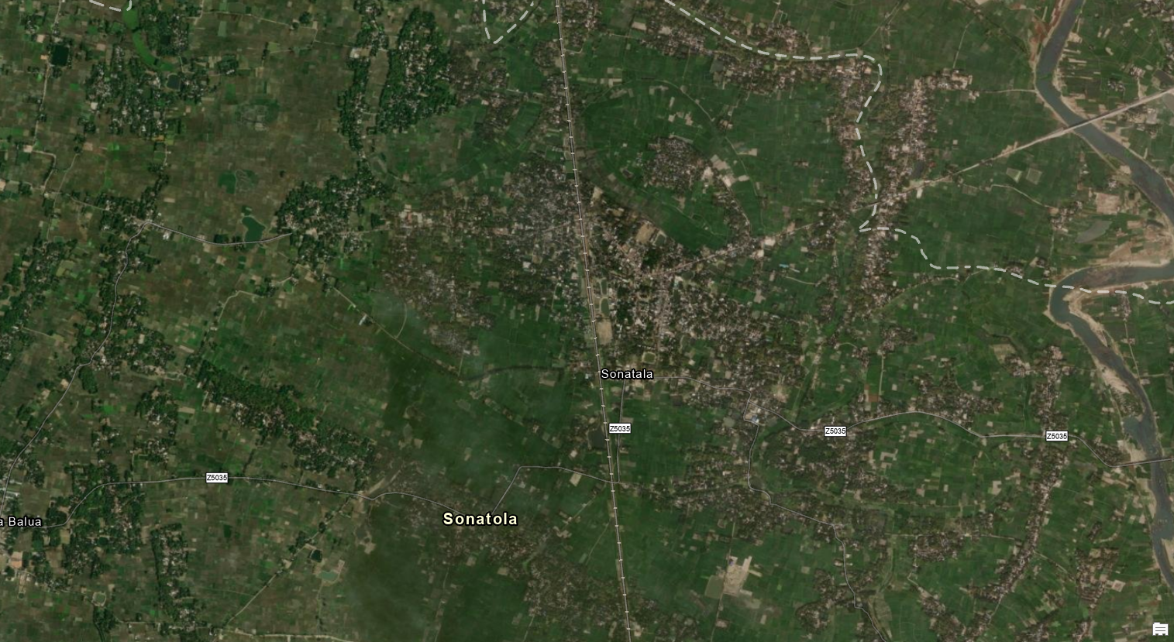
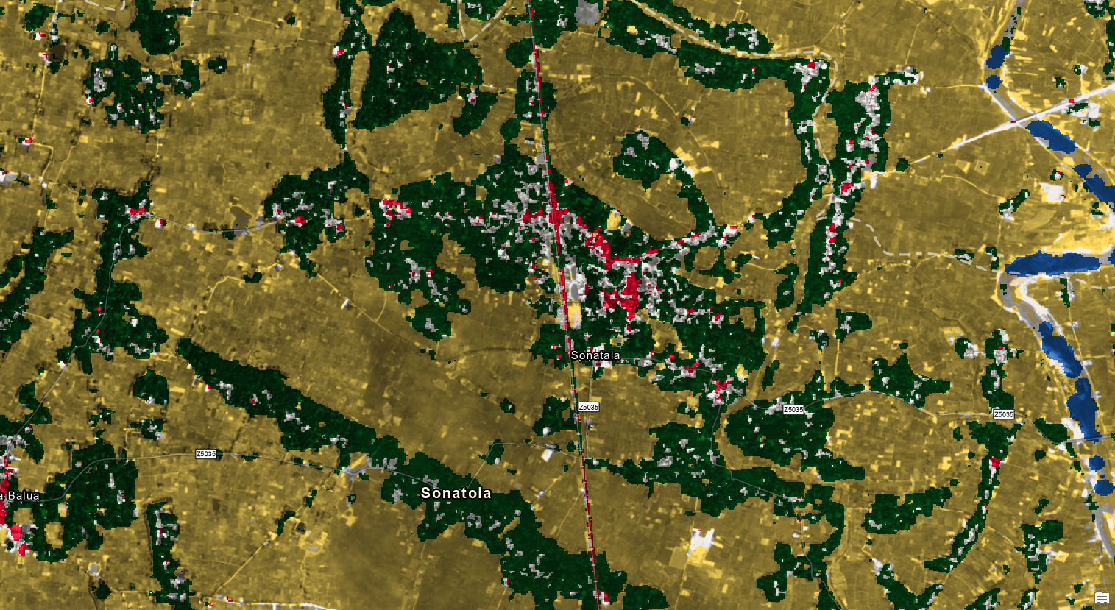
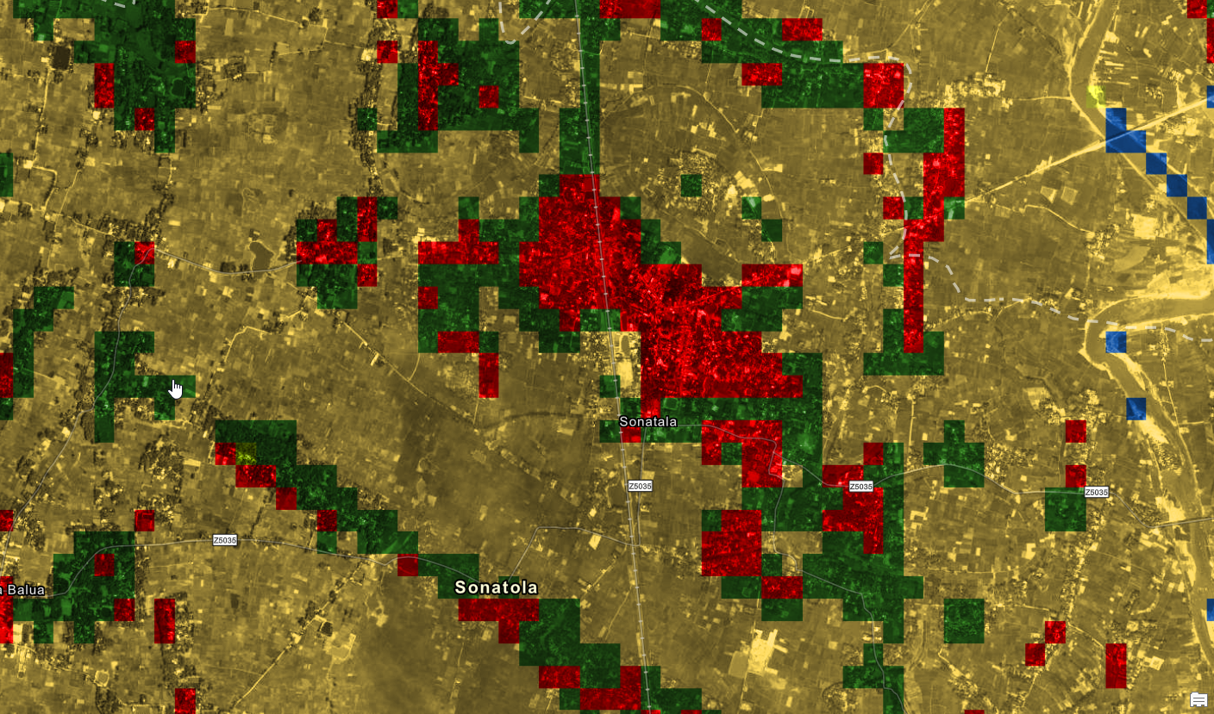
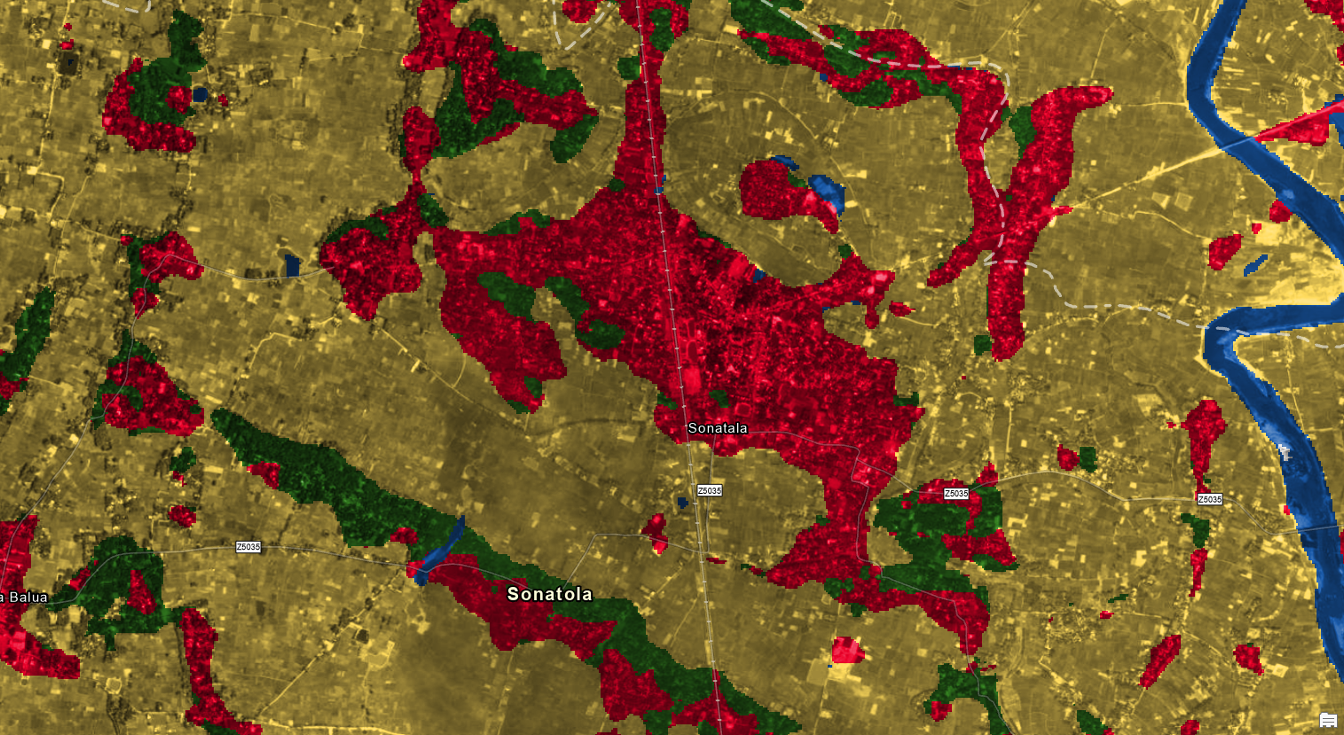
Resulting Land Use and Land Cover maps (Example Sonatala, Bangladesh)
Esri Imagery Basemap 2020
10 m ESA WorldCover 2020 Land Cover
2019 Copernicus Global Land Service: Land Cover 100m
10m Sentinel 2020 Land Use/Land Cover - Esri

Slide 6
What’s Next for 10m Land Use/Land Cover
Since the 2020 map launch
  The team has extented this same deep learning approach to create a globally consistent time series. (2017-2021) with change detection for 2017-2021, 2018-2021, 2019-2021, and 2020-2021
  We will soon launch a Land Use/Land Cover on demand capability. This can include change detection from the previous year or alternate date.
Next Work
  Improve results in bare and rangeland classes we are evaluating the addition of Sentinel-1(Radar) in the deep learning process to improve under performing classes.
Feb 2023
  We will add the annual 2022 land use/ land cover map to the open data series.

Slide 7



Thank You
Sean Breyer, sbreyer@esri.com
DOI: 10.1109/IGARSS47720.2021.9553499
Open Data Access: LivingAtlas.arcgis.com/landcover/

