Slide 1

Using X-ray imaging to find the magnetopause location
Andrey Samsonov¹, Steven Sembay², Jennifer Carter², Graziella Branduardi-Raymont¹, Andrew Read²
¹Mullard Space Science Laboratory, UCL, UK
²Leicester University, UK

Slide 2
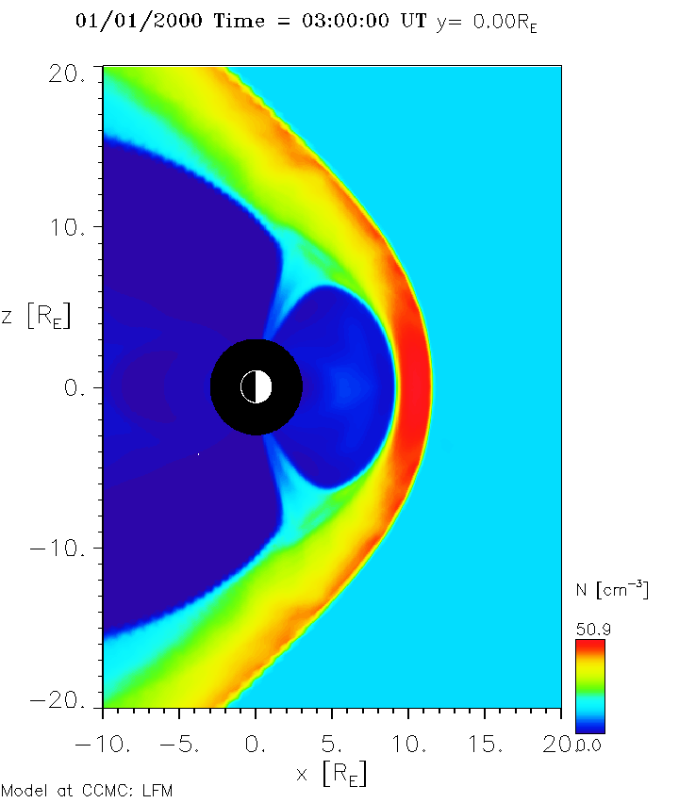
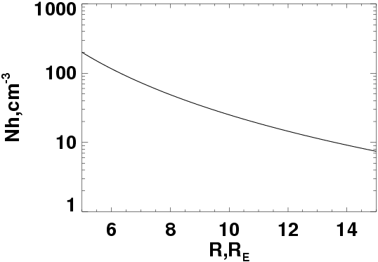
X-rays resulted from Solar Wind Charge Exchange
An example of typical reaction: O⁷⁺ + H → O⁶⁺ + H⁺ + hν
X-ray emissivity
where α ≈ 10⁻¹⁵ eV cm² (interaction efficiency factor),
N_{sw} – solar wind density (from MHD), N_{H} – exospheric neutral density (from empirical models)
Nsw in MHD
MP
BS

Slide 3
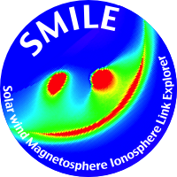


SMILE
Solar wind Magnetosphere Ionosphere Link Explorer
CME ➔
Credit: ESA
Notes:
SMILE is a SCIENTIFIC mission that will investigate … never attempted before.
Consider the impact of a CME arriving at the Earth. It will compress the magnetosphere and for favourable conditions of magnetic field orientations solar wind plasma will penetrate in the magnetosheath. We know that soft X-rays are produced in the dayside magnetosheath and the cusps by the process of SWCX.
The ultimate consequences are geomagnetic storms and particle precipitation into the polar regions, where the aurorae are the footprints of this whole interaction.
So SMILE combines global X-ray imaging of the dayside magnetosheath and the cusps, simultaneous UV imaging of the Northern aurora and in situ monitoring of the solar wind and magnetosheath conditions from a highly elliptical northern polar orbit that takes it out to 19 Earth’s radii.

Slide 4
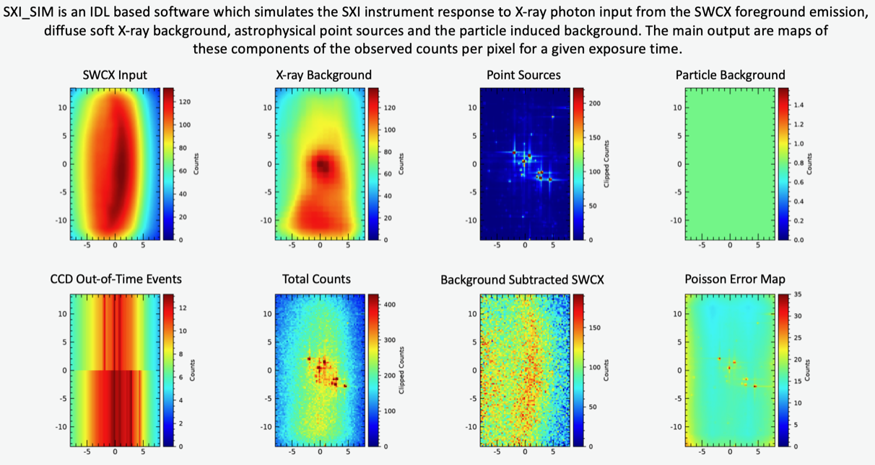
Emissivity integrated from SMILE position along Line of Sight
SXI_SIM code developed at Leicester University
SMILE

Slide 5
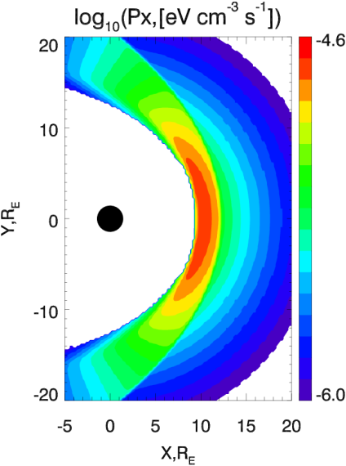
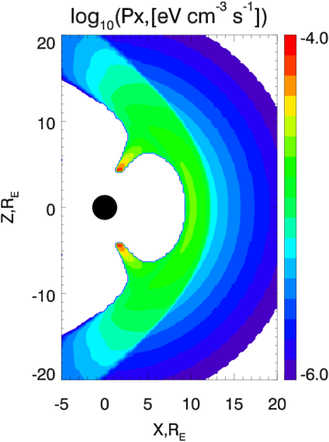
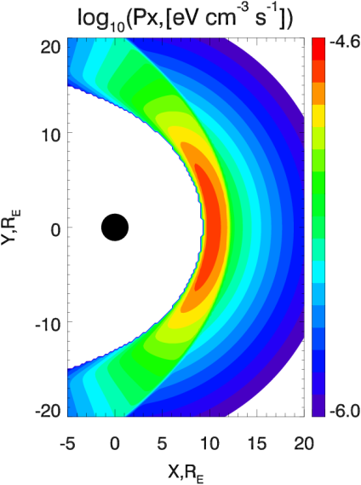

Magnetospheric masking
Method 1: By using threshold conditions for the thermal pressure and velocity (p<p(msph), Vx>0.15Vx(sw))
Method 2: By tracing flowlines and making cusp outlines with thermal pressure distribution
(p>0.7p_{max}).

Slide 6
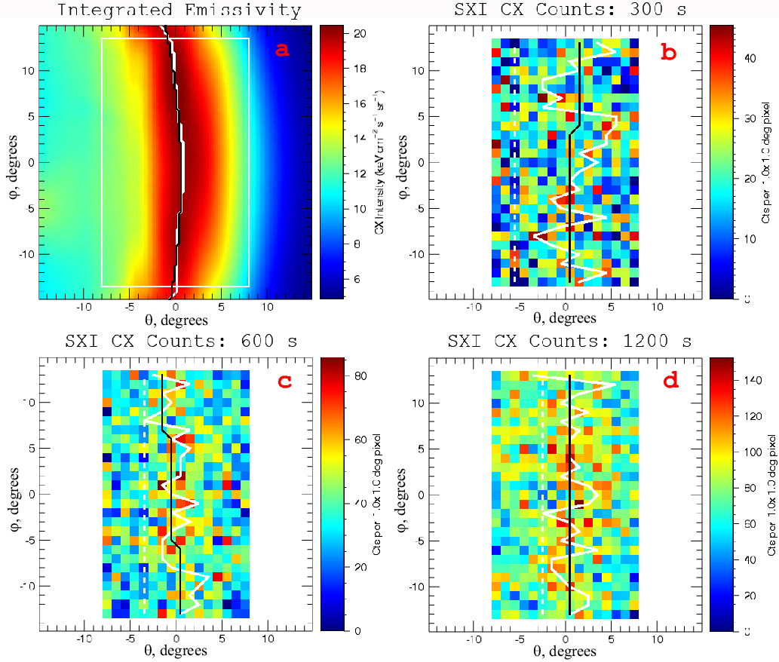
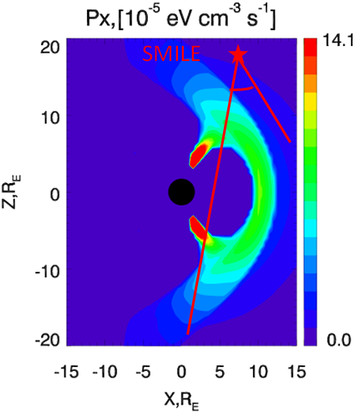
Integrated emissivity:
emissivity Px integrated along
Line-Of-Sight
SXI counts maps

Slide 7
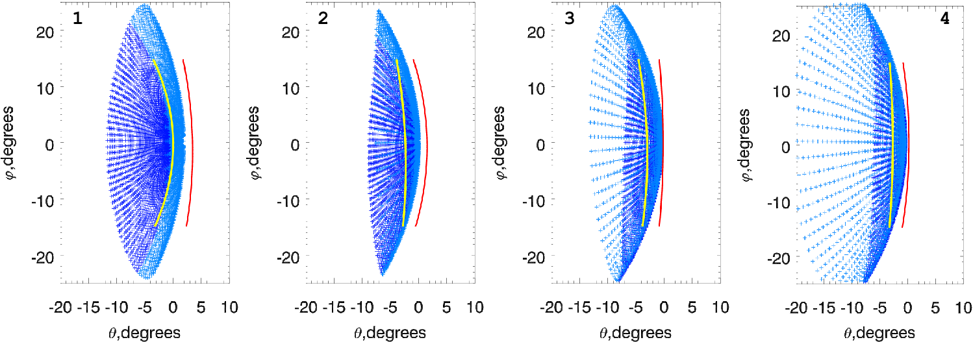
Four points along the SMILE orbit, magnetopause surface calculated by the modified Shue model (see Jorgensen et al. (2019), Sun et al. (2020))
Max Ix
Max grad(Ix)

Slide 8
Conclusion
Some MHD models predict a relatively high density in the magnetosphere. We develop the three methods of magnetospheric masking to outline the magnetospheric region and change the density there.
We verify the assumption that the maximum Ix is tangent to the magnetopause. We find that the tangent direction is located between max(Ix) and max(grad(Ix)). The results depend on the masking method, solar wind conditions, and spacecraft position. Since the distance between max(Ix) and max(grad(Ix)) is relatively small (e.g., ~0.5 R_{E} at S-E line), we could suggest that max(Ix) indicates the outer magnetopause edge.
Contact: a.samsonov@ucl.ac.uk

