Slide 1



Improvement of disaster management approaches in Japan using paddy field
Debanjali Saha, Kazuo Oki, Koshi Yoshida and Hideaki Kamiya
Presenting author: Debanjali Saha
Doctoral student
Oki Lab, Department of Civil Engineering
EGU General Assembly 2022
23 May, 2022

Slide 2
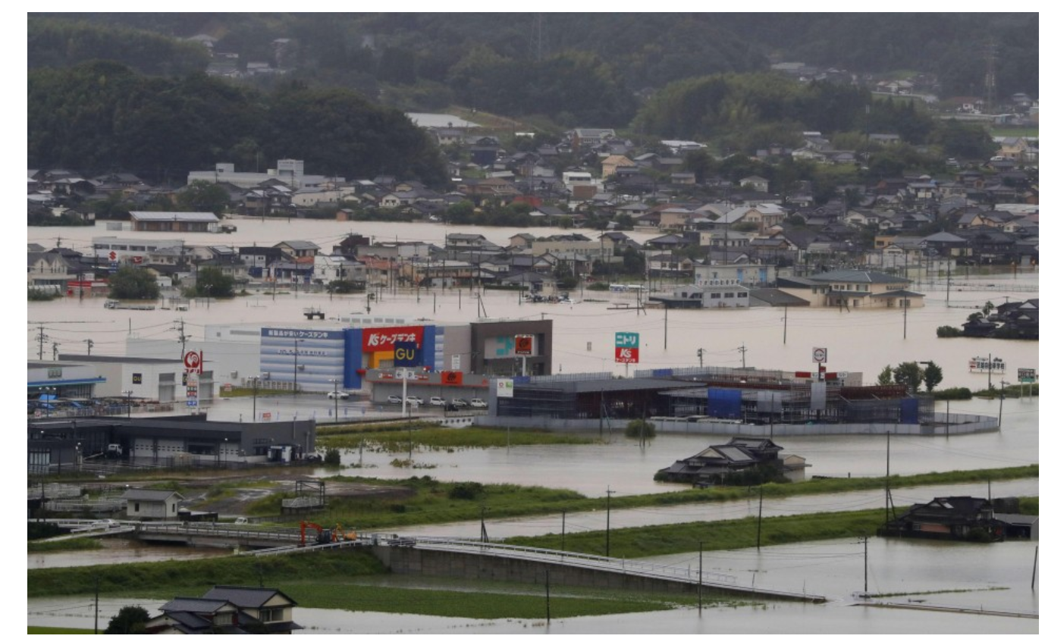
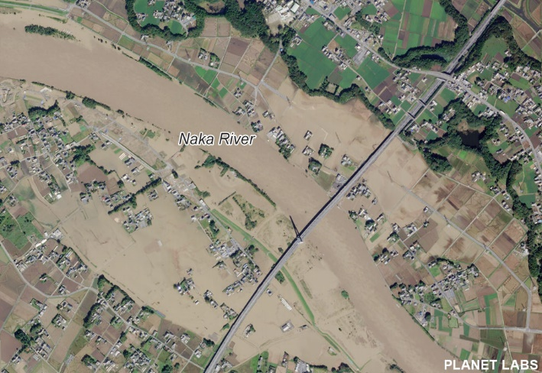
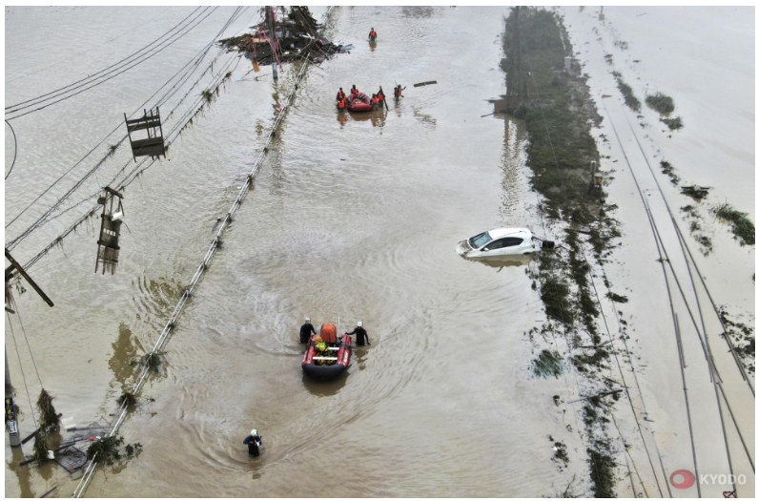
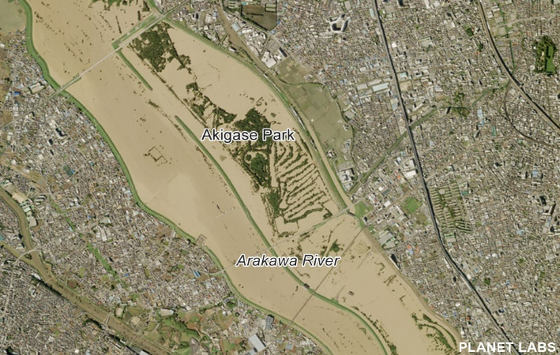
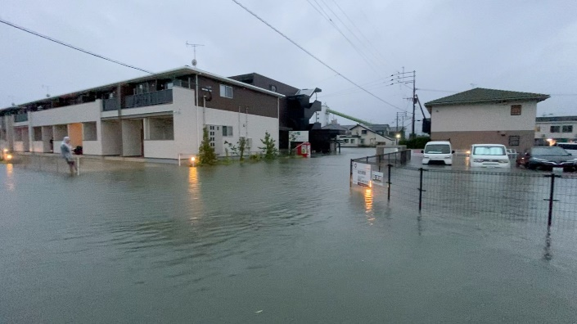


Background
Objectives & Methodology
Results
Discussion
Future work
Japan has a long history of severe natural disasters
Growing risk of climate change impacts may increase the devastation of major typhoon, extreme rainfall events and floods
Cost-effective and sustainable disaster management measures to reduce the effects are essential in every sector
Flood disasters in Japan in the last few years
Source: MLIT Japan, Kyodo News and Reuters
Using the paddy fields in river flood plain areas as storage reservoir, impact of flood disaster can be minimized with minimum structural intervention and cost
EGU General Assembly 2022: 23 May, 2022
Slide #2

Slide 3
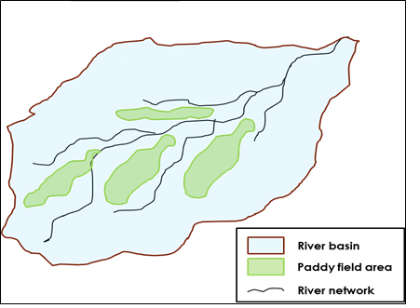



Background
Objectives & Methodology
Results
Discussion
Future work
Paddy fields remain mostly unused after harvest
Rainfall due to major typhoon can be captured by nearby paddy fields
Proposed height increase till 50cm
Closing the drainage outlet (Oct-Dec) will store rainwater within paddy field
Existing or extended paddy bund = flood water reservoir
Reduced river discharge and inundation damage
Usual height of paddy field bund (20-25cm)
Closing off usual drainage outlet
Schematic diagram of paddy reservoir in river basin area
Schematic diagram of proposed modification of paddy field bunds
Major benefit: cost-effective and non-structural DRR intervention
New research: assessing paddy field’s contribution in Japan as storage reservoir using hydrological modelling
EGU General Assembly 2022: 23 May, 2022
Slide #3

Slide 4
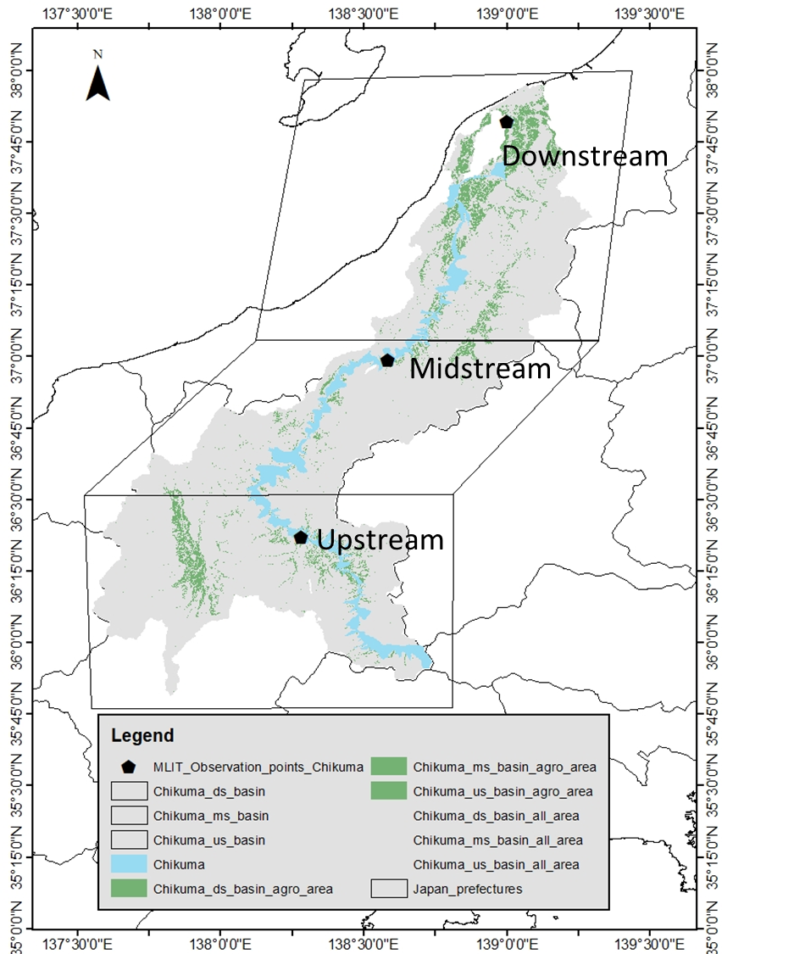
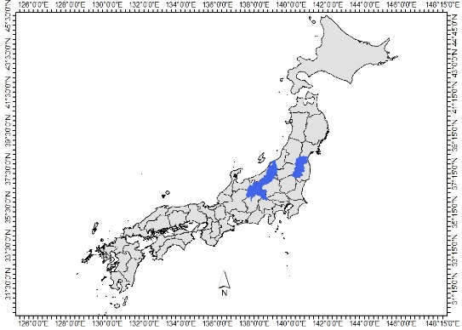
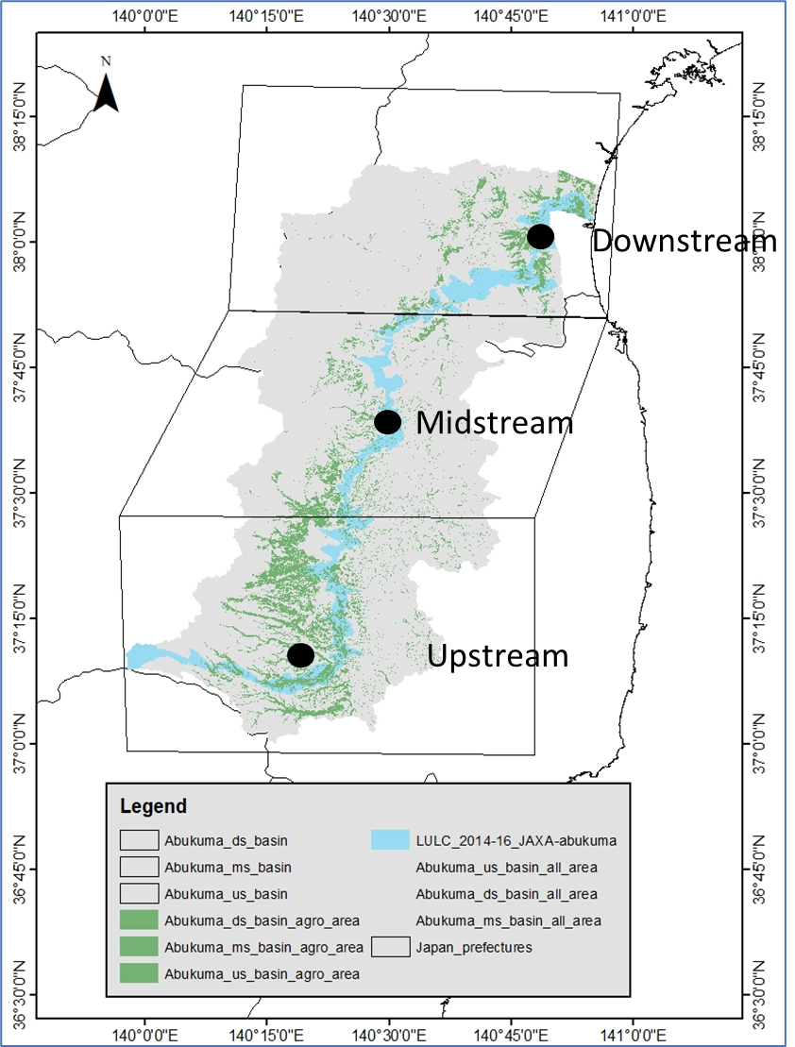
Objectives & Methodology
Background
Results
Discussion
Future work
Japan
2 Major rivers
Hydrological model simulation using H08 for scenarios ‘with paddy storage’ and ‘no storage’
Compare 2018 and 2019 for normal flood and extreme flood scenarios
Calculate reduction in discharge for paddy field bund scenarios (present and extended)
H08 simulation for default ‘no paddy storage’ scenario
A part of H08 simulation with a separate model for ‘with paddy storage’ scenario
Study area: Chikuma river basin, Location: 36° ~ 38 °N, 138 ° ~ 139 ° E
Uses the numerical formulae and all variables included in the model (downscaled from global data)
Total runoff is calculated and used in H08 for discharge calculation
Study area: Abukuma river basin, Location: 37° ~ 39 °N, 139 ° ~ 141 ° E
EGU General Assembly 2022: 23 May, 2022
Slide #4

Slide 5
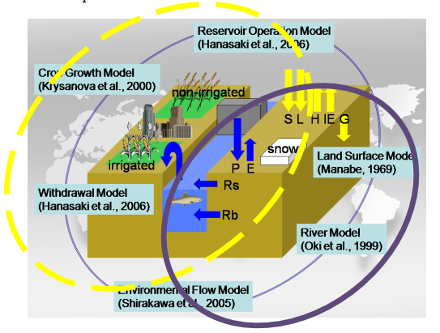
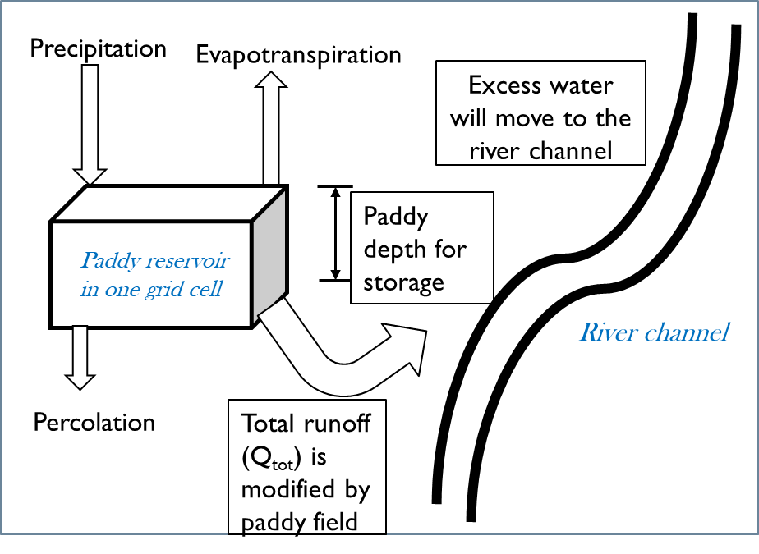
Objectives & Methodology
Background
Results
Discussion
Future work
H08: global hydrological and water resources model
‘Land surface module’ and ‘River module’ used for a regional simulation (5 arc min resolution)
Default scenario: river runoff and discharge calculation for every grid cell
Paddy reservoir: excess runoff after daily water balance, contributes to river discharge
Schematic diagram of H08 model’s different module interactions
Source: Hanasaki et al., 2018
Schematic diagram of paddy reservoir storage and runoff generation
From JAXA-EORC
P – ET – Percolation –initial storage = intermediate runoff;
if intermediate runoff > paddy storage capacity,
runoff – storage = final runoff to river
if intermediate runoff < paddy storage,
no runoff
Land use map
X
Paddy bund height
Paddy field area
Volumetric water storage capacity of paddy reservoir
Assuming equal capacity of every paddy field grid in H08
Runoff generates discharge in H08
EGU General Assembly 2022: 23 May, 2022
Slide #5

Slide 6

Results
Background
Objectives & Methodology
Discussion
Future work
Better model calibration in upstream section of rivers
Normal flood year discharge can be simulated with good correlation
Extreme event of 2019 has some discrepancies
Some parameter adjustment is still necessary (Manning’s coefficient, flow velocity, etc.)
Sample graph of observed and simulated discharge comparison in upstream section of one of the study areas (Abukuma river)
EGU General Assembly 2022: 23 May, 2022
Slide #6

Slide 7
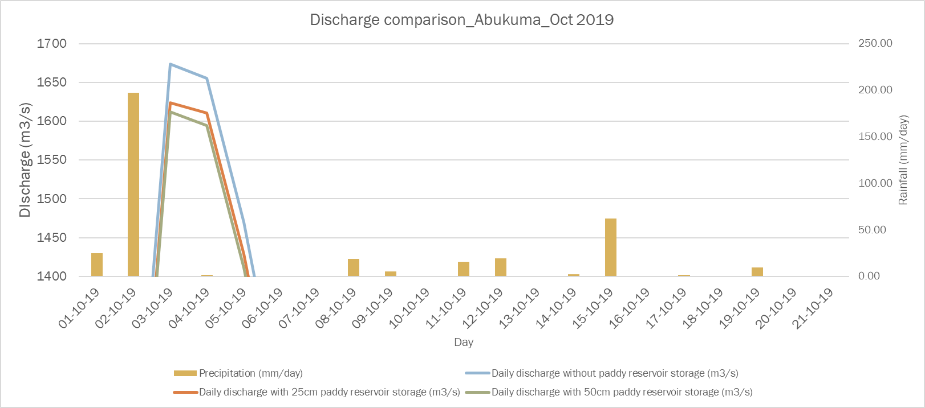
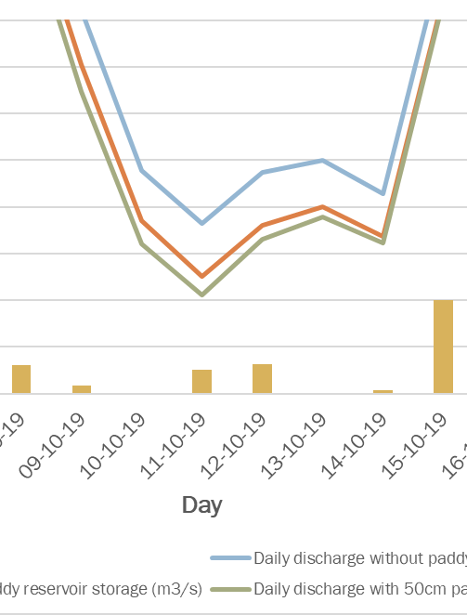
Results
Background
Objectives & Methodology
Discussion
Future work
Discharge reduction percentage: 2018
Existing bund (25cm): 21-25% (avg)
Extended bund (50cm): around 35%
Reduced discharge
Extreme event year 2019
Existing bund (25cm): 10-15% (avg)
Extended bund (50cm): around 20%
Reduced discharge
Reduced discharge
Other sections of river basin also show significant discharge reduction
Sample graph of discharge reduction in Abukuma river basin due to paddy reservoir storage
EGU General Assembly 2022: 23 May, 2022
Slide #7

Slide 8
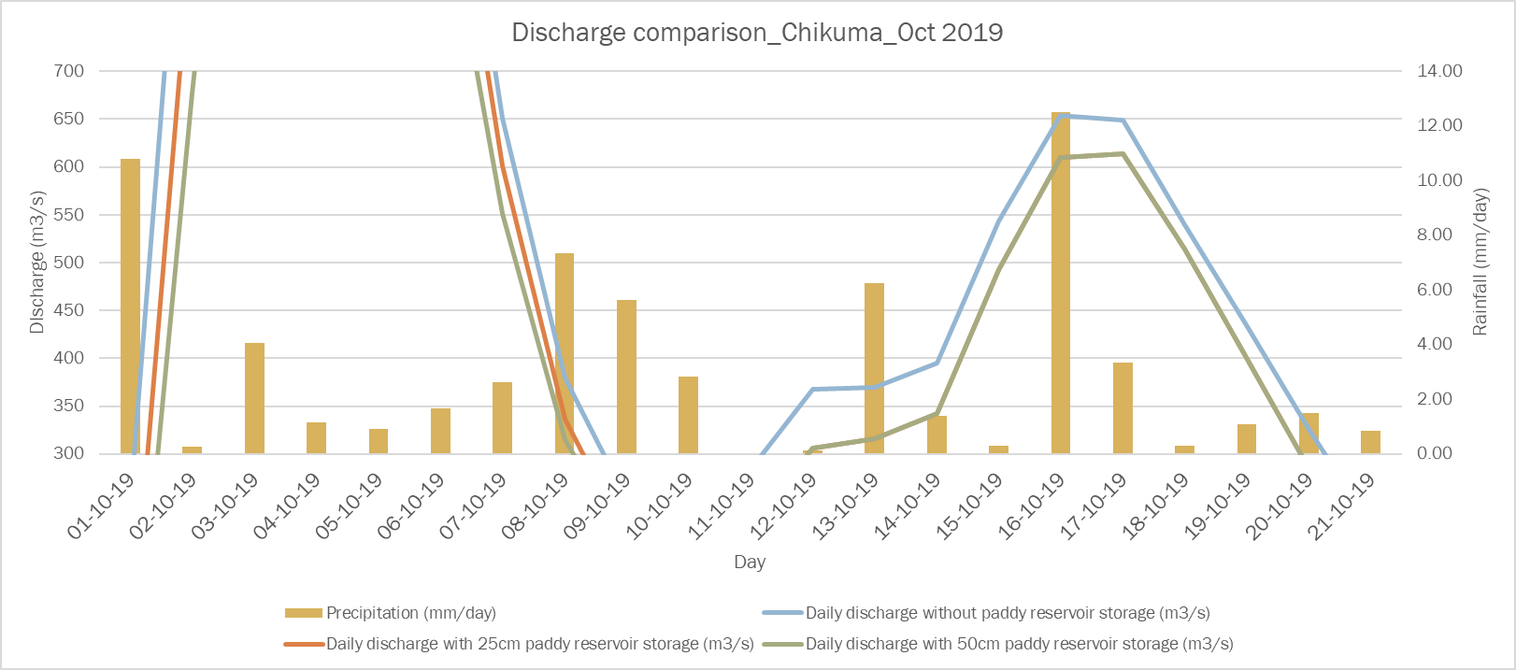
Results
Background
Objectives & Methodology
Discussion
Future work
Discharge reduction percentage: 2018
Existing bund (25cm): 25-30% (avg)
Extended bund (50cm): around 33%
Reduced discharge
Extreme event year 2019
Existing bund (25cm): 20-23% (avg)
Extended bund (50cm): around 21%
Reduced discharge
Reduced discharge
If 3-4 days consecutive heavy rain (300-400 mm) can cause overflow, paddy reservoir storage potential decreases, but it still provides certain protection
Sample graph of discharge reduction (October) in Chikuma river basin due to paddy reservoir storage
EGU General Assembly 2022: 23 May, 2022
Slide #8

Slide 9










Background
Objectives & Methodology
Results
Discussion
Future work
Existing bund: considerable discharge reduction
Protected infrastructure and assets
Less inundation damage in river floodplain
Extended bund (50cm): higher reduction
Information dissemination for practical application
Selection criteria of most suitable section in river basin
Researchers, Govt officials
Farmers, end users
Highest peak discharge reduction (%)
Maximum paddy field coverage (%)
Highly populated area
Having history of previous extreme disaster
Discharge and inundation reduction
Most effective location
No crop damage (after harvest strategy)
No necessity of higher cost or labor
Public awareness
EGU General Assembly 2022: 23 May, 2022
Slide #9

Slide 10







Future work
Background
Objectives & Methodology
Results
Discussion
Discharge reduction assessment in other major rivers
Inundation mapping for ‘no paddy storage’ and ‘with paddy reservoir’ scenarios
Cost benefit analysis of proposed paddy reservoir storage strategy
Discussion with farmers and end users about the proposed strategy
EGU General Assembly 2022: 23 May, 2022
Slide #10

Slide 11

Necessary datasets
River basin mesh data from MLIT data inventory (when the river is considered as the main stream and tributaries are arranged for each 3rd mesh 1/10 subdivision [100m mesh])
River basin ancillary data (geographical location, length and catchment area, basin population) from MLIT documents
Typhoon Hagibis inundation estimation data from GSI
Land use and land cover data from JAXA-EORC (HRLULC 30m resolution map of Japan [2014 – 2016], ver.18.03)
Regional scale H08 data downscaled from global data of H08
Surface meteorological data for 2018 from H08 model and for 2019, from JAXA Today’s Earth (realtime hourly data from MSM/GPV ver. experiments at 1/60 degree scale in Japan)
Land topography/DEM from CaMaFlood model river network (UTokyo research work)

