Slide 1

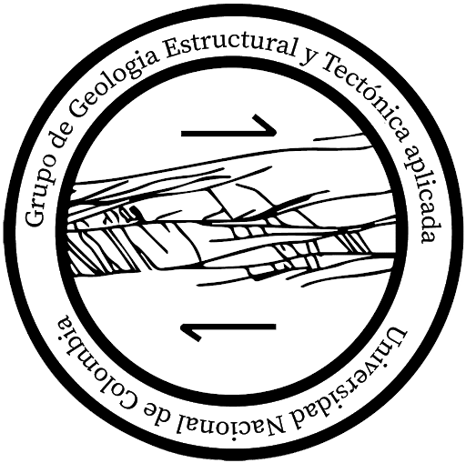



QUATERNARY MAGMATISM ABOVE A SLAB TEAR, NORTHERN ANDES OF COLOMBIA
Camilo A. Conde-Carvajal ^{1,2}, Andreas Kammer^{1,2}, Michael A. Avila-Paez ^{1,2}, Sofía Cubillos ^{1,2}, Alejandro Piraquive ^{1,2} Albrecht von Quadt ^{1,2}
¹Group of Applied Structural Geology and Tectonics, National University of Colombia, Bogotá. Department of Geosciences
²Grupo De Asuntos Nucleares, Dirección De Asuntos Nucleares, Servicio Geológico Colombiano, Bogotá, Colombia
³Department of Earth Sciences, Institute of Geochemistry and Petrology, Eth Zentrum, Zürich, Switzerland
INTRODUCTION
MAGMATISM
AGE
DISCUSSION
OSPP

Slide 2
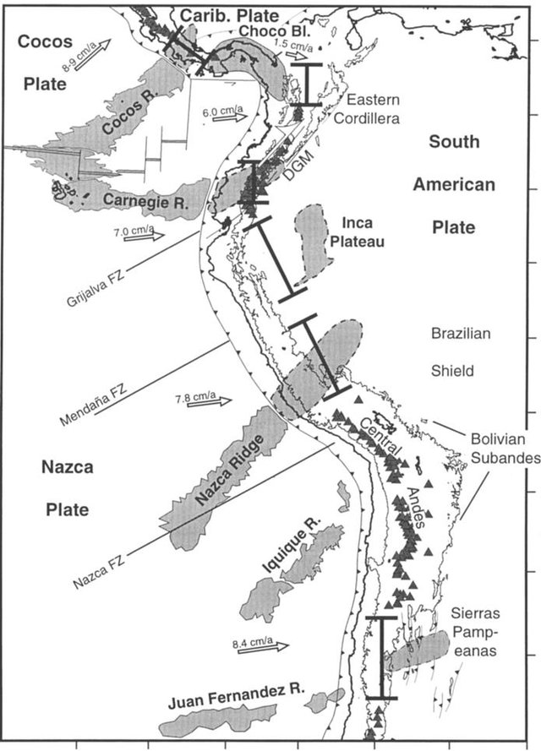
(Gutscher et al., 2000)
INTRODUCTION
MAGMATISM
AGE
DISCUSSION
OSPP

Slide 3
(Gutscher et al., 2000)
INTRODUCTION
MAGMATISM
AGE
DISCUSSION
OSPP

Slide 4
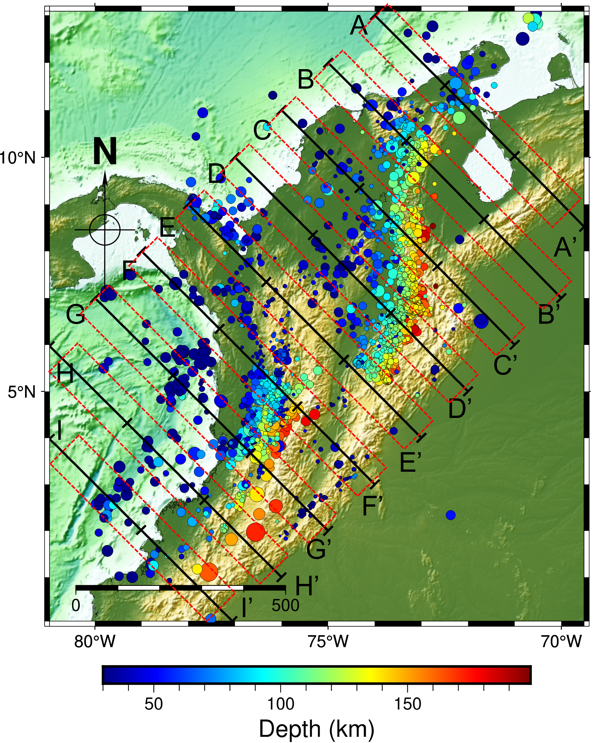
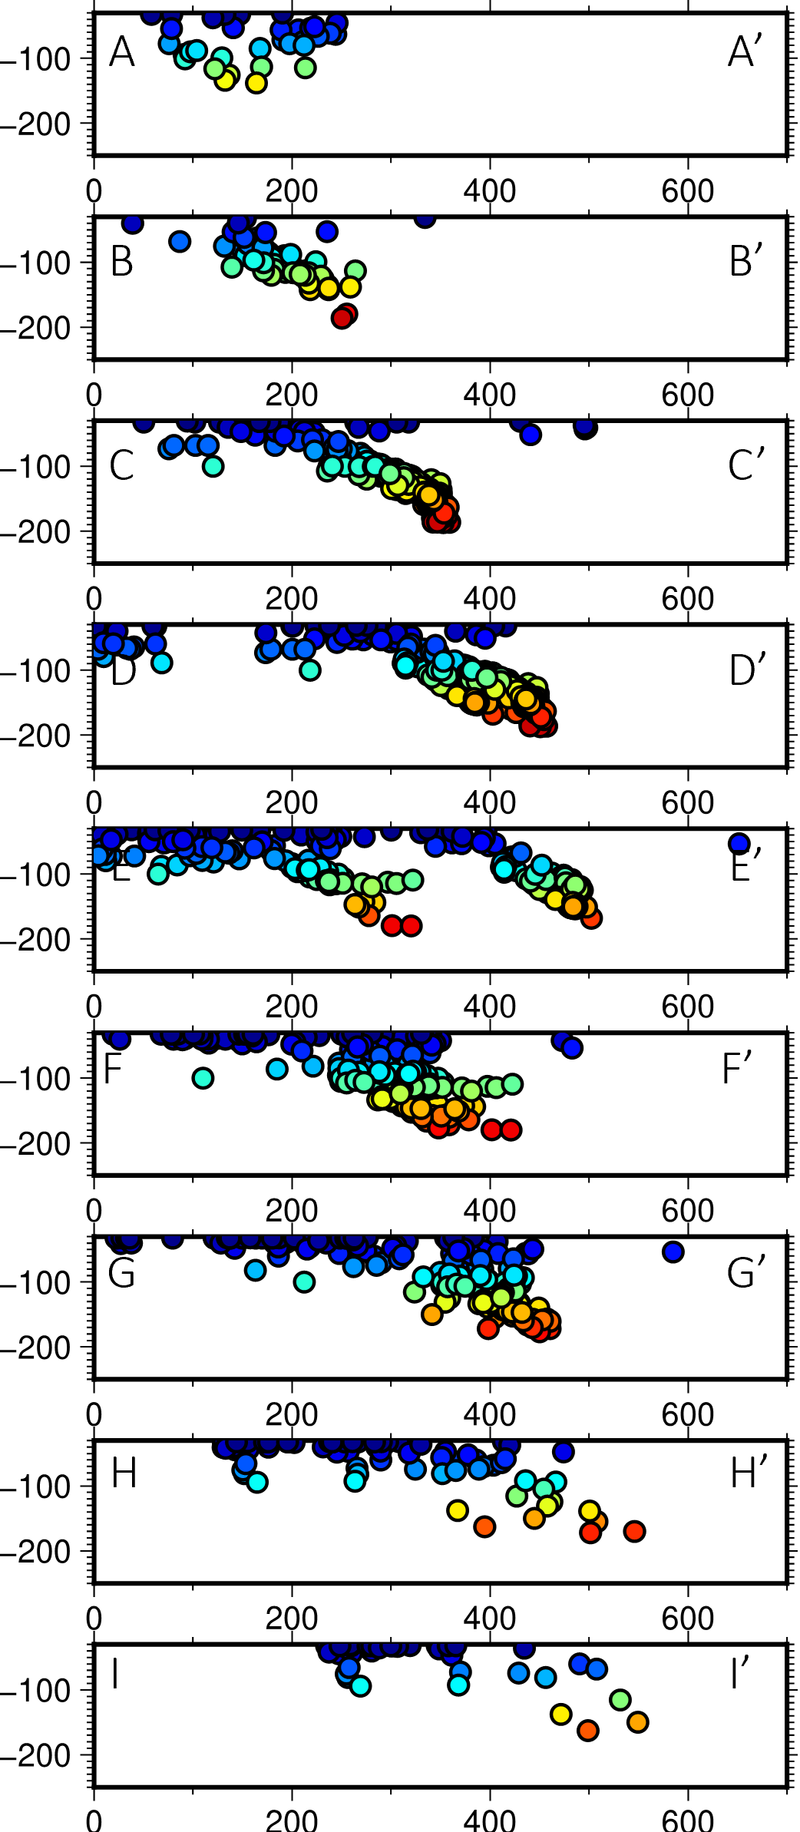
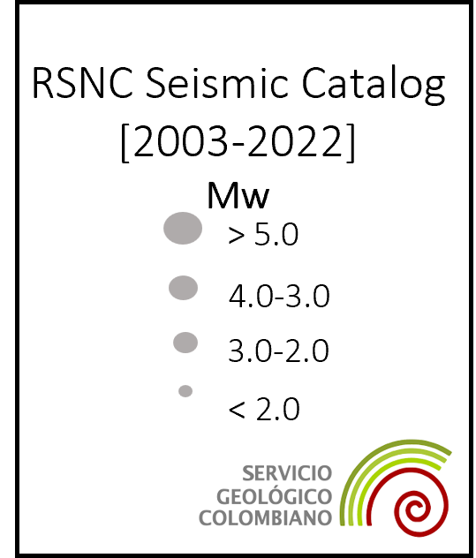
SEISMIC EVIDENCE OF A SLAB TEAR
50
100
150
INTRODUCTION
MAGMATISM
AGE
DISCUSSION
OSPP

Slide 5
SEISMIC EVIDENCE OF A SLAB TEAR
50
100
150
INTRODUCTION
MAGMATISM
AGE
DISCUSSION
OSPP

Slide 6
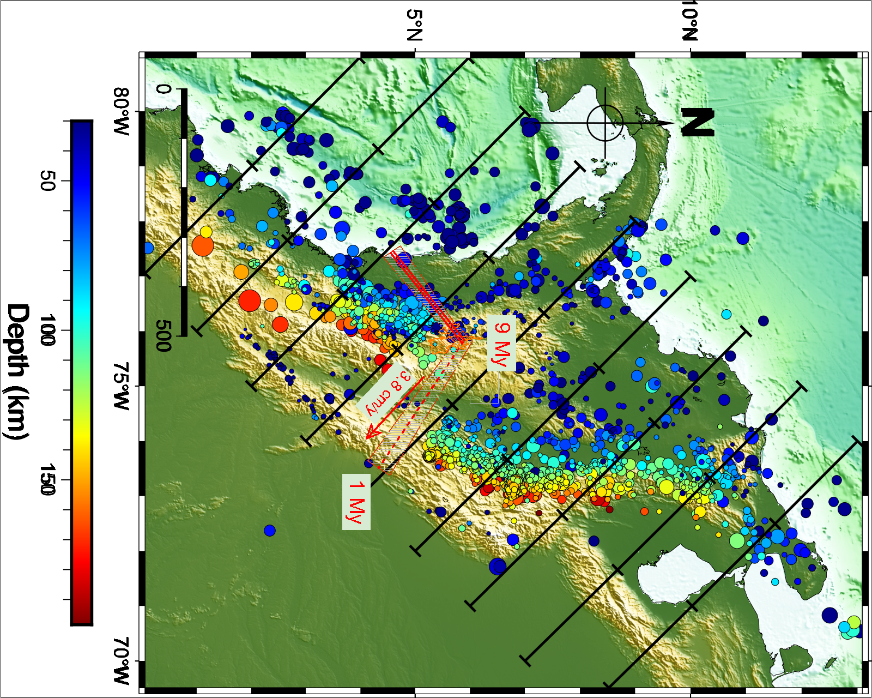
INTRODUCTION
MAGMATISM
AGE
DISCUSSION
OSPP

Slide 7
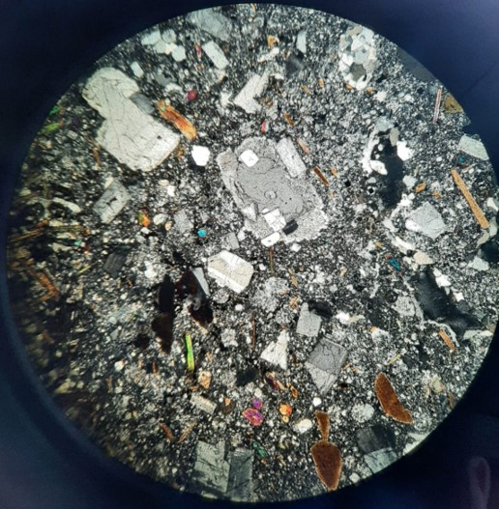
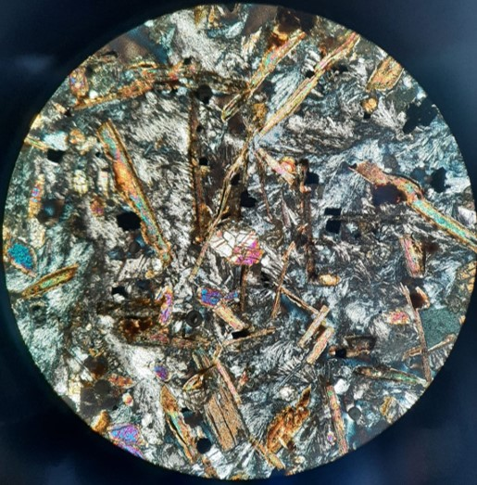
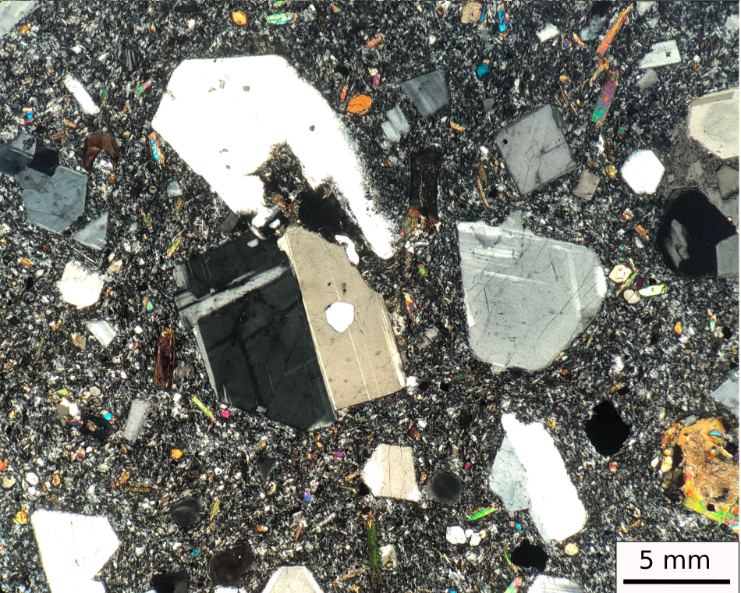
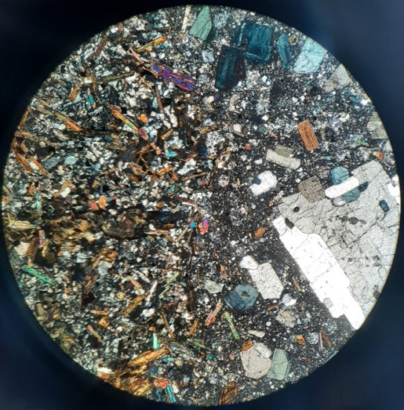
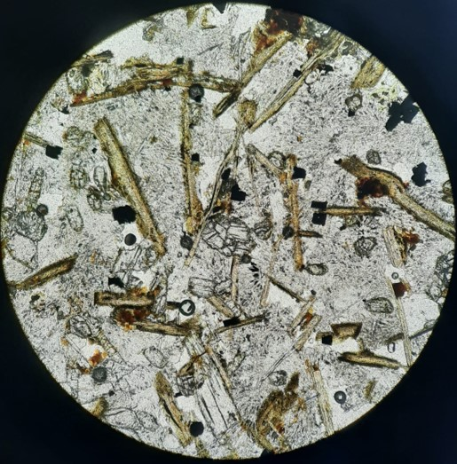
INTRODUCTION
MAGMATISM
AGE
DISCUSSION
OSPP

Slide 8
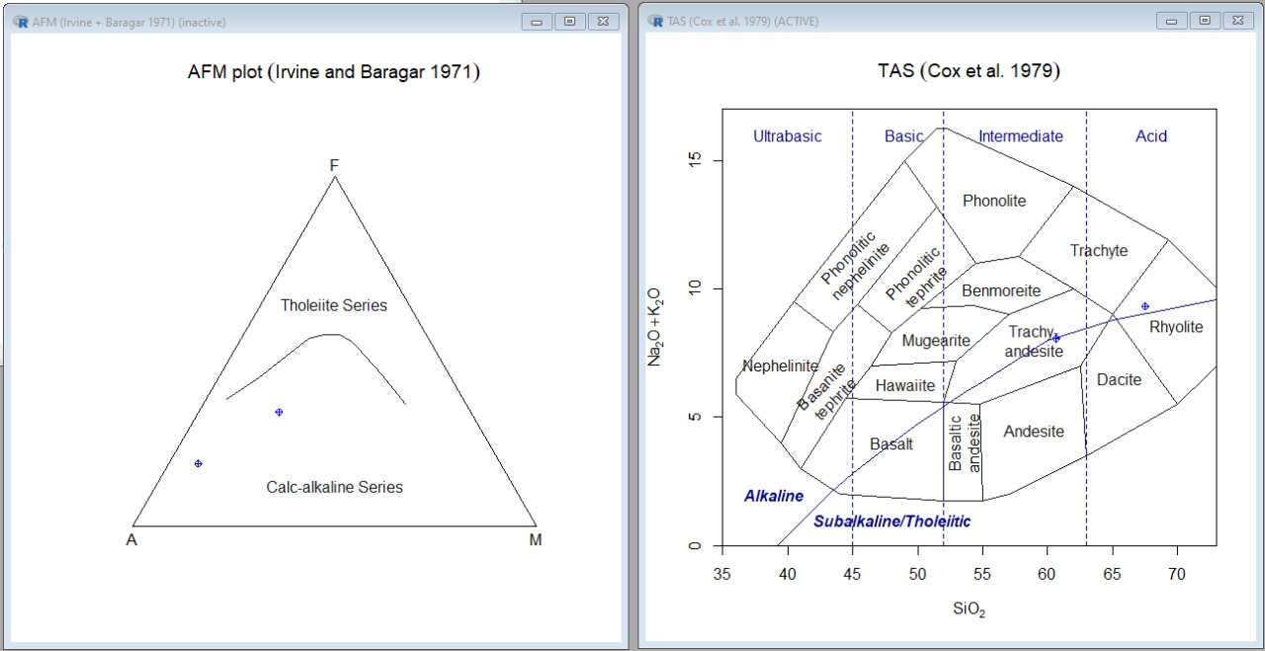
INTRODUCTION
MAGMATISM
AGE
DISCUSSION
OSPP

Slide 9
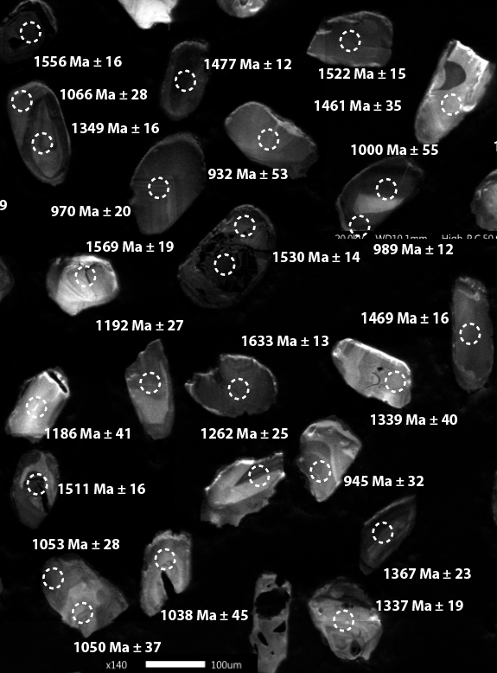
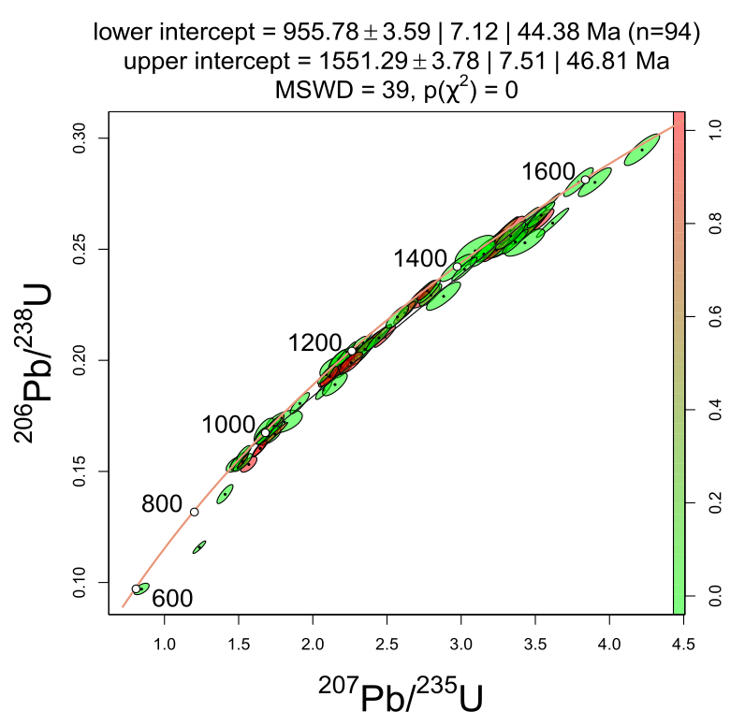
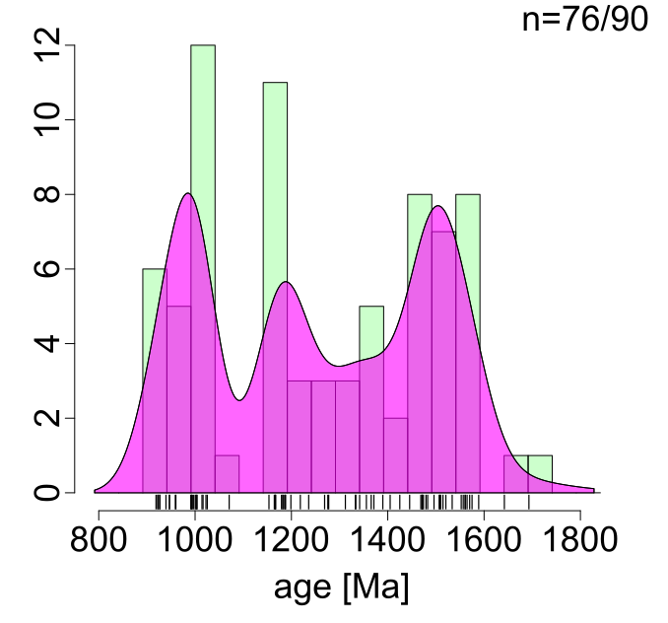
Phyllites, Quetame massif (basement) derived from Grenvillian and Cratonic sources
Paleo-Neoproterozoic ages
(Piraquive & Von Quadt)
INTRODUCTION
MAGMATISM
AGE
DISCUSSION
OSPP

Slide 10
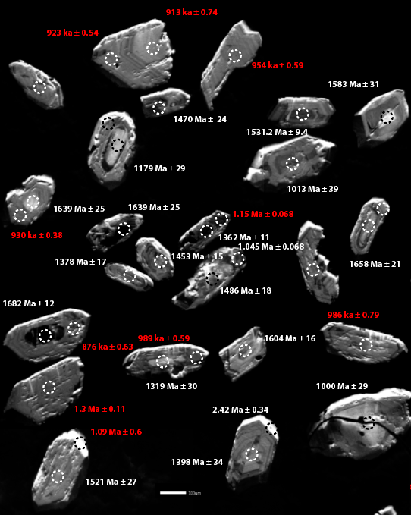
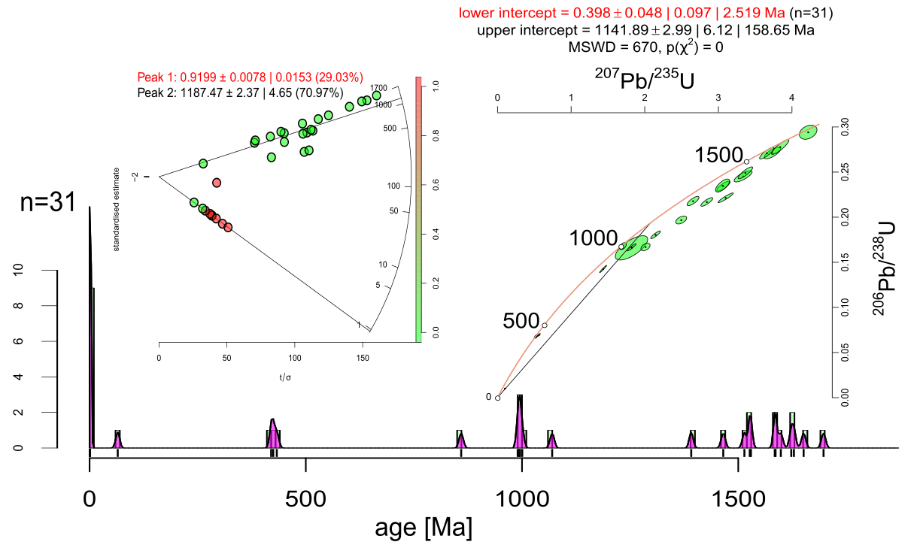
Ryolites reveal two main age trends:
(Piraquive & Von Quadt)
INTRODUCTION
MAGMATISM
AGE
DISCUSSION
OSPP

Slide 11
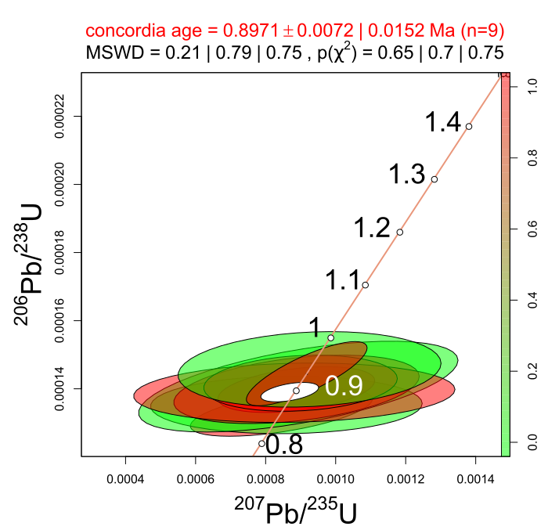
Filtering inheritance:
Pleistocene age for the subvolcanic effusion:
897 ka ± 0.072
The youngest volcanic event in the Eastern Cordillera
(Piraquive & Von Quadt)
INTRODUCTION
MAGMATISM
AGE
DISCUSSION
OSPP

Slide 12
DISCUSSION
The geochemical characterization, petrography and dating of magmatic bodies can help to understand the evolution of a slab tear and its influence on the subducted and overlying plate.
Caldas Tear can provide a thermal anomaly however the influence of tearing the subducting slab on the tectonic evolution of the subduction upper plate is still poorly known
Evidences suggest that the presence of east–west aligned volcanic rocks along with locally elevated geothermal gradient values are related to Caldas Tear
INTRODUCTION
MAGMATISM
AGE
DISCUSSION
OSPP

Slide 13


Thank you!
*Camilo A. Conde-Carvajal, Andreas Kammer, Michael A. Avila-Paez, Sofía Cubillos, Alejandro Piraquive, Albrecht von Quadt
OSPP
*Contact: dyayac@unal.edu.co
INTRODUCTION
MAGMATISM
AGE
DISCUSSION
OSPP

