Slide 1



Effect of nitrogen limitation and soil biophysics on Holocene greening of the Sahara
Jooyeop Lee¹, Jinkyu Hong^{1*}, Martin Claussen^{2,3}, Jeongwon Kim¹, Je-Woo Hong⁴, In-Sun Song⁵
¹Ecosystem–Atmosphere Process Laboratory, Department of Atmospheric Sciences, Yonsei University, Seoul, Korea ²Max Planck Institute for Meteorology, Hamburg, Germany
³Center for Earth System Research and Sustainability (CEN), Universität Hamburg, Germany ⁴Korea Adaptation Center for Climate Change, Korea Environment Institute, Sejong, Korea
⁵Mathematical Atmospheric Physics Lab, Department of Atmospheric Sciences, Yonsei University, Seoul, Korea
contact : Jooyeop Lee (jooyeop94@yonsei.ac.kr)

Slide 2


Contents
Introduction
Methodology
Results
Summary
/9

Slide 3
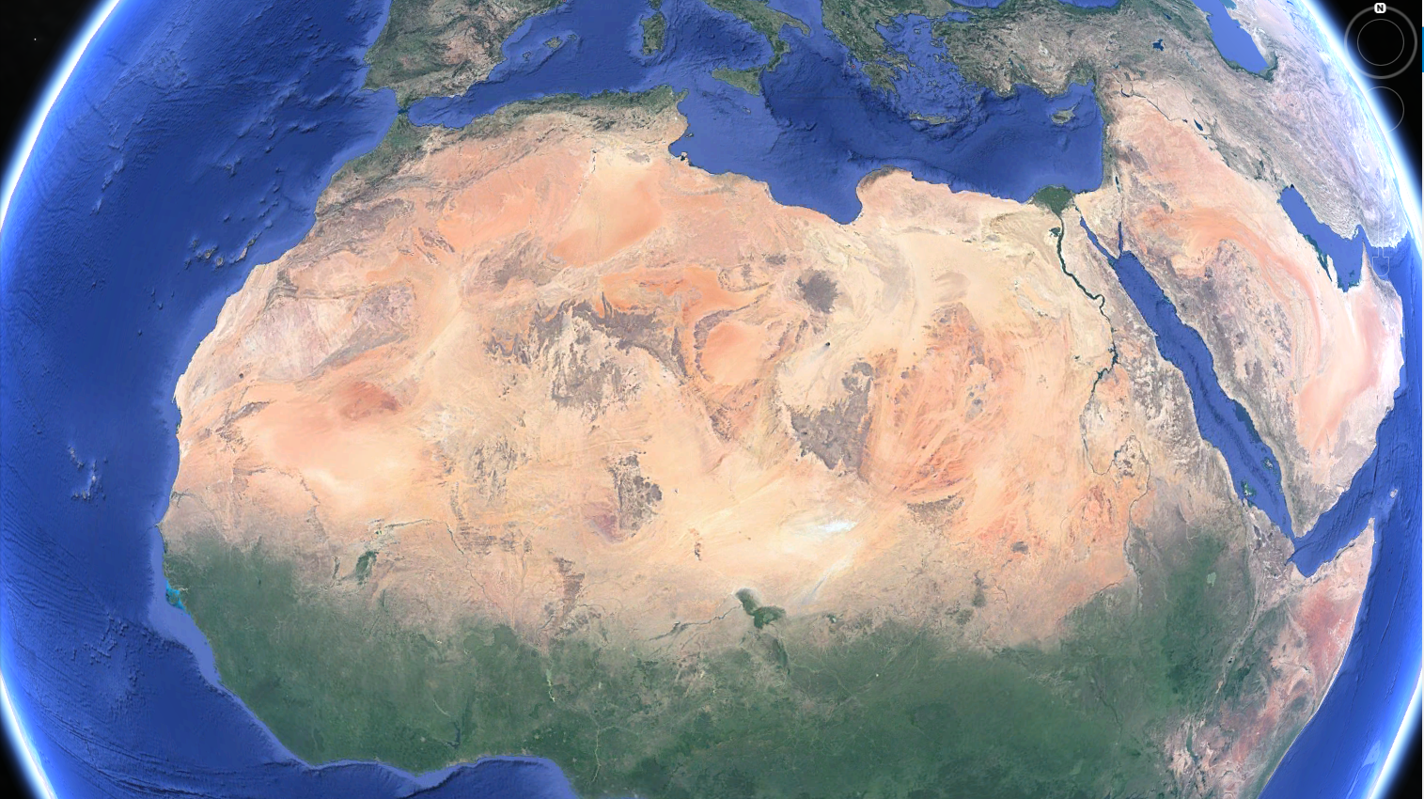


Introduction
Green Sahara ? The wetter than present Sahara that existed 8-6 thousand years ago.
Past (23$°$N )
Present (15$°$N)
Google Earth
/9

Slide 4
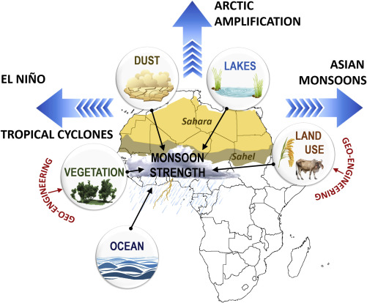
Introduction
African monsoon intensity and location are the result of various interactions.
Climate models are not sufficiently simulating the green Saharan monsoon intensity and location.
This study attempts to analyze the effect of nitrogen-carbon interaction and soil characteristics in simulating the Green Sahara.
(Pausata et al., 2020)
/9

Slide 5
Methodology
< Experimental Settings >
Abbreviation | Description
0K | 500 years simulation using the pre–industrial conditions for orbital forcing and CO₂ concentration with CESM1 model including CNDV option.
8K | 500 years simulation using the mid–Holocene conditions for orbital forcing and CO₂ concentration with CESM1 model including CNDV option.
8KCN | Same as 8K except that soil carbon and nitrogen are prescribed as the values in the current Sahel region with CESM1 model including CNDV option.
8KCNS | Same as 8KCN except that the North African soil type was prescribed as loam with CESM1 model including CNDV option.
Soil C & N
0K
8K
8KCN
8KCNS
Orbital Forcing + CO₂
Loamier Soil
/9

Slide 6
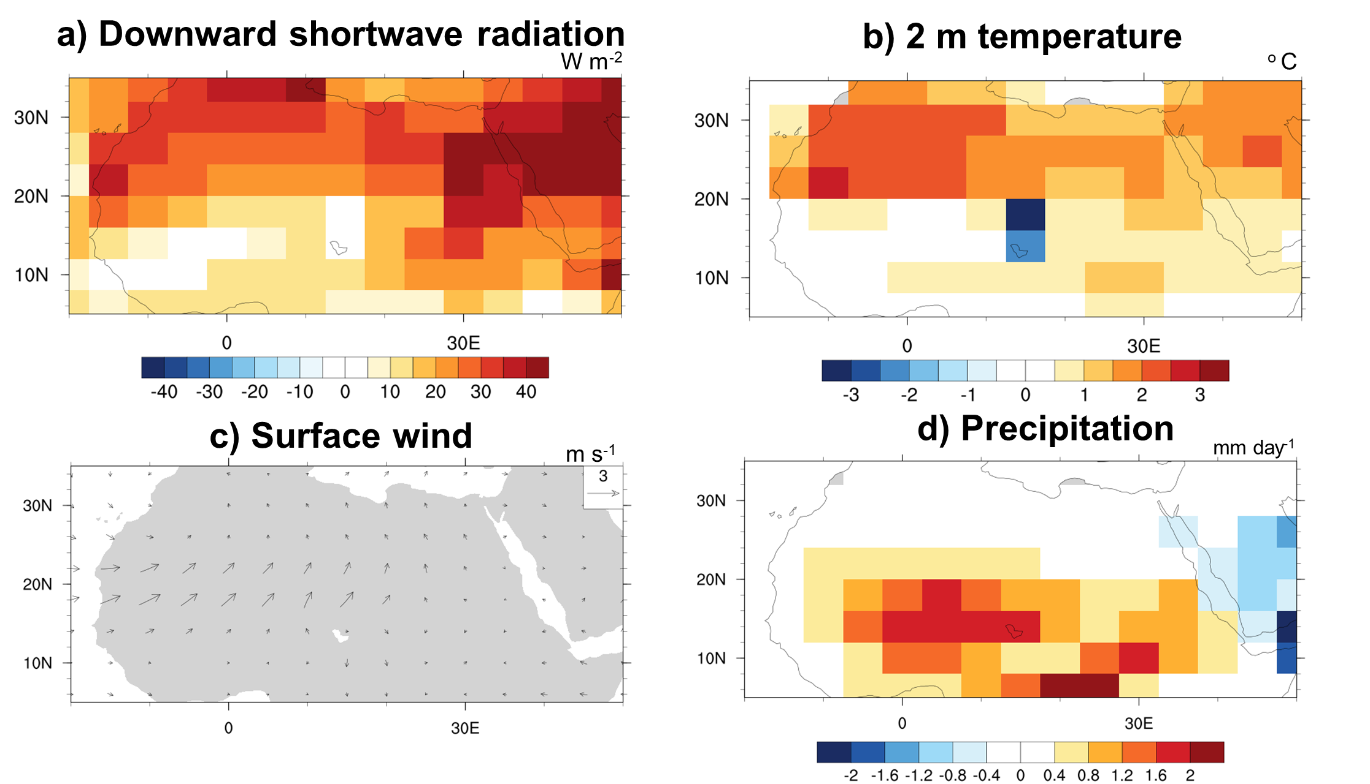
Results 1 – Green Saharan Climatic results
EMH – PI (8K-0K)
EMH : Early to Mid- Holocene
PI : Pre-Industrial
Orbital change $→$ simulated Radiation/ 2m T/ Rain $↑$
/9

Slide 7
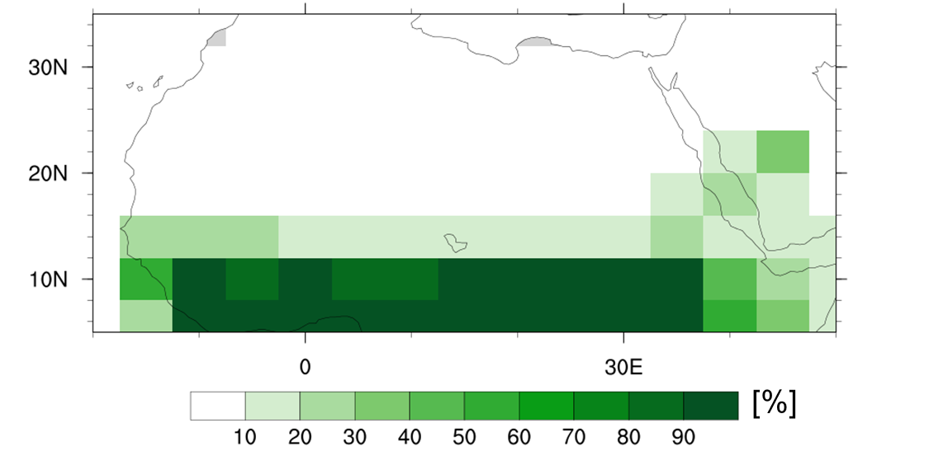
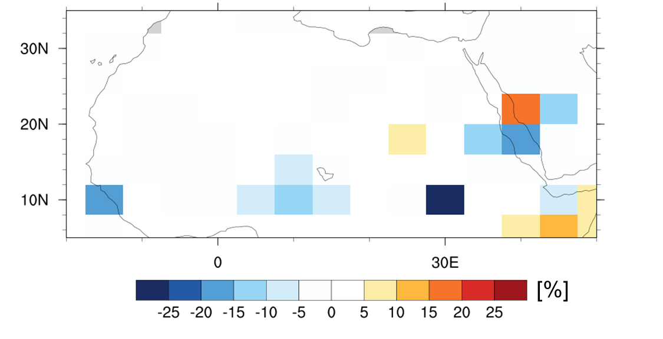
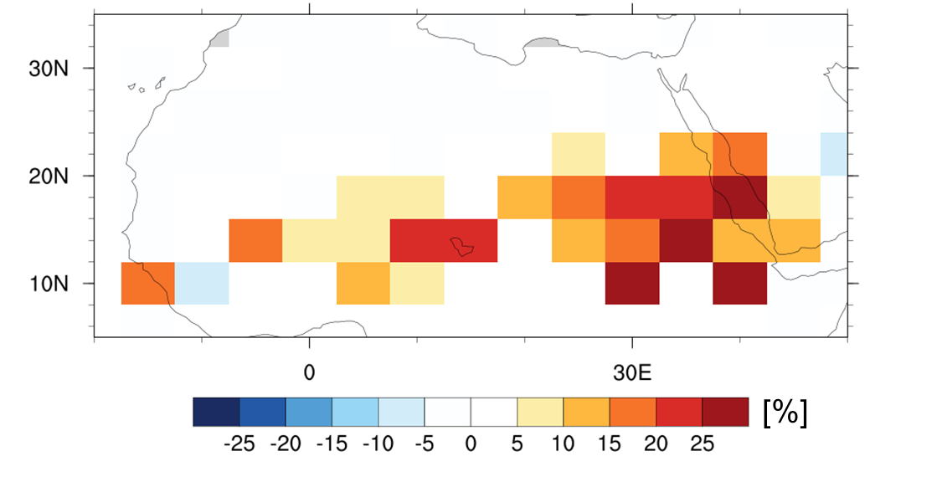
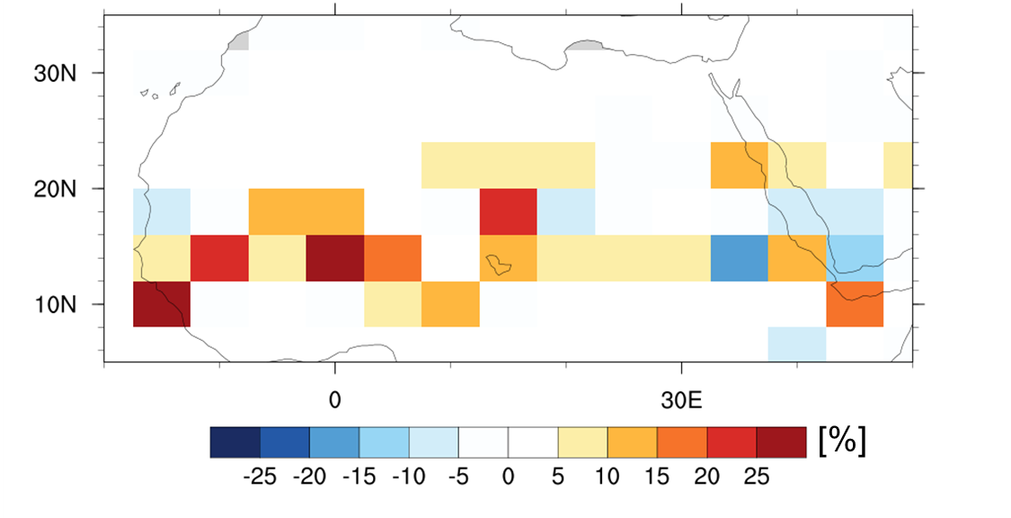


Results 2 – Green Saharan Vegetation results
Vegetation Fraction
Vegetation of the past are not well represented by orbital changes alone!
PreIndustrial (0K)
Orbital Forcing + CO₂ (8K-0K)
C – N interaction (8KCN-8K)
Soil type Considered (8KCNS-8KCN)
81% $↑$
152% $↑$
Soil C-N processes & Soil type plays an important role in GS simulation.
/9
[%]
[%]

Slide 8
Summary
We reproduced the Holocene green Sahara using the CESM model.
Proper representation of nitrogen-carbon interactions and soil properties in Earth system models can make a significant contribution to the reproduction of the green Sahara.
Future climate simulation may need to consider consequent changes in soil nitrogen and texture with changes in vegetation cover and density.
/9

Slide 9
Thank You!
This presentation is based on : Lee, J., Claussen, M., Kim, J., Hong, J. W., Song, I. S., and Hong, J. (2022). Effect of nitrogen limitation and soil biophysics on Holocene greening of the Sahara. Climate of the Past, 18(2), 313-326. *This work was supported by National Research Foundation of Korea (NRF) grants funded by the Korean government (NRF-2018R1A5A1024958).
visit EAPL (https://eapl.yonsei.ac.kr)

