Slide 1


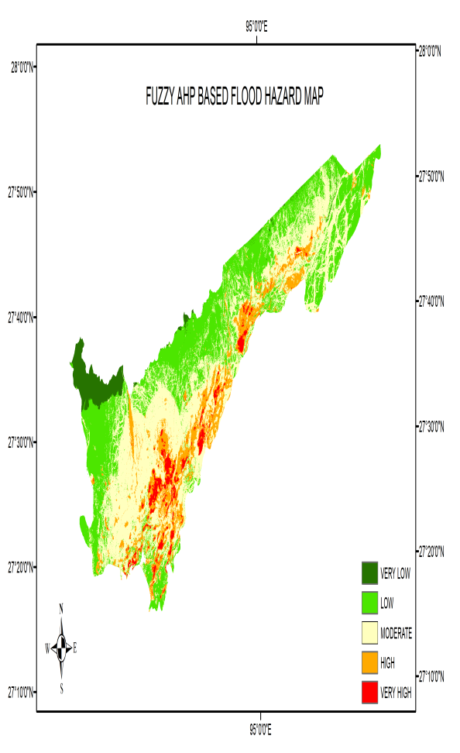
A fuzzy multi-criteria decision tree model for flood hazard assessment
in the Dhemaji district of the state of Assam in India
Dr. Diganta Barman, Dr. Anupal Baruah , Dr. Arjun BM , Dr. S P Aggarwal
Different Geo-spatial layers
Flood hazard map
Introduction
Assam , the North Eastern State of India is prone to natural disasters like flood and erosion with its vast network of rivers .
Out of the 33 districts, the Dhemaji district, bordering the Arunachal Pradesh is
highly vulnerable and affected by the monsoon flood each year.
A fuzzy AHP framework is developed here for flood hazard assessment of Dhemaji District, Assam, India
Flood hazard map
Revenue circles adjacent to the Brahmaputra river shows high to very high flood hazard

