Slide 1



Development of operational salt intrusion forecasts
Bas Wullems, Albrecht Weerts & Claudia Brauer
SALTI Solutions

Slide 2
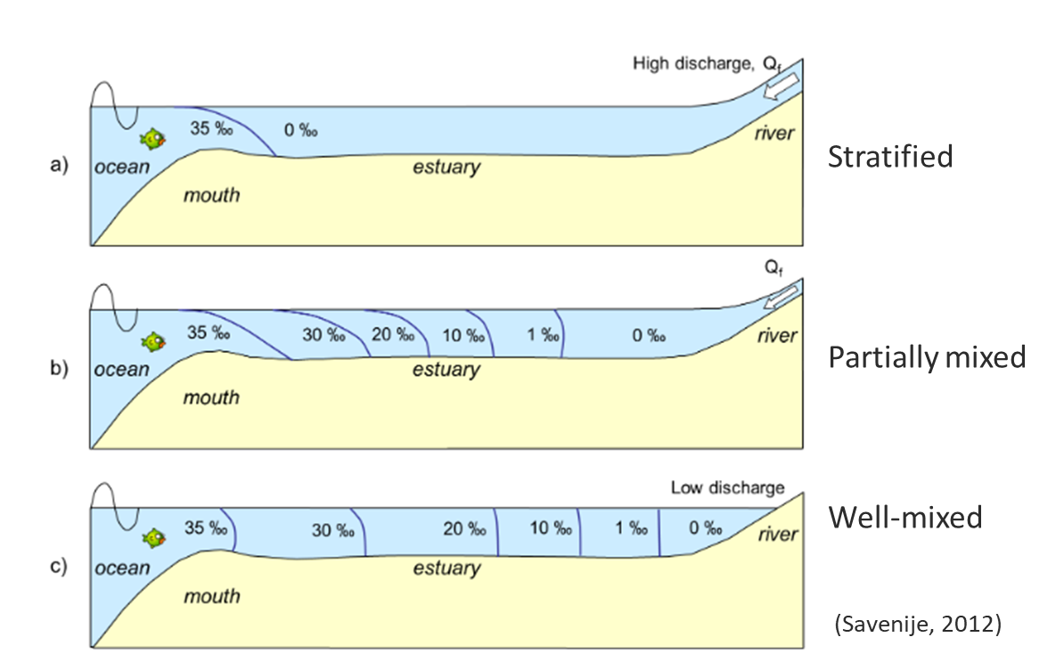
Salt intrusion in estuaries

Slide 3
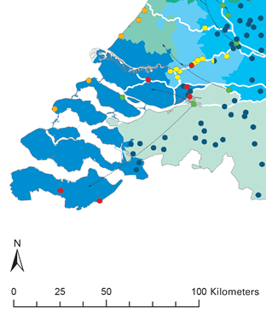
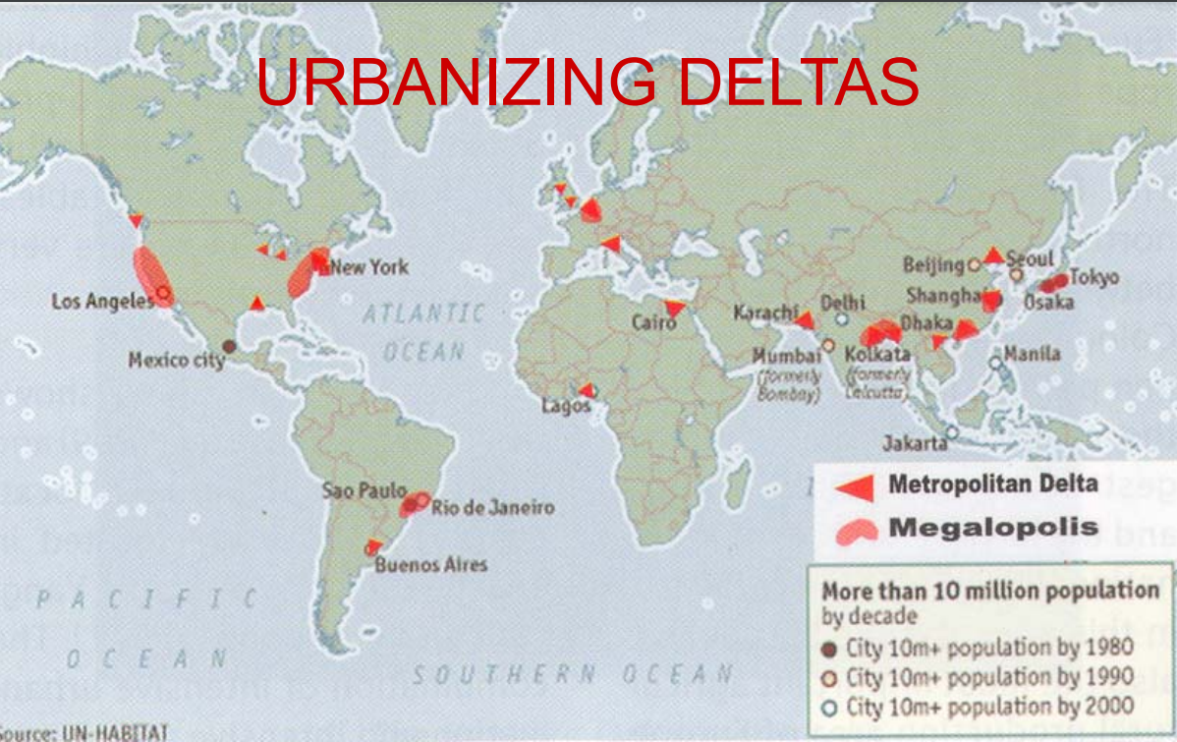
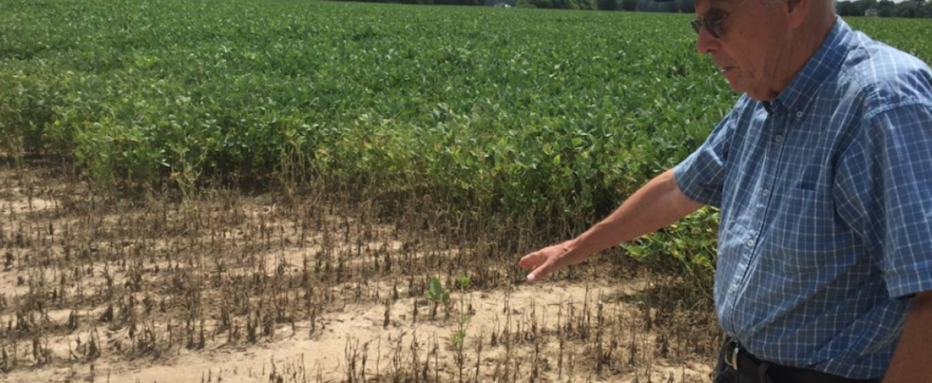
Impacts
Drinking water inlets in the southwestern Netherlands (VEWIN, 2022)
Salt damage to crops.
(Global center on adaptation,
Carey L. Biron, 2 Oct 2019)

Slide 4
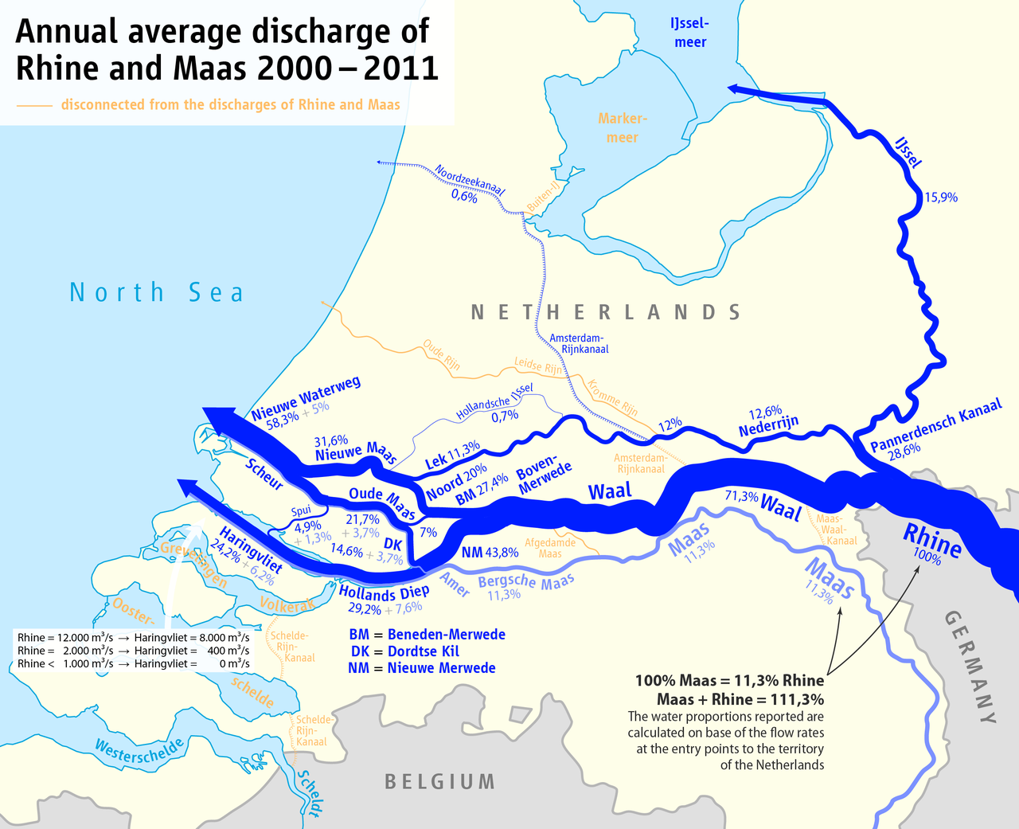
Study area: Rhine-Meuse Delta

Slide 5
Goals
SALTI Solutions:
Guaranteeing freshwater with a virtual delta
This PhD-project:
Increasing the lead-time of operational salt intrusion forecasts

Slide 6
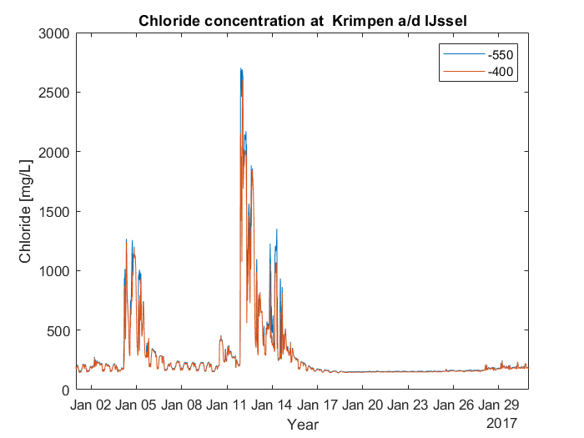
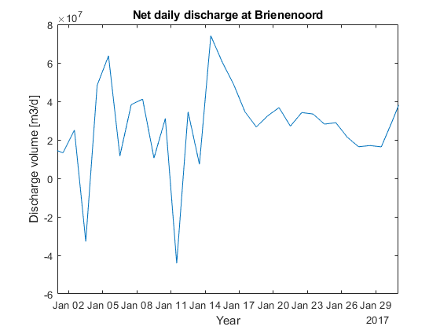
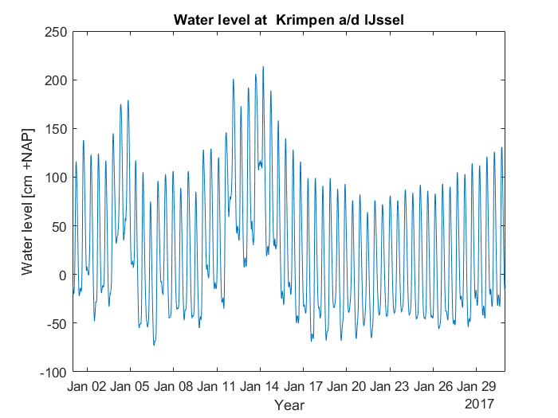
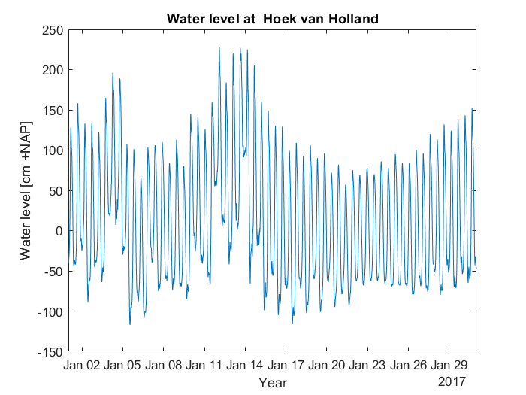
Approach
1. Data-driven models

Slide 7
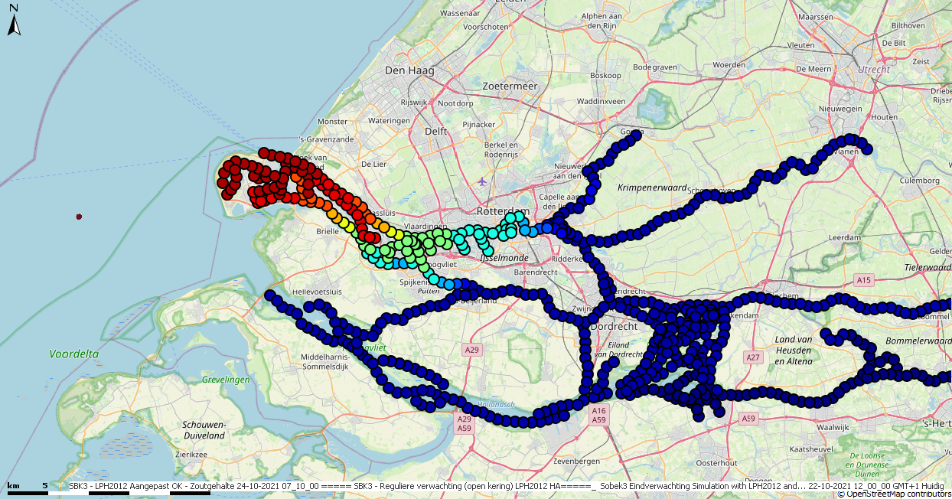
Approach
2. Adaptations to SOBEK’s dispersion coefficient

Slide 8
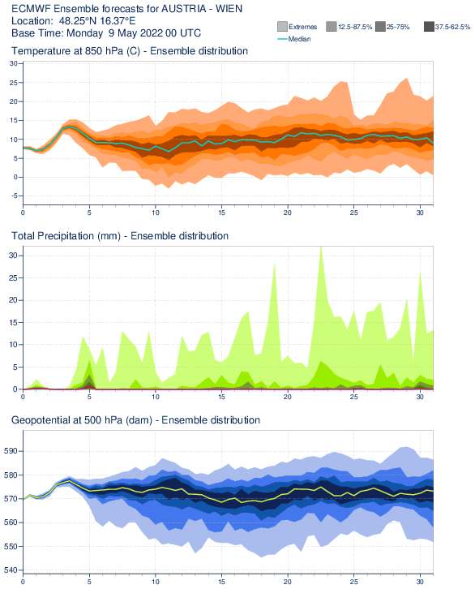
Approach
3. Propagation of measurement uncertainty

Slide 9
Approach
4. Re-analysis of historic events
(Prinsen & Becker, 2013)

Slide 10
Thank you!
Contact: bas.wullems@wur.nl
SALTI Solutions

