Slide 1


Improving the precision of garnet Sm-Nd isochron ages using aqua regia leachate analyses
Shreya Mukherjee, Ankita Nandi, Avishek Adhikari, and Ravikant Vadlamani
INDIAN INSTITUTE OF TECHNOLOGY KHARAGPUR
DEPARTMENT OF GEOLOGY AND GEOPHYSICS

Slide 2
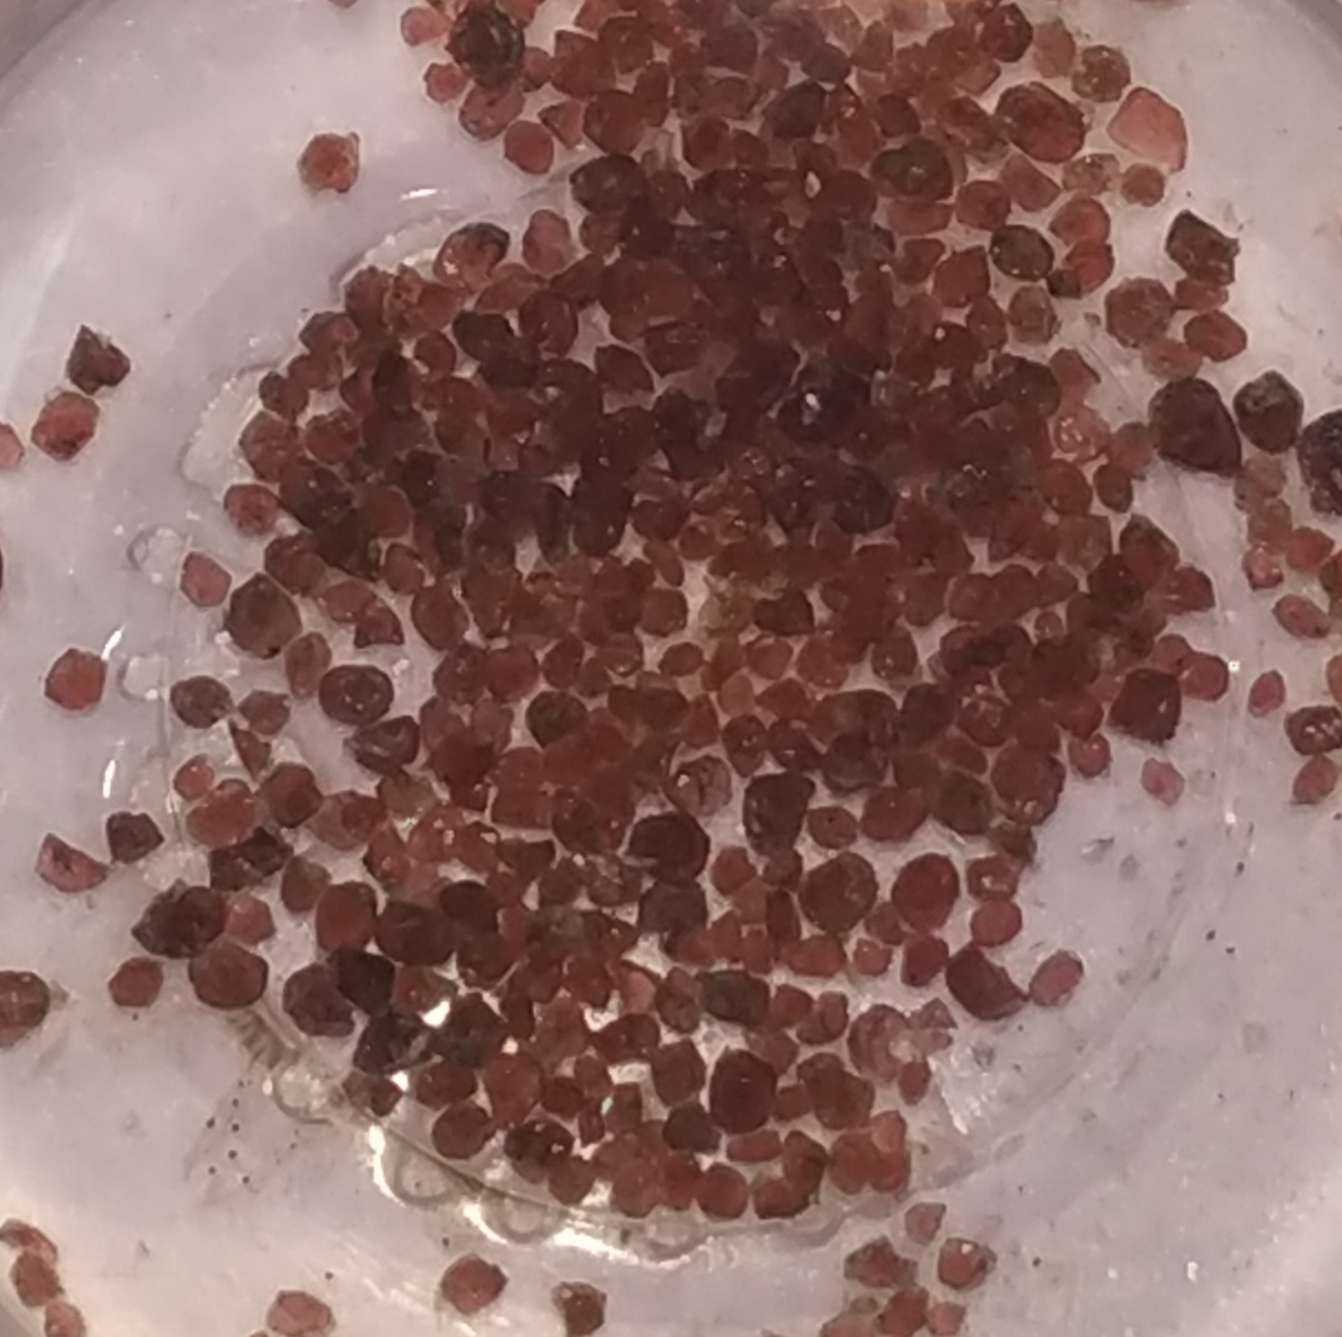
Introduction
Garnet- X3Y2Si3O12
Xsite =8-fold coordination occupied by divalent Fe, Mg, Ca, Mn
Ysite=6-fold coordination occupied by trivalent Al, Fe, Cr
Garnet growth is a fundamental result of metamorphism (Brown et al., 2022) which can be utilized to constrain metamorphic and mantle processes.

Slide 3
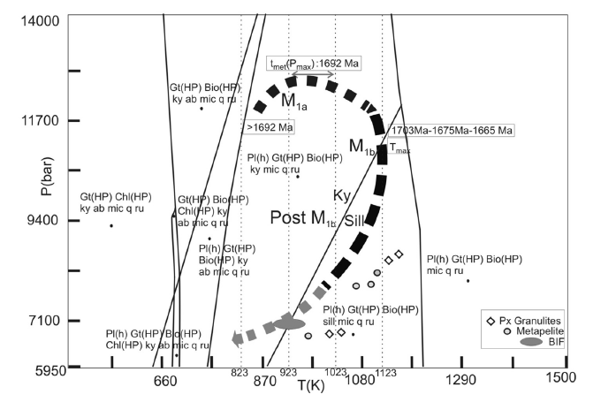
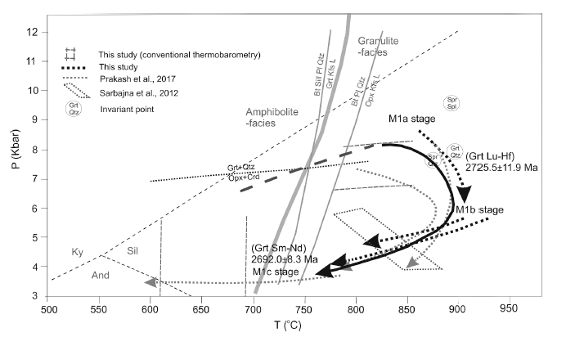
Garnet chronology, can yield precise dates of metamorphic and tectonic events which can be directly linked to specific pressure-temperature conditions during its growth.
(Mukherjee et al., 2019; Mukherjee et al., 2022)

Slide 4
Methodology
Inclusions and leaching protocol
Leaching and partial dissolution protocols can be used to remove micro-inclusions from garnet porphyroblasts (Zhou and Hensen 1995; Amato et al. 1999; Scherer et al. 2000; Baxter et al. 2002; Thoni 2003; Anczkiewicz and Thirlwall 2003; Ravikant 2006; Pollington and Baxter 2011, Baxter et al. 2017, Vadlamani 2019; Mukherjee et al. 2019).
Sm-Nd ages can be severely affected by the presence of monazite, apatite and phosphate micro inclusions
Inspired from previous studies, we carried out sequential H2SO4 (discarded) followed by aqua regia leaching (collected).

Slide 5
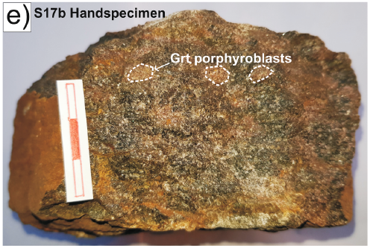
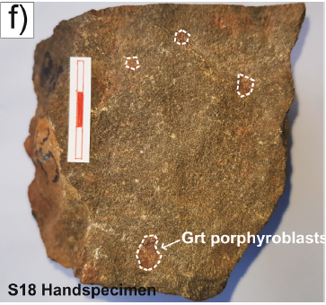
Results
Experiments were performed on garnet porphyroblasts separated from two samples of garnet-orthopyroxene-cordierite granulite enclaves from around Karimnagar, Eastern Dharwar craton, India.
Regressing the leached residual garnet fractions along with their whole-rock yielded ages (at 2SD) of 2696±10 Ma and 2683±15 Ma (Mukherjee et al., 2022). The residual garnet fractions yielded higher ¹⁴⁷Sm/¹⁴⁴Nd ratios, indicating cleaner garnet fractions.
a
An even greater improvement on the precision of the Sm-Nd ages was observed when the aqua regia leachates were analyzed and regressed along with the whole-rock and leached garnet fractions, with higher ¹⁴⁷Sm/¹⁴⁴Nd ratios than the analyzed garnets yielded ages with improved precisions of 2695±8Ma and 2682±9 Ma, thereby improving the precision of the fitted isochron.
b

Slide 7
The ¹⁴⁷Sm/¹⁴⁴Nd ratios in the aqua regia leachate fractions range ~ 1.955-2.934, which improves the precision on the age.

Slide 8
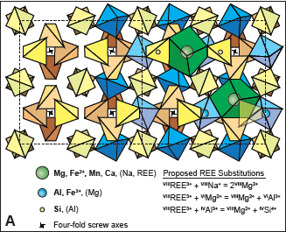
Discussion
This can be linked to the structure of the garnet crystals and the effect of aqua regia on its different lattice sites. Garnet is a nesosilicate, X₃Y₂(ZO₄)₃, with ZO₄ in the tetrahedral site (Si and Al), Y in the octahedral site (Al, Fe^{3+,} Mg) with coordination number 6, X (Mg, Fe^{2+,} Mn, Ca, Na, REE) in the polyhedral site with coordination number 8 (Kohn and Penniston-Dorland 2017). Since the polyhedral site consist of FeO, MgO, CaO and MnO, it is evident that these oxide bonds are easily broken with aqua regia than the silicate bonds prior to digestion. Furthermore, the preferential dissolution of Sm over Nd in aqua regia can be attributed to
concentration of Sm is higher than the concentration of Nd within garnet porphyroblasts, due to the fractionation of Sm over Nd during garnet growth.
ii) the ionic radius of Sm³⁺ with coordination number 8 is smaller (1.08 Å) than the ionic radius of Nd³⁺ with coordination number 8 (1.12 Å), which influences higher dissolution of Sm³⁺ over Nd³⁺.
(Kohn and Penniston-Dorland 2017)

Slide 9
Conclusion
The aqua regia leachate fractions lie on the same isochron with the whole-rock and residual (leached) garnet fractions, we consider that the leachates do not involve elemental partitioning.
We conclude that aqua regia leachate fractions can be effectively used to improve the precision on Sm-Nd whole rock garnet isochron ages.

Slide 10
References
Amato, J. M., Johnson, C. M., Baumgartner, L. P., & Beard, B. L. 1999. Rapid exhumation of the Zermatt-Saas ophiolite deduced from high-precision SmNd and RbSr geochronology. Earth and Planetary Science Letters, 171(3), 425-438.
Anczkiewicz, R., & Thirlwall, M. F. 2003. Improving precision of Sm-Nd garnet dating by H2SO4 leaching: a simple solution to the phosphate inclusion problem. Geological Society, London, Special Publications, 220(1), 83-91.
Baxter EF, Ague JJ, Depaolo DJ 2002 Prograde temperature–time evolution in the Barrovian type-locality constrained by Sm/Nd garnet ages from Glen Clova, Scotland. J Geol Soc London 159:71–82
Baxter, E. F., & Scherer, E. E. 2013. Garnet geochronology: timekeeper of Tectonometamorphic processes. Elements, 9, 433–438.
Baxter, E. F., Caddick, M. J., & Dragovic, B. 2017. Garnet: A rock-forming mineral petrochronometer. Reviews in Mineralogy and Geochemistry, 83(1), 469-533.
Brown, D. A., Simpson, A., Hand, M., Morrissey, L. J., Gilbert, S., & Tamblyn, R. 2022. Laser-ablation Lu-Hf dating reveals Laurentian garnet in subducted rocks from southern Australia. Geology.
Kohn, M. J., & Penniston-Dorland, S. C. 2017. Diffusion: Obstacles and opportunities in petrochronology. Reviews in Mineralogy and Geochemistry, 83(1), 103-152.
Mukherjee, S., Adhikari, A., Vadlamani, R., 2019. Constraining Paleoproterozoic (~1.7 Ga) collisional orogenesis between the Eastern Dharwar and Bastar cratons: New Sm–Nd garnet isochron and Th–U-total Pb monazite chemical ages from the Bhopalpatnam orogen, central India. Lithos 350-351, 105247.
Mukherjee, S., Adhikari, A., Nicoli, G., & Vadlamani, R. 2022) Neoarchean (∼ 2.73–2.70 Ga) accretionary history of the eastern Dharwar Craton, India: Lu-Hf and Sm-Nd garnet geochronologic constraints from the Karimnagar granulite-facies supracrustal enclaves. Precambrian Research, 375, 106657.
Pollington AD, Baxter EF 2011 High precision microsampling and preparation of zoned garnet porphyroblasts for Sm–Nd geochronology. Chem Geol 281:270–282
Ravikant, V., 2006. Sm-Nd isotopic evidence for late mesoproterozoic metamorphic relics in the east african orogen from the schirmacher oasis, east Antarctica. J. Geol. 114 (5), 615-625. https://doi.org/10.1086/506163.
Scherer EE, Cameron KL, Blichert-Toft J 2000 Lu–Hf garnet geochronology: Closure temperature relative to the Sm–Nd system and the effects of trace mineral inclusions. Geochim Cosmochim Acta 64:3413–3432
Thöni, M. 2003. Sm–Nd isotope systematics in garnet from different lithologies (Eastern Alps): age results, and an evaluation of potential problems for garnet Sm–Nd chronometry [Chem. Geol. 185 2002 255–281]. Chemical Geology, 194(4), 353-379.
Vadlamani, R. 2019) Cambrian garnet Sm-Nd isotopic ages from the polydeformed Bolangir anorthosite complex, Eastern Ghats Belt, India: implications for intraplate orogeny coeval with Kuunga orogeny during Gondwana assembly. The Journal of Geology, 127(4), 437-456.
Zhou, B., & Hensen, B. J. 1995. Inherited SmNd isotope components preserved in monazite inclusions within garnets in leucogneiss from East Antarctica and implications for closure temperature studies. Chemical Geology, 121(1-4), 317-326.

Slide 11

Thank you

