Slide 1



Preliminary studies on V(III) determination in the form of picnolate complex using hr icp-ms
Lucija KNEŽEVIĆ ^{1*}, Jelena MANDIĆ², Igor ŽIVKOVIĆ¹, Dario OMANOVIĆ¹, Elvira BURA-NAKIĆ¹
¹Division for Marine and Environmental Research, „Ruđer Bošković” Institute, Zagreb, Croatia
²Laboratory for Chemichal Oceanography and Sedimentology of the Sea, Institute of Oceanography and Fisheries, Split, Croatia
*lknezev@irb.hr

Slide 2

Vanadium aqueous chemistry
Stability of V(III) under strong „anoxic” or „euxinic” conditions
Fast hydrolysis followed by rapid precpitation
Possible strong complexation with organic ligands and stabilisation in natural sediments
Gustafsson et al. 2019
Rapid oxidation
Instability even with strong ligands (EDTA)
Complex matrix of natural samples

Slide 3
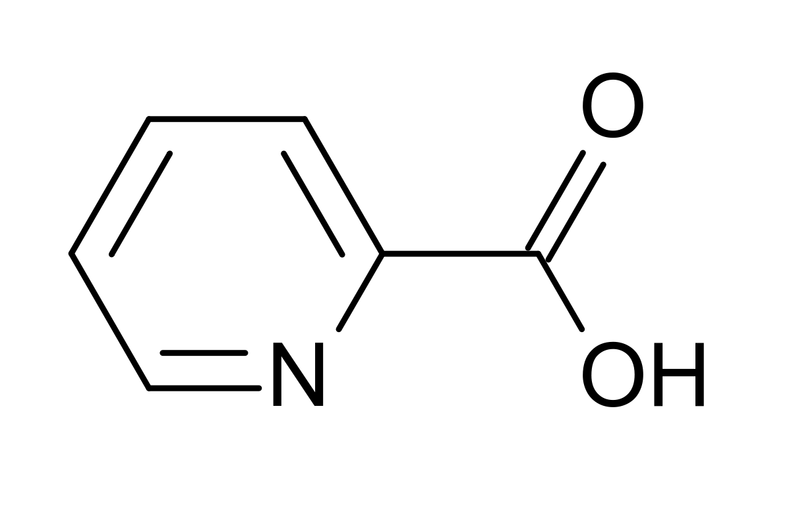
V(III) – picnolate complex
Highly stable properties of V(III)-picnolate complex
Coordiantion through the pyridine ring nitrogen and the carboxylate oxygen to V(III) cation
Generation of highly distorted octahedral geometry

Slide 4
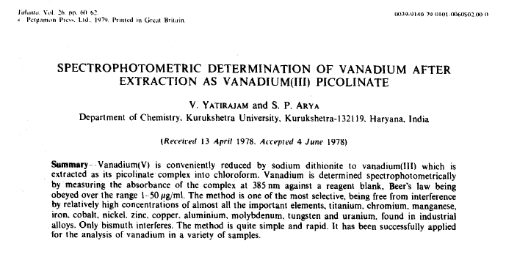
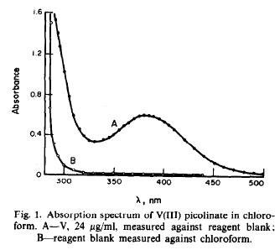
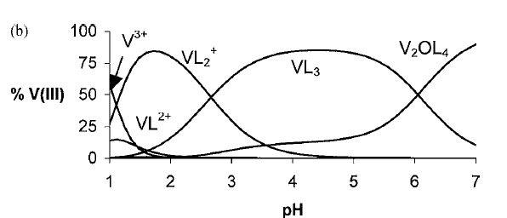
V(III) – picnolate complex
VL₃
Lubes et al. 2005

Slide 5
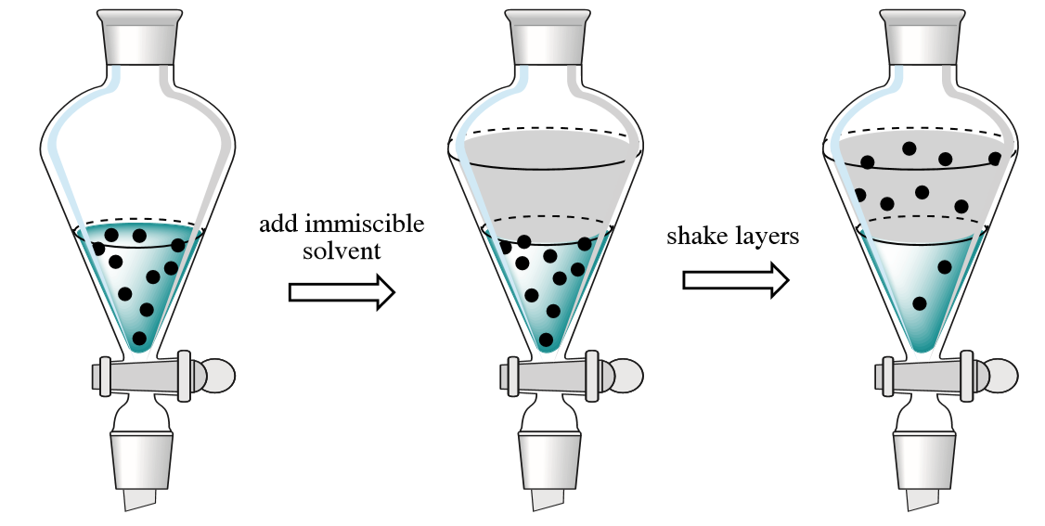
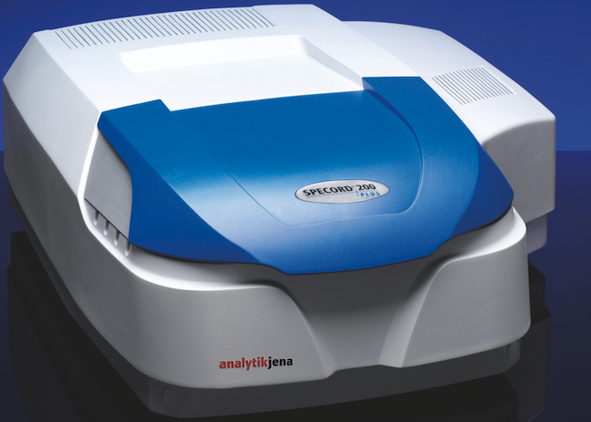
V(III) – picnolate complex
0.08 M borate buffer + 1.8% Picnolic acid +
V(III)/sample
Chloroform
Extracted V(III)-picnolate complex
direct
Λ= 385 nm

Slide 6
V(III) – picnolate complex
Results so far...
Majority of V(III) extracted in the 1st extract
In mixture with other V species comproportionation is taking place!
Environmental imapct of comproportionation reaction??

Slide 7
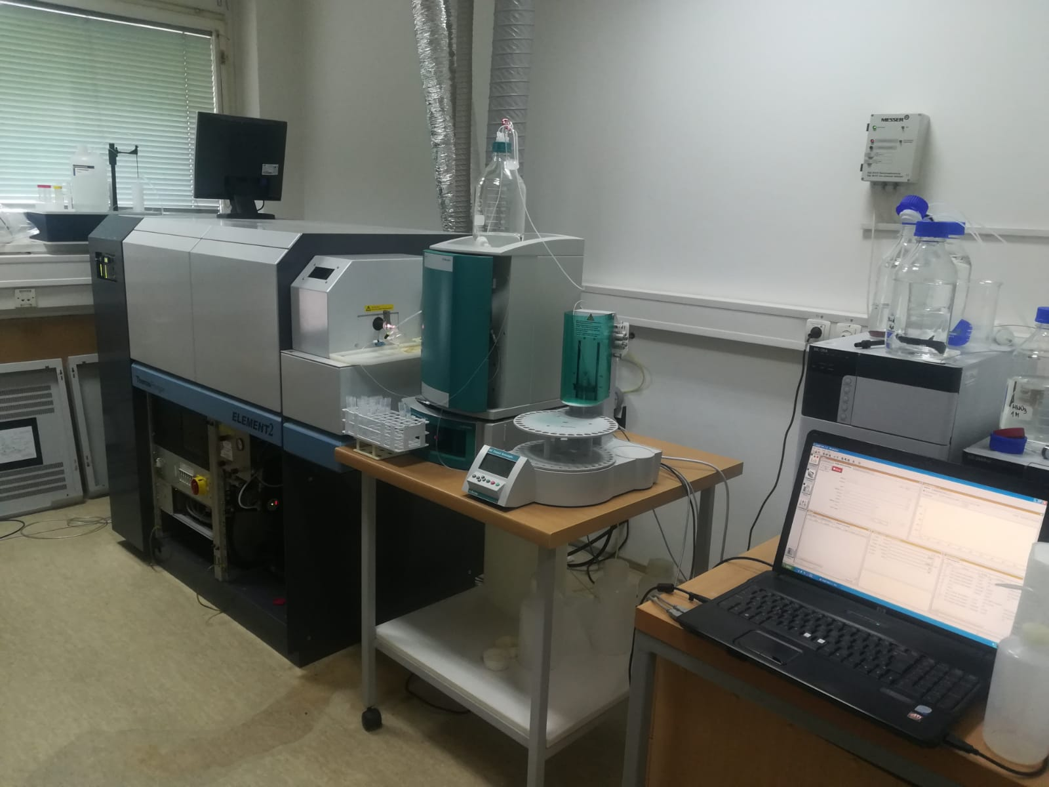
V(III) – picnolate complex
Spectrum of environmental samples...
Big interferences (probably Fe or pigments)
Strongly needed usage of HR ICP MS
Future plans...
Evaporate extracts to dryness / redissolve in 2% HNO₃
Determine presence of V(III) in anoxic sediments
Examine possible effect of comproportionation reaction and

Slide 8


Questions...
Thank you!
Research within this work was funded by Croatian Science Foundation , Project “REDOX” IP-2018-01-7813, “REDOX”.

